Slide 1
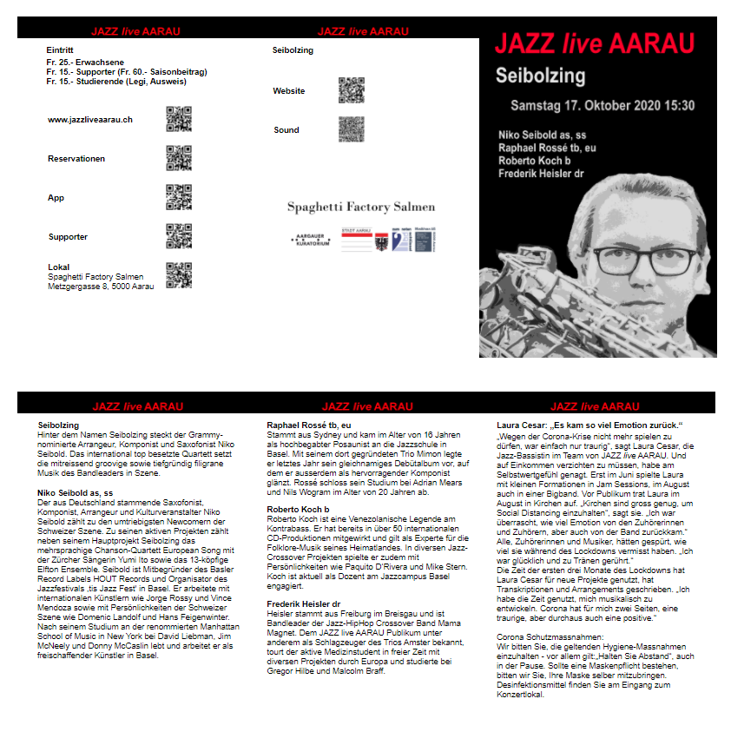
Flyer Application
Flyer is a web application but it is also based on Flyer function in the Windows application Admin.
The tasks for the Flyer application are:
Input and edit of band and musician texts for the flyers
Input and edit of free texts for the flyers
Creation and adding of QR Codes and images for the flyers
Creation of the season flyers as HTML elements (models)
Print of – creation of PDF print jobs for - the season flyers
QR codes
band
QR codes
JAZZ live AARAU
Image
sponsors
Image
concert
Page 5 Page 6 Page 1
Band text
Free text
Muscian texts
Muscian
text
Page 2 Page 3 Page 4

Slide 2
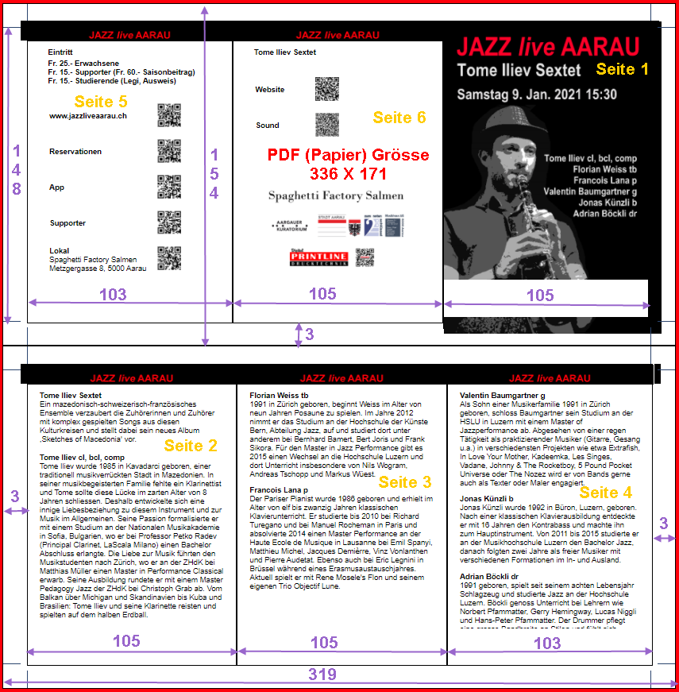
Input data to the printer are two PDF files (or two pages of a PDF file).
The flyer is defined in millimeter.
The size of the pages that will be printed are 319 X 154 millimeter. Three millimeters will be cut away.
The resulting size is 313 X 148 mm.
After folding, the size of the Flyer is 105 X 148 millimeter, i.e. format A6

Slide 3
Element PagePrint id= id_page_print_one
Element PageFiveBox
Element PageSixBox
Element PageOneBox
Element PagePrint id= id_page_print_two
Element PageTwoBox
Element PageThreeBox
Element PageFourBox

Slide 4
Datei FlyerFoldedA6.htm:
head
PageTwoBox
List of (.css) files with style data
div logo
List of (.js) files with JavaScript functions
div text column
div logo
body onload= mainFlyerA6(…)
div band name
div header
div band text
table Dropdown for login, icon flyer and div for help
div musician name
div musician text
div Create PDF files (not yet used)
div musician name
div musician text
PagePrint
div musician name
PageFiveBox
PageSixBox
PageOneBox
div musician text
PagePrint
PageThreeBox
PageTwoBox
PageThreeBox
PageFourBox
div logo
div text column
div logo
div musician name
div musician text
div dropdowns
div edit XML
div name and warning
div musician name
div musician text
div musician name
div musician text
div musician name
div element errors
div musician text

Slide 5
Startup Flyer
eventSelectLoginDropDown
User Login
setGlobalParametersLoadXml
displayPagePrintOne
displayPagePrintTwo
g_user_case_str
Global variables
g_user_case_str = admin, printer, tester or concert number
loadSubdirNames
g_subdirectory_names_xml
afterLoadSubdirNames
g_current_season_number
loadApplicationXml
g_application_xml
afterLoadApplicationXml
initLoadSeasonXml
g_current_season_xml
case_load = 1, edit_number=1
loadXmlEdit

