Slide 1
Agenda
What is DevOps & its Practices
What is CI/CD & its workflow
What does Jenkins do and its functionality
Jenkins Integration with Git, SonarQube & Artifactory
Setting-up CI/CD Pipeline in Jenkins
Administering Jenkins

Slide 2
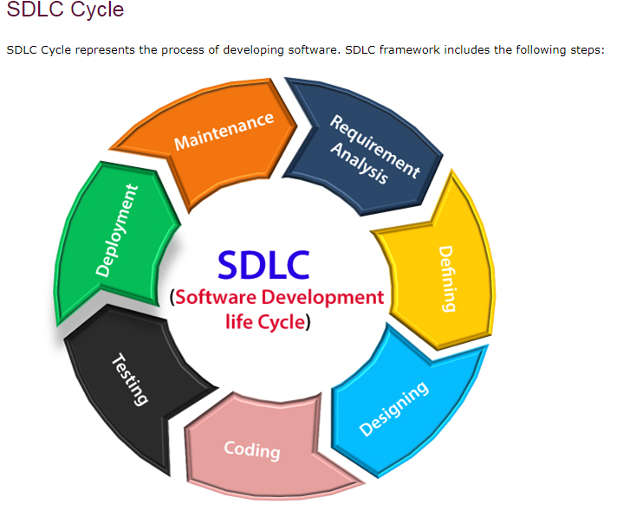

Slide 3
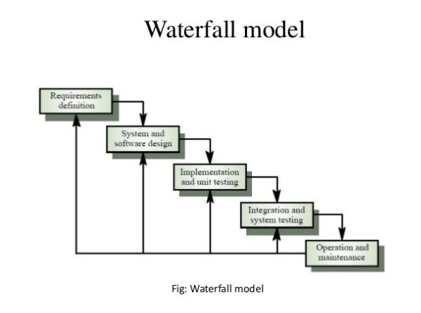

Slide 4
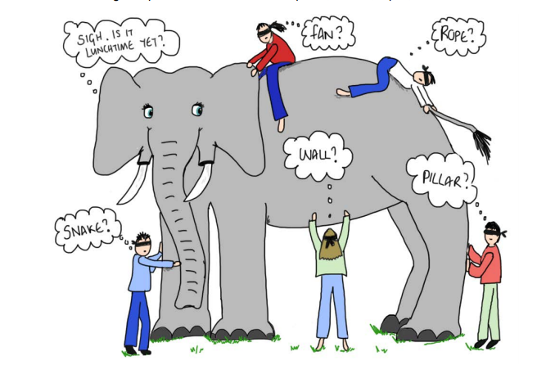

Slide 5
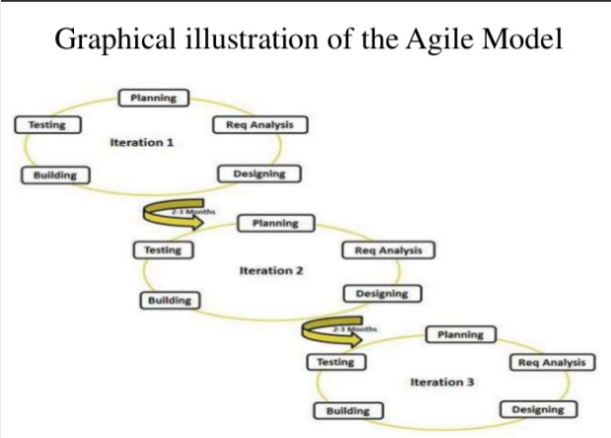

Slide 6
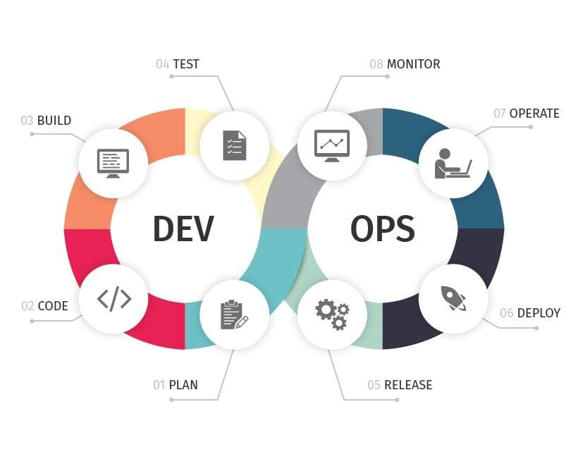

Slide 7
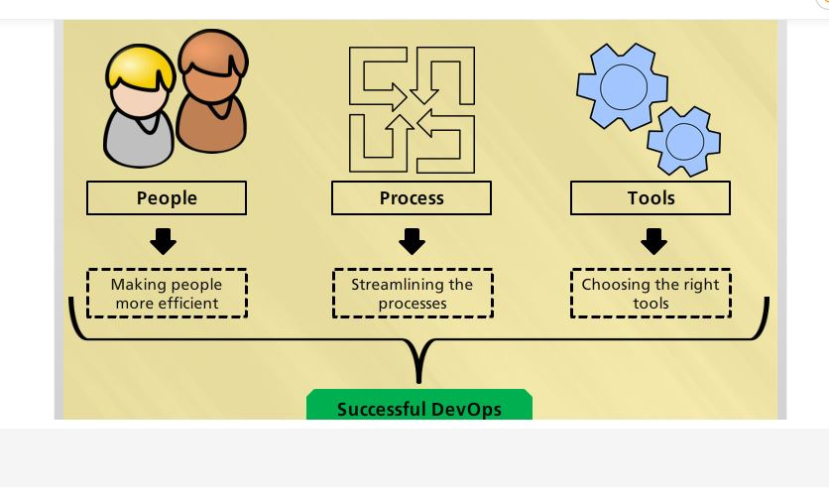
What is DevOps?
DevOps integrates developers and operations teams in order to improve collaboration and productivity by automating infrastructure, automating workflows and continuously measuring application performance.
DevOps is the union of people, process and products to enable continuous delivery of value to end users

Slide 8
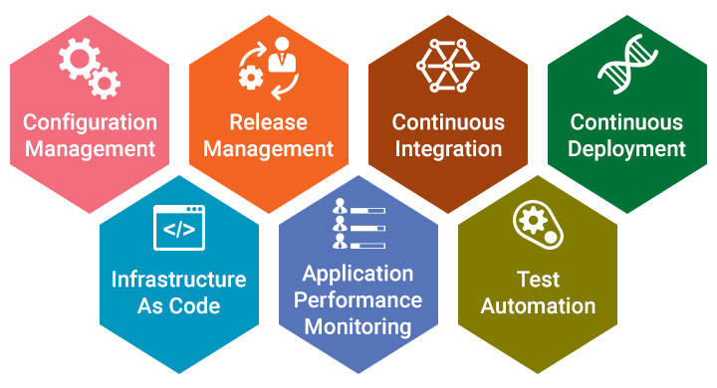
7 DevOps Practices
DevOps Practices
For achieving CI/CD, CT & CM a good number of tools and technologies will be used.
Notes:
DevOps Practices

Slide 9
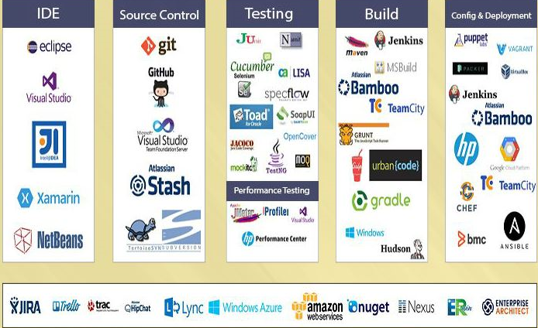
DevOps Tools
DevOps is not a Technology. It is a culture which combines various tools and technologies for faster delivery of software and feedback loop through CI, CD, CT and CM
Notes:
DevOps Tools

Slide 10
Benefits of DevOps
Developing high quality software
Deploying in frequent cycles
Reducing time to move from idea to implementation
Increased Application / product up time
Increased Productivity, Revenue & Profitability
Increase in customer satisfaction

Slide 11
What is CI?
Continuous Integration is a software development practice where members of a team integrate their work frequently, usually each person integrates at least daily - leading to multiple integrations per day. Each integration is verified by an automated build (including test) to detect integration errors as quickly as possible.
CI Tools
Java build scheduler - Jenkins, Cruisecontrol
Static code analysis : SonarQube, Checkstyle, PMD
Code Coverage : Jcov, Clover, Serenity
Unit Testing : NUnit, JUnit
Functional Testing : Cucumber, Selenium

Slide 12
CI Workflow
CI Workflow

Slide 13
What is Continuous Deployment?
Continuous Deployment is a software development practice, where software is built in such a way that it can be released automatically to production any time.
CD is a logical extension of Continuous Integration, which together aims at giving developers and end users an incredible experience by:
Detecting bugs at an early stage.
Ensuring seamless deployments to all environments

Slide 14
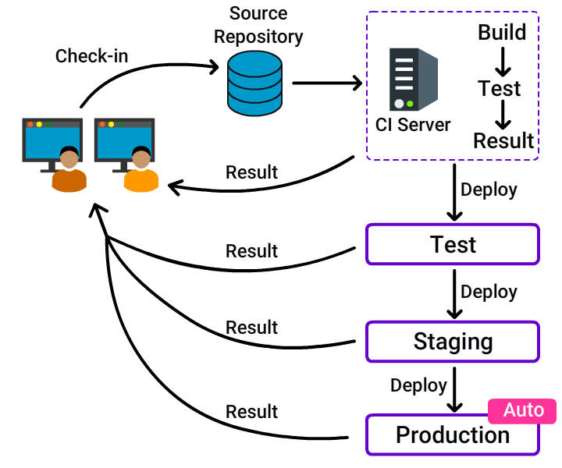
What is Continuous Deployment?
What is Continuous Deployment?

Slide 15
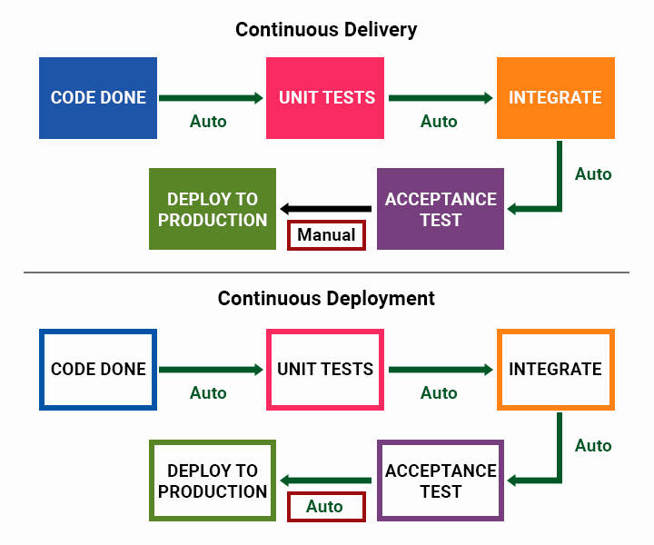
Continuous Delivery and Continuous Deployment

Slide 16
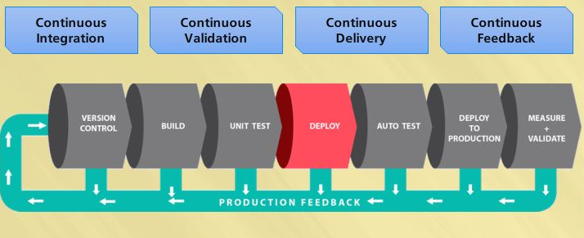
CI/CD Overview
Notes:
Feedback loop

Slide 17
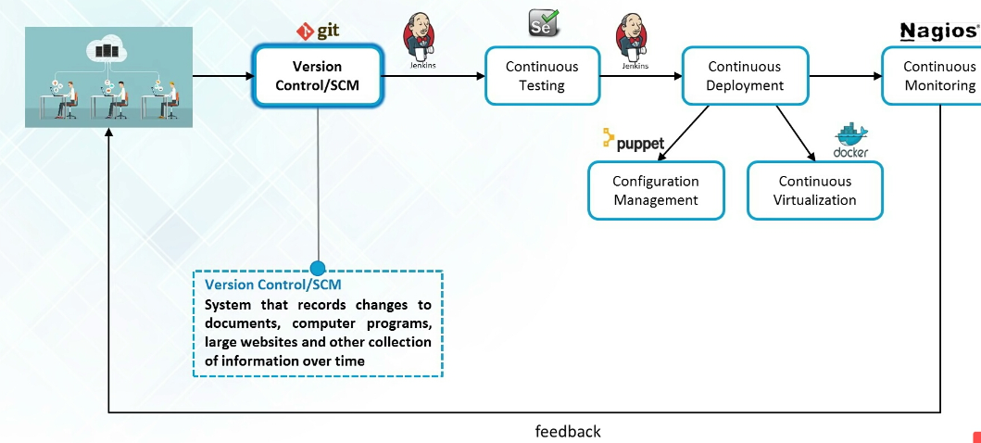
Feedback Loop
Notes:
Feedback Loop

Slide 18
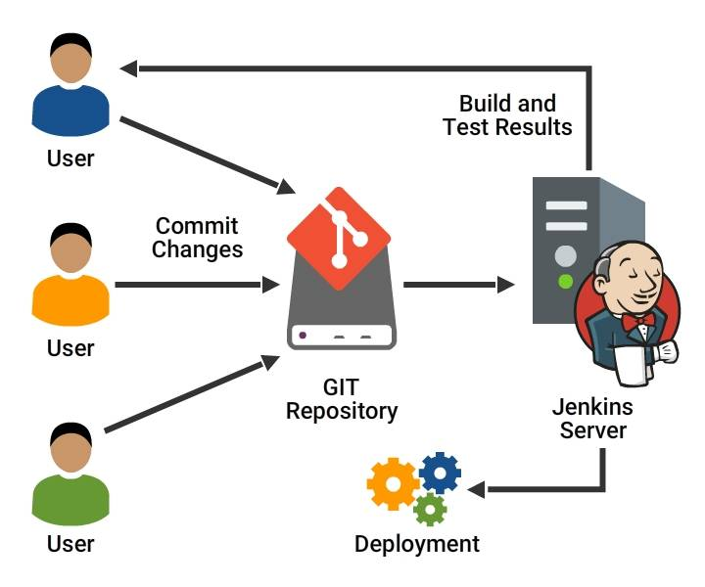
What does Jenkins do?
What does Jenkins do?
Notes:
What does Jenkins do?

Slide 19
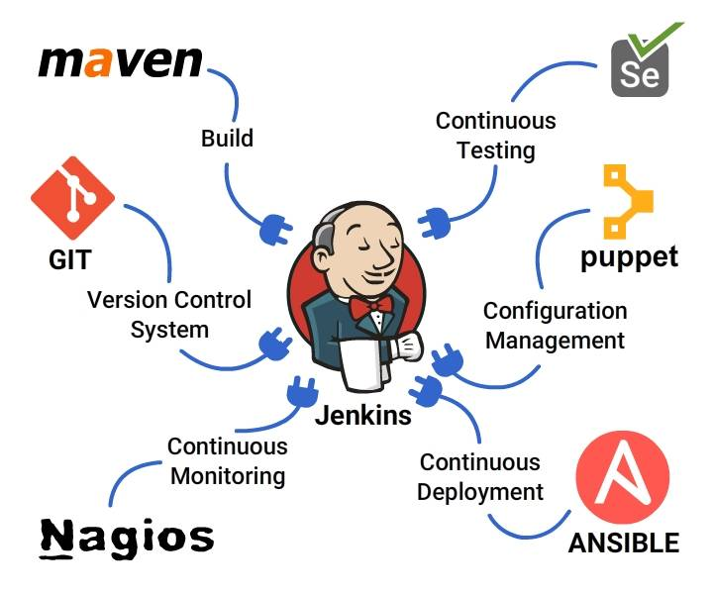
Extending Jenkins Functionality
Jenkins Functionality
Notes:
Jenkins Functionality

Slide 20
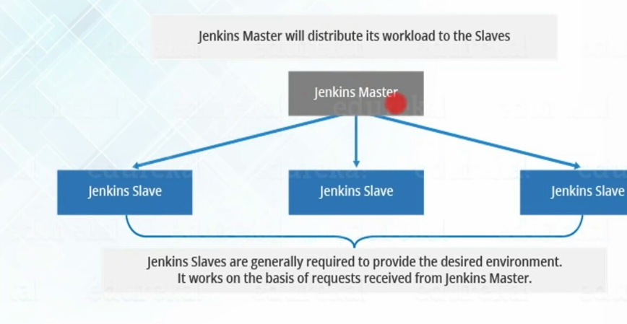

Slide 21
Jenkins Intergration with GIT:
1. Create java program or file in git Project
2. Adding project in git to github:
-- Goto project location in git folder-> initilize the repository (git init) .
-- add untracked files with git add . & git commit -m "added java program"
--Goto github account and create project-> create repository (hello world) and copy the location (URL) of repository ssh or https--
-- git remote add origin and paste the url of the repository
-- git push -u origin master
3.Create jenkins job to run java program->configure->source code management->Git(Install git plugin)->paste the repository URL and give github credentials
4. Build triggers->POLL SCM->Schedule->cron job (*****), apply and save.

Slide 22
Setting-up CI/CD Pipeline in Jenkins
Creating Pipeline project:
- On Jenkins home page, click on new item.
- Give Job name and Select Pipeline project. Click on 'Ok'
- In General section, select the project is paramatereized.
- On Pipeline section, select the definition as 'Pipeline Script'
- Start writing the pipeline script in the workspace.
Stages in Continuous Integration:
- Stage: Build
Git checkout with git URL.
Building with maven project “mvn clean install”
- Stage: Static code analysis
checking code standards with Maven “mvn sonar:sonar Dsonar.host.url”
- Stage: Artifactory
curl -v “nexus url” --user --upload-file $WORKSPACE/target/*.jar
Stages in Continuous Deployment:
- Stage: Pulling Artifact
curl -vvv -X GET -u $nexus_username:$nexus_password "$url" -H
"accept:application/json" -O –progress-bar
- Stage: Deploy to Tomcat or OCP

