Slide 1
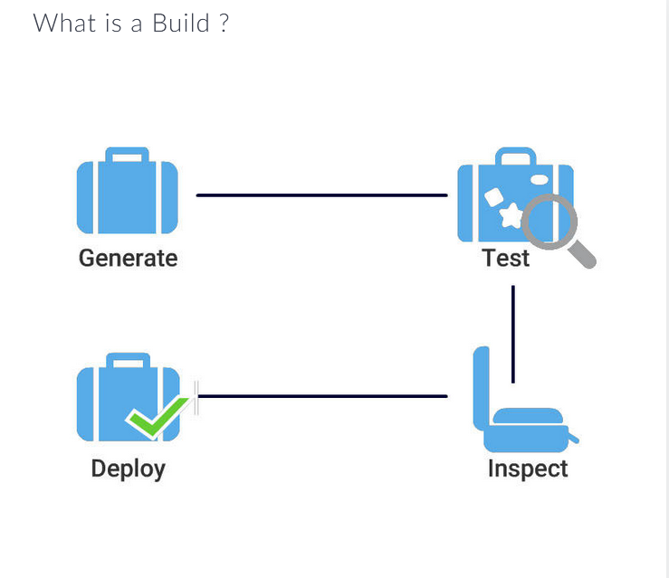
Package your code into executable files
Notes:
Build-Package your code into executable files

Slide 2
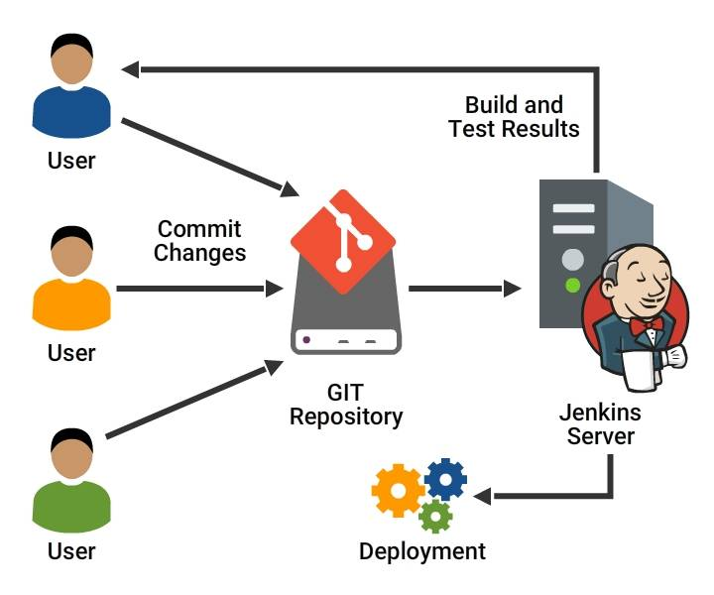
What does Jenkins do?
What does Jenkins do?
Notes:
What does Jenkins do?

Slide 3
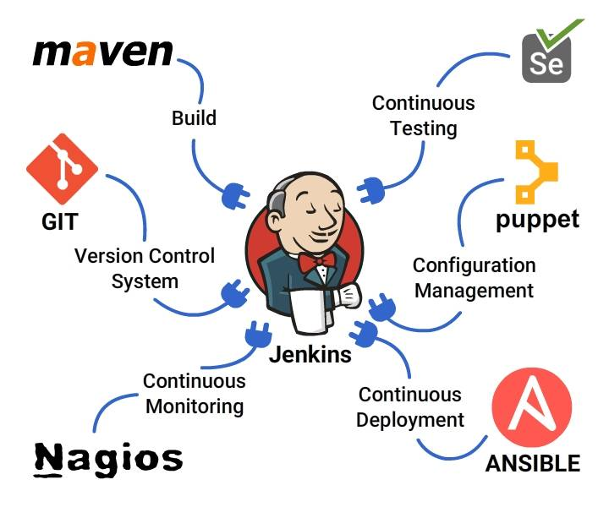
Extending Jenkins Functionality
Jenkins Functionality
Notes:
Jenkins Functionality

Slide 4
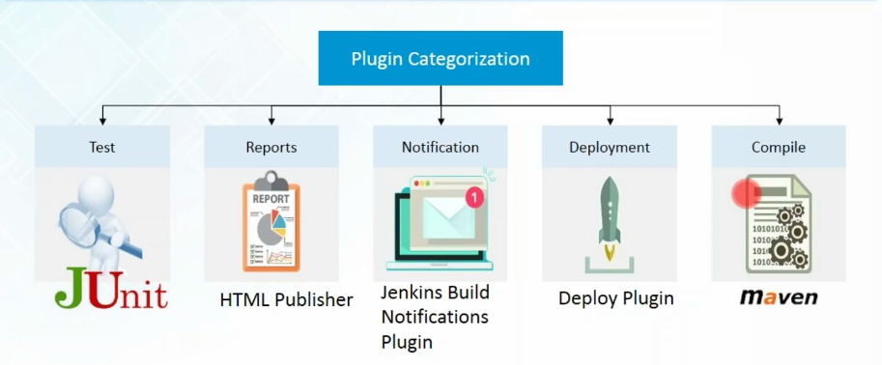

Slide 5
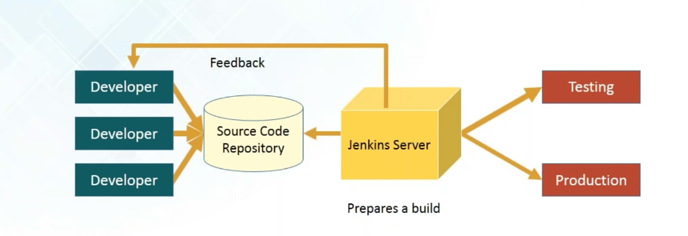
Jenkins Workflow
Notes:
Jenkins Workflow

Slide 6
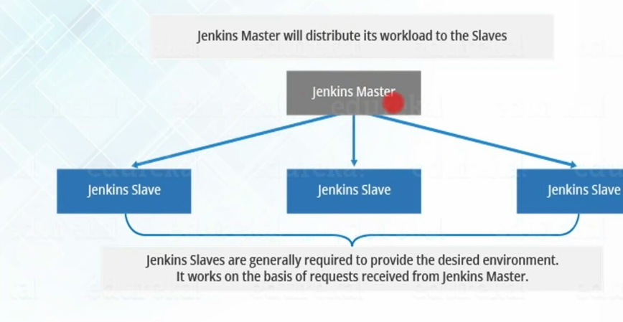

Slide 7
Master-Slave architecture
Master-Slave architecture
Notes:
Master-Slave architecture

Slide 8
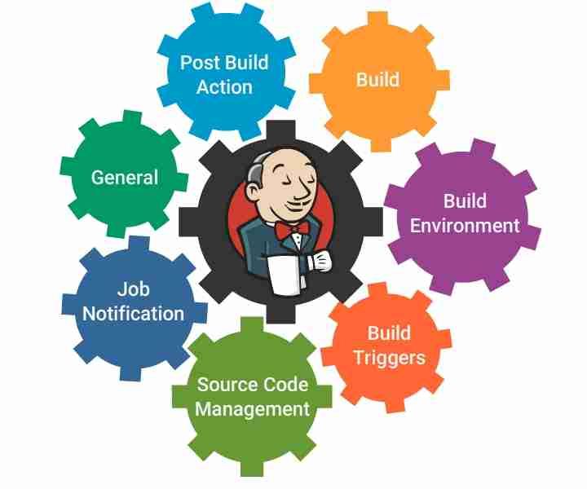
Set up a simple project
Set up a simple project
Notes:
Set up a simple project

Slide 9
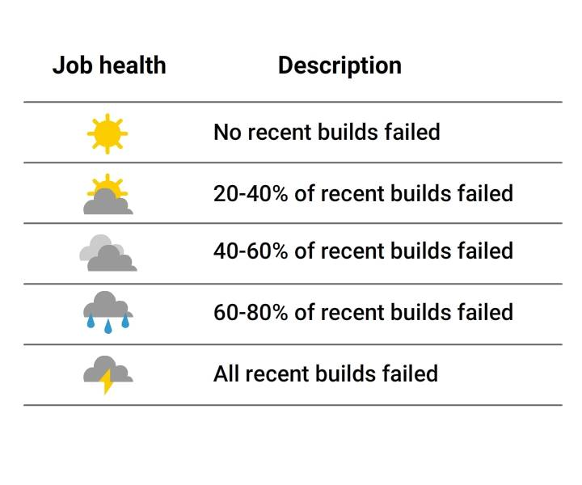
Build job status
Build Status is indicated in two ways :
A weather icon (on the home page dashboard) - shows you a record of multiple builds
A colored ball (on the individual project page) - shows you status of a single build
Job Status
Notes:
Build job status
Build Status is indicated in two ways :
A weather icon (on the home page dashboard) - shows you a record of multiple builds
A colored ball (on the individual project page) - shows you status of a single build

Slide 10
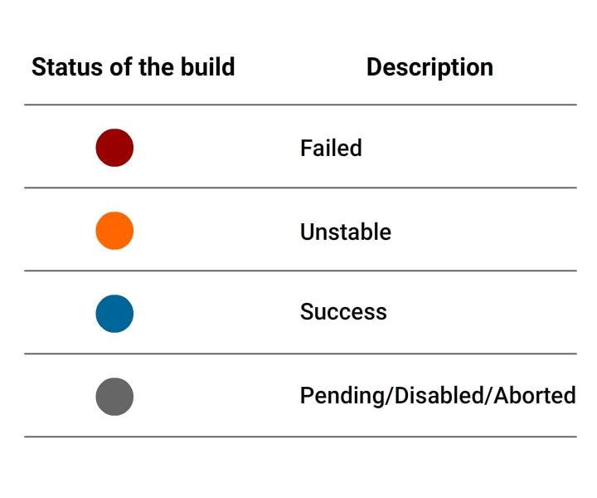
Project Status
Project Status

Slide 11
Create new project

Slide 12
Configure SCM

Slide 13
Configure Build Triggers

Slide 14
Adding a Build Step

Slide 15
Configure Post Build Activities

Slide 16
Notifications

Slide 17
Executing a job build

Slide 18
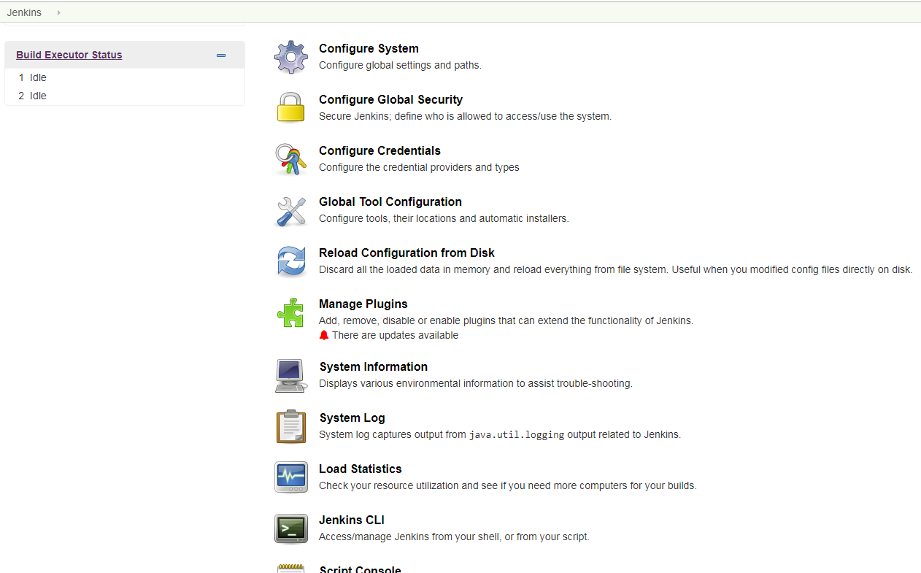
Basic configurations
How Jenkins work: Setup
Manage Jenkins-> Configure system, Configure global security,Manage plugins, manage users,jenkisn cli, script console, manage & assign roles

Slide 19
Jenkins Intergration with GIT:
1. Create java program or file in git Project
2. Adding project in git to github:
-- Goto project location in git folder-> initilize the repository (git init) .
-- add untracked files with git add . & git commit -m "added java program"
--Goto github account and create project-> create repository (hello world) and copy the location (URL) of repository ssh or https--
-- git remote add origin and paste the url of the repository
-- git push -u origin master
3.Create jenkins job to run java program->configure->source code management->Git(Install git plugin)->paste the repository URL and give github credentials
4. Build triggers->POLL SCM->Schedule->cron job (*****), apply and save.

Slide 20
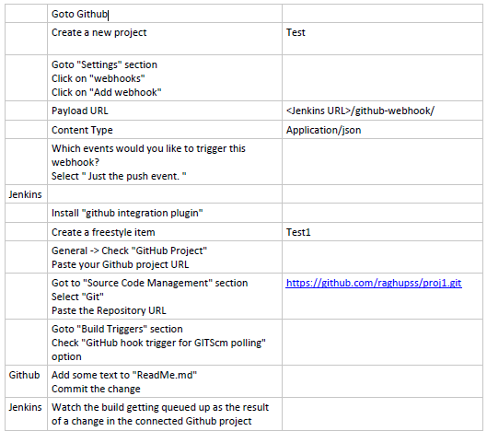
Github Jenkins Webhook Configuration

Slide 21
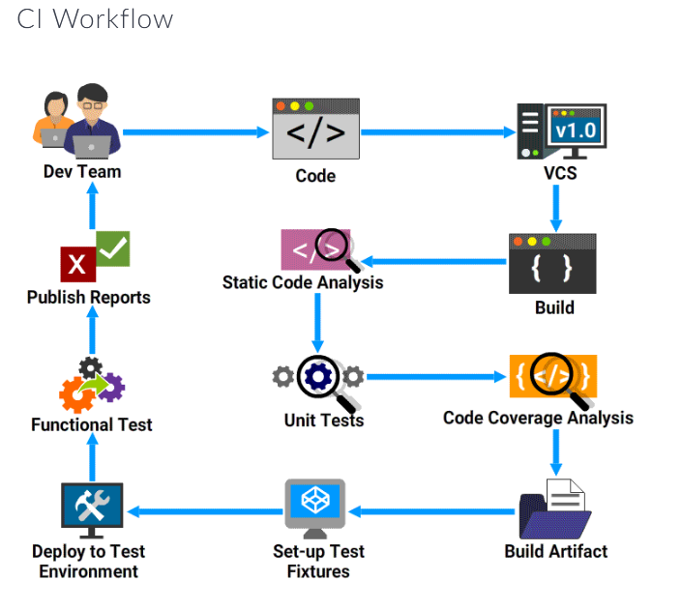

Slide 22
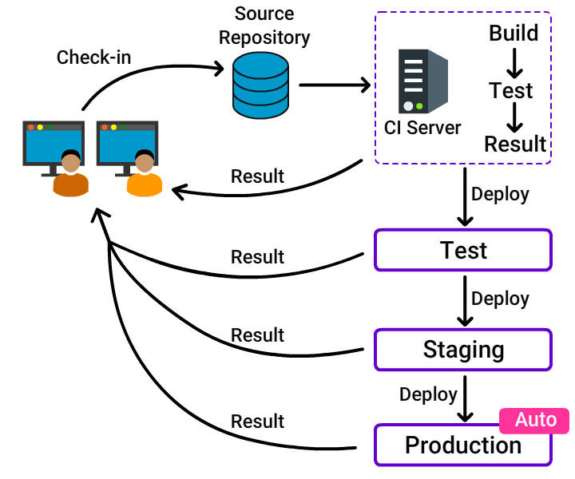
What is Continuous Deployment?

Slide 23
Installation of Jenkins server:
Login to the Jenkins VM and update the packages.
Step 1: Update the system with stable packages.
sudo yum install epel-release
sudo yum update
sudo reboot
When the reboot finishes, login with the same sudo user.
Step 2: Install Java.
Before installing Jenkins, setup a Java virtual machine OpenJDK Runtime Environment 1.8.0 using YUM:
sudo yum install java-1.8.0-openjdk.x86_64
After the installation, confirm it by running the following command:
java -version
Step 3: Install Jenkins
cd ~
sudo wget -O /etc/yum.repos.d/jenkins.repo https://pkg.jenkins.io/redhat-stable/jenkins.repo
sudo rpm --import https://pkg.jenkins.io/redhat-stable/jenkins.io.key
yum install jenkins
Start the Jenkins service and set it to run at boot time:
sudo systemctl start jenkins.service
sudo systemctl enable jenkins.service
Now, test Jenkins by visiting the following address from your web browser:
http://10.129.211.118:8080

Slide 24
Launching slave node in Jenkins
Creating Slave node
- login to Jenkins
- Go to Manage Jenkins and select Manage nodes
- Click on new node and type node name
- Select the permanent agent and click on 'ok‘
Configure slave node to Master:
- Go to configure in slave node
- Give the remote directory path & label names
- Launch Method : Launch slave agents via SSH
- Host : “maven vm ip”
- Credentials: “Add username/password of maven vm”
- Host key Verification Strategy : Non verifying Verification Strategy
- Click on 'Save'

Slide 25
Setting-up CI/CD Pipeline in Jenkins
Creating Pipeline project:
- On Jenkins home page, click on new item.
- Give Job name and Select Pipeline project. Click on 'Ok'
- In General section, select the project is paramatereized.
- On Pipeline section, select the definition as 'Pipeline Script'
- Start writing the pipeline script in the workspace.
Stages in Continuous Integration:
- Stage: Build
Git checkout with git URL.
Building with maven project “mvn clean install”
- Stage: Static code analysis
checking code standards with Maven “mvn sonar:sonar Dsonar.host.url”
- Stage: Artifactory
curl -v “nexus url” --user --upload-file $WORKSPACE/target/*.jar
Stages in Continuous Deployment:
- Stage: Pulling Artifact
curl -vvv -X GET -u $nexus_username:$nexus_password "$url" -H
"accept:application/json" -O –progress-bar
- Stage: Deploy to Tomcat or OCP

