Slide 1
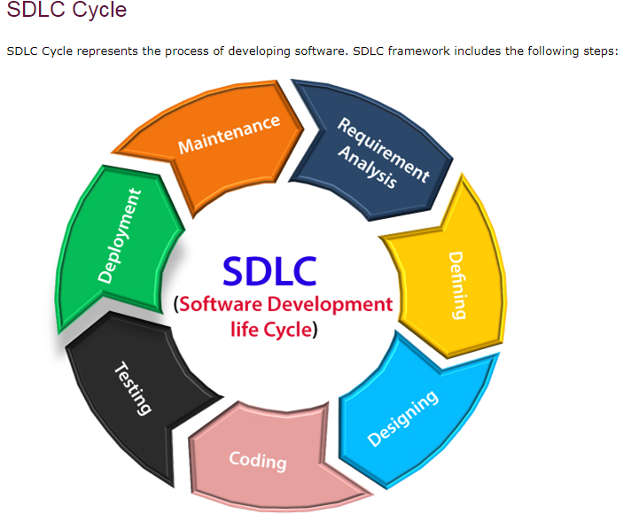

Slide 2
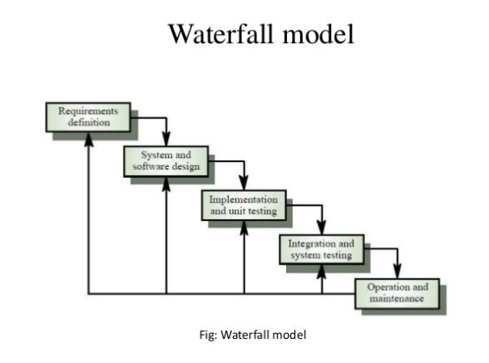

Slide 3


Slide 4
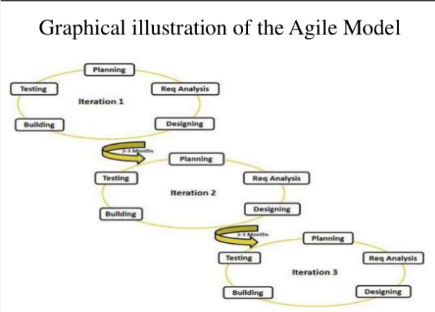

Slide 5
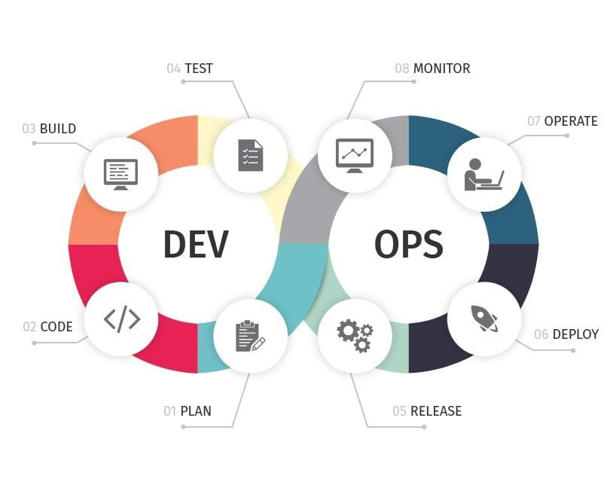

Slide 6
What is DevOps?
DevOps integrates developers and operations teams in order to improve collaboration and productivity by automating infrastructure, automating workflows and continuously measuring application performance.
DevOps is not a Technology. It is a culture which combines various tools and technologies for faster delivery of software and feedback loop through CI, CD, CT and CM
For achieving CI/CD, CT & CM a good number of tools and technologies will be used.

Slide 7
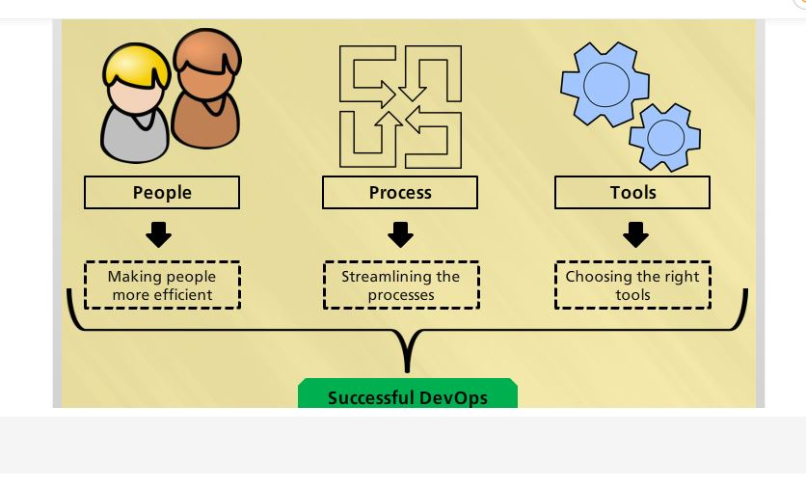
DevOps is the union of people, process and products to enable continuous delivery of value to end users

Slide 8
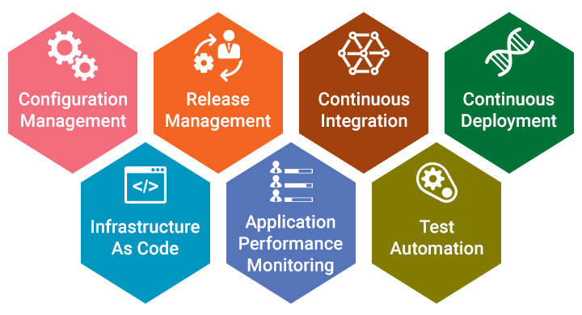
7 DevOps Practices
DevOps Practices
Notes:
DevOps Practices

Slide 9
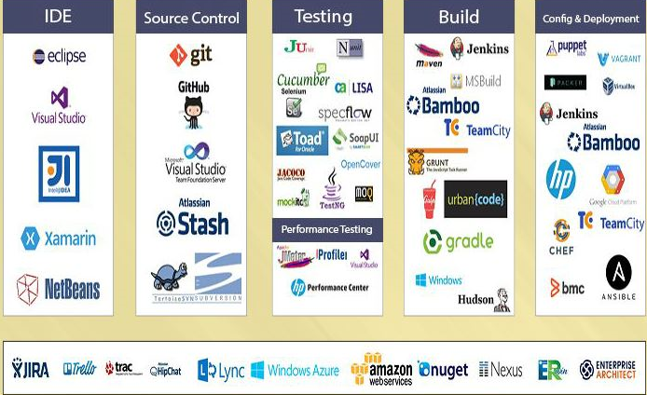
DevOps Tools
Notes:
DevOps Tools

Slide 10
Benefits of DevOps
Developing high quality software
Deploying in frequent cycles
Reducing time to move from idea to implementation
Increased Application / product up time
Increased Productiviy, Revenue & Profitability
Increase in customer satisfaction

Slide 11
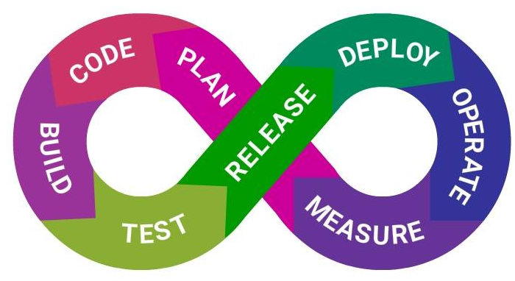
What is CI?
Continuous Integration is a software development practice where members of a team integrate their work frequently, usually each person integrates at least daily - leading to multiple integrations per day. Each integration is verified by an automated build (including test) to detect integration errors as quickly as possible.

Slide 12
Benefits of CI
Continuous Integration does not get rid of bugs, but it does make it easier to find and remove.
When developers cultivate the habit of integrating their code changes regularly:
Changes will be typically small.
Errors can be detected quickly.
Pointing out the change that introduced an error can be done quickly.
Immediate bug detection
A deployable system at any given point

Slide 13
Continuous Integration
Plan for code changes.
Perform the code changes, then compile and test.
Check the results.
Act on the results.

Slide 14
CI Services
Source Code Control
Code Compile
Integrate Database Changes
Run Tests
Code Inspection

Slide 15
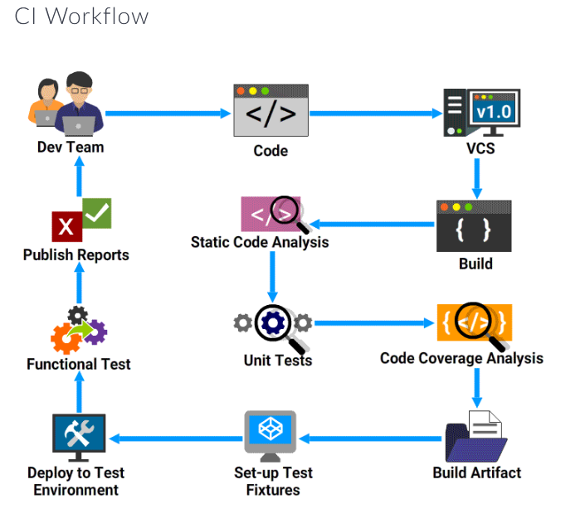

Slide 16
CI Workflow

Slide 17

CI Tools
CI Tools
Java build scheduler - Jenkins, Cruisecontrol
Static code analysis : SonarQube, Checkstyle, PMD
Code Coverage : Jcov, Clover, Serenity
Unit Testing : NUnit, JUnit
Functional Testing : Cucumber, Selenium

Slide 18
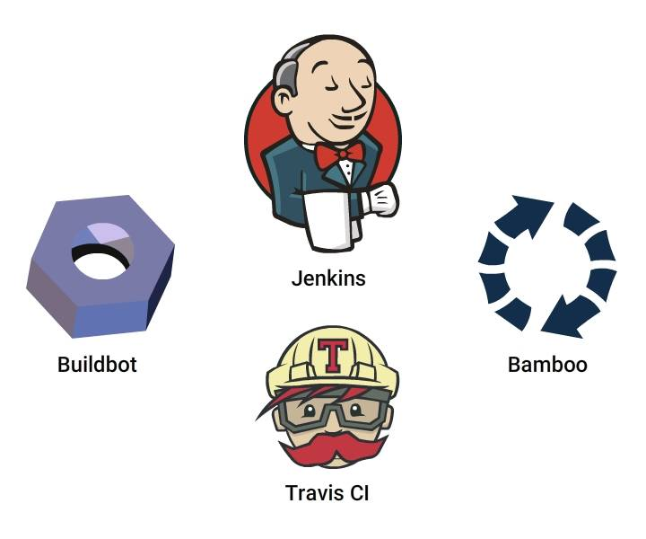
How to enable CI?
You need a tool to create a CI enabled environment. Jenkins, Travis CI, Bamboo,Buildbot are different tools available to enable CI

Slide 19
What is Continuous Deployment?
Continuous Deployment is a software development practice, where software is built in such a way that it can be released automatically to production any time.
CD is a logical extension of Continuous Integration, which together aims at giving developers and end users an incredible experience by:
Detecting bugs at an early stage.
Ensuring seamless deployments to all environments

Slide 20
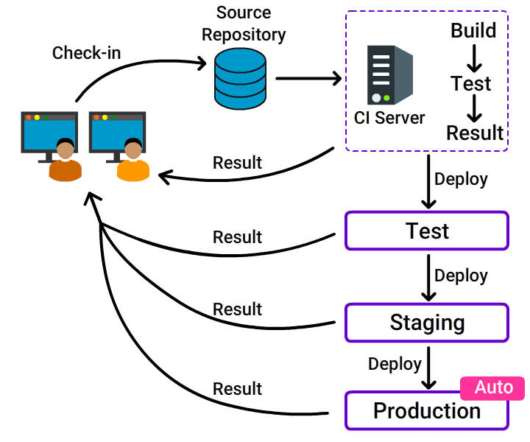
What is Continuous Deployment?
What is Continuous Deployment?

Slide 21
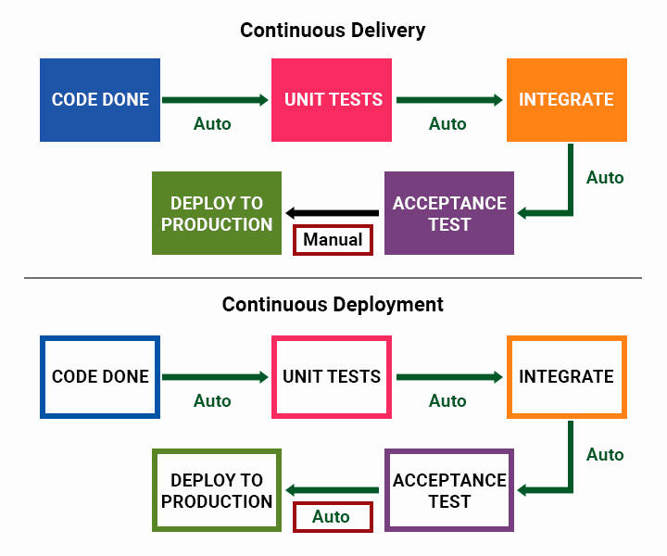
Continuous Delivery and Continuous Deployment

Slide 22
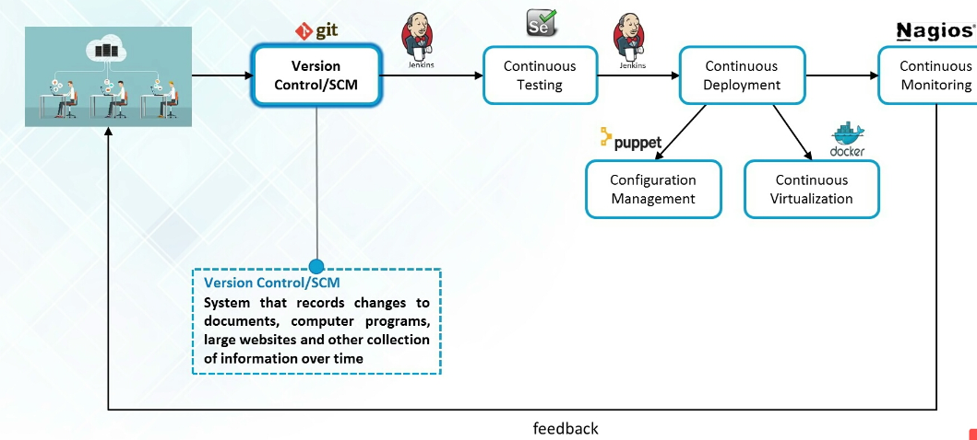
Feedback Loop
Notes:
Feedback Loop

Slide 23
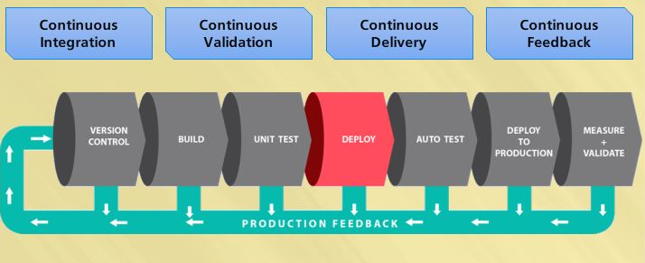
CI/CD Overview
Notes:
Feedback loop

