Slide 1
SonarQube
• SonarQube is an open source platform that allows you to track
and improve the quality of source code.
• It's a code analysis tool for continuous inspection of code quality.
• SonarQube can be used in any project to inspect the code.
It supports more than 25+ languages.
• With SonarQube, developer has the ownership of code.
• It ensures fast, efficient report generation & detect issues.
• Results are shown in UI having charts, graphs, and red-blue light.

Slide 2
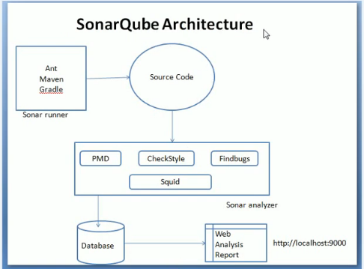

Slide 3
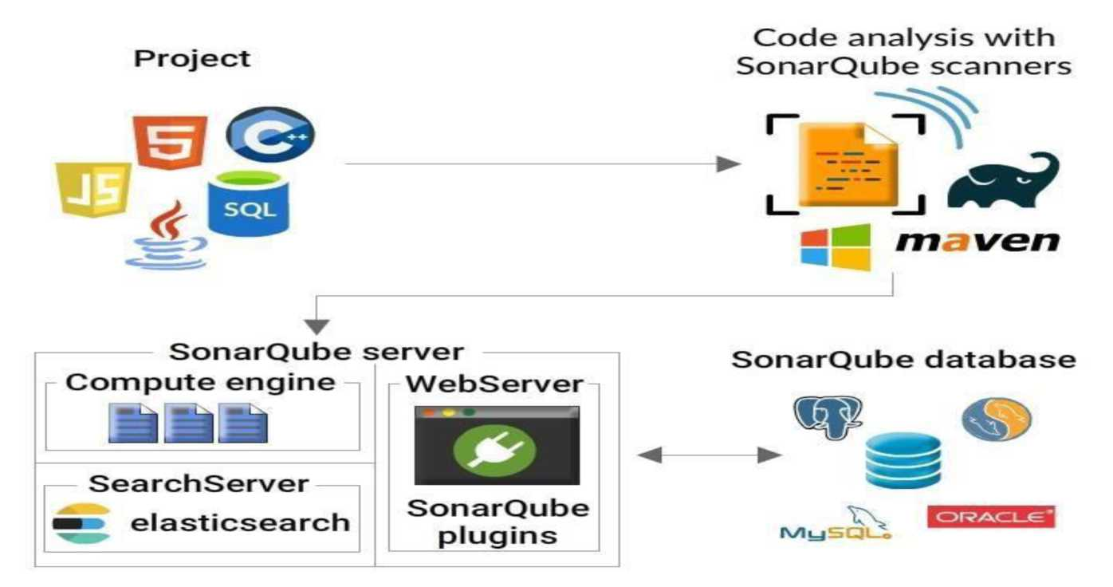
Component level Architecture

Slide 4
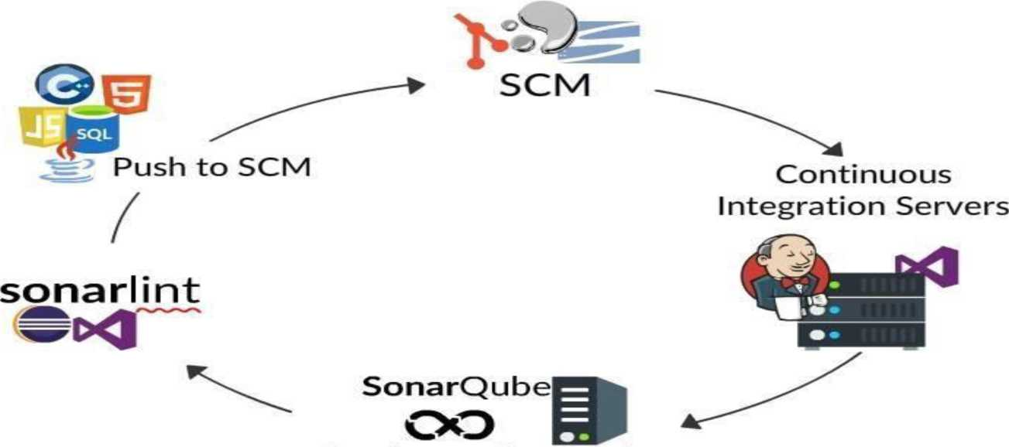
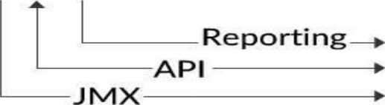

Integration
Continuous Integration

Slide 5
Requirements for Installation
The essential requirement to run SonarQube is Java, it should be installed in your system.
Hardware Requirements:
The SonarQube server needs 2GB of RAM to run efficiently.
It is recommended to use Oracle JRE 8 and OpenJDK 8.
And in databases, you can use PostgreSQL 8.x/9.x l, Microsoft SQL Server-2014/2016, and MYSQL 5.6/5.7

Slide 6
Installation
• SonarQube incorporates with Eclipse, Visual Studio, and IntelliJ ID development environment through SonarLint plugins or else you can install in your local machine.
• Steps:
Install SonarQube.
Unzip the file.
Move it to the desired directory (e.g., opt).
Go to the directory, open the terminal, then run •/opt/sonarqube/bin/[OS]/sonar.sh
Go to the file: /home/<yourusername>/Downloads/sonarqube-6.7.4/conf/sonar.properties
Now move the sonar.properties file to "/etc/sonarqube" folder.
Start the SonarQube server:
/etc/sonarqube/bin/[OS]/sonar.sh console
Then log into http://localhost:9000with System Administrator credentials

Slide 7
.
Installing Database
SonarQube has an inbuilt database available along with installation that supports small projects. This database can be made use of by executing the following commands.
wget
https://sonarsource.bintray.com/Distribution/sonarqube/sonarqube-7.1 .zip
unzip sonarqube-7.1.zip •mv sonarqube-7.1 /opt/sonar
Following are the set of commands given as an example to install MySQL and make it as a SonarQube DB.
After installing MYSQL, run mysql -u root -p. Username and password would be set at the time of installation.

Slide 8
Database Cont..
Let's create a sonar database by executing these commands.
CREATE DATABASE sonar CHARACTER SET utf8 COLLATE utf8_general_ci;
CREATE USER 'sonar' IDENTIFIED BY 'sonar';
GRANT ALL ON sonar.* TO 'sonar'@'%' IDENTIFIED BY 'sonar
GRANT ALL ON sonar.* TO 'sonar'@'localhost' IDENTIFIED BY 'sonar';
FLUSH PRIVILEGES;

Slide 9
SonarQube Scanner
•After the installation of SonarQube, you can install an analyzer to analyze a project. So install the Sonar Scanner (analyzer of SonarQube) and configure according to your needs.
• For Gradle Project-Scanner for Gradle .
• For MSBuild- Scanner for MSBuild .
• For Jenkin Project-Scanner for Jenkins.
• For Maven Project-Scanner for Maven.
• For Ant-Scanner for Ant.
• For Azure Devops-Scanner for Azure

Slide 10
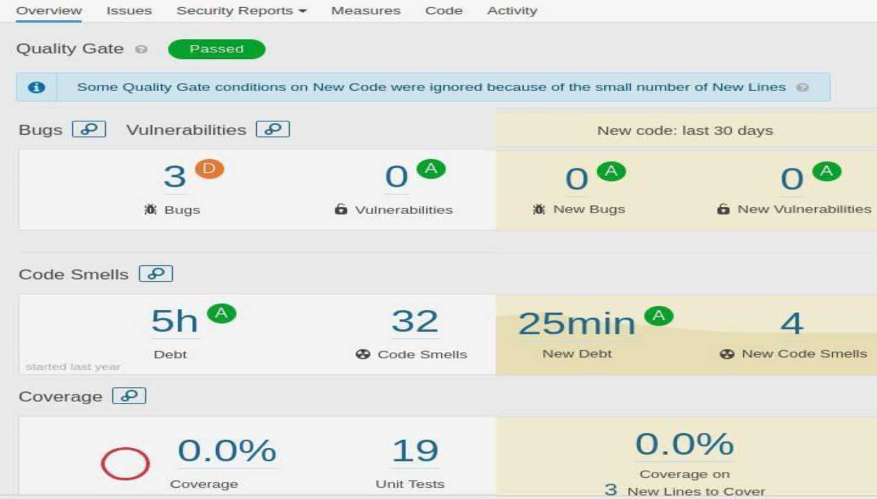
Sample project report

Slide 11
*• \M »r— *»• *+
SonarQube Plugin for Maven Project
I) Download the latest SonarQube Server J
itpivVwww sonamulx: or
Mavcn from http maven apache, orp download cgi
Java. It requires Java 8: http: www.oracle com tcchnetwork java javase downloads jdk8-downloads-2133151 .him!
Install Java 8 and Maven on your computer and Set the JAVA HOME in environment variables
2) Extract the SonarQube server zip file ami navigate to bin folder
3) Open the Command Prompt and navigate to SonarQube bin folder and execute StartSonar bat file I) Create maven project and add below dependency in pom xml file
<!— https: mvnrcpositorv com artifact org codchaus mojo sonar-mavcn-plugm -> •dependency >
< groupld >org codchaus mojo* groupld>
<anifactld 'sonar-maveti-plugin< artifactld>
<version>3 4.0 905< version>

Slide 12
Introduction to Rules
You can click on the top "Rules" menu item to see rules. By default, you will see all the available rules.
Language: the language to which a rule applies.
Type: Bug, Vulnerability or Code Smell rules.
Tag:- it is possible to add tags to rules
Repository:- the engine that contributes rules to SonarQube.
Default Severity: the original severity of the rule - as defined by the plugin that contributes to this rule.
Status:- rules can have 3 different statuses(Beta, Depreciated, Ready).
Template:- display rule templates
Quality Profile:- Quality Profiles are collections of rules to apply during an analysis..

Slide 13
There are three basic types of rules:-
1. Reliability rules-related to bugs in a project.
2. Maintainability rules are enforced to detect code smells (code smell is an indication that there are chances of bugs, failure in future).
3. Security rules - related to vulnerability and security hotspots.
Creation of Rules:
SonarQube already has some minimal number of rules. You can activate/deactivate rules according to your need.
To create a custom rule you need following details:-
Name
Key
Description
Type
Severity
Status
factoryMethod

Slide 14
Issues
1. Open - set by SonarQube when a new issue is being encountered.
2. Confirmed - manually being set to indicate that the issue is valid.
3. Resolved - manually being set to show that the issue will be closed in the next analysis.
4 .Reopened - place automatically by SonarQube when a resolved issue hasn't been corrected.
5. Closed - automatically being closed by SonarQube.
Resolutions
When an issue is closed it will have one of the two resolutions:
Fixed - placed automatically when a subsequent analysis shows that the issue has been fixed.

Slide 15
Removed - placed automatically when either the related coding rule or the file is no longer available. The rule may not be available because it has been removed from the profile or because the underlying plugin has been uninstalled. The file will not be available because it has been deleted from the project, moved to a different location or being renamed.
Resolved issues will have one of the two resolutions:
False Positive - manually being set. Won't Fix - manually being set.

Slide 16
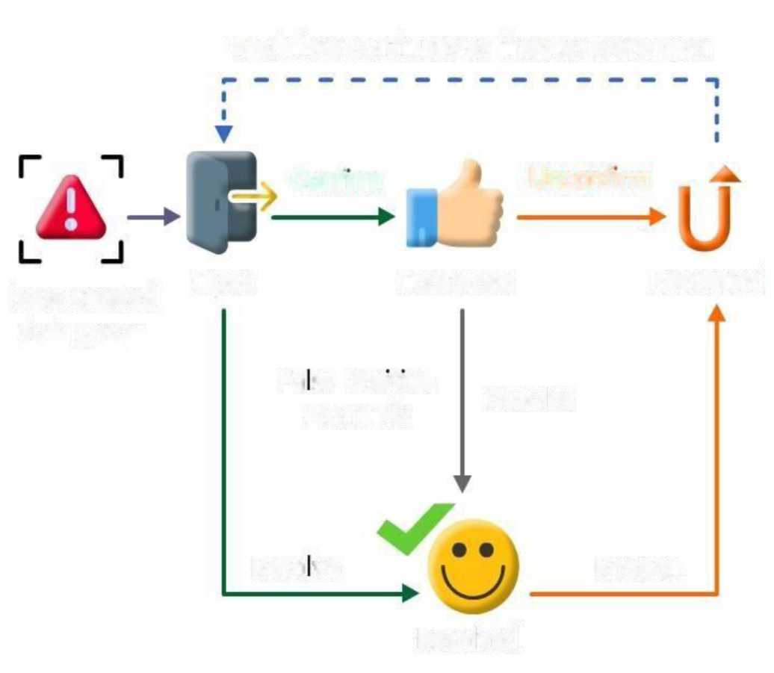
Issue workflow
Workflow continues as if status were open
Confirm
Unconfirm
Issue created
Open
Confirmed
Reopened
during scan
Fa se Positive
Resolve
Won't Fix
Reso ve
Reopen
Resolved

Slide 17
Gravity of issue
•Each issue has one of the five cases.
•1. BLOCKER-The bug that has a major impact on the behavior of the application in production as in memory leak and unclosed JDBC connection.
•2. CRITICAL- The bug which represents security flaw as in empty catch block, SQL Injection.
•3. MAJOR- The flaw which has a great impact in developer productivity as in duplicated blocks, unused parameters.
•4. MINOR- Quality flaws which have a lesser impact as in switch cases must have minimum of three cases.
•5. Info- Its neither a bug nor a flaw, just a finding.

Slide 18
Code Viewer
It's an important part of SonarQube. It shows the files (source code and test files).
The statistics of the file:
Lines of Code Bugs
Vulnerabilities Code Smells Coverage Duplication

