Slide 1
MD simulation
Present By: Yingying
03/03/2021

Slide 2
Three main parts for MD simulation
PDB file
Topology Files
Parameter Files
Atom name
Coordinate
Header
Mass
Residue
Atom
Group
Angle
Dihedral
Mass
Bond
Angle
Dihedral
Improper

Slide 3
Three main parts for MD simulation
PDB file
Topology Files
Parameter Files
Atom name
Coordinate
Header
Mass
Residue
Atom
Group
Angle
Dihedral
Mass
Bond
Angle
Dihedral
Improper

Slide 4
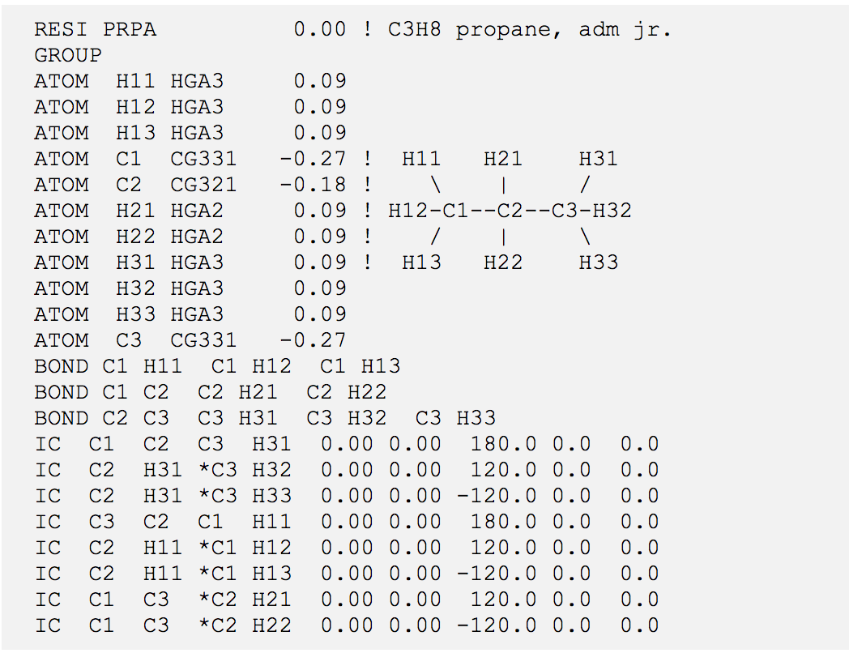
Topology Files
1
MASS info
File_name.rtf

Slide 5
Three main parts for MD simulation
PDB file
Topology Files
Parameter Files
Atom name
Coordinate
Header
Mass
Residue
Atom
Group
Angle
Dihedral
Mass
Bond
Angle
Dihedral
Improper

Slide 6
Parameter Files
ATOMS
MASS -1 H 1.00800 ! polar H
BONDS
!!V(bond) = Kb(b - b0)**2!
!Kb: kcal/mole/A**2!b0: A!
!atom type Kb b0!
NH2 CT1 240.000 1.4550 ! From LSN NH2-CT2
ANGLES
!V(angle) = Ktheta(Theta - Theta0)**2
!atom types Ktheta Theta0 Kub S0
H NH2 CT1 50.000 111.00 ! From LSN HC-NH2-CT2
DIHEDRALS
!V(dihedral) = Kchi(1 + cos(n(chi) - delta))
!atom types Kchi n delta
NH2 CT1 C O 0.0000 1 0.00

Slide 7
All the topology files and parameter files for protein are provided by CHARMM, you don’t need to provide.
What we need to do is to provide the topology files and parameter files for ligand.
If you have a customize topology file and parameter file, you need to pay attention, the atom type in ligand can’t be same with atom type in protein.
** LEVEL -1 WARNING FROM <PARRDR> ** *** ATOM already exists with the same name **************
Make sure all the headers in files !!!

Slide 8
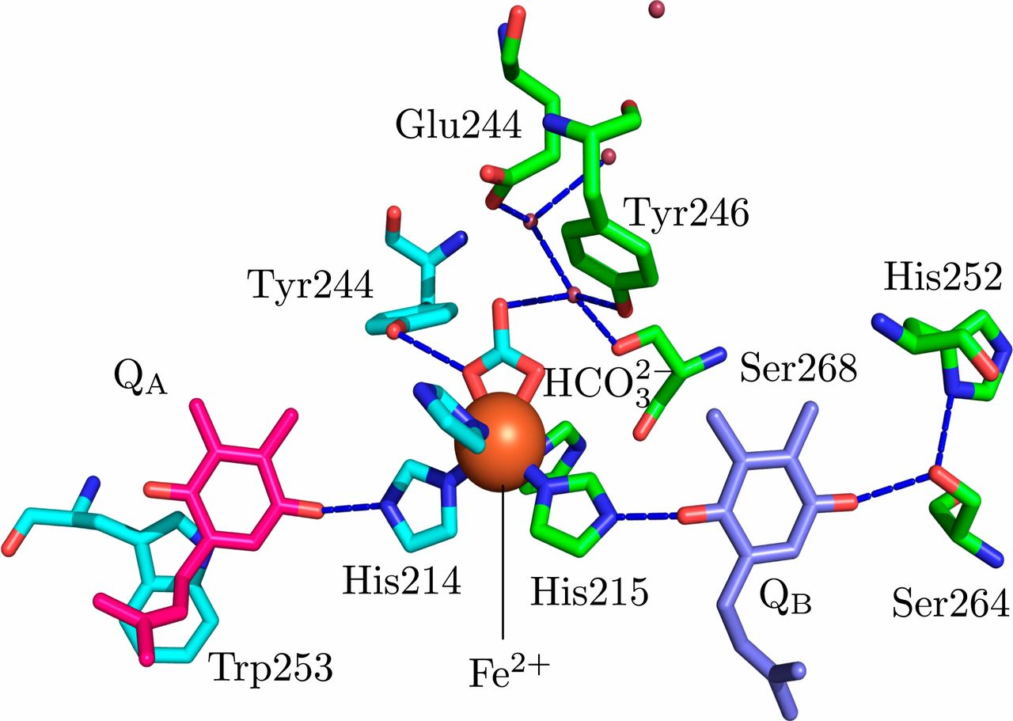
Patching

Slide 9
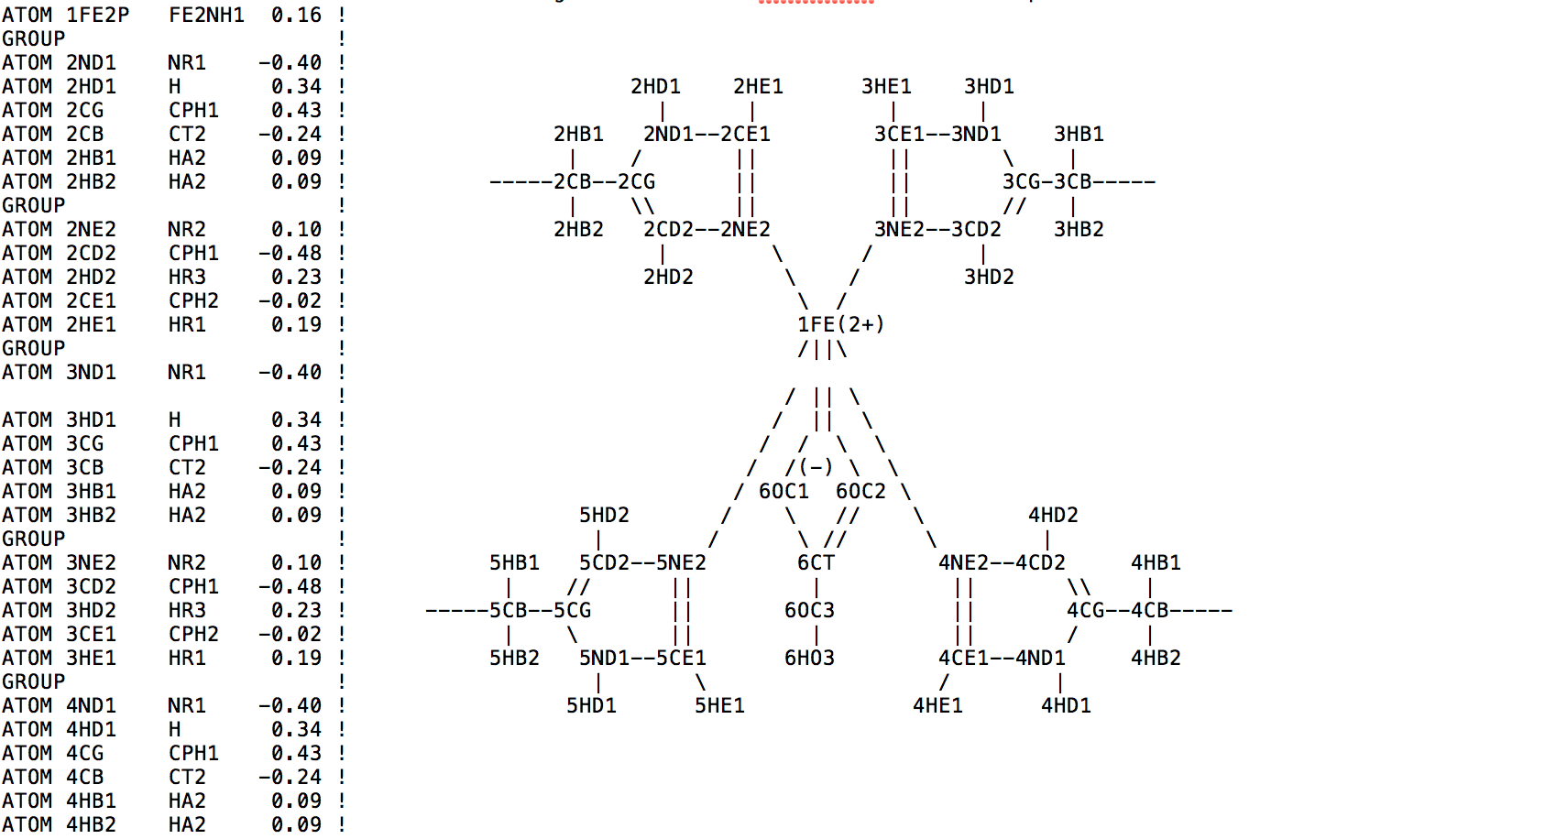
Patching
.str file: including topology file and parameter file

Slide 10
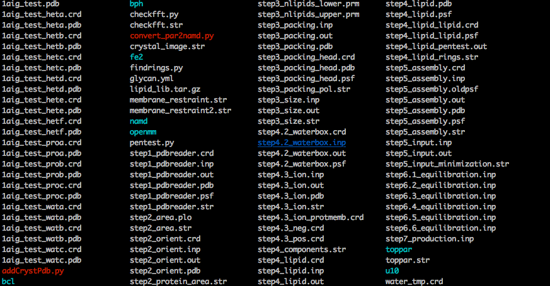
Patching

Slide 11
Patching
After we get the .str file, we need to do:
Update the toppar.str file in folder from CHARMM GUI by adding lines:
stream toppar/patching_file_name.str
Edit a patch-step1.inp file, including the patch lines:
patch RCFE PROA 230 PROB 266 PROB 219 PROA 190 PROB 234 HETD 308 noangle nodihedral
Run the command line: charmm < patch-step1.inp > patch-step1.out&
This step will reproduce step1* with the patch information
Run following command lines:
charmm < step2_orient.inp > step2_orient.out&
charmm < step5_assembly.inp > step5_assembly.out&
charmm < step5_input.inp > step5_input.out&
You will get new step5*, than you can go into openmm, modify toppar.str in openmm folder by adding lines:
../toppar/patching_file_name.str Run the MD simulation:
.run.sh

