Slide 1
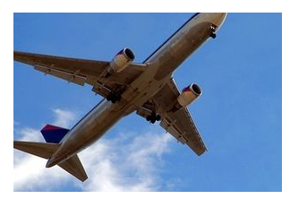
Case Study
You work for Airline X as GM Sales. For any flight, let’s assume for simplicity that there are always 100 seats. When selling flight tickets, you could always sell exactly 100 tickets. However, you know that in most flights, some people will not show up, so you could maximize sales by reselling that ticket.
How do you decide how many tickets you should oversell for each flight?
Remember, if you oversell by more than the number of people who don’t show, you will lose money in terms of putting those people on other flights plus some compensation

Slide 2
Probability Distribution: Binomial Distribution
Binomial Distribution arises whenever a finite number of trials are conducted as a part of an experiment and the trials are generated by a Bernoulli Process.
Bernoulli Process:
Each trial can have only two outcomes
Each outcomes’ probability of occurrence remains constant from one trial to another
The trials are independent, outcomes of one trial do not affect the outcomes of the other trial.

Slide 3
Probability Distribution: Binomial Distribution
Nine percent of undergraduate students carry credit card balances greater than $7000 (Reader’s Digest, July 2002). Suppose 10 undergraduate students are selected randomly to be interviewed about credit card usage.
a. Is the selection of 10 students a binomial experiment? Explain.

Slide 4
Probability Distribution: Binomial Distribution
Fifty percent of Americans believed the country was in a recession, even though technically the economy had not shown two straight quarters of negative growth (BusinessWeek, July 30, 2001). Suppose 50 Americans are chosen randomly and asked about their opinions on recession. Would this experiment be an example of a binomial process?

Slide 5
Probability Distribution: Binomial Distribution
Three of the 10 airplane tires at a hangar are faulty. 3 tires are selected at random for a plane; let F be the number of faulty tires found. Is F a binomial random variable?

Slide 6
1. A call center receives 20 call per hour on an average. Should the center be employing more people if they expect more than 25 calls in an hour, when the center cannot take more than 8 percent of the risk?
2. Cars arrive at a toll with mean 80 cars per hour. If the attendant makes a 3-minute phone call, what is the probability that at least 3 cars arrive during the call? (‘Number of Cars’ is a discreet variable)

