Slide 1
Video 8
Understanding the Frame Clause

Slide 2
Understanding Frame Clause
select * ,
sum(sold) over (PARTITION BY fruit, date(month)
order by date(month)
ROWS BETWEEN UNBOUNDED PRECEDING AND CURRENT ROW) as running_total
from fruitmart

Slide 3
Understanding Frame Clause
select * ,
sum(sold) over (PARTITION BY fruit, date(month)
order by date(month)
ROWS BETWEEN UNBOUNDED PRECEDING AND CURRENT ROW) as running_total
from fruitmart
Frame Scope

Slide 4
Understanding Frame Clause
select * ,
sum(sold) over (PARTITION BY fruit, date(month)
order by date(month)
ROWS BETWEEN UNBOUNDED PRECEDING AND CURRENT ROW) as running_total
from fruitmart
Frame Start

Slide 5
Understanding Frame Clause
select * ,
sum(sold) over (PARTITION BY fruit, date(month)
order by date(month)
ROWS BETWEEN UNBOUNDED PRECEDING AND CURRENT ROW) as running_total
from fruitmart
Frame End

Slide 6
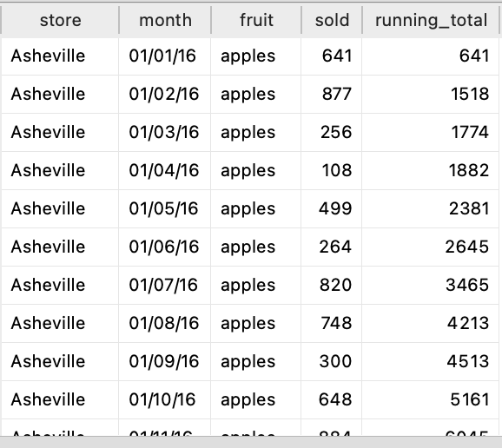
Understanding Frame Clause
select * ,
sum(sold) over (PARTITION BY fruit, date(month)
order by date(month)
ROWS BETWEEN UNBOUNDED PRECEDING AND CURRENT ROW) as running_total
from fruitmart

Slide 7
Understanding Frame Clause
select * ,
sum(sold) over (PARTITION BY fruit, date(month)
order by date(month)
ROWS BETWEEN UNBOUNDED PRECEDING AND CURRENT ROW) as running_total
from fruitmart
Frame Start: Row 1, Frame End : Row1

Slide 8
Understanding Frame Clause
select * ,
sum(sold) over (PARTITION BY fruit, date(month)
order by date(month)
ROWS BETWEEN UNBOUNDED PRECEDING AND CURRENT ROW) as running_total
from fruitmart
Frame Start: Row 1, Frame End : Row2

Slide 9
Understanding Frame Clause
select * ,
sum(sold) over (PARTITION BY fruit, date(month)
order by date(month)
ROWS BETWEEN UNBOUNDED PRECEDING AND CURRENT ROW) as running_total
from fruitmart
Frame Start: Row 1, Frame End : Row3

Slide 10
Understanding Frame Clause
select * ,
sum(sold) over (PARTITION BY fruit, date(month)
order by date(month)
ROWS BETWEEN 1 PRECEDING AND 1 FOLLOWING) as moving_total
from fruitmart

Slide 11
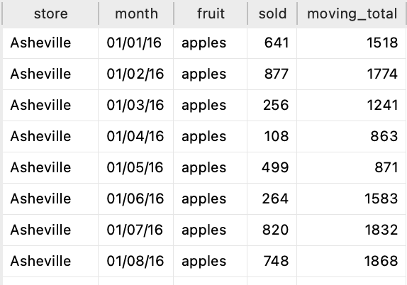
Understanding Frame Clause
select * ,
sum(sold) over (PARTITION BY fruit, date(month)
order by date(month)
ROWS BETWEEN 1 PRECEDING AND 1 FOLLOWING) as moving_total
from fruitmart
Frame Start: Row1
Frame End: Row 2
641+877 = 1518

Slide 12
Understanding Frame Clause
select * ,
sum(sold) over (PARTITION BY fruit, date(month)
order by date(month)
ROWS BETWEEN 1 PRECEDING AND 1 FOLLOWING) as moving_total
from fruitmart
Frame Start: Row1
Frame End: Row 3
641+877+256 = 1774

Slide 13
Understanding Frame Clause
select * ,
sum(sold) over (PARTITION BY fruit, date(month)
order by date(month)
ROWS BETWEEN 1 PRECEDING AND 1 FOLLOWING) as moving_total
from fruitmart
Frame Start: Row2
Frame End: Row 4
877+256+108 = 1241

Slide 14
Understanding Frame Clause
Frame Scope | Frame Start | FRAME End
ROWS | UNBOUNDED PRECEEDING | UNBOUNDED FOLLOWING
ROWS | 1,2,3.. PRECEEDING | 1,2,3.. FOLLOWING
ROWS | CURRENT ROW | CURRENT ROW

Slide 15
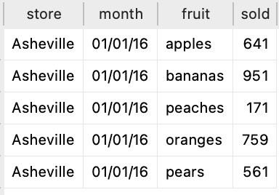
Understanding Frame Clause
Frame Scope | Frame Start | FRAME End
ROWS | UNBOUNDED PRECEEDING | UNBOUNDED FOLLOWING
ROWS | 1 PRECEEDING | 1 FOLLOWING
ROWS | CURRENT ROW | CURRENT ROW

Slide 16
Understanding Frame Clause
Frame Scope | Frame Start | FRAME End
ROWS | UNBOUNDED PRECEEDING | UNBOUNDED FOLLOWING
ROWS | 1 PRECEEDING | 1 FOLLOWING
ROWS | CURRENT ROW | CURRENT ROW
Frame Start: Row1
Frame End Row 4
641+951+171+759

Slide 17
Understanding Frame Clause
Frame Scope | Frame Start | FRAME End
ROWS | UNBOUNDED PRECEEDING | UNBOUNDED FOLLOWING
ROWS | 1 PRECEEDING | 1 FOLLOWING
ROWS | CURRENT ROW | CURRENT ROW

Slide 18
Understanding Frame Clause
Frame Scope | Frame Start | FRAME End
ROWS | UNBOUNDED PRECEEDING | UNBOUNDED FOLLOWING
ROWS | 1 PRECEEDING | 1 FOLLOWING
ROWS | CURRENT ROW | CURRENT ROW
Frame Starts: Row 3
Frame Ends: Row 4
171+759

