Slide 1
Linear Regression

Slide 2
Linear Regression
Classical Approach
Fitting a straight line: OLS/MLE
Sample fit and significance of predictors
Model assumptions

Slide 3
Linear Regression
Classical Approach
Marketing Mix Problem
If $X are spent on doing TV advertisements what will be the increase in sales?
How much should a Marketing Manager spend on marketing through various channels(TV, Newspaper)?
Why would answer to these questions might be needed?
Unit Sales | Base Price | TV(Impressions) | Radio(Impressions) | Instore | Online
 |  |  |  |  | Facebook
 |  |  |  |  | Twitter
 |  |  |  |  | Facebook
 |  |  |  |  | Twitter
 |  |  |  |  | Facebook

Slide 4
Linear Regression: What is it?
Y | X
10 | 1
9 | 2
8 | 3
7 | 4
? | 5
Y | X
10 | 1
9 | 2
8 | 3
7 | 4
6 | 5
Y | X
3.03 | 1
3.73 | 2
4.43 | 3
5.13 | 4
? | 5
Y | X
3.03 | 1
3.73 | 2
4.43 | 3
5.13 | 4
5.83 | 5

Slide 5
Linear Regression: What is it?
Y | X | X’
1.53 | 1 | 5
1.93 | 2 | 6
2.33 | 3 | 7
2.73 | 4 | 8
? | 5 | 9
Y | X | X’
1.53 | 1 | 5
1.93 | 2 | 6
2.33 | 3 | 7
2.73 | 4 | 8
3.13 | 5 | 9

Slide 6
Linear Regression: What is it?
Y | X
10 | 1
9 | 2
8 | 3
7 | 4
? | 5
Y | X
10 | 1
9 | 2
8 | 3
7 | 4
6 | 5
Y=11-X
Y | X
3.03 | 1
3.73 | 2
4.43 | 3
5.13 | 4
? | 5
Y | X
3.03 | 1
3.73 | 2
4.43 | 3
5.13 | 4
5.83 | 5
Y=2.33+X*0.7

Slide 7
Linear Regression: What is it?
Y | X | X’
1.53 | 1 | 5
1.93 | 2 | 6
2.33 | 3 | 7
2.73 | 4 | 8
? | 5 | 9
Y | X | X’
1.53 | 1 | 5
1.93 | 2 | 6
2.33 | 3 | 7
2.73 | 4 | 8
3.13 | 5 | 9
Y=2.33+X*0.7-X’*0.3
Y=α+β1*X+β2*X’

Slide 8
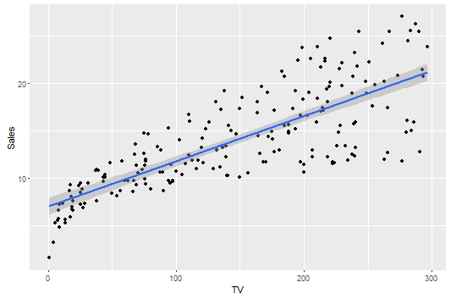
Linear Regression: Classical Approach
Sales = 7.03 + 0.04(TV)
What does 7.03 mean?
What does 0.04 signify?

Slide 9
Linear Regression: Multiple factors
Sales=2.33+TV*0.7-Radio*0.3
Unit Sales | Base Price | TV(Impressions) | Radio(Impressions) | Instore | Online
 |  |  |  |  | Facebook
 |  |  |  |  | Twitter
 |  |  |  |  | Facebook
 |  |  |  |  | Twitter
 |  |  |  |  | Facebook

Slide 10
Linear Regression: Multiple factors
Unit Sales | Base Price | Online | Facebook | Twitter
 |  | Facebook | 1 | 0
 |  | Twitter | 0 | 1
 |  | Facebook | 1 | 0
 |  | Twitter | 0 | 1
 |  | Facebook | 1 | 0
Unit Sales | Base Price | Online | Facebook
 |  | Facebook | 1
 |  | Twitter | 0
 |  | Facebook | 1
 |  | Twitter | 0
 |  | Facebook | 1
Sales=2.33+Price*0.8+Facebook*2.8

Slide 11

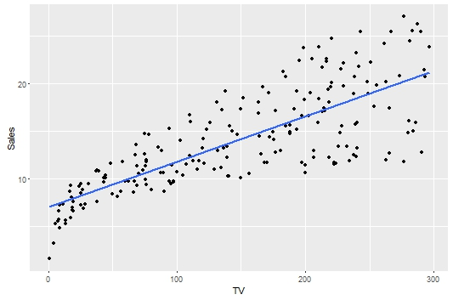
Linear Regression: Classical Approach
Minimise
Which line is the best fit line?
e1^2

Slide 12
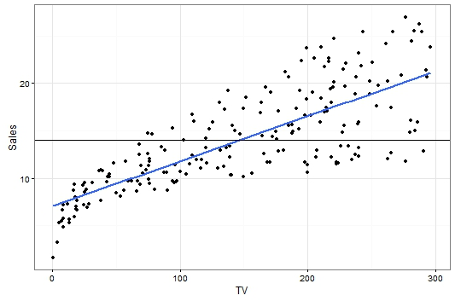
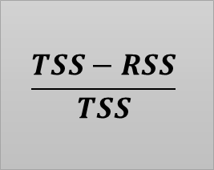
Linear Regression: Classical Approach
RSS
TSS
$$\frac{TSS−RSS}{TSS}$$
R^2

Slide 13
Linear Regression: Classical Approach
Sales = 7.03 + 0.04(TV)
What data are we working with: Sample?

Slide 14
Linear Regression: Classical Approach
From one sample to another will Sales be the same, for same values of TV advertising?

Slide 15
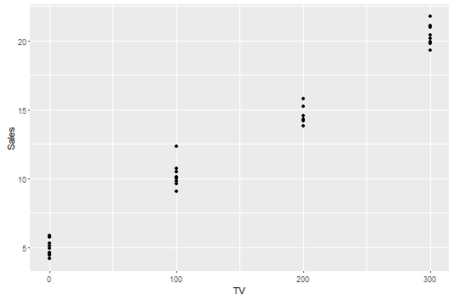
Linear Regression: Classical Approach
Sales | TV
10 | 2
11 | 2
9 | 2
12 | 2
15 | 2
13 | 2

Slide 16
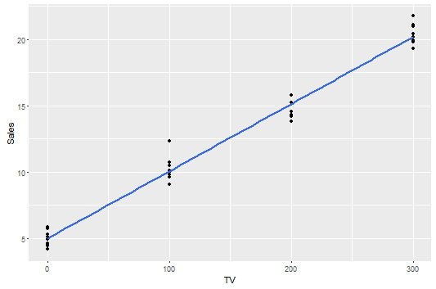
Linear Regression: Classical Approach
Sales | TV
10 | 2
11 | 2
9 | 2
12 | 2
15 | 2
13 | 2

Slide 17
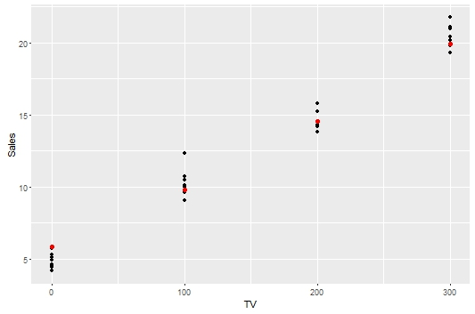
Linear Regression: Classical Approach
Sales | TV
10 | 2
11 | 2
9 | 2
12 | 2
15 | 2
13 | 2

Slide 18
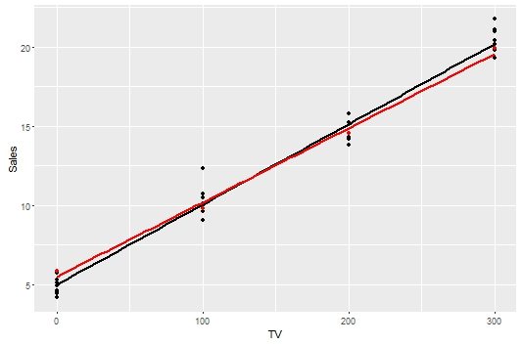
Linear Regression: Classical Approach
Sales | TV
10 | 2
11 | 2
9 | 2
12 | 2
15 | 2
13 | 2
Sales_i = a1 + b1(TV_i) + error

Slide 19
Linear Regression: Classical Approach
What should be the characteristics of this error term if our estimate of the relationship has to be good?
Mean of error = ? Should it be small/large or close to zero?
Should your estimated function be overestimating more often than it underestimates?
Assumption 1: Error~N(0,sigma)

Slide 20
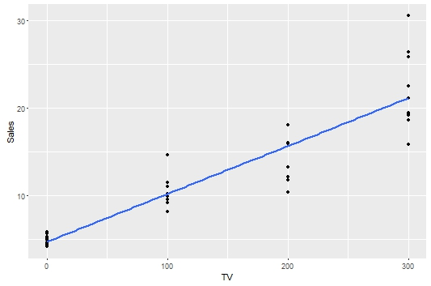
Linear Regression: Classical Approach
When will you most trust conditional mean estimates?
Assumption 2: Constant Variation

Slide 21
Linear Regression: Classical Approach
If inputs to a model are duplicates of each other, the duplicated input will not add any value to the model we build
In our case the $ amount spent on TV advertisements gives us the same information as equivalent Rs amount spent
Assumption 3: No multicollinearity

Slide 22
Linear Regression: Classical Approach
Sales=α+β1*TV+β2*Radio+β3*Facebook+β4*Twitter

