Slide 1
Logistic Regression

Slide 2
Supervised Learning: Classifying using a linear model
Classification: Fitting lines
Logistic function
Logistic regression: Cost function
Regularization: L1 and L2
Classifying multiple classes
Cross Entropy Loss

Slide 3
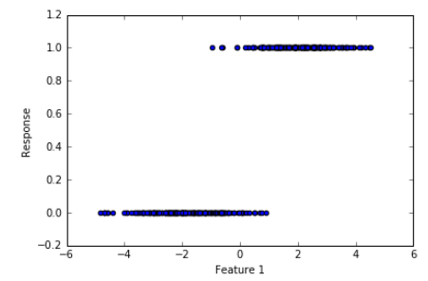
Supervised Learning: Fitting lines
Feature 1 (Age_Normalized) | Feature 2 (Income_Normalized) | Response (Good/Bad)
….. | …… | Good = 1
….. | …… | Bad = 0
….. | …… | ……
…... | ….. | ……
Fit a model of the form, Response=b0+b1Feature1

Slide 4
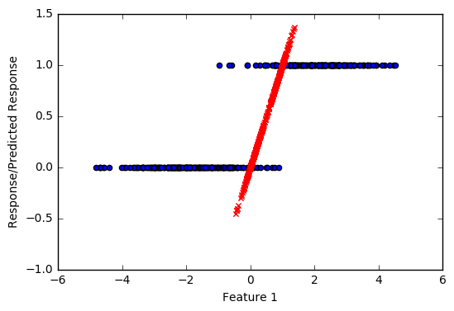
Supervised Learning: Fitting line
We fit a straight line to the data, where the response is binary in nature $y∈\{0,1\}$
Notice the predictions in red colour
Predictions < 0 or Predictions > 1
0<Predictions<1
We are trying to fit:
$$\hat{y}= β0+β1X1+β2X2+ε=f\left(X1,X2\right)$$
The problem with fitting linear model is:
$$f\left(X1,X2\right)∈\left(−∞,+∞\right)$$
$$y∈\{0,1\}$$

Slide 5
Supervised Learning: Fitting line
Age | Target
20 | 1
20 | 0
21 | 1
21 | 0
Age | Proportion (1)
20 | 0.50
21 | 0.50

Slide 6
Supervised Learning: Fitting a line
Instead of estimating $y∈\{0,1\}$ we can try to estimate the Prob(y=1) = $\hat{p}$
$$\hat{p}∈(0,1)$$
These estimates make sense now
We are trying to fit:
$$\hat{p}= β0+β1X1+β2X2+ε=f\left(X1,X2\right)$$
The problem still is:
$$f\left(X1,X2\right)∈\left(−∞,+∞\right)$$
$$\hat{p}∈(0,1)$$

Slide 7
Supervised Learning: Fitting a line
Age | Target
20 | 1
20 | 1
20 | 1
20 | 0
21 | 1
21 | 0
Age | Pr (1) | Pr/1-Pr
20 | 0.75 | 3
21 | 0.50 | 0.5
Maximum and Minimum value Pr/(1-Pr) ?
Minimum value of Pr(1) ?
Pr(1) = 0
Maximum value of Pr(1) ?
Pr(1) = 1
Min Pr(1) = 0, Pr/(1-Pr) = ?
Pr/(1-Pr) =0
Max Pr(1) = 1, Pr/(1-Pr) = ?
Pr/(1-Pr) =Infinity
0<=Pr/(1-Pr)<=Infinity

Slide 8
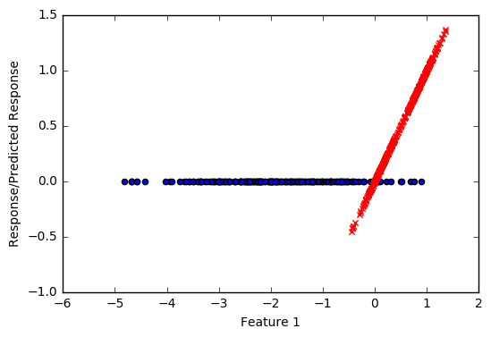
Supervised Learning: Fitting a line
Instead of estimating $y∈\{0,1\}$ we can try to estimate the $\frac{\hat{p}}{1−\hat{p}}$
$$\frac{\hat{p}}{1−\hat{p}}∈(0,+∞)$$
These estimates make sense now
We are trying to fit:
$$\frac{\hat{p}}{1−\hat{p}}= β0+β1X1+β2X2+ε=f\left(X1,X2\right)$$
The problem still is:
$$f\left(X1,X2\right)∈\left(−∞,+∞\right)$$
$$\frac{\hat{p}}{1−\hat{p}}∈(0,+∞)$$

Slide 9
Supervised Learning: Fitting a line
Age | Target
20 | 1
20 | 1
20 | 1
20 | 0
21 | 1
21 | 0
Age | Pr (1) | Pr/1-Pr | log(Pr/(1-Pr))
20 | 0.75 | 3 | 1.09
21 | 0.50 | 0.5 | -0.70
0<=Pr/(1-Pr)<=Infinity
-Infinity<=log(Pr/(1-Pr))<=Infinity

Slide 10
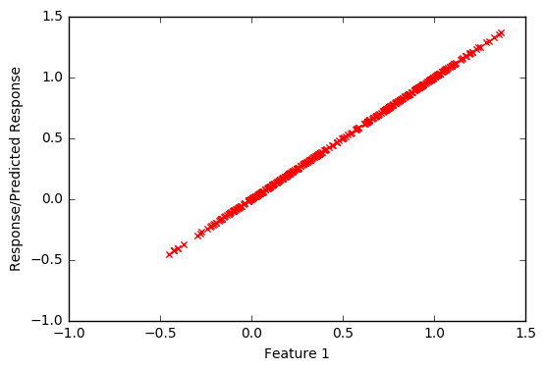
Supervised Learning: Fitting a line
Instead of estimating $y∈\{0,1\}$ we can try to estimate the log($\frac{\hat{p}}{1−\hat{p}}$)
log$\frac{\hat{p}}{1−\hat{p}}∈(−∞,+∞)$
All estimates make sense now
We are trying to fit:
log$\frac{\hat{p}}{1−\hat{p}}= β0+β1X1+β2X2+ε=f\left(X1,X2\right)$
$$f\left(X1,X2\right)∈\left(−∞,+∞\right)$$
log$\frac{\hat{p}}{1−\hat{p}}∈(−∞,+∞)$

Slide 11
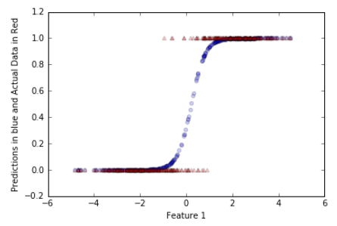
Supervised Learning: Logistic Function
log$\frac{\hat{p}}{1−\hat{p}}= β0+β1X1+β2X2+ε$
$$\hat{p}=\frac{e^{β0+β1X1+β2X2+ε}}{1+e^{β0+β1X1+β2X2+ε}}$$
Logistic function

Slide 12
Supervised Learning: Logistic Cost Function
To estimate the model parameters from data, one needs to define a loss/cost function
In the case of linear regression we used RSS as a cost function and we minimized it, RSS = $\sum_{i=1}^{n}{(y\text{i}\text{ – }x\text{i}\text{T}\text{β}}$)² = (y-Xβ)^{T}(y-Xβ)
How can we define a loss function in a classification setting?

Slide 13
Supervised Learning: Logistic Cost Function
Age | Good_Bad (Good =1) | Prediction
20 | 1
21 | 1
24 | 0
25 | 0
29 | 0
30 | 1
38 | 1
log$\frac{\hat{p}}{1−\hat{p}}= β0+β1Age$
$$\hat{p}=\frac{e^{β0+β1Age}}{1+e^{β0+β1Age}}$$

Slide 14
Supervised Learning: Logistic Cost Function
Age | Good_Bad (Good =1) | Prediction
20 | 1 | 0.90
21 | 1 | 0.95
24 | 0 | 0.30
25 | 0 | 0.21
29 | 0 | 0.19
30 | 1 | 0.99
38 | 1 | 0.98
log$\frac{\hat{p}}{1−\hat{p}}= β0+β1Age$
$$\hat{p}=\frac{e^{β0+β1Age}}{1+e^{β0+β1Age}}$$
Age | Good_Bad (Good =1) | Prediction
20 | 1 | 0.70
21 | 1 | 0.60
24 | 0 | 0.50
25 | 0 | 0.45
29 | 0 | 0.70
30 | 1 | 0.62
38 | 1 | 0.40
$$β0=0.3$$
$$β_{1}=2.2$$
$$β0=0.7$$
$$β_{1}=1.7$$
29 | 0 | 0.70

Slide 15
Supervised Learning: Logistic Cost Function
Age | Good_Bad (Good =1) | Prediction
20 | 1 | 0.90
21 | 1 | 0.95
24 | 0 | 0.30
25 | 0 | 0.21
29 | 0 | 0.19
30 | 1 | 0.99
38 | 1 | 0.98
log$\frac{\hat{p}}{1−\hat{p}}= β0+β1Age$
$$\hat{p}=\frac{e^{β0+β1Age}}{1+e^{β0+β1Age}}$$
$$β0=0.7$$
$$β_{1}=1.7$$
Age | Good_Bad (Good =1) | Prediction
20 | 1 | 0.70
21 | 1 | 0.60
24 | 0 | 0.50
25 | 0 | 0.45
29 | 0 | 0.70
30 | 1 | 0.62
38 | 1 | 0.40
$$β0=0.3$$
$$β_{1}=2.2$$
The cost function to be minimised is:
Cost $=−\sum_{i=1}^{1=n}{yilog\left(Pi\right)+\left(1−yi\right)log⁡(1−Pi)}$
Cost $=−\sum_{i=1}^{1=n}{yilog(\frac{e^{β0+β1Age_{i}}}{1+e^{β0+β1Age_{i}}})+\left(1−yi\right)log⁡(1−\frac{e^{β0+β1Age_{i}}}{1+e^{β0+β1Age_{i}}})}$
$$yi=1, if Target =1,else yi=0$$

Slide 16
Supervised Learning: Logistic Cost Function
The objective would now be to minimise
Cost $=−\sum_{i=1}^{1=n}{yilog\left(Pi\right)+\left(1−yi\right)log⁡(1−Pi)}$
$$Cost=−\sum_{i=1}^{1=n}{yilog(\frac{e^{βX_{i}}}{1+e^{βX_{i}}})+\left(1−yi\right)log⁡(1−\frac{e^{βX_{i}}}{1+e^{βX_{i})}}}$$
There is no closed form solution to this optimization problem, this is solved using
Numerical optimization procedures such as Newton’s Method etc

Slide 17
Supervised Learning: L1 and L2 regularization
Just like linear regression, we can introduce regularization in the logistic regression also
The aim of using regularization is to prevent overfit.
The L2 regularization is implemented as:
The objective would now be to minimise
$Cost=−\sum_{i=1}^{1=n}{yilog(\frac{e^{βX_{i}}}{1+e^{βX_{i}}})+\left(1−yi\right)log⁡(1−\frac{e^{βX_{i}}}{1+e^{βX_{i}}})}$ + λ$\sum{\text{β}\text{′}}$_{i}²
(β‘ is a model parameter vector without the intercept term)

Slide 18
Supervised Learning: L1 and L2 regularization
The L1 regularization is implemented as:
The objective would now be to minimise
$Cost=−\sum_{i=1}^{1=n}{yilog(\frac{e^{βX_{i}}}{1+e^{βX_{i}}})+\left(1−yi\right)log⁡(1−\frac{e^{βX_{i}}}{1+e^{βX_{i}}})}$ + α$\sum{\text{|}\text{β}}$’_{i}|
(β‘ is a model parameter vector without the intercept term)

Slide 19
Supervised Learning: Classification Performance Metrics
Its easy to think about performance metrics for a regression model, the notion of accuracy in a regression setting is fairly straightforward.
How can we talk about the notion of accuracy in a binary classification scenario?
What output will a logistic regression model produce?
How can probability of event be used to classify?

Slide 20
Supervised Learning: Classification Performance Metrics
Age | Good_Bad | Prediction
23 | 1 | 0.90
24 | 1 | 0.75
25 | 1 | 0.60
26 | 0 | 0.45
27 | 0 | 0.40
28 | 0 | 0.30
29 | 1 | 0.82
Age | Good_Bad | Prediction | Pred_Label
23 | 1 | 0.90 | 1
24 | 1 | 0.75 | 1
25 | 1 | 0.60 | 1
26 | 0 | 0.45 | 0
27 | 0 | 0.40 | 0
28 | 0 | 0.30 | 0
29 | 1 | 0.82 | 1
Threshold=0.5
Accuracy = 100%
Accuracy = # of Correctly predicted labels/N

Slide 21
Supervised Learning: Classification Performance Metrics
Age | Good_Bad | Prediction
23 | 1 | 0.90
24 | 1 | 0.75
25 | 1 | 0.48
26 | 0 | 0.52
27 | 0 | 0.53
28 | 0 | 0.30
29 | 1 | 0.82
Age | Good_Bad | Prediction | Pred_Label
23 | 1 | 0.90 | 1
24 | 1 | 0.75 | 1
25 | 1 | 0.48 | 0
26 | 0 | 0.52 | 1
27 | 0 | 0.53 | 1
28 | 0 | 0.30 | 0
29 | 1 | 0.82 | 1
Threshold=0.5
 | Actual_Class 1 | Actual_Class 0
Predicted_Class 1 | 3 | 2
Predicted_Class 0 | 1 | 1

Slide 22
S Supervised Learning: Classification Performance Metrics
 | Actual_Class 1 | Actual_Class 0
Predicted_Class 1 | True Positive | False Positive
Predicted_Class 0 | False Negative | True Negative
Precision = tp/(tp+fp)
Recall = tp/(tp+fn)

Slide 23
Supervised Learning: Classification Performance Metrics
What is the peculiarity of the previous approach?
What will happen if p>0.6 is used to make classification?
Will Precision-Recall change?

Slide 24
Supervised Learning: Classification Performance Metrics
Age | Good_Bad | Prediction
23 | 1 | 0.90
24 | 1 | 0.75
25 | 1 | 0.48
26 | 0 | 0.52
27 | 0 | 0.53
28 | 0 | 0.30
29 | 1 | 0.82
Age | Good_Bad | Prediction | Pred_Label
23 | 1 | 0.90 | 1
24 | 1 | 0.75 | 1
25 | 1 | 0.48 | 1
26 | 0 | 0.52 | 1
27 | 0 | 0.53 | 1
28 | 0 | 0.30 | 0
29 | 1 | 0.82 | 1
Threshold=0.4
 | Actual_Class 1 | Actual_Class 0
Predicted_Class 1 | 4 | 2
Predicted_Class 0 | 0 | 1

Slide 25
Supervised Learning: Classification Performance Metrics
 | Actual_Class 1 | Actual_Class 0
Predicted_Class 1 | True Positive | False Positive
Predicted_Class 0 | False Negative | True Negative
Cutoff | TPR=TP/N | FPR=FP/N
P1 | TPR1 | FPR1
P2 | TPR2 | FPR2
.. | .. | ..
Pn | TPRn | FPRn

Slide 26
Supervised Learning: Classification Performance Metrics
 | Actual_Class 1 | Actual_Class 0
Predicted_Class 1 | True Positive | False Positive
Predicted_Class 0 | False Negative | True Negative
Cutoff | TPR=TP/N | FPR=FP/N
P1 | TPR1 | FPR1
P2 | TPR2 | FPR2
.. | .. | ..
Pn | TPRn | FPRn
True Positive Rate
ROC Curve
False Positive Rate

Slide 27
Supervised Learning: Classification Performance Metrics
 | Actual_Class 1 | Actual_Class 0
Predicted_Class 1 | True Positive | False Positive
Predicted_Class 0 | False Negative | True Negative
Cutoff | TPR=TP/N | FPR=FP/N
P1 | TPR1 | FPR1
P2 | TPR2 | FPR2
.. | .. | ..
Pn | TPRn | FPRn
True Positive Rate
AUC is a consolidated measure
False Positive Rate

Slide 28
Supervised Learning: Logistic Regression
Code Demo

Slide 29
Supervised Learning: Classifying multiple classes
The classical binary logistic model can be extended to handle multiple classes
There are two approaches to deal with multiple classes:
One Vs Rest/ One Vs All
Multinomial Logistic

Slide 30
Supervised Learning: Classifying multiple classes
One Vs Rest or One Vs All
Assume, that there are K classes, then for each of the K classes a binary classifier is built predicting:
$$\left\{\begin{aligned}If the sample belongs to Kth class, 1 \\ If the sample doesn^{′}t belong to Kth class, 0\end{aligned}\right.$$

Slide 31
Supervised Learning: Classifying multiple classes
Age | Income | Status
20 | $10 K | Paid
25 | $ 30 K | Paid
32 | $ 18 K | Late Payment
19 | $ 3 K | Not Paid
70 | $ 12 K | Paid
62 | $ 9 K | Late Payment
Model 1 predicting P(Paid) vs P(Not Paid or Late Payment)
Model 2 predicting P(Not Paid) vs P(Paid or Late Payment)
Model 3 predicting P(Late Payment) vs P(Paid or Not Paid)

Slide 32
Supervised Learning: Classifying multiple classes
Model 1 predicting P(Paid) vs P(Not Paid or Late Payment)
Age | Income | Status | Target
20 | $10 K | Paid | 1
25 | $ 30 K | Paid | 1
32 | $ 18 K | Late Payment | 0
19 | $ 3 K | Not Paid | 0
70 | $ 12 K | Paid | 1
62 | $ 9 K | Late Payment | 0

Slide 33
Supervised Learning: Classifying multiple classes
Model 2 predicting P(Not Paid) vs P(Paid or Late Payment)
Age | Income | Status | Target
20 | $10 K | Paid | 0
25 | $ 30 K | Paid | 0
32 | $ 18 K | Late Payment | 0
19 | $ 3 K | Not Paid | 1
70 | $ 12 K | Paid | 0
62 | $ 9 K | Late Payment | 0

Slide 34
Supervised Learning: Classifying multiple classes
Model 3 predicting P(Late Payment) vs P(Paid or Not Paid)
Age | Income | Status | Target
20 | $10 K | Paid | 0
25 | $ 30 K | Paid | 0
32 | $ 18 K | Late Payment | 1
19 | $ 3 K | Not Paid | 0
70 | $ 12 K | Paid | 0
62 | $ 9 K | Late Payment | 1

Slide 35
Supervised Learning: Classifying multiple classes
Age | Income | Status
20 | $10 K | Paid
25 | $ 30 K | Paid
32 | $ 18 K | Late Payment
19 | $ 3 K | Not Paid
70 | $ 12 K | Paid
62 | $ 9 K | Late Payment
23 | $ 12 k
Model 1 predicting P(Paid) vs P(Not Paid or Late Payment) = 0.81
Model 2 predicting P(Not Paid) vs P(Paid or Late Payment) = 0.62
Model 3 predicting P(Late Payment) vs P(Paid or Not Paid) = 0.70
Will pay
?

Slide 36
Supervised Learning: Classifying multiple classes
Multinomial Logistic or Max Ent or Soft Max:
In One Vs All/ One Vs Rest approach, you would have noticed that the sum of the Probabilities of K classes can exceed 1.
For example in the previous illustration we had estimated:
Model 1 predicting P(Paid) vs P(Not Paid or Late Payment) = 0.81
Model 2 predicting P(Not Paid) vs P(Paid or Late Payment) = 0.62
Model 3 predicting P(Late Payment) vs P(Paid or Not Paid) = 0.70

Slide 37
Supervised Learning: Classifying multiple classes
Multinomial Logistic or Max Ent or Soft Max:
Here the following model is fit, for each of the K classes, the Kth class probability is modelled as
All the Probabilities are estimated simultaneously
This method has a nice property that all the K class probabilities sum to 1
P(y=k|X=xi)=$\frac{e^{βiX}i}{\sum{e^{βiXi}}}$
Class A (0.4), Class B(0.30), Class C(0.30)
Predict Class A

Slide 38
Supervised Learning: Loss Function multiple classes
When Max Ent or Soft Max is used the following cost function is minimized:
$Cost=−\sum_{n=1}^{N}{\sum_{k=1}^{K}{y}}$_{nk} $ln⁡(\frac{e^{βnkX}nk}{\sum{e^{βnkXnk}}}$)
This cost function is also known as a cross entropy loss

Slide 39
Supervised Learning: Loss Function multiple classes
Code demo

Slide 40
Supervised Learning: Logistic Regression Recap
Logit function
Binary classifier: Cost function
Regularization: L1 and L2
Multiclass classification using Soft Max
Multiclass loss function

