Slide 1
Introduction
What does Statistics cover?
Summary Statistics
Inferential Statistics
Population vs Sample
Probability Theory
Probability calculations
Conditional Probability
Probability Distribution Concepts
Types of Distributions
Discrete
Continuous

Slide 2
Statistics – What is it?
Dictionary definition of statistics –
“the science that deals with the collection, classification, analysis, and
interpretation of numerical facts or data, and that, by use of
mathematical theories of probability, imposes order and regularity on
aggregates of more or less disparate elements.”
There are two parts to the definition
the collection, classification, analysis and interpretation of numeric data
AND
the use of probability theory to impose order on aggregates of data
We will look at each of these elements in the following slides

Slide 3

Statistics - Introduction
In general, statistics deals with summarizing information about data in a meaningful and relevant way.
Describe the population of Bangalore?
population in 2010 is 5.4 million
That is a statistic about Bangalore’s population – the total (sum) of all full-time residents of Bangalore
What other statistics can you think of?
“Population density” “Median Age” “Distribution by Religion” “Literacy Rate”
All of these are statistics used to summarize information, because talking about each data point is impossible

Slide 4
Statistics - Introduction
Data Series : 17,4,33,2,51,23,3,41,18,2,4,2
Mean = 16.67
(17+4+33+2+51+23+3+41+18+2+4+2)/12
Median = 10.5 (4+17)/2 – Why?
Mode = 2 – Why?
Minimum = 2
Maximum = 51
What are some commonly used statistics to summarize information?
Sum: Total of all values in dataset
Mean : The average of all values in the dataset
Median : Mid value of sorted data
If even series?
Mode – Most commonly occurring value in a series
Minimum – Lowest value in Series
Maximum – Highest value in Series

Slide 5
Statistics - Introduction
We can describe the series we looked at in the previous example as:
“Minimum of 2, Maximum of 51, average of 16.6.”
Given this description of the data series, what picture do we form of the data?
The easiest way to visualize data is to look at its “distribution”

Slide 6
Statistics - Introduction
A distribution is a visualization of a frequency distribution table
If we take the data series we were just looking at:
17,4,33,2,51,23,3,41,18,2,4,2
We can create a frequency table, which is just counting the number of times each value appears in the data series
We can see the frequency count of each
data value in this table
A better way of creating this table would be
to use ranges of values, rather than individual
data points

Slide 7
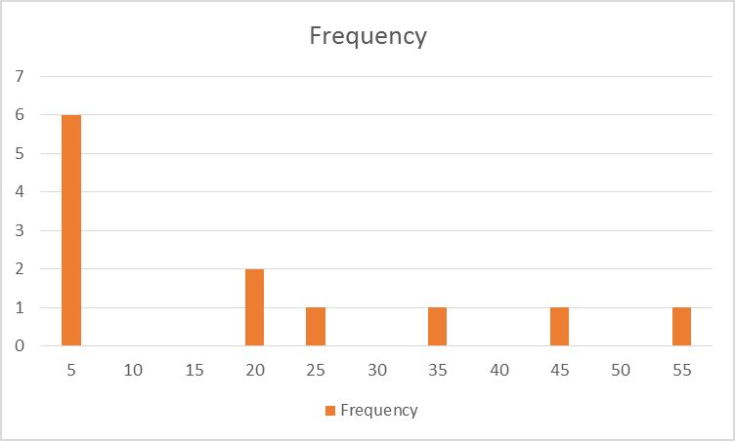
Statistics - distributions
Bin – refers to the value range
So 5 refers to “0 – 5”
According to this table, there are 6 observations that have values between 0 – 5, 2 observations with values between 15 – 20 and so on
The quickest way to get a sense of this data is to turn this into a visualization

Slide 8
Statistics - distributions
This visualization gives us a “picture” of the data - this is a data distribution
We can also draw a line joining the bars – like this

Slide 9
Statistics - Introduction
We can describe the series we looked at in the previous example as:
“Minimum of 2, Maximum of 51, average of 16.6.”
Given this description of the data series, what picture do we form of the data?

Slide 10
Statistics - Introduction
We also use summary statistics to understand variation or dispersion in the data
For example: Range, Variance, Standard Deviation

Slide 11
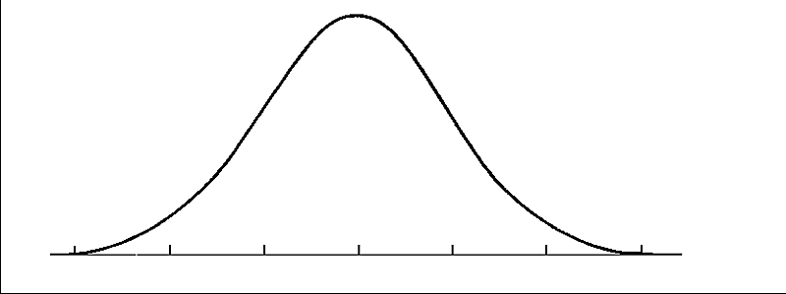
Range
Range = Highest observation – lowest observation
Interquartile Range = 3rd quartile (Q3) – 1st Quartile (Q1)
Lowest observation
1st quartile
Median
3rd quartile
Highest observation
Interquartile range
Notes:
The range is easy to understand and calculate. However, its usefulness as a measure of dispersion is limited. It only takes the highest and lowest values into account and ignores the nature of variation among all other observations in the data. Hence it is heavily influenced by extreme values.
The interquartile range is the measure of spread between the 25th percentile and 75th percentile in the data. It measures approximately how far from the median we need to go on wither side to capture half of the observations. It is a better measure than range as it is less affected by extreme observations.

Slide 12
Variance
Customer Number | Average minute usage (monthly) | X-µ | (x-µ)²
1 | 228 | -6.8 | 46.24
2 | 260 | 25.2 | 635.04
3 | 252 | 17.2 | 295.84
4 | 298 | 63.2 | 3994.24
5 | 234 | -0.8 | 0.64
6 | 50 | -184.8 | 34151.04
7 | 264 | 29.2 | 852.64
8 | 230 | -4.8 | 23.04
9 | 304 | 69.2 | 4788.64
10 | 228 | -6.8 | 46.24
Variance = σ² = ∑(x-µ)²/N
Standard Deviation = σ = √ σ²
x=observation
µ= population mean
N= number of observations in the population
Variance = (44833.6/10) = 4483
Standard deviation = √4483 = 67

Slide 13
Application and uses of std deviation
For any data set, it can be proved mathematically that
Atleast 75% of all data points will lie within 2 std deviations of the mean,
and atleast 89% within 3 std deviations
This is Chebyshev’s Inequality
Supposing we had a data series, with a min of 200, a max of 1500, a mean of 600, and a std deviation of 80
Then, it has to be that atleast 75% of all the data points in the series will be within the range:
600 – 2*80, 600 + 2*80 : (440, 760)
And, atleast 89% of all data points will be within the range:
600 – 3*80, 600 + 3*80 : (360, 840)

Slide 14
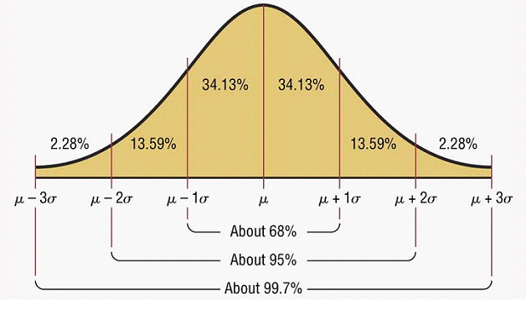
Uses of Standard Deviation
Notes:
For a normal distribution or a bell shaped curve like the one on the slide, 68% of values lie within 1 std deviation of the mean.
About 95% lie within 2 std deviations from the mean
About 99% lie within 3 std deviations.
For any distribution, regardless of the shape, at least 75% of the values lie within +/- 2 std deviations of mean and 89% within +/- 3 std deviations.

Slide 15
Summary statistics : Shape Measures
We have reviewed average measures and range measures. Another measure used in descriptive statistics is Shape
One measure of shape is the degree of skewness
What is skewness? It is the absence of symmetry
A symmetric shape is one where the left side of the data distribution is a mirror image of the right (side relative to mean)

Slide 16
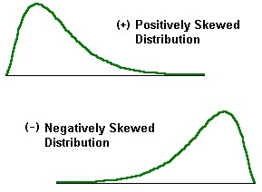

Shape Measures
Skewness: Degree of Asymmetry
Positive Skew; Long tail to the Right
Negative Skew: Long tail to the Left

Slide 17
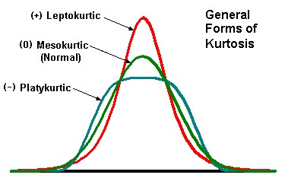

Shape Measures Contd.
Another measure of shape is Kurtosis, or the sharpness of the peak of the distribution
The following figure illustrates the various types of kurtosis:

Slide 18
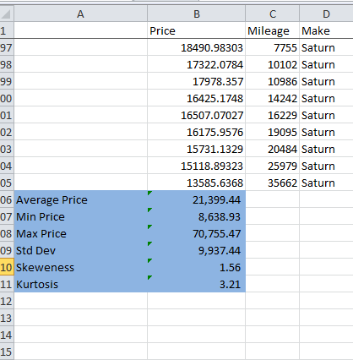
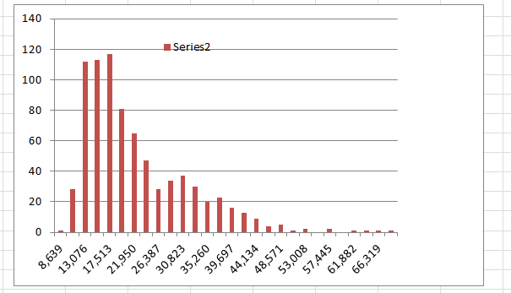
Car PRICE DATA

Slide 19
Summary Statistics
Why is it important for us to learn about summary statistics?
Description of a large number of data points
Generate inferences from the summary statistics
Example
You are working for a credit card company, and you are tasked with understanding drivers of default. You have access to billing and demographic data.
You divide the data into customers who have a great payment record, and customers who have been late with payments at least 3 times in the last year
“Good”
‘‘Not so Good”
Mean Income: $37k
Std Dev of Income: $5K
Mean Income: $26k
Std Dev of Income: $9k

Slide 20
Statistics – Types
Two types of statistics
Descriptive 
Provides a visual, tabular or numeric summary of large amounts of data to explain its key characteristics
Identify patterns in large amounts of data
Data Set is assumed as stand-alone
Inferential
Uses a sample of data to make inferences about the general population
Assumes that sample is representative of a larger population
Draws conclusions about population based on the smaller sample
Notes:
Examples of descriptive statistics
Measures of central tendency
Measures of dispersion
Measures of association
Cross-tabulation contingency table
Histogram
Quantile, Q-Q plot
Scatterplot
Box plot
Examples of inferential statistics
Probabilities
Regression
Decision trees
Descriptive statistics are distinguished from inferential statistics in that descriptive statistics aim to summarize a data set quantitatively without employing a probabilistic formulation, rather than use the data to make inferences about the population that the data are thought to represent.
Even when a data analysis draws its main conclusions using inferential statistics, descriptive statistics are generally also presented.

Slide 21
Sample vs Population
In the previous slide, we have introduced the concept of sample and population
Examples of Populations
All applications received for credit cards from Bank XYZ
All consumers of Product Y
What others can you think of?
Examples of Samples:
All applications received in the last 3 months
Women consumers over the age of 45 that have bough Product Y in the last 6 months

Slide 22
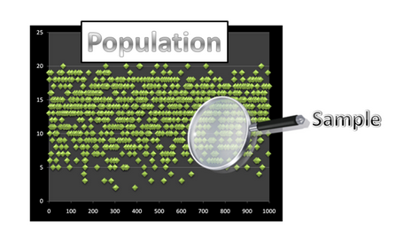
Sample vs Population
Why do we need to separate the two?
Population (or the Universe) tends to be very large, making it difficult (or impossible) to collect and analyze data on the population
It is easier to take a subset of the population, analyze the subset, and then make inferences about the population
The second point depends on a fundamental assumption – what is that?
Representativeness
We have to find a sample that is representative of the population that it belongs to

Slide 23
Sample vs Population
Clearly, we can choose many samples from a population. A good sample is that which is chosen:
Without bias :(not choosing only high income respondents)
Full coverage: All segments in population are correctly represented
Nonresponse inclusive: If 20% of your population are defaulters, your sample ideally should also have 20% defaulters

Slide 24
How to Choose a Sample
So how do we select a sample?
Simple random sample :
All members in a population have an equal chance of being selected in the sample
Stratified random sampling:
Population members are first divided into groups or strata based on meaningfulness. Then random samples are taken from each strata
The important thing to remember while building a sample is representativeness. We assume that the sample represents the population, so any inferences we draw about the sample will be true of the population
Notes:
Sampling theory is a vast subject that studies the different types in which samples can be created that are “random” and without bias.
Remember that a large sample does not always mean a good sample. Also remember that there are a minimum number of observations you need in a sample to make it representative. So very small sample sizes are not good for drawing inferences about a population. A general rule of thumb is at least 30

Slide 25
Statistical Estimation
What kind of inferences can we make in statistics?
We can estimate unknown population parameters based on properties of a sample
We can test hypothesis about a population based on sample parameters

Slide 26

Case Study
You work for Airline X as GM Sales. For any flight, let’s assume for simplicity that there are always 100 seats. When selling flight tickets, you could always sell exactly 100 tickets. However, you know that in most flights, some people will not show up, so you could maximize sales by reselling that ticket.
How do you decide how many tickets you should oversell for each flight?
Remember, if you oversell by more than the number of people who don’t show, you will lose money in terms of putting those people on other flights plus some compensation

Slide 27
Random Variables and Probability
We now should spend some time understanding the concept of random variables and how they apply to statistical theory
Let’s say you are taking a math test. If you answer all the questions correctly, you will get 100%. This is not “random”
But let’s say you are in a class of 50 students. How many students will score 100%? That is a random variable
A random variable is one that takes a numerical value whose outcome is determined by an experiment.
In the student example, the test is the experiment
Notes:
How would you define experiment in the airline case listed? Do not take experiment literally

Slide 28
Case Study
In the airlines examples, the number of people who don’t show for each flight is a random variable
Let’s assume there are 10 flights per day. If we collect data on no-shows for each day for 100 days, we will get a distribution of outcomes, with no show percentages ranging from ?
For the most part, you would expect very very few flights with 0% no show, 100% no shows. Most likely the most frequent % is somewhere between 2 – 10%
Notes:
The reason the no show is a random variable is that there is no single controlling factor for no shows, and truly the no show % is random for any day till the flight takes off.

Slide 29
Probability Distribution: Binomial Distribution
Binomial Distribution arises whenever a finite number of trials are conducted as a part of an experiment and the trials are generated by a Bernoulli Process.
Bernoulli Process:
Each trial can have only two outcomes
Each outcomes’ probability of occurrence remains constant from one trial to another
The trials are independent, outcomes of one trial do not affect the outcomes of the other trial.

Slide 30
Probability Distribution: Binomial Distribution
Nine percent of undergraduate students carry credit card balances greater than $7000 (Reader’s Digest, July 2002). Suppose 10 undergraduate students are selected randomly to be interviewed about credit card usage.
a. Is the selection of 10 students a binomial experiment? Explain.

Slide 31
Probability Distribution: Binomial Distribution
Fifty percent of Americans believed the country was in a recession, even though technically the economy had not shown two straight quarters of negative growth (BusinessWeek, July 30, 2001). Suppose 50 Americans are chosen randomly and asked about their opinions on recession. Would this experiment be an example of a binomial process?

Slide 32
Probability Distribution: Binomial Distribution
Three of the 10 airplane tires at a hangar are faulty. 10 tires are selected at random for a plane; let F be the number of faulty tires found. Is F a binomial random variable?

Slide 33
Binomial Distribution
1. An oil exploration firm plans to drill 6 holes. They believe that the probability that each hole will yield oil is 0.10. Since they will be drilling in different locations, the outcomes are statistically independent.
If the firm needs two or more holes to produce oil to stay in business, what is the probability that they will stay in business?
2. An XYZ cell phone is made from 55 components. Each component has a .002 probability of being defective. What is the probability that an XYZ cell phone will not work perfectly?
3. Suppose that 48% of individuals 85 years and older have Alzheimer’s Disease. You go to a nursing home that has been feeding residents a diet consisting of natural, organic, and healthy foods including free range chickens, omega 3 eggs, flax seed, etc. You find that only 29 of 100 residents who are 85-years and older have Alzheimer’s disease? What is the likelihood of this outcome?

Slide 34
Discrete Distribution: Poisson
Another discrete probability distribution, that is used to model number of events occurring in a time frame
Examples include:
Number of insurance claims in a month
Disease spread in a day
Number of telephone calls in an hour
Number of patients needing emergency services in a day
The following conditions apply to correctly use a Poisson Distribution:
Events have to be counted as whole numbers
Events are independent: so if one event occurs, it does not impact the chances of the second event occurring
Avg frequency of occurrence for the given time period is known
Number of events that have already occurred can be counted

Slide 35
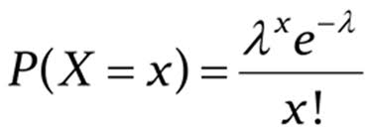
Discrete Distribution
poisson
Poisson Probabilities are calculated as:
Where, Lambda is the mean number of occurrences in a given interval of time .
Notice here that there is no n (sample size) impact
Similar to how the Binomial probabilities are calculated, for every X and Lambda we can calculate the Poisson Probabilities
Mean of a Poisson Dist is Lambda; Std Deviation is Sq Root of Lambda

Slide 36
Poisson Distribution
1. A call centre receives 20 call per hour on an average. Should the centre be employing more people if they expect more than 25 calls in an hour, when the centre cannot take more than 8 percent of the risk?
2. Cars arrive at a toll with mean 80 cars per hour. If the attendant makes a 3-minute phone call, what is the probability that at least 3 cars arrive during the call? (‘Number of Cars’ is a discreet variable)

Slide 37
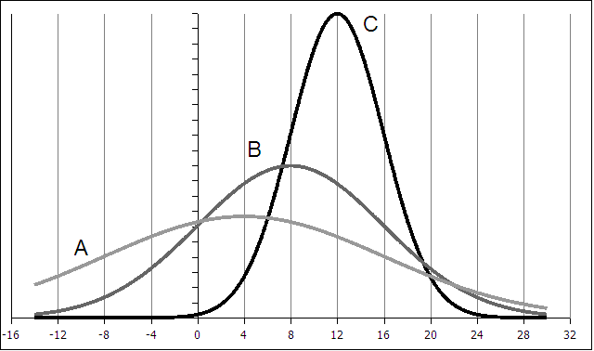
Normal Probability Distribution
Symmetric about the (single) mean
Mean = Median = Mode
The two tails extend indefinitely and never touch the axis
What are the differences between the curves?
Notes:
Which of these are normal? Why?

Slide 38
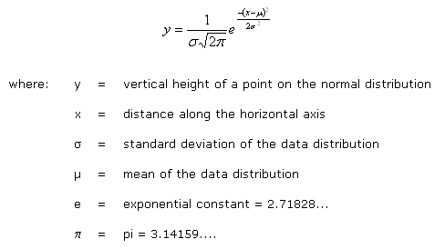
Normal Probability Distribution
http://www.pavementinteractive.org/index.php?title=Normal_Distribution

Slide 39
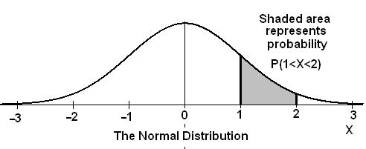
Normal Distribution
Area under the curve:
The total area under a normal probability curve is always 1 . This property allows
us to think of the area as probability, and therefore we can compute probability
two values on the curve
Notes:
When we were dealing with discrete probability distributions each value of x was related to a specific probability. In continuous probability distributions we can't point to specific values of x with spaces between the x values. The values of x all flow together. Thus when we discussed the Empirical Rule we talked about 68% of the data being between the mean plus one standard deviation and the mean minus one standard deviation (mean +s and mean-s). When dealing with with continuous distributions, and in our case it will usually be the normal distribution (pictured below) we will talk about the probability that x will be between certain values.
For continuous distributions the probability that the variable will fall between two values is the area under the curve between those values.
The normal distribution is a continuous probability distribution. This has several implications for probability.
The total area under the normal curve is equal to 1.
The probability that a normal random variable X equals any particular value is 0.
The probability that X is greater than a equals the area under the normal curve bounded by aand plus infinity (as indicated by the non-shaded area in the figure below).
The probability that X is less than a equals the area under the normal curve bounded by a and minus infinity (as indicated by the shaded area in the figure below).
Additionally, every normal curve (regardless of its mean or standard deviation) conforms to the following "rule".
About 68% of the area under the curve falls within 1 standard deviation of the mean.
About 95% of the area under the curve falls within 2 standard deviations of the mean.
About 99.7% of the area under the curve falls within 3 standard deviations of the mean.
Collectively, these points are known as the empirical rule or the 68-95-99.7 rule. Clearly, given a normal distribution, most outcomes will be within 3 standard deviations of the mean.

Slide 40
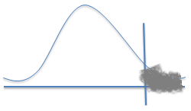
Normal Distribution
Let’s say we are interested in IQ of Jigsaw students. We test 100 students and find that IQ is normally distributed with an average of 108, with a std deviation of 7.
Supposing you pick a random person from those 100 students. What are the chances that that student has an IQ > 115?
What we know:
IQ Score: Random variable
Distribution: Continuous normal
Mean = 108
Std Dev: 7
We need: P(Score > 115)
Which is nothing but 1 – P (SCORE < = 115)
We can of course rely on Excel:
NORMDIST(Outcome, Mean, Std Dev, Cuml)
108
115
Notes:
You can c

Slide 41
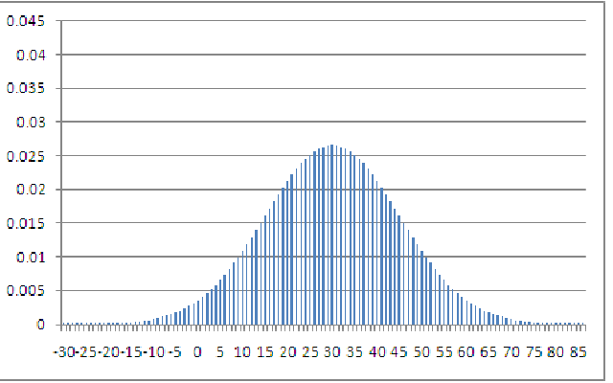
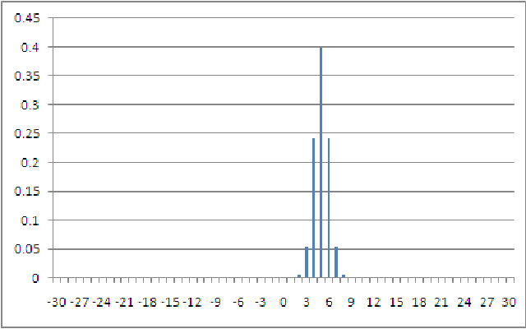
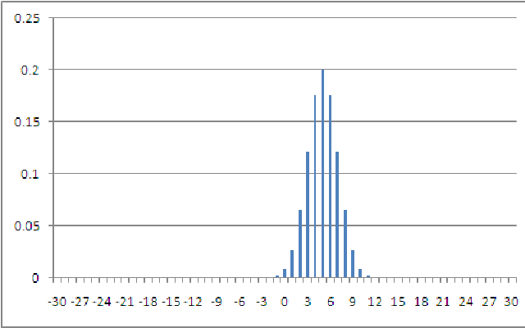
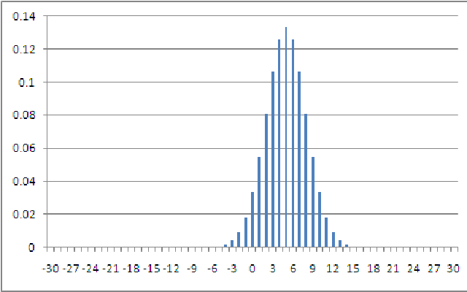
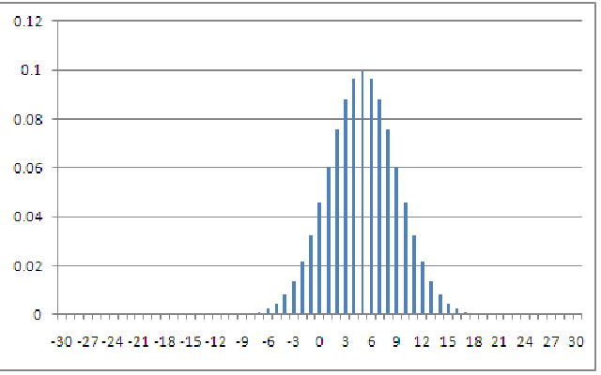
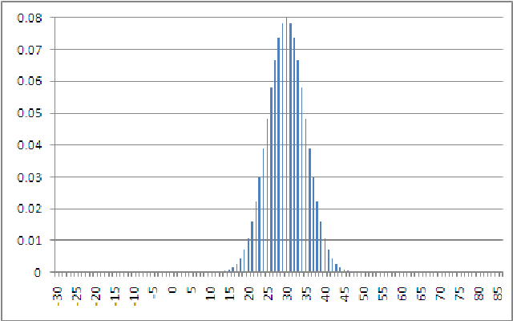
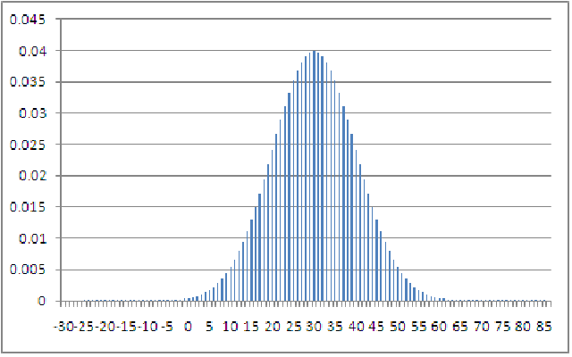
Normal Distribution
We can compute the probabilities for any Mean, Std Dev and and an X

Slide 42
Normal Distribution
Instead of calculating probabilities for every combination of Mean and Std Deviation, we can standardize – express any X as number of deviations from the mean
So for example, if Mean = 5, Std Deviation = 3, then
2 = (2-5)/3 = -1 std deviation from the Mean
3 = (3-5)/3 = -0.66 std deviation from the Mean
4 = (4-5)/3 = -0.33 std deviation from the mean
5 = (5-5)/3 =0 std deviations from the mean
6 = (6-5)/3 = 0.33 std deviations from the mean
7 = (7-5)/3 = 0.66 std deviations from the mean
8 = (8-5)/3 = 1 std deviation from the mean
We already know what the probability is for X = 2 when Mean = 5 and Std Dev =2. So probability of -1 std deviation from Mean for this distribution is known
What will be probability of -1 std deviation from Mean for dist where Mean = 6 and Std Dev = 3?

Slide 43
Normal Distribution
What does this imply?
As long as something is -1 std deviation from any mean, p values will be the same.
So you will not need to calculate the probability tables. You can just use this conversion
Notes:
What does this imply? As long as something is -1 std deviation from any mean, p values will be the same. So you will not need to calculate the probability tables. You can just use this conversion

Slide 44
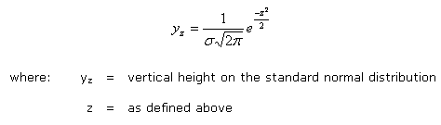
Standard Normal Distribution
The standard normal distribution is a special case of the normal distribution with a mean of 0 and a std deviation of 1 (why is mean 0?)
All normal distributions can be converted to std normal by the following formula
Where X is the value of the random variable in the original normal distribution, is the mean, and is the std. deviation of the original normal distribution
Notes:
The Z score is nothing but standardized distance from mean

Slide 45
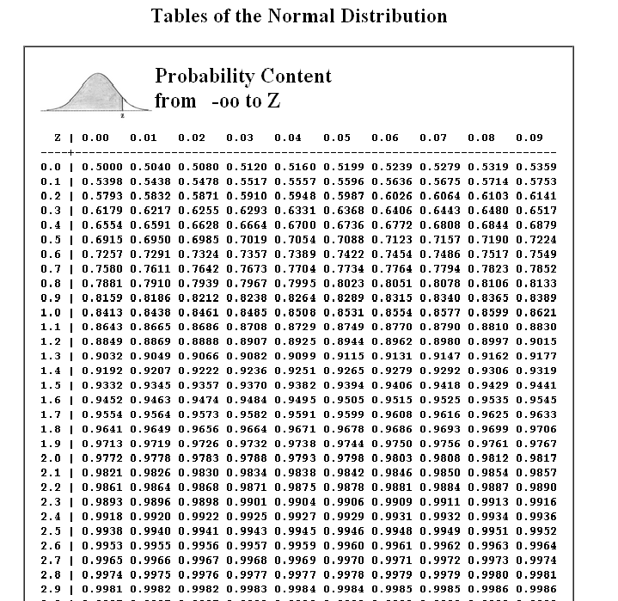
Standard Normal Distribution
Notes:
Let’s review some examples:
Let’s say that you are looking at credit card applications and you find that number of years of work experience is approximately normally distributed with a mean of 8 and a std deviation of 1.2. You have looked at 100 observations.
What is the probability that a respondent will have 8 years of experience?
P(Z = (8-8)/1.2); P (Z=0) = 0.5
What is the probability that a respondent will have 9 years or less of experience?
=p (z< ((9-8)/1.2)) = p(z <=0.5) = 0.79
What is the probability that a respondent will have less than 7 years of experience?
p (Z < (7-8/1.2)) = p(z <= -0.3) = p(Z >0.3) = 1-p(Z<0.3) = 1-0.79 =0.21
What is the probability that a respondent will have between 7 and 9 years of experience?
P (z<(9-8)/1.2)) – p(z<(7-8/1.2)) = 0.79 – 0.21 = 0.58
What is the probability that a respondent will have between 9 and 11 years of experience?
P(z <(11-8)/1.2)) – p(z< (9-8/1.2)) = p (z < 2.5) – p (z< 0.3) = 0.99 – 0.79 = 0.20
What is the probability that the average experience of 5 respondents will be less than 8 years?
= p (z<(7-8)/(1.2/5^0.5)) = p (z < -1.8) = p (z > 1.8) = 1 – p(z <1.8) = 1- 0.9641 = 0.03

Slide 46
Standard Normal Distribution
Case Study 1
You are the training manager for your company and are developing online modules for specific business modules. Once participants finish the content, they need to take a test consisting of 20 questions. You are trying to decide how many minutes to time the test.
You ask 5 colleagues chosen at random to take the test, and average time across the 5 is 45 minutes, with standard deviation of 7 minutes.
Which option would you choose for the test timing (and why?)
Average time taken is 45 minutes, so 45 minutes
45 plus some buffer: maybe 50 minutes?
45 minutes plus lots of buffer, maybe 80 minutes?

Slide 47
Standard Normal Distribution
Case Study 2:
You are the general manager for retail chain A. You are looking at optimizing your inventory costs. For Brand A, an FMCG product, you are looking at weekly sales at stores in large metros. You find that on average weekly sales for Brand A are 600 units, with a std deviation of 150 units, and that average stock in any store at beginning of week is 400 units
Your minimum order quantity is 300. You do not want to be in a situation where in a particular week total stock at hand is to go below 300. What do you think the chances are of that situation happening – high or low?

Slide 48
Appendix

Slide 49
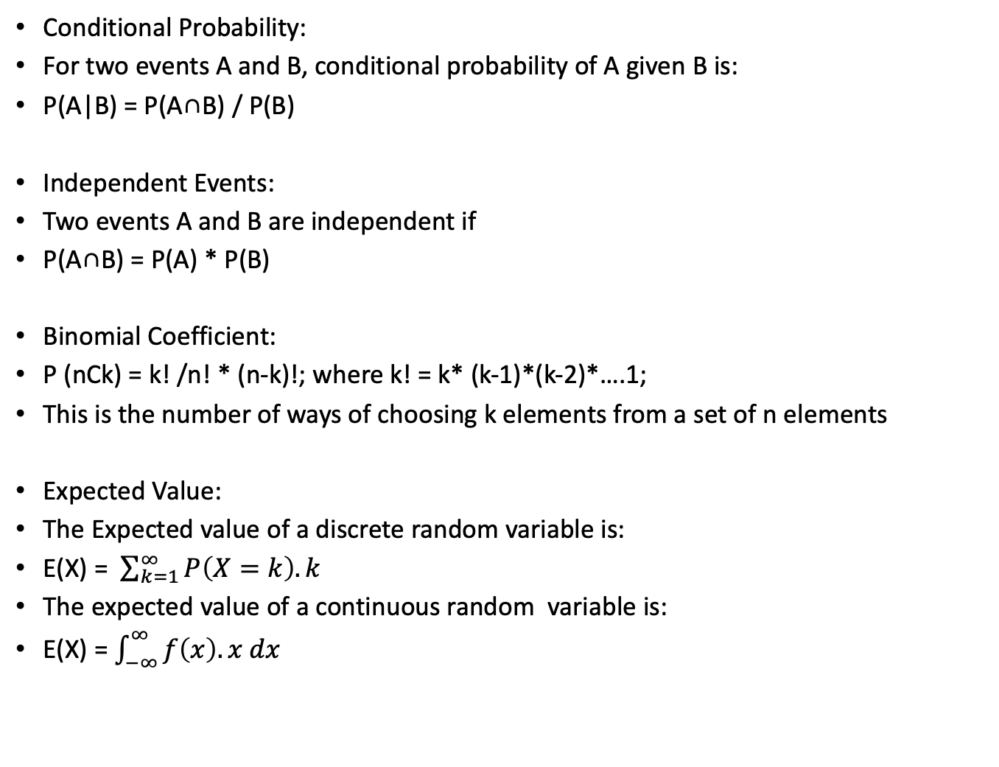
Conditional Probability:
For two events A and B, conditional probability of A given B is:
P(A|B) = P(A∩B) / P(B)
Independent Events:
Two events A and B are independent if
P(A∩B) = P(A) * P(B)
Binomial Coefficient:
P (nCk) = k! /n! * (n-k)!; where k! = k* (k-1)*(k-2)*….1;
This is the number of ways of choosing k elements from a set of n elements
Expected Value:
The Expected value of a discrete random variable is:
E(X) = $\sum_{k=1}^{∞}{P\left(X=k\right).k}$
The expected value of a continuous random variable is:
E(X) = $\int_{−∞}^{∞}{f\left(x\right).x dx}$
Notes:
What is the expected value of a throw of a single dice?
Probability of 1 or 2 or 3 or 4 or 5 or 6 = 1/6
So E(X) = Sum of K = 1 to 6, P(X= K) (=1/6) * k
= 1/6*1 + 1/6*2 + 1/6*3 + 1/6*4 + 1/6*5 + 1/6*6
=3.5

