Slide 2
Central limit theorem
We will introduce one important concept here that will aid us in calculating
the probability or chance: the Central Limit Theorem
Supposing we have a population of 10,000 respondents to a survey, and we wish to pick a sample of 500
How many samples are possible?
What will be the mean of the samples? Same? Different?
If we plot a frequency distribution of the sample means – Excel simulation
Notes:
The concept of a sampling distribution, allows us to determine the probability that the particular sample obtained will be unrepresentative.
On the basis of sample information, we can make inference about the parent population.
Sampling Error.
No sample will have the exact same mean and standard deviation as the population
Sampling distribution of the mean
In research sampling error is often unknown since we do not have the population parameters
A distribution of means of several different samples of our population
Less widely distributed than the population
Usually Normal
Central Limit Theorem:
If a random sample of n observations is selected from a population (any population), then when n is sufficiently large, the sampling distribution of x will be approximately normal.
(The larger the sample size, the better will be the normal approximation to the sampling distribution of x.)

Slide 3
Central limit theorem
Central Limit Theorem:
As sample size grows sufficiently large, the sampling distribution of
the means will tend towards a normal distribution (even if the underlying
population is not normal)
Mathematically:
When we select simple random samples of size n, the distribution of these sample
can be modeled means with a probability model that is
Implications : If sample size is sufficiently large (> 30), you can always use a
normal distribution as your test distribution without worrying about true
population distribution

Slide 4
Hypothesis testing
Inventory Optimization
You want to optimize inventory costs , and you are reviewing mobile electronic equipment. You have been using a daily sales average for this category as 310, with a std deviation of 85 (based on past data a year ago). You take a current sample of the last 45 days to validate, and find that avg daily sales are 338. Should you increase inventory levels?
SIMPLE ANSWERS?
Yes, data clearly shows increase in inventory levels.
No – we need a larger sample before we decide
© Jigsaw Academy Education Pvt. Ltd.

Slide 5
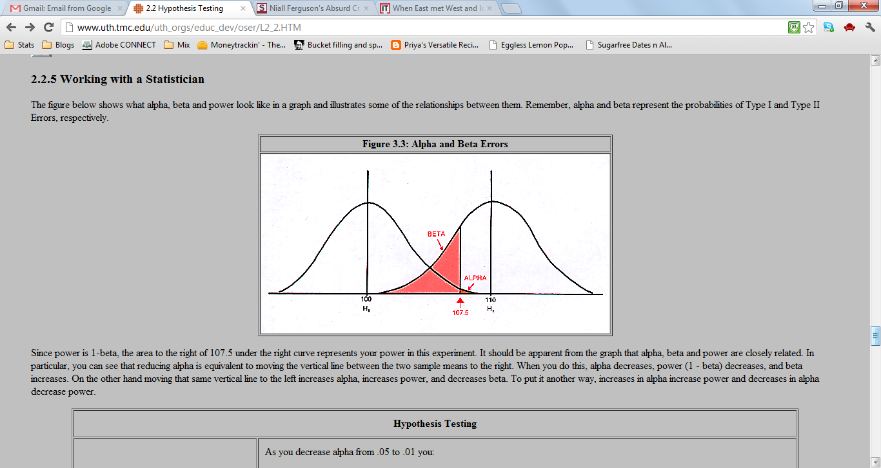
Hypothesis testing
One way to solve this is to run a hypothesis test.
1. Set up NULL HYPOTHESIS
There is no increase in daily rate, observed differences are simply random chance variation
2. Set up ALTERNATE HYPOTHESIS:
Negation of Null: There is an increase in daily sales rate
3. Calculate Probability of observed outcome

Slide 6
Hypothesis testing
Probability of Observed Outcome?
Use Central Limit Theorem.
This sample is one of multiple possible samples from the population of customers,
and therefore means of all possible samples will follow a normal distribution
Given a normal distribution, we can compute probability of an observed outcome.
= NORM.DIST(338,315,85/(45^0.5),TRUE)

Slide 7
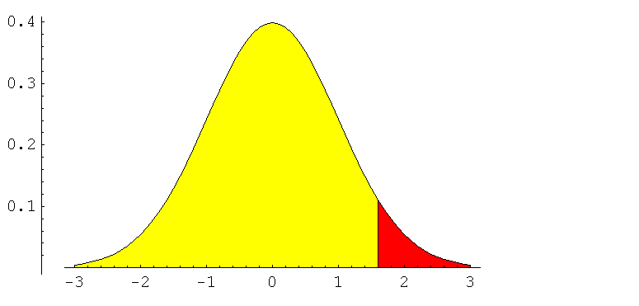
Hypothesis testing
= NORM.DIST(338,315,85/(45^0.5),TRUE)
What will this generate?
We need probability of outcomes as extreme or more extreme assuming that the null is true
That is:
1 – norm.dist(338,315,85/(45^0.5),true)

Slide 8
Hypothesis testing
What if the observed probability was low?
What if the observed probability was high?
How do we decide the separation between low and high?
Low? Or High?
20%

Slide 9
Hypothesis testing
Cut-off : SIGNIFICANCE LEVEL (ALPHA, α )
Calculated Probability: P-VALUE
IF:
P-VALUE < SIGNIFICANCE LEVEL
REJECT THE NULL HYPOTHESIS
P-VALUE > SIGNIFICANCE LEVEL
FAIL TO REJECT THE NULL HYPOTHESIS
α

Slide 10
Hypothesis testing
Significance Level usually 5%
In the inventory example:
Null Hypothesis: Daily Sales rate has not changed
Alternate Hypothesis: Daily Sales Rate has increased
Significance Level: 5%
P-Value : 1 – NORM.DIST(338,315,85,TRUE) = 0.013
Conclusion?

Slide 11
Hypothesis testing
You believe that average discounts on books is maintained around 24%. You take a random sample of 100 books and find that average discount is 26%, with a std deviation of 6%. Is this a substantial difference?

Slide 12
Hypothesis testing
You believe that average discounts on books is maintained around 24%. You take a random sample of 100 books and find that average discount is 26%, with a std deviation of 6%. Is this a substantial difference? Are your books discounted more than expected?
NULL HYPOTHESIS:
Discounts are still averaging 24%
ALTERNATE HYPOTHESIS:
Discounts are steeper than 24%
SIGNIFICANCE LEVEL:
10%
P –VALUE:
= 1- norm.dist(26,24, 6/10, true) = 0.0004
CONCLUSION?
Notice used Sample std deviation instead of pop. std dev

Slide 13
Hypothesis testing
Types of Hypothesis Tests:
1. One Tail and Two Tail Tests
2. Large Sample (Z Tests) and Small Sample Tests (T Tests)
3. One sample and Two Sample Tests
Single Sample Z/T tests, Independent Sample T tests, Paired Sample T tests
4. Multiple sample tests
ANOVA
5. Non-parametric Tests
Chi Square Tests

Slide 14
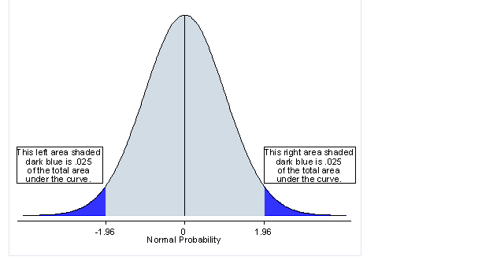
Hypothesis testing
If Alternate Hypothesis is set up as:
Sample mean not equal to population mean:
Two Tail Test
P-VALUE should be compared to SIGNIFICANCE LEVEL/2

Slide 15
Hypothesis testing
You believe that average discounts on books is maintained around 24%. You take a random sample of 100 books and find that average discount is 26%, with a std deviation of 6%. Are your books discounted more than expected?
Null: Stays the Same: Discounts are still 24%
Alternate1: Discounts are STEEPER than 24%
Alternate2:Two Tail Hypothesis: Discounts are NOT EQUAL to 24%
Alpha: 5% (Same)
P-value : 1- norm.dist(26,24,6/10, true) = 0.0004 (Calculated the same way)
If One Tail: 0.0004 < 0.05 – Reject Null
If Two Tail: 0.0004 < 0.025 – Reject Null

Slide 16
Hypothesis testing
You believe that average discounts on books is maintained around 24%. You take a random sample of 100 books and find that average discount is 26%, with a std deviation of 6%. Is there a substantial difference
Null: Stays the Same: Discounts are still 24%
Alternate1: Discounts are STEEPER than 24%
Alternate2:Two Tail Hypothesis: Discounts are NOT EQUAL to 24%
Alpha: 5% (Same)
P-value : 1- norm.dist(26,24,6/10, true) = 0.0004 (Calculated the same way)
If One Tail: 0.0004 < 0.05 – Reject Null
If Two Tail: 0.0004 < 0.025 – Reject Null

Slide 17
Hypothesis testing
How do we choose one tail vs two tail:
Depends on the business context
For example:
1. You work for a manufacturer of cereals, and are receiving consumer complaints of package weight being less than printed weight on your product. You take a random sample from your production process and want to run a check. What alternate hypothesis will you choose?
2. You are working for a parts manufacturer for an airline company, and are creating components for engine parts. You have received specifications from the airline company around the weight of each valve. When you run a quality check on the finished product, what alternate hypothesis will you choose?
REMEMBER: Decide which tail test you will run before calculating p-value

Slide 18
Drill Exercises
The average number of weeks that banner ads run at a Web site is estimated to be 5.5. You want to check the accuracy of this estimate. A sample of 50 ads reveals a sample average of 5.1 weeks with a sample standard deviation of 2.3 weeks. State the null and alternative hypotheses and carry out the test at the 5% level of significance.
According to The New York Times, 3-D printers are now becoming a reality. If a manufacturer of the new high-tech printers claims that the new device can print a page in 3 seconds on average, and a random sample of 20 pages shows a sample mean of 4.6 seconds and sample standard deviation of 2.1 seconds, can the manufacturer’s claim be rejected?

Slide 19
Hypothesis testing
Types of Hypothesis Tests:
1. One Tail and Two Tail Tests
2. Large Sample (Z Tests) and Small Sample Tests (T Tests)
3. One sample and Two Sample Tests
Single Sample Z/T tests, Independent Sample T tests, Paired Sample T tests
4. Multiple sample tests
ANOVA
5. Non-parametric Tests
Chi Square Tests

Slide 20
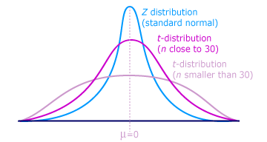
Hypothesis testing
Large Sample and Small Sample Tests
Is sample size > 30 – Use CLT and Normal Distribution
Sample Size < 30 – Use T Distribution
Suppose we have a simple random sample of size n
drawn from a Normal population with mean µ and
standard deviation sigma.
has a t distribution with n-1 degrees of freedom

Slide 21
HYPOTHESIS TESTING T - TESTS
If sample size is < 30, your data may not be normally distributed.
In order to compute probability of an observed outcome when sample size < 30, use a t- distribution or a t-test
Suppose we have a simple random sample of size n drawn from a Normal population with
mean µ and standard deviation sigma.
has a t distribution with n-1 degrees of freedom
As sample size increases and approaches 30, the t-dist
approximates a normal distribution
© Jigsaw Academy Education Pvt. Ltd.

Slide 22
HYPOTHESIS TESTING T - TESTS
You believe books are your most popular category of sales, with a 35% share of transactions. A random sample of 10 days shows books share of total daily sales averaging 32%, std deviation 3%. Has share of books reduced? Use a 5% level of significance
NULL HYPOTHESIS
Share of books category = 35%
ALTERNATE HYPOTHESIS
Share of books category not equal to 35% (TWO TAIL TEST)
SIGNIFICANCE LEVEL: 5%
P-VALUE: Calculate T stat, and use Excel
T = (32 -35)/(3/(10^0.5)) = -3.16
Excel: = T.DIST(X, deg_freedom, cumulative) = T.DIST(-3.16, 9, TRUE) = 0.005

Slide 23
HYPOTHESIS TESTING T - TESTS
2 parts to the T-Test in Excel:
Calculate Test Statistic – distance measure
Include Test Statistic in the T.DIST function
Don’t need to do that for Normal Distribution because p-values of a normal distribution are the same irrespective of sample size
But p-values of a T-Dist depend on Sample size.

Slide 24
Drill Questions
1.Suppose that a claim is made that the average billionaire is 60 years old or younger. The following is a random sample of billionaires’ ages, drawn from the Forbes list.
80, 70, 76, 54, 59, 52, 74, 64, 76, 67, 39, 67, 43, 62, 57, 91, 55

Slide 25
Hypothesis testing
Types of Hypothesis Tests:
1. One Tail and Two Tail Tests
2. Large Sample (Z Tests) and Small Sample Tests (T Tests)
3. One sample and Two Sample Tests
Single Sample Z/T tests, Independent Sample T tests, Paired Sample T tests
4. Multiple sample tests
ANOVA
5. Non-parametric Tests
Chi Square Tests

Slide 26
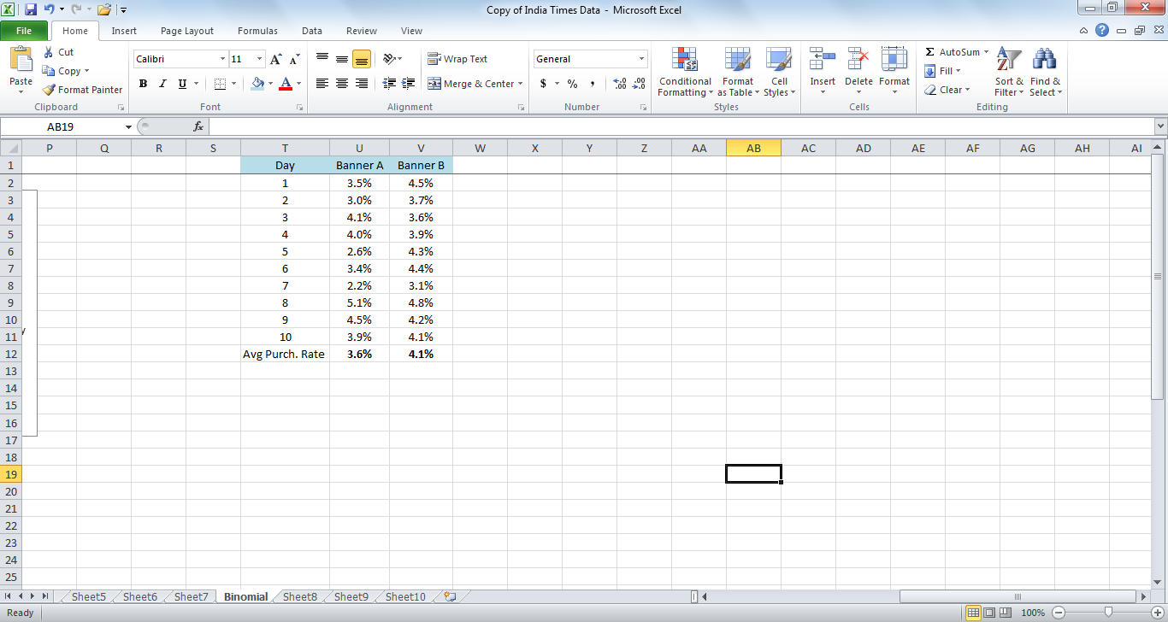
HYPOTHESIS TESTING T - TESTS
Often, we want to test difference in sample means between two samples (not sample vs population)
example: A/B Testing

Slide 27
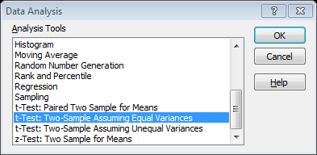
HYPOTHESIS TESTING T - TESTS
Independent Sample T Tests
Excel: Data \Data Analysis\ T-Test: Two Sample

Slide 28


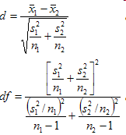
Two-sample t-tests
The test statistic is:
Assuming equal variance between the two samples.
If variances are unequal:
© Jigsaw Academy Education Pvt. Ltd.
Notes:
where x bar 1 and x bar 2 are the sample means, s² is the pooled sample variance, n1 and n2 are the sample sizes and t is a Student t quantile with n1 + n2 - 2 degrees of freedom.
where x bar 1 and x bar 2 are the sample means, s² is the sample variance, n1 and n2 are the sample sizes, d is the Behrens-Welch test statistic evaluated as a Student t quantile with df freedom using Satterthwaite's approximation – unequal variances

Slide 29
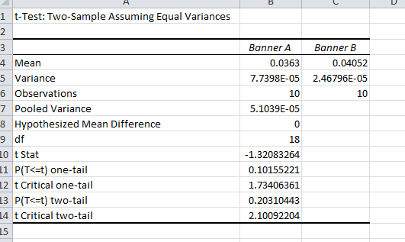
HYPOTHESIS TESTING T - TESTS

Slide 30
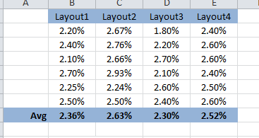
HYPOTHESIS TESTING Multiple sample tests
What if you have multiple samples?
Supposing you are checking effectiveness of click rate based on 4 different layouts
This is the data:

Slide 31
Two-sample t-tests
In the previous example, we compared two samples that had equal observations
If there are unequal observations, we can still use the t-test, but the degrees of freedom used should be 1 less the small sample size
We can also assume similar variance across the two samples, in which case the t-stat will be simplified, but if variance is not similar, use the test for unequal variance in Excel
© Jigsaw Academy Education Pvt. Ltd.

Slide 32
Paired difference t-tests
In the previous example, we looked at comparisons of average call time for a random 10 calls before the project was implemented, and a random 10 calls after a solution was designed
In some cases, we may want to test observations that are paired to see if there is a true difference in their means before and after the experiment
For example, let’s say we are testing the efficacy of a particular drug that claims will help patients lose weight
We record average weight for 8 respondents before and after they take the drug for 20 weeks
© Jigsaw Academy Education Pvt. Ltd.
Notes:
The average weight of respondents before taking the drug is 169 kgs. After they take the drug, it is 158 kgs. But, we will not test the difference between 169 and 158. We will compute the difference pre and post for each PAIR, and then look at the difference in the mean of the difference

Slide 33

Paired difference t-tests
Test statistic is:
Where d is the difference in scores. We need to calculate the mean and standard error of the pre-post differences for each pair and then use that for the test statistic
Let’s say our hypothesis is that the drug does have a positive impact on weight loss, and we would like to use a 95% confidence level.
How would you test the hypothesis?
© Jigsaw Academy Education Pvt. Ltd.
Notes:
Note that the alternate hypothesis is that Mean of Group 1 > Mean of Group 2, so that you would need to look at a 1 tailed test.

Slide 34
HYPOTHESIS TESTING
Different types (or cases) of hypothesis testing:
Distributions are not normal? 
Population std deviation is not known? 
Sample sizes are very small? 
Want to test a directional hypothesis : that is, sample mean > pop mean, for ex, as opposed to sample mean not equal to pop mean? 
Compare two samples, not sample to a population? 

Slide 35
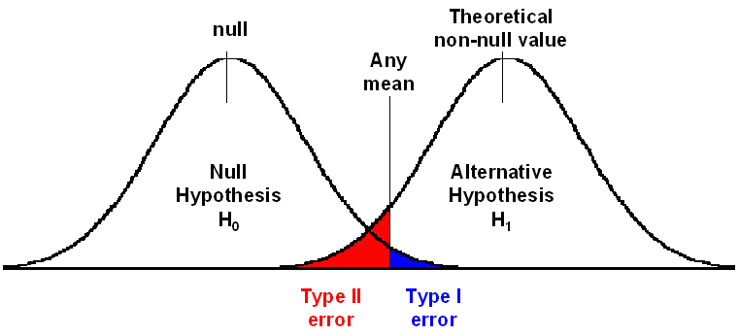
HYPOTHESIS TESTING errors
Error Types
Reject the null hypothesis when in fact it is true - Type I Error
Fail to reject the null hypothesis when in fact it is not true - Type II Error

Slide 36
HYPOTHESIS TESTING errors
Type I Error | False Positive Rejecting H0, when its True | Concluding that a difference exists when it does not
Type II Error | False Negative Failing to Reject H0, when it is false | Concluding that a difference does not exist when it does
Which is more serious?

Slide 37
HYPOTHESIS TESTING errors
Outcome | Ho: Not Guilty Ha: Guilty Reality: Not Guilty | Ho: Not Guilty Ha: Guilty Reality : Guilty
Convict | Type I Error | Correct Decision
Free | Correct Decision | Type II Error
Which is more serious? Debatable: (Hanged, Petty Crime)

Slide 38
HYPOTHESIS TESTING errors
Outcome | Ho: OK Ha: Not Ok Reality : Part OK | Ho: OK Ha: Not Ok Reality: Part not ok
Throw | Type I Error | Correct Decision
Keep | Correct Decision | Type II Error
Which is more serious?

Slide 39
HYPOTHESIS TESTING errors
Size of Error?
Type I : α Significance Level
Type II: β Related to Power. Usually set to 20%. It is a function of sample size, sample variance , and α
What does 20% in Type II imply? You are willing to take a risk of not capturing an impact that exists 20% of the time
Outcome | Part Ok | Part Not Ok
Throw | Type I Error (p=α) | Correct Decision (p=1-β)
Keep | Correct Decision (p= 1 –α) | Type II Error (p= β)

