Slide 1


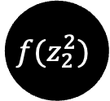


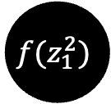




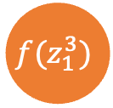


Neural Network Training
$$Loss= RSS={∑\left(actual−h^{3}\right)}^{2}$$
x1
$$w_{11}^{2}$$
$$f(z_{1}^{2})$$
$$h_{1}^{2},$$
$$w_{11}^{3}$$
$$w_{12}^{2}$$
$$f(z_{1}^{3})$$
$$h^{3}$$
$$w_{12}^{3}$$
$$w_{21}^{2}$$
$$h_{2}^{2},$$
$$f(z_{2}^{2})$$
x2
$$w_{22}^{2}$$

Slide 2

Neural Network Training
$$Loss= RSS={∑\left(actual−h^{3}\right)}^{2}$$
x1
$$w_{11}^{2}$$
$$Loss=f\left(\left(w^{3},w_{0}^{3}\right),(w^{2},w_{0}^{2}) \right)$$
$$f(z_{1}^{2})$$
$$h_{1}^{2},$$
$$w_{11}^{3}$$
$$w_{12}^{2}$$
$$f(z_{1}^{3})$$
$$h^{3}$$
$$w_{12}^{3}$$
$$w_{21}^{2}$$
$$h_{2}^{2},$$
$$f(z_{2}^{2})$$
x2
$$w_{22}^{2}$$

Slide 3
Neural Network Training
$$Loss= RSS={∑\left(actual−h^{3}\right)}^{2}$$
x1
$$w_{11}^{2}$$
$$Loss=f\left(\left(w^{3},w_{0}^{3}\right),(w^{2},w_{0}^{2}) \right)$$
$$f(z_{1}^{2})$$
$$h_{1}^{2},$$
$$w_{11}^{3}$$
To reduce the loss, all the weights have to be adjusted.
We initialize these weights with random values at the outset.
$$w_{12}^{2}$$
$$f(z_{1}^{3})$$
$$h^{3}$$
$$w_{12}^{3}$$
$$w_{21}^{2}$$
$$h_{2}^{2},$$
$$f(z_{2}^{2})$$
x2
$$w_{22}^{2}$$

Slide 4


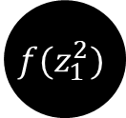

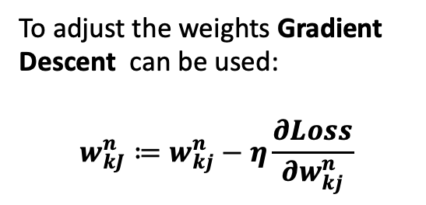

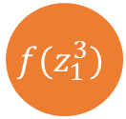
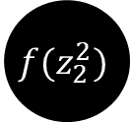
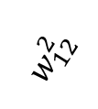

Neural Networks: Updating weights
x1
$$w_{11}^{2}$$
To adjust the weights Gradient Descent can be used:
$$w_{kJ}^{n}≔w_{kj}^{n}−η\frac{∂Loss}{∂w_{kj}^{n}}$$
$$f(z_{1}^{2})$$
$$h_{1}^{2},$$
$$w_{11}^{3}$$
$$w_{12}^{2}$$
$$f(z_{1}^{3})$$
$$h^{3}$$
$$w_{12}^{3}$$
$$w_{21}^{2}$$
$$h_{2}^{2},$$
$$f(z_{2}^{2})$$
x2
$$w_{22}^{2}$$

Slide 5
Neural Networks: Updating weights
x1
$$w_{11}^{2}$$
To adjust the weights Gradient Descent can be used:
$$w_{kJ}^{n}≔w_{kj}^{n}−η\frac{∂Loss}{∂w_{kj}^{n}}$$
$$f(z_{1}^{2})$$
$$h_{1}^{2},$$
$$w_{11}^{3}$$
$$w_{12}^{2}$$
$$f(z_{1}^{3})$$
$$h^{3}$$
$$w_{12}^{3}$$
How many weights need to be updated?
$$w_{21}^{2}$$
$$h_{2}^{2},$$
$$f(z_{2}^{2})$$
x2
$$w_{22}^{2}$$

Slide 6

Neural Networks: Updating weights
x1
$$w_{11}^{2}$$
To adjust the weights Gradient Descent can be used:
$$w_{kJ}^{n}≔w_{kj}^{n}−η\frac{∂Loss}{∂w_{kj}^{n}}$$
$$f(z_{1}^{2})$$
$$h_{1}^{2},$$
$$w_{11}^{3}$$
$$w_{12}^{2}$$
$$f(z_{1}^{3})$$
$$h^{3}$$
$$w_{12}^{3}$$
How many weights need to be updated?
$$w_{21}^{2}$$
$$h_{2}^{2},$$
$$f(z_{2}^{2})$$
x2
$$w_{22}^{2}$$

Slide 7

Neural Networks: Updating weights
x1
$$w_{11}^{2}$$
To adjust the weights Gradient Descent can be used:
$$w_{kJ}^{n}≔w_{kj}^{n}−η\frac{∂Loss}{∂w_{kj}^{n}}$$
$$f(z_{1}^{2})$$
$$h_{1}^{2},$$
$$w_{11}^{3}$$
$$w_{12}^{2}$$
$$f(z_{1}^{3})$$
$$h^{3}$$
$$w_{12}^{3}$$
How many weights need to be updated?
$$w_{21}^{2}$$
$$h_{2}^{2},$$
$$f(z_{2}^{2})$$
x2
$$w_{22}^{2}$$

Slide 8

Neural Networks: Updating weights
x1
$$w_{11}^{2}$$
To adjust the weights Gradient Descent can be used:
$$w_{kJ}^{n}≔w_{kj}^{n}−η\frac{∂Loss}{∂w_{kj}^{n}}$$
$$f(z_{1}^{2})$$
$$h_{1}^{2},$$
$$w_{11}^{3}$$
$$w_{12}^{2}$$
$$f(z_{1}^{3})$$
$$h^{3}$$
$$w_{12}^{3}$$
How many weights need to be updated?
$$w_{21}^{2}$$
$$h_{2}^{2},$$
$$f(z_{2}^{2})$$
x2
$$w_{22}^{2}$$

Slide 9

Neural Networks: Updating weights
x1
$$w_{11}^{2}$$
To adjust the weights Gradient Descent can be used:
$$w_{kJ}^{n}≔w_{kj}^{n}−η\frac{∂Loss}{∂w_{kj}^{n}}$$
$$f(z_{1}^{2})$$
$$h_{1}^{2},$$
$$w_{11}^{3}$$
$$w_{12}^{2}$$
$$f(z_{1}^{3})$$
$$h^{3}$$
$$w_{12}^{3}$$
How many weights need to be updated?
$$w_{21}^{2}$$
$$h_{2}^{2},$$
$$f(z_{2}^{2})$$
x2
$$w_{22}^{2}$$

Slide 10


Neural Networks: Updating weights
x1
$$w_{11}^{2}$$
To adjust the weights Gradient Descent can be used:
$$w_{kJ}^{n}≔w_{kj}^{n}−η\frac{∂Loss}{∂w_{kj}^{n}}$$
$$f(z_{1}^{2})$$
$$h_{1}^{2},$$
$$w_{11}^{3}$$
$$w_{12}^{2}$$
$$f(z_{1}^{3})$$
$$h^{3}$$
$$w_{12}^{3}$$
How many weights need to be updated?
$$w_{21}^{2}$$
$$h_{2}^{2},$$
$$f(z_{2}^{2})$$
x2
$$w_{22}^{2}$$

Slide 11
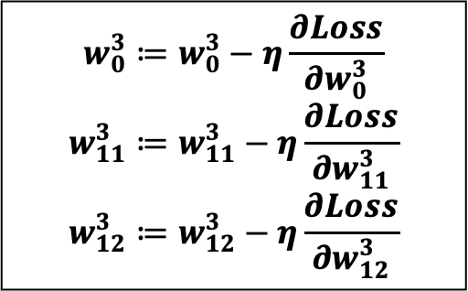
Neural Networks: Updating weights
x1
$$w_{11}^{2}$$
To adjust the weights Gradient Descent can be used:
$$w_{kJ}^{n}≔w_{kj}^{n}−η\frac{∂Loss}{∂w_{kj}^{n}}$$
$$f(z_{1}^{2})$$
$$h_{1}^{2},$$
$$w_{11}^{3}$$
$$w_{12}^{2}$$
$$f(z_{1}^{3})$$
$$h^{3}$$
$$w_{12}^{3}$$
How many weights need to be updated?
$$w_{21}^{2}$$
$$h_{2}^{2},$$
$$f(z_{2}^{2})$$
x2
$$w_{22}^{2}$$
$$w_{0}^{3}≔w_{0}^{3}−η\frac{∂Loss}{∂w_{0}^{3}}$$
$$w_{11}^{3}≔w_{11}^{3}−η\frac{∂Loss}{∂w_{11}^{3}}$$
$$w_{12}^{3}≔w_{12}^{3}−η\frac{∂Loss}{∂w_{12}^{3}}$$

Slide 12


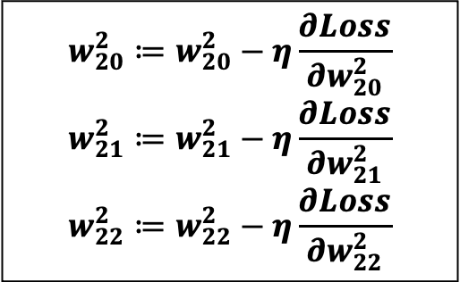
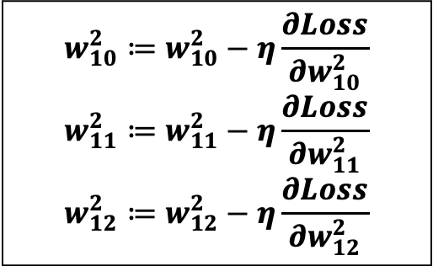
Neural Networks: Updating weights
x1
$$w_{11}^{2}$$
To adjust the weights Gradient Descent can be used:
$$w_{kJ}^{n}≔w_{kj}^{n}−η\frac{∂Loss}{∂w_{kj}^{n}}$$
$$f(z_{1}^{2})$$
$$h_{1}^{2},$$
$$w_{11}^{3}$$
$$w_{12}^{2}$$
$$f(z_{1}^{3})$$
$$h^{3}$$
$$w_{12}^{3}$$
How many weights need to be updated?
$$w_{21}^{2}$$
$$h_{2}^{2},$$
$$f(z_{2}^{2})$$
x2
$$w_{22}^{2}$$
$$w_{10}^{2}≔w_{10}^{2}−η\frac{∂Loss}{∂w_{10}^{2}}$$
$$w_{11}^{2}≔w_{11}^{2}−η\frac{∂Loss}{∂w_{11}^{2}}$$
$$w_{12}^{2}≔w_{12}^{2}−η\frac{∂Loss}{∂w_{12}^{2}}$$
$$w_{20}^{2}≔w_{20}^{2}−η\frac{∂Loss}{∂w_{20}^{2}}$$
$$w_{21}^{2}≔w_{21}^{2}−η\frac{∂Loss}{∂w_{21}^{2}}$$
$$w_{22}^{2}≔w_{22}^{2}−η\frac{∂Loss}{∂w_{22}^{2}}$$

Slide 13
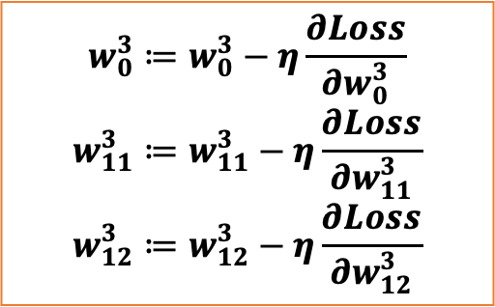
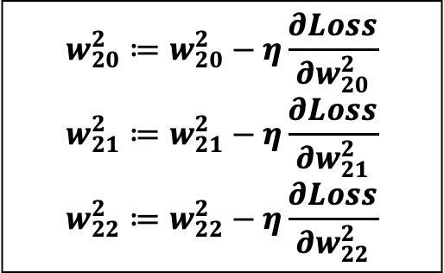
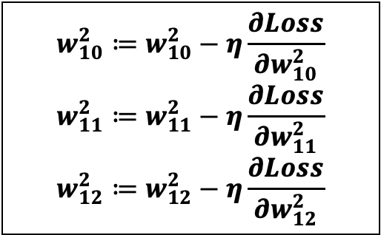
Neural Networks: Updating weights
x1
$$w_{11}^{2}$$
$$f(z_{1}^{2})$$
$$w_{0}^{3}≔w_{0}^{3}−η\frac{∂Loss}{∂w_{0}^{3}}$$
$$w_{11}^{3}≔w_{11}^{3}−η\frac{∂Loss}{∂w_{11}^{3}}$$
$$w_{12}^{3}≔w_{12}^{3}−η\frac{∂Loss}{∂w_{12}^{3}}$$
$$h_{1}^{2},$$
$$w_{11}^{3}$$
$$w_{12}^{2}$$
$$f(z_{1}^{3})$$
$$h^{3}$$
$$w_{12}^{3}$$
$$w_{21}^{2}$$
$$h_{2}^{2},$$
$$f(z_{2}^{2})$$
x2
$$w_{22}^{2}$$
$$w_{10}^{2}≔w_{10}^{2}−η\frac{∂Loss}{∂w_{10}^{2}}$$
$$w_{11}^{2}≔w_{11}^{2}−η\frac{∂Loss}{∂w_{11}^{2}}$$
$$w_{12}^{2}≔w_{12}^{2}−η\frac{∂Loss}{∂w_{12}^{2}}$$
$$w_{20}^{2}≔w_{20}^{2}−η\frac{∂Loss}{∂w_{20}^{2}}$$
$$w_{21}^{2}≔w_{21}^{2}−η\frac{∂Loss}{∂w_{21}^{2}}$$
$$w_{22}^{2}≔w_{22}^{2}−η\frac{∂Loss}{∂w_{22}^{2}}$$

Slide 14
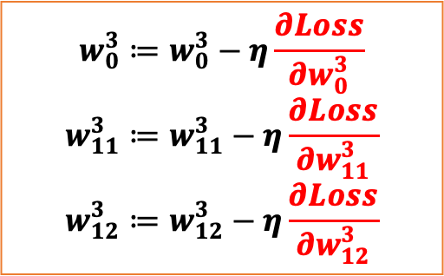
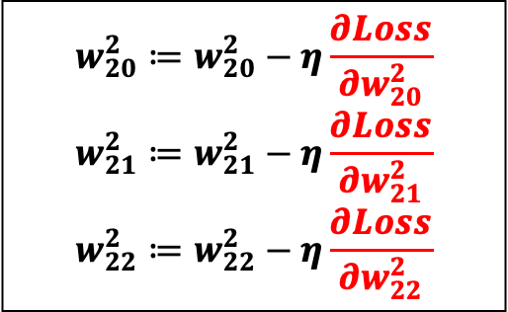
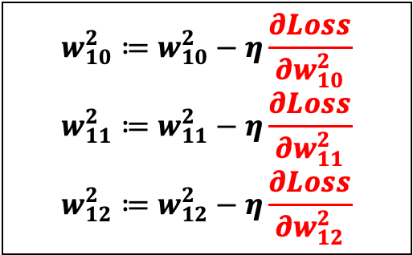
Neural Networks: Updating weights
x1
$$w_{11}^{2}$$
$$f(z_{1}^{2})$$
$$w_{0}^{3}≔w_{0}^{3}−η\frac{∂Loss}{∂w_{0}^{3}}$$
$$w_{11}^{3}≔w_{11}^{3}−η\frac{∂Loss}{∂w_{11}^{3}}$$
$$w_{12}^{3}≔w_{12}^{3}−η\frac{∂Loss}{∂w_{12}^{3}}$$
$$h_{1}^{2},$$
$$w_{11}^{3}$$
$$w_{12}^{2}$$
$$f(z_{1}^{3})$$
$$h^{3}$$
$$w_{12}^{3}$$
$$w_{21}^{2}$$
$$h_{2}^{2},$$
$$f(z_{2}^{2})$$
x2
$$w_{22}^{2}$$
$$w_{10}^{2}≔w_{10}^{2}−η\frac{∂Loss}{∂w_{10}^{2}}$$
$$w_{11}^{2}≔w_{11}^{2}−η\frac{∂Loss}{∂w_{11}^{2}}$$
$$w_{12}^{2}≔w_{12}^{2}−η\frac{∂Loss}{∂w_{12}^{2}}$$
$$w_{20}^{2}≔w_{20}^{2}−η\frac{∂Loss}{∂w_{20}^{2}}$$
$$w_{21}^{2}≔w_{21}^{2}−η\frac{∂Loss}{∂w_{21}^{2}}$$
$$w_{22}^{2}≔w_{22}^{2}−η\frac{∂Loss}{∂w_{22}^{2}}$$

Slide 15
Neural Networks: Updating weights
To compute these gradients, we use an algorithm called backpropagation
x1
$$w_{11}^{2}$$
$$f(z_{1}^{2})$$
$$w_{0}^{3}≔w_{0}^{3}−η\frac{∂Loss}{∂w_{0}^{3}}$$
$$w_{11}^{3}≔w_{11}^{3}−η\frac{∂Loss}{∂w_{11}^{3}}$$
$$w_{12}^{3}≔w_{12}^{3}−η\frac{∂Loss}{∂w_{12}^{3}}$$
$$h_{1}^{2},$$
$$w_{11}^{3}$$
$$w_{12}^{2}$$
$$f(z_{1}^{3})$$
$$h^{3}$$
$$w_{12}^{3}$$
$$w_{21}^{2}$$
$$h_{2}^{2},$$
$$f(z_{2}^{2})$$
x2
$$w_{22}^{2}$$
$$w_{10}^{2}≔w_{10}^{2}−η\frac{∂Loss}{∂w_{10}^{2}}$$
$$w_{11}^{2}≔w_{11}^{2}−η\frac{∂Loss}{∂w_{11}^{2}}$$
$$w_{12}^{2}≔w_{12}^{2}−η\frac{∂Loss}{∂w_{12}^{2}}$$
$$w_{20}^{2}≔w_{20}^{2}−η\frac{∂Loss}{∂w_{20}^{2}}$$
$$w_{21}^{2}≔w_{21}^{2}−η\frac{∂Loss}{∂w_{21}^{2}}$$
$$w_{22}^{2}≔w_{22}^{2}−η\frac{∂Loss}{∂w_{22}^{2}}$$

Slide 16






Neural Networks: Backpropagation
$$z_{1}$$
$$z_{2}$$
$$h_{1}$$
$$h_{2}$$
x
$$w_{1}$$
$$w_{2}$$

Slide 17
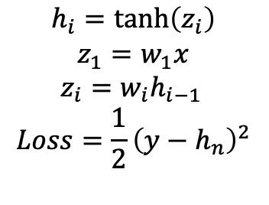
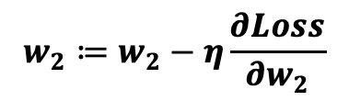
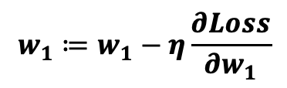
Neural Networks: Backpropagation
$$h_{i}=\tanh\left(z_{i}\right)$$
$$z_{1}=w_{1}x$$
$$z_{i}=w_{i}h_{i−1 }$$
$$Loss=\frac{1}{2}{\left(y−h_{n}\right)}^{2}$$
$$z_{1}$$
$$z_{2}$$
$$h_{1}$$
$$h_{2}$$
x
$$w_{1}$$
$$w_{2}$$
$$w_{1}≔w_{1}−η\frac{∂Loss}{∂w_{1}}$$
$$w_{2}≔w_{2}−η\frac{∂Loss}{∂w_{2}}$$

Slide 18
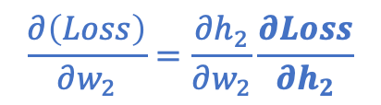
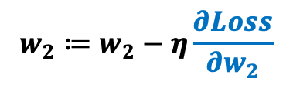
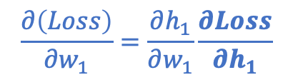
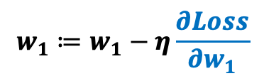
Neural Networks: Backpropagation
$$h_{i}=\tanh\left(z_{i}\right)$$
$$z_{1}=w_{1}x$$
$$z_{i}=w_{i}h_{i−1 }$$
$$Loss=\frac{1}{2}{\left(y−h_{n}\right)}^{2}$$
$$z_{1}$$
$$z_{2}$$
$$h_{1}$$
$$h_{2}$$
x
$$w_{1}$$
$$w_{2}$$
$$w_{1}≔w_{1}−η\frac{∂Loss}{∂w_{1}}$$
$$w_{2}≔w_{2}−η\frac{∂Loss}{∂w_{2}}$$
$$\frac{∂\left(Loss\right)}{∂w_{1}}=\frac{∂h_{1}}{∂w_{1}}\frac{∂Loss}{∂h_{1}}$$
$$\frac{∂\left(Loss\right)}{∂w_{2}}=\frac{∂h_{2}}{∂w_{2}}\frac{∂Loss}{∂h_{2}}$$

Slide 19
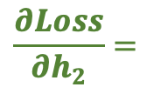
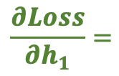
Neural Networks: Backpropagation
$$h_{i}=\tanh\left(z_{i}\right)$$
$$z_{1}=w_{1}x$$
$$z_{i}=w_{i}h_{i−1 }$$
$$Loss=\frac{1}{2}{\left(y−h_{n}\right)}^{2}$$
$$z_{1}$$
$$z_{2}$$
$$h_{1}$$
$$h_{2}$$
x
$$w_{1}$$
$$w_{2}$$
$$w_{1}≔w_{1}−η\frac{∂Loss}{∂w_{1}}$$
$$w_{2}≔w_{2}−η\frac{∂Loss}{∂w_{2}}$$
$$\frac{∂\left(Loss\right)}{∂w_{1}}=\frac{∂h_{1}}{∂w_{1}}\frac{∂Loss}{∂h_{1}}$$
$$\frac{∂\left(Loss\right)}{∂w_{2}}=\frac{∂h_{2}}{∂w_{2}}\frac{∂Loss}{∂h_{2}}$$
$$\frac{∂Loss}{∂h_{1}}=$$
$$\frac{∂Loss}{∂h_{2}}=$$

Slide 20
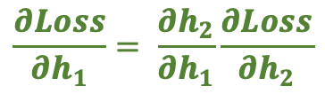

Neural Networks: Backpropagation
$$h_{i}=\tanh\left(z_{i}\right)$$
$$z_{1}=w_{1}x$$
$$z_{i}=w_{i}h_{i−1 }$$
$$Loss=\frac{1}{2}{\left(y−h_{n}\right)}^{2}$$
$$z_{1}$$
$$z_{2}$$
$$h_{1}$$
$$h_{2}$$
x
$$w_{1}$$
$$w_{2}$$
$$w_{1}≔w_{1}−η\frac{∂Loss}{∂w_{1}}$$
$$w_{2}≔w_{2}−η\frac{∂Loss}{∂w_{2}}$$
$$\frac{∂\left(Loss\right)}{∂w_{1}}=\frac{∂h_{1}}{∂w_{1}}\frac{∂Loss}{∂h_{1}}$$
$$\frac{∂\left(Loss\right)}{∂w_{2}}=\frac{∂h_{2}}{∂w_{2}}\frac{∂Loss}{∂h_{2}}$$
$$\frac{∂Loss}{∂h_{1}}= \frac{∂h_{2}}{∂h_{1}}\frac{∂Loss}{∂h_{2}}$$
$\frac{∂Loss}{∂h_{2}}= \frac{∂}{∂h_{2}}$ $\frac{1}{2}{\left(y−h_{2}\right)}^{2}=−(y−h_{2})$

Slide 21
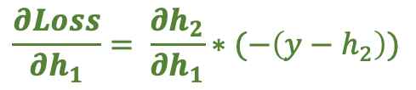
Neural Networks: Backpropagation
$$h_{i}=\tanh\left(z_{i}\right)$$
$$z_{1}=w_{1}x$$
$$z_{i}=w_{i}h_{i−1 }$$
$$Loss=\frac{1}{2}{\left(y−h_{n}\right)}^{2}$$
$$z_{1}$$
$$z_{2}$$
$$h_{1}$$
$$h_{2}$$
x
$$w_{1}$$
$$w_{2}$$
$$w_{1}≔w_{1}−η\frac{∂Loss}{∂w_{1}}$$
$$w_{2}≔w_{2}−η\frac{∂Loss}{∂w_{2}}$$
$$\frac{∂\left(Loss\right)}{∂w_{1}}=\frac{∂h_{1}}{∂w_{1}}\frac{∂Loss}{∂h_{1}}$$
$$\frac{∂\left(Loss\right)}{∂w_{2}}=\frac{∂h_{2}}{∂w_{2}}\frac{∂Loss}{∂h_{2}}$$
$$\frac{∂Loss}{∂h_{1}}= \frac{∂h_{2}}{∂h_{1}}\frac{∂Loss}{∂h_{2}}$$
$\frac{∂Loss}{∂h_{2}}= \frac{∂}{∂h_{2}}$ $\frac{1}{2}{\left(y−h_{2}\right)}^{2}=−(y−h_{2})$
$$\frac{∂Loss}{∂h_{1}}= \frac{∂h_{2}}{∂h_{1}}∗(−\left(y−h_{2}\right))$$

Slide 22
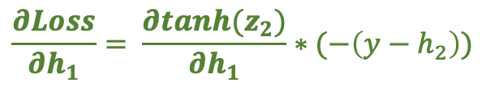
Neural Networks: Backpropagation
$$h_{i}=\tanh\left(z_{i}\right)$$
$$z_{1}=w_{1}x$$
$$z_{i}=w_{i}h_{i−1 }$$
$$Loss=\frac{1}{2}{\left(y−h_{n}\right)}^{2}$$
$$z_{1}$$
$$z_{2}$$
$$h_{1}$$
$$h_{2}$$
x
$$w_{1}$$
$$w_{2}$$
$$w_{1}≔w_{1}−η\frac{∂Loss}{∂w_{1}}$$
$$w_{2}≔w_{2}−η\frac{∂Loss}{∂w_{2}}$$
$$\frac{∂\left(Loss\right)}{∂w_{1}}=\frac{∂h_{1}}{∂w_{1}}\frac{∂Loss}{∂h_{1}}$$
$$\frac{∂\left(Loss\right)}{∂w_{2}}=\frac{∂h_{2}}{∂w_{2}}\frac{∂Loss}{∂h_{2}}$$
$$\frac{∂Loss}{∂h_{1}}= \frac{∂h_{2}}{∂h_{1}}\frac{∂Loss}{∂h_{2}}$$
$\frac{∂Loss}{∂h_{2}}= \frac{∂}{∂h_{2}}$ $\frac{1}{2}{\left(y−h_{2}\right)}^{2}=−(y−h_{2})$
$$\frac{∂Loss}{∂h_{1}}= \frac{∂tanh(z_{2})}{∂h_{1}}∗(−\left(y−h_{2}\right))$$

Slide 23
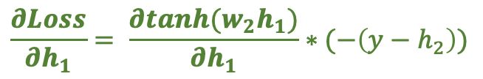
Neural Networks: Backpropagation
$$h_{i}=\tanh\left(z_{i}\right)$$
$$z_{1}=w_{1}x$$
$$z_{i}=w_{i}h_{i−1 }$$
$$Loss=\frac{1}{2}{\left(y−h_{n}\right)}^{2}$$
$$z_{1}$$
$$z_{2}$$
$$h_{1}$$
$$h_{2}$$
x
$$w_{1}$$
$$w_{2}$$
$$w_{1}≔w_{1}−η\frac{∂Loss}{∂w_{1}}$$
$$w_{2}≔w_{2}−η\frac{∂Loss}{∂w_{2}}$$
$$\frac{∂\left(Loss\right)}{∂w_{1}}=\frac{∂h_{1}}{∂w_{1}}\frac{∂Loss}{∂h_{1}}$$
$$\frac{∂\left(Loss\right)}{∂w_{2}}=\frac{∂h_{2}}{∂w_{2}}\frac{∂Loss}{∂h_{2}}$$
$$\frac{∂Loss}{∂h_{1}}= \frac{∂h_{2}}{∂h_{1}}\frac{∂Loss}{∂h_{2}}$$
$\frac{∂Loss}{∂h_{2}}= \frac{∂}{∂h_{2}}$ $\frac{1}{2}{\left(y−h_{2}\right)}^{2}=−(y−h_{2})$
$$\frac{∂Loss}{∂h_{1}}= \frac{∂tanh(w_{2}h_{1})}{∂h_{1}}∗(−\left(y−h_{2}\right))$$

Slide 24
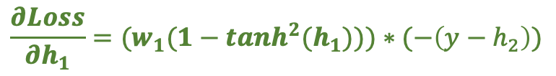
Neural Networks: Backpropagation
$$h_{i}=\tanh\left(z_{i}\right)$$
$$z_{1}=w_{1}x$$
$$z_{i}=w_{i}h_{i−1 }$$
$$Loss=\frac{1}{2}{\left(y−h_{n}\right)}^{2}$$
$$z_{1}$$
$$z_{2}$$
$$h_{1}$$
$$h_{2}$$
x
$$w_{1}$$
$$w_{2}$$
$$w_{1}≔w_{1}−η\frac{∂Loss}{∂w_{1}}$$
$$w_{2}≔w_{2}−η\frac{∂Loss}{∂w_{2}}$$
$$\frac{∂\left(Loss\right)}{∂w_{1}}=\frac{∂h_{1}}{∂w_{1}}\frac{∂Loss}{∂h_{1}}$$
$$\frac{∂\left(Loss\right)}{∂w_{2}}=\frac{∂h_{2}}{∂w_{2}}\frac{∂Loss}{∂h_{2}}$$
$$\frac{∂Loss}{∂h_{1}}= \frac{∂h_{2}}{∂h_{1}}\frac{∂Loss}{∂h_{2}}$$
$\frac{∂Loss}{∂h_{2}}= \frac{∂}{∂h_{2}}$ $\frac{1}{2}{\left(y−h_{2}\right)}^{2}=−(y−h_{2})$
$$\frac{∂Loss}{∂h_{1}}=(w_{1}(1−tanh^{2}(h_{1})))∗(−\left(y−h_{2}\right))$$

Slide 25




Neural Networks: Backpropagation
$$z_{1}$$
$$z_{2}$$
$$z_{3}$$
$$h_{1}$$
$$h_{2}$$
$$h_{3}$$
x
$$w_{1}$$
$$w_{2}$$
$$w_{3}$$

Slide 26
Neural Networks: Backpropagation
$$h_{i}=\tanh\left(z_{i}\right)$$
$$z_{1}=w_{1}x$$
$$z_{i}=w_{i}h_{i−1 }$$
$$Loss=\frac{1}{2}{\left(y−h_{n}\right)}^{2}$$
$$z_{1}$$
$$z_{2}$$
$$z_{3}$$
$$h_{1}$$
$$h_{2}$$
$$h_{3}$$
x
$$w_{1}$$
$$w_{2}$$
$$w_{3}$$

Slide 27
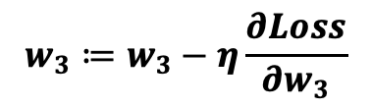
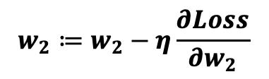
Neural Networks: Backpropagation
$$h_{i}=\tanh\left(z_{i}\right)$$
$$z_{1}=w_{1}x$$
$$z_{i}=w_{i}h_{i−1 }$$
$$Loss=\frac{1}{2}{\left(y−h_{n}\right)}^{2}$$
$$z_{1}$$
$$z_{2}$$
$$z_{3}$$
$$h_{1}$$
$$h_{2}$$
$$h_{3}$$
x
$$w_{1}$$
$$w_{2}$$
$$w_{3}$$
$$w_{1}≔w_{1}−η\frac{∂Loss}{∂w_{1}}$$
$$w_{2}≔w_{2}−η\frac{∂Loss}{∂w_{2}}$$
$$w_{3}≔w_{3}−η\frac{∂Loss}{∂w_{3}}$$

Slide 28
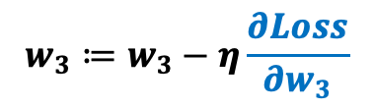
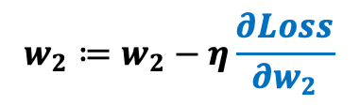
Neural Networks: Backpropagation
$$h_{i}=\tanh\left(z_{i}\right)$$
$$z_{1}=w_{1}x$$
$$z_{i}=w_{i}h_{i−1 }$$
$$Loss=\frac{1}{2}{\left(y−h_{n}\right)}^{2}$$
$$z_{1}$$
$$z_{2}$$
$$z_{3}$$
$$h_{1}$$
$$h_{2}$$
$$h_{3}$$
x
$$w_{1}$$
$$w_{2}$$
$$w_{3}$$
$$w_{1}≔w_{1}−η\frac{∂Loss}{∂w_{1}}$$
$$w_{2}≔w_{2}−η\frac{∂Loss}{∂w_{2}}$$
$$w_{3}≔w_{3}−η\frac{∂Loss}{∂w_{3}}$$

Slide 29
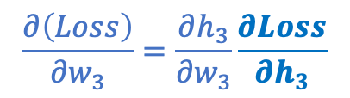
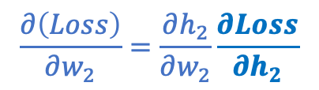
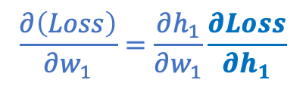
Neural Networks: Backpropagation
$$h_{i}=\tanh\left(z_{i}\right)$$
$$z_{1}=w_{1}x$$
$$z_{i}=w_{i}h_{i−1 }$$
$$Loss=\frac{1}{2}{\left(y−h_{n}\right)}^{2}$$
$$z_{1}$$
$$z_{2}$$
$$z_{3}$$
$$h_{1}$$
$$h_{2}$$
$$h_{3}$$
x
$$w_{1}$$
$$w_{2}$$
$$w_{3}$$
$$w_{1}≔w_{1}−η\frac{∂Loss}{∂w_{1}}$$
$$w_{2}≔w_{2}−η\frac{∂Loss}{∂w_{2}}$$
$$w_{3}≔w_{3}−η\frac{∂Loss}{∂w_{3}}$$
$$\frac{∂\left(Loss\right)}{∂w_{1}}=\frac{∂h_{1}}{∂w_{1}}\frac{∂Loss}{∂h_{1}}$$
$$\frac{∂\left(Loss\right)}{∂w_{2}}=\frac{∂h_{2}}{∂w_{2}}\frac{∂Loss}{∂h_{2}}$$
$$\frac{∂\left(Loss\right)}{∂w_{3}}=\frac{∂h_{3}}{∂w_{3}}\frac{∂Loss}{∂h_{3}}$$

Slide 30
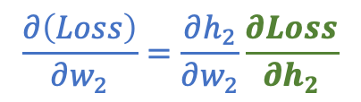
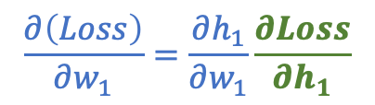

Neural Networks: Backpropagation
$$h_{i}=\tanh\left(z_{i}\right)$$
$$z_{1}=w_{1}x$$
$$z_{i}=w_{i}h_{i−1 }$$
$$Loss=\frac{1}{2}{\left(y−h_{n}\right)}^{2}$$
$$z_{1}$$
$$z_{2}$$
$$z_{3}$$
$$h_{1}$$
$$h_{2}$$
$$h_{3}$$
x
$$w_{1}$$
$$w_{2}$$
$$w_{3}$$
$$w_{1}≔w_{1}−η\frac{∂Loss}{∂w_{1}}$$
$$w_{2}≔w_{2}−η\frac{∂Loss}{∂w_{2}}$$
$$w_{3}≔w_{3}−η\frac{∂Loss}{∂w_{3}}$$
$$\frac{∂\left(Loss\right)}{∂w_{1}}=\frac{∂h_{1}}{∂w_{1}}\frac{∂Loss}{∂h_{1}}$$
$$\frac{∂\left(Loss\right)}{∂w_{2}}=\frac{∂h_{2}}{∂w_{2}}\frac{∂Loss}{∂h_{2}}$$
$$\frac{∂\left(Loss\right)}{∂w_{3}}=\frac{∂h_{3}}{∂w_{3}}\frac{∂Loss}{∂h_{3}}$$

Slide 31
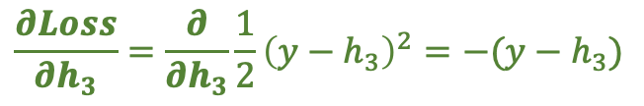
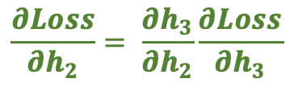
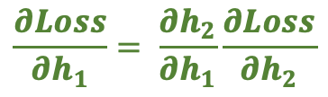
Neural Networks: Backpropagation
$$h_{i}=\tanh\left(z_{i}\right)$$
$$z_{1}=w_{1}x$$
$$z_{i}=w_{i}h_{i−1 }$$
$$Loss=\frac{1}{2}{\left(y−h_{n}\right)}^{2}$$
$$z_{1}$$
$$z_{2}$$
$$z_{3}$$
$$h_{1}$$
$$h_{2}$$
$$h_{3}$$
x
$$w_{1}$$
$$w_{2}$$
$$w_{3}$$
$$w_{1}≔w_{1}−η\frac{∂Loss}{∂w_{1}}$$
$$w_{2}≔w_{2}−η\frac{∂Loss}{∂w_{2}}$$
$$w_{3}≔w_{3}−η\frac{∂Loss}{∂w_{3}}$$
$$\frac{∂\left(Loss\right)}{∂w_{1}}=\frac{∂h_{1}}{∂w_{1}}\frac{∂Loss}{∂h_{1}}$$
$$\frac{∂\left(Loss\right)}{∂w_{2}}=\frac{∂h_{2}}{∂w_{2}}\frac{∂Loss}{∂h_{2}}$$
$$\frac{∂\left(Loss\right)}{∂w_{3}}=\frac{∂h_{3}}{∂w_{3}}\frac{∂Loss}{∂h_{3}}$$
$$\frac{∂Loss}{∂h_{1}}= \frac{∂h_{2}}{∂h_{1}}\frac{∂Loss}{∂h_{2}}$$
$$\frac{∂Loss}{∂h_{2}}= \frac{∂h_{3}}{∂h_{2}}\frac{∂Loss}{∂h_{3}}$$
$$\frac{∂Loss}{∂h_{3}}=\frac{∂}{∂h_{3}}\frac{1}{2}{\left(y−h_{3}\right)}^{2}=−(y−h_{3})$$

Slide 32
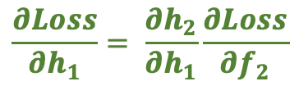
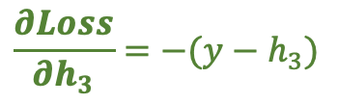
Neural Networks: Backpropagation
$$h_{i}=\tanh\left(z_{i}\right)$$
$$z_{1}=w_{1}x$$
$$z_{i}=w_{i}h_{i−1 }$$
$$Loss=\frac{1}{2}{\left(y−h_{n}\right)}^{2}$$
$$z_{1}$$
$$z_{2}$$
$$z_{3}$$
$$h_{1}$$
$$h_{2}$$
$$h_{3}$$
x
$$w_{1}$$
$$w_{2}$$
$$w_{3}$$
$$w_{1}≔w_{1}−η\frac{∂Loss}{∂w_{1}}$$
$$w_{2}≔w_{2}−η\frac{∂Loss}{∂w_{2}}$$
$$w_{3}≔w_{3}−η\frac{∂Loss}{∂w_{3}}$$
$$\frac{∂\left(Loss\right)}{∂w_{1}}=\frac{∂h_{1}}{∂w_{1}}\frac{∂Loss}{∂h_{1}}$$
$$\frac{∂\left(Loss\right)}{∂w_{2}}=\frac{∂h_{2}}{∂w_{2}}\frac{∂Loss}{∂h_{2}}$$
$$\frac{∂\left(Loss\right)}{∂w_{3}}=\frac{∂h_{3}}{∂w_{3}}\frac{∂Loss}{∂h_{3}}$$
$$\frac{∂Loss}{∂h_{1}}= \frac{∂h_{2}}{∂h_{1}}\frac{∂Loss}{∂f_{2}}$$
$$\frac{∂Loss}{∂h_{2}}= \frac{∂h_{3}}{∂h_{2}}\frac{∂Loss}{∂h_{3}}$$
$$\frac{∂Loss}{∂h_{3}}=−(y−h_{3})$$

Slide 33
Neural Networks: Backpropagation
$$h_{i}=\tanh\left(z_{i}\right)$$
$$z_{1}=w_{1}x$$
$$z_{i}=w_{i}h_{i−1 }$$
$$Loss=\frac{1}{2}{\left(y−h_{n}\right)}^{2}$$
$$z_{1}$$
$$z_{2}$$
$$z_{3}$$
$$h_{1}$$
$$h_{2}$$
$$h_{3}$$
x
$$w_{1}$$
$$w_{2}$$
$$w_{3}$$
$$w_{1}≔w_{1}−η\frac{∂Loss}{∂w_{1}}$$
$$w_{2}≔w_{2}−η\frac{∂Loss}{∂w_{2}}$$
$$w_{3}≔w_{3}−η\frac{∂Loss}{∂w_{3}}$$
$$\frac{∂\left(Loss\right)}{∂w_{1}}=\frac{∂h_{1}}{∂w_{1}}\frac{∂Loss}{∂h_{1}}$$
$$\frac{∂\left(Loss\right)}{∂w_{2}}=\frac{∂h_{2}}{∂w_{2}}\frac{∂Loss}{∂h_{2}}$$
$$\frac{∂\left(Loss\right)}{∂w_{3}}=\frac{∂h_{3}}{∂w_{3}}\frac{∂Loss}{∂h_{3}}$$
$$\frac{∂Loss}{∂h_{1}}= \frac{∂h_{2}}{∂h_{1}}\frac{∂Loss}{∂f_{2}}$$
$$\frac{∂Loss}{∂h_{2}}= \frac{∂h_{3}}{∂h_{2}}\frac{∂Loss}{∂h_{3}}$$
$$\frac{∂Loss}{∂h_{3}}=−(y−h_{3})$$
$$\frac{∂Loss}{∂h_{1}}= \frac{∂h_{2}}{∂h_{1}}\frac{∂Loss}{∂h_{2}}$$

Slide 34

Neural Networks: Backpropagation
$$h_{i}=\tanh\left(z_{i}\right)$$
$$z_{1}=w_{1}x$$
$$z_{i}=w_{i}h_{i−1 }$$
$$Loss=\frac{1}{2}{\left(y−h_{n}\right)}^{2}$$
$$z_{1}$$
$$z_{2}$$
$$z_{3}$$
$$h_{1}$$
$$h_{2}$$
$$h_{3}$$
x
$$w_{1}$$
$$w_{2}$$
$$w_{3}$$
$$w_{1}≔w_{1}−η\frac{∂Loss}{∂w_{1}}$$
$$w_{2}≔w_{2}−η\frac{∂Loss}{∂w_{2}}$$
$$w_{3}≔w_{3}−η\frac{∂Loss}{∂w_{3}}$$
$$\frac{∂\left(Loss\right)}{∂w_{1}}=\frac{∂h_{1}}{∂w_{1}}\frac{∂Loss}{∂h_{1}}$$
$$\frac{∂\left(Loss\right)}{∂w_{2}}=\frac{∂h_{2}}{∂w_{2}}\frac{∂Loss}{∂h_{2}}$$
$$\frac{∂\left(Loss\right)}{∂w_{3}}=\frac{∂h_{3}}{∂w_{3}}\frac{∂Loss}{∂h_{3}}$$
$$\frac{∂Loss}{∂h_{1}}= \frac{∂h_{2}}{∂h_{1}}\frac{∂Loss}{∂f_{2}}$$
$$\frac{∂Loss}{∂h_{2}}= \frac{∂h_{3}}{∂h_{2}}\frac{∂Loss}{∂h_{3}}$$
$$\frac{∂Loss}{∂h_{3}}=\frac{∂}{∂h_{3}}\frac{1}{2}=−(y−h_{3})$$
$$\frac{∂Loss}{∂h_{1}}= \frac{∂h_{2}}{∂h_{1}}\frac{∂Loss}{∂h_{2}}$$

Slide 35

Neural Networks: Backpropagation
$$h_{i}=\tanh\left(z_{i}\right)$$
$$z_{1}=w_{1}x$$
$$z_{i}=w_{i}h_{i−1 }$$
$$Loss=\frac{1}{2}{\left(y−h_{n}\right)}^{2}$$
$$z_{1}$$
$$z_{2}$$
$$z_{3}$$
$$h_{1}$$
$$h_{2}$$
$$h_{3}$$
x
$$w_{1}$$
$$w_{2}$$
$$w_{3}$$
$$w_{1}≔w_{1}−η\frac{∂Loss}{∂w_{1}}$$
$$w_{2}≔w_{2}−η\frac{∂Loss}{∂w_{2}}$$
$$w_{3}≔w_{3}−η\frac{∂Loss}{∂w_{3}}$$
$$\frac{∂\left(Loss\right)}{∂w_{1}}=\frac{∂h_{1}}{∂w_{1}}\frac{∂Loss}{∂h_{1}}$$
$$\frac{∂\left(Loss\right)}{∂w_{2}}=\frac{∂h_{2}}{∂w_{2}}\frac{∂Loss}{∂h_{2}}$$
$$\frac{∂\left(Loss\right)}{∂w_{3}}=\frac{∂h_{3}}{∂w_{3}}\frac{∂Loss}{∂h_{3}}$$
$$\frac{∂Loss}{∂h_{1}}= \frac{∂h_{2}}{∂h_{1}}\frac{∂Loss}{∂f_{2}}$$
$$\frac{∂Loss}{∂h_{2}}= \frac{∂h_{3}}{∂h_{2}}\frac{∂Loss}{∂h_{3}}$$
$$\frac{∂Loss}{∂h_{3}}=\frac{∂}{∂h_{3}}\frac{1}{2}=−(y−h_{3})$$
$$\frac{∂Loss}{∂h_{1}}= \frac{∂h_{2}}{∂h_{1}}\frac{∂h_{3}}{∂h_{2}}\frac{∂Loss}{∂h_{3}}$$

Slide 36
Neural Networks: Backpropagation
$$h_{i}=\tanh\left(z_{i}\right)$$
$$z_{1}=w_{1}x$$
$$z_{i}=w_{i}h_{i−1 }$$
$$Loss=\frac{1}{2}{\left(y−h_{n}\right)}^{2}$$
$$z_{1}$$
$$z_{2}$$
$$z_{3}$$
$$h_{1}$$
$$h_{2}$$
$$h_{3}$$
x
$$w_{1}$$
$$w_{2}$$
$$w_{3}$$
$$w_{1}≔w_{1}−η\frac{∂Loss}{∂w_{1}}$$
$$w_{2}≔w_{2}−η\frac{∂Loss}{∂w_{2}}$$
$$w_{3}≔w_{3}−η\frac{∂Loss}{∂w_{3}}$$
$$\frac{∂\left(Loss\right)}{∂w_{1}}=\frac{∂h_{1}}{∂w_{1}}\frac{∂Loss}{∂h_{1}}$$
$$\frac{∂\left(Loss\right)}{∂w_{2}}=\frac{∂h_{2}}{∂w_{2}}\frac{∂Loss}{∂h_{2}}$$
$$\frac{∂\left(Loss\right)}{∂w_{3}}=\frac{∂h_{3}}{∂w_{3}}\frac{∂Loss}{∂h_{3}}$$
$$\frac{∂Loss}{∂h_{1}}= \frac{∂h_{2}}{∂h_{1}}\frac{∂Loss}{∂f_{2}}$$
$$\frac{∂Loss}{∂h_{2}}= \frac{∂h_{3}}{∂h_{2}}\frac{∂Loss}{∂h_{3}}$$
$$\frac{∂Loss}{∂h_{3}}=\frac{∂}{∂h_{3}}\frac{1}{2}=−(y−h_{3})$$
$$\frac{∂Loss}{∂h_{1}}= \frac{∂h_{2}}{∂h_{1}}\frac{∂h_{3}}{∂h_{2}}\frac{∂Loss}{∂h_{3}}$$

Slide 37

Neural Networks: Backpropagation
$$h_{i}=\tanh\left(z_{i}\right)$$
$$z_{1}=w_{1}x$$
$$z_{i}=w_{i}h_{i−1 }$$
$$Loss=\frac{1}{2}{\left(y−h_{n}\right)}^{2}$$
$$z_{1}$$
$$z_{2}$$
$$z_{3}$$
$$h_{1}$$
$$h_{2}$$
$$h_{3}$$
x
$$w_{1}$$
$$w_{2}$$
$$w_{3}$$
$$w_{1}≔w_{1}−η\frac{∂Loss}{∂w_{1}}$$
$$w_{2}≔w_{2}−η\frac{∂Loss}{∂w_{2}}$$
$$w_{3}≔w_{3}−η\frac{∂Loss}{∂w_{3}}$$
$$\frac{∂\left(Loss\right)}{∂w_{1}}=\frac{∂h_{1}}{∂w_{1}}\frac{∂Loss}{∂h_{1}}$$
$$\frac{∂\left(Loss\right)}{∂w_{2}}=\frac{∂h_{2}}{∂w_{2}}\frac{∂Loss}{∂h_{2}}$$
$$\frac{∂\left(Loss\right)}{∂w_{3}}=\frac{∂h_{3}}{∂w_{3}}\frac{∂Loss}{∂h_{3}}$$
$$\frac{∂Loss}{∂h_{1}}= \frac{∂h_{2}}{∂h_{1}}\frac{∂Loss}{∂f_{2}}$$
$$\frac{∂Loss}{∂h_{2}}= \frac{∂h_{3}}{∂h_{2}}\frac{∂Loss}{∂h_{3}}$$
$$\frac{∂Loss}{∂h_{3}}=\frac{∂}{∂h_{3}}\frac{1}{2}=−(y−h_{3})$$
$$\frac{∂Loss}{∂h_{1}}= \frac{∂h_{2}}{∂h_{1}}\frac{∂h_{3}}{∂h_{2}}∗(−((y−h_{3})))$$

Slide 38




Neural Networks: Backpropagation
$$z_{1}$$
$$z_{2}$$
$$z_{3}$$
$$h_{1}$$
$$h_{2}$$
$$h_{3}$$
$$z_{n}$$
$h_{n}$
x
$$w_{1}$$
$$w_{2}$$
$$w_{3}$$
$$w_{n}$$
$$w_{1}≔w_{1}−η\frac{∂Loss}{∂w_{1}}$$
$$w_{2}≔w_{2}−η\frac{∂Loss}{∂w_{2}}$$
$$w_{3}≔w_{3}−η\frac{∂Loss}{∂w_{3}}$$
$$w_{n}≔w_{n}−η\frac{∂Loss}{∂w_{n}}$$

Slide 39



Neural Networks: Backpropagation
$$z_{1}$$
$$z_{2}$$
$$z_{3}$$
$$h_{1}$$
$$h_{2}$$
$$h_{3}$$
$$z_{n}$$
$$h_{n}$$
x
$$w_{1}$$
$$w_{2}$$
$$w_{3}$$
$$w_{n}$$
$$w_{1}≔w_{1}−η\frac{∂Loss}{∂w_{1}}$$
$$w_{2}≔w_{2}−η\frac{∂Loss}{∂w_{2}}$$
$$w_{3}≔w_{3}−η\frac{∂Loss}{∂w_{3}}$$
$$w_{n}≔w_{n}−η\frac{∂Loss}{∂w_{n}}$$
$$\frac{∂\left(Loss\right)}{∂w_{1}}=\frac{∂h_{1}}{∂w_{1}}\frac{∂Loss}{∂h_{1}}$$
$$\frac{∂\left(Loss\right)}{∂w_{2}}=\frac{∂h_{2}}{∂w_{2}}\frac{∂Loss}{∂h_{2}}$$
$$\frac{∂\left(Loss\right)}{∂w_{3}}=\frac{∂h_{3}}{∂w_{3}}\frac{∂Loss}{∂h_{3}}$$
$$\frac{∂\left(Loss\right)}{∂w_{n}}=\frac{∂h_{3}}{∂w_{n}}\frac{∂Loss}{∂h_{n}}$$

Slide 40

Neural Networks: Backpropagation
$$h_{i}=\tanh\left(z_{i}\right)$$
$$z_{1}=w_{1}x$$
$$z_{i}=w_{i}h_{i−1 }$$
$$Loss=\frac{1}{2}{\left(y−h_{n}\right)}^{2}$$
$$z_{1}$$
$$z_{2}$$
$$z_{3}$$
$$h_{1}$$
$$h_{2}$$
$$h_{3}$$
$$z_{n}$$
$$h_{n}$$
x
$$w_{1}$$
$$w_{2}$$
$$w_{3}$$
$$w_{n}$$
$$w_{1}≔w_{1}−η\frac{∂Loss}{∂w_{1}}$$
$$w_{2}≔w_{2}−η\frac{∂Loss}{∂w_{2}}$$
$$w_{3}≔w_{3}−η\frac{∂Loss}{∂w_{3}}$$
$$w_{n}≔w_{n}−η\frac{∂Loss}{∂w_{n}}$$
$$\frac{∂\left(Loss\right)}{∂w_{1}}=\frac{∂h_{1}}{∂w_{1}}\frac{∂Loss}{∂h_{1}}$$
$$\frac{∂\left(Loss\right)}{∂w_{2}}=\frac{∂h_{2}}{∂w_{2}}\frac{∂Loss}{∂h_{2}}$$
$$\frac{∂\left(Loss\right)}{∂w_{3}}=\frac{∂h_{3}}{∂w_{3}}\frac{∂Loss}{∂h_{3}}$$
$$\frac{∂\left(Loss\right)}{∂w_{n}}=\frac{∂h_{3}}{∂w_{n}}\frac{∂Loss}{∂h_{n}}$$

Slide 41





Neural Networks: Backpropagation
$$h_{i}=\tanh\left(z_{i}\right)$$
$$z_{1}=w_{1}x$$
$$z_{i}=w_{i}h_{i−1 }$$
$$Loss=\frac{1}{2}{\left(y−h_{n}\right)}^{2}$$
$$z_{1}$$
$$z_{2}$$
$$z_{3}$$
$$h_{1}$$
$$h_{2}$$
$$h_{3}$$
$$z_{n}$$
$$h_{n}$$
x
$$w_{1}$$
$$w_{2}$$
$$w_{3}$$
$$w_{n}$$
$$w_{1}≔w_{1}−η\frac{∂Loss}{∂w_{1}}$$
$$w_{2}≔w_{2}−η\frac{∂Loss}{∂w_{2}}$$
$$w_{3}≔w_{3}−η\frac{∂Loss}{∂w_{3}}$$
$$w_{n}≔w_{n}−η\frac{∂Loss}{∂w_{n}}$$
$$\frac{∂\left(Loss\right)}{∂w_{1}}=\frac{∂h_{1}}{∂w_{1}}\frac{∂Loss}{∂h_{1}}$$
$$\frac{∂\left(Loss\right)}{∂w_{2}}=\frac{∂h_{2}}{∂w_{2}}\frac{∂Loss}{∂h_{2}}$$
$$\frac{∂\left(Loss\right)}{∂w_{3}}=\frac{∂h_{3}}{∂w_{3}}\frac{∂Loss}{∂h_{3}}$$
$$\frac{∂\left(Loss\right)}{∂w_{n}}=\frac{∂h_{3}}{∂w_{n}}\frac{∂Loss}{∂h_{n}}$$
$$\frac{∂Loss}{∂h_{1}}=?$$
$$\frac{∂Loss}{∂h_{2}}=?$$
$$\frac{∂Loss}{∂h_{3}}= ?$$
$$\frac{∂Loss}{∂h_{n}}= ?$$
$$\frac{∂Loss}{∂h_{1}}= ?$$

Slide 42



Neural Networks: Backpropagation
$$h_{i}=\tanh\left(z_{i}\right)$$
$$z_{1}=w_{1}x$$
$$z_{i}=w_{i}h_{i−1 }$$
$$Loss=\frac{1}{2}{\left(y−h_{n}\right)}^{2}$$
$$z_{1}$$
$$z_{2}$$
$$z_{3}$$
$$h_{1}$$
$$h_{2}$$
$$h_{3}$$
$$z_{n}$$
$$h_{n}$$
x
$$w_{1}$$
$$w_{2}$$
$$w_{3}$$
$$w_{n}$$
$$w_{1}≔w_{1}−η\frac{∂Loss}{∂w_{1}}$$
$$w_{2}≔w_{2}−η\frac{∂Loss}{∂w_{2}}$$
$$w_{3}≔w_{3}−η\frac{∂Loss}{∂w_{3}}$$
$$w_{n}≔w_{n}−η\frac{∂Loss}{∂w_{n}}$$
$$\frac{∂\left(Loss\right)}{∂w_{1}}=\frac{∂h_{1}}{∂w_{1}}\frac{∂Loss}{∂h_{1}}$$
$$\frac{∂\left(Loss\right)}{∂w_{2}}=\frac{∂h_{2}}{∂w_{2}}\frac{∂Loss}{∂h_{2}}$$
$$\frac{∂\left(Loss\right)}{∂w_{3}}=\frac{∂h_{3}}{∂w_{3}}\frac{∂Loss}{∂h_{3}}$$
$$\frac{∂\left(Loss\right)}{∂w_{n}}=\frac{∂h_{3}}{∂w_{n}}\frac{∂Loss}{∂h_{n}}$$
$$\frac{∂Loss}{∂h_{1}}= \frac{∂h_{2}}{∂h_{1}}\frac{∂Loss}{∂h_{2}}$$
$$\frac{∂Loss}{∂h_{2}}= \frac{∂h_{3}}{∂h_{2}}\frac{∂Loss}{∂h_{3}}$$
$$\frac{∂Loss}{∂h_{3}}=\frac{∂h_{4}}{∂h_{3}}\frac{∂Loss}{∂f_{4}}$$
$$\frac{∂Loss}{∂h_{n}}=\frac{∂}{∂h_{n}}\frac{1}{2}{\left(y−h_{n}\right)}^{2}$$
$$\frac{∂Loss}{∂f_{1}}= ?$$

Slide 43

Neural Networks: Backpropagation
$$h_{i}=\tanh\left(z_{i}\right)$$
$$z_{1}=w_{1}x$$
$$z_{i}=w_{i}h_{i−1 }$$
$$Loss=\frac{1}{2}{\left(y−h_{n}\right)}^{2}$$
$$z_{1}$$
$$z_{2}$$
$$z_{3}$$
$$h_{1}$$
$$h_{2}$$
$$h_{3}$$
$$z_{n}$$
$$h_{n}$$
x
$$w_{1}$$
$$w_{2}$$
$$w_{3}$$
$$w_{n}$$
$$w_{1}≔w_{1}−η\frac{∂Loss}{∂w_{1}}$$
$$w_{2}≔w_{2}−η\frac{∂Loss}{∂w_{2}}$$
$$w_{3}≔w_{3}−η\frac{∂Loss}{∂w_{3}}$$
$$w_{n}≔w_{n}−η\frac{∂Loss}{∂w_{n}}$$
$$\frac{∂\left(Loss\right)}{∂w_{1}}=\frac{∂h_{1}}{∂w_{1}}\frac{∂Loss}{∂h_{1}}$$
$$\frac{∂\left(Loss\right)}{∂w_{2}}=\frac{∂h_{2}}{∂w_{2}}\frac{∂Loss}{∂h_{2}}$$
$$\frac{∂\left(Loss\right)}{∂w_{3}}=\frac{∂h_{3}}{∂w_{3}}\frac{∂Loss}{∂h_{3}}$$
$$\frac{∂\left(Loss\right)}{∂w_{n}}=\frac{∂h_{3}}{∂w_{n}}\frac{∂Loss}{∂h_{n}}$$
$$\frac{∂Loss}{∂h_{1}}= \frac{∂h_{2}}{∂h_{1}}\frac{∂Loss}{∂h_{2}}$$
$$\frac{∂Loss}{∂h_{2}}= \frac{∂h_{3}}{∂h_{2}}\frac{∂Loss}{∂h_{3}}$$
$$\frac{∂Loss}{∂h_{3}}=\frac{∂h_{4}}{∂h_{3}}\frac{∂Loss}{∂f_{4}}$$
$$\frac{∂Loss}{∂h_{n}}=−(y−h_{n})$$
$$\frac{∂Loss}{∂h_{1}}= ?$$

Slide 44

Neural Networks: Backpropagation
$$h_{i}=\tanh\left(z_{i}\right)$$
$$z_{1}=w_{1}x$$
$$z_{i}=w_{i}h_{i−1 }$$
$$Loss=\frac{1}{2}{\left(y−h_{n}\right)}^{2}$$
$$z_{1}$$
$$z_{2}$$
$$z_{3}$$
$$h_{1}$$
$$h_{2}$$
$$h_{3}$$
$$z_{n}$$
$$h_{n}$$
x
$$w_{1}$$
$$w_{2}$$
$$w_{3}$$
$$w_{n}$$
$$w_{1}≔w_{1}−η\frac{∂Loss}{∂w_{1}}$$
$$w_{2}≔w_{2}−η\frac{∂Loss}{∂w_{2}}$$
$$w_{3}≔w_{3}−η\frac{∂Loss}{∂w_{3}}$$
$$w_{n}≔w_{n}−η\frac{∂Loss}{∂w_{n}}$$
$$\frac{∂\left(Loss\right)}{∂w_{1}}=\frac{∂h_{1}}{∂w_{1}}\frac{∂Loss}{∂h_{1}}$$
$$\frac{∂\left(Loss\right)}{∂w_{2}}=\frac{∂h_{2}}{∂w_{2}}\frac{∂Loss}{∂h_{2}}$$
$$\frac{∂\left(Loss\right)}{∂w_{3}}=\frac{∂h_{3}}{∂w_{3}}\frac{∂Loss}{∂h_{3}}$$
$$\frac{∂\left(Loss\right)}{∂w_{n}}=\frac{∂h_{3}}{∂w_{n}}\frac{∂Loss}{∂h_{n}}$$
$$\frac{∂Loss}{∂h_{1}}= \frac{∂h_{2}}{∂h_{1}}\frac{∂Loss}{∂h_{2}}$$
$$\frac{∂Loss}{∂h_{2}}= \frac{∂h_{3}}{∂h_{2}}\frac{∂Loss}{∂h_{3}}$$
$$\frac{∂Loss}{∂h_{3}}=\frac{∂h_{4}}{∂h_{3}}\frac{∂Loss}{∂f_{4}}$$
$$\frac{∂Loss}{∂h_{n}}=−(y−h_{n})$$
$$\frac{∂Loss}{∂h_{1}}=\frac{∂h_{2}}{∂h_{1}}\frac{∂Loss}{∂h_{2}}$$

Slide 45
Neural Networks: Backpropagation
$$h_{i}=\tanh\left(z_{i}\right)$$
$$z_{1}=w_{1}x$$
$$z_{i}=w_{i}h_{i−1 }$$
$$Loss=\frac{1}{2}{\left(y−h_{n}\right)}^{2}$$
$$z_{1}$$
$$z_{2}$$
$$z_{3}$$
$$h_{1}$$
$$h_{2}$$
$$h_{3}$$
$$z_{n}$$
$$h_{n}$$
x
$$w_{1}$$
$$w_{2}$$
$$w_{3}$$
$$w_{n}$$
$$w_{1}≔w_{1}−η\frac{∂Loss}{∂w_{1}}$$
$$w_{2}≔w_{2}−η\frac{∂Loss}{∂w_{2}}$$
$$w_{3}≔w_{3}−η\frac{∂Loss}{∂w_{3}}$$
$$w_{n}≔w_{n}−η\frac{∂Loss}{∂w_{n}}$$
$$\frac{∂\left(Loss\right)}{∂w_{1}}=\frac{∂h_{1}}{∂w_{1}}\frac{∂Loss}{∂h_{1}}$$
$$\frac{∂\left(Loss\right)}{∂w_{2}}=\frac{∂h_{2}}{∂w_{2}}\frac{∂Loss}{∂h_{2}}$$
$$\frac{∂\left(Loss\right)}{∂w_{3}}=\frac{∂h_{3}}{∂w_{3}}\frac{∂Loss}{∂h_{3}}$$
$$\frac{∂\left(Loss\right)}{∂w_{n}}=\frac{∂h_{3}}{∂w_{n}}\frac{∂Loss}{∂h_{n}}$$
$$\frac{∂Loss}{∂h_{1}}= \frac{∂h_{2}}{∂h_{1}}\frac{∂Loss}{∂h_{2}}$$
$$\frac{∂Loss}{∂h_{2}}= \frac{∂h_{3}}{∂h_{2}}\frac{∂Loss}{∂h_{3}}$$
$$\frac{∂Loss}{∂h_{3}}=\frac{∂h_{4}}{∂h_{3}}\frac{∂Loss}{∂f_{4}}$$
$$\frac{∂Loss}{∂h_{n}}=−(y−h_{n})$$
$$\frac{∂Loss}{∂h_{1}}=\frac{∂h_{2}}{∂h_{1}}\frac{∂Loss}{∂h_{2}}$$

Slide 46

Neural Networks: Backpropagation
$$h_{i}=\tanh\left(z_{i}\right)$$
$$z_{1}=w_{1}x$$
$$z_{i}=w_{i}h_{i−1 }$$
$$Loss=\frac{1}{2}{\left(y−h_{n}\right)}^{2}$$
$$z_{1}$$
$$z_{2}$$
$$z_{3}$$
$$h_{1}$$
$$h_{2}$$
$$h_{3}$$
$$z_{n}$$
$$h_{n}$$
x
$$w_{1}$$
$$w_{2}$$
$$w_{3}$$
$$w_{n}$$
$$w_{1}≔w_{1}−η\frac{∂Loss}{∂w_{1}}$$
$$w_{2}≔w_{2}−η\frac{∂Loss}{∂w_{2}}$$
$$w_{3}≔w_{3}−η\frac{∂Loss}{∂w_{3}}$$
$$w_{n}≔w_{n}−η\frac{∂Loss}{∂w_{n}}$$
$$\frac{∂\left(Loss\right)}{∂w_{1}}=\frac{∂h_{1}}{∂w_{1}}\frac{∂Loss}{∂h_{1}}$$
$$\frac{∂\left(Loss\right)}{∂w_{2}}=\frac{∂h_{2}}{∂w_{2}}\frac{∂Loss}{∂h_{2}}$$
$$\frac{∂\left(Loss\right)}{∂w_{3}}=\frac{∂h_{3}}{∂w_{3}}\frac{∂Loss}{∂h_{3}}$$
$$\frac{∂\left(Loss\right)}{∂w_{n}}=\frac{∂h_{3}}{∂w_{n}}\frac{∂Loss}{∂h_{n}}$$
$$\frac{∂Loss}{∂h_{1}}= \frac{∂h_{2}}{∂h_{1}}\frac{∂Loss}{∂h_{2}}$$
$$\frac{∂Loss}{∂h_{2}}= \frac{∂h_{3}}{∂h_{2}}\frac{∂Loss}{∂h_{3}}$$
$$\frac{∂Loss}{∂h_{3}}=\frac{∂h_{4}}{∂h_{3}}\frac{∂Loss}{∂f_{4}}$$
$$\frac{∂Loss}{∂h_{n}}=−(y−h_{n})$$
$$\frac{∂Loss}{∂h_{1}}=\frac{∂h_{2}}{∂h_{1}}\frac{∂h_{3}}{∂h_{2}}\frac{∂Loss}{∂h_{3}}$$

Slide 47
Neural Networks: Backpropagation
$$h_{i}=\tanh\left(z_{i}\right)$$
$$z_{1}=w_{1}x$$
$$z_{i}=w_{i}h_{i−1 }$$
$$Loss=\frac{1}{2}{\left(y−h_{n}\right)}^{2}$$
$$z_{1}$$
$$z_{2}$$
$$z_{3}$$
$$h_{1}$$
$$h_{2}$$
$$h_{3}$$
$$z_{n}$$
$$h_{n}$$
x
$$w_{1}$$
$$w_{2}$$
$$w_{3}$$
$$w_{n}$$
$$w_{1}≔w_{1}−η\frac{∂Loss}{∂w_{1}}$$
$$w_{2}≔w_{2}−η\frac{∂Loss}{∂w_{2}}$$
$$w_{3}≔w_{3}−η\frac{∂Loss}{∂w_{3}}$$
$$w_{n}≔w_{n}−η\frac{∂Loss}{∂w_{n}}$$
$$\frac{∂\left(Loss\right)}{∂w_{1}}=\frac{∂h_{1}}{∂w_{1}}\frac{∂Loss}{∂h_{1}}$$
$$\frac{∂\left(Loss\right)}{∂w_{2}}=\frac{∂h_{2}}{∂w_{2}}\frac{∂Loss}{∂h_{2}}$$
$$\frac{∂\left(Loss\right)}{∂w_{3}}=\frac{∂h_{3}}{∂w_{3}}\frac{∂Loss}{∂h_{3}}$$
$$\frac{∂\left(Loss\right)}{∂w_{n}}=\frac{∂h_{3}}{∂w_{n}}\frac{∂Loss}{∂h_{n}}$$
$$\frac{∂Loss}{∂h_{1}}= \frac{∂h_{2}}{∂h_{1}}\frac{∂Loss}{∂h_{2}}$$
$$\frac{∂Loss}{∂h_{2}}= \frac{∂h_{3}}{∂h_{2}}\frac{∂Loss}{∂h_{3}}$$
$$\frac{∂Loss}{∂h_{3}}=\frac{∂h_{4}}{∂h_{3}}\frac{∂Loss}{∂f_{4}}$$
$$\frac{∂Loss}{∂h_{n}}=−(y−h_{n})$$
$$\frac{∂Loss}{∂h_{1}}=\frac{∂h_{2}}{∂h_{1}}\frac{∂h_{3}}{∂h_{2}}\frac{∂Loss}{∂h_{3}}$$

Slide 48

Neural Networks: Backpropagation
$$h_{i}=\tanh\left(z_{i}\right)$$
$$z_{1}=w_{1}x$$
$$z_{i}=w_{i}h_{i−1 }$$
$$Loss=\frac{1}{2}{\left(y−h_{n}\right)}^{2}$$
$$z_{1}$$
$$z_{2}$$
$$z_{3}$$
$$h_{1}$$
$$h_{2}$$
$$h_{3}$$
$$z_{n}$$
$$h_{n}$$
x
$$w_{1}$$
$$w_{2}$$
$$w_{3}$$
$$w_{n}$$
$$w_{1}≔w_{1}−η\frac{∂Loss}{∂w_{1}}$$
$$w_{2}≔w_{2}−η\frac{∂Loss}{∂w_{2}}$$
$$w_{3}≔w_{3}−η\frac{∂Loss}{∂w_{3}}$$
$$w_{n}≔w_{n}−η\frac{∂Loss}{∂w_{n}}$$
$$\frac{∂\left(Loss\right)}{∂w_{1}}=\frac{∂h_{1}}{∂w_{1}}\frac{∂Loss}{∂h_{1}}$$
$$\frac{∂\left(Loss\right)}{∂w_{2}}=\frac{∂h_{2}}{∂w_{2}}\frac{∂Loss}{∂h_{2}}$$
$$\frac{∂\left(Loss\right)}{∂w_{3}}=\frac{∂h_{3}}{∂w_{3}}\frac{∂Loss}{∂h_{3}}$$
$$\frac{∂\left(Loss\right)}{∂w_{n}}=\frac{∂h_{3}}{∂w_{n}}\frac{∂Loss}{∂h_{n}}$$
$$\frac{∂Loss}{∂h_{1}}= \frac{∂h_{2}}{∂h_{1}}\frac{∂Loss}{∂h_{2}}$$
$$\frac{∂Loss}{∂h_{2}}= \frac{∂h_{3}}{∂h_{2}}\frac{∂Loss}{∂h_{3}}$$
$$\frac{∂Loss}{∂h_{3}}=\frac{∂h_{4}}{∂h_{3}}\frac{∂Loss}{∂f_{4}}$$
$$\frac{∂Loss}{∂h_{n}}=−(y−h_{n})$$
$$\frac{∂Loss}{∂h_{1}}=\frac{∂h_{2}}{∂h_{1}}\frac{∂h_{3}}{∂h_{2}}\frac{∂h_{4}}{∂h_{3}}\frac{∂Loss}{∂h_{4}}$$

Slide 49

Neural Networks: Backpropagation
$$h_{i}=\tanh\left(z_{i}\right)$$
$$z_{1}=w_{1}x$$
$$z_{i}=w_{i}h_{i−1 }$$
$$Loss=\frac{1}{2}{\left(y−h_{n}\right)}^{2}$$
$$z_{1}$$
$$z_{2}$$
$$z_{3}$$
$$h_{1}$$
$$h_{2}$$
$$h_{3}$$
$$z_{n}$$
$$h_{n}$$
x
$$w_{1}$$
$$w_{2}$$
$$w_{3}$$
$$w_{n}$$
$$w_{1}≔w_{1}−η\frac{∂Loss}{∂w_{1}}$$
$$w_{2}≔w_{2}−η\frac{∂Loss}{∂w_{2}}$$
$$w_{3}≔w_{3}−η\frac{∂Loss}{∂w_{3}}$$
$$w_{n}≔w_{n}−η\frac{∂Loss}{∂w_{n}}$$
$$\frac{∂\left(Loss\right)}{∂w_{1}}=\frac{∂h_{1}}{∂w_{1}}\frac{∂Loss}{∂h_{1}}$$
$$\frac{∂\left(Loss\right)}{∂w_{2}}=\frac{∂h_{2}}{∂w_{2}}\frac{∂Loss}{∂h_{2}}$$
$$\frac{∂\left(Loss\right)}{∂w_{3}}=\frac{∂h_{3}}{∂w_{3}}\frac{∂Loss}{∂h_{3}}$$
$$\frac{∂\left(Loss\right)}{∂w_{n}}=\frac{∂h_{3}}{∂w_{n}}\frac{∂Loss}{∂h_{n}}$$
$$\frac{∂Loss}{∂h_{1}}= \frac{∂h_{2}}{∂h_{1}}\frac{∂Loss}{∂h_{2}}$$
$$\frac{∂Loss}{∂h_{2}}= \frac{∂h_{3}}{∂h_{2}}\frac{∂Loss}{∂h_{3}}$$
$$\frac{∂Loss}{∂h_{3}}=\frac{∂h_{4}}{∂h_{3}}\frac{∂Loss}{∂f_{4}}$$
$$\frac{∂Loss}{∂h_{n}}=−(y−h_{n})$$
$$\frac{∂Loss}{∂h_{1}}=\frac{∂h_{2}}{∂h_{1}}\frac{∂h_{3}}{∂h_{2}}\frac{∂h_{4}}{∂h_{3}}\frac{∂Loss}{∂h_{4}}$$

Slide 50

Neural Networks: Backpropagation
$$h_{i}=\tanh\left(z_{i}\right)$$
$$z_{1}=w_{1}x$$
$$z_{i}=w_{i}h_{i−1 }$$
$$Loss=\frac{1}{2}{\left(y−h_{n}\right)}^{2}$$
$$z_{1}$$
$$z_{2}$$
$$z_{3}$$
$$h_{1}$$
$$h_{2}$$
$$h_{3}$$
$$z_{n}$$
$$h_{n}$$
x
$$w_{1}$$
$$w_{2}$$
$$w_{3}$$
$$w_{n}$$
$$w_{1}≔w_{1}−η\frac{∂Loss}{∂w_{1}}$$
$$w_{2}≔w_{2}−η\frac{∂Loss}{∂w_{2}}$$
$$w_{3}≔w_{3}−η\frac{∂Loss}{∂w_{3}}$$
$$w_{n}≔w_{n}−η\frac{∂Loss}{∂w_{n}}$$
$$\frac{∂\left(Loss\right)}{∂w_{1}}=\frac{∂h_{1}}{∂w_{1}}\frac{∂Loss}{∂h_{1}}$$
$$\frac{∂\left(Loss\right)}{∂w_{2}}=\frac{∂h_{2}}{∂w_{2}}\frac{∂Loss}{∂h_{2}}$$
$$\frac{∂\left(Loss\right)}{∂w_{3}}=\frac{∂h_{3}}{∂w_{3}}\frac{∂Loss}{∂h_{3}}$$
$$\frac{∂\left(Loss\right)}{∂w_{n}}=\frac{∂h_{3}}{∂w_{n}}\frac{∂Loss}{∂h_{n}}$$
$$\frac{∂Loss}{∂h_{1}}= \frac{∂h_{2}}{∂h_{1}}\frac{∂Loss}{∂h_{2}}$$
$$\frac{∂Loss}{∂h_{2}}= \frac{∂h_{3}}{∂h_{2}}\frac{∂Loss}{∂h_{3}}$$
$$\frac{∂Loss}{∂h_{3}}=\frac{∂h_{4}}{∂h_{3}}\frac{∂Loss}{∂f_{4}}$$
$$\frac{∂Loss}{∂h_{n}}=−(y−h_{n})$$
$$\frac{∂Loss}{∂h_{1}}=\frac{∂h_{2}}{∂h_{1}}\frac{∂h_{3}}{∂h_{2}}\frac{∂h_{4}}{∂h_{3}}\frac{∂h_{5}}{∂h_{4}}\frac{∂Loss}{∂h_{5}}$$

Slide 51

Neural Networks: Backpropagation
$$h_{i}=\tanh\left(z_{i}\right)$$
$$z_{1}=w_{1}x$$
$$z_{i}=w_{i}h_{i−1 }$$
$$Loss=\frac{1}{2}{\left(y−h_{n}\right)}^{2}$$
$$z_{1}$$
$$z_{2}$$
$$z_{3}$$
$$h_{1}$$
$$h_{2}$$
$$h_{3}$$
$$z_{n}$$
$$h_{n}$$
x
$$w_{1}$$
$$w_{2}$$
$$w_{3}$$
$$w_{n}$$
$$w_{1}≔w_{1}−η\frac{∂Loss}{∂w_{1}}$$
$$w_{2}≔w_{2}−η\frac{∂Loss}{∂w_{2}}$$
$$w_{3}≔w_{3}−η\frac{∂Loss}{∂w_{3}}$$
$$w_{n}≔w_{n}−η\frac{∂Loss}{∂w_{n}}$$
$$\frac{∂\left(Loss\right)}{∂w_{1}}=\frac{∂h_{1}}{∂w_{1}}\frac{∂Loss}{∂h_{1}}$$
$$\frac{∂\left(Loss\right)}{∂w_{2}}=\frac{∂h_{2}}{∂w_{2}}\frac{∂Loss}{∂h_{2}}$$
$$\frac{∂\left(Loss\right)}{∂w_{3}}=\frac{∂h_{3}}{∂w_{3}}\frac{∂Loss}{∂h_{3}}$$
$$\frac{∂\left(Loss\right)}{∂w_{n}}=\frac{∂h_{3}}{∂w_{n}}\frac{∂Loss}{∂h_{n}}$$
$$\frac{∂Loss}{∂h_{1}}= \frac{∂h_{2}}{∂h_{1}}\frac{∂Loss}{∂h_{2}}$$
$$\frac{∂Loss}{∂h_{2}}= \frac{∂h_{3}}{∂h_{2}}\frac{∂Loss}{∂h_{3}}$$
$$\frac{∂Loss}{∂h_{3}}=\frac{∂h_{4}}{∂h_{3}}\frac{∂Loss}{∂f_{4}}$$
$$\frac{∂Loss}{∂h_{n}}=−(y−h_{n})$$
$$\frac{∂Loss}{∂h_{1}}=\frac{∂h_{2}}{∂h_{1}}\frac{∂h_{3}}{∂h_{2}}\frac{∂h_{4}}{∂h_{3}}\frac{∂h_{5}}{∂h_{4}} …….∗(−(y−h_{n}))$$
Notes:
Convert the f to h

