Slide 1
Convolutional Neural Networks
Overview
Convolution
Architecture
Code Demo

Slide 2
Overview
Convolutional Neural Networks are used extensively in computer vision problems
They differ from Multi Layer Perceptron in the manner in which they are architecture
CNN have become popular now, because of relatively cheap computing

Slide 3
Overview
Traditionally, images are flattened and then used in ML algorithm
Flattening destroys the spatial information present in the image
Flattening can dramatically increase the parameters of MLP

Slide 4
Overview
Assume we have 60,000 black and white images, each image being 256 by 256 pixel
If these images are flattened, what would be the dimension of the matrix so created?
$256×256=65536$!!!
If you create a simple MLP with one hidden layer and 20 neurons and one output layer, how many parameters will you have?

Slide 5
Overview
1
65536 + 1 intercept
1 | 2 | … | 65536
2
O
…
20
$$\left(65536+1\right)∗20‼!$$

Slide 6
Overview
Clearly, vanilla MLP will not be suitable for image classification tasks
Hence we need a new Neural Network Architecture, one that will:
Have less parameters
Takes the whole image as an input instead of flattening it

Slide 7
Convolution
What is Convolution?
Kernel
$$\left[\begin{matrix}0 & 1 & 2 \\ 2 & 2 & 0 \\ 0 & 1 & 2\end{matrix}\right]$$

Slide 8
Convolution
The output size of a convolving kernel is affected by:
Zero Padding
Kernel Size
Strides

Slide 9
Convolution
No padding, unit strides

Slide 10
Convolution
Double Padding Unit Strides

Slide 11
Convolution
Single Padding, Unit Strides

Slide 12
Convolution: Meaning
What would convolution do?
Intuitive explanation…

Slide 13

CNN Architecture: Meaning
Convolved Output
$$\left[\begin{matrix}w1 & w2 & w3 \\ w4 & w5 & w6 \\ w7 & w8 & w9\end{matrix}\right]$$

Slide 14
CNN Architecture: Meaning
Convolved Output
$$\left[\begin{matrix}w1 & w2 & w3 \\ w4 & w5 & w6 \\ w7 & w8 & w9\end{matrix}\right]$$

Slide 15
CNN Architecture: Meaning
Convolved Output
$$\left[\begin{matrix}w1 & w2 & w3 \\ w4 & w5 & w6 \\ w7 & w8 & w9\end{matrix}\right]$$

Slide 16
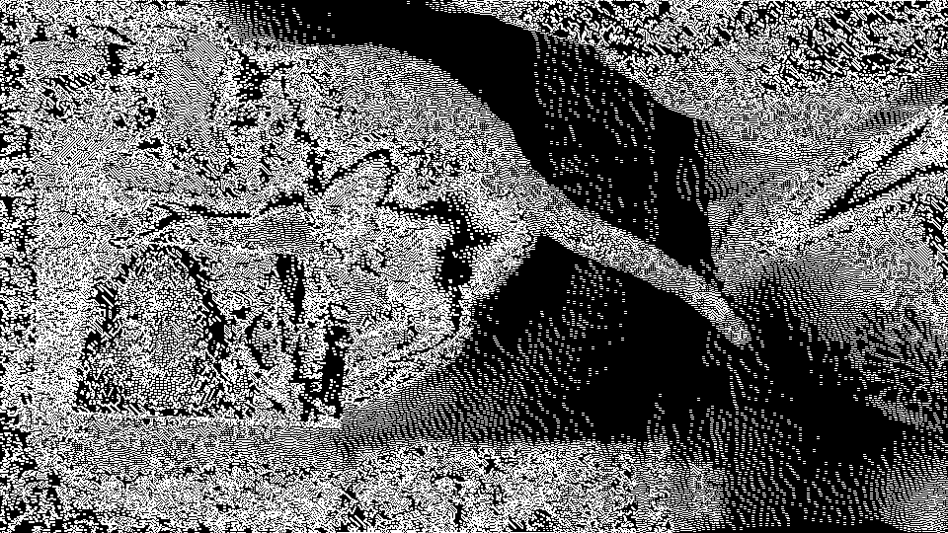
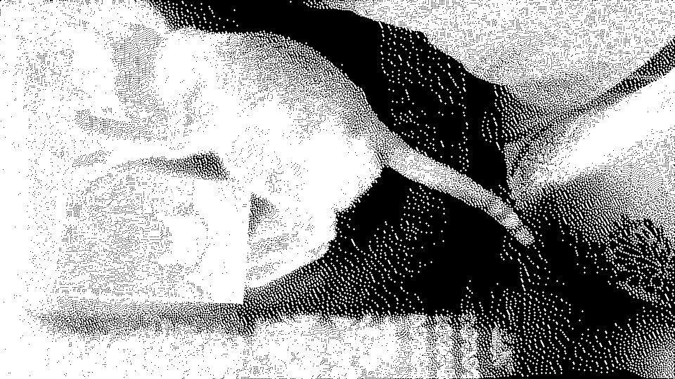
Convolution: Meaning
Edge Detection
Blur

Slide 17
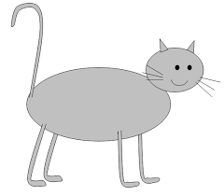
CNN Architecture: Convolutional Layers

Slide 18
CNN Architecture: Convolutional Layers

Slide 19
CNN Architecture: Convolutional Layers

Slide 20
CNN Architecture: Convolutional Layers

Slide 21
CNN Architecture: Convolutional Layers

Slide 22
CNN Architecture: Convolutional Layers

Slide 23
CNN Architecture: Convolutional Layers

Slide 24
CNN Architecture: Convolutional Layers

Slide 25
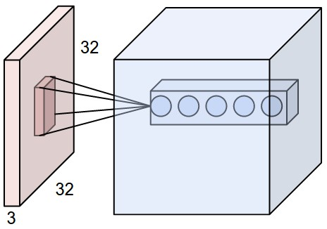
CNN Architecture: Convolutional Layers
Different kernels give rise to different convolved outputs
Convolutional Layers here would imply, applying different kernels

Slide 26
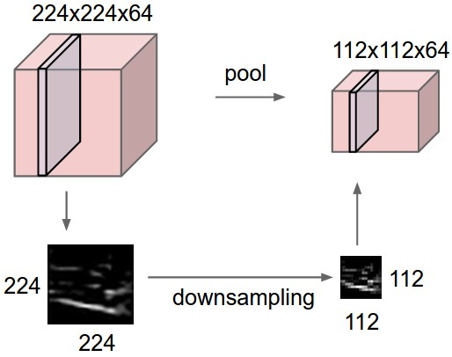
CNN Architecture: Pooling Layers

Slide 27
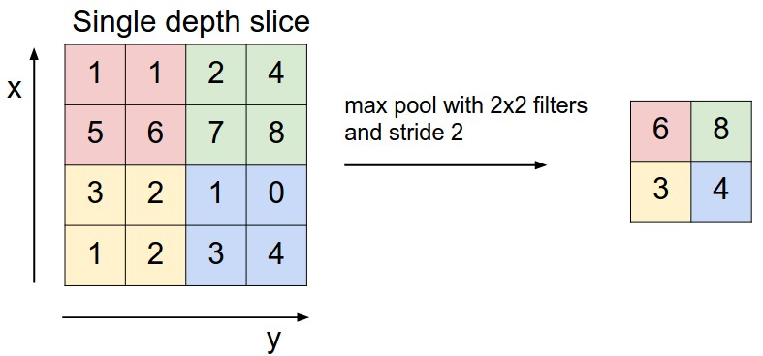
CNN Architecture: Pooling Layers

Slide 28
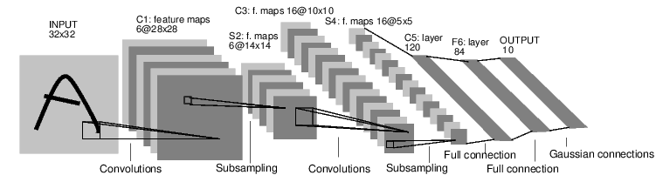
CNN Architecture: Complete Architecture

Slide 29
CNN: Training
Choose those parameters, that minimize loss: Cross Entropy, RSS
Parameters: Kernel Weights in convolutional layers and neuron weights in fully connected layers
Gradient Descent + Backpropagation is used to minimise the loss
Forward and backward pass, mini batches

Slide 30
CNN Architecture: Number of Parameters
What would be the number of parameters in this network?

Slide 31
CNN Architecture: Number of Parameters
What would be the number of parameters in this network?
See, the first convolution layer, assume we are using a $3×3$ kernel

Slide 32
CNN Architecture: Number of Parameters
What would be the number of parameters in this network?
See, the first convolution layer, assume we are using a $3×3$ kernel
Each kernel will have $3×3=9+1$ intercept term

Slide 33
CNN Architecture: Number of Parameters
What would be the number of parameters in this network?
See, the first convolution layer, assume we are using a $3×3$ kernel
Each kernel will have $3×3=9+1$ intercept term
We have 6 convolution neurons in the first layer, so weights will be $10×6=60$

Slide 34
CNN Architecture: Number of Parameters
If instead we had flattened the image? And used an MLP with 6 neurons in the first layer?

Slide 35
CNN Architecture: Number of Parameters
If instead we had flattened the image? And used an MLP with 6 neurons in the first layer?
Each neuron would have, $32×32=1024 and 1$intercept term

Slide 36
CNN Architecture: Number of Parameters
If instead we had flattened the image? And used an MLP with 6 neurons in the first layer?
Each neuron would have, $32×32=1024 and 1$intercept term
Total number of parameters in layer 1 = $1025×6=6150$ !!!!

Slide 37
CNN: Regularisation
L1+L2 regularisation is possible
Drop out layers can be implemented as well

Slide 38
CNN: Hyperparameters
Number of Convolutional layers
Number of fully connected layers
Size of kernel in convolutional layer
Padding+Strides
Type of activations in fully connected layers
Grid search can be done, computationally very-very expensive

Slide 39
Convolutional Neural Networks Continued
Convolution Arithmetic
Pre-trained Neural Networks
Transfer Learning and Fine Tuning

Slide 40
Convolutional Neural Networks Continued
So far we have seen what CNNs are and how they work
If you are trying to build a CNN from scratch, then you may need to decide on:
The kernel size
The strides
Padding
As has been explained in Introduction to CNN, all the above mentioned parameters affect the output size
As a matter of fact, we will also, see that these parameters are inter-related.
We will discuss how input size of an image, the kernel size, the strides and padding are related to each other and impact the output size of a convolution operation
This will help us in deciding what should be the value of one of these parameters, once we know the value of the others.

Slide 41
Convolutional Neural Networks Continued
The relationship between output, kernel size, strides, input size and padding is:
$$n_{out}=\frac{n_{in}+2p−k }{s}+1$$
$n_{out}$= Size of output
$n_{in }$= Size of input
$p$ = Padding size
$k$ = Kernel Size
$s$ = Size of stride

Slide 42
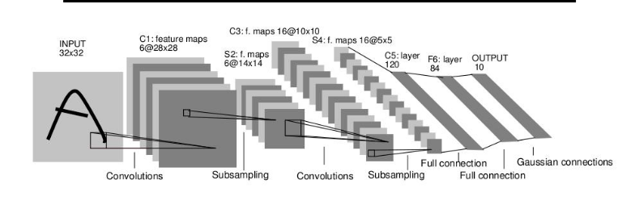
Convolutional Neural Networks Continued
Now we will look into creating a NN architecture very similar to the one given below:

Slide 43
Convolutional Neural Networks Continued
Now we will look into creating a NN architecture very similar to the one given below:
K=?, $n_{in }$=32, $n_{out}$=28,p=0, s=1

Slide 44
Convolutional Neural Networks Continued
Now we will look into creating a NN architecture very similar to the one given below:
$$n_{out}=\frac{n_{in}+2p−k }{s}+1$$
K=?, $n_{in }$=32, $n_{out}$=28,p=0, s=1

Slide 45
Convolutional Neural Networks Continued
Now we will look into creating a NN architecture very similar to the one given below:
$$n_{out}=\frac{n_{in}+2p−k }{s}+1$$
$$28=\frac{32+2∗0−k }{1}+1$$
K=?, $n_{in }$=32, $n_{out}$=28,p=0, s=1

Slide 46
Convolutional Neural Networks Continued
Now we will look into creating a NN architecture very similar to the one given below:
$$n_{out}=\frac{n_{in}+2p−k }{s}+1$$
$$28=\frac{32+2∗0−k }{1}+1$$
K=5, $n_{in }$=32, $n_{out}$=28,p=0, s=1

Slide 47
Convolutional Neural Networks Continued
Now we will look into creating a NN architecture very similar to the one given below:
K=?, $n_{in }$=28, $n_{out}$=14,p=0, s=2

Slide 48
Convolutional Neural Networks Continued
Now we will look into creating a NN architecture very similar to the one given below:
$$n_{out}=\frac{n_{in}+2p−k }{s}+1$$
K=?, $n_{in }$=28, $n_{out}$=14,p=0, s=2

Slide 49
Convolutional Neural Networks Continued
Now we will look into creating a NN architecture very similar to the one given below:
$$n_{out}=\frac{n_{in}+2p−k }{s}+1$$
$$14=\frac{28+2∗0−k }{2}+1$$
K=?, $n_{in }$=28, $n_{out}$=14,p=0, s=2

Slide 50
Convolutional Neural Networks Continued
Now we will look into creating a NN architecture very similar to the one given below:
$$n_{out}=\frac{n_{in}+2p−k }{s}+1$$
$$14=\frac{28+2∗0−k }{2}+1$$
K=2, $n_{in }$=28, $n_{out}$=14,p=0, s=2

Slide 51
Code Demo

Slide 52
Pre-trained Neural Networks
Training a Neural Network from scratch, is not always an option
Training is computationally very expensive
Also, you will require to collect a lots of images if you want to train an accurate CNN
This essentially means, that training CNNs to identify common world objects is a very costly proposition
Many researchers and companies, open source, the models that they train to identify common world objects
These models can be used as is or one can fine tune these pre-trained models to suite to a particular classification task.
Let’s talk about some of the most commonly used pre-trained models.

Slide 53
Pre-trained Neural Networks
Pre-trained models are usually created by Deep Learning Researchers or companies such as Google
These models are usually trained on Image Net data set.
Image Net is a very large database of common world objects and living beings
Below we list some very popular pre-trained CNN models and the datasets on which these models were trained.
Model | Released By | Trained on
VGG16 | Vgg team, University of Oxford | Image Net
VGG19 | Vgg team, University of Oxford | Image Net
Alex Net | SuperVision Group, Hinton et all | Image Net
Inception V3 | Google Research | Image Net

Slide 54
Code Demo

Slide 55
Pre-trained Neural Networks
Pre-trained models can also be used as feature extractors
Convolution Block
Top Layer
Input

Slide 56
Pre-trained Neural Networks
Pre-trained models can also be used as feature extractors
Convolution Block
Top Layer
Prediction
Input

Slide 57
Pre-trained Neural Networks
Pre-trained models can also be used as feature extractors
Convolution Block
Extracts Features
Input

Slide 58
Code Demo

Slide 59
Transfer Learning and Fine Tuning: Using Pre-trained models
Pre-trained models can be fine tuned to do a task very similar to what the model was originally trained for
For example, if a model is able to identify a car then it can be adapted to differentiate between a sports car and a luxury car.
In such a scenario, the pre-trained model is used as a feature-extractor.
When we do, as suggested above, its said to be transfer learning

Slide 60
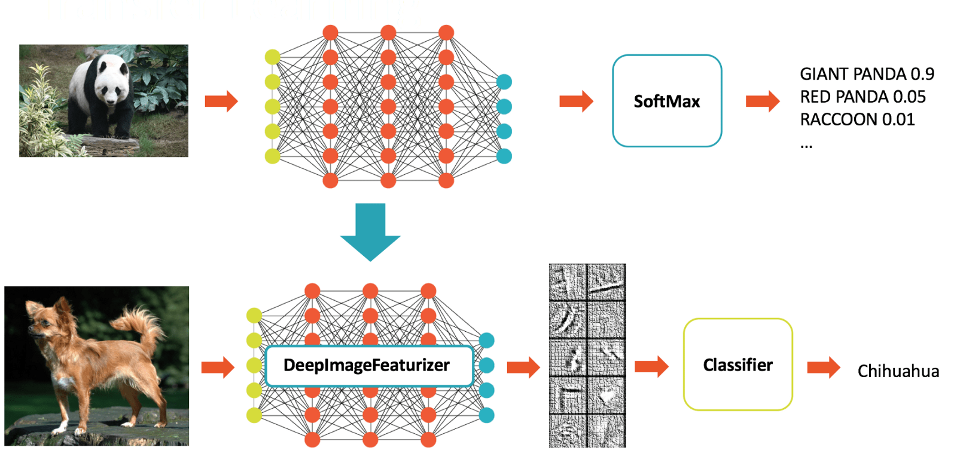
Transfer Learning: How does it work

Slide 61
Transfer Learning: How does it work
Pre-trained model

Slide 62
Transfer Learning: How does it work
Weights Learnt
Pre-trained model

Slide 63
Transfer Learning: How does it work
Weights Learnt

Slide 64
Transfer Learning: How does it work
Weights Learnt
Learn the weights of this layer only

Slide 65
Transfer Learning: How does it work
Original Data
Convolution Block
Softmax Layer

Slide 66
Transfer Learning: How does it work
Original Data
Convolution Block
Softmax Layer
Training

Slide 67
Transfer Learning: How does it work
Original Data
Convolution Block:
Learn Weights
Softmax Layer
Training

Slide 68
Transfer Learning: How does it work
Original Data
Convolution Block:
Learn Weights
Softmax Layer
Training
Convolution Block:
Learnt Weights

Slide 69
Transfer Learning: How does it work
Original Data
Convolution Block:
Learn Weights
Top Layer
Training
New Data
Convolution Block:
Learnt Weights
New Top Layer

Slide 70
Transfer Learning: How does it work
Original Data
Convolution Block:
Learn Weights
Top Layer
Training
New Data
Convolution Block:
Learnt Weights
New Top Layer

Slide 71
Transfer Learning: Image Augmentation
Transfer learning is usually used when the data size is small.
To avoid the model from overfitting, Image Augmentation can be used
This essentially, is a process, in which new image data is generated from the existing images by introducing some distortions

Slide 72
Transfer Learning: Image Augmentation
Transfer learning is usually used when the data size is small.
To avoid the model from overfitting, Image Augmentation can be used
This essentially, is a process, in which new image data is generated from the existing images by introducing some distortions

Slide 73


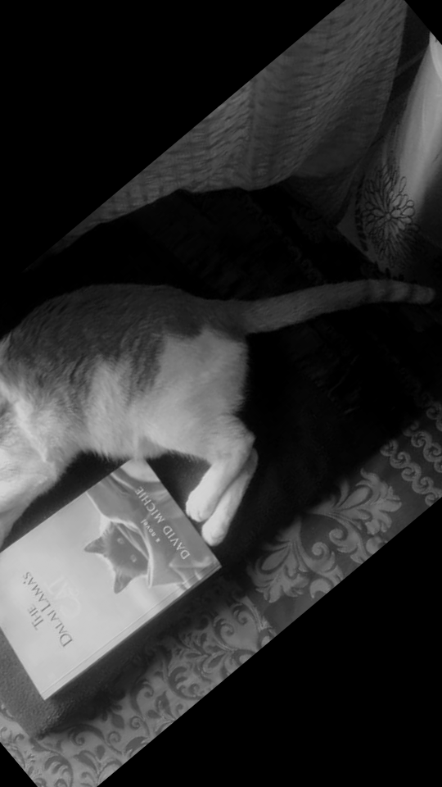
Transfer Learning: Image Augmentation
Transfer learning is usually used when the data size is small.
To avoid the model from overfitting, Image Augmentation can be used
This essentially, is a process, in which new image data is generated from the existing images by introducing some distortions
Flips

Slide 74
Transfer Learning: Image Augmentation
Transfer learning is usually used when the data size is small.
To avoid the model from overfitting, Image Augmentation can be used
This essentially, is a process, in which new image data is generated from the existing images by introducing some distortions
Rotation

Slide 75
Transfer Learning: Image Augmentation
Transfer learning is usually used when the data size is small.
To avoid the model from overfitting, Image Augmentation can be used
This essentially, is a process, in which new image data is generated from the existing images by introducing some distortions
Random Crop

