Slide 1
Kmeans Clustering
Gunnvant Singh

Slide 2
Unsupervised Learning
Till now, there used to be a target variable
Age | Income | Default
20 | 3000 | 1
30 | 4000 | 1
40 | 5000 | 0
50 | 6000 | 0
60 | 7000 | 0
Sometimes we don’t want to predict a target variable

Slide 3
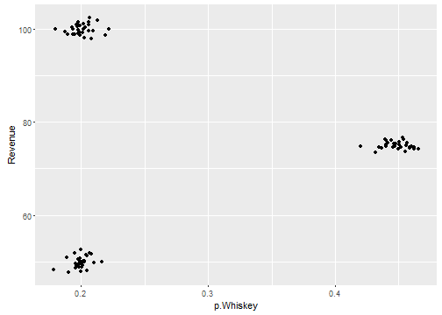
Unsupervised Learning
Store_id | P.Whisky | Revenue
1 | 0.40 | 80
2 | 0.20 | 60
3 | 0.35 | 40
4 | 0.22 | 90
5 | 0.45 | 75

Slide 4
Clustering
Suppose from a web analytics platform we have data on:
Number of hits
Duration of stays on a web page
Number of pages visited
Amount of money spent
Many categories can be potentially discovered
Group of people with high hit rate, small amount of money spent
Group of people with short duration stay, large amount of money spent
And many more..

Slide 5
Clustering
How many groups?
How did you find?
What if you need segments by 4 variables?
Store_id | P.Whisky | Revenue
1 | 0.40 | 80
2 | 0.20 | 60
3 | 0.35 | 40
4 | 0.22 | 90
5 | 0.45 | 75

Slide 6
Clustering
Cluster: How? Visualise?
What if there are 8 variables using which we need to create clusters?
We need an algorithm!!!!
KMeans

Slide 7
Clustering: KMeans
KMeans is an iterative algorithm
The “K” in KMeans, stands for the number of clusters to be found out in data, it’s a user supplied parameter
The output of KMeans algorithm is, the cluster label for each row of data

Slide 8
Clustering: KMeans
P.Whisky | Revenue
0.40 | 80
0.20 | 60
0.21 | 40
0.22 | 90
0.45 | 75
Label
1
2
2
3
1
3
1
2

Slide 9
Clustering: KMeans
Algorithm
Initialize “K” cluster centres randomly
Find the distance of each point from “K” cluster centres
Based on the proximity of each point from “K” cluster centres we give cluster labels to each of the data points
After, the clusters are formed, we re-compute the cluster centres
Repeat a), b) and c) till convergence (Till no data point changes cluster membership in succeeding iterations)

Slide 10
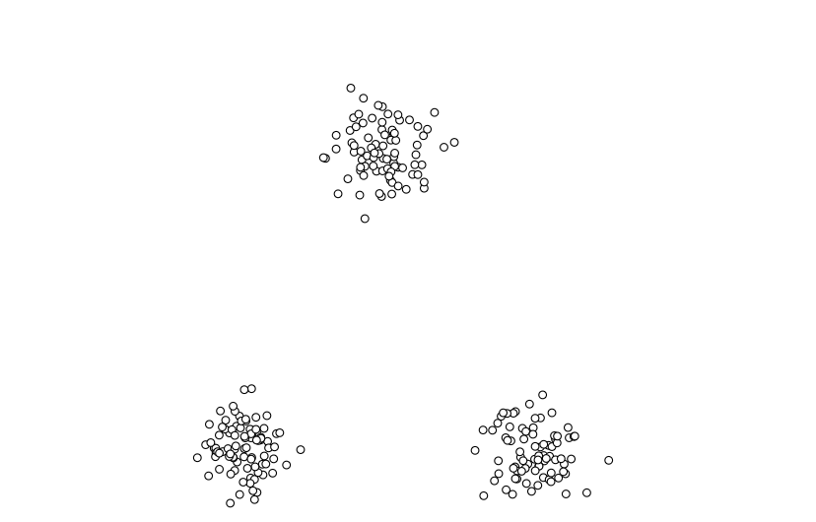
Clustering: KMeans
There are 3 data clusters
K=3

Slide 11
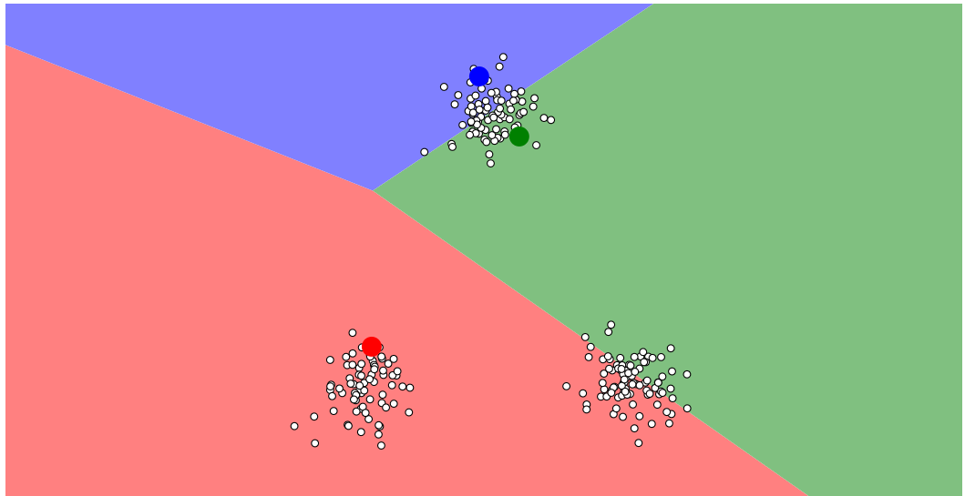
Clustering: KMeans
Randomly Assign 3 points as cluster centres

Slide 12
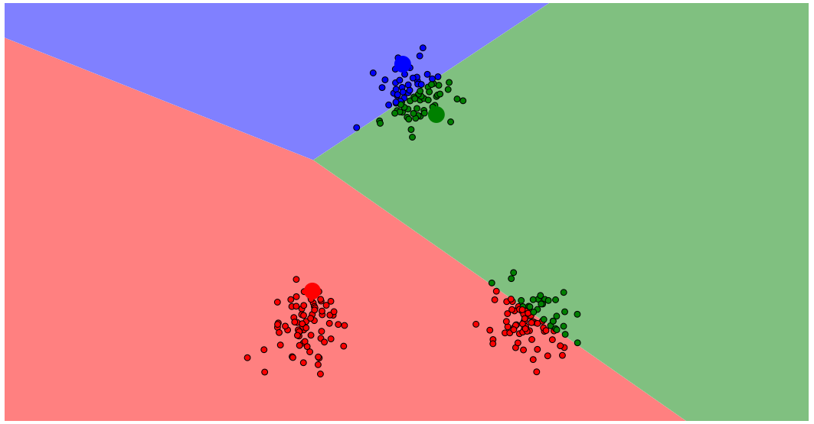
Clustering: KMeans
Compute distances of each point from each of the cluster centres and assign cluster labels

Slide 13
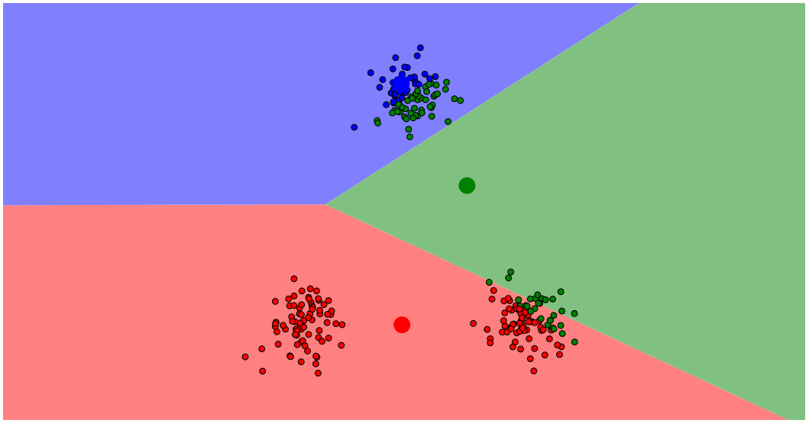
Clustering: KMeans
Re-compute Cluster Centres

Slide 14
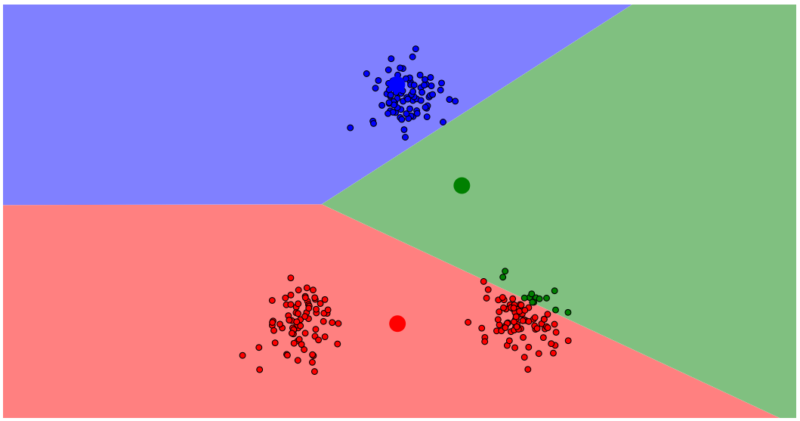
Clustering: KMeans
Compute distances of each point from each of the cluster centres and assign cluster labels

Slide 15
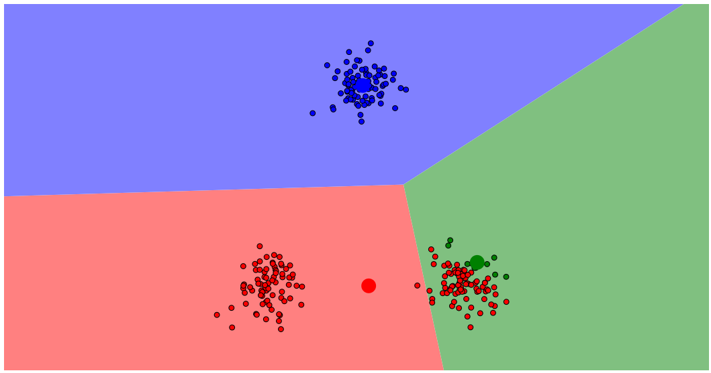
Clustering: KMeans
Re-Compute Cluster Centres

Slide 16
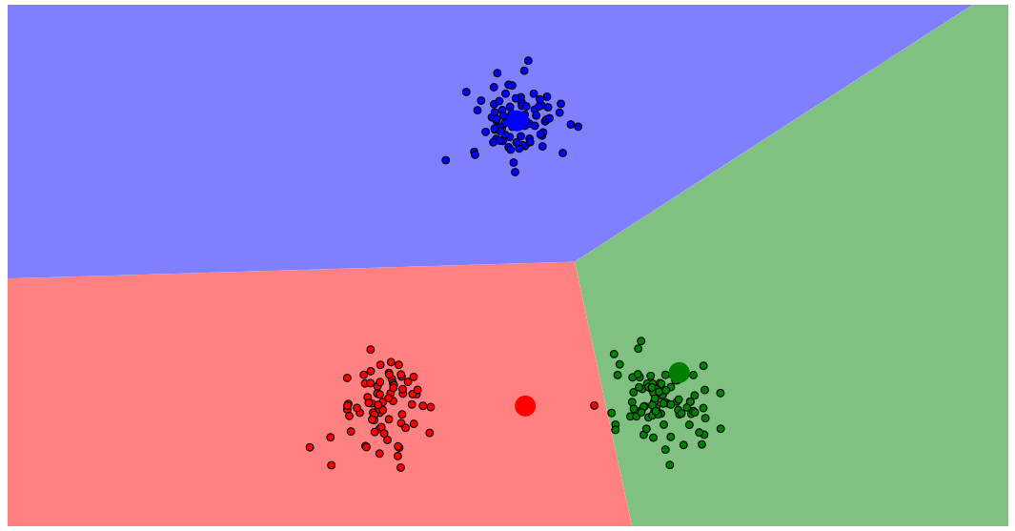
Clustering: KMeans
Compute distances of each point from each of the cluster centres and assign cluster labels

Slide 17
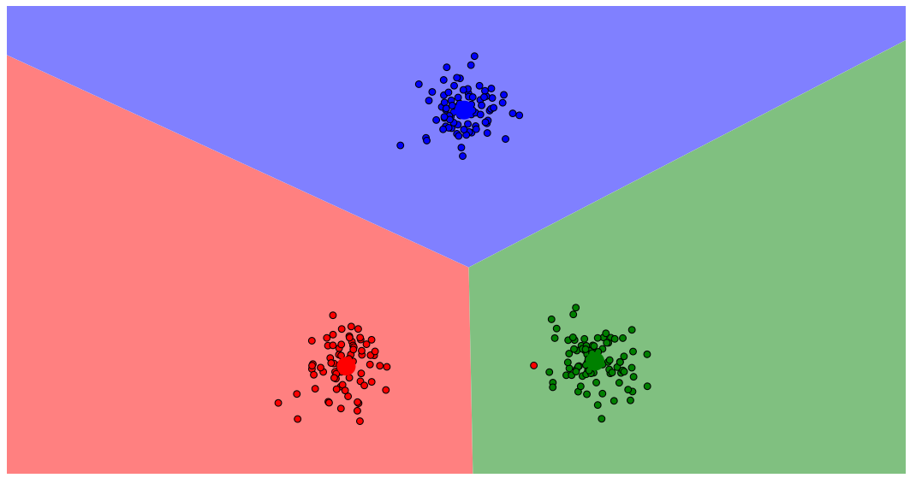
Clustering: KMeans
Re-Compute Cluster Centres

Slide 18
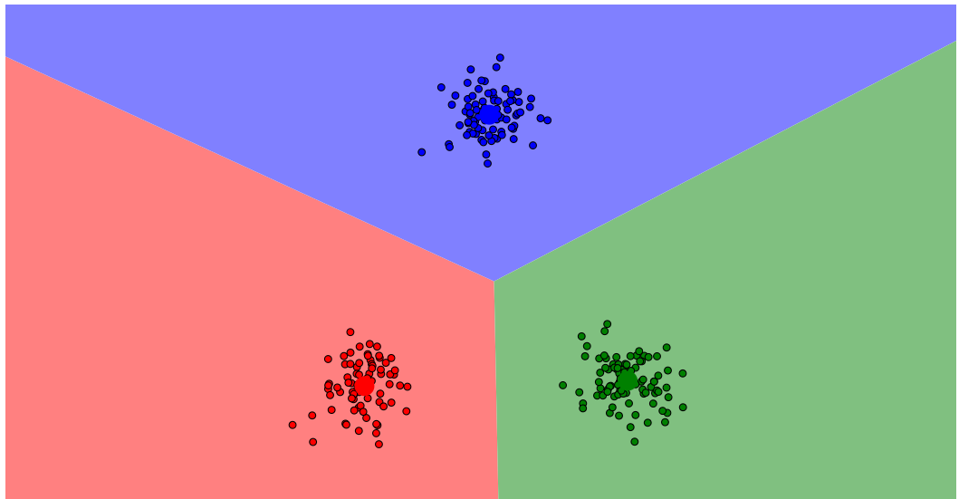
Clustering: KMeans
Compute distances of each point from each of the cluster centres and assign cluster labels

Slide 19
Clustering: KMeans
Once we intuitively understand how Kmeans work, there are some peculiarities about Kmeans that we need to keep in mind:
Data Level:
Only numeric data can be fed to a Kmeans Algorithm
Data should be scaled
Algorithm Level:
How to find out what could be a good value of “K”?

Slide 20
Clustering: Kmeans, Numeric Data
Revenue | Size (Sq ft) | Footfall | City
4000 | 1000 | 80 | Blr
3000 | 1200 | 90 | Blr
8000 | 1400 | 100 | Chennai
9000 | 900 | 200 | Blr
2000 | 1234 | 324 | Chennai
Revenue | Size (Sq ft) | Footfall | City_Blr | City_Ch
4000 | 1000 | 80 | 1 | 0
3000 | 1200 | 90 | 1 | 0
8000 | 1400 | 100 | 0 | 1
9000 | 900 | 200 | 1 | 0
2000 | 1234 | 324 | 0 | 1

Slide 21
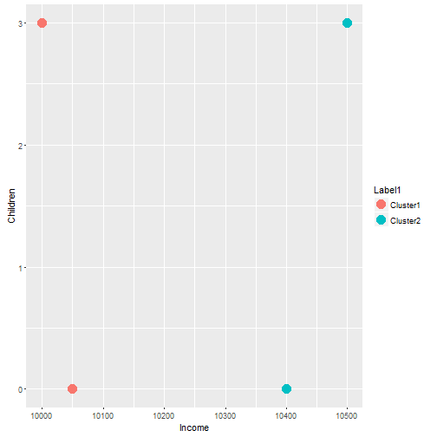
Clustering: Kmeans, Data Should Be Scaled
Income | Children
10050 | 0
10050 | 2
10400 | 0
10500 | 2

Slide 22
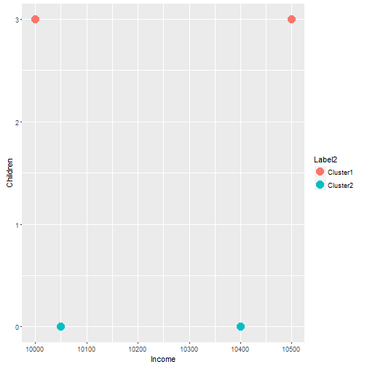
Clustering: Kmeans, Data Should Be Scaled
Income | Children
10050 | 0
10050 | 2
10400 | 0
10500 | 2

Slide 23
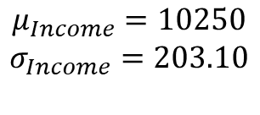

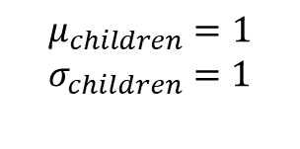
Clustering: Kmeans, Data Should Be Scaled
Income | Children
10050 | 0
10050 | 2
10400 | 0
10500 | 2
Income
-0.98
-0.98
0.73
1.23
Children
-1
1
-1
1
$$Z_{i}=(x_{i}−μ)/σ$$
$$μ_{Income}=10250$$
$$σ_{Income}=203.10$$
$$μ_{children}=1$$
$$σ_{children}=1$$
Similar Scale

Slide 24
Clustering KMeans: Good value of K?
Store_id | P.Whisky | Revenue
1 | 0.40 | 80
2 | 0.20 | 60
3 | 0.35 | 40
4 | 0.22 | 90
5 | 0.45 | 75
How many clusters?
3, K=3

Slide 25
Clustering KMeans: Good value of K?
Income | Credit Limit | # Withdrawls | Card Usage | FICO | Age
… | … | … | … | … | …
… | … | … | … | … | …
… | … | … | … | … | …
How many clusters?
3,4,5,6,..16?
How would we know?

Slide 26
Clustering KMeans: Good value of K?
Income | Credit Limit | # Withdrawls | Card Usage | FICO | Age
… | … | … | … | … | …
… | … | … | … | … | …
… | … | … | … | … | …
How many clusters?
3,4,5,6,..16?
How would we know?
Some times there is context. For example, Marketing team of a bank might want to understand only 3 segments

Slide 27
Clustering KMeans: Good value of K?
Income | Credit Limit | # Withdrawls | Card Usage | FICO | Age
… | … | … | … | … | …
… | … | … | … | … | …
… | … | … | … | … | …
How many clusters?
3,4,5,6,..16?
How would we know?
Some times, there may be no context available, then how do we figure out a good value of K?

Slide 28
Clustering KMeans: Good value of K?
If we create 3 clusters:
(i) Clusters are compact
(ii) Clusters are far apart
So a good choice of K will lead to:
Compact Clusters
Well separated clusters

Slide 29
Clustering KMeans: Good value of K?
# Clusters | Compactness
1 | M1
2 | M2
3 | M3
4 | M4
.. | ..
3 | M3
Choose K=3

Slide 30
Clustering KMeans: Good value of K?
Can we measure compactness of clusters?

Slide 31
Clustering KMeans: Good value of K?
Can we measure compactness of clusters?
Rev | P.Whisky
.. | ..
.. | ..
.. | ..
.. | ..
.. | ..
.. | ..
.. | ..

Slide 32
Clustering KMeans: Good value of K?
Can we measure compactness of clusters?
Rev | P.Whisky
.. | ..
.. | ..
.. | ..
.. | ..
.. | ..
.. | ..
.. | ..

Slide 33
Clustering KMeans: Good value of K?
Can we measure compactness of clusters?
Rev | P.Whisky
.. | ..
.. | ..
.. | ..
.. | ..
.. | ..
.. | ..
.. | ..

Slide 34
Clustering KMeans: Good value of K?
Can we measure compactness of clusters?
Rev | P.Whisky
.. | ..
78 | 0.42
75 | 0.45
76 | 0.42
.. | ..
.. | ..
.. | ..

Slide 35

Clustering KMeans: Good value of K?
Can we measure compactness of clusters?
Rev | P.Whisky
.. | ..
78 | 0.42
75 | 0.45
76 | 0.42
.. | ..
.. | ..
.. | ..
$$WSS_{1}=∑{\left(x_{i}−μ_{i}\right)}^{2}$$

Slide 36
Clustering KMeans: Good value of K?
Can we measure compactness of clusters?
Rev | P.Whisky
.. | ..
78 | 0.42
75 | 0.45
76 | 0.42
.. | ..
.. | ..
.. | ..
$$WSS_{1}=∑{\left(x_{i}−μ_{i}\right)}^{2}$$
$$WSS_{1}={\left(78−75\right)}^{2}+{\left(0.42−0.45\right)}^{2}+{\left(76−75\right)}^{2}+{\left(0.42−0.45\right)}^{2}$$

Slide 37

Clustering KMeans: Good value of K?
Can we measure compactness of clusters?
$$WSS_{2}=∑{\left(x_{i}−μ_{i}\right)}^{2}$$

Slide 38

Clustering KMeans: Good value of K?
Can we measure compactness of clusters?
$$WSS_{3}=∑{\left(x_{i}−μ_{i}\right)}^{2}$$

Slide 39
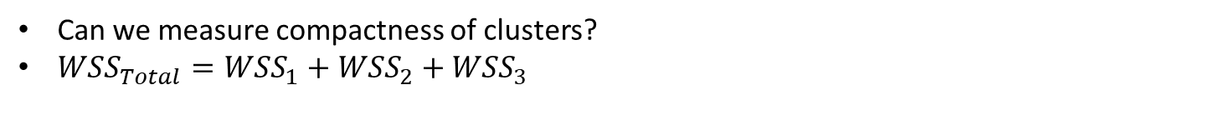
Clustering KMeans: Good value of K?
Can we measure compactness of clusters?
$WSS_{Total}=WSS_{1}+WSS_{2}+WSS_{3}$

Slide 40
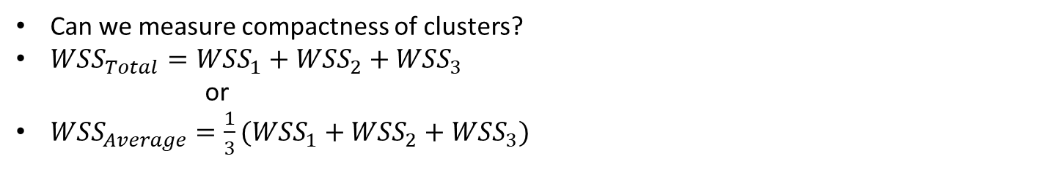
Clustering KMeans: Good value of K?
Can we measure compactness of clusters?
$WSS_{Total}=WSS_{1}+WSS_{2}+WSS_{3}$
or
$WSS_{Average}=\frac{1}{3}(WSS_{1}+WSS_{2}+WSS_{3})$

Slide 41
Clustering KMeans: Good value of K?
Can we measure compactness of clusters?
$WSS_{Total}=WSS_{1}+WSS_{2}+WSS_{3}$
or
$WSS_{Average}=\frac{1}{3}(WSS_{1}+WSS_{2}+WSS_{3})$
# Clusters | WSS
1 | M1
2 | M2
3 | M3
4 | M4
.. | ..

Slide 42
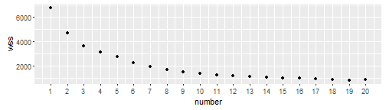
Clustering KMeans: Good value of K?
Scree Plot/Elbow Plot

Slide 43
Clustering KMeans: Good value of K?

Slide 44
Clustering KMeans: Good value of K?
Anything between 8 to 12 clusters seems like a good number
Now what?

Slide 45
Clustering KMeans: Good value of K?
The next task that we do is, we create cluster profiles
Once cluster models are created, we should try to understand what each cluster represents
This process is known as creating cluster profiles
Based on this we finalize if a 8 cluster model is better or 11 cluster model, as suggested by the Elbow Curve

Slide 46

Clustering KMeans: Good value of K? Cluster Profiles
Revenue | P.Whisky | Cluster
.. | .. | 1
.. | .. | 1
.. | .. | 2
.. | .. | 2
.. | .. | 3
.. | .. | 3
.. | .. | 1
Mean Revenue= 120, std = 10
Mean Revenue Cluster 1 = 200
Mean Revenue Cluster 2 = 125
Mean Revenue Cluster 3 = 75
Mean P.Whisky= 0.20, std= 0.10
Mean P.Whisky Cluster 1 = 0.40
Mean P.Whisky Cluster 2 = 0.21
Mean P.Whisky Cluster 3 = 0.05
Mean Revenue= 120, std = 10
Z Revenue Cluster 1 = 8
Z Revenue Cluster 2 = 0.5
Z Revenue Cluster 3 = -4.5
Mean P.Whisky= 0.20, std= 0.10
Z P.Whisky Cluster 1 = 2
Z P.Whisky Cluster 2 = 1
Z P.Whisky Cluster 3 = -1.5
$$Z=(x−μ)/σ$$

