Slide 1
Backpropagation
Gunnvant Saini

Slide 2
Backpropagation Scalar Form 1
z1
f1
z2
f2
zL
fL
w1
w2
wL
x

Slide 3
Backpropagation Scalar Form 1
z1
f1
z2
f2
zL
fL
w1
w2
wL
x
How many parameters will have to be changed while doing gradient descent

Slide 4

Backpropagation Scalar Form 1
z1
f1
z2
f2
zL
fL
w1
w2
wL
x
How many parameters will have to be changed while doing gradient descent
$$w_{1}≔w_{1}−η∇_{\left\{w_{1}\right\}}Loss$$

Slide 5

Backpropagation Scalar Form 1
z1
f1
z2
f2
zL
fL
w1
w2
wL
x
How many parameters will have to be changed while doing gradient descent
$$w_{1}≔w_{1}−η∇_{\left\{w_{1}\right\}}Loss$$
$$w_{2}≔w_{2}−η∇_{\left\{w_{2}\right\}}Loss$$

Slide 6

Backpropagation Scalar Form 1
z1
f1
z2
f2
zL
fL
w1
w2
wL
x
How many parameters will have to be changed while doing gradient descent
$$w_{1}≔w_{1}−η∇_{\left\{w_{1}\right\}}Loss$$
$$w_{2}≔w_{2}−η∇_{\left\{w_{2}\right\}}Loss$$
$$w_{n}≔w_{n}−η∇_{\left\{w_{n}\right\}}Loss$$

Slide 7
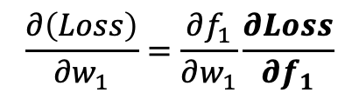

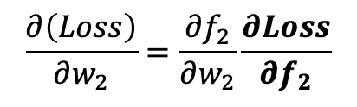

Backpropagation Scalar Form 1
z1
f1
z2
f2
zL
fL
w1
w2
wL
x
$$w_{1}≔w_{1}−η∇_{\left\{w_{1}\right\}}Loss$$
$$w_{2}≔w_{2}−η∇_{\left\{w_{2}\right\}}Loss$$
$$\frac{∂\left(Loss\right)}{∂w_{1}}=\frac{∂f_{1}}{∂w_{1}}\frac{∂Loss}{∂f_{1}}$$
$$\frac{∂\left(Loss\right)}{∂w_{2}}=\frac{∂f_{2}}{∂w_{2}}\frac{∂Loss}{∂f_{2}}$$

Slide 8

Backpropagation Scalar Form 1
$$f_{i}=\tanh\left(z_{i}\right)$$
$$z_{i}=w_{i}f_{i−1 }$$
$$Loss=\frac{1}{2}{\left(y−f_{L}\right)}^{2}$$
$$f_{i}^{′}=f_{i} (1−\tanh^{2}{(z_{i})) }∀ i≠1$$
$$f_{i}^{′}=x (1−\tanh^{2}{(z_{i})) }∀ i=1$$
z1
f1
z2
f2
zL
fL
w1
w2
wL
x
$$w_{1}≔w_{1}−η∇_{\left\{w_{1}\right\}}Loss$$
$$w_{2}≔w_{2}−η∇_{\left\{w_{2}\right\}}Loss$$
$$\frac{∂\left(Loss\right)}{∂w_{1}}=\frac{∂f_{1}}{∂w_{1}}\frac{∂Loss}{∂f_{1}}$$
$$\frac{∂\left(Loss\right)}{∂w_{2}}=\frac{∂f_{2}}{∂w_{2}}\frac{∂Loss}{∂f_{2}}$$

Slide 9
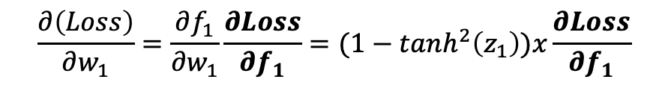
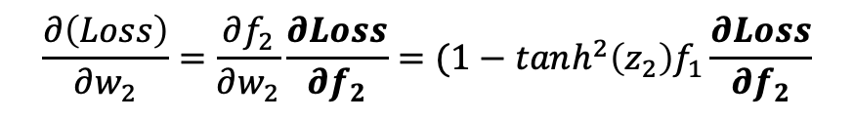
Backpropagation Scalar Form 1
$$f_{i}=\tanh\left(z_{i}\right)$$
$$z_{i}=w_{i}f_{i−1 }$$
$$Loss=\frac{1}{2}{\left(y−f_{L}\right)}^{2}$$
$$f_{i}^{′}=f_{i} (1−\tanh^{2}{(z_{i})) }∀ i≠1$$
$$f_{i}^{′}=x (1−\tanh^{2}{(z_{i})) }∀ i=1$$
z1
f1
z2
f2
zL
fL
w1
w2
wL
x
$$w_{1}≔w_{1}−η∇_{\left\{w_{1}\right\}}Loss$$
$$w_{2}≔w_{2}−η∇_{\left\{w_{2}\right\}}Loss$$
$$\frac{∂\left(Loss\right)}{∂w_{1}}=\frac{∂f_{1}}{∂w_{1}}\frac{∂Loss}{∂f_{1}}=(1−tanh^{2}\left(z_{1}\right))x\frac{∂Loss}{∂f_{1}}$$
$$\frac{∂\left(Loss\right)}{∂w_{2}}=\frac{∂f_{2}}{∂w_{2}}\frac{∂Loss}{∂f_{2}}=(1−tanh^{2}\left(z_{2}\right)f_{1}\frac{∂Loss}{∂f_{2}}$$

Slide 10
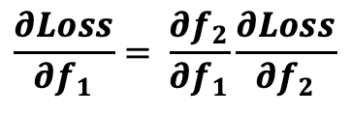
Backpropagation Scalar Form 1
$$f_{i}=\tanh\left(z_{i}\right)$$
$$z_{i}=w_{i}f_{i−1 }$$
$$Loss=\frac{1}{2}{\left(y−f_{L}\right)}^{2}$$
$$f_{i}^{′}=f_{i} (1−\tanh^{2}{(z_{i})) }∀ i≠1$$
$$f_{i}^{′}=x (1−\tanh^{2}{(z_{i})) }∀ i=1$$
z1
f1
z2
f2
zL
fL
w1
w2
wL
x
$$w_{1}≔w_{1}−η∇_{\left\{w_{1}\right\}}Loss$$
$$w_{2}≔w_{2}−η∇_{\left\{w_{2}\right\}}Loss$$
$$\frac{∂\left(Loss\right)}{∂w_{1}}=\frac{∂f_{1}}{∂w_{1}}\frac{∂Loss}{∂f_{1}}=(1−tanh^{2}\left(z_{1}\right))x\frac{∂Loss}{∂f_{1}}$$
$$\frac{∂\left(Loss\right)}{∂w_{2}}=\frac{∂f_{2}}{∂w_{2}}\frac{∂Loss}{∂f_{2}}=(1−tanh^{2}\left(z_{2}\right)f_{1}\frac{∂Loss}{∂f_{2}}$$
$$\frac{∂Loss}{∂f_{1}}= \frac{∂f_{2}}{∂f_{1}}\frac{∂Loss}{∂f_{2}}$$

Slide 11
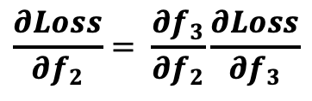
Backpropagation Scalar Form 1
$$f_{i}=\tanh\left(z_{i}\right)$$
$$z_{i}=w_{i}f_{i−1 }$$
$$Loss=\frac{1}{2}{\left(y−f_{L}\right)}^{2}$$
$$f_{i}^{′}=f_{i} (1−\tanh^{2}{(z_{i})) }∀ i≠1$$
$$f_{i}^{′}=x (1−\tanh^{2}{(z_{i})) }∀ i=1$$
z1
f1
z2
f2
zL
fL
w1
w2
wL
x
$$w_{1}≔w_{1}−η∇_{\left\{w_{1}\right\}}Loss$$
$$w_{2}≔w_{2}−η∇_{\left\{w_{2}\right\}}Loss$$
$$\frac{∂\left(Loss\right)}{∂w_{1}}=\frac{∂f_{1}}{∂w_{1}}\frac{∂Loss}{∂f_{1}}=(1−tanh^{2}\left(z_{1}\right))x\frac{∂Loss}{∂f_{1}}$$
$$\frac{∂\left(Loss\right)}{∂w_{2}}=\frac{∂f_{2}}{∂w_{2}}\frac{∂Loss}{∂f_{2}}=(1−tanh^{2}\left(z_{2}\right)f_{1}\frac{∂Loss}{∂f_{2}}$$
$$\frac{∂Loss}{∂f_{1}}= \frac{∂f_{2}}{∂f_{1}}\frac{∂Loss}{∂f_{2}}$$
$$\frac{∂Loss}{∂f_{2}}= \frac{∂f_{3}}{∂f_{2}}\frac{∂Loss}{∂f_{3}}$$

Slide 12
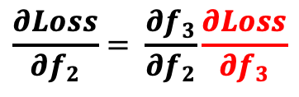
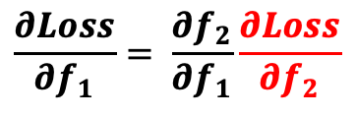
Backpropagation Scalar Form 1
$$f_{i}=\tanh\left(z_{i}\right)$$
$$z_{i}=w_{i}f_{i−1 }$$
$$Loss=\frac{1}{2}{\left(y−f_{L}\right)}^{2}$$
$$f_{i}^{′}=f_{i} (1−\tanh^{2}{(z_{i})) }∀ i≠1$$
$$f_{i}^{′}=x (1−\tanh^{2}{(z_{i})) }∀ i=1$$
z1
f1
z2
f2
zL
fL
w1
w2
wL
x
$$w_{1}≔w_{1}−η∇_{\left\{w_{1}\right\}}Loss$$
$$w_{2}≔w_{2}−η∇_{\left\{w_{2}\right\}}Loss$$
$$\frac{∂\left(Loss\right)}{∂w_{1}}=\frac{∂f_{1}}{∂w_{1}}\frac{∂Loss}{∂f_{1}}=(1−tanh^{2}\left(z_{1}\right))x\frac{∂Loss}{∂f_{1}}$$
$$\frac{∂\left(Loss\right)}{∂w_{2}}=\frac{∂f_{2}}{∂w_{2}}\frac{∂Loss}{∂f_{2}}=(1−tanh^{2}\left(z_{2}\right)f_{1}\frac{∂Loss}{∂f_{2}}$$
$$\frac{∂Loss}{∂f_{1}}= \frac{∂f_{2}}{∂f_{1}}\frac{∂Loss}{∂f_{2}}$$
$$\frac{∂Loss}{∂f_{2}}= \frac{∂f_{3}}{∂f_{2}}\frac{∂Loss}{∂f_{3}}$$

Slide 13
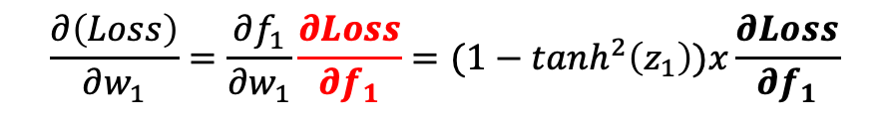
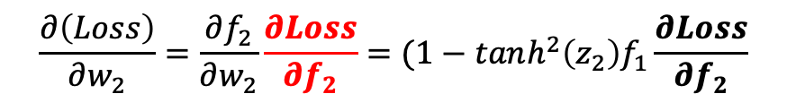
Backpropagation Scalar Form 1
$$f_{i}=\tanh\left(z_{i}\right)$$
$$z_{i}=w_{i}f_{i−1 }$$
$$Loss=\frac{1}{2}{\left(y−f_{L}\right)}^{2}$$
$$f_{i}^{′}=f_{i} (1−\tanh^{2}{(z_{i})) }∀ i≠1$$
$$f_{i}^{′}=x (1−\tanh^{2}{(z_{i})) }∀ i=1$$
z1
f1
z2
f2
zL
fL
w1
w2
wL
x
$$w_{1}≔w_{1}−η∇_{\left\{w_{1}\right\}}Loss$$
$$w_{2}≔w_{2}−η∇_{\left\{w_{2}\right\}}Loss$$
$$\frac{∂\left(Loss\right)}{∂w_{1}}=\frac{∂f_{1}}{∂w_{1}}\frac{∂Loss}{∂f_{1}}=(1−tanh^{2}\left(z_{1}\right))x\frac{∂Loss}{∂f_{1}}$$
$$\frac{∂\left(Loss\right)}{∂w_{2}}=\frac{∂f_{2}}{∂w_{2}}\frac{∂Loss}{∂f_{2}}=(1−tanh^{2}\left(z_{2}\right)f_{1}\frac{∂Loss}{∂f_{2}}$$
$$\frac{∂Loss}{∂f_{1}}= \frac{∂f_{2}}{∂f_{1}}\frac{∂Loss}{∂f_{2}}$$
Do you see the recursive relationship?
$$\frac{∂Loss}{∂f_{2}}= \frac{∂f_{3}}{∂f_{2}}\frac{∂Loss}{∂f_{3}}$$

Slide 14

Backpropagation Scalar Form 1
$$f_{i}=\tanh\left(z_{i}\right)$$
$$z_{i}=w_{i}f_{i−1 }$$
$$Loss=\frac{1}{2}{\left(y−f_{L}\right)}^{2}$$
$$f_{i}^{′}=w_{i}(1−\tanh^{2}{(z_{i})) }∀ i≠1$$
$$f_{i}^{′}=x (1−\tanh^{2}{(z_{i})) }∀ i=1$$
z1
f1
z2
f2
zL
fL
w1
w2
wL
x
$$w_{1}≔w_{1}−η∇_{\left\{w_{1}\right\}}Loss$$
$$\frac{∂\left(Loss\right)}{∂w_{1}}=\frac{∂f_{1}}{∂w_{1}}\frac{∂Loss}{∂f_{1}}=(1−tanh^{2}\left(z_{1}\right))x\frac{∂Loss}{∂f_{1}}$$
Can we expand this expression further?
$$\frac{∂Loss}{∂f_{1}}= \frac{∂f_{2}}{∂f_{1}}\frac{∂Loss}{∂f_{2}}$$

Slide 15
Backpropagation Scalar Form 1
$$f_{i}=\tanh\left(z_{i}\right)$$
$$z_{i}=w_{i}f_{i−1 }$$
$$Loss=\frac{1}{2}{\left(y−f_{L}\right)}^{2}$$
$$f_{i}^{′}=w_{i}(1−\tanh^{2}{(z_{i})) }∀ i≠1$$
$$f_{i}^{′}=x (1−\tanh^{2}{(z_{i})) }∀ i=1$$
z1
f1
z2
f2
zL
fL
w1
w2
wL
x
$$w_{1}≔w_{1}−η∇_{\left\{w_{1}\right\}}Loss$$
$$\frac{∂\left(Loss\right)}{∂w_{1}}=\frac{∂f_{1}}{∂w_{1}}\frac{∂Loss}{∂f_{1}}=(1−tanh^{2}\left(z_{1}\right))x\frac{∂Loss}{∂f_{1}}$$
$$\frac{∂Loss}{∂f_{1}}= \frac{∂f_{2}}{∂f_{1}}\frac{∂Loss}{∂f_{2}}=\frac{∂f_{2}}{∂f_{1}}\frac{∂f_{3}}{∂f_{4}}\frac{∂f_{4}}{∂f_{5}}……\frac{∂Loss}{∂f_{L}}=w_{2}\left(1−tanh^{2}\left(z_{2}\right)\right)∗w_{3}\left(1−tanh^{2}\left(z_{3}\right)\right)∗……∗−(y−f_{L})$$

Slide 16

Backpropagation: Scalar Form 2
$$f_{i}=\tanh\left(z_{i}\right)$$
$$z_{i}=w_{i}f_{i−1 }$$
$$Loss=\frac{1}{2}{\left(y−f_{L}\right)}^{2}$$
$$f_{i}^{′}=w_{i}(1−\tanh^{2}{(z_{i})) }∀ i≠1$$
$$f_{i}^{′}=x (1−\tanh^{2}{(z_{i})) }∀ i=1$$
z1
zL
f1
z2
f2
fL
w1
w2
wL
x
$$w_{1}≔w_{1}−η∇_{\left\{w_{1}\right\}}Loss$$
$$\frac{∂\left(Loss\right)}{∂w_{1}}=\frac{∂z_{1}}{∂w_{1}}\frac{∂Loss}{∂z_{1}}=x\frac{∂Loss}{∂z_{1}}$$

Slide 17
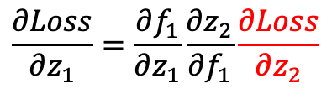
Backpropagation: Scalar Form 2
$$f_{i}=\tanh\left(z_{i}\right)$$
$$z_{i}=w_{i}f_{i−1 }$$
$$Loss=\frac{1}{2}{\left(y−f_{L}\right)}^{2}$$
$$f_{i}^{′}=w_{i}(1−\tanh^{2}{(z_{i})) }∀ i≠1$$
$$f_{i}^{′}=x (1−\tanh^{2}{(z_{i})) }∀ i=1$$
z1
zL
f1
z2
f2
fL
w1
w2
wL
x
$$w_{1}≔w_{1}−η∇_{\left\{w_{1}\right\}}Loss$$
$$\frac{∂\left(Loss\right)}{∂w_{1}}=\frac{∂z_{1}}{∂w_{1}}\frac{∂Loss}{∂z_{1}}=x\frac{∂Loss}{∂z_{1}}$$
$$\frac{∂Loss}{∂z_{1}}=\frac{∂f_{1}}{∂z_{1}}\frac{{∂z}_{2}}{∂f_{1}}\frac{∂Loss}{∂z_{2}}$$

Slide 18
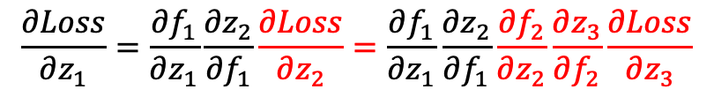
Backpropagation: Scalar Form 2
$$f_{i}=\tanh\left(z_{i}\right)$$
$$z_{i}=w_{i}f_{i−1 }$$
$$Loss=\frac{1}{2}{\left(y−f_{L}\right)}^{2}$$
$$f_{i}^{′}=w_{i}(1−\tanh^{2}{(z_{i})) }∀ i≠1$$
$$f_{i}^{′}=x (1−\tanh^{2}{(z_{i})) }∀ i=1$$
z1
zL
f1
z2
f2
fL
w1
w2
wL
x
$$w_{1}≔w_{1}−η∇_{\left\{w_{1}\right\}}Loss$$
$$\frac{∂\left(Loss\right)}{∂w_{1}}=\frac{∂z_{1}}{∂w_{1}}\frac{∂Loss}{∂z_{1}}=x\frac{∂Loss}{∂z_{1}}$$
$$\frac{∂Loss}{∂z_{1}}=\frac{∂f_{1}}{∂z_{1}}\frac{{∂z}_{2}}{∂f_{1}}\frac{∂Loss}{∂z_{2}}=\frac{∂f_{1}}{∂z_{1}}\frac{∂z_{2}}{∂f_{1}}\frac{∂f_{2}}{∂z_{2}}\frac{∂z_{3}}{∂f_{2}}\frac{∂Loss}{∂z_{3}}$$

Slide 19
Backpropagation: Scalar Form 2
$$f_{i}=\tanh\left(z_{i}\right)$$
$$z_{i}=w_{i}f_{i−1 }$$
$$Loss=\frac{1}{2}{\left(y−f_{L}\right)}^{2}$$
$$f_{i}^{′}=w_{i}(1−\tanh^{2}{(z_{i})) }∀ i≠1$$
$$f_{i}^{′}=x (1−\tanh^{2}{(z_{i})) }∀ i=1$$
z1
zL
f1
z2
f2
fL
w1
w2
wL
x
$$w_{1}≔w_{1}−η∇_{\left\{w_{1}\right\}}Loss$$
$$\frac{∂\left(Loss\right)}{∂w_{1}}=\frac{∂z_{1}}{∂w_{1}}\frac{∂Loss}{∂z_{1}}=x\frac{∂Loss}{∂z_{1}}$$
$$\frac{∂Loss}{∂z_{1}}=\frac{∂f_{1}}{∂z_{1}}\frac{{∂z}_{2}}{∂f_{1}}\frac{∂Loss}{∂z_{2}}=\frac{∂f_{1}}{∂z_{1}}\frac{∂z_{2}}{∂f_{1}}\frac{∂f_{2}}{∂z_{2}}\frac{∂z_{3}}{∂f_{2}}\frac{∂Loss}{∂z_{3}}=\frac{∂f_{1}}{∂z_{1}}\frac{∂z_{2}}{∂f_{1}}\frac{∂f_{2}}{∂z_{2}}\frac{∂z_{3}}{∂f_{2}}\frac{∂f_{3}}{∂z_{3}}\frac{∂z_{4}}{∂f_{3}}….\frac{∂Loss}{∂z_{L}}$$

Slide 20

Backpropagation: Scalar Form 2
$$f_{i}=\tanh\left(z_{i}\right)$$
$$z_{i}=w_{i}f_{i−1 }$$
$$Loss=\frac{1}{2}{\left(y−f_{L}\right)}^{2}$$
$$f_{i}^{′}=w_{i}(1−\tanh^{2}{(z_{i})) }∀ i≠1$$
$$f_{i}^{′}=x (1−\tanh^{2}{(z_{i})) }∀ i=1$$
z1
zL
f1
z2
f2
fL
w1
w2
wL
x
$$w_{1}≔w_{1}−η∇_{\left\{w_{1}\right\}}Loss$$
$$δ_{1}$$
$$\frac{∂\left(Loss\right)}{∂w_{1}}=\frac{∂z_{1}}{∂w_{1}}\frac{∂Loss}{∂z_{1}}=x\frac{∂Loss}{∂z_{1}}$$
$$\frac{∂Loss}{∂z_{1}}=\frac{∂f_{1}}{∂z_{1}}\frac{{∂z}_{2}}{∂f_{1}}\frac{∂Loss}{∂z_{2}}=\frac{∂f_{1}}{∂z_{1}}\frac{∂z_{2}}{∂f_{1}}\frac{∂f_{2}}{∂z_{2}}\frac{∂z_{3}}{∂f_{2}}\frac{∂Loss}{∂z_{3}}=\frac{∂f_{1}}{∂z_{1}}\frac{∂z_{2}}{∂f_{1}}\frac{∂f_{2}}{∂z_{2}}\frac{∂z_{3}}{∂f_{2}}\frac{∂f_{3}}{∂z_{3}}\frac{∂z_{4}}{∂f_{3}}….\frac{∂Loss}{∂z_{L}}$$

Slide 21

Backpropagation: Scalar Form 2
$$f_{i}=\tanh\left(z_{i}\right)$$
$$z_{i}=w_{i}f_{i−1 }$$
$$Loss=\frac{1}{2}{\left(y−f_{L}\right)}^{2}$$
$$f_{i}^{′}=w_{i}(1−\tanh^{2}{(z_{i})) }∀ i≠1$$
$$f_{i}^{′}=x (1−\tanh^{2}{(z_{i})) }∀ i=1$$
z1
zL
f1
z2
f2
fL
w1
w2
wL
x
$$w_{1}≔w_{1}−η∇_{\left\{w_{1}\right\}}Loss$$
$$δ_{1}$$
$$\frac{∂\left(Loss\right)}{∂w_{1}}=\frac{∂z_{1}}{∂w_{1}}\frac{∂Loss}{∂z_{1}}=x\frac{∂Loss}{∂z_{1}}$$
$$δ_{2}$$
$$\frac{∂Loss}{∂z_{1}}=\frac{∂f_{1}}{∂z_{1}}\frac{{∂z}_{2}}{∂f_{1}}\frac{∂Loss}{∂z_{2}}=\frac{∂f_{1}}{∂z_{1}}\frac{∂z_{2}}{∂f_{1}}\frac{∂f_{2}}{∂z_{2}}\frac{∂z_{3}}{∂f_{2}}\frac{∂Loss}{∂z_{3}}=\frac{∂f_{1}}{∂z_{1}}\frac{∂z_{2}}{∂f_{1}}\frac{∂f_{2}}{∂z_{2}}\frac{∂z_{3}}{∂f_{2}}\frac{∂f_{3}}{∂z_{3}}\frac{∂z_{4}}{∂f_{3}}….\frac{∂Loss}{∂z_{L}}$$

Slide 22

Backpropagation: Scalar Form 2
$$f_{i}=\tanh\left(z_{i}\right)$$
$$z_{i}=w_{i}f_{i−1 }$$
$$Loss=\frac{1}{2}{\left(y−f_{L}\right)}^{2}$$
$$f_{i}^{′}=w_{i}(1−\tanh^{2}{(z_{i})) }∀ i≠1$$
$$f_{i}^{′}=x (1−\tanh^{2}{(z_{i})) }∀ i=1$$
z1
zL
f1
z2
f2
fL
w1
w2
wL
x
$$w_{1}≔w_{1}−η∇_{\left\{w_{1}\right\}}Loss$$
$$δ_{1}$$
$$\frac{∂\left(Loss\right)}{∂w_{1}}=\frac{∂z_{1}}{∂w_{1}}\frac{∂Loss}{∂z_{1}}=x\frac{∂Loss}{∂z_{1}}$$
$$δ_{2}$$
$$δ_{3}$$
$$\frac{∂Loss}{∂z_{1}}=\frac{∂f_{1}}{∂z_{1}}\frac{{∂z}_{2}}{∂f_{1}}\frac{∂Loss}{∂z_{2}}=\frac{∂f_{1}}{∂z_{1}}\frac{∂z_{2}}{∂f_{1}}\frac{∂f_{2}}{∂z_{2}}\frac{∂z_{3}}{∂f_{2}}\frac{∂Loss}{∂z_{3}}=\frac{∂f_{1}}{∂z_{1}}\frac{∂z_{2}}{∂f_{1}}\frac{∂f_{2}}{∂z_{2}}\frac{∂z_{3}}{∂f_{2}}\frac{∂f_{3}}{∂z_{3}}\frac{∂z_{4}}{∂f_{3}}….\frac{∂Loss}{∂z_{L}}$$

Slide 23

Backpropagation: Scalar Form 2
$$f_{i}=\tanh\left(z_{i}\right)$$
$$z_{i}=w_{i}f_{i−1 }$$
$$Loss=\frac{1}{2}{\left(y−f_{L}\right)}^{2}$$
$$f_{i}^{′}=w_{i}(1−\tanh^{2}{(z_{i})) }∀ i≠1$$
$$f_{i}^{′}=x (1−\tanh^{2}{(z_{i})) }∀ i=1$$
z1
zL
f1
z2
f2
fL
w1
w2
wL
x
$$w_{1}≔w_{1}−η∇_{\left\{w_{1}\right\}}Loss$$
$$δ_{1}$$
$$\frac{∂\left(Loss\right)}{∂w_{1}}=\frac{∂z_{1}}{∂w_{1}}\frac{∂Loss}{∂z_{1}}=x\frac{∂Loss}{∂z_{1}}$$
$$δ_{2}$$
$$δ_{3}$$
$$δ_{4}$$
$$\frac{∂Loss}{∂z_{1}}=\frac{∂f_{1}}{∂z_{1}}\frac{{∂z}_{2}}{∂f_{1}}\frac{∂Loss}{∂z_{2}}=\frac{∂f_{1}}{∂z_{1}}\frac{∂z_{2}}{∂f_{1}}\frac{∂f_{2}}{∂z_{2}}\frac{∂z_{3}}{∂f_{2}}\frac{∂Loss}{∂z_{3}}=\frac{∂f_{1}}{∂z_{1}}\frac{∂z_{2}}{∂f_{1}}\frac{∂f_{2}}{∂z_{2}}\frac{∂z_{3}}{∂f_{2}}\frac{∂f_{3}}{∂z_{3}}\frac{∂z_{4}}{∂f_{3}}….\frac{∂Loss}{∂z_{L}}$$

Slide 24
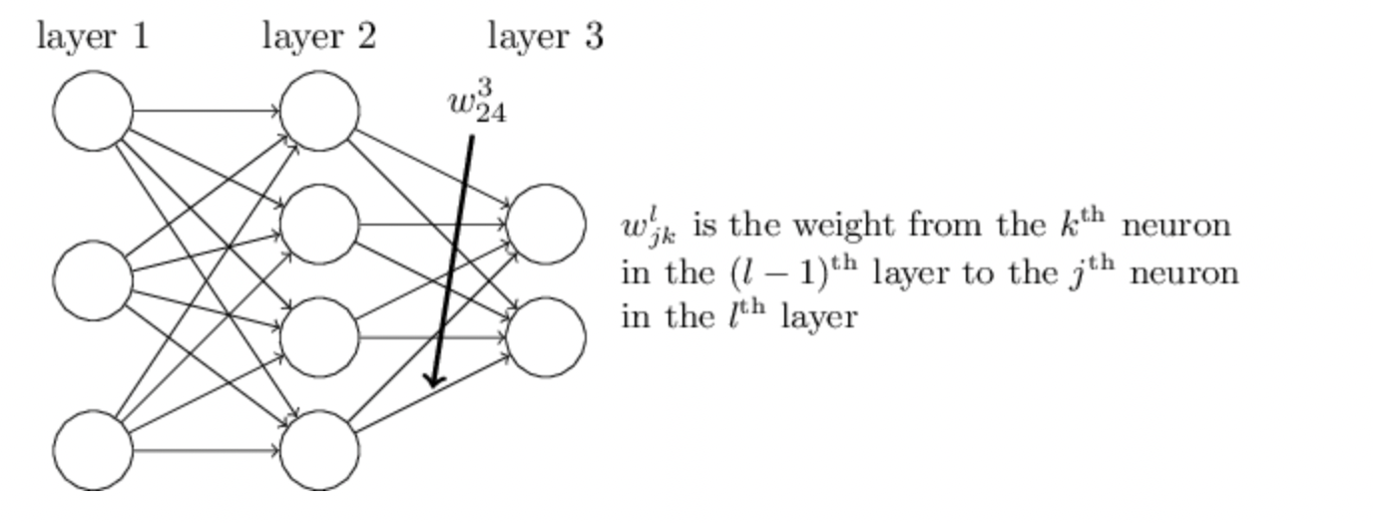
Backpropagation Vector Form

Slide 25
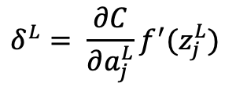
Backpropagation Vector Form
$$δ^{L}= \frac{∂C}{∂a_{j}^{L}}f^{′}(z_{j}^{L})$$

Slide 26
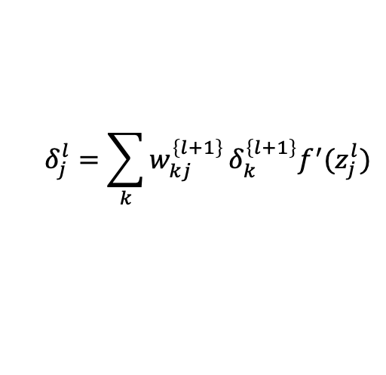
Backpropagation Vector Form
$$δ^{L}= \frac{∂C}{∂a_{j}^{L}}f^{′}(z_{j}^{L})$$
$$δ_{j}^{l}=\sum_{k}{w_{kj}^{\left\{l+1\right\}}}δ_{k}^{\left\{l+1\right\}}f^{′}(z_{j}^{l})$$

Slide 27
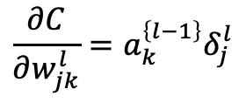
Backpropagation Vector Form
$$δ^{L}= \frac{∂C}{∂a_{j}^{L}}f^{′}(z_{j}^{L})$$
$$δ_{j}^{l}=\sum_{k}{w_{kj}^{\left\{l+1\right\}}}δ_{k}^{\left\{l+1\right\}}f^{′}(z_{j}^{l})$$
$$\frac{∂C}{∂w_{jk}^{l}}=a_{k}^{\left\{l−1\right\}}δ_{j}^{l}$$

Slide 28
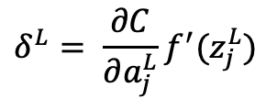
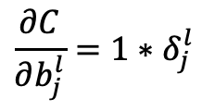
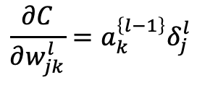
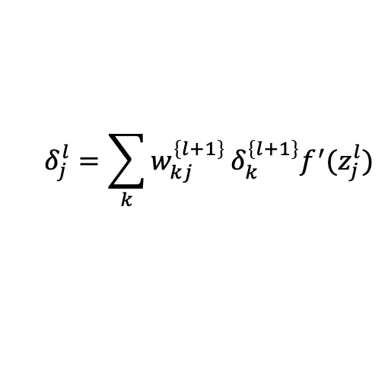
Backpropagation Vector Form
$$δ^{L}= \frac{∂C}{∂a_{j}^{L}}f^{′}(z_{j}^{L})$$
$$δ_{j}^{l}=\sum_{k}{w_{kj}^{\left\{l+1\right\}}}δ_{k}^{\left\{l+1\right\}}f^{′}(z_{j}^{l})$$
$$\frac{∂C}{∂w_{jk}^{l}}=a_{k}^{\left\{l−1\right\}}δ_{j}^{l}$$
$$\frac{∂C}{∂b_{j}^{l}}=1∗δ_{j}^{l}$$

Slide 29
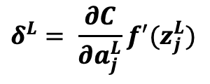
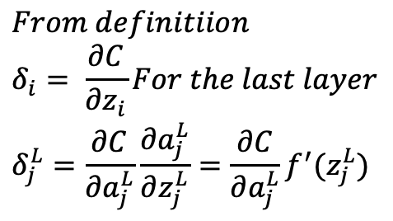
Backpropagation Vector Form (Derivation)
$$δ^{L}= \frac{∂C}{∂a_{j}^{L}}f^{′}(z_{j}^{L})$$
$$From definitiion \\ δ_{i}= \frac{∂C}{∂z_{i}}For the last layer \\ δ_{j}^{L}=\frac{∂C}{∂a_{j}^{L}}\frac{∂a_{j}^{L}}{∂z_{j}^{L}}=\frac{∂C}{∂a_{j}^{L}}f^{′}(z_{j}^{L})$$

Slide 30
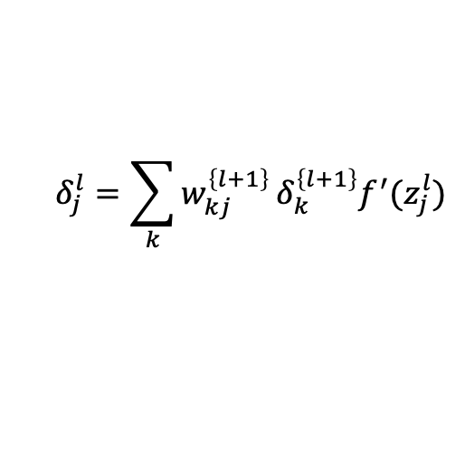
Backpropagation Vector Form (Derivation)
$$δ_{j}^{l}=\sum_{k}{w_{kj}^{\left\{l+1\right\}}}δ_{k}^{\left\{l+1\right\}}f^{′}(z_{j}^{l})$$

Slide 31
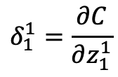
Backpropagation Vector Form (Derivation)
$$δ_{j}^{l}=\sum_{k}{w_{kj}^{\left\{l+1\right\}}}δ_{k}^{\left\{l+1\right\}}f^{′}(z_{j}^{l})$$
$$δ_{1}^{1}=\frac{∂C}{∂z_{1}^{1}}$$

Slide 32

Backpropagation Vector Form (Derivation)
$$δ_{j}^{l}=\sum_{k}{w_{kj}^{\left\{l+1\right\}}}δ_{k}^{\left\{l+1\right\}}f^{′}(z_{j}^{l})$$
$$δ_{1}^{1}=\frac{∂C}{∂z_{1}^{1}}$$
Changing $z_{1}^{1}$ will impact what values in the network?

Slide 33

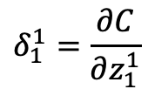
Backpropagation Vector Form (Derivation)
$$δ_{j}^{l}=\sum_{k}{w_{kj}^{\left\{l+1\right\}}}δ_{k}^{\left\{l+1\right\}}f^{′}(z_{j}^{l})$$
$$δ_{1}^{1}=\frac{∂C}{∂z_{1}^{1}}$$
Changing $z_{1}^{2}$ will impact what values in the network?

Slide 34
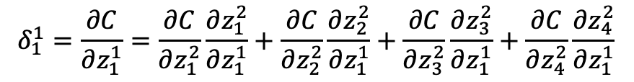
Backpropagation Vector Form (Derivation)
$$δ_{j}^{l}=\sum_{k}{w_{kj}^{\left\{l+1\right\}}}δ_{k}^{\left\{l+1\right\}}f^{′}(z_{j}^{l})$$
$$δ_{1}^{1}=\frac{∂C}{∂z_{1}^{1}}=\frac{∂C}{∂z_{1}^{2}}\frac{∂z_{1}^{2}}{∂z_{1}^{1}}+\frac{∂C}{∂z_{2}^{2}}\frac{∂z_{2}^{2}}{∂z_{1}^{1}}+\frac{∂C}{∂z_{3}^{2}}\frac{∂z_{3}^{2}}{∂z_{1}^{1}}+\frac{∂C}{∂z_{4}^{2}}\frac{∂z_{4}^{2}}{∂z_{1}^{1}}$$
Changing $z_{1}^{2}$ will impact what values in the network?

Slide 35
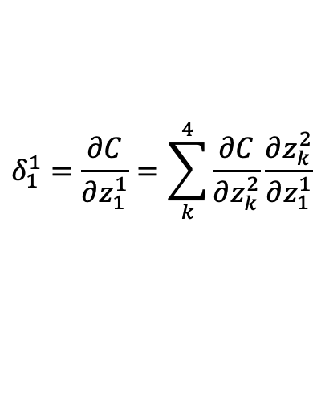
Backpropagation Vector Form (Derivation)
$$δ_{j}^{l}=\sum_{k}{w_{kj}^{\left\{l+1\right\}}}δ_{k}^{\left\{l+1\right\}}f^{′}(z_{j}^{l})$$
$$δ_{1}^{1}=\frac{∂C}{∂z_{1}^{1}}=\sum_{k}^{4}{\frac{∂C}{∂z_{k}^{2}}\frac{∂z_{k}^{2}}{∂z_{1}^{1}}}$$

Slide 36
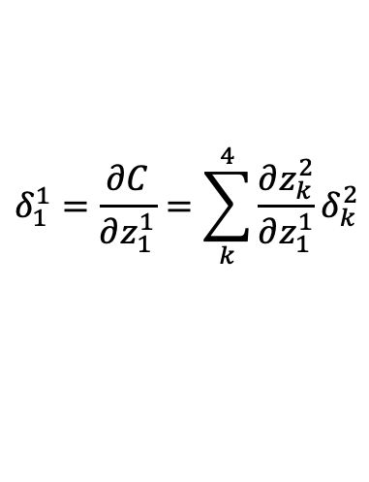
Backpropagation Vector Form (Derivation)
$$δ_{j}^{l}=\sum_{k}{w_{kj}^{\left\{l+1\right\}}}δ_{k}^{\left\{l+1\right\}}f^{′}(z_{j}^{l})$$
$$δ_{1}^{1}=\frac{∂C}{∂z_{1}^{1}}=\sum_{k}^{4}{\frac{∂z_{k}^{2}}{∂z_{1}^{1}}δ_{k}^{2}}$$

Slide 37
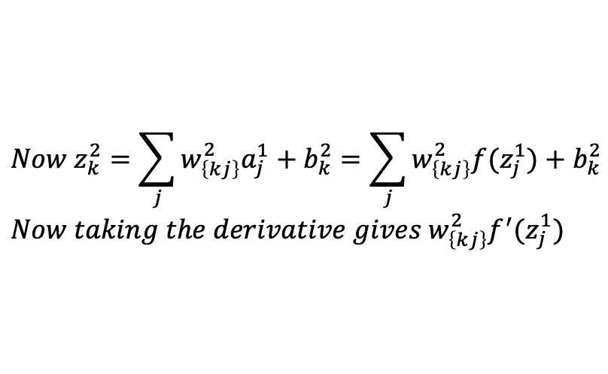
Backpropagation Vector Form (Derivation)
$$δ_{j}^{l}=\sum_{k}{w_{kj}^{\left\{l+1\right\}}}δ_{k}^{\left\{l+1\right\}}f^{′}(z_{j}^{l})$$
$$δ_{1}^{1}=\frac{∂C}{∂z_{1}^{1}}=\sum_{k}^{4}{\frac{∂z_{k}^{2}}{∂z_{1}^{1}}δ_{k}^{2}}$$
$$Now z_{k}^{2}=\sum_{j}{w_{\left\{kj\right\}}^{2}a_{j}^{1}}+b_{k}^{2}=\sum_{j}{w_{\left\{kj\right\}}^{2}f(z_{j}^{1})}+b_{k}^{2} \\ Now taking the derivative gives w_{\left\{kj\right\}}^{2}f^{′}(z_{j}^{1})$$

Slide 38
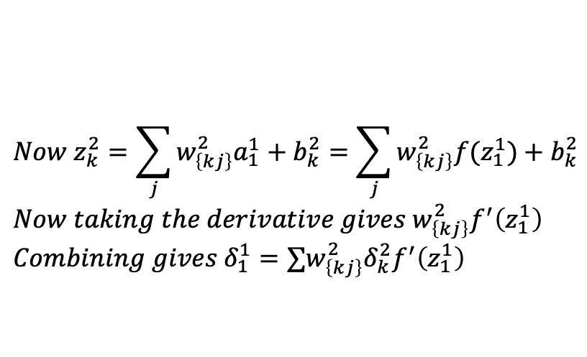
Backpropagation Vector Form (Derivation)
$$δ_{j}^{l}=\sum_{k}{w_{kj}^{\left\{l+1\right\}}}δ_{k}^{\left\{l+1\right\}}f^{′}(z_{j}^{l})$$
$$δ_{1}^{1}=\frac{∂C}{∂z_{1}^{1}}=\sum_{k}^{4}{\frac{∂z_{k}^{2}}{∂z_{1}^{1}}δ_{k}^{2}}$$
$$Now z_{k}^{2}=\sum_{j}{w_{\left\{kj\right\}}^{2}a_{1}^{1}}+b_{k}^{2}=\sum_{j}{w_{\left\{kj\right\}}^{2}f(z_{1}^{1})}+b_{k}^{2} \\ Now taking the derivative gives w_{\left\{kj\right\}}^{2}f^{′}\left(z_{1}^{1}\right) \\ Combining gives δ_{1}^{1}=∑w_{\left\{kj\right\}}^{2}δ_{k}^{2}f^{′}\left(z_{1}^{1}\right)$$

Slide 39
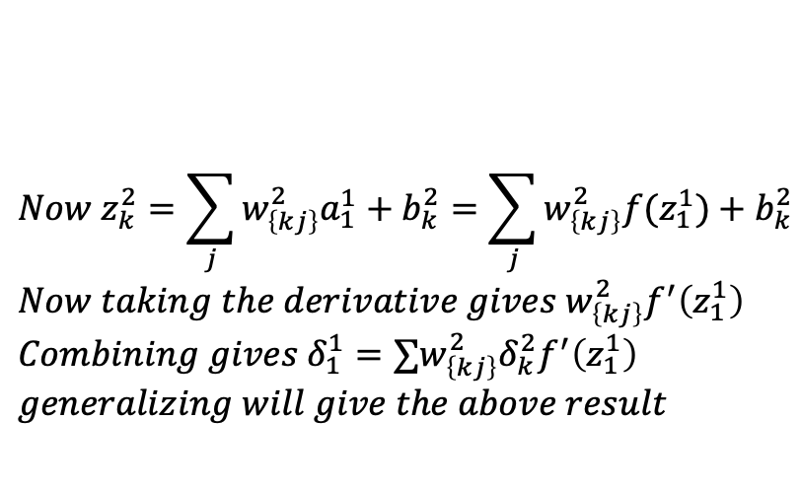
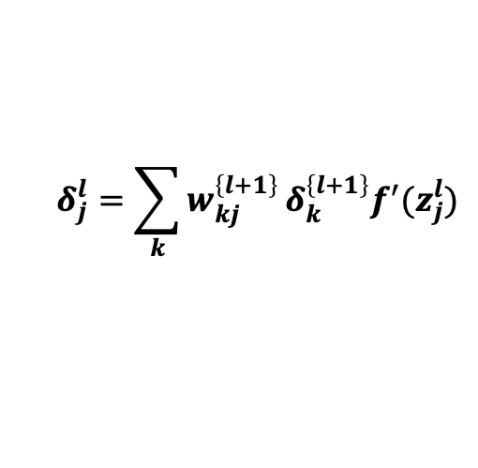
Backpropagation Vector Form (Derivation)
$$δ_{j}^{l}=\sum_{k}{w_{kj}^{\left\{l+1\right\}}}δ_{k}^{\left\{l+1\right\}}f^{′}(z_{j}^{l})$$
$$δ_{1}^{1}=\frac{∂C}{∂z_{1}^{1}}=\sum_{k}^{4}{\frac{∂z_{k}^{2}}{∂z_{1}^{1}}δ_{k}^{2}}$$
$$Now z_{k}^{2}=\sum_{j}{w_{\left\{kj\right\}}^{2}a_{1}^{1}}+b_{k}^{2}=\sum_{j}{w_{\left\{kj\right\}}^{2}f(z_{1}^{1})}+b_{k}^{2} \\ Now taking the derivative gives w_{\left\{kj\right\}}^{2}f^{′}\left(z_{1}^{1}\right) \\ Combining gives δ_{1}^{1}=∑w_{\left\{kj\right\}}^{2}δ_{k}^{2}f^{′}\left(z_{1}^{1}\right) \\ generalizing will give the above result$$

Slide 40
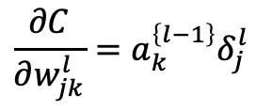
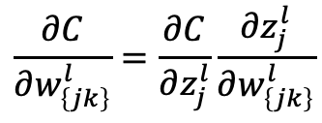
Backpropagation Vector Form (Derivation)
$$\frac{∂C}{∂w_{jk}^{l}}=a_{k}^{\left\{l−1\right\}}δ_{j}^{l}$$
$$\frac{∂C}{∂w_{\left\{jk\right\}}^{l}}=\frac{∂C}{∂z_{j}^{l}}\frac{∂z_{j}^{l}}{∂w_{\left\{jk\right\}}^{l}}$$

Slide 41
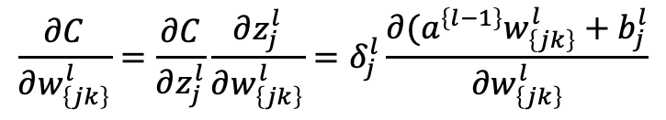
Backpropagation Vector Form (Derivation)
$$\frac{∂C}{∂w_{jk}^{l}}=a_{k}^{\left\{l−1\right\}}δ_{j}^{l}$$
$$\frac{∂C}{∂w_{\left\{jk\right\}}^{l}}=\frac{∂C}{∂z_{j}^{l}}\frac{∂z_{j}^{l}}{∂w_{\left\{jk\right\}}^{l}}=δ_{j}^{l}\frac{∂(a^{\left\{l−1\right\}}w_{\left\{jk\right\}}^{l}+b_{j}^{l}}{∂w_{\left\{jk\right\}}^{l}}$$

Slide 42
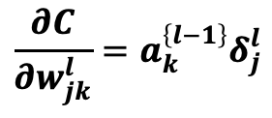
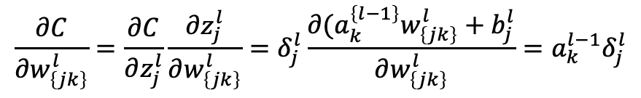
Backpropagation Vector Form (Derivation)
$$\frac{∂C}{∂w_{jk}^{l}}=a_{k}^{\left\{l−1\right\}}δ_{j}^{l}$$
$$\frac{∂C}{∂w_{\left\{jk\right\}}^{l}}=\frac{∂C}{∂z_{j}^{l}}\frac{∂z_{j}^{l}}{∂w_{\left\{jk\right\}}^{l}}=δ_{j}^{l}\frac{∂(a_{k}^{\left\{l−1\right\}}w_{\left\{jk\right\}}^{l}+b_{j}^{l}}{∂w_{\left\{jk\right\}}^{l}}=a_{k}^{l−1}δ_{j}^{l}$$

