Slide 1
Analytics Methodology and Problem Statement
Gunnvant Singh

Slide 2
ANALYTICS METHODOLOGY
A general framework for data mining and analytics
Steps in the analytics methodology
Problem Identification
Solution Design
Solution Implementation
Solution Monitoring
Best Practices in Analytics

Slide 3
ANALYTICS METHODOLOGY
A general framework for data mining and analytics
Analytics and data mining projects are implemented across a wide range of industries and problems
Different techniques and business constraints require many different solutions
But just like project management, there are some well defined stages of an analytics project – an understanding of which will help us plan and allocate resources for successful on-time completion

Slide 4
Analytics Methodology
Problem Definition
Solution Design
Solution Implementation
Solution Monitoring
Notes:
Typical methodologies implemented for analytical problem solving will include a problem definition stage, a “best” solution identification stage, a solution development and implementation phase, followed ideally by a solution monitoring phase. Most analysts tend to jump to Phase 3 with very cursory reviews of objectives and solution identification stages, leading to ineffective solutioning and significant loss of time and effort in the later stages of the project. Phase 4, which is solution monitoring is also a critical phase that is not given its due importance once an initial solution is implemented. The solution is only as good as the data on which it has been built, and if there are fundamental changes to data attributes, quality or other external factors impacting data, then the solution may not be an effective solution anymore and in fact may be creating more harm than good.
To that extent, project management in analytics is similar to any other project management, but built on data being a key driver of decisions around solutioning and implementation

Slide 5
Analytics Methodology
Problem Definition
Attack the “right” problem
Define problem specifics
Solution Design
Available data will sometimes drive solutions
Complex analytical models not always best solutions
Solution Implementation
Majority of time spent here
Iterative process
Assess effectiveness over time
Ongoing
Solution Monitoring
Notes:
Typical methodologies implemented for analytical problem solving will include a problem definition stage, a “best” solution identification stage, a solution development and implementation phase, followed ideally by a solution monitoring phase. Most analysts tend to jump to Phase 3 with very cursory reviews of objectives and solution identification stages, leading to ineffective solutioning and significant loss of time and effort in the later stages of the project. Phase 4, which is solution monitoring is also a critical phase that is not given its due importance once an initial solution is implemented. The solution is only as good as the data on which it has been built, and if there are fundamental changes to data attributes, quality or other external factors impacting data, then the solution may not be an effective solution anymore and in fact may be creating more harm than good.
To that extent, project management in analytics is similar to any other project management, but built on data being a key driver of decisions around solutioning and implementation

Slide 6
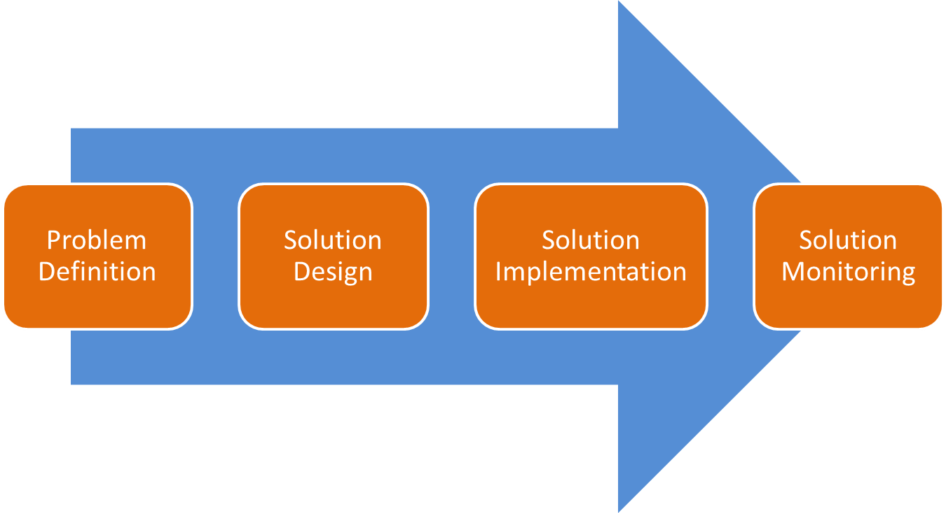
ANALYTICS METHODOLOGY
Problem Identification
How do I identify my most valuable customers?
How do I identify the best promotional tactic for my products?
How do I ensure that I minimize losses from product not being available on shelf?
How do I optimize inventory?
How do I detect customers that are likely to default on bill payment?
How can I increase my revenues by making customers buy more of my products?

Slide 7
Problem Definition
Problem Definition
It is critical to frame problem accurately and realistically
Here’s a “problem” statement
“We want to accept credit card applications only from good customers”
Problems with the “Problem” statement ?
Notes:
What other issues can you think of? Other examples of problem statements include misspecified issues, incomplete statements

Slide 8
Problem Definition
“We want to accept credit card applications only from good customers”
Problems with the “Problem” statement ?
What/Who are “good” customers?
How can one control applications to be “only good”?
Is it realistic to assume that one can build a static algorithm that will never allow acceptance from a customer with a “bad” record?
Notes:
What other issues can you think of? Other examples of problem statements include misspecified issues, incomplete statements

Slide 9
Problem Definition
“We want to accept credit card applications only from good customers”
Problems with the “Problem” statement ?
What/Who are “good” customers?
How can one control applications to be “only good”?
Is it realistic to assume that one can build a static algorithm that will never allow acceptance from a customer with a “bad” record?
Notes:
What other issues can you think of? Other examples of problem statements include misspecified issues, incomplete statements

Slide 10
Problem Definition – Contd.
How could this problem statement be modified to allow useful analytic solution development?
Example: Use SMART technique:
Specific
Measurable
Attainable
Realistic
Timely
Understand the business context thoroughly to ensure you are tackling the right problem
Notes:
1. Reduce losses from credit card default by at least 30% in the first 12 months post implementation of new strategy
2. Develop an algorithm to screen applications that do not meet “good customer” defined criteria that will reduce defaults by 20% in the next 3 months.
3. Identify strategies to reduce defaults by 20% in the next three months by allowing at risk customers additional payment options
Understanding the business context is key to problem definition and solution in any field, and also true for analytics. NEED EXAMPLE

Slide 11
Problem definition: RISK
1. Reduce losses from credit card default by at least 30% in the first 12 months post implementation of new strategy
2. Develop an algorithm to screen applications that do not meet “good customer” defined criteria that will reduce defaults by 20% in the next 3 months.
3. Identify strategies to reduce defaults by 20% in the next three months by allowing at risk customers additional payment options

Slide 12
Problem definition: REVENUE
1. Identify customer segments that generate higher average spend and create a direct marketing campaign to target them in order to increase avg spend by 15% in the next year
2. Create screening criteria for identify attractive customers to offer rewards for sign up, to increase avg spend on portofio by 15% in the next 6 months

Slide 13
ANALYTICS METHODOLOGY
The “best” solution based on theory may not be the “best” solution in practice
Lack of good data or specific variables
Solution implementation constraints
Other business constraints
Need to understand how solution will be implemented to finalize best solution

Slide 14
Solution design
Solution Design
There could be multiple ways of approaching a problem, and not all analytical based
Is an analytics solution always the best approach?
In general, if you want to use data to drive decisions, you need to first make sure that you have the right data
For example, you want to predict the potential trial rate of an ultra-luxury brand that you want to launch, but you have so far launched brands that are more value conscious – no data for an analytical approach
You could try to obtain data on competitor launches or run some qualitative research in this case, but it is not a good idea to develop a trial % based on a different segment of population

Slide 15
Solution design
Sometimes, solution design depends on end use:
Reporting for insights : Use historical data to understand performance and identify patterns in data and use as basis for future planning
Forecasting: Use past data collected over time for actual forecasts of future performance
Predictive Analytics: Similar to forecasting, but not just time related
Optimization: Develop strategies to derive optimal use of resources given constraints
Notes:
Reporting: simple charts and pivots to more advanced techniques like Regression, Clustering, Segmentation etc
Forecasting: Time Series forecasts
Predictive Analytics: Advanced regression techniques, Machine Learning Techniques
Optimization: Simulation techniques etc

Slide 16
ANALYTICS METHODOLOGY
Solution Implementation
Typically is the longest phase
Starts with data collection
Data Preparation and Exploratory Data Analysis will typically form a significant part of total project effort and time
Initial modeling results and calibration
Finalization of models post calibrations
Interpretation and framing of results in business context

Slide 17
Solution Implementation
Once the best solution approach has been identified, the actual solution building and implementation phase will start
This phase includes all the data exploration and preparation phases, the analytical techniques application, and the final implementation of the derived solution
This phase typically accounts for anywhere between 60 – 80% of total project time
Notes:
When creating an analytics project plan, remember that the iterative nature of the solution implementation phase will imply that a majority of time will be spent in this stage.

Slide 18
Solution Implementation
Typical Steps within Solution Implementation
Data Exploration
Data Preparation
Data Partitioning
Model Building – Test Data Set
Initial Model
Model Iterations and Tweaking
Final Model
Validation Model
More Iterations If required based on Validation Model Results
Interpretation of results into business friendly context
Solution implementation

Slide 19
ANALYTICS METHODOLOGY
Solution Monitoring
Very important phase that is sometimes ignored
Once solution is implemented, need to ensure that original assumptions/constraints still hold
Constant monitoring of solution to ensure changes are accurately captured and assessed
Solutions age – need to track reliability over time

Slide 20
Solution Monitoring
Solution monitoring is required to ensure that solution supplied is continuously providing expected results
For example, if we have devised a model to predict probability of default, if the characteristics of the underlying applicant pool changes or there are other external factors affecting population behavior, you will need to modify the solution or potentially come up with a new one
Notes:
US Mortgage example

Slide 21
Analytics Best Practices
Models should be as simple as possible
Model results and recommendations need to be actionable
Models need to be rigorously validated on multiple sample sets if possible
The most critical three things to remember:
Business Knowledge, Business Knowledge, Business Knowledge
Notes:
By Point 1, we do not mean that analytical techniques used should be simple, but that it is better to have as simple a model as possible in terms of number of variables and actionability. For example, let’s say you are building a forecasting model. If you final model has 30 variables, remember that if any of the 30 variables changes in terms of underlying patterns, your model will not be optimal. It is better to be parsimonious in your modeling
Supposing you are running a promotion effectiveness model, and you find that advertising on TV is not as effective as say newspaper ads. You cannot recommend that the brand switch of TV ad entirely and focus on newspaper ads only.
Typically, your model is best for the sample you are working on. If you run the model on a different sample from the same population and it derives very different results, you do not have a useful model

Slide 22
Case Study: Auto Insurance
Business Problem: Auto insurance company wants to improve profitability by moving from a flat insurance rate to risk-based pricing
How will results be used: Differentiated risk profiles to be created based on the automobile’s characteristics. Differential pricing chart to be created and used based on the risk profile
How will results be implemented: Final output in form of a table that can be referenced by insurance agents
Notes:
An auto insurance company wants to move to a risk-based pricing. The company has data on over 100000 cars for the length of their tenure. The company wants to use this to come up with a pricing structure that is aligned to the accident risk of the automobile.
The final results need to be in the form of a simple table or series of tables that can be referenced by insurance agents when they sell the product.

Slide 23
Case Study: Auto Insurance
Policy Dataccc
Policy Num | Car model | Year | Displacement | City | Policy Start Date | Policy End Date | IDV | Premium
1 | Honda City | 2004 | 2000 cc | Bangalore | 20/1/2010 | 19/1/2011 | 400000 | 4000
2 | Ford Ikon | 2005 | 1300 cc | Delhi | 12/3/2010 | 11/3/2011 | 240000 | 2800
Claim Data
Claim Num | Loss Date | Claim Status | Policy Num | Car model | Year | Total Claim Amount
1 | 16/5/2010 | Closed | 1 | Honda City | 2004 | 2345
2 | 11/9/2010 | Closed | 1 | Honda City | 2004 | 3245
3 | 12/10/2010 | Pending | 2 | Ford Ikon | 2005 | 1250
Notes:
In India, the insurance is for the automobile not the driver, hence driver information is not available.
However the company has these 2 sets of information available to it.
The first set of data is at the policy level. It contains automobile characteristics for every insurance policy.
Policy num is the unique id for every policy
Model, year and engine size of car
City where car is registered
Start and end dates for the policy
IDV = Insured’s declared value. This is what the car is insured for. The value goes down as the car gets older.
Premium = current premium is a fixed % of the IDV. It can go up and down depending on # of claims made in the prior years
Claims data
Claim num – unique id for every claim. Multiple claims can be filed on the same policy.
Loss date – date of accident
Claim status – whether paid off or still pending
Total claim amount – Total amount that is claimed by the insured

Slide 24
Case Study: Auto Insurance
What needs to be done?
What will be the target variable?
What will be the predictor variables?
Which analytic technique will be used?
Notes:
How ill you convert this business problem into an analytic problem. To be converted into an analytic problem, you need a target variable. What will be the target variable here?
TV = Total claim amount as a % of IDV
Continuous target variable
Predictor variables – model, year, displacement, city
Analytic technique – regression or decision trees to come up with a simple table. DT most appropriate.

Slide 25
Case Study: Auto Insurance
What needs to be done?
What will be the target variable?
What will be the predictor variables?
Which analytic technique will be used?
Problem Definition
Solution Identification
Notes:
How ill you convert this business problem into an analytic problem. To be converted into an analytic problem, you need a target variable. What will be the target variable here?
TV = Total claim amount as a % of IDV
Continuous target variable
Predictor variables – model, year, displacement, city
Analytic technique – regression or decision trees to come up with a simple table. DT most appropriate.

Slide 26
Case Study: Auto Insurance
What needs to be done?
Assess “Risk” of the car
Which variable captures risk?
Premium?
IDV?
Claims?
Number of claims?
Total claims?
Notes:
How ill you convert this business problem into an analytic problem. To be converted into an analytic problem, you need a target variable. What will be the target variable here?
TV = Total claim amount as a % of IDV
Continuous target variable
Predictor variables – model, year, displacement, city
Analytic technique – regression or decision trees to come up with a simple table. DT most appropriate.

Slide 27
Case Study: Auto Insurance
What needs to be done?
Once we have risk, what next?
Relate risk to attributes
Risk = f(car age, engine size, city of registration etc)
Problem Definition: Capture risk of a car based on car attributes in order to calculate premium that will maximize profit
Notes:
How ill you convert this business problem into an analytic problem. To be converted into an analytic problem, you need a target variable. What will be the target variable here?
TV = Total claim amount as a % of IDV
Continuous target variable
Predictor variables – model, year, displacement, city
Analytic technique – regression or decision trees to come up with a simple table. DT most appropriate.

Slide 28
Case Study: Auto Insurance
What needs to be done?
What will be the target variable?
Is it just claims?
Target will be: Claims / IDV
Notes:
How ill you convert this business problem into an analytic problem. To be converted into an analytic problem, you need a target variable. What will be the target variable here?
TV = Total claim amount as a % of IDV
Continuous target variable
Predictor variables – model, year, displacement, city
Analytic technique – regression or decision trees to come up with a simple table. DT most appropriate.

Slide 29
Case Study: Auto Insurance
What needs to be done?
What will be the target variable?
What will be the predictor variables?
Attributes available
Age
Engine Size
City
Manufacturer
Model
Notes:
How ill you convert this business problem into an analytic problem. To be converted into an analytic problem, you need a target variable. What will be the target variable here?
TV = Total claim amount as a % of IDV
Continuous target variable
Predictor variables – model, year, displacement, city
Analytic technique – regression or decision trees to come up with a simple table. DT most appropriate.

Slide 30
Case Study: Auto Insurance
What needs to be done?
What will be the target variable?
What will be the predictor variables?
Which analytic technique will be used?
Regression
Decision Trees
Notes:
How ill you convert this business problem into an analytic problem. To be converted into an analytic problem, you need a target variable. What will be the target variable here?
TV = Total claim amount as a % of IDV
Continuous target variable
Predictor variables – model, year, displacement, city
Analytic technique – regression or decision trees to come up with a simple table. DT most appropriate.

Slide 31
Case Study: Credit Card churn
Business Problem: A credit card company wants to predict customer churn so the likely attriters can be made an offer to stay on
What data will you need?
How do you define attrition?
Only customers who have called in to cancel their credit cards
Customers who have cancelled card or not used it in the last 3 months
Customers who have not used their card in the last 6 months
Notes:
This is a case study of a credit card company which wants to predict attrition. So the problem seems to be straight forward here. Build a model to predict customer attrition.
However there are some added complexities. How do you define people who have attrited? Are they Only customers who have called in to cancel their credit cards or are they
Customers who have cancelled card or not used it in the last 3 months or even
Customers who have not used their card in the last 6 months
It is very important for the analyst and the business teams to be in sync on the definition of the target variable. Otherwise, however good the model, it will be predicting something other than what the business needs.

Slide 32
Case Study: Credit Card churn
Business Problem: A credit card company wants to predict customer churn so the likely attriters can be made an offer to stay on.
Is all attrition equal?
Notes:
This is a case study of a credit card company which wants to predict attrition. So the problem seems to be straight forward here. Build a model to predict customer attrition.
However there are some added complexities. How do you define people who have attrited? Are they Only customers who have called in to cancel their credit cards or are they
Customers who have cancelled card or not used it in the last 3 months or even
Customers who have not used their card in the last 6 months
It is very important for the analyst and the business teams to be in sync on the definition of the target variable. Otherwise, however good the model, it will be predicting something other than what the business needs.

Slide 33
ML in Action

Slide 34
ML in Action
Types of Data
Structured
Unstructured
Essentially tabular data
Data about patient history
Data from mobile apps
IoT sensor data
Essentially signal data
X ray images, CT Scans etc
Medical reports in free flowing text form

Slide 35
ML in Action
Data : Structured
Data on patient history can be used to build systems that can predict the risk of a particular disease

Slide 36
ML in Action
Data : Structured
Data from sensors on machines can be used to predict when machines will fail.

Slide 37
ML in Action
Predictors

Slide 38
ML in Action
Target

Slide 39
ML in Action
Define what the solution should do
How will you collect the data for each of the two scenarios?
It should ideally be able to tell you that some time in future the machine will fail or the some one will get diabetes
Will you collect the measurements of your predictors at the same time instance as you collect the measurements for the target variable?

Slide 40
ML in Action
Data : Structured
Linear Models
Tree based Models

Slide 41
ML in Action
$$\frac{\log\left(p\right) }{log⁡(1−p)}=β_{0}+β_{1}Pregnancies+β_{2}Glucose+…+β_{8}Age$$

Slide 42
ML in Action
$$\frac{\log\left(p\right) }{log⁡(1−p)}=β_{0}+β_{1}Pregnancies+β_{2}Glucose+…+β_{8}Age$$
$$\frac{\log\left(p\right) }{log⁡(1−p)}=−8.40+0.12∗Pregnancies+0.035∗Glucose+…+0.014Age$$

Slide 43
ML in Action
$$\frac{\log\left(p\right) }{log⁡(1−p)}=β_{0}+β_{1}Pregnancies+β_{2}Glucose+…+β_{8}Age$$
$$\frac{\log\left(p\right) }{log⁡(1−p)}=−8.40+0.12∗Pregnancies+0.035∗Glucose+…+0.014Age$$
$$\frac{\log\left(p\right) }{log⁡(1−p)}=−8.40+0.12∗6+0.035∗148+…+0.014∗50$$

Slide 44
ML in Action
$$\frac{\log\left(p\right) }{log⁡(1−p)}=β_{0}+β_{1}Pregnancies+β_{2}Glucose+…+β_{8}Age$$
$$\frac{\log\left(p\right) }{log⁡(1−p)}=−8.40+0.12∗Pregnancies+0.035∗Glucose+…+0.014Age$$
$$\frac{\log\left(p\right) }{log⁡(1−p)}=−8.40+0.12∗6+0.035∗148+…+0.014∗50$$
$p=0.72$, 72% chance that someone with vital stats as highlighted above will have diabetes 3 months from now

Slide 45
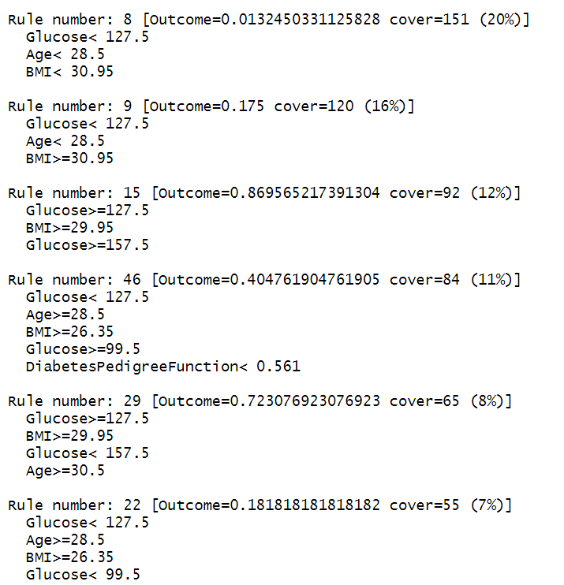
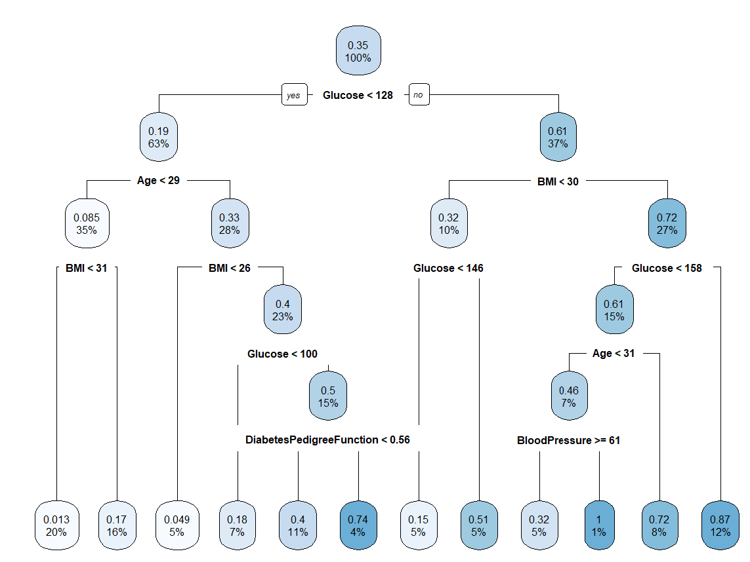
ML in Action

Slide 46
ML in Action
How will you deploy?
$$\frac{\log\left(p\right) }{log⁡(1−p)}=−8.40+0.12∗Pregnancies+0.035∗Glucose+…+0.014Age$$

Slide 47
ML in Action
if glucose < 128:
if bmi < 130:
if age<32:
return 0.16
Trees can be deployed as nested if-else blocks
Linear models can be deployed as expressions
$$\frac{\log\left(p\right) }{log⁡(1−p)}=−8.40+0.12∗Pregnancies+0.035∗Glucose+…+0.014Age$$

Slide 48
ML in Action
Data : Unstructured
Image Classification
X Ray images
CT Scans
Images of blood smear
Health Insurance claims
Image Data
Object Detection
Text Data
Image Segmentation
Text Classification
Named Entity
Recognition

Slide 49
ML in Action
Image Data : Classification
In such scenarios what would be the labels and how would the data look like?
Detect Lung Infection through x-ray images
Detect cancerous tumours from X Ray images or CT Scans
Who will create these labels? Will data be easy to come for such projects?

Slide 50
ML in Action
X Ray image
Cancerous
Model
X Ray image
Not Cancerous
X Ray image
Cancerous/Non Cancerous ?
X Ray image
Cancerous
X Ray image
Not Cancerous
Neural Networks

Slide 51
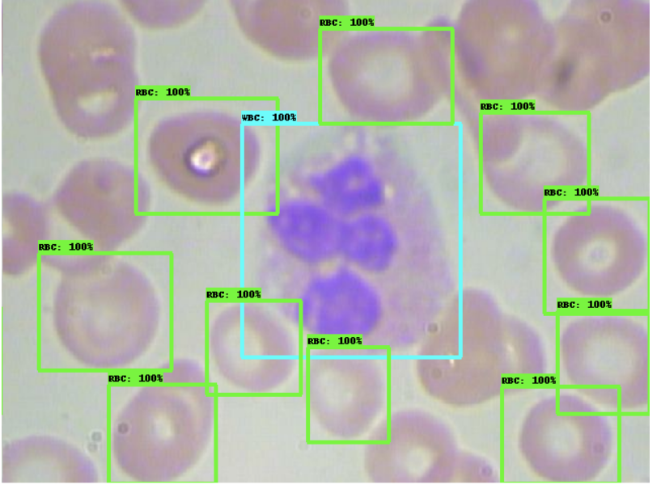
ML in Action
Image Data : Object Detection
In such scenarios what would be the labels and how would the data look like?
Count the RBC/WBC in a blood smear
Count the number of tumours
Count the number of cracks on road

Slide 52
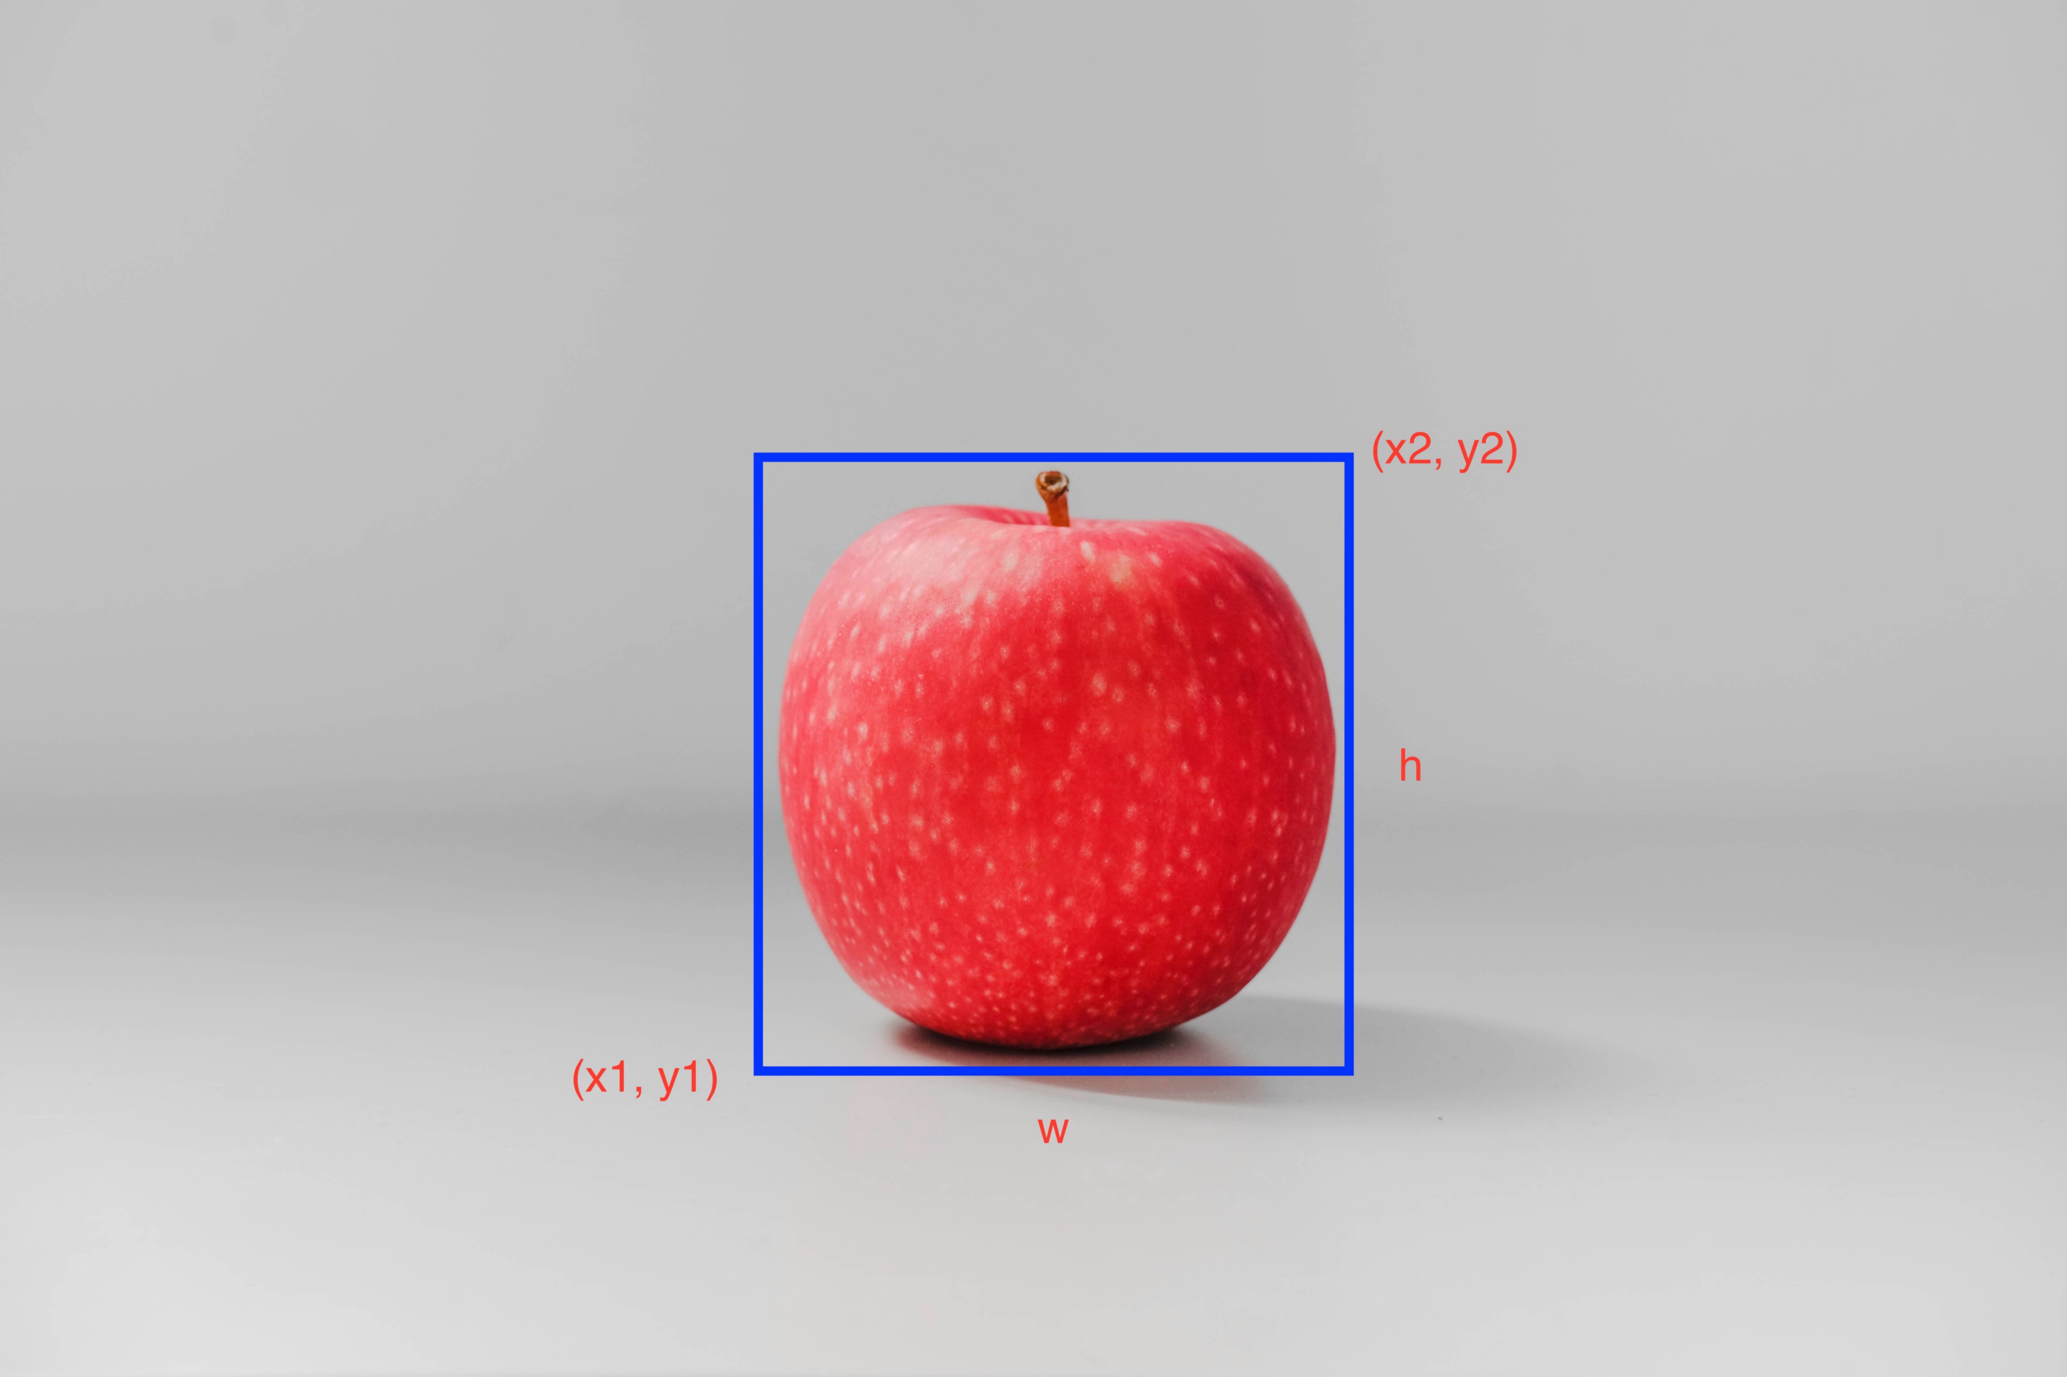
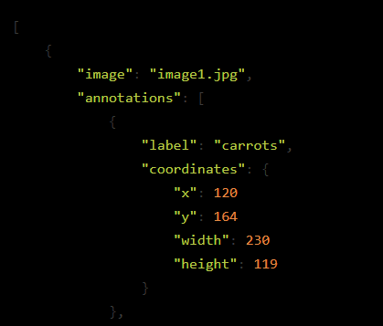
ML in Action

Slide 53
ML in Action
Object Detector
Image blood smear
Neural Network

Slide 54
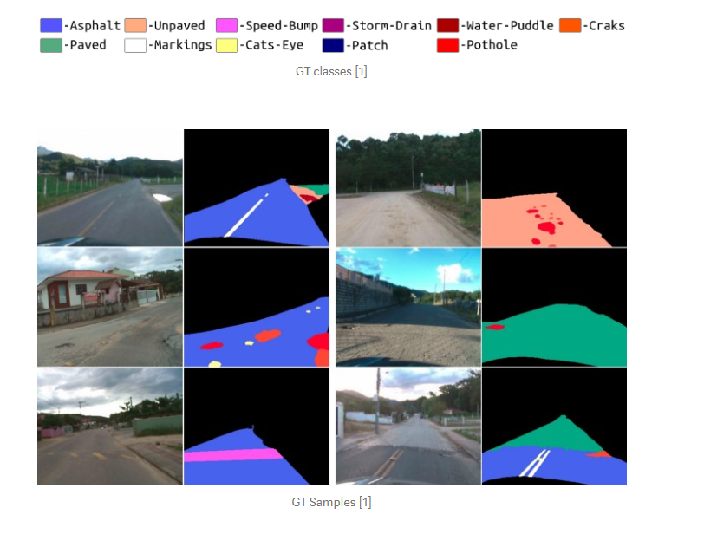
ML in Action
Image Data : Segmentation
Find the area under potholes on roads
Find the area of tumours

Slide 55
ML in Action
In such scenarios what would be the labels and how would the data look like?
Labelme demo

Slide 56
ML in Action
Segmentation Model
Image of road
Neural Network

Slide 57
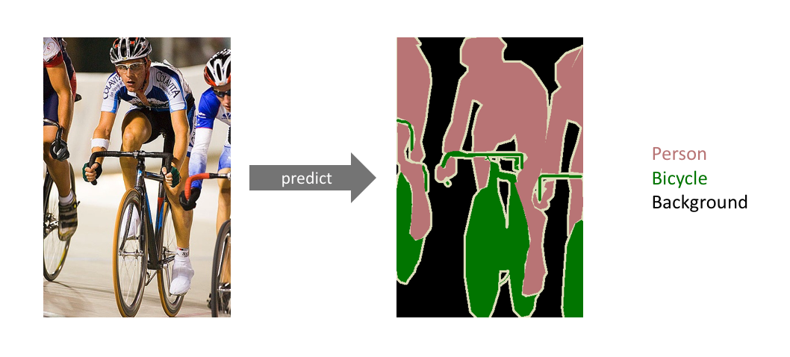
ML in Action

Slide 58
ML in Action
Text Data
Text Classification
Named Entity
Recognition
From medical history records, predict if health insurance should be given or not
From medical history records, extract the medications and diseases the applicant had

Slide 59
ML in Action
Text Data : Classification
In such scenarios what would be the labels and how would the data look like?
From medical records, predict if insurance should be given or not
Create a ticketing system that can assign tickets to relevant agents automatically

Slide 60
ML in Action
4 page long, medical record, Applicant 1
Insurance given
Text
Classifier
4 page long, medical record, Applicant New
4 page long, medical record, Applicant 2
Give Insurance/Not give?
Insurance given
4 page long, medical record, Applicant 3
Neural Network
Insurance not given

Slide 61
ML in Action
Text Data : Named Entity Recognition
From medical records, extract names of medications and diseases
From company memos, redact the names of important officials and places

Slide 62
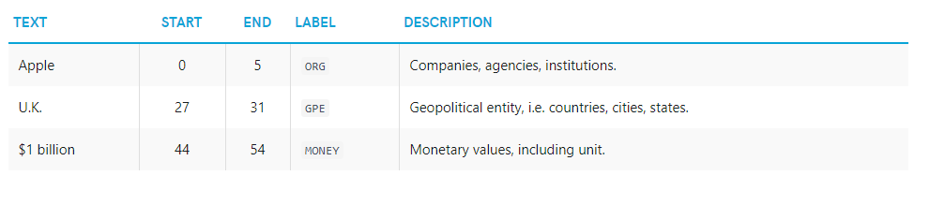
ML in Action
"Apple is looking at buying U.K. startup for $1 billion"
Notes:
BPO: Agent notes on call levels, audio and text notes.

Slide 63
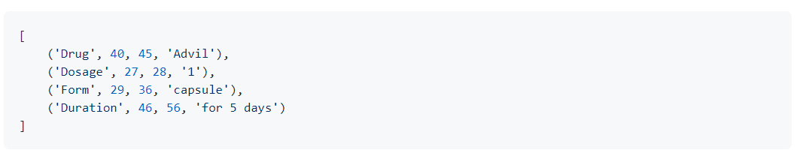
ML in Action

Slide 64
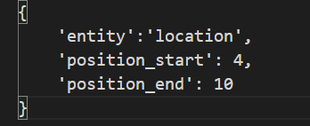
ML in Action
In such scenarios what would be the labels and how would the data look like?
This is a sentence talks about Mumbai and BJP.

Slide 65
ML in Action
How to deploy models that can do ML on images or text?
Is the user of ML algorithm ok to share data? Eg people may not be comfortable sharing medical information to third party.
Relatively difficult to deploy
You may need to do work with very low level system apis (eg Mobile: ARM support)
Yes
No
Relatively easy to deploy
Tensorflow/pytorch, to run predictions
Deploy as Web App
Deploy as mobile/desktop app

Slide 66
ML in Action
Despite the hype, ML is not an answer to all the problems
In fact, it can help in very limited number of use cases
When to use ML?
Mostly wherever automation is needed
Support desk ticket routing
Counting RBC/WBC
Finding cracks/potholes on highways

Slide 67
Creating Data Products
Despite the hype, ML is not an answer to all the problems
In fact, it can help in very limited number of use cases
When to use ML?
Mostly wherever automation is needed
&
Support desk ticket routing
Counting RBC/WBC
Finding cracks/potholes on highways

Slide 68
Creating Data Products
Despite the hype, ML is not an answer to all the problems
In fact, it can help in very limited number of use cases
When to use ML?
Mostly wherever automation is needed
&
You can live with some error
Support desk ticket routing
Counting RBC/WBC
Finding cracks/potholes on highways

Slide 69
Creating Data Products
Despite the hype, ML is not an answer to all the problems
In fact, it can help in very limited number of use cases
When to use ML?
Mostly wherever automation is needed
&
You can live with some error
&
Support desk ticket routing
Counting RBC/WBC
Finding cracks/potholes on highways

Slide 70
Creating Data Products
Despite the hype, ML is not an answer to all the problems
In fact, it can help in very limited number of use cases
When to use ML?
Mostly wherever automation is needed
&
You can live with some error
&
You have a labelled data
Support desk ticket routing
Counting RBC/WBC
Finding cracks/potholes on highways

Slide 71
Creating Data Products
Yes
Automation needed?
No
Some error OK?
Yes
No

Slide 72
Creating Data Products
Yes
ML Quadrant
Automation needed?
No
Some error OK?
Yes
No

Slide 73
Creating Data Products
Assessing impact of ML efforts:
How good is your ML solution vs Non ML manual approach?
Eg if your ML solution offers an accuracy of 80% what is the accuracy of Non ML manual approach, what is its cost?
Can you augment ML model with some human input?

Slide 74
Creating Data Products
Assessing impact of ML efforts:
Case Study:
“Suppose you are implementing an automatic ticketing system so that support tickets are allocated to relevant agents. You are proposing to use an ML solution, as you already have labelled data from your ticketing system, where you know historically which ticket was answered by which agent. You now want to deploy an ML solution, instead of a manual one. In your POC’s you have seen that your model is 82% accurate. What other questions will you ask in order find the viability of your ML solution?

