Slide 1
Video 2
Types of window functions

Slide 2
Types of Window Functions
Aggregate Functions
Ranking Functions
Lead/Lag

Slide 3
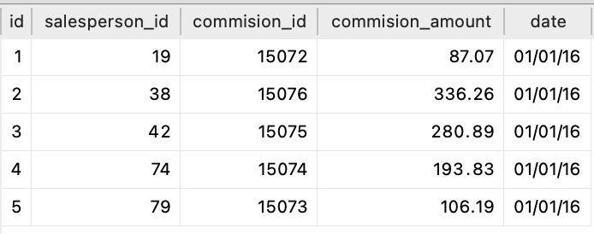
Aggregate Functions
Show daily commission for each agent along with total commission earned by each agent

Slide 4
Aggregate Functions
Show daily commission for each agent along with total commission earned by each agent
Partition by sales agent and find the sum() in each partition to get total, ordered by the date

Slide 5
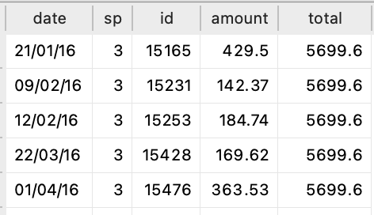
Aggregate Functions
Show daily commission for each agent along with total commission earned by each agent
Partition by sales agent and find the sum() in each partition to get total, ordered by the date

Slide 6
Aggregate Functions
Show daily commission for each agent along with total commission earned by each agent
Partition by sales agent and find the sum() in each partition to get total, ordered by the date
We can use min(), max(), avg() etc to compute aggregations in each window

Slide 7
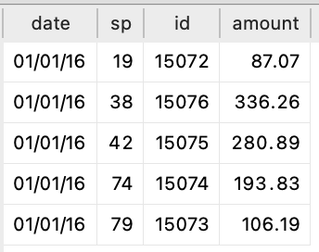
Aggregate Functions
Use aggregate functions when we want aggregations by each window along with individual values

Slide 8
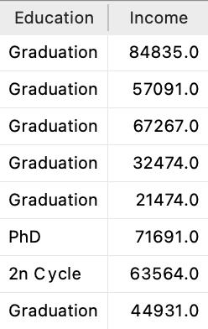
Ranking Functions

Slide 9
Ranking Functions
Sort/Sort Income for each level in Education column

Slide 10
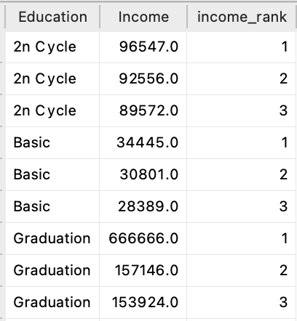
Ranking Functions
Sort/Sort Income for each level in Education column

Slide 11
Ranking Functions
Sort/Sort Income for each level in Education column

Slide 12
Ranking Functions
Sort/Sort Income for each level in Education column

Slide 13
Ranking Functions
Sort/Sort Income for each level in Education column

Slide 14
Ranking Functions
Sort/Sort Income for each level in Education column
There are several types of ranking functions based on how they break ties that are available.
Use ranking functions when we need to rank items in each group individually

Slide 15
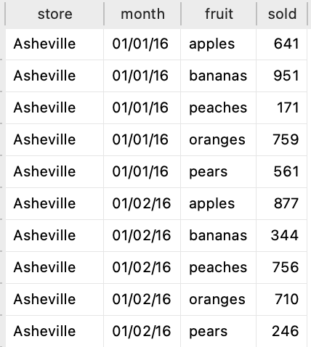
Lead/Lag

Slide 16
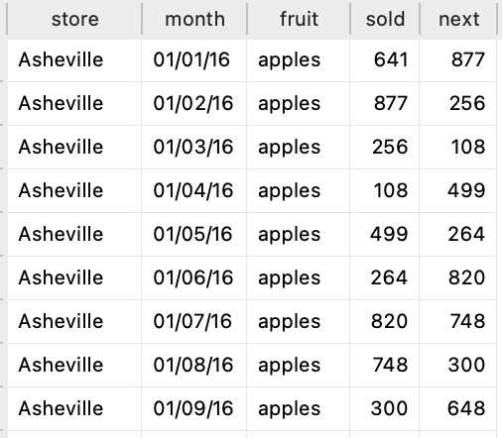
Lead/Lag
Lead() to find next value

Slide 17
Lead/Lag
Lead() to find next value

Slide 18
Lead/Lag
Lead() to find next value

Slide 19
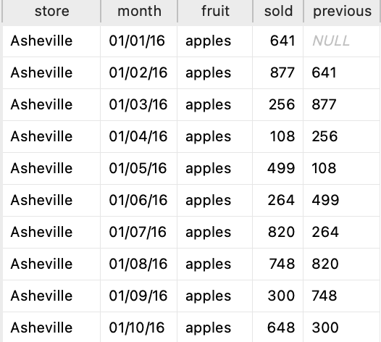
Lead/Lag
Lag() to find previous value

Slide 20
Lead/Lag
Lag() to find previous value

Slide 21
Lead/Lag
Lag() to find previous value

