Slide 1
Helping Predict Stocks
know nothing about stocks? predictive modeling here to help
Predictive modeling over 2yrs vs 1yr

Slide 2

Large well known companies stocks chosen:
Amazon AMZN
Apple AAPL
Tesla TSLA
Marriott MAR
Netflix NFLX
Microsoft MSFT

Slide 3
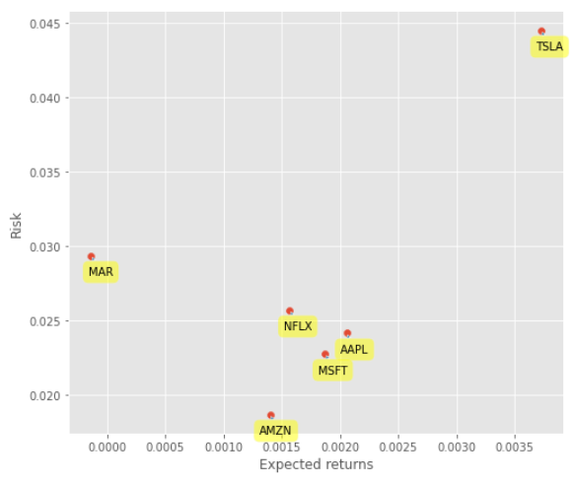
Risk VS Reward
based on last years stock history

Slide 4
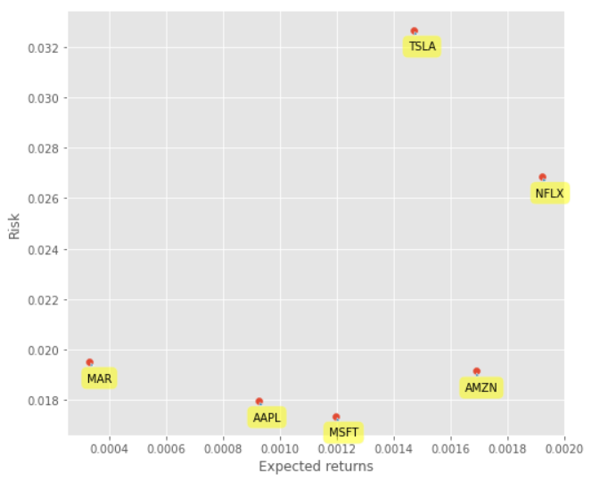
What difference does a year make?
Predictions based on last years performance
Predictions based on last 2 years performance

Slide 5
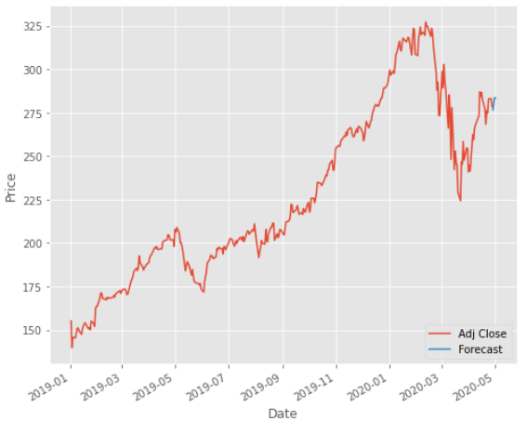
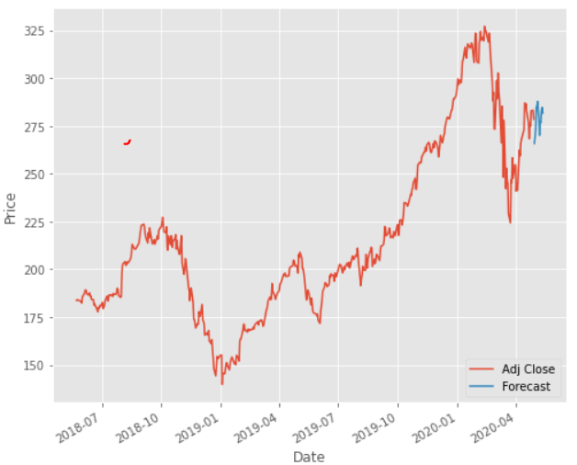
Apple predictions
(medium risk, medium reward)
Confidence level 0.95995…
Confidence level 0.95977…
1yr
2yr

Slide 6
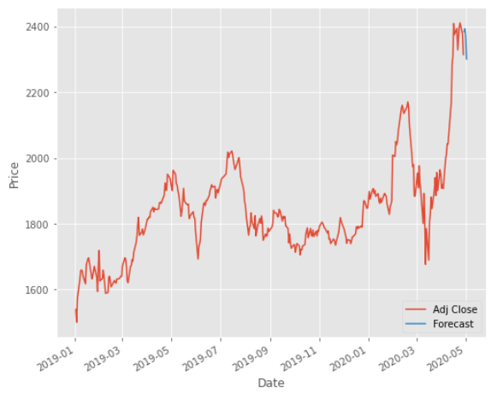
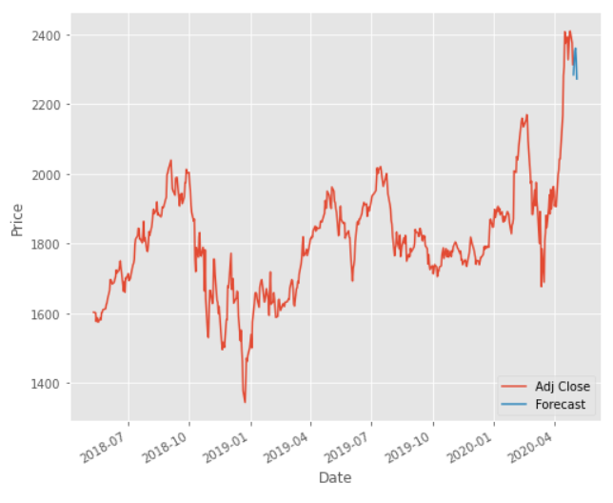
Amazon Predictions
(low risk, medium reward)
Confidence level 0.79797…
Confidence level 0.75681…
1yr
2yr

Slide 7
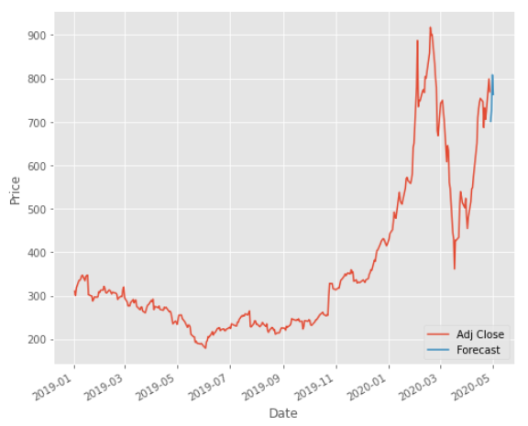
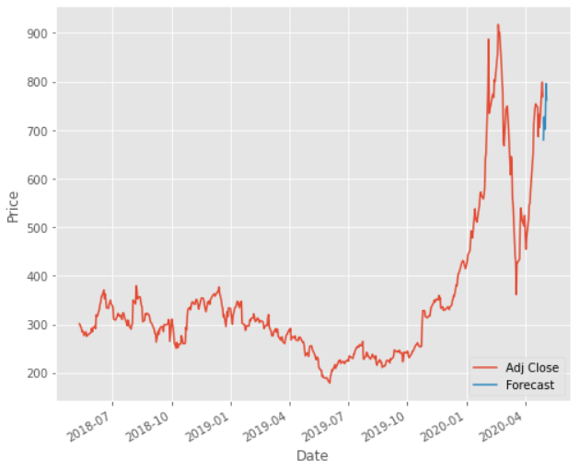
Tesla Predictions
(High risk, High reward)
Confidence level 0.90512…
Confidence level 0.8835…
1yr
2yr

Slide 8
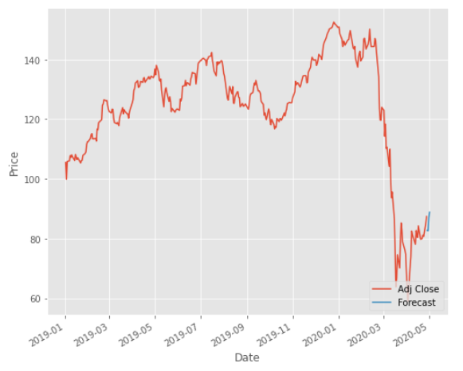
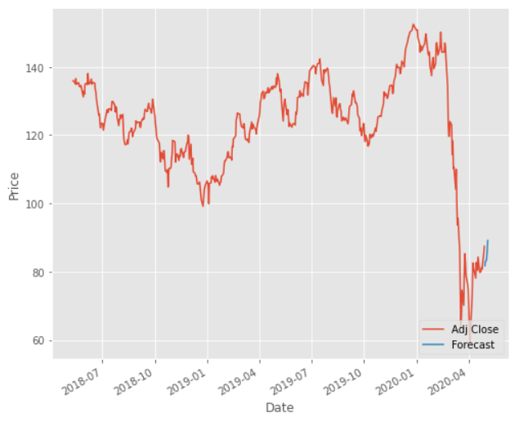
Marriott Predictions
(medium risk, medium reward)
Confidence level 0.85835…
Confidence level 0.77936…
1yr
2yr

Slide 9
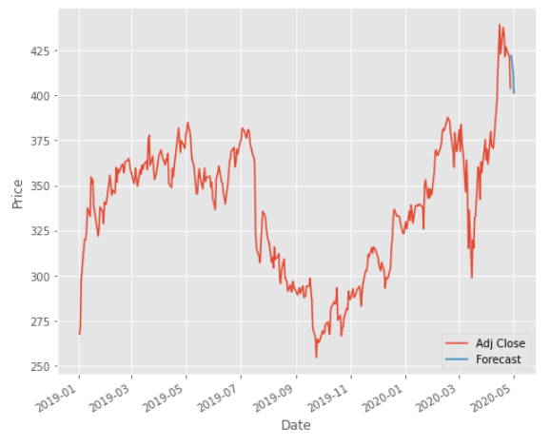
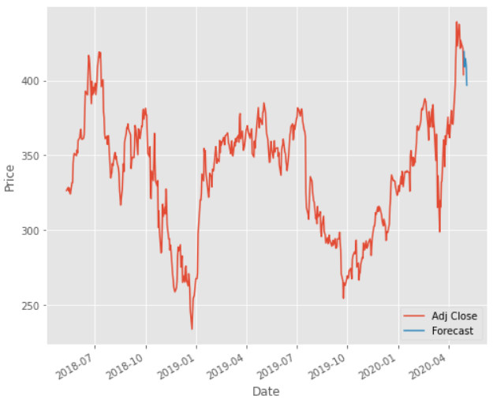
NETFLIX Predictions
(low risk, medium reward)
Confidence level 0.8378…
Confidence level 0.7100…
1yr
2yr

Slide 10
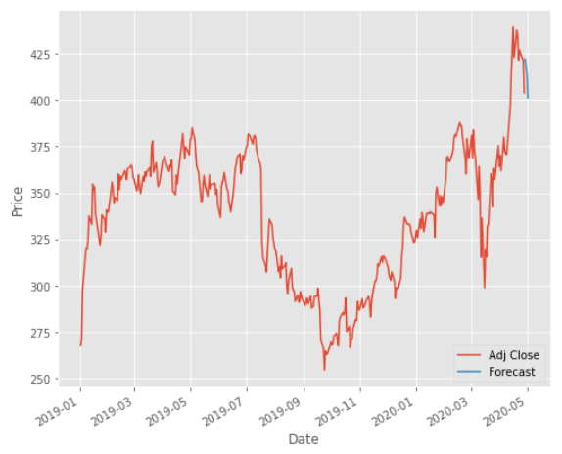
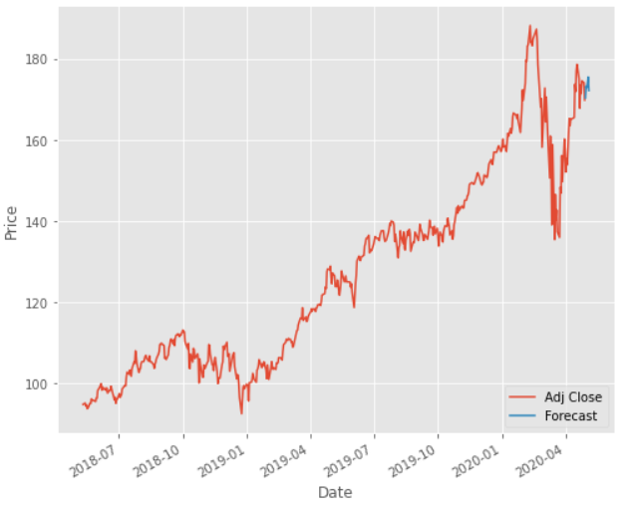
Microsoft
(medium risk, medium reward)
Confidence level 0.8378…
Confidence level 0.9566…
1yr
2yr

Slide 11
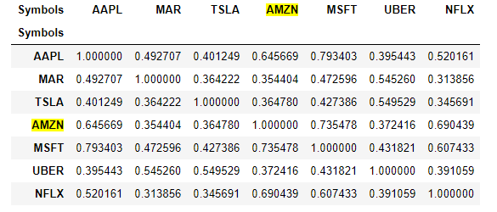
Correlation(s)

Slide 12
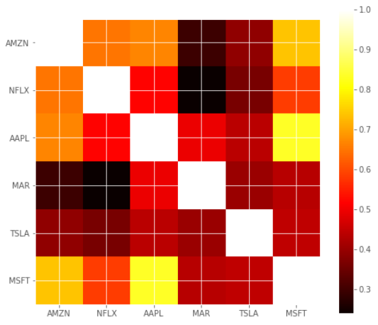
Correlations Visualized

Slide 13
Takeaways:
•Predictive modeling does provide insight into potential changes in the stock market
•Models alone are not enough to promise profitable stocks
•An educated gamble

Slide 14


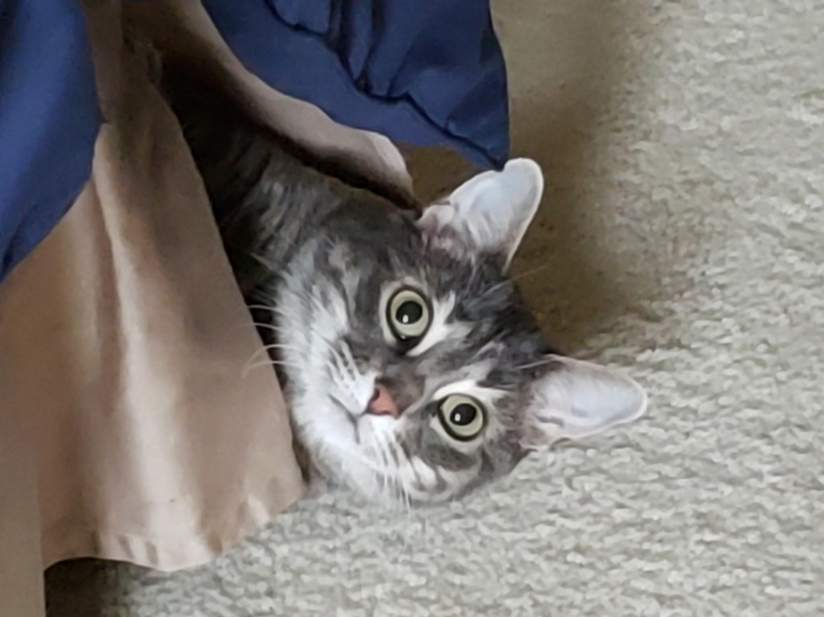
Ayo’s laura
Robert the Wolverine
Gus’s Annabelle

