Slide 1
Atari ST knowhow
This presentation is so borked that any change to it will make Impress crash unexpectedly
Workshop 3:
The impossible demo
music

Slide 2
The Atari ST
In previous talks we saw that the ST can't:
do 500 colors at once
play digital samples
have higher resolution than 320x200
move the whole screen contents
accomplish bitwise shifting of huge graphics
use playfields like the Amiga

Slide 3
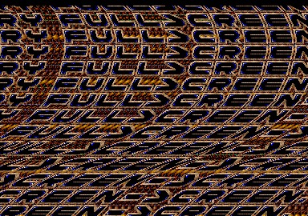
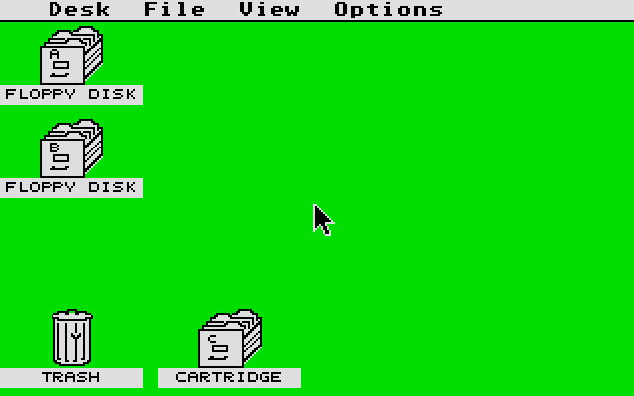
The Parallax Distorter
But of course we are going to show that all at once

Slide 4
Parallax?
Part of graphics move in the same direction than other graphics but at different speed
Gives an impression of depth
Often used in animated film
And of course in video games
Types
  Unidirectional (vertical or horizontal)
  Multi directional
Part of graphics move in the same direction than other graphics but at different speed
Gives an impression of depth
Often used in animated film
And of course in video games
Types
  Unidirectional (vertical or horizontal)
  Multi directional

Slide 5

Distorter, Scroller, Fullscreen?
See previous talk
Distorter:
A logo moving left and right
Add a wave = move each line individually
Quite slow
Preshifting is the key => 16 times the memory
Left right boders: what about background?
Masking with AND & OR

Slide 6

Distorter, Scroller, Fullscreen?
See previous talk
Scroller:
A
B
C
D
E
F
G
H
I
J
K
L
M
N
O
P
Q
R
S
T
U
V
W
X
Y
Z
THIS IS MY FIRST SCROLLTEXT
Read next text letter
Locate font data
Copy font data to buffer start
Copy buffer to screen
Shift buffer one position left
Wait vbl
text
font
T
T
TH
TH
THI
buffer
buffer
screen
T
TH
THI

Slide 7

Distorter, Scroller, Fullscreen?
See previous talk
Fullscreen:
Switch here to 60Hz
Shiraz didn't expect that...
If hpos=13 and freq=60 then enable H
If hpos=0 and freq=70
then enable H
line0
If line=34 && freq=60 then enable V
If line=59 && freq=50 then enable V
If hpos=14 and freq=50 then enable H
If hpos=93 and freq=60 then disable H
Switch here to 60Hz
You have to do this every line
=> holy grail of programming: synchron code
If hpos=94 and freq=50 then disable H
Got you!
line0
25 lines more
If line=234 && freq=60 then disable V
If line=259 && freq=50 then disable V
Switch here to 60Hz
70Hz 50Hz
60Hz 50Hz
43 lines more

Slide 8
Distorted scroller in fullscreen
Part of graphics move in the same direction than other graphics but at different speed
Gives an impression of depth
Often used in animated film
And of course in video games
Types
  Unidirectional (vertical or horizontal)
  Multi directional
You get the picture...
A
B
C
D
E
F
G
H
I
J
K
L
M
N
O
P
Q
R
S
T
U
V
W
X
Y
Z
Switch here to 60Hz
If hpos=13 and freq=60 then enable H
If hpos=0 and freq=70
then enable H
THIS IS MY FIRST SCROLLTEXT
line0
A logo moving left and right
Add a wave = move each line individually
Quite slow
Preshifting is the key => 16 times the memory
Left right boders: what about background?
Masking with AND & OR
If line=34 && freq=60 then enable V
If line=59 && freq=50 then enable V
If hpos=14 and freq=50 then enable H
If hpos=93 and freq=60 then disable H
text
Switch here to 60Hz
font
digisound
If hpos=94 and freq=50 then disable H
Got you!
T
line0
T
TH
TH
THI
25 lines more
If line=234 && freq=60 then disable V
If line=259 && freq=50 then disable V
buffer
buffer
Switch here to 60Hz
70Hz 50Hz
60Hz 50Hz
screen
43 lines more

Slide 9
Initial idea
Several demos had many scrollers moving in a wavy pattern
It was clear this is done
by moving the screen address

Slide 10

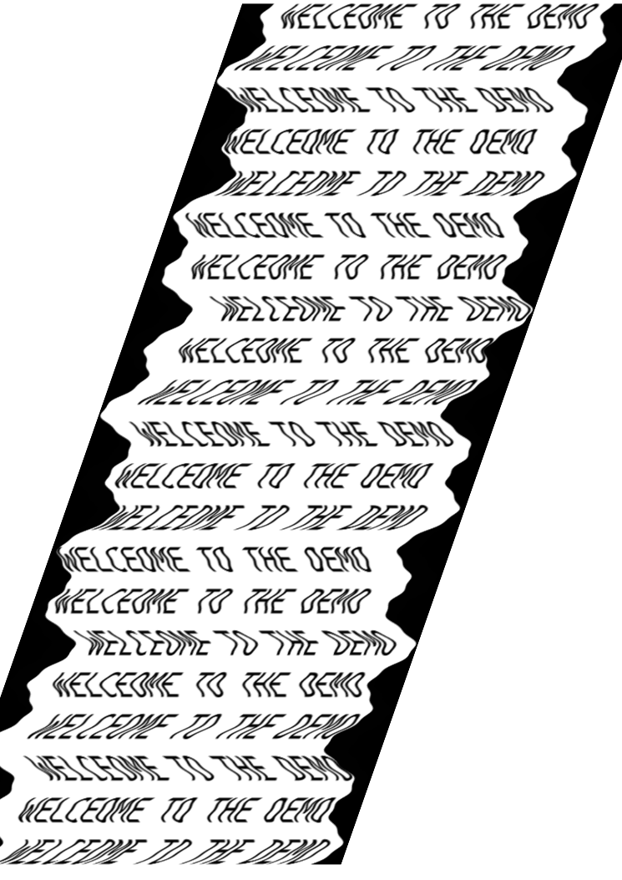
Initial idea
But you can move anything.
Y U NO made the scroll itself bend?
And a bigger font?
Would have a too fast distorter
unless... you use multiple screens...
4 screens => distorter ¼ speed
Needs one more screen for buffering

Slide 11
Screen 1
Distorter wave

Slide 12
Screen 2

Slide 13
Screen 3

Slide 14
Screen 4

Slide 15
Screen 5

Slide 16
Screen 1 Screen 5

Slide 17
Screen 1
Change screen address

Slide 18
Screen 1
Copy from screen 5

Slide 19
Screen organization
1
2
Copy routine. Copies ¼ scroll per VBL
Not much CPU needed
3
Scroll routine writes every VBL 1 full
Scroller at the bottom of each screen
4
5

Slide 20

playfield
The name playfield is a technical term used on the AMIGA to designate it's 2 independent hardware transparency screens
PLAYFIELD
As this ST method allows to simulate moving massive amount of data independently from other screen contents we called it like that
One of the first to use it was TCB in Cuddly, but did not use it to full effect. It got used to it's extreme in the Nostalgic-O-Demo megascroll.

Slide 21
playfield
colorcycling
Color lookup table
Screen with vertical bars

Slide 22
playfield
colorcycling
Color lookup table
Screen with repeated vertical bars

Slide 23
playfield
Different color palette in each scanline

Slide 24
playfield
Different color palette in each scanline
Different colors for each palette

Slide 25
combination
The vertical stripes are part of the font!
This means they are also distorted.

Slide 26
combination
The vertical stripes are part of the font!
This means they are also distorted.
To make the background straight, the
Color palettes need to be moved to the
Reverse of the distorter wave
+

Slide 27
combination
The vertical stripes are part of the font!
This means they are also distorted.
To make the background straight, the
Color palettes need to be moved to the
Reverse of the distorter wave
And why not add another wave?
+
+

Slide 28
Implementation
How much data?
The demo has to run in 512K
1 screen = 280x230 x5 buffers = 320K
Font: 32x32 pixels x 40 characters x 4 planes
= 20K (approximate)
Shift font 16x: 320k => too much!!!
=> we need to shift in real time

Slide 29
Implementation
Not enough CPU to shift 26 columns of 32 words.
What about preshifting scroll buffers
  It is easier to shift 1 character 16 times: addx
  Max scroll speed will be 16 pixel/VBL
1 buffer = 26x32 x4 planes = 6K
16 shifts: 106K
This fits barely in the RAM. Fill the rest with a digi sample

Slide 30
Implementation
Scroll buffers are as wide as screen
Not possible to do double length (no RAM)
Not possible to rotate the buffers 16 pixels (no CPU)
Solution: a copy routine which copies from one of the 26 possible positions, or 26 different precoded routines.
Buffer
Screen
E DECOME TO TH
COME TO THE DE
Routine number 4

Slide 31

Shifting
Wow, what?
  Font not shifted
  Bit distorter
CPU is slow, one should not do that!
While coding screen: not enough CPU to shift
=> reduce font size from 32 to 26 to 20 pixels
Then only ask graphics man to design font

Slide 32
Digisound
Reduced font gives a lot more RAM for sound
To increase sound length: compressed
Real time decompression
A special delta compression already used
in the Zoolook screen in ULM new year demo
What finally makes the screen stand out:
  the jumping scrollers are in sync with the sample

Slide 33
ressources
Git repository with 41 revisions
  Explanatory checkin comments
  All revisions assemble and show state of progress
  Try to change some vars and code!
PDF with scan of original paper notes
Finished screen in: Dark Side of the Spoon

