Slide 1
REST API & Implementing it in CodeIgniter

Slide 2




Who Am I
PHP Developer & Consultant
Reviewed “Testing with Qunit”
Helped to bring out thesis on “Business Prospective of cloud computing”
Founder of Website “WebGunny.com”
RIP Jun 2010 - Dec 2011
Notes:
I am a PHP Developer & Consultant
Have reviewed “Testing with Quinit”
Helped to bring out thesis on Business Prospective of cloud computing
Founder of webgunny.com – A iGaming portal whose revenue is based on advertisement. However, I shutdown that site after 1.8 years of operation

Slide 3
In this talk...
Why REST API is a heart of every product
REST API – As developer UI
Best Practices of REST API
REST API in codeigniter

Slide 4
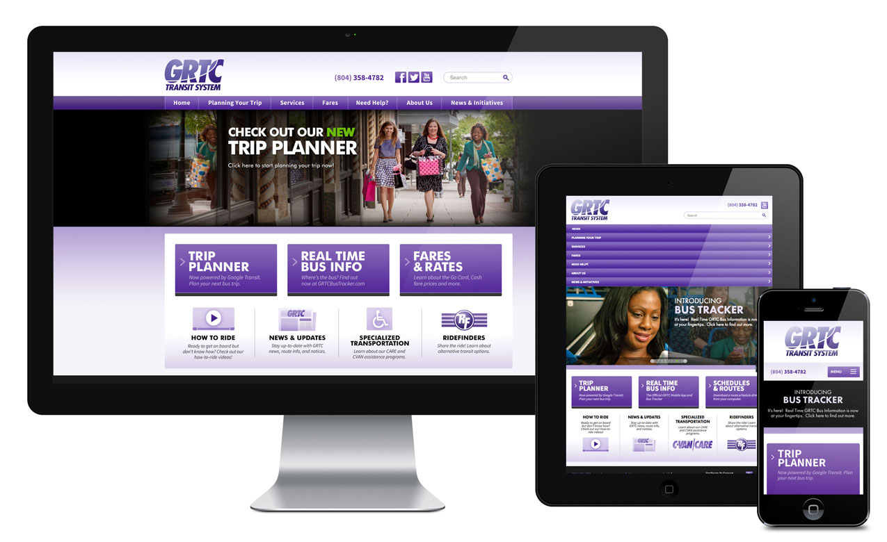
Single Source of Truth
Notes:
Let’s say you started building your next product – A task management system.
Users can login, add tasks, assign it to people in their team, discuss on a task, change status & so on.
You built it in MVC – It’s a Nice Architecture and launched it.
Around 10 users started using it...Few users became a fan of your app – A loyal users
They demanded the app to be on Mobile devices with good native experience.
Now the problem arises. You must rewrite the business logic for ios ,android, firefox os & so on.
It’s like redoing the whole app in all the devices!!! That’s wired!!!
Did we had made something which would have escaped us from this problem ?
Yes, you should have implemented a REST API – Representational state transfer Application Programming Interface
All your application, be it a desktop app, web app, mobile app will all your API to run your business logic
Once the API is being implemented you can integrate with Google Glasses, iWatches anything you name....

Slide 5
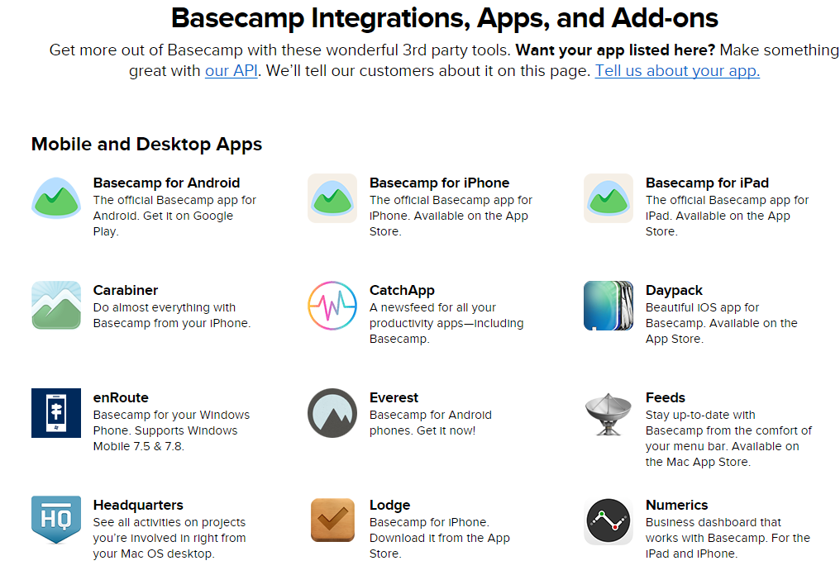
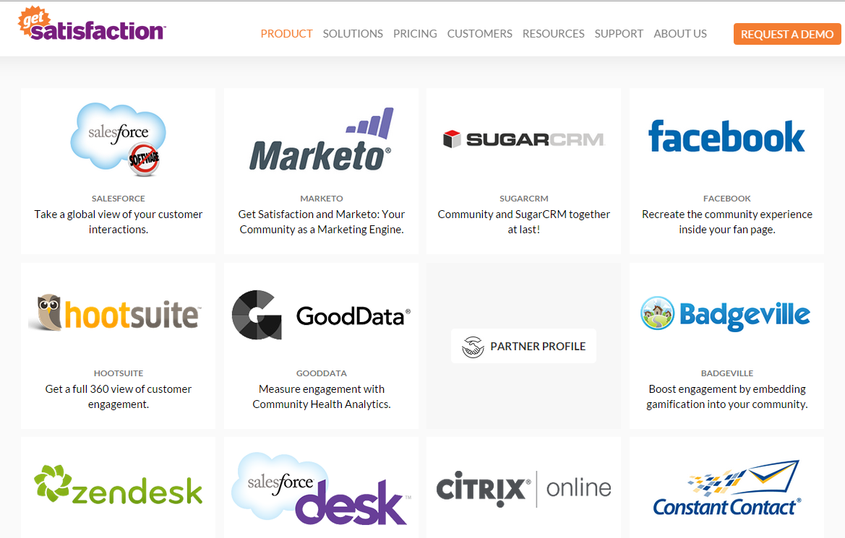
Your App is not isolated
Notes:
Now all your loyal users are happy. You customers increased.
Soon one of your customer want to integrate your app with his home grown app
Now you can ask your customer to use your API to integration
Of course, with some authentation & authorization

Slide 6

Developer is your API customer
Notes:
But...here is a catch..you actual API customer is not the end user. He is a developer
Now the question is to how to make the developer happy with your API
Simple answer – Build a developer friendly API

Slide 7

Building Developer Friendly API
Notes:
It’s definitely not a rocket science.
It’s just a common sense with some intelligence

Slide 8
Let’s Start with best practices
API End Point :
https://www.YourApp.com/Api/
OR
https://Api.YourApp.com/
Finally Format:
https://www.YourApp.com/Api/ResourceName

Slide 9
Identifying resources
You can make the resources more sensible based on your product
For example
Tasks
Comments
Notifications
Users
Projects
Files

Slide 10
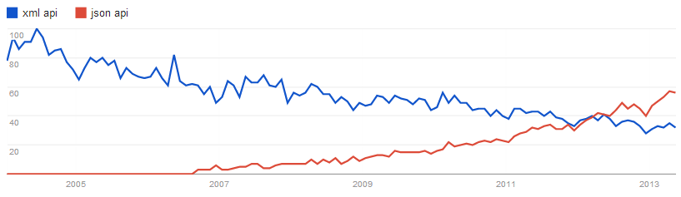
JSON Everywhere

Slide 11
Make Use of HTTP Verbs
GET /task - Retrieves a list of task
GET /task/12 - Retrieves a specific task
POST /task - Creates a new task
PUT /task/12 - Updates task #12
PATCH /task/12 - Partially updates task #12
DELETE /task/ - Deletes all task
DELETE /task/12 - Deletes task #12
Notes:
Build your API around HTTP Action – GET, POST, PUT,PATCH,DELETE
In example you can see the first one retrieves all the tasks

Slide 12
Map the relationships
GET /task/12/comments - Retrieves list of comments for task #12
GET /task /12/comments/5 - Retrieves comment #5 for task #12
POST /task /12/comments - Creates a new comments in task #12
PUT /task /12/comments/5 - Updates comments #5 for task #12
PATCH /task /12/comments/5 - Partially updates comment #5 for task #12
DELETE /task/12/comments/5 - Deletes comment #5 for task #12
Notes:
Next , Map the relationship
First example retrives all the comments on a task #12

Slide 13
Search Sort & Filter
GET /tasks?sort=-priority - Retrieves a list of task in descending order of priority
GET /tasks?sort=-priority,created_at - Retrieves a list of tasks in descending order of priority then by date created
Notes:
Build a mechanism to search/sort/filter
You can use some common sense here and build a aliases API call
For example build a separate API call to get all recently completed tasks

Slide 14
Aliases for common queries
To make the API experience more pleasant for the average consumer
GET /tasks?status=completed
GET /tasks/recently_completed

Slide 15
Allow the fields to be selected
The API consumer doesn't always need the full
representation of a resource.
GET /task?fields=id,title,updated_at

Slide 16
Paging of data
Paging makes the API fast & responsive
GET /notification?page=1&per_page=50

Slide 17
Return full resource after action
A PUT, POST or PATCH call may make modifications to fields
Return the updated (or created) representation as part of the response.
Prevent an API consumer from having to hit the API again
Notes:
Let your API return full details about the task on every operation.
Say you updated a task by calling a API request.
Instead of just return Boolean if the activity is successful
Just return full details of the task
This will reduce the work of the developer to hit the API gain to get the updated data

Slide 18
Auto loading related resources
{ "id" : 12,
“TaskName" : "I have a question!",
"summary" : "Hi, ....",
"customer" : { "name" : "Bob" },
assigned_user: { "id" : 42, "name" : "Jim", }
}
Notes:
It’s a best practice to related data.
For example, instead of just returning the assigned user ID
It Return the whole user object/resource along with the user name.
This will also reduce the number of hits to API server

Slide 19
Make Error Message Friendly
The API should always return sensible HTTP status codes
400 series status codes for client issues & 500 series status codes for server issues
API should standardize that all 400 series errors come with consumable JSON error representation
{ "code" : 1234,
"message" : “task field validation failed ",
"description" : “Due date is not set"
}
Notes:
Make errors friendly to understand. API should always return sensible HTTP status code
200 – For successfully operation
400 – For errors data validation etc
500 – For server errors
Also return the standard error object with the proper message stating why the operation failed.
It would be good if you can provide a code for all your errors.

Slide 20
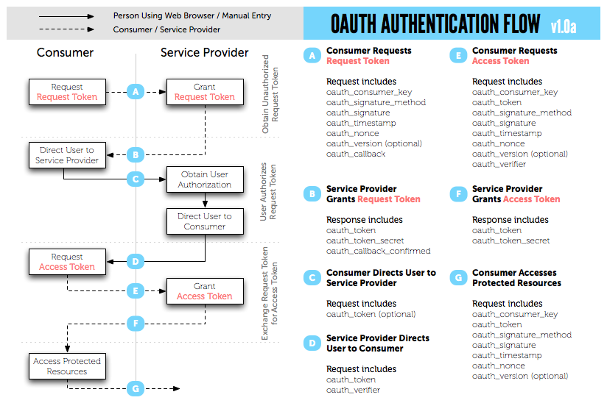
Authentication

Slide 21
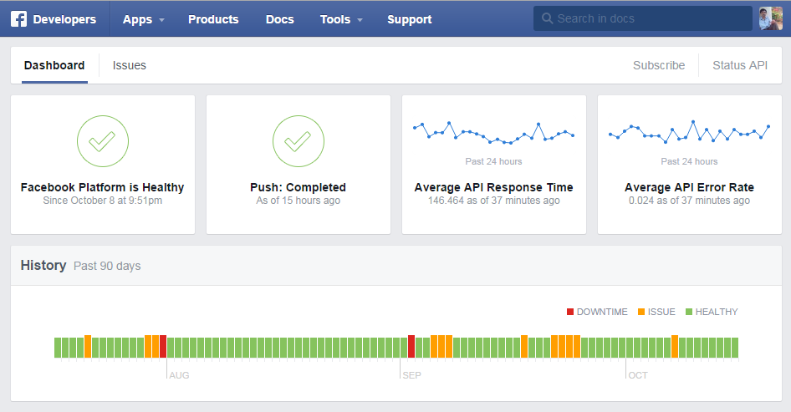
API Status History

Slide 22
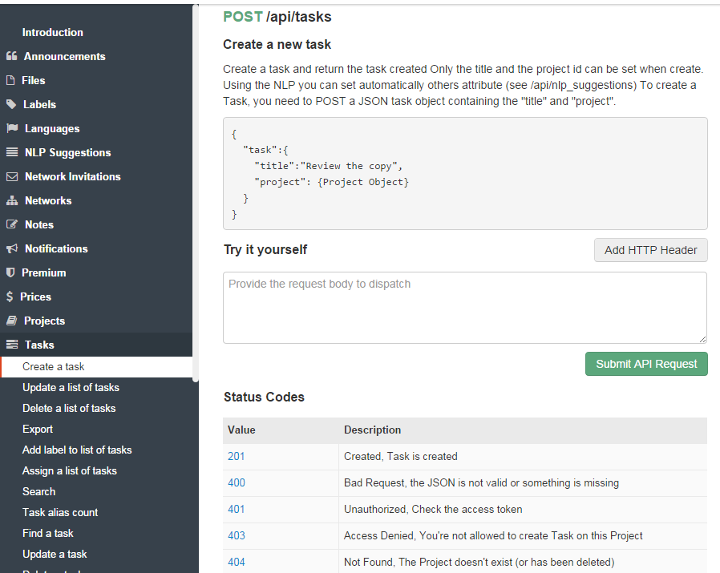
Documentation

Slide 23
REST API in Codeigniter
Your App
Your API
UI/ Controller
Rest Client

Slide 24
What we need
Codeigniter
chriskacerguis/codeigniter-restserver
Router implementation

Slide 25
Structuring the project
/application
/controller/
api/ //For all api controllers
/libraries //For the third-party libraries
REST_server.php
Format.php
/config //For all config files
Router.php
Rest_server.php

Slide 26
Router Implementation
//res/id/function/id --> res/function/id/num/sid/num
$route['api/([a-z_]+)/(:any)/([a-z_]+)/(:any)'] = 'api/$1/$3/id/$2/rid/$4';
//res/id/function --> res/function/id/num
$route['api/([a-z_]+)/(:any)/([a-z_]+)'] = 'api/$1/$3/id/$2';
//res/function --> res/function
$route['api/([a-z_]+)/([a-z_]+)'] = 'api/$1/$2/';
//res/id --> res/index/id/num
$route['api/([a-z_]+)/(:any)'] = 'api/$1/index/id/$2';
//res/ --> //res/
$route['api/([a-z_]+)'] = 'api/$1';

Slide 27
Creating a first API controller
require(APPPATH . '/libraries/Rest_Service.php');
class task extends REST_Service{
public function index_get() { //Logic }
public function index_post() { //Logic }
public function index_put() { //Logic }
public function index_patch() { //Logic }
public function index_delete() { //Logic }
}

Slide 28
Every Function has 2 Reaction
public function index_get() {
if($this->get('id'))
{
//Application Logic
$this->response($results,$code);
}
else
{
//Application Logic
$this->response($results,$code);
}
}

Slide 29
HTTP Action Vs SQL
Get (select)
Get All
Get by ID
Post (Insert)
Put (update all fields )
Patch (update selected fields)
Delete (delete)
Delete All
Delete by ID

Slide 30
Summary
REST API is heart of product
REST API is a developer UI
Follow the best practices of REST API
Use “chriskacerguis/codeigniter-restserver” to implement REST in codeigniter

Slide 31
Questions ?
Website:SachinGKulkarni.com
Twitter:@sachingk30
Email:sachingk.30@gmail.com

