Slide 1
Experimental Design Microbial Sequencing
Matthew L. Settles
Genome Center Bioinformatics Core
University of California, Davis
settles@ucdavis.edu; bioinformatics.core@ucdavis.edu

Slide 2
General rules for preparing and experiment/ samples
Prepare more samples then you are going to need, i.e. expect some will be of poor quality, or fail
Preparation stages should occur across all samples at the same time (or as close as possible) and by the same person
Spend time practicing a new technique to produce the highest quality product you can, reliably
Quality should be established using Fragment analysis traces (pseudo-gel images, RNA RIN > 7.0)
DNA/RNA should not be degraded
260/280 ratios for RNA should be approximately 2.0 and 260/230 should be between 2.0 and 2.2. Values over 1.8 are acceptable
Quantity should be determined with a Fluorometer, such as a Qubit.

Slide 3
Sample preparation
In high throughput biological work (Microarrays, Sequencing, HT Genotyping, etc.), what may seem like small technical details introduced during sample extraction/preparation can lead to large changes, or technical bias, in the data.
Not to say this doesn’t occur with smaller scale analysis such as Sanger sequencing or qRT-PCR, but they do become more apparent (seen on a global scale) and may cause significant issues during analysis.

Slide 4
Be Consistent
BE CONSISTENT ACROSS ALL SAMPLES!!!

Slide 5
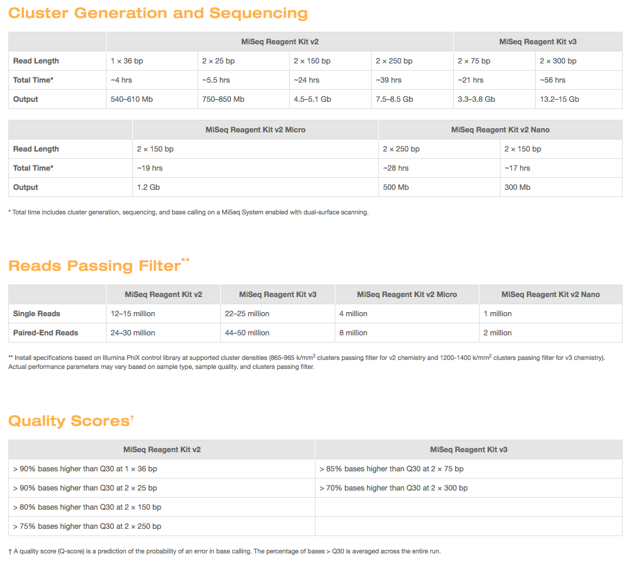
Illumina MISEQ SEQUENCING
https://www.illumina.com/systems/sequencing-platforms/miseq/specifications.html

Slide 6
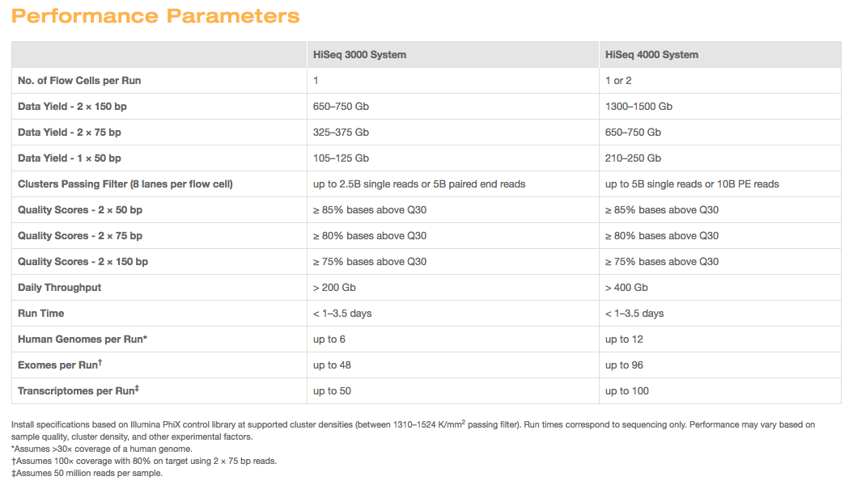
Illumina HiSeq Sequencing
https://www.illumina.com/systems/sequencing-platforms/hiseq-3000-4000/specifications.html

Slide 7
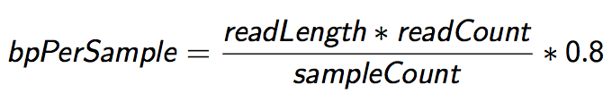
Sequencing Depth
The first and most basic question is how many base pairs of sequence data will I get Factors to consider are:
1. Number of reads being sequenced
2. Read length (if paired consider then as individuals)
3. Number of samples being sequenced
4. Expected percentage of usable data
The number of reads and read length data are best obtained from the manufacturer’s website (search for specifications) and always use the lower end of the estimate.

Slide 8

Genomic Coverage
Once you have the number of base pairs per sample you can then determine expected coverage
Factors to consider then are:
Length of the genome
Any extra-genomic sequence (ie mitochondria, virus, plasmids, etc.). For bacteria in particular, these can become a significant percentage
$$\frac{ExpectedCoverage}{sample}=\frac{\frac{\left(readLength ∗numReads\right)∗0.8}{numSamples}\text{∗ }\text{num}\text{.}\text{lanes}}{TotalGenomicContent}$$

Slide 9
Metagenomics Sequencing
Considerations (when a literature search turns up nothing)
Proportion that is host (non-microbial genomic content)
Proportion that is microbial (genomic content of interest)
Number of species
Genome size of each species
Relative abundance of each species
The back of the envelope calculation
$$\frac{numReads}{sample}=\frac{Coverage∗\left(AverageGenomeSize\right)}{ReadLen ∗DilutionFactor ∗(1−hostProportion)} ∗\frac{1}{0.8}$$

Slide 10
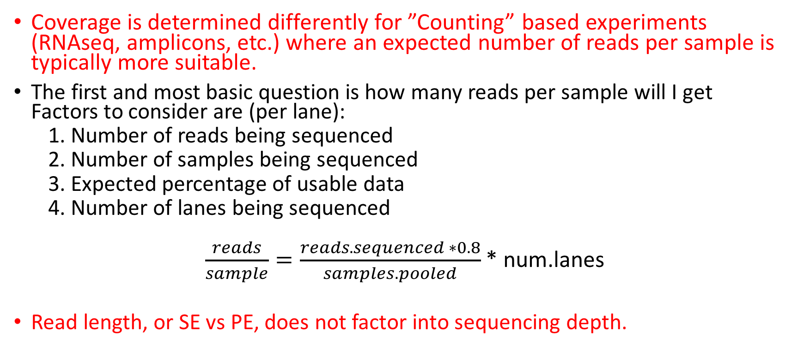
Sequencing Depth – Counting based experiments
Coverage is determined differently for ”Counting” based experiments (RNAseq, amplicons, etc.) where an expected number of reads per sample is typically more suitable.
The first and most basic question is how many reads per sample will I get Factors to consider are (per lane):
1. Number of reads being sequenced
2. Number of samples being sequenced
3. Expected percentage of usable data
4. Number of lanes being sequenced
$\frac{reads}{sample}=\frac{reads.sequenced ∗0.8}{samples.pooled}$* num.lanes
Read length, or SE vs PE, does not factor into sequencing depth.

Slide 11


Amplicon Sequencing (Communities, genotyping)
Considerations
Number of reads being sequenced
Proportion that is diversity sample (e.g. PhiX)
Number of samples being pooled in the run
The back of the envelope calculation
$$\frac{reads}{sample}=\frac{reads_sequenced∗\left(1 −diversity_sample\right)}{num_samples}$$
example
$$\frac{102,000}{sample}=\frac{18e6 ∗\left(1−0.15\right)}{150}$$
Recommendations
Illumina ‘recommends’ 100K per sample
I’ve used 30K per sample historically, others are fine with 3K per sample
Really should have as many reads as your experiment needs

Slide 12
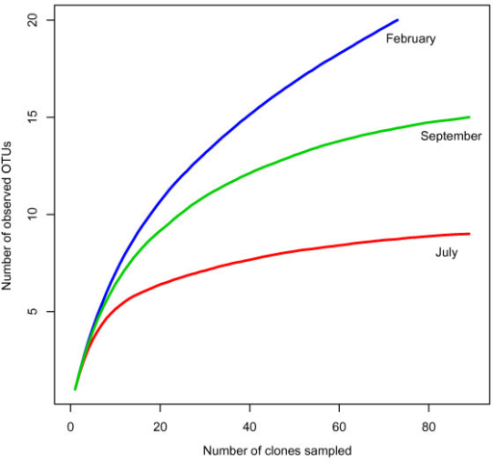
How Much? Community Rarefaction curves
’Deep’ sequence a number of test samples
amplicons: ~ 1M+ reads.
metagenomics: 1 full HiSeq lane
Plot rarefactions curves of organism identification, to determine if saturation is achieved

Slide 13
Metagenomics assembly
To determine if you’ve sequenced ‘enough’ to re-assemble ‘most’ of the community member’s genetic content, look to what is left over - proportionally

Slide 14
Amplicons vs. Metagenomics
Metagenomics
Shotgun libraries intended to sequence random genomic sequences from the entire bacterial community.
Can be costly per sample ($500 to multi thousands per sample)
Better resolution and sensitivity to characterize the sample
Due to cost, can only do relatively few samples
Amplicon community profiling
Sequence only one regions of one gene (e.g. 16s, ITS, LSU)
Cheap per sample (at scale, down to $20/sample)
Due to cost, can do many hundreds of samples make more global inferences

Slide 15
Community Sequencing Designs
Taxonomic Identification
Amplicon based (e.g. 16s variable regions)
Shotgun Metagenomics
Functional Characterization
Shotgun Metagenomics
Shotgun Metatranscriptomics (active)
Genome Assembly, Function and Variation
Shotgun Metagenomics
Shotgun Metatranscriptomics

Slide 16
Cost Estimation
DNA/RNA extraction and QA/QC (Bioanalyzer/Gels)
Metatranscriptomes: Enrichment of RNA of interest and RNA library preparation
Library QA/QC (Bioanalyzer and Qubit)
Pooling ($10/library)
Metagenomes: DNA library preparation
Library QA/QC (Bioanalyzer and Qubit)
Pooling ($10/library)
Community Profiling: PCR reactions
Library QA/QC (Bioanalyzer and Qubit/microplate reader)
Pooling
Sequencing (Number of Lanes / runs)
Bioinformatics (General rule is to estimate the same amount as data generation, i.e. double your budget)
http://dnatech.genomecenter.ucdavis.edu/prices/

Slide 17
Bioinformatics Costs
Bioinformatics includes:
Storage of data
Access and use of computational resources and software
System Administration time
Bioinformatics Data Analysis time
Back and forth consultation/analysis to extract biological meaning
Rule of thumb:
Bioinformatics can and should cost as much (sometimes more) as the cost of data generation.

Slide 18
Cost Estimation
Amplicons
384 Samples
Amplicon generation ($20/sample)= $7,680
Sequencing PE300, target 30K reads per sample
Bioinformatics
Metagenome
12 samples (DNA) = $400/sample
Expectations: Host Proportion 40%, use average genome size of eColi, Target the 1% and coverage of 20
Sequencing PE150
Bionformatics

Slide 19
Taxonomic Assignment
KRAKEN
A taxonomic classifier using k-mers, current db contains > 75Gb of microbial genome data (unique kmers).
Requires a large server, 128Gb to 256Gb of memory
Assigns each read to its lowest common ancestor in the tree in a taxonomic tree based on the set of kmers in a read
Accepts ‘single’ read fasta format (flags for pairs and fastq)
Output is ‘unusable’, meant for additional processing
Kraken-translate to output taxonomic assignment for every read, output can then be used to build abundance tables
Kraken-filter will move a read up the tree based on confidence of mapping (loosely based on proportion of kmers)
Can build your own database
Kraken-report and kraken-mpa-report for abundance table construction
MetaPhlAn
Classifies by using a set of marker genes – measures species abundances

Slide 20
Assembly
Many assemblers to choose from and more each day
Relatively recent tutorial using cloud computing
http://www.ncbi.nlm.nih.gov/pmc/articles/PMC4496567/
Most metagenomics assemblers use kmers
Either normalize reads by kmers (remove what appears to be redundant information)
Or first bin by kmers (each bin is assumed to be a unique species), then assemble each bin (first normalizing by kmers).
Map reads back to assembly to estimate coverage/count
BUT then you have to do some with ambiguous contigs
Identify ORFs, marker genes, etc. to characterize gene/taxon content
IT IS all about the databases!!

Slide 21
MG-RAST
The MG-RAST system provides answers to the following scientific questions:
Who is out there? Identifying the composition of a microbial community either by using amplicon data for single genes or by deriving community composition from shotgun metagenomic data using sequence similarities.
What are they doing? Using shotgun data (or metatranscriptomic data) to derive the functional complement of a microbial community using similarity searches against a number of databases.
Who is doing what? Based on sequence similarity searches, identifying the organisms encoding specific functions.
Finally compare samples to each other

Slide 22
MG-RAST
Can upload
16s amplicons
Metagenomes/Metatranscriptomes
Assembled contigs
Raw reads
Use their resources for analysis, don’t have to have your own computational resources
More of a black box, but can download many of output data options
Subjected to their philosophy for analysis of metagenomic/transcriptomic data
A downloadable alternative to MG-RAST is MEGAN5

Slide 23
Take Homes
Experience and/or literature searches (other peoples experiences) will provide the best justification for estimates on needed depth.
‘Longer’ reads are better than short reads.
Paired-end reads are more useful than single-end reads
Libraries can be sequenced again, so do a pilot, perform a preliminary analysis, then sequence more accordingly.

