Slide 1
Experimental Design Microbial Sequencing
Matthew L. Settles
Genome Center Bioinformatics Core
University of California, Davis
settles@ucdavis.edu; bioinformatics.core@ucdavis.edu

Slide 2
Microbial community analysis
Goal: A culture independent method for profiling the diversity of a community.
High-throughput sequencing technologies (such as Illumina) can sequence millions of amplicons, across thousands of samples in a single run, and are today our best approach to deeply assess the environmental or clinical diversity of complex microbial assemblages of archaea, bacteria, and eukaryotes.
Using sequence variation within a common gene (e.g. 16s) to assign and count community members rather than counting individual cells. Assume each sequence variant is one community member.

Slide 3
Treating Bioinformatics as a Data Science
Seven stages to data science
Define the question of interest
Get the data
Clean the data
Explore the data
Fit statistical models
Communicate the results
Make your analysis reproducible
Data science done well looks easy and that’s a big problem for data scientists
simplystatistics.org
March 3, 2015 by Jeff Leek

Slide 4
Designing Experiments
Beginning with the question of interest ( and work backwards )
The final step of an analysis is the application of statistical models.
Traditional statistical considerations and basic principals of statistical design of experiments apply.
Control for effects of outside variables, avoid/consider possible biases, avoid confounding variables in sample preparation.
Randomization of samples, plots, etc.
Replication is essential (triplicates are THE minimum)
You should know your final statistical model and comparisons before beginning your experiment.

Slide 5
General rules for preparing an experiment and samples
Prepare more samples then you are going to need, i.e. expect some will be of poor quality, or fail
Preparation stages should occur across all samples at the same time (or as close as possible) and by the same person
Spend time practicing a new technique to produce the highest quality product you can, reliably
Quality should be established using Fragment analysis traces (pseudo-gel images, RNA RIN > 7.0)
DNA/RNA should not be degraded
260/280 ratios for RNA should be approximately 2.0 and 260/230 should be between 2.0 and 2.2. Values over 1.8 are acceptable
Quantity should be determined with a Fluorometer, such as a Qubit.

Slide 6
Sample preparation
In high throughput biological work (Microarrays, Sequencing, HT Genotyping, etc.), what may seem like small technical details introduced during sample extraction/preparation can lead to large changes, or technical bias, in the data.
Not to say this doesn’t occur with smaller scale analysis such as Sanger sequencing or qRT-PCR, but they do become more apparent (seen on a global scale) and may cause significant issues during analysis.

Slide 7
Be Consistent
BE CONSISTENT ACROSS ALL SAMPLES!!!

Slide 8
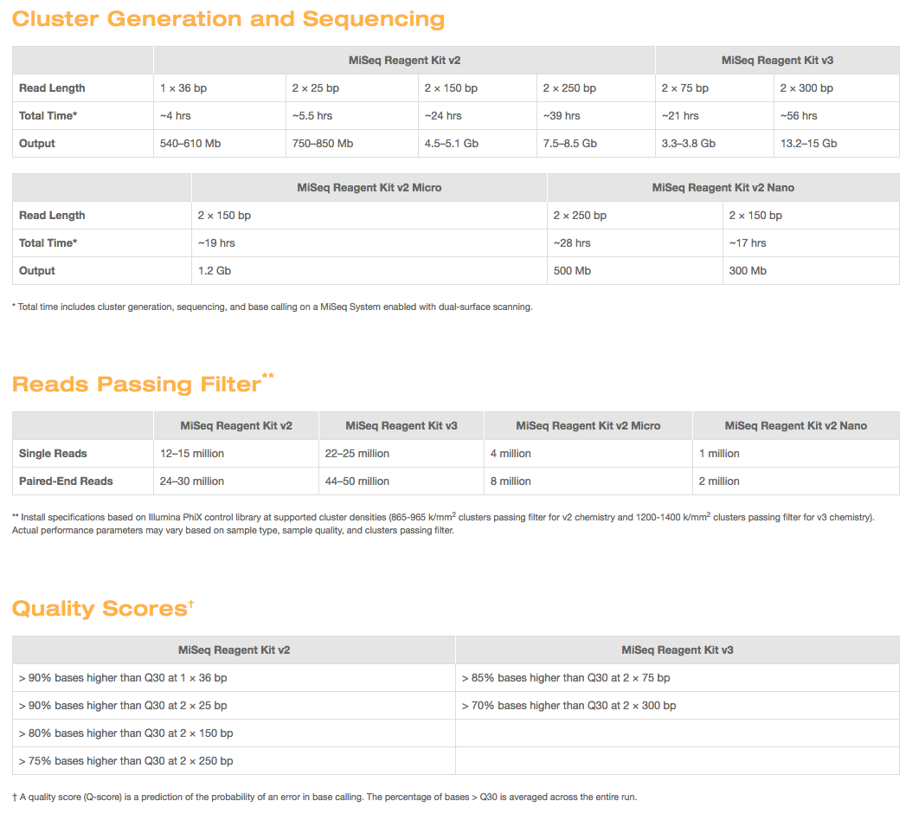
Illumina MISEQ SEQUENCING
https://www.illumina.com/systems/sequencing-platforms/miseq/specifications.html

Slide 9
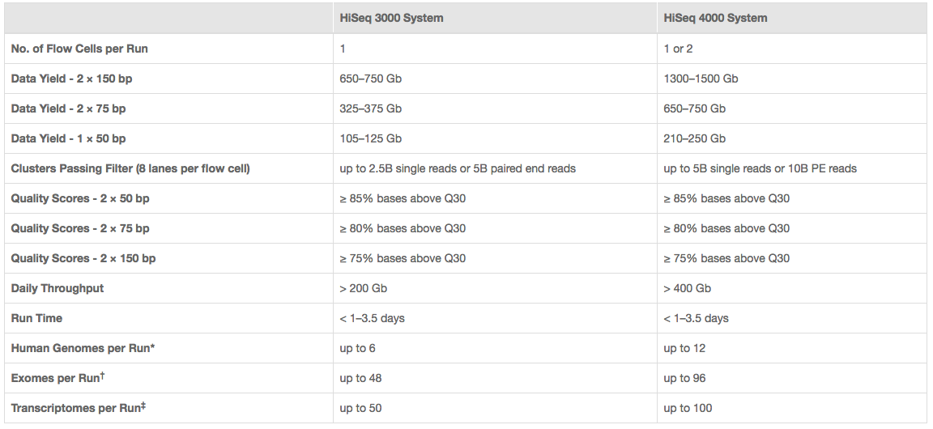
Illumina HiSeq sequencing costs
I use 350M fragments per lane
http://www.illumina.com/systems/hiseq-3000-4000/specifications.html

Slide 10
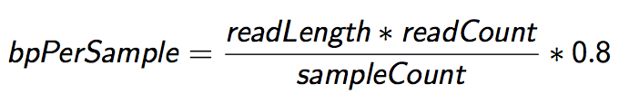
Sequencing Depth
The first and most basic question is how many base pairs of sequence data will I get Factors to consider are:
1. Number of reads being sequenced
2. Read length (if paired consider then as individuals)
3. Number of samples being sequenced
4. Expected percentage of usable data
The number of reads and read length data are best obtained from the manufacturer’s website (search for specifications) and always use the lower end of the estimate.

Slide 11

Genomic Coverage
Once you have the number of base pairs per sample you can then determine expected coverage
Factors to consider then are:
Length of the genome
Any extra-genomic sequence (ie mitochondria, virus, plasmids, etc.). For bacteria in particular, these can become a significant percentage
$$\frac{ExpectedCoverage}{sample}=\frac{\frac{\left(readLength ∗numReads\right)∗0.8}{numSamples}\text{∗ }\text{num}\text{.}\text{lanes}}{TotalGenomicContent}$$

Slide 12
Metagenomics Sequencing
Considerations (when a literature search turns up nothing)
Proportion that is host (non-microbial genomic content)
Proportion that is microbial (genomic content of interest)
Number of species
Genome size of each species
Relative abundance of each species
The back of the envelope calculation
$$\frac{numReads}{sample}=\frac{Coverage∗\left(AverageGenomeSize\right)}{ReadLen ∗DilutionFactor ∗(1−hostProportion)} ∗\frac{1}{0.8}$$

Slide 13
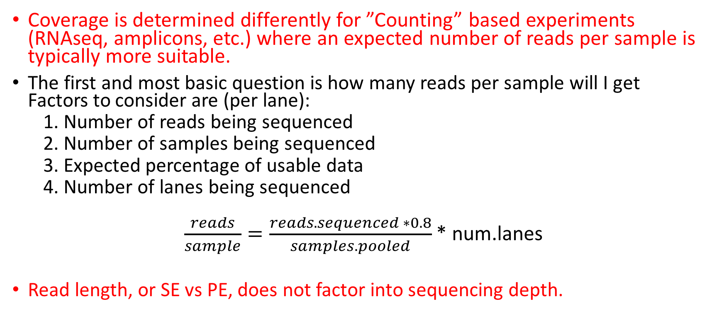
Sequencing Depth – Counting based experiments
Coverage is determined differently for ”Counting” based experiments (RNAseq, amplicons, etc.) where an expected number of reads per sample is typically more suitable.
The first and most basic question is how many reads per sample will I get Factors to consider are (per lane):
1. Number of reads being sequenced
2. Number of samples being sequenced
3. Expected percentage of usable data
4. Number of lanes being sequenced
$\frac{reads}{sample}=\frac{reads.sequenced ∗0.8}{samples.pooled}$* num.lanes
Read length, or SE vs PE, does not factor into sequencing depth.

Slide 14


Amplicon Sequencing (Communities, genotyping)
Considerations
Number of reads being sequenced
Proportion that is diversity sample (e.g. PhiX)
Number of samples being pooled in the run
The back of the envelope calculation
$$\frac{reads}{sample}=\frac{reads_sequenced∗\left(1 −diversity_sample\right)}{num_samples}$$
example
$$\frac{102,000}{sample}=\frac{18e6 ∗\left(1−0.15\right)}{150}$$
Recommendations
Illumina ‘recommends’ 100K per sample
I’ve used 30K per sample historically, others are fine with 3K per sample
Really should have as many reads as your experiment needs

Slide 15
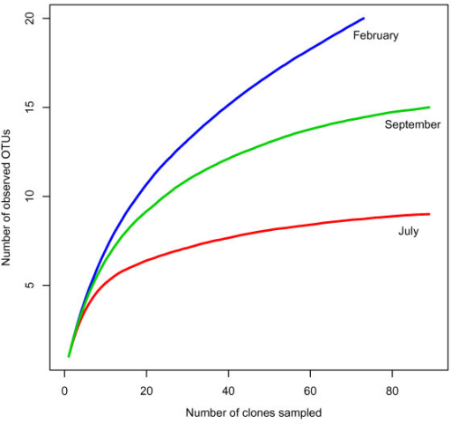
How Much? Community Rarefaction curves
’Deep’ sequence a number of test samples
amplicons: ~ 1M+ reads.
metagenomics: 1 full HiSeq lane
Plot rarefactions curves of organism identification, to determine if saturation is achieved

Slide 16
Metagenomics assembly
To determine if you’ve sequenced ‘enough’ to re-assemble ‘most’ of the community member’s genetic content, look to what is left over - proportionally

Slide 17
Amplicons vs. Metagenomics
Metagenomics
Shotgun libraries intended to sequence random genomic sequences from the entire bacterial community.
Can be costly per sample ($500 to multi thousands per sample)
Better resolution and sensitivity to characterize the sample
Due to cost, can only do relatively few samples
Amplicon community profiling
Sequence only one regions of one gene (e.g. 16s, ITS, LSU)
Cheap per sample (at scale, down to $20/sample)
Due to cost, can do many hundreds of samples make more global inferences

Slide 18
Community Sequencing Designs
Taxonomic Identification
Amplicon based (e.g. 16s variable regions)
Shotgun Metagenomics
Functional Characterization
Shotgun Metagenomics
Shotgun Metatranscriptomics (active)
Genome Assembly, Function and Variation
Shotgun Metagenomics
Shotgun Metatranscriptomics

Slide 19
Cost Estimation
DNA/RNA extraction and QA/QC (Bioanalyzer/Gels)
Metatranscriptomes: Enrichment of RNA of interest and RNA library preparation
Library QA/QC (Bioanalyzer and Qubit)
Pooling
Metagenomes: DNA library preparation
Library QA/QC (Bioanalyzer and Qubit)
Pooling
Community Profiling: PCR reactions
Library QA/QC (Bioanalyzer and Qubit/microplate reader)
Pooling
Sequencing (Number of Lanes / runs)
Bioinformatics (General rule is to estimate the same amount as data generation, i.e. double your budget)
http://dnatech.genomecenter.ucdavis.edu/prices/

Slide 20
Bioinformatics Costs
Bioinformatics includes:
Storage of data
Access and use of computational resources and software
System Administration time
Bioinformatics Data Analysis time
Back and forth consultation/analysis to extract biological meaning
Rule of thumb:
Bioinformatics can and should cost as much (sometimes more) as the cost of data generation.

Slide 21
Cost Estimation
Amplicons
384 Samples
Amplicon generation ($20/sample)= $7,680
Sequencing PE300, target 30K reads per sample
Bioinformatics
Metagenome
12 samples (DNA) = $400/sample
Expectations: Host Proportion 40%, use average genome size of eColi, Target the 1% and coverage of 20
Sequencing PE150
Bioinformatics

Slide 22
Take Homes
Experience and/or literature searches (other peoples experiences) will provide the best justification for estimates on needed depth.
‘Longer’ reads are better than short reads.
Paired-end reads are more useful than single-end reads
Libraries can be sequenced again, so do a pilot, perform a preliminary analysis, then sequence more accordingly.

Slide 23
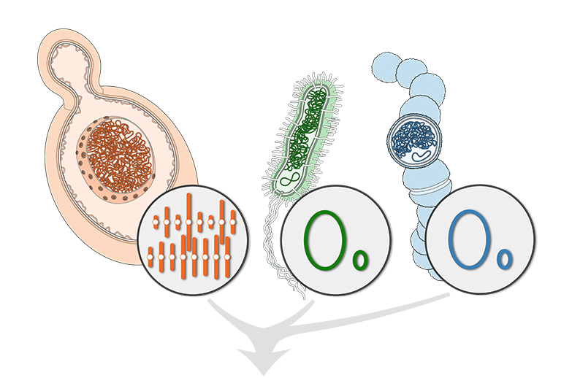
Proximity-Ligation chemically links DNA inside the same cells
Connects metagenome sequences

Slide 24
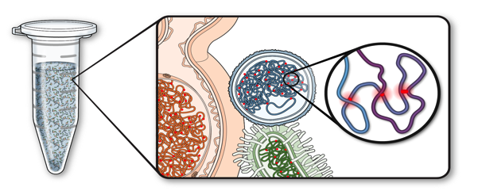
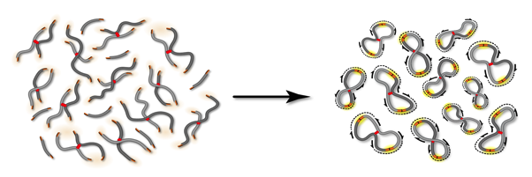
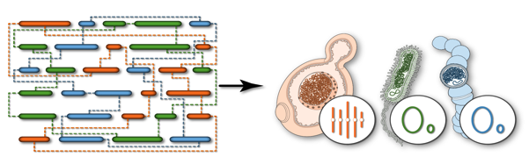
Proximity-Guided Metagenome Assembly (ProxiMeta™)
Crosslink intact cells to capture intra-cellular interactions
Isolate and sequence crosslinked junctions
Use proximity connections to deconvolute metagenome

Slide 25
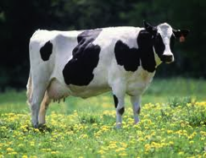
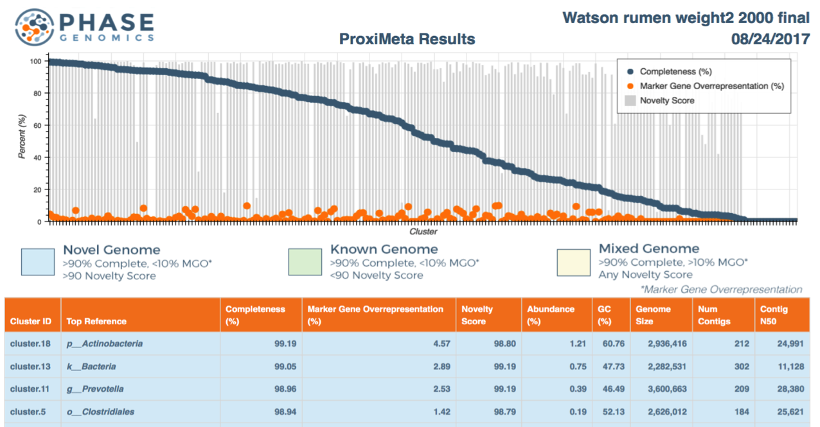
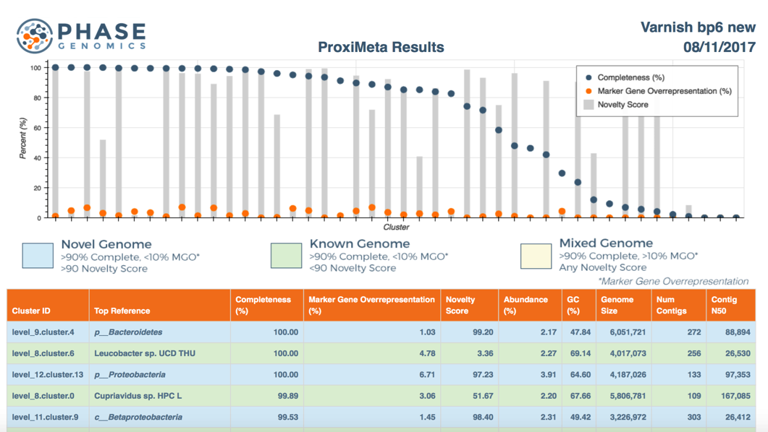
High numbers of high-quality, novel genomes directly from rumen samples
In collaboration with Titus Brown, Herminia Loza-Tavera
Stewart et al., Nature Comms, 2018

Slide 26
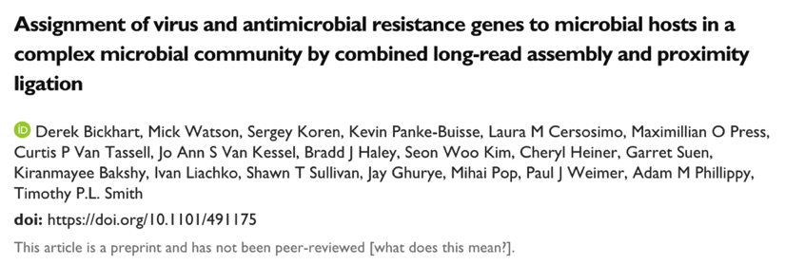
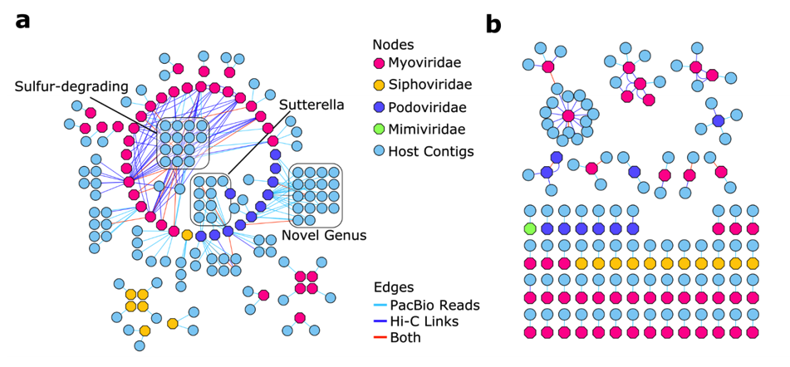
Connecting viruses with their hosts in rumen
Bickhart et al., BioRxiv, Dec 2018

