Slide 1
dbcAmplicons pipeline Bioinformatics
Matthew L. Settles
Genome Center Bioinformatics Core
University of California, Davis
settles@ucdavis.edu; bioinformatics.core@ucdavis.edu

Slide 2
Workshop dataset: Slashpile
Slash Pile – Accumulated debris from cutting brush or trimming trees
Measured, bacteria and fungal communities using 5 amplicons
16sV1V3
16sV4V5
ITS1
ITS2
LSU
3 – slashpiles
2 depths
Distance from slashpile

Slide 3
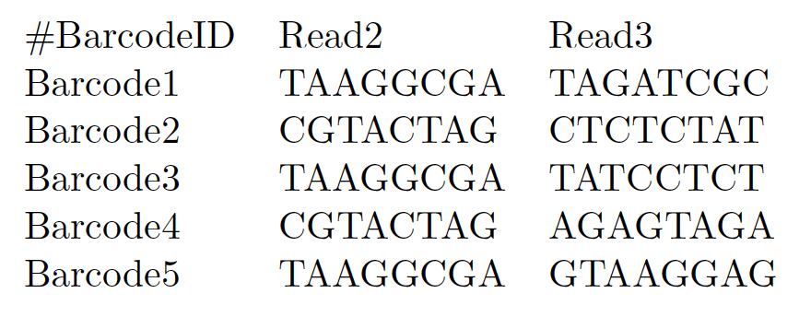
Input Files: Barcode Table
Requires 3 columns: BarcodeID [a name for the pair], Index1 (Read2 in RC), Index2 (Read3) in a plain tab-delimited text file. Orientation is important, but you can change in the preprocess arguments. First line is a comment and just help me remembers.

Slide 4
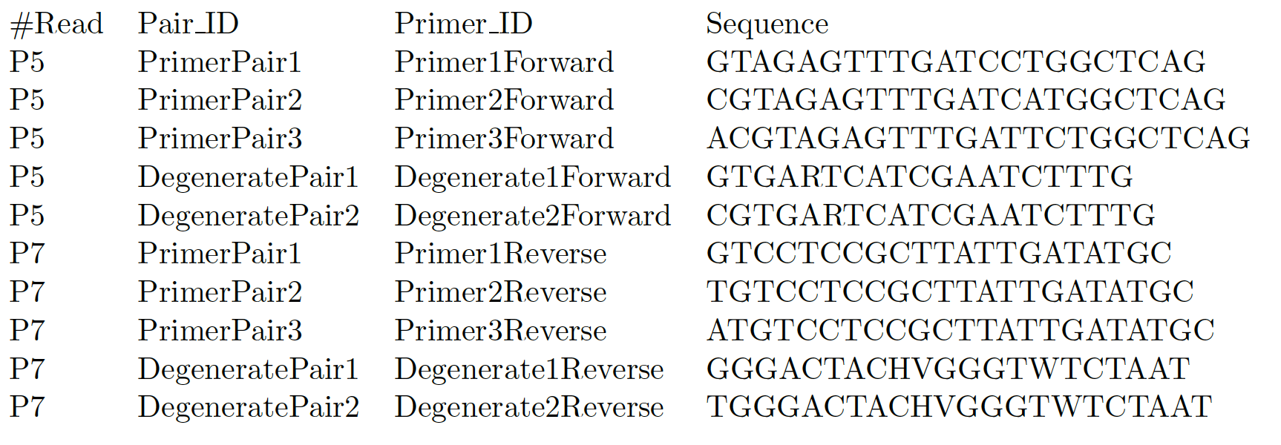
Input Files: Primer Table
Requires 4 columns: the read in which the primer should be checked for (allowable are P5/P7, R1/R2, READ1/READ2, F/R, FORWARD/REVERSE, Primer Pair ID describes which should be found ‘together’, Primer ID individual id, and sequence (IUPAC ambiguity characters are allowed).

Slide 5
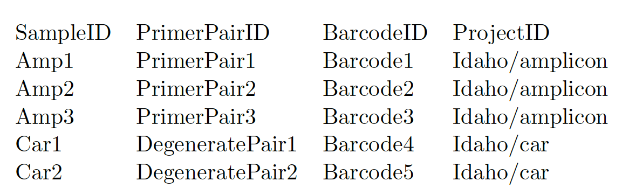
Input Files: Sample Sheet
Requires 4 columns and a header: SampleID samples name, PrimerPairID same as in primer file, barcodeID same as in barcode file, and ProjectID which represents the file prefix for the output and can include a path. SampleID, PrimerPairID, BarcodeID pairs must be unique. In addition for PrimerPairID, can be comma separated, * (match any primer), or ‘-’ should match no primer.
Additional columns are allowed and will be added to the biom file in dbcAmplicons abundances.
Samples
Allowed Characters:
a-zA-Z0-9_-
Projects
Disallowed Characters:
:"\'*?<>|<space>

Slide 6
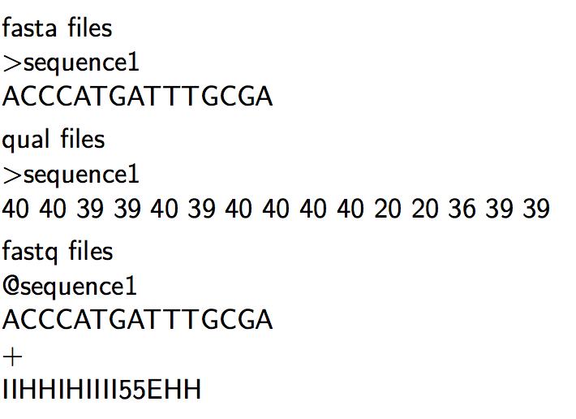
Input Files: Sequencing Read files

Slide 7
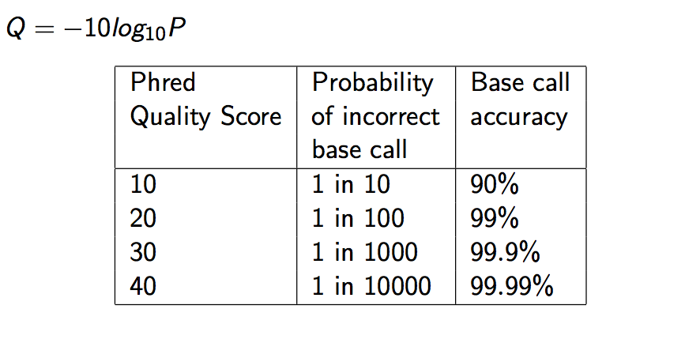
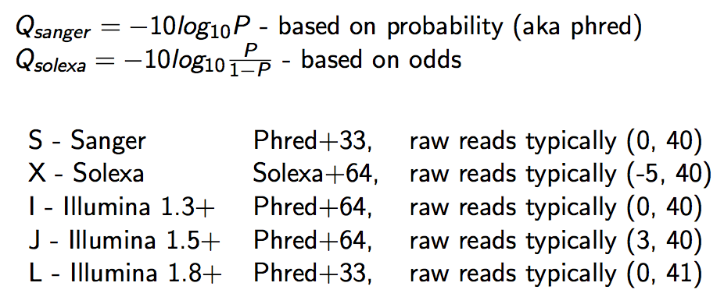
Quality Scores

Slide 8
Illumina Read naming conventions
CASAVA 1.8 or greater Read IDs
@EAS139:136:FC706VJ:2:2104:15343:197393 1:Y:18:ATCACG
EAS139 the unique instrument name
136 the run id
FC706VJ the flowcell id
2 flowcell lane
2104 tile number within the flowcell lane
15343 ’x’-coordinate of the cluster within the tile
197393 ’y’-coordinate of the cluster within the tile
1 the member of a pair, 1 or 2 (paired-end or mate-pair reads only)
Y Y if the read fails filter (read is bad), N otherwise
18 0 when none of the control bits are on, otherwise it is an even number
ATCACG index sequence

Slide 9
Reads from the sequencing provider
Fastq files are actually not raw data from the provider, “raw” data is actually bcl files.
Sequencing provider will run an application bcl2fastq with a sample sheet to produce demultiplexed (by barcode) fastq files.
For dbcAmplicons you want to request from your sequencing provider non-demultiplexed fastq (so one set of fastqs for the entire run) with the index reads.

Slide 10
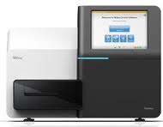
Bioinformatics
Illumina bcl2fastq 1.8.4
Four
Fastq files
Barcode Table
“Preprocess”
Demultiplex barcode and
primer sequences
dbcAmplicons
Python Application
Primer Table
Sample Sheet
Barcode | Match determined by edit-distance, allowing for 1 mismatch per barcode (by default)
Primers | Match determined by Levenshtein Distance allowing for 4 mismatches (by default) with the final 4 (by default) bases required to be perfect matches
Overlap paired reads
(wrapper around custom Flash2)
Downstream Analysis
https://github.com/msettles/dbcAmplicons

Slide 11
Downstream Analysis
Population Community Profiling ( i.e. microbial, bacterial, fungal, etc. )
dbcAmplicons Python Application
Screen | Using Bowtie2, screen targets against a reference fasta file, separating reads by those that produce matches and those that do not match sequences in the reference database.
Classify | Wrapper around the MSU Ribosomal Database Project (RDP) Classifier for Bacterial and Archaeal 16S rRNA sequences, Fungal 28S rRNA, fungal ITS regions
Abundance | Reduce RDP classifier results to abundance tables (or biom file format), rows are taxa and columns are samples ready for additional community analysis.
Targeted Re-sequencing
 | Consensus - Reduce reads to consensus sequence for each sample and amplicon
R-functions to be added into dbcAmplicons | Most Common – Reduce reads to the most commonly occurring read in the sample and amplicon ( that is present in at least 5% and 5 reads, by default )
 | Haplotypes – Impute the different haplotypes in the sample and amplicon

Slide 12
Supplemental Scripts
convert2Readto4Read.py
For when samples are processed by someone else
splitReadsBySample.py
To facilitate upload to the SRA
preprocPair_with_inlineBC.py
Cut out inline BC and create 4 reads for standard input processing
Will work with ”Mills lab” protocol
dbcVersionReport.sh
Print out version numbers of all tools

Slide 13
dbcAmplicons: Preprocessing
Read in the metadata input tables: Barcodes, Primers (optional), Samples (optional)
Read in a batch of reads (default 100,000), for each read
Compare index barcodes to the barcode table, note best matching barcode
Compare 5’ end of reads to the primer table, note best matching primer
Compare to barcode:primer pair to the sample table, note sampleID and projectID
If its a legitimate reads (contains matching barcode,primer,sample) output the reads to the output file
Output Identified_Barcodes.txt file
Output: Preprocessed reads, Identified_Barcodes.txt file

Slide 14
Barcode/Primer Comparison
Barcode Comparison
Primer Comparison
GGCTTGGTCATTTAGAGGAAGTAA
Primer 1
ACTGACTG
1
TACGGCTTGGTCATTTAGAGGAAGTAA
Primer 2
GTCAGCTA
6
ACTTACTG
CGGCTTGGTCATTTAGAGGAAGTAA
Primer 3
TCAGTCAG
5
Primer 4
ACGGCTTGGTCATTTAGAGGAAGTAA
CGTACGTA
6
TACGGACTTG_TCATTTACAGGAAGTAAAAGTCGTAA
Read
Compares each barcode to all possible barcodes and returns the best match < desired edit distance
Compares the beginning (primer region) of each read to all possible primers and returns the best match < specified maximimum Levenshtein disteance + final 4 exact match

Slide 15
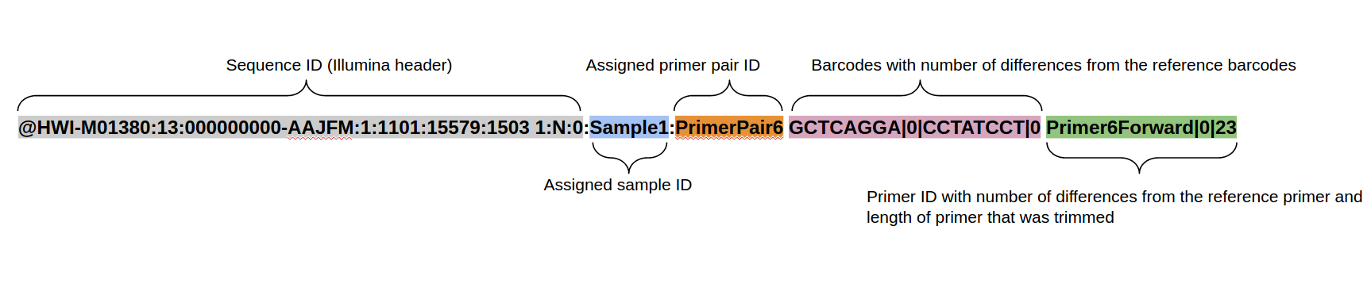
The new read header
Header format of all identified sequences:

Slide 16
dbcAmplicions: join
Uses Flash2 to merge reads that overlap to produce a longer (or sometimes shorter read).
Modification include:
Performs complete overlaps with adapter trimming
Allows for different sized reads (after cutting primer off)
Discards reads with > 50% Q of 10 or less, which are indicative of adapter/primer dimers
Output:
prefix.notCombined_1.fastq.gz, prefix.notCombined_2.fastq.gz
prefix.extendedFrags.fastq.gz
prefix.hist
prefix.histogram

Slide 17
Flash2 – overlapping of reads and adapter removal in paired end reads
Insert size
Insert size > length of the number of cycles
Read 2
Target Region
Read 1
Product: Read Pair
Insert size < length of the number of cycles (10bp min)
Insert size
Read 2
Target Region
Read 1
Product: Extended, Single
Insert size < length of the read length
Insert size
Read 2
Target Region
Read 1
Product: Adapter Trimmed, Single
https://github.com/dstreett/FLASH2

Slide 18
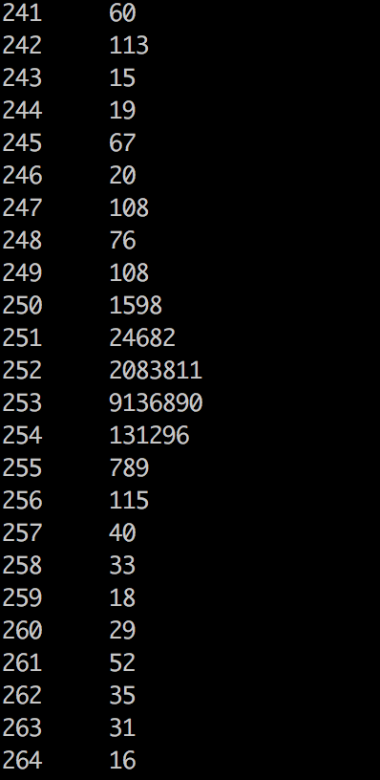
Flash2 typically produces tight sizes

Slide 19
dbcAmplicons: classify
Uses the RDP (Ribosomal Database Project) classifier for bacterial and archaeal 16S, fungal LSU, ITS warcup/unite databases. You can provide your own training database
Classifies sequences to the closest taxonomic reference provides a bootstrap score for reliability
Concatenates Paired-end reads
Can trim off low quality ends, to some value Q
Output: fixrank file
HWI-M01380:26:000000000-ABHNY:1:2116:24606:7147|Slashpile27:16sV1V3:470 Bacteria domain 1.0 "Proteobacteria“ phylum 1.0 ………. Through Genus/Species

Slide 20
Direct Classification - RDP
Ribosomal Database Project (RDP) - naïve Bayesian Classifier
Compares each read to a database
Database is updates periodically
Compares by k-mers (15 mers)
100 bootstraps to establish confidence in result
Order does not matter, no 3% !
Drawbacks
Accepts only fasta (though website implies fastq) files
Can be slow
Down to genus only (for 16s, species for ITS)
Kmer database are based on whole 16s
Cannot group together unknown OTUs that represent unique taxa

Slide 21
Clustering
Clustering – “Because of the increasing sizes of today’s amplicon datasets, fast and greedy de novo clustering heuristics are the preferred and only practical approach to produce OTUs”. I DISAGREE
Shared steps in these current algorithms are:
An amplicon is drawn out of the amplicon pool and becomes the center of a new OTU (centroid selection)
This centroid is then compared to all other amplicons remaining in the pool.
Amplicons for which the distance is within a global clustering threshold, t (e.g. 3%), to the centroid are moved from the pool to the OUT
The OTU is then closed. These steps are repeated as long as amplicons remain in the pool.

Slide 22
Reasons why I’m not a fan
Little to no biological rational to any of the clustering parameters, modify the parameters to get a result you like.
Dependent on ordering, reorder our reads you can get different set of OTUs. Often not repeatable from run to run.
3% (or any other cutoff) is BS.
Most clustering algorithms do not consider sequencing errors.
If you generate more data you have to start the clustering process all over again as population of sequences matters.
I’m sure there is more

Slide 23
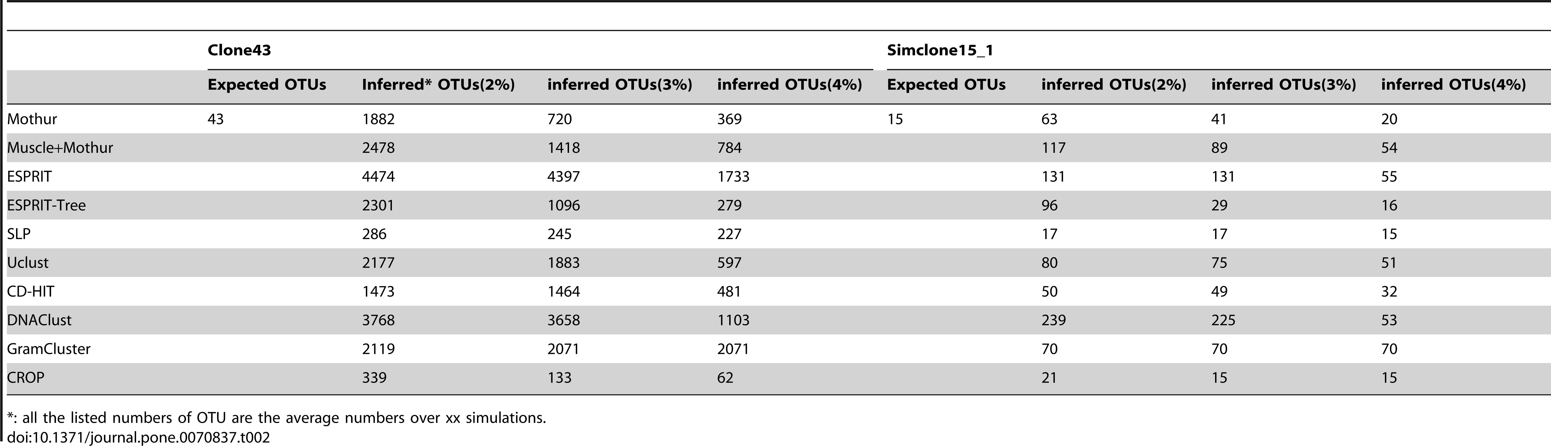

OTU clustering Comparison
Chen W, Zhang CK, Cheng Y, Zhang S, Zhao H (2013) A Comparison of Methods for Clustering 16S rRNA Sequences into OTUs. PLoS ONE 8(8): e70837. doi:10.1371/journal.pone.0070837
http://journals.plos.org/plosone/article?id=info:doi/10.1371/journal.pone.0070837

Slide 24
dbcAmplicons: abundance
Takes fixrank file(s) outputs abundances tables and taxa_info table
Abundance tables
Rows are taxa
Columns are samples
Counts of the number of amplicons for each taxa/samples
Proportions tables
Same as abundance but each cell is the proportion of amplicons (so counts in cell divided by the columns sum)
Biom file (Biological Observation Matrix)
JSON file format for microbiome files
http://biom-format.org
Abundance tables are 0 heavy, a biom file removes the 0’s as well as stores extra metadata

Slide 25
Abundance tables and Biom files
Taxon_Name | Level | Slashpile1 | Slashpile10 | Slashpile11 | Slashpile13 | Slashpile14 | Slashpile15 | Slashpile16 | Slashpile17
Archaea | domain | 0 | 0 | 0 | 1 | 1 | 1 | 1 | 0
Pyrolobus | genus | 1 | 0 | 0 | 0 | 0 | 0 | 0 | 0
Bacteria | domain | 2981 | 1479 | 110 | 2674 | 1732 | 2707 | 1303 | 2706
Acetothermia_genera_incertae_sedis | genus | 0 | 0 | 0 | 0 | 0 | 0 | 0 | 1
Acidobacteria | phylum | 84 | 34 | 4 | 85 | 60 | 110 | 17 | 60
Acidobacteria_Gp1 | class | 376 | 252 | 31 | 444 | 378 | 565 | 13 | 218
Gp10 | genus | 17 | 5 | 0 | 1 | 6 | 5 | 2 | 0
Gp11 | genus | 3 | 0 | 0 | 4 | 0 | 12 | 0 | 0
Gp12 | genus | 6 | 0 | 0 | 1 | 2 | 2 | 0 | 1
Gp13 | genus | 19 | 1 | 0 | 5 | 4 | 11 | 1 | 4
Gp15 | genus | 47 | 6 | 0 | 10 | 3 | 29 | 1 | 27
Gp16 | genus | 187 | 135 | 6 | 132 | 105 | 171 | 12 | 69
Gp17 | genus | 21 | 6 | 1 | 12 | 8 | 11 | 15 | 6
Gp18 | genus | 0 | 0 | 0 | 0 | 0 | 1 | 0 | 0
Gp19 | genus | 1 | 0 | 0 | 0 | 1 | 0 | 0 | 1
Acidicapsa | genus | 9 | 17 | 6 | 29 | 11 | 11 | 0 | 1
Acidipila | genus | 17 | 9 | 8 | 18 | 20 | 36 | 0 | 7
Acidobacterium | genus | 13 | 4 | 0 | 4 | 2 | 5 | 1 | 0
Bryocella | genus | 75 | 75 | 8 | 104 | 115 | 166 | 1 | 125
The BIOM file format (canonically pronounced biome) is designed to be a general-use format for representing biological sample by observation contingency tables. BIOM is a recognized standard for the Earth Microbiome Project and is a Genomics Standards Consortium supported project. Contains the abundance counts, the sample names, full taxonomic string [domain through genus/species], and any sample metadata in the sample sheet.

Slide 26
Samples.taxa_info.txt
Taxon_Name | MeanBootstrapValue | MeanLengthMerged | PercentageAsPairs | Total
d__Archaea | 0.523 | 298 | 0 | 21
d__Archaea;p__Crenarchaeota;c__Thermoprotei;o__Desulfurococcales;f__Pyrodictiaceae;g__Pyrolobus | 0.63 | 555 | 0 | 1
d__Bacteria | 0.984 | 459 | 0 | 63378
d__Bacteria;p__Acetothermia;c__Acetothermia_genera_incertae_sedis;o__Acetothermia_genera_incertae_sedis;f__Acetothermia_genera_incertae_sedis;g__Acetothermia_genera_incertae_sedis | 0.54 | 452 | 0 | 3
d__Bacteria;p__Acidobacteria | 0.696 | 476 | 0 | 1869
d__Bacteria;p__Acidobacteria;c__Acidobacteria_Gp1 | 0.85 | 462 | 0 | 9286
d__Bacteria;p__Acidobacteria;c__Acidobacteria_Gp10;o__Gp10;f__Gp10;g__Gp10 | 0.771 | 497 | 0 | 247
d__Bacteria;p__Acidobacteria;c__Acidobacteria_Gp11;o__Gp11;f__Gp11;g__Gp11 | 0.949 | 466 | 0 | 45
d__Bacteria;p__Acidobacteria;c__Acidobacteria_Gp12;o__Gp12;f__Gp12;g__Gp12 | 0.691 | 455 | 0 | 70
Supplies extra information about the tax identified in the experiment as well as the full taxonomic path.

Slide 27
Future Directions
dbcAmplicons is a data reduction pipeline, produces abundance/biome files, post processing most typically done in R.
Include “error-correcting barcodes” in demultiplexing
Identification of PCR duplicates (using UMIs)
Replace RDP classification with another scheme
Dada2 implementation of RDP classifier
Use amplicon length in classification
Include screening of diversity sample in preprocessing to get an idea of actual proportion in the pool
Incorporate the R genotyping pipeline into dbcAmplicons
Extend to inferring copy number (or ploidy levels)
Correct for copy number (16s)
Output data for rarefaction curves

Slide 28
Post Processing
Pretty much do all of my post analysis (abundance table, Biome) in R
Common Packages
Vegan
https://github.com/vegandevs/vegan
Vegetarian
https://github.com/cran/vegetarian
Phyloseq (uses vegan, ade4, ape, picante)
https://joey711.github.io/phyloseq/
Ecological Diversity Analysis
how does the structure of taxa across samples/groups compare
Ordination Analysis (multivariate analysis)
Visualize the relative similarity/dissimilarity across samples, test for taxa/environment relationships
Differential Abundance Analysis (univariate analysis)
Uses tools from RNAseq (limma, edgeR)
Visualization (temporal, heatmaps, ’trees’, more)

Slide 29
Standardization/Normalization
Relative (proportional) abundances
Divide by sum of sample, values 0-100%
LogCPM from RNAseq
Hellinger standardization
http://biol09.biol.umontreal.ca/PLcourses/Section_7.7_Transformations.pdf
Others
Wisconsin

Slide 30
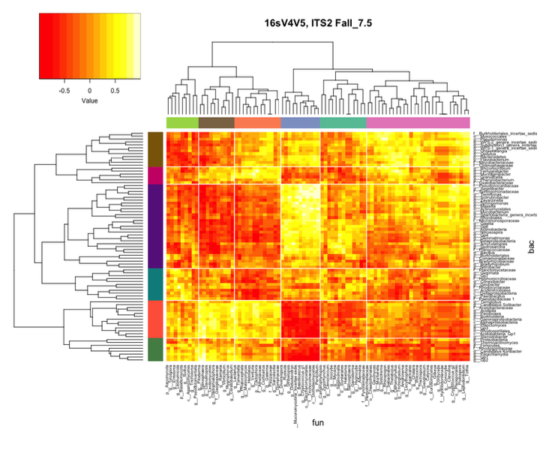
Multi community analysis

