Slide 1

A Universal JPEG Image Steganalysis Method Based on Collaborative Representation
Jun Guo*, Yanqing Guo, Lingyun Li, Ming Li
School of Information and Communication Engineering
Dalian University of Technology
Dalian, China, 116024
E-mail: {guojun, lingyunli}@mail.dlut.edu.cn; {guoyq, mli}@dlut.edu.cn

Slide 2





Contents
1
Motivation of Our Work
2
Proposed Method
3
Experiments and Results
3
4
Summary and Future Work
4

Slide 3
Contents
1
Motivation of Our Work
2
Proposed Method
3
Experiments and Results
3
4
Summary and Future Work
4

Slide 4
Motivation of Our Work
Battle of Steganography and Steganalysis
Steganography
embed message signal
into cover images to get
stego images;
message undetectable
in covert communication
Steganalysis
features sensitive to
change due to embedding
build decision model
using machine learning
recognize stego images
from plain cover images

Slide 5
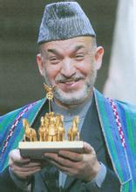
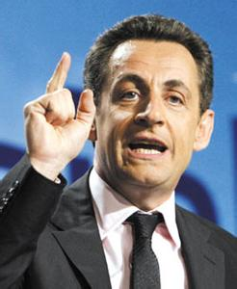
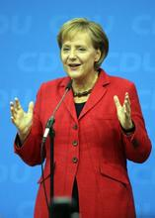
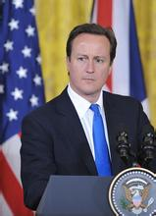
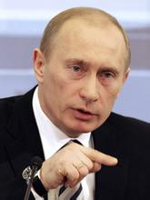
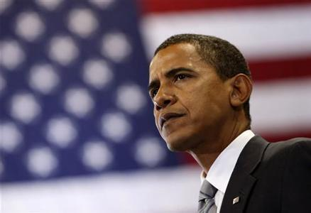
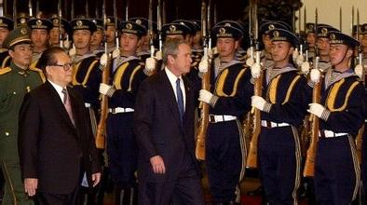
Motivation of Our Work
Battle of Steganography and Steganalysis
Internet
Receiver
Sender
Attack time
200109110758
Attack time
200109110758

Slide 6




Motivation of Our Work
A Common Steganalysis Model
……
SVM
Ensemble Classifier
Query
Image
Feature
Extraction
Classifier
Decision
PF274
Cover Image
Rich Model (22,510)
Stego Image
……
Notes:
Success of state of the art steganalysis methods rely on having prior knowledge of steganography to build the training set.
——cover images, embedding algorithm is known.

Slide 7
Motivation of Our Work
A Certain Inevitability for Steganalysis
Large
data
Simple classifier
large samples
diverse enough
rich features
……
SVM
Ensemble Fisher
Linear Discriminant
……
general model
Limitations:
It costs much labor to collect images for steganalysis. And it is more likely
time-consuming in training and has potentially “overfitting” problems.
How can we obtain a model robust for universal
steganalysis to break through the above limitations?

Slide 8
Contents
1
Motivation of Our Work
2
Proposed Method
3
Experiments and Results
3
4
Summary and Future Work
4

Slide 9
Proposed Method
Underlying Structure in Steganalysis
In many applications, high-dimensional features belonging to the same
class exhibit degenerate structure. That is, they often lie on or near low-
dimensional subspaces, submanifolds, or stratifications.
[J. Wright, Y. Ma, J. Mairal, G. Sapiro, T. Huang, and S. Yan 10]: Sparse
representation for computer vision and pattern recognition.
Feature
+
Classifier
Feature
+
Collaborative
Representation

Slide 10
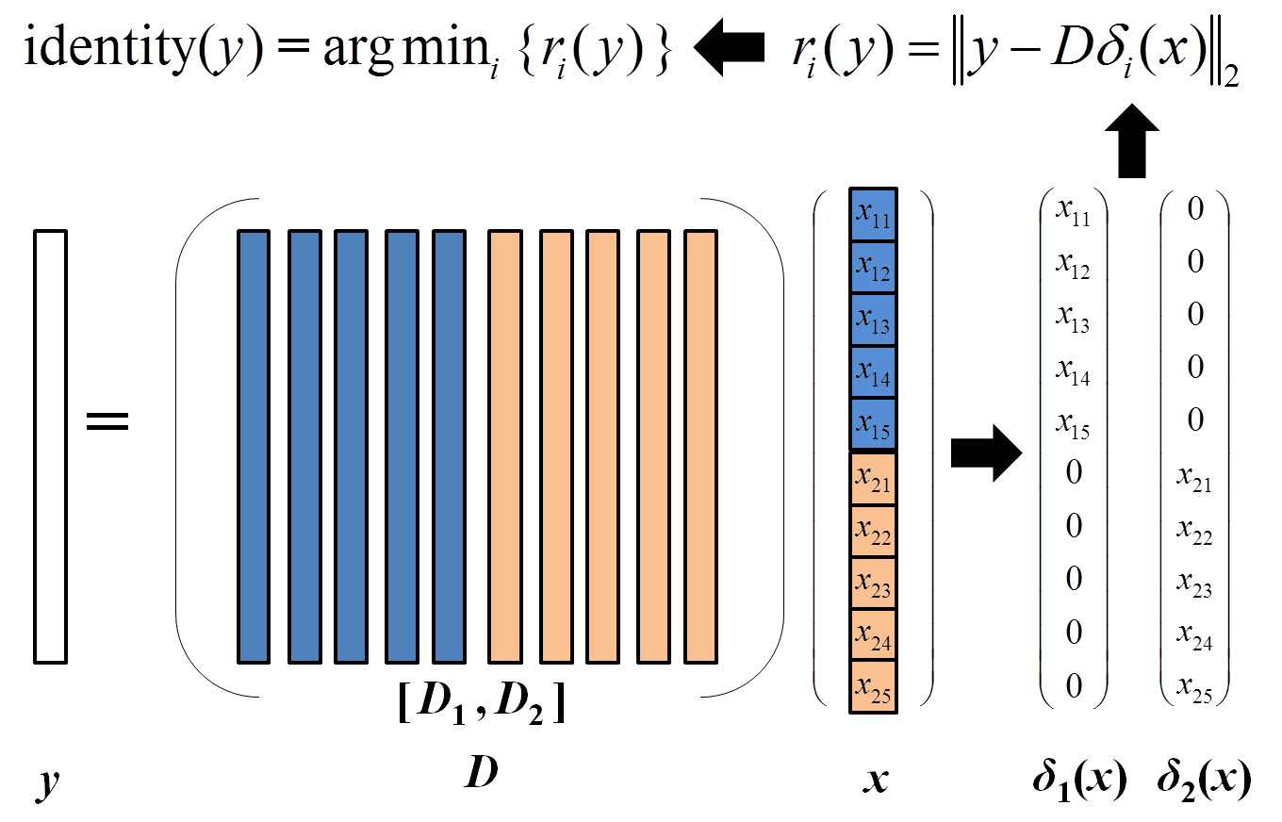
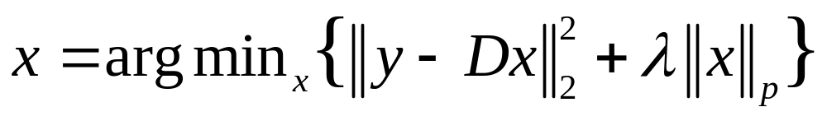
Proposed Method
Main idea
Collaborative Representation (CR):

Slide 11
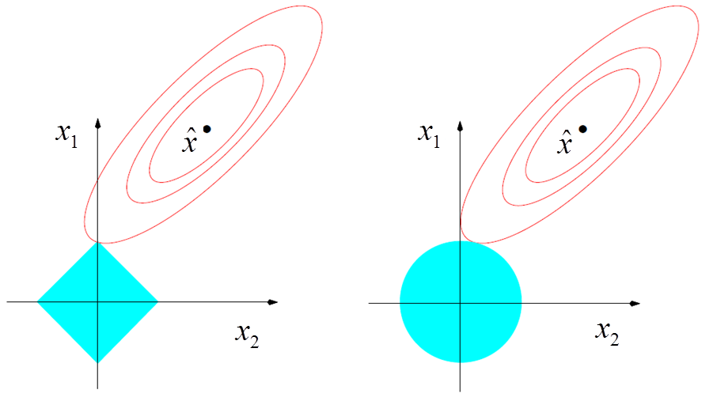
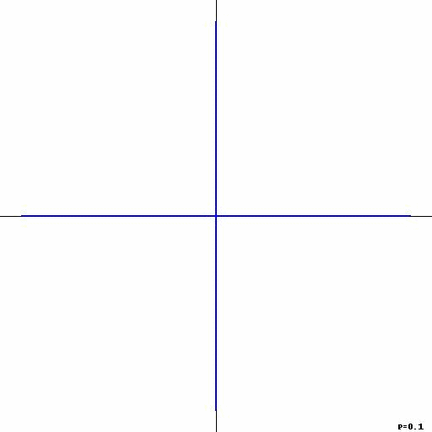
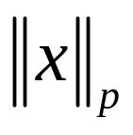
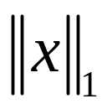
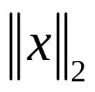
Proposed Method
Main idea
Collaborative Representation (CR):
Notes:
CRC with a l2-norm has a closed-form solution; others have iterative solutions.

Slide 12
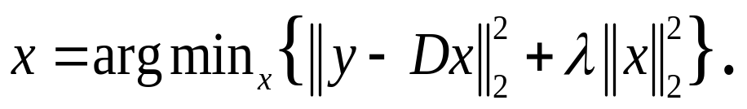
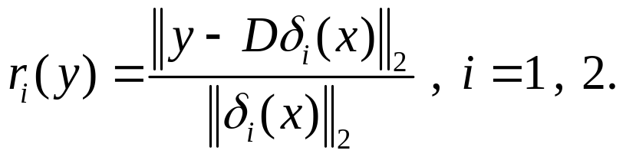
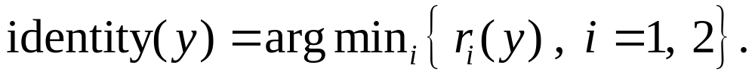
Proposed Method
Main idea
Algorithm: Steganalysis Based on Collaborative Representation
Input: A training sample set D for two classes (cover and stego), a testing sample y. 1. Normalize all the columns of the dictionary D to have unit l₂-norm. 2. Code y over D by l₂-minimization as 3. Calculate the residuals as Output: Identity of the testing sample y as

Slide 13
Contents
1
Motivation of Our Work
2
Proposed Method
3
Experiments and Results
3
4
Summary and Future Work
4

Slide 14

Experiments and Results
Experimental Setup
Database: BOSSbase ver. 1.01, 10000 JPEG images.
Image: 8-bit grayscale, 512×512, quality factor 85.
Steganographic Algorithms: Jsteg, Outgess, MB1, F5, nsF5.
Features: PF-274.
Approach compared with:
  SVM: PF-274 + libSVM
  SRC: PF-274 + l₁-norm

Slide 15
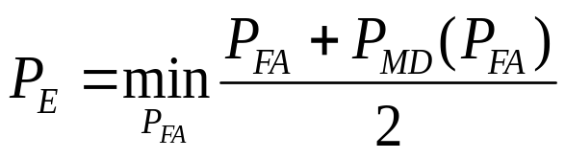
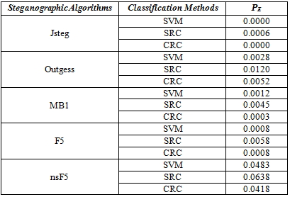
Experiments and Results
Experiment 1
Detection Results of Five Steganographic Algorithms
For Payload 0.25 BPAC.
  P_{FA} :
  False Alarm Rate
  P_{MD} :
  Missed Detection Rate

Slide 16
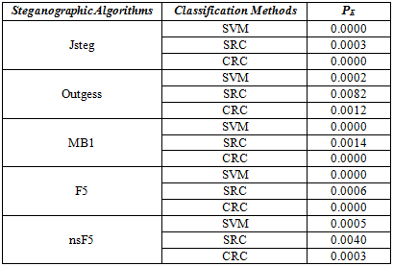
Experiments and Results
Experiment 2
Detection Results of Five Steganographic Algorithms
For Payload 0.50 BPAC.
  P_{FA} :
  False Alarm Rate
  P_{MD} :
  Missed Detection Rate

Slide 17
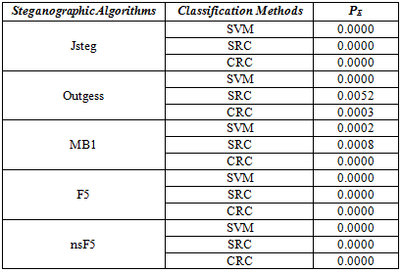
Experiments and Results
Experiment 3
Detection Results of Five Steganographic Algorithms
For Payload 1.00 BPAC.
  P_{FA} :
  False Alarm Rate
  P_{MD} :
  Missed Detection Rate

Slide 18
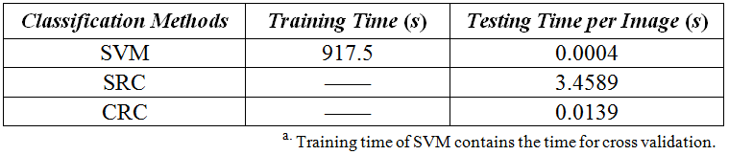
Experiments and Results
Experiment 4
MATLAB R2010a on an Intel Core i5-3470 processor
3.20 GHz combined with 3.68 GB RAM
A 64-bit Windows 7 operating system
The Average Running Time:

Slide 19
Contents
1
Motivation of Our Work
2
Proposed Method
3
Experiments and Results
3
4
Summary and Future work
4

Slide 20
Summary
Traditional steganalysis methods
  cost much labor to collect images for steganalysis
  more likely time-consuming in training
  potentially “overfitting” problems
Steganalysis Based on Collaborative Representation
  exploit feature’s degenerate structure in steganalysis
  solve the least square problem in a binary classification
  improve steganalysis detection accuracy
  a fast speed due to lower computational complexity

Slide 21
Future Work
New Strategy for Content-Mismatched Steganalysis
  How to utilize collaborative representation in a single set, which is not diverse, small number?
  How to make full use of the sample set to obtain a better dictionary?
  Investigate if there exists low-dimensional subspaces, submanifolds, or stratifications for PF-274 in a lower payload case.
  The combination of kernel-CRC and image steganalysis in a lower payload case.
  ……

Slide 22
Thank you！

