Slide 1
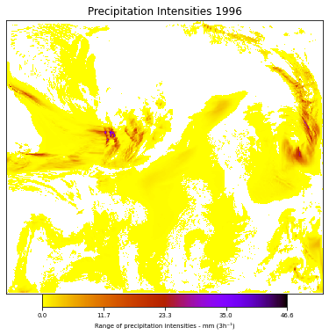
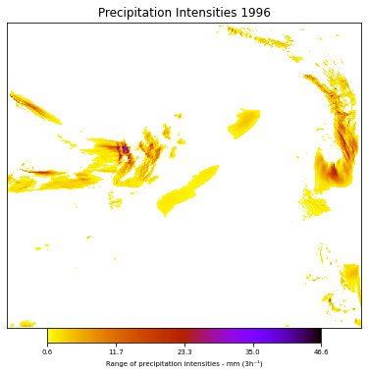
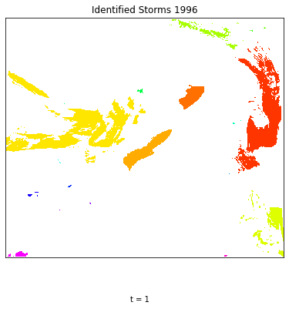
STEP(Storm Tracking and Evaluation Protocol)
0. Thresholding:
Set precipitation < threshold to zero (paper: 0.033 mm/h = 0.1 mm/3h)
1. Identification:
Divide the precipitation field at time t into individual storms.
Result: labeled array = Identification(precipitation: array, morph_structure: array)
Raw WRF precipitation
(mm/3h) 120 km grid
Threshold = 0.6 mm/3h
Identified storms

Slide 2
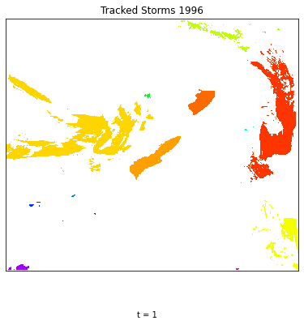
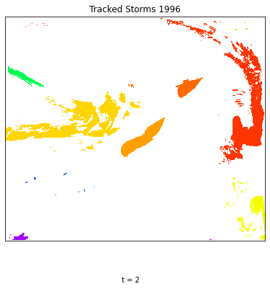
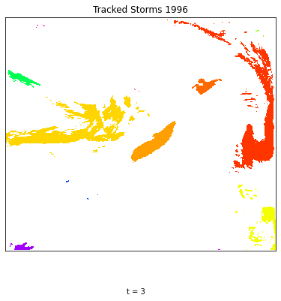
STEP(Storm Tracking and Evaluation Protocol)
0. Thresholding:
Set precipitation < threshold to zero (paper: 0.033 mm/h = 0.1 mm/3h)
1. Identification:
Divide the precipitation field at time t into individual storms.
Result: labeled array = Identification(precipitation: array, morph_structure: array)
2. Tracking:
Track storms over time
Result: labeled array of storm sequentially over time = Track(labeled array, precipitation, tau, phi, km, angle, test: boolean)
t1
t2
t3
Notes:
Erosion: for each pixel find the smallest area in neighboring pixels in the

Slide 3
STEP(Storm Tracking and Evaluation Protocol)
0. Thresholding:
Set precipitation < threshold to zero (paper: 0.033 mm/h = 0.1 mm/3h)
1. Identification:
Divide the precipitation field at time t into individual storms.
Result: labeled array = Identification(precipitation: array, morph_structure: array)
2. Tracking:
Track storms over time
Result: labeled array of storm sequentially over time = Track(labeled array, precipitation, tau, phi, km, angle, test: boolean)
3. Quantification
1) Duration: Return total timesteps * interval of each storm
2) Size: Return the total pixels * pixel area (144 km2 for WRF) of each storm at time t
3) Avg precipitation: Return the total precipitation intensity / total pixels of each storm at time t
4) Central loc: Return the mass centroid weighted by precipitation intensity of each storm at time t
Notes:
Erosion: for each pixel find the smallest area in neighboring pixels in the

Slide 4
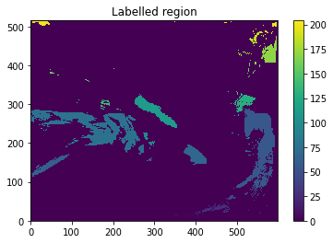
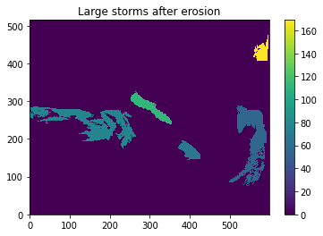
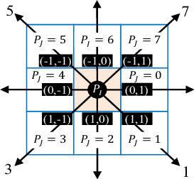
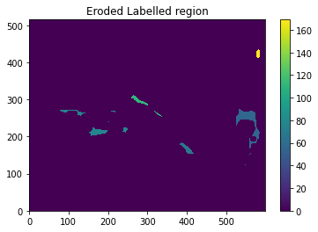
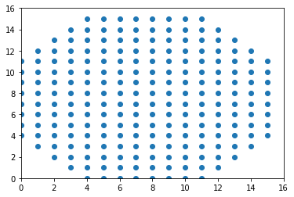
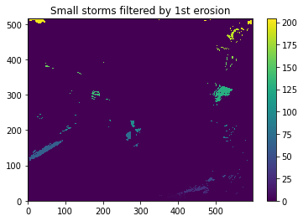
STEP(Storm Tracking and Evaluation Protocol)
Detailed algorithm for Identification (For t = 0 precipitation after thresholding)
1. Find continuous regions to create a label array
3. Keep labels of remained storms, extracted from label array
Consider as large storms (remained > 1 pixel after erosion)
(8 direction connection)
2. Erosion
4. Keep labels of eroded storms, extracted from label array
Consider as small storms
Morph structure:
(16, 16) array
Center (7.5, 7.5)
Radius = 8.5
Notes:
Morphological dilation sets a pixel at (i,j) to the maximum over all pixels in the neighborhood centered at (i,j).
Morphological erosion sets a pixel at (i,j) to the minimum over all pixels in the neighborhood centered at (i,j).

Slide 5

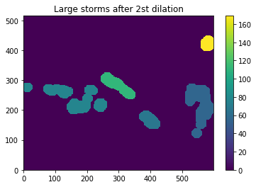
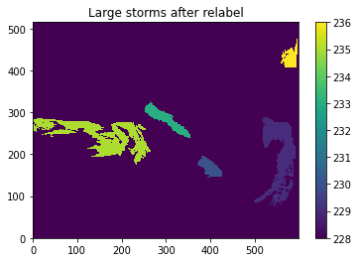
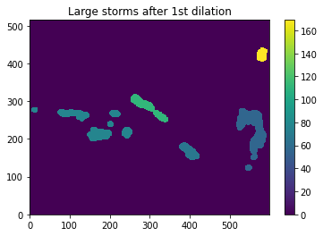
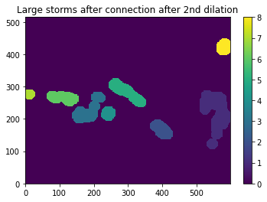
STEP(Storm Tracking and Evaluation Protocol)
Detailed algorithm for Identification (For t = 0 precipitation after thresholding)
5. Almost-connect component labeling for large storms
5.5 Extract and combine overlapping storms
Find all large storms overlapping with one connected region
Merge and relabel all overlapping large storms
5.1 Erosion
5.3 2nd dilation
5.2 Dilation
5.4 Connect labeling
Note: only five large storms with label 229, 230, 233, 235, 236
These three are overwritten during iteration.

Slide 6
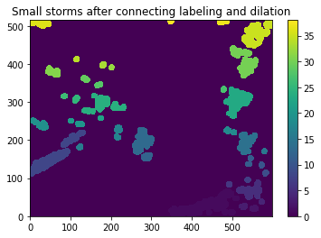
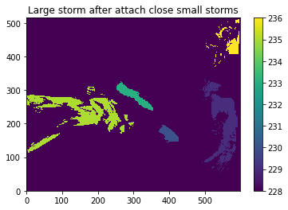
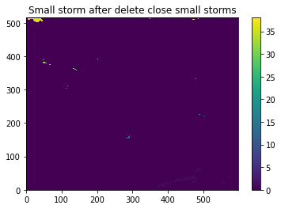
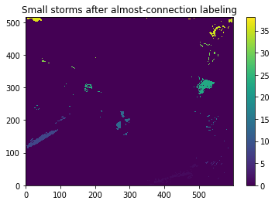
STEP(Storm Tracking and Evaluation Protocol)
Detailed algorithm for Identification (For t = 0 precipitation after thresholding)
6. Almost-connect component labeling for small storms
6.1 Dilation and connect labeling
6.3 Attach the small storm to closest overlapping large storm
For each small storm, calculate its dilation’s overlapping pixels with each large storms
If there is overlapping:
Attach the small storm to the large storm with the largest overlapping pixels
2) If there is no overlapping:
Consider the small storm as an individual storm, extract the filtered small storms again from label array.
6.2 Extract connected small storms

Slide 7
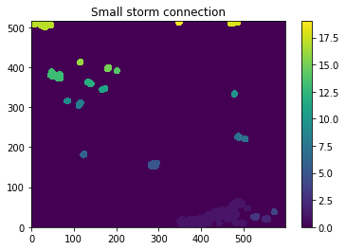
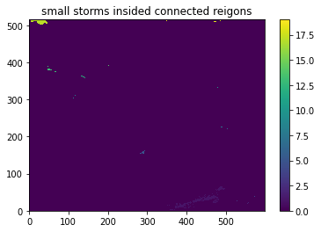
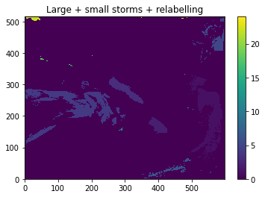
STEP(Storm Tracking and Evaluation Protocol)
Detailed algorithm for Identification (For t = 0 precipitation after thresholding)
6. Almost-connect component labeling for small storms
7. Combine large storm and filtered small storms together and relabel them
6.4 Dilate and connect the filtered small storms
6.5 Extract filtered small storms inside the connected regions

Slide 8
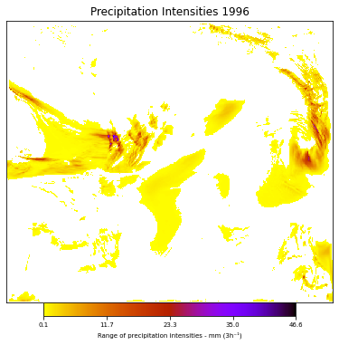
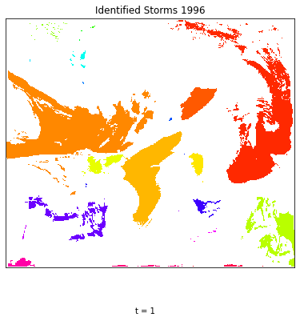
STEP(Storm Tracking and Evaluation Protocol)
0. Thresholding:
Set precipitation < threshold to zero (paper: 0.033 mm/h = 0.1 mm/3h)
1. Identification:
Divide the precipitation field at time t into individual storms.
Result: labeled array = Identification(precipitation: array, morph_structure: array)
Threshold = 0.1 mm/3h
Identified storms

Slide 9
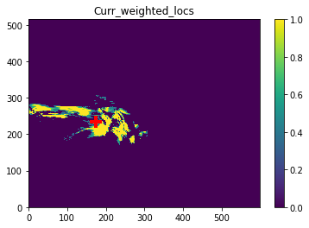
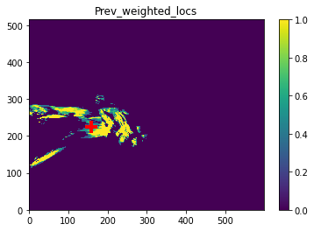
STEP(Storm Tracking and Evaluation Protocol)
Detailed algorithm for Tracking:
1. For storm i (curr_strom) in all storms at t[1], compute its similarity metrics with storm j (prev_storm) at t[0]
2. If similarity > tau (const, 0.7 in this case):
Compute the distance between mass centroids of curr_storm and prev_storm
If distance < d (const, 18.6 pixels in this case):
Keep the size and label of the prev_storm
If distance >= d:
Compute the mass centroid of the prev_storm’s predecessor (pred_storm) at t[-1]
Compute the Angle between vectors of centroid displacements:
v1 = (x_curr – x_prev, y_curr – y_prev)
v2 = (x_prev – x_pred, y_prev – y_pred)
Angle = arccos(dot(v1,v2)/(||v1||*||v2||)) ∈[0, pi]
If Angle < 2/3*pi (120°)
Keep the size and label of the prev storm
3. Label the curr_storm with the label of the largest prev_storm
4. If there is no matched prev_storm
Give the curr_storm a new label
Angle < 120°
Curr_storm
t[1]
Angle > 120°
Curr_storm
t[1]
Prev_storm
t[0]
Prev_storm
t[0]
Pred_storm
t[-1]
Pred_storm
t[-1]
Notes:
d needs to change, 120 degree might change for daily precipitation… Justify the parameters

Slide 10
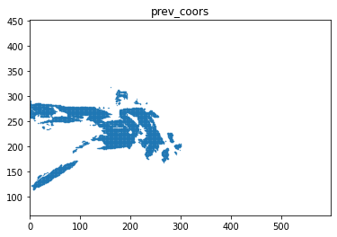
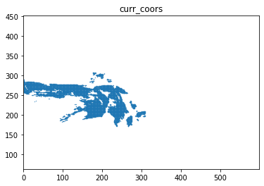
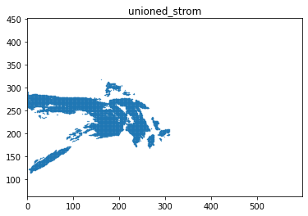
STEP(Storm Tracking and Evaluation Protocol)
2. Tracking:
Similarity metric
Previous storm A
Current storm B
Previous storm A
Current storm B
A
B
For points x, y in A∪B
1. Euclidian distance
2. Precipitation weight for x
3. Precipitation weight for y
4. Weighted exponential transform
5. Similarity:
F(1) is horizontal coord
F(2) is vertical coord
Union A + B
This weight is 0 if x is outside of A
This weight is 0 if y is outside of B
> tau: const., 0.7 in tutorial)
phi: constant, 0.003 in tutorial
exp(-phi*d) -> 1 if d -> 0
exp(-phi*d) -> 0 if d -> infinte
△(x,y) = 0 if not in A∩B
Therefore, the effective computational domain is A∩B!

Slide 11
STEP(Storm Tracking and Evaluation Protocol)
2. Tracking:
Comments
F(i) can include more normalized variables:
Assuming that two consecutive storm share some similar characteristics:
u, v, water vapor, temperature…
2. The effective computation domain is A∩B
3. The functions of precipitation weight terms is unclear
Similarity metric
Previous storm A
Current storm B
A
B
F(1) is horizontal coord (pixels)
F(2) is vertical coord (pixels)
Velocity…water vapor…temp…more variables..
For points x, y in A∪B
1. Euclidian distance
2. Precipitation weight for x
3. Precipitation weight for y
4. Weighted exponential transform
5. Similarity:
This weight is 0 if x is outside of A
This weight is 0 if y is outside of B
phi: constant, 0.003 in tutorial
exp(-phi*d) -> 1 if d -> 0
exp(-phi*d) -> 0 if d -> infinte
> tau: const., 0.7 in tutorial)
△(x,y) =0 if not in A∩B
Therefore, the effective computational domain is A∩B!
Notes:
Try add numba

Slide 12
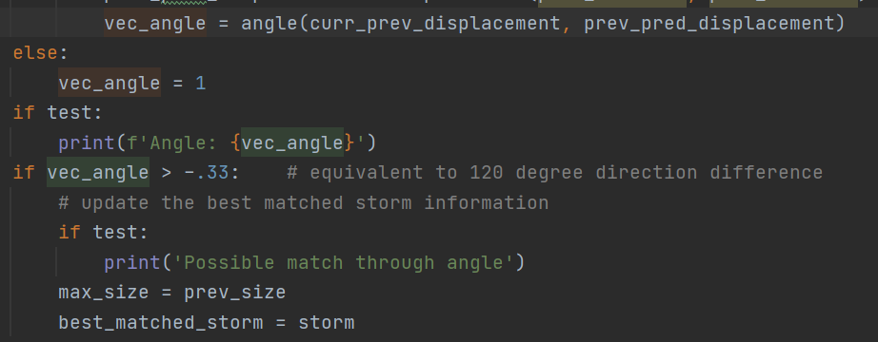
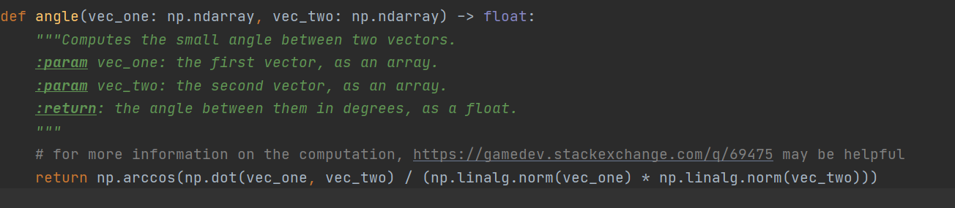
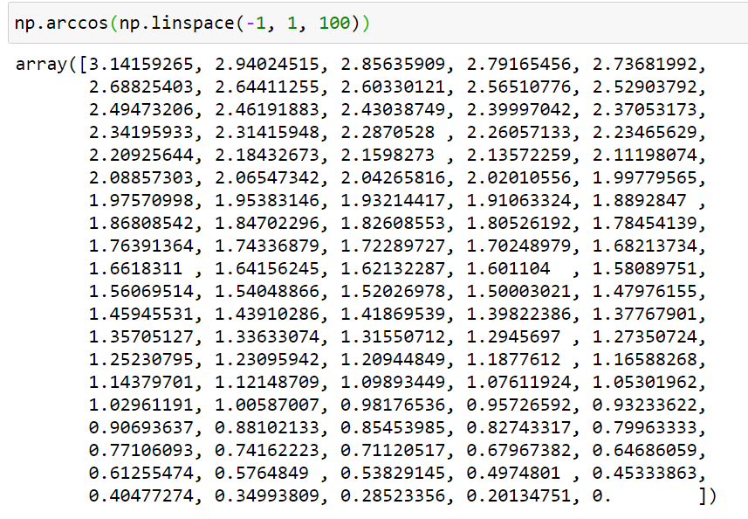
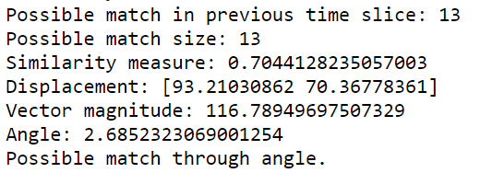
Since np.arccos(x) always returns [0, pi],
so function angle will only return degree > 0
So vec_angle > -.33: is always True
That means, if the prev storm and curr storm has a too large distance, they can still pass the angle test. The distance filter is invalid due to this bug.
Fix:
If vec_angle > 2.09: # equivalent to 120 degree direction difference
STEP(Storm Tracking and Evaluation Protocol)
2. Tracking:
Bug report: tracking.py line 134

Slide 13
STEP(Storm Tracking and Evaluation Protocol)
2. Tracking:
Possible memory issues:
In calculating similarity:
8 GB is not enough (my computer 16 GB, but memory capacity for python may be 8GB)
For local testing:
WRF precipitation: 12 km grid, continent US, 5 timesteps, storm size < 5000 pixels
Notes:
Reduce to the float32…
Add python library nmba

Slide 14
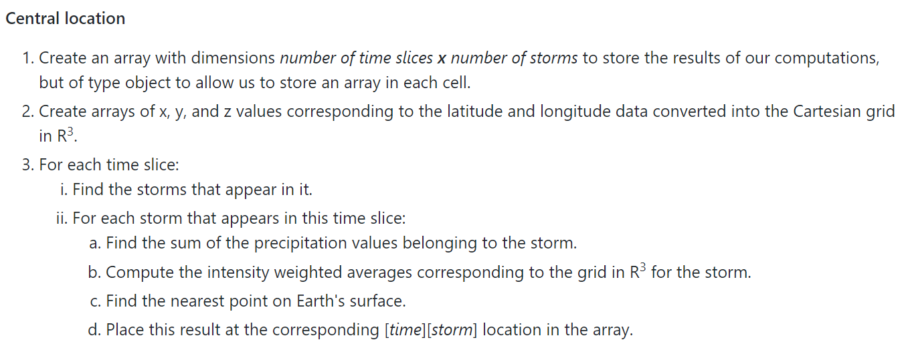
STEP(Storm Tracking and Evaluation Protocol)
3. Quantification
Details about the mass centroid:
1. Compute x, y, z arrays for the cartesian grid
x_array = cos(lats) * cos(longs)
y_array = cos(lats) * sin(longs)
z_array = sin(lats)
2. For one storm at time t
1) Compute total precipitation
2) x_avg = sum( cell_x * precip / total precip), same to y_avg, and z_avg
3)
h_avg = sqrt(x_avg**2 + y_avg**2)
Central_loc (degree) =
Central_loc (degree)=

