Slide 1

Introduction to Data Analytics
ITC 5201

Slide 2
Pandas
We will use pandas to:
Read in data from Excel.
Manipulate data in spreadsheet.

Slide 3
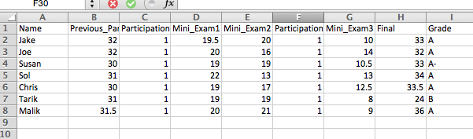
Reading in Data From Excel
I have the following data saved in the file “Grades_Short.csv”:
Let’s see how we read this data into pandas:

Slide 4
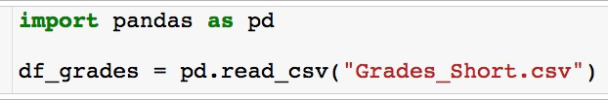


Reading in Data From Excel
I have the following data saved in the file “Grades_Short.csv”:
Reading the data into a variable called
df_grades.
Let’s see how we read this data into pandas:
Built in read_csv method
Path to file

Slide 5
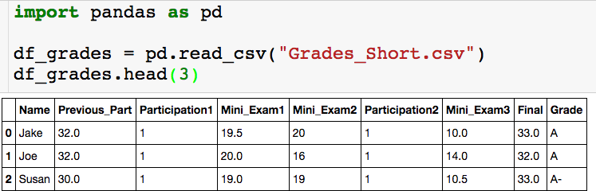
The head() Method
Using the head() method
If the data is really large you don’t want to print out the entire dataframe to your
output.
The head(n) method outputs the first n rows of the data frame. If n is not supplied, the default is the first 5 rows.
I like to run the head() method after I read in the dataframe to check that everything got read in correctly.
There is also a tail(n) method that returns the last n rows of the dataframe

Slide 6
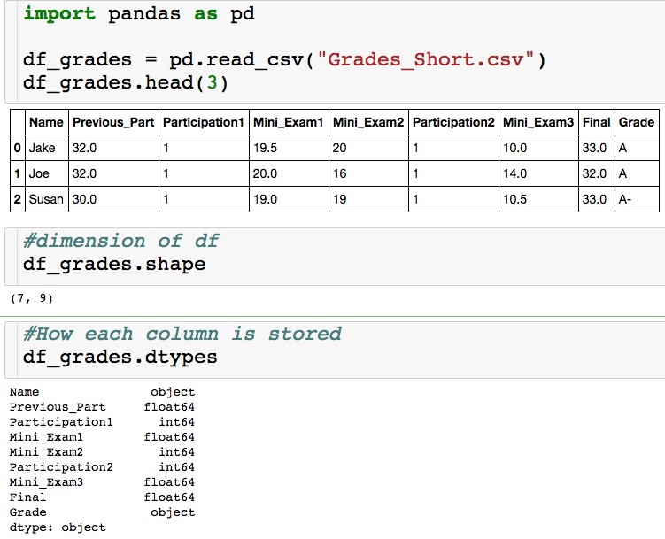
Basic Features
Think of this
as a list
object = string float64 = decimal int64 = integer

Slide 7
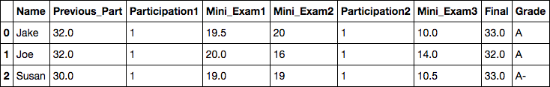
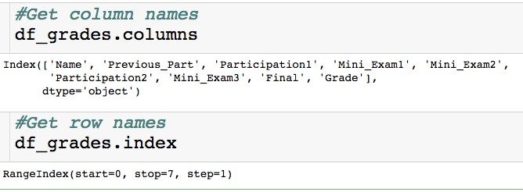
Basic Features
column names
row names = index

Slide 8
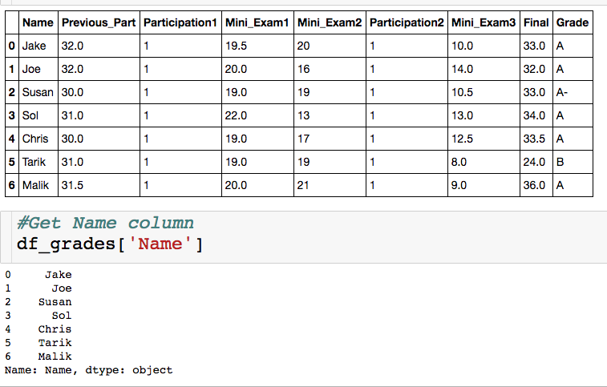
Selecting a Single Column
Between square brackets, the column must be given as a string
Outputs column as a series
A series is a one dimensional dataframe..more on this in the slicing
section

Slide 9
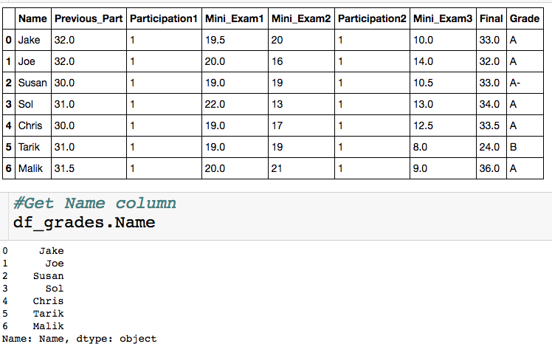
Selecting a Single Column
Exactly equivalent way to get Name column
• + : don’t have to type brackets or quotes
-: won’t generalize to selecting multiple columns,, won’t work if
column names have spaces, can’t create new columns this way

Slide 10
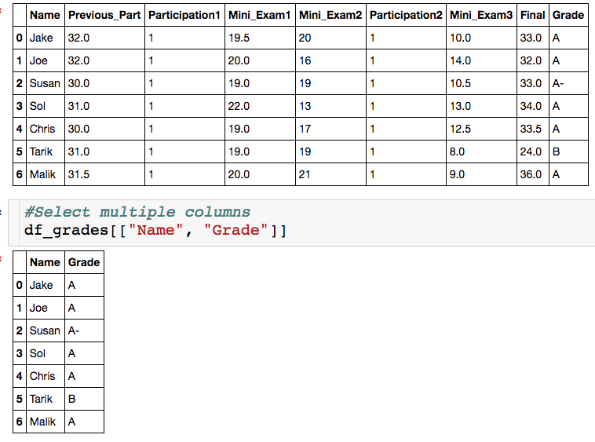
Selecting Multiple Columns
List of strings, which correspond to column names.
You can select as many column as
you want.
Column don’t have to be contiguous.

Slide 11
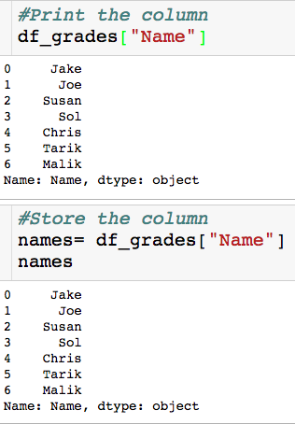
Storing Result
Why store a slice?
We might want/have to do our
analysis is steps.
Less error prone
More readable
The variable name stores a
series

Slide 12
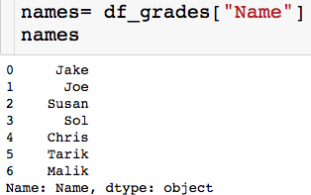
Slicing a Series
Slice/index through the index, which is usually numbers

Slide 13

Slicing a Series
Slice/index through the index, which is usually numbers
Picking out single element

Slide 14
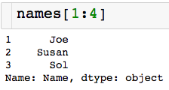
Slicing a Series
Slice/index through the index, which is usually numbers
Picking out single element
Contiguous slice
non_inclusive

Slide 15
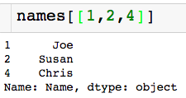
Slicing a Series
Slice/index through the index, which is usually numbers
Picking out single element
Contiguous slice
Arbitrary slice

Slide 16
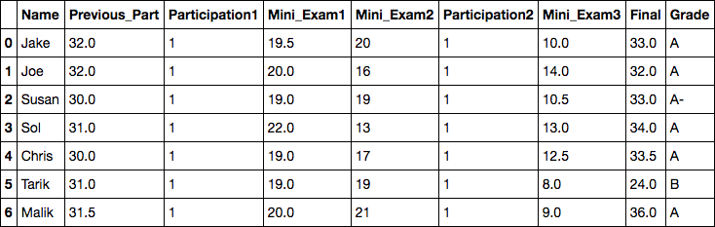
Slicing a Data Frame
There are a few ways to pick slice a data frame, we will use the .loc method.
Access elements through the index labels column names
We will see how to change both of these labels later on

Slide 17

Slicing a Data Frame
Pick a single value out.
Column name (string)
Index label (number)

Slide 18
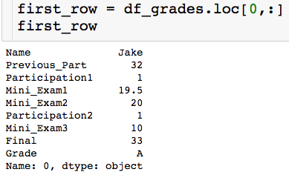
Slicing a Data Frame
Pick out entire row:
“pick out all
columns”
first_row is a series

Slide 19
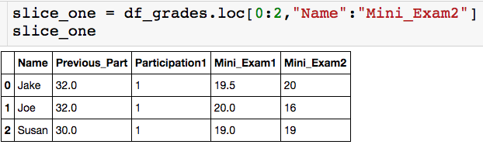
Slicing a Data Frame
Pick out contiguous chunk:
Endpoints are inclusive!

Slide 20
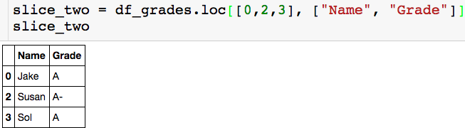
Slicing a Data Frame
Pick out arbitrary chunk:

Slide 21
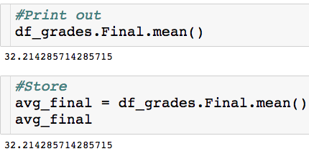
Built in Functions
How do I compute the average score on the final?
Built in mean() method

Slide 22

Built in Functions
How do I compute the highest Mini Exam 1 score?

Slide 23
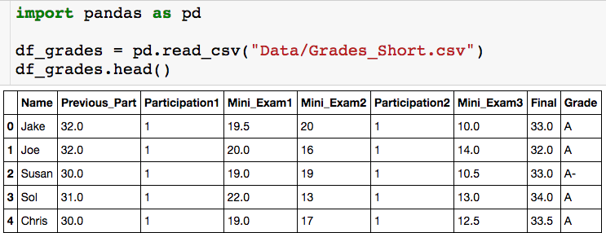

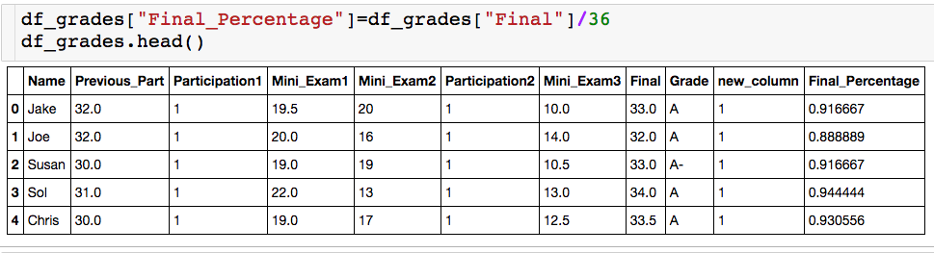
Creating New Columns
We can also create column as function of other column. The Final was worth 36
points, let’s create a column for each student’s percentage.

Slide 24
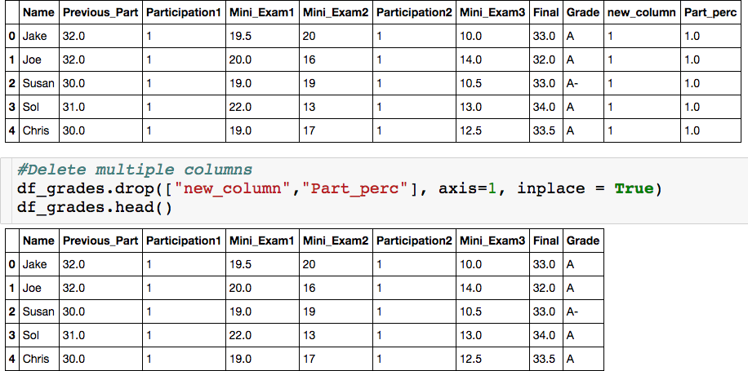
Deleting Columns

Slide 25
The Drop Method
inplace = True– change df_grades
inplace = False – return dataframe with specified columns deleted, do not change df_grades
List of column of index label
axis = 1 – delete specified columns
axis = 0 – delete specified rows

Slide 26
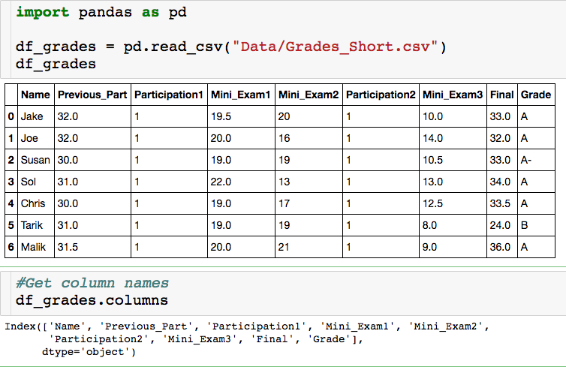
Changing Column Names

Slide 27
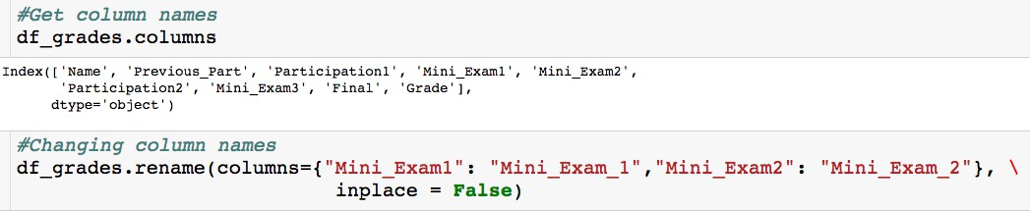
Changing Column Names

Slide 28

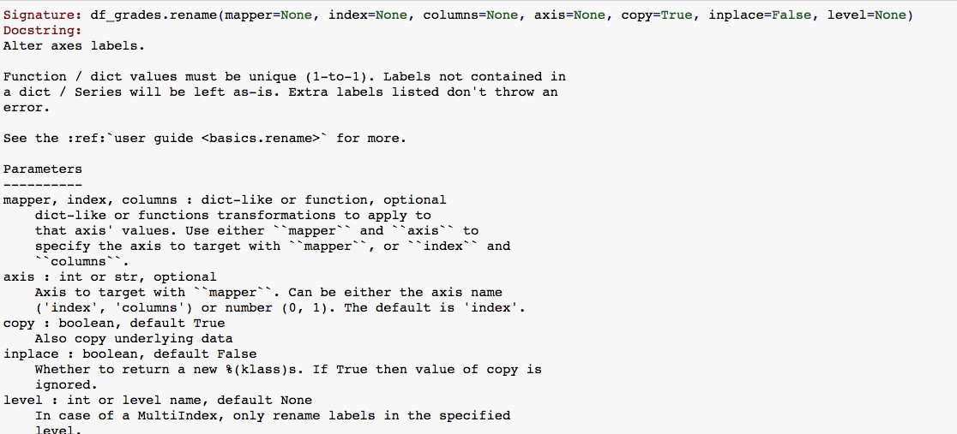
Changing Column Names

Slide 29
Changing Column Names
“curly” brackets around new column name assignments

Slide 30
Changing Column Names
“old_column_name”: “new_column_name”

Slide 31
Changing Column Names
inplace = False (default) returns a new dataframe
(df_grades is unaltered) with updated column names.

Slide 32
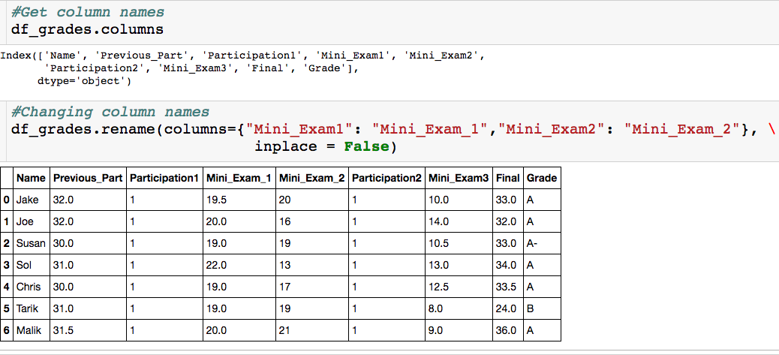
Changing Column Names

Slide 33
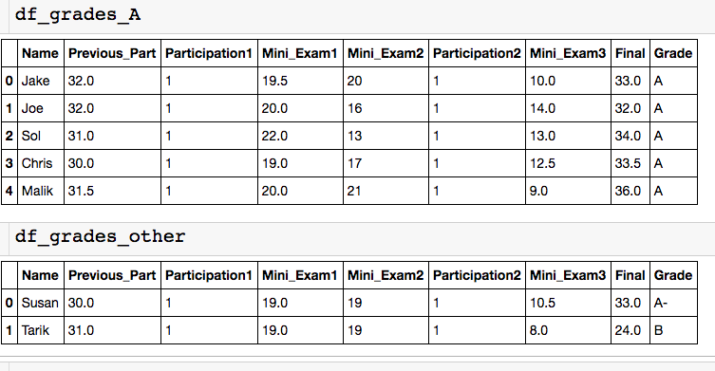
Concatenating DataFrames - Stacked
Let’s say you had separate csv files with the info for the students who got an A and
everyone else, but you want to analyze everything together.

Slide 34
Concatenating DataFrames - Stacked
axis = 0 (default) – combine the two dataframes by stacking them on top of each other. Set axis =1 to stack side by side.

Slide 35
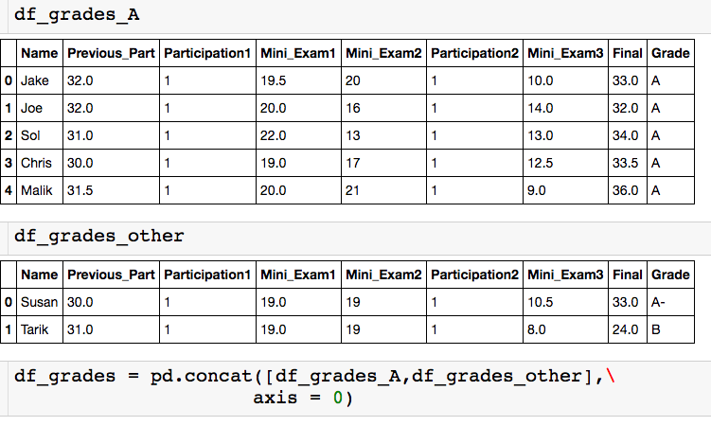
Concatenating DataFrames - Stacked
# of columns has to match
What is going to happen to index?

Slide 36
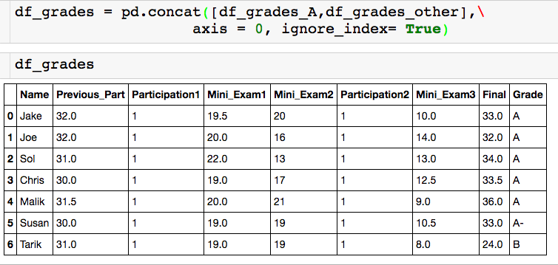
Concatenating DataFrames - Stacked
Notice the ignore_index input!

Slide 37
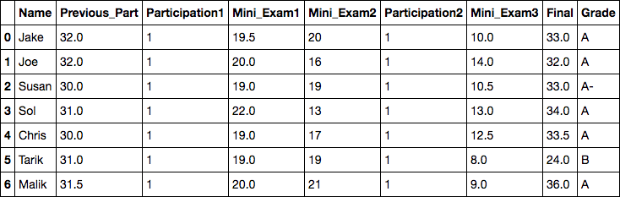
Using the Index
The index in this case is row numbers.
What if I want to quickly see Joe’s row?
I have to look up what row Joe is in.
Instead, I can make the index the column name.

Slide 38

Using the Index
Column that will become index (make sure this
is unique).

Slide 39
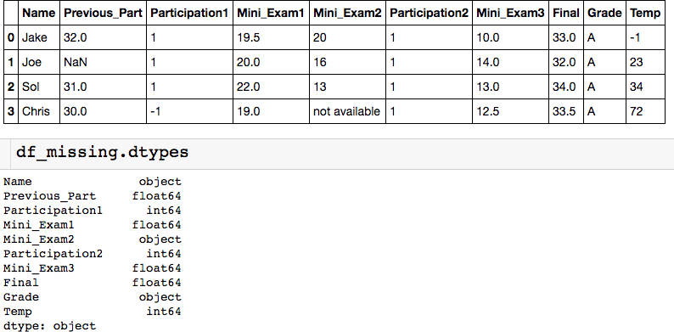
Missing Data
We can replace the missing data with a true NaN (right now everything is just a string).

Slide 40
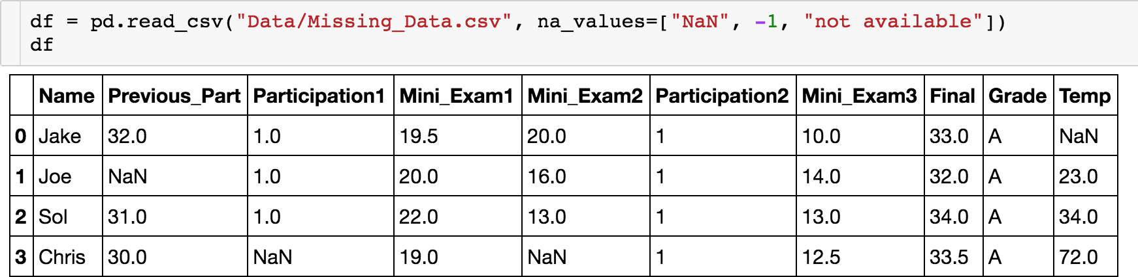
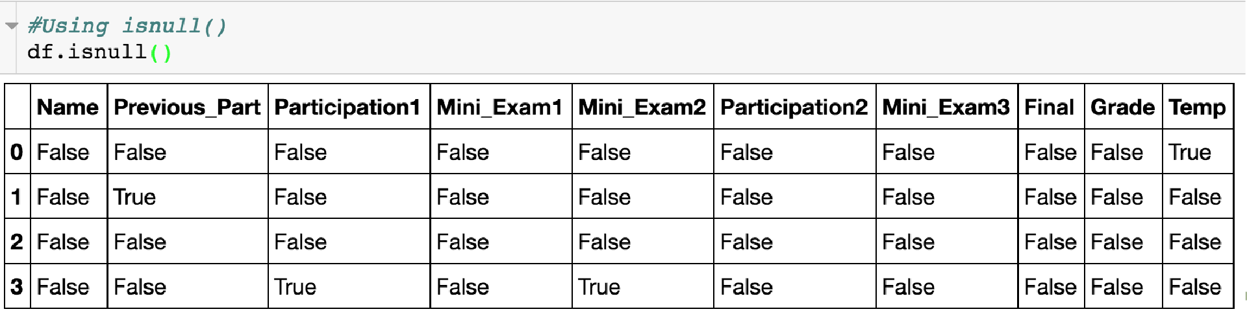
Isnull() Method
The isnull() method lets you check where the NaNs are:

Slide 41
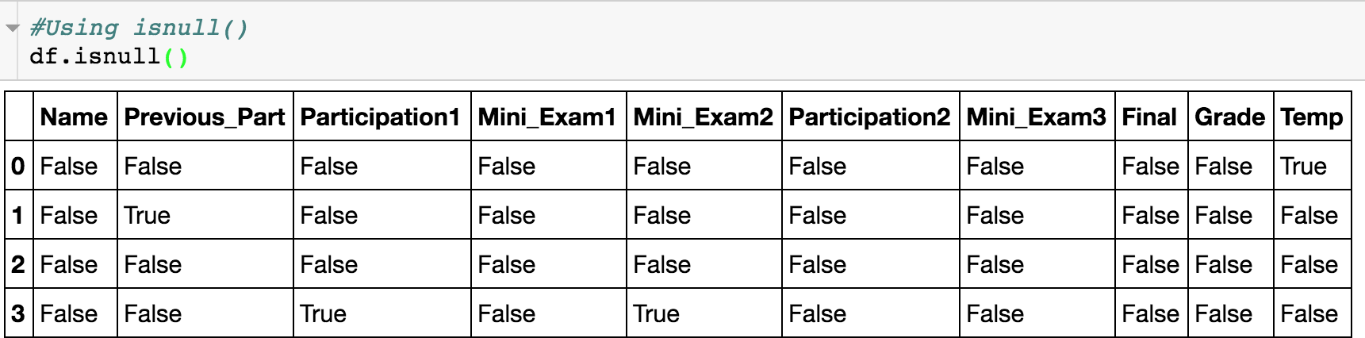
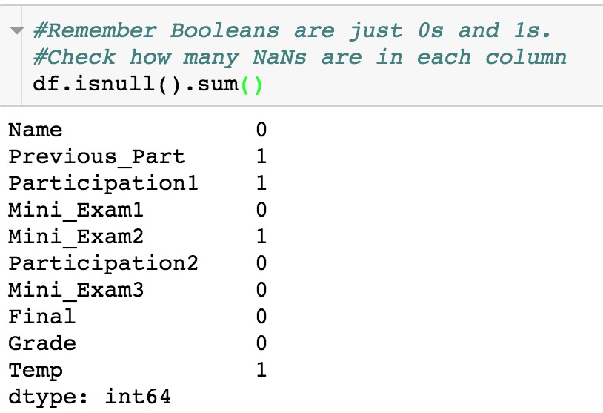
Isnull() Method
The isnull() method lets you check where the NaNs are:

Slide 42
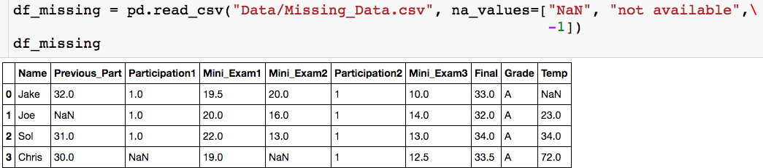
Dropna() Method
How do I get rid of all rows with NaN?

Slide 43
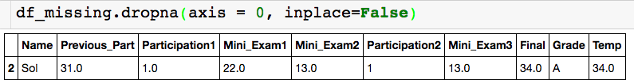
Dropna() Method
How do I get rid of all rows with NaN?
Setting axis = 1 would drop all columns with an NaN

Slide 44

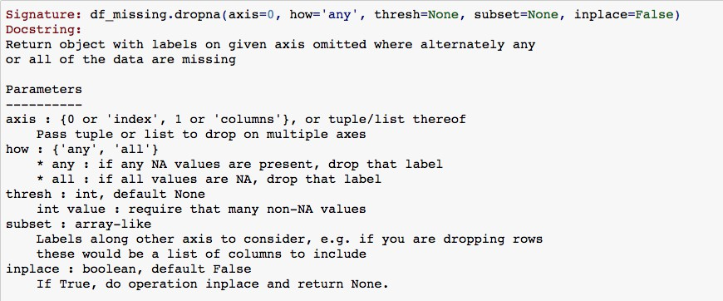
Dropna() Method

Slide 45
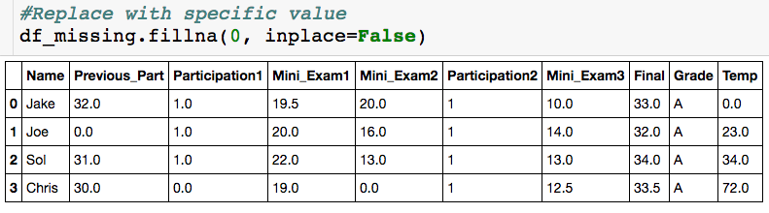
Fillna() Method
Rather than getting rid of rows/columns, we fill the “holes” in a number of ways.

