Slide 1
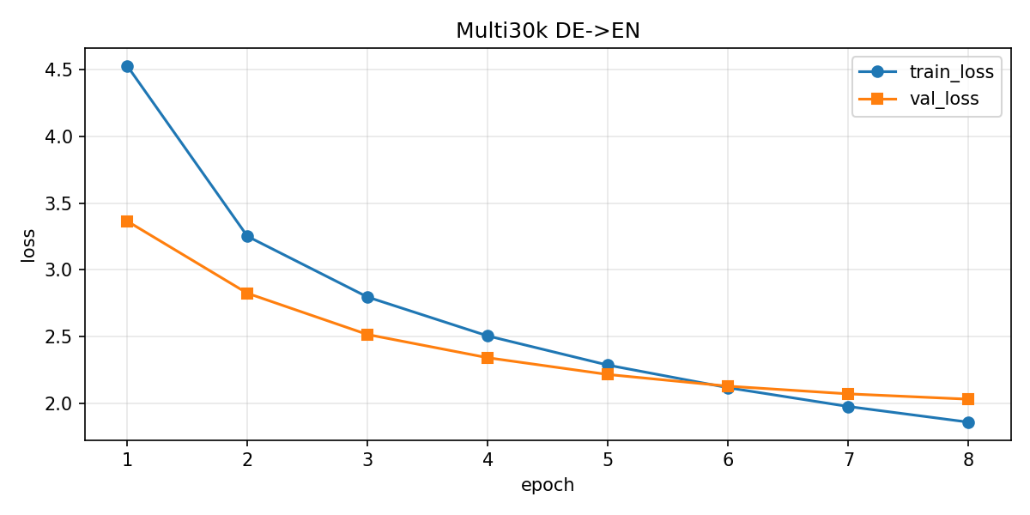
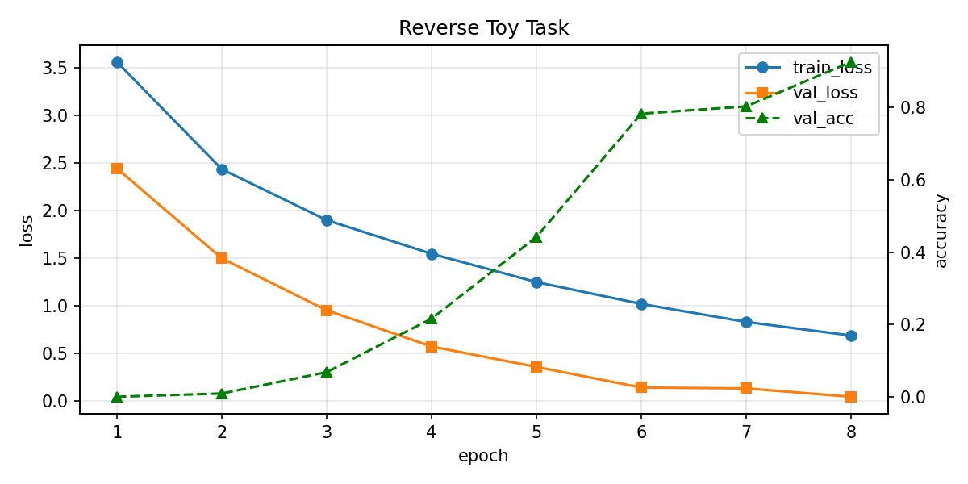
Transformer from Scratch
课程 Project 海报 | PyTorch Encoder-Decoder Transformer
核心模块
Embedding + Positional Encoding
Scaled Dot-Product Attention
Multi-Head Attention
Encoder / Decoder / Mask
实验设置
Multi30k / 合成语料
d_model=256, heads=8, layers=3
Adam + NLLLoss + grad clip
Teacher Forcing
结果
Best val loss: 2.0334
BLEU: 76.52
Reverse val acc: 92.58%
Total params: ~9.88M
GitHub 结构：README / requirements / train.py / test.py / model.py / data / configs / results / figures / checkpoints / PPT / poster / report

