Slide 1

Machine Learning Based Face Mask Recognition
Jiaqi Guo
Manzhu Wang
Xinyi Su
Chenxi Liu
Notes:
This is video report for Northwestern university Machine learning.

Slide 2
Introduction and dataset
Design a framework to classify a set of face mask images
Three types of dataset : Correct Masking, Incorrect Masking and No masking
Each dataset has around 1500 samples
Link to the dataset: https://github.com/GuoJiaqi-1020/EE-475-ML-Final-Project/tree/main/Data
Notes:
As the COVID-19 has brought great disaster, personal protection has become particularly necessary. To controlling the spread of the epidemic, everyone should wear masks. The objective of this project is to design a framework to classify a set of face masking images. Collecting facial images through cameras and performing masking wearing recognition.
There are three classes(Correct Masking, Incorrect Masking and No masking)

Slide 3
Data preprocessing
Load the original face mask data with pixel of 20*20, 50*50 and 100*100
Transfer the RGB image to gray image
Notes:
For the data-preprocessing, we down sampled the images, then converted them into grayscale images, and extracted features using various algorithm.

Slide 4
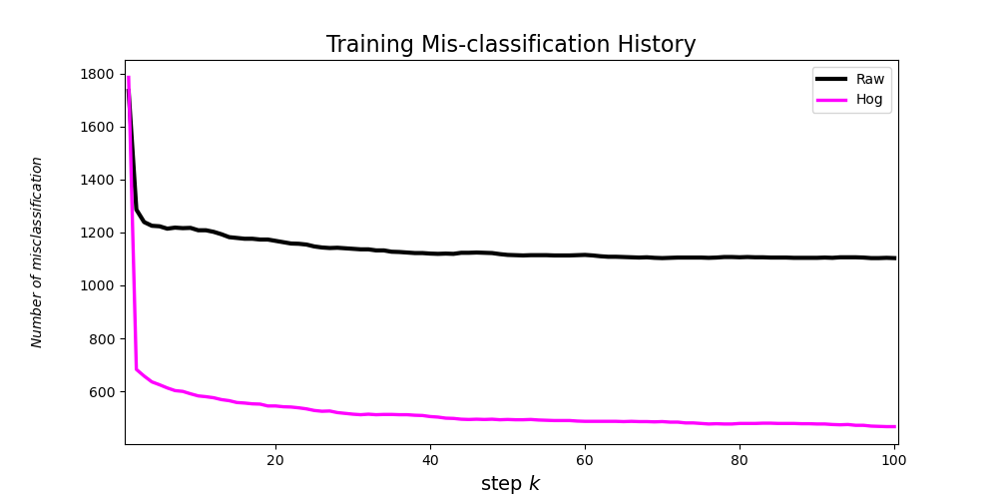
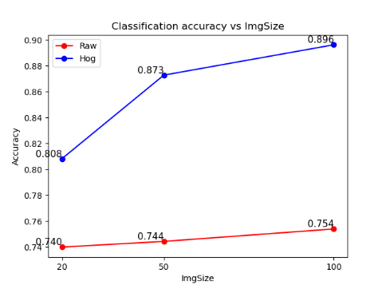
Algorithm 1: Linear classifier（Baseline）
Optimization method: gradient decent (with diminishing study rate, start from 0.02)
HOG feature has increased the model accuracy by nearly 15%
HOG feature has higher sensitivity towards the image resolution. (fig 2)
The best accuracy of this model is 89.6% (using 100×100 resolution)
Notes:
The first algorithm is a linear classifier, In the training process of the model, we mainly encountered two problems
When we choose a fixed learning rate, the cost of training will show significant fluctuations, indicating that our choice of learning rate is too large. However, when we choose a smaller learning rate, the model convergence speed will slow down, which will result in a low training efficiency.
The second problems is that the contour and shape of a face cannot be well represented by using the raw image data, so the classification accuracy of the model trained by using the original image is comparatively low.
To solve those two problem ,we introduced a diminishing study rate and extract the HoG feature. And the result are concluded as above.

Slide 5
Algorithm 2: SVM
SVM: Training examples to points in space to maximize the width of the gap between the two categories
We set the penalty term C as 1
We compare the linear, polynomial and rbf kernel.
We choose gray and hog data as out training data in this experiment.
Notes:
The second model is SVM, here, we set the penalty term C as 1. since a low C makes the decision surface smooth. And we also deployed several kernel functions to map the input features to a higher dimensional space. And here is the result.

Slide 6
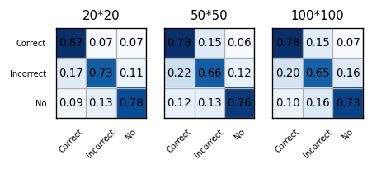
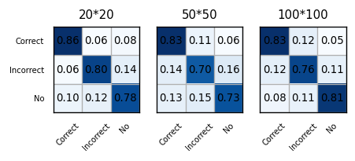
Algorithm 2: SVM
SVM with linear kernel, using gray and hog images as data
Accuracy: 0.79 0.73 0.72
Accuracy: 0.81 0.75 0.80
Notes:
For the left figure,
It is not difficult to find that with the increase of image size, the accuracy of our model even decreases, which is very counterintuitive.
For the right figure,
Although the classification accuracy was slightly improved after the HoG feature was used, the overall performance of the model was still unsatisfactory, which indicates that Linear kernel has reached its performance limit, and we must find an alternative methodology to replace it.

Slide 7

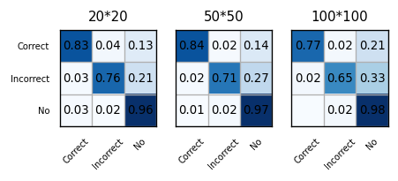
Algorithm 2: SVM
SVM with 3 degree polynomial kernel, using gray and hog images as data
Accuracy: 0.86 0.87 0.87
Accuracy: 0.85 0.84 0.80
Notes:
Here we introduced the 3-degree polynomial kernel. As can be seen from the figure at the left, the classification accuracy of all categories has been largely improved.
However, Different from the previous control groups, when we replaced gray scale image with HoG features, the classification accuracy did not improve as we expected.

Slide 8

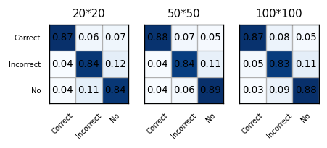
Algorithm 2: SVM
SVM with RBF kernel, using gray images as data. Beta is set to 1 / n_features.
Accuracy: 0.88 0.89 0.89
Accuracy: 0.85 0.87 0.86
Notes:
Finally, we test the effect of RBF kernel. Compared with linear kernel, both RBF kernel and POLY kernel can significantly improve the effect of the model. Meanwhile, when gray Scale image(50×50) was used as the input, we obtained the highest accuracy of the SVM model, which is 89.1%
The most interesting thing we can observe is that the highest resolution of image does not produce the best results. Probably the reason is, it is harder for SVM to split high dimension data space.

Slide 9
Algorithm 3: Decision Tree
Decision Tree: Decision Trees (DTs) are a non-parametric supervised learning method used for classification and regression.
The goal is to create a model that predicts the value of a target variable by learning simple decision rules inferred from the data features.
In our setting, the maximum depth of the tree is nor specified, nodes are expanded until all leaves are pure or until all leaves contain less than 2 samples.
And we compare the results of using gray, hog and canny dataset.
Notes:
Our third model is the decision tree. The decision tree is a very popular model. However, the structure of a single decision tree is always too simple, which leads to low classification accuracy. And here is the result.

Slide 10
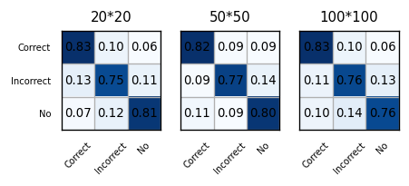
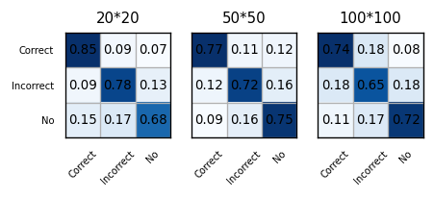
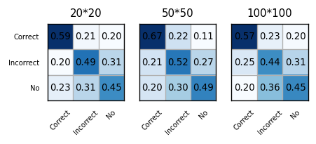
Algorithm 3: Decision Tree
Random Forest using gray, hog and canny image
Accuracy: 0.80 0.80 0.78
Accuracy: 0.77 0.75 0.70
Accuracy: 0.51 0.56 0.48
Notes:
In conclusion, the performance of decision tree model is not satisfactory, so we introduce the random forest model

Slide 11
Algorithm 4: Random Forest
Random Forest: a meta estimator that fits several decision tree classifiers on various sub-samples of the dataset
Use averaging to improve the predictive accuracy and control over-fitting
We set the maximum depth of the tree is nor specified, nodes are expanded until all leaves are pure or until all leaves contain less than 2 samples.
We compare the results of 5, 10 and 50 subtrees on only gray dataset
Notes:
Random forest is a classifier that contains multiple decision trees, and its output category is determined by the mode of the result of individual trees.
Since the growth of each tree in the random forest has grow to the maximum extent and has a certain degree of randomness, the performance and robustness of the overall model can be improved when we integrate them together.

Slide 12


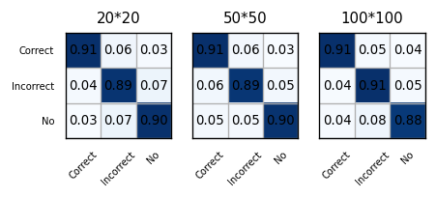
Algorithm 4: Random Forest
Random Forest using 5, 10, 50 subtrees on gray image
Accuracy: 0.84 0.85 0.85
Accuracy: 0.86 0.87 0.87
Accuracy: 0.90 0.90 0.90
Notes:
We can see that random forest has higher accuracy than a single tree, and the more subtress we use, the higher accuarcy we can gain.

Slide 13
Conclusion
1. For SVM, Compared with linear kernel, RBF Kernel and Poly Kernel can largely improve the classification performance.
2. Using the Hog algorithm to extract image features can better describe the local targets with gradient and directional density distribution. In most cases, we can obtain a better classification accuracy.
3. All the models obtained satisfactory results after optimization. Among them, the highest accuracy was obtained by random forest algorithm with an accuracy of 90.1% (Image Size: 50×50).

Slide 14
Thank you for your attention!

