Slide 1

Machine Learning Based Face Mask Recognition
Jiaqi Guo
Manzhu Wang
Xinyi Su
Chenxi Liu

Slide 2
Introduction and dataset
Design a framework to classify a set of face mask images
Three types of dataset : Correct Masking, Incorrect Masking and No masking
Each dataset has around 1500 samples
Link to the dataset: https://github.com/GuoJiaqi-1020/EE-475-ML-Final-Project/tree/main/Data
Notes:
As the COVID-19 has brought great disaster, personal protection has become particularly necessary. To controlling the spread of the epidemic, everyone should wear masks. The objective of this project is to design a framework to classify a set of face mask images. Collecting facial images through cameras and performing masking wearing recognition (Correct, Incorrect and No mask) with specific machine learning frameworks.
There are three types of dataset (Correct Masking, Incorrect Masking and No masking)
And each dataset has around 1500 samples.

Slide 3
Data preprocessing
Load the original face mask data with pixel of 20*20, 50*50 and 100*100
Transfer the RGB image to gray image
Notes:
Image down sampling: the original image has different sizes, we uniformly down-sample the images into 20×20, 50×50 and 100×100 sizes
Convert a RGB image to a gray image: combine the R, G, B channels of the image

Slide 4
Data preprocessing
Use Histogram of Oriented Gradients to extract features from RGB image
Use Canny edge detector to extract features from gray image
Notes:
HoG algorithm extraction feature (histogram-based feature): use the image gradient information to reflect the edge information of the image and characterize the local appearance and shape of the image through local gradient
Compute 8 direction in each 2*2 pixel
Use Canny edge detector to extract features from gray image
Compute 8 direction in each 2*2 pixel
Why extract Hog?
In an image, the appearance and shape of a local target can be well described by the directional density distribution of the gradient or edge. Therefore, it is suitable for face recognition.

Slide 5
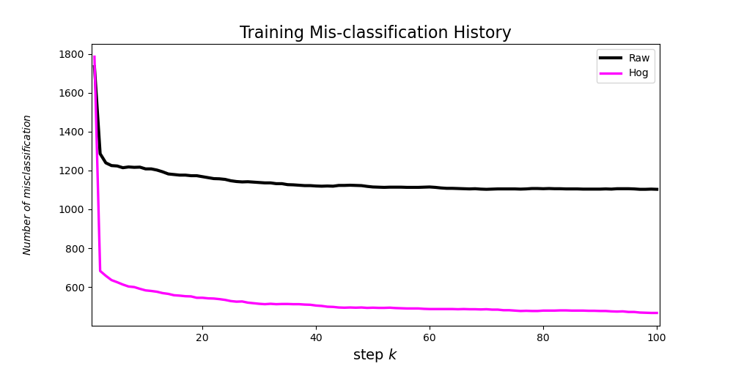
Algorithm 1: Linear classifier（Baseline）
Optimization method: gradient decent (with diminishing study rate, start from 0.02)
Number of misclassification by using raw dataset and HOG dataset
HOG increase the accuracy by nearly 15%
The best accuracy of this model is 89.6%
Notes:
Optimization method: gradient decent (with diminishing study rate, start from 0.02)
The reason for choosing diminishing study rate：if don't choose it, the cost during training will fluctuate significantly, which shows that our learning rate is too large (started with 0.01). But when we choose a smaller learning rate, the model convergence rate and efficiency is too slow. So, we choose diminishing study rate, study rate = alpha/k (number of training rounds)
By using Hog dataset as model input, we at least increased the accuracy by nearly 15% (significant effect)
Incorrect masking has the lowest recognition accuracy, which is only 0.86
The larger the Hog, the higher the accuracy rate and finally to 89.6% (the best accuracy of this model).
But for the raw data control group, the accuracy rate is not obvious improved. It’s about 74%. The clearer the image, the greater the advantage of histogram-based features.

Slide 6
Algorithm 2: SVM
SVM: Training examples to points in space to maximize the width of the gap between the two categories
We set the penalty term C as 1
We compare the linear, polynomial and rbf kernel.
We choose gray and hog data as out training data in this experiment.
Notes:
SVM maps training examples to points in space to maximize the width of the gap between the two categories. New examples are then mapped into that same space and predicted to belong to a category based on which side of the gap they fall. As we are using a soft margin SVM, we set the penalty term C as 1. A low C makes the decision surface smooth, while a high C aims at classifying all training examples correctly. And we are using a kernel function to map the input features to a higher dimension space. In this experiment, we compare the linear, polynomial and rbf kernel. We choose gray and hog data as out training data in this experiment.

Slide 7
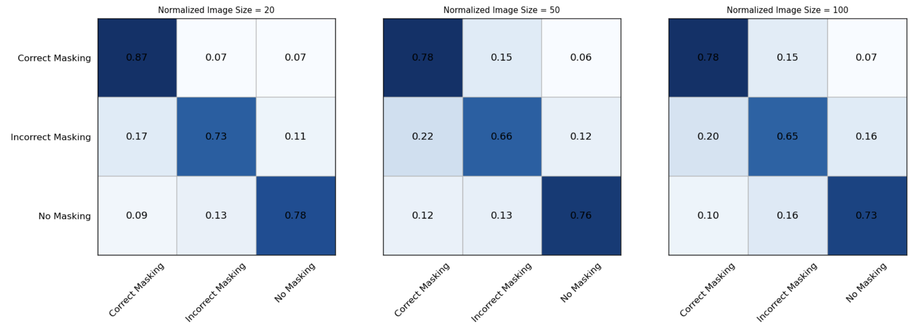
Algorithm 2: SVM
SVM with linear kernel, using gray images as data
Accuracy: 0.7905701754385965 0.7324561403508771 0.7214912280701754

Slide 8
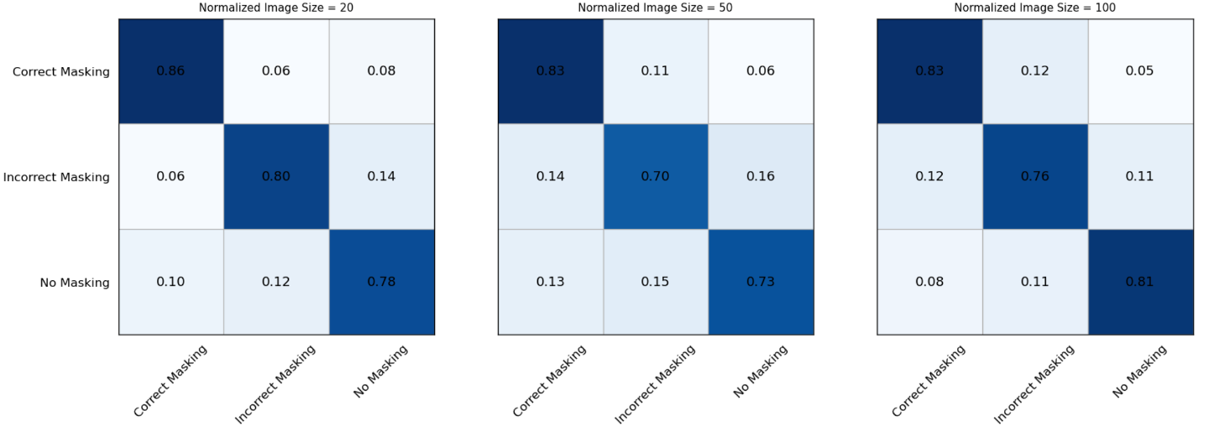
Algorithm 2: SVM
SVM with linear kernel, using hog images as data
Accuracy:
0.8125 0.7521929824561403 0.8004385964912281

Slide 9
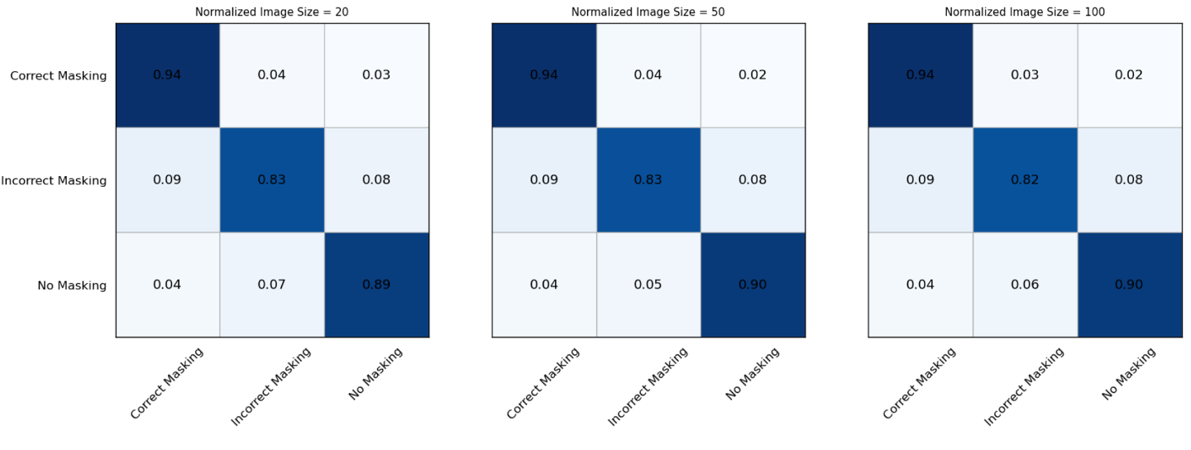
Algorithm 2: SVM
SVM with RBF kernel, using gray images as data
Accuracy:
0.8859649122807017 0.8914473684210527 0.8903508771929824

Slide 10
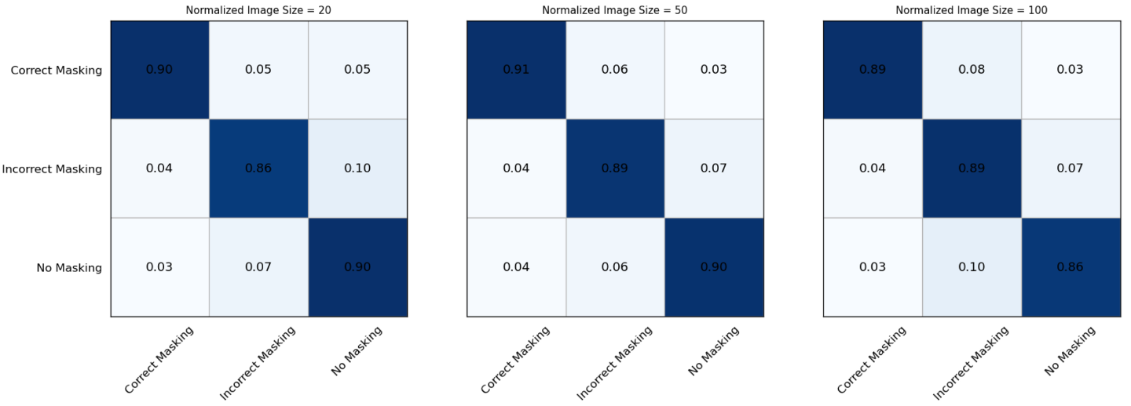
Algorithm 2: SVM
SVM with RBF kernel, using hog images as data
Accuracy:
0.8881578947368421 0.8980263157894737 0.881578947368421

Slide 11
Algorithm 3: Random Forest
Random Forest: a meta estimator that fits several decision tree classifiers on various sub-samples of the dataset
Use averaging to improve the predictive accuracy and control over-fitting
We set the maximum depth of the tree is nor specified, nodes are expanded until all leaves are pure or until all leaves contain less than 2
We compare the results of 5, 10 and 50 subtrees on only gray dataset
Notes:
Random forest is a classifier that contains multiple decision trees, and its output category is determined by the mode of the output category of individual trees.
Our model contains 5 decision trees, each has a depth of 7
The size of training set is 4500. For each tree, 67% of the training samples are randomly chose and replaced from the training set (this sampling method is called the bootstrap sample method) as the training set of the tree;
Why do we use random forest here?
If it is not for sampling with replacement, then the training samples of each tree are different, and there is no intersection, so that each tree is "biased", each tree after training is very different and the final classification of the random forest depends on the voting of multiple trees (weak classifiers), this kind of voting should be "seek agreement", so using a completely different training set to train each tree is not helpful to the final classification result.
Because every tree in the random forest grows to the maximum extent, the import of two randomness’s is crucial to the classification performance of random forests. Random forests are not easy to fall into over-fitting, and have good robustness
A random forest is a meta estimator that fits a number of decision tree classifiers on various sub-samples of the dataset and uses averaging to improve the predictive accuracy and control over-fitting. In our setting, The maximum depth of the tree is nor specified, nodes are expanded until all leaves are pure or until all leaves contain less than 2. And we compare the results of 5, 10 and 50 subtrees on only gray dataset.

Slide 12
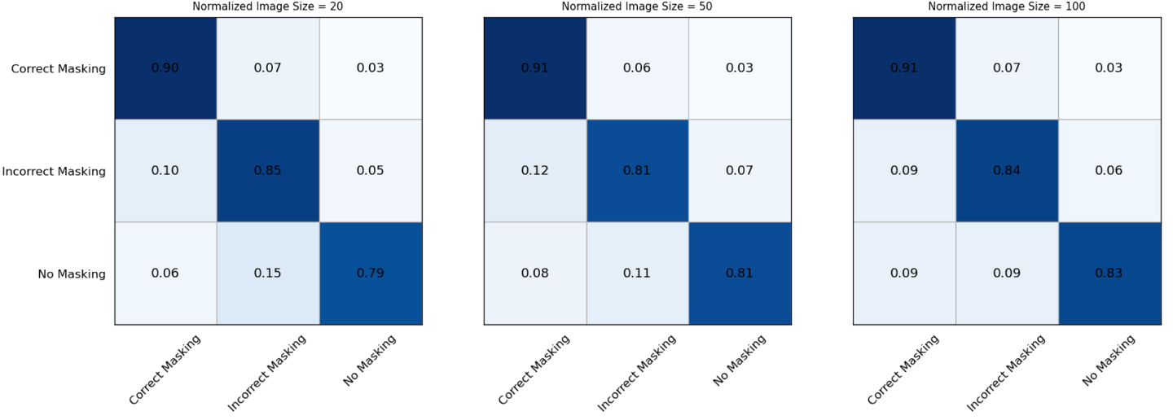
Algorithm 3: Random Forest
Random Forest using 5 subtrees on gray image
Accuracy: 0.8453947368421053 0.8442982456140351 0.8585526315789473

Slide 13
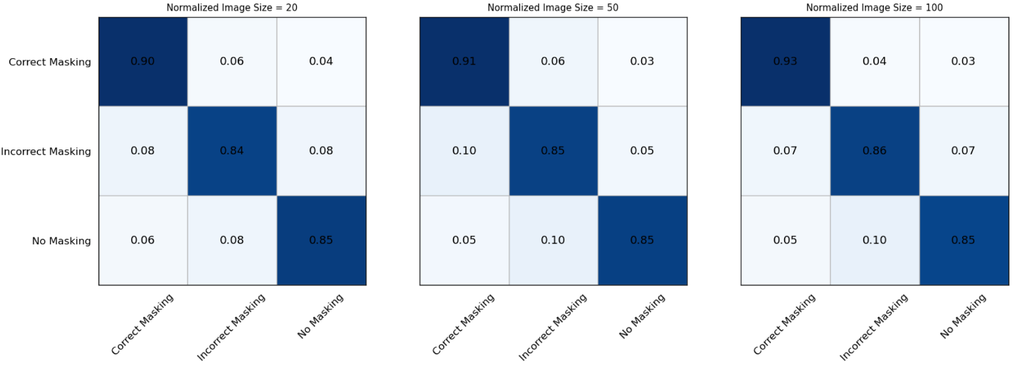
Algorithm 3: Random Forest
Random Forest using 10 subtrees on gray image
Accuracy: 0.8640350877192983 0.868421052631579 0.8804824561403509

Slide 14
Algorithm 3: Random Forest
Random Forest using 50 subtrees on gray image
Accuracy: 0.9024122807017544 0.8925438596491229 0.8991228070175439
Notes:
We can see that hog extractor has bad influence on the results, while canny extractor has very bad influence on the results. And the accuarcy of a single tree is worse than SVM with rbf kernel.
We can see that random forest has higher accuracy than a single tree, and the more subtrees we use, the higher accuarcy we can gain.

Slide 15
Conclusion
1. Compared with linear kernel, RBF Kernel can significantly improve the classification performance of SVM model.
2. Using the Hog algorithm to extract image features can better describe the appearance and shape of local targets with gradient and directional density distribution. Therefore, compared with using Raw image data directly, we can obtain higher classification accuracy.
3. All the models obtained satisfactory results after optimization. Among them, the highest classification accuracy was obtained by random forest algorithm with an accuracy of 89.8% (Image Size: 50×50).

Slide 16
Thank you for your attention!

