Slide 1
Story
A few factors that affect the users activity:
User: active, preference…
Voucher: received (Day_of_week, Is_weekend , Day_of_month)
discount, max_value, type…
Shop: Total_sales, Sales_use_coupon, Total_coupon, Use_coupon_rate
User-shop
Voucher-user
Voucher-shop
活跃用户更可能使用优惠券，活跃商家所发出的优惠券更可能被使用，用户对某个商家的喜爱程度越高越可能使用这个商家发的优惠券

Slide 2
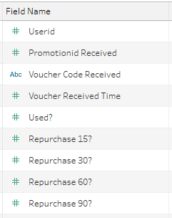
Data SRC
Training_data
Predict_data
Transaction_MY
User_profiles_MY
Likes
View_log_0-30
Voucher_distribution_active_date
Voucher_mechanics
User
Voucher
Date

Slide 3
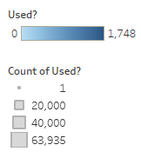
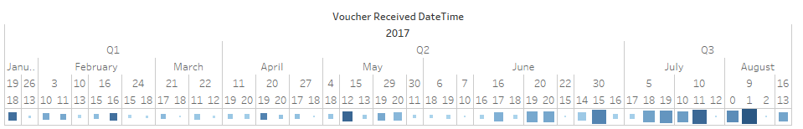

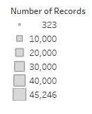
Data
Training data:
2017 January to August (Pacific Standard Time)
Predict data:
2017 August (Pacific Standard Time)

Slide 4
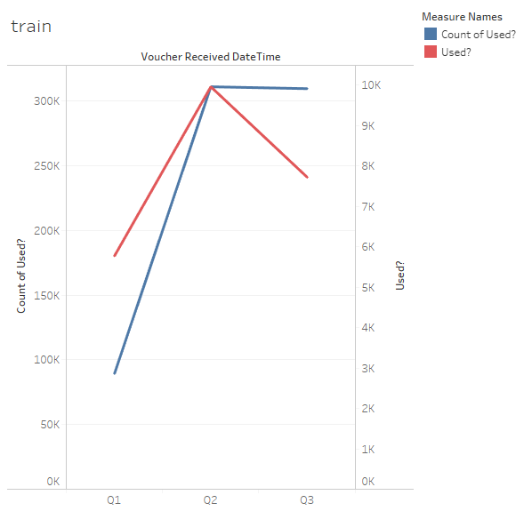
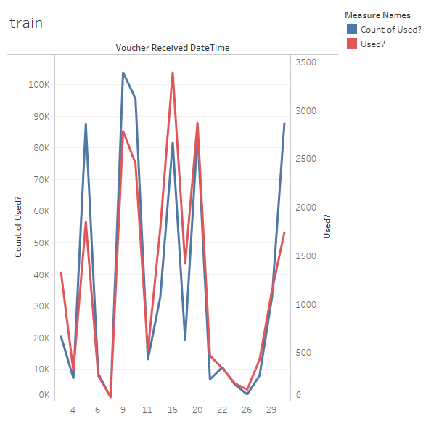
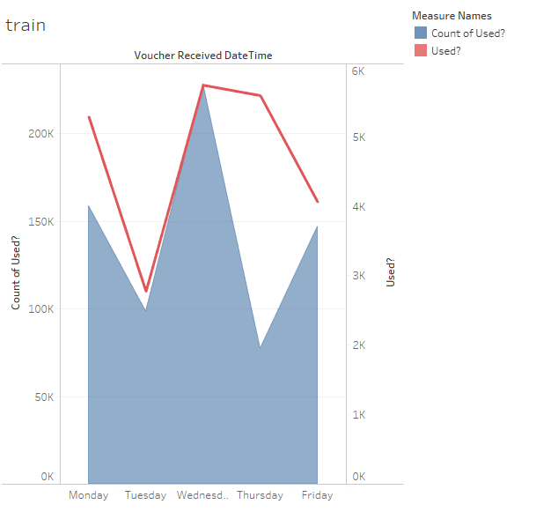
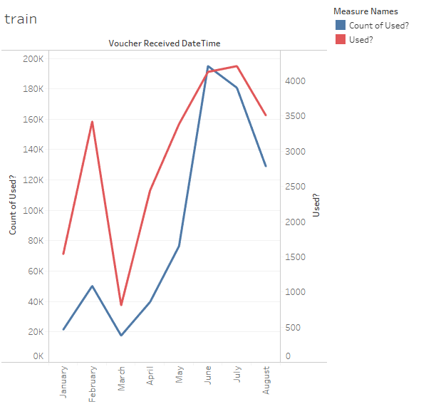
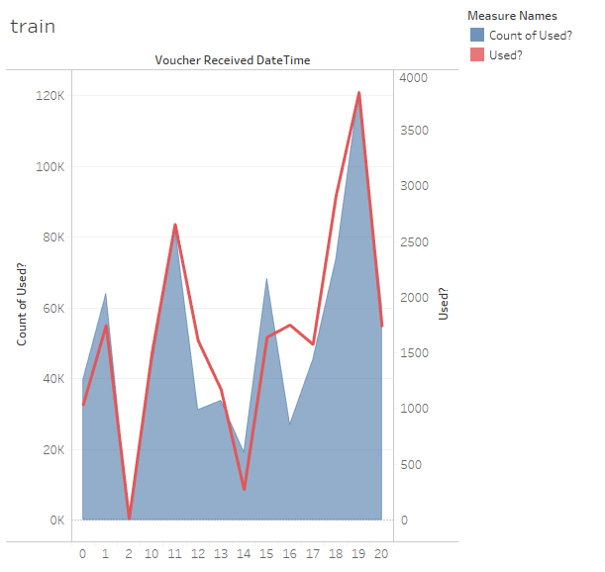
time
Quarter
Day
weekday
Month
Hour

Slide 5
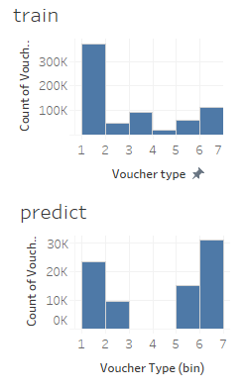
Discount | Max_value | Type
20 | 1000000 | 1
50 | 2000000 | 2
50 | 1500000 | 3
20 | 1500000 | 4
50 | 1000000 | 5
30 | 1000000 | 6
voucher
94 promotion_id (92 in train, 4 in predict)
The four promotion ids in predict data only on Aug 16

Slide 6
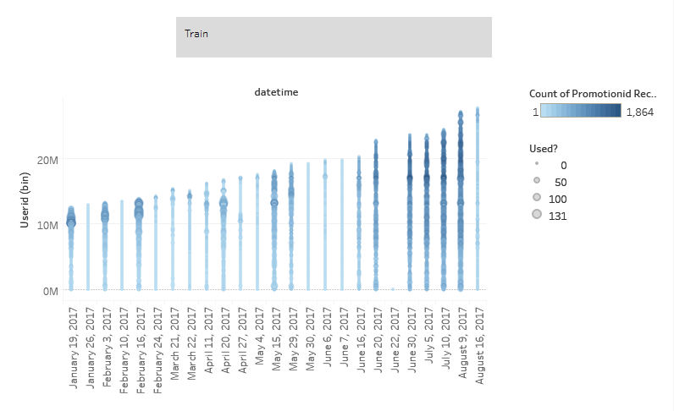

Slide 7
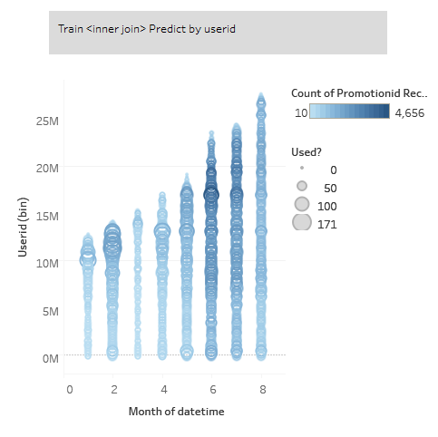

Slide 8
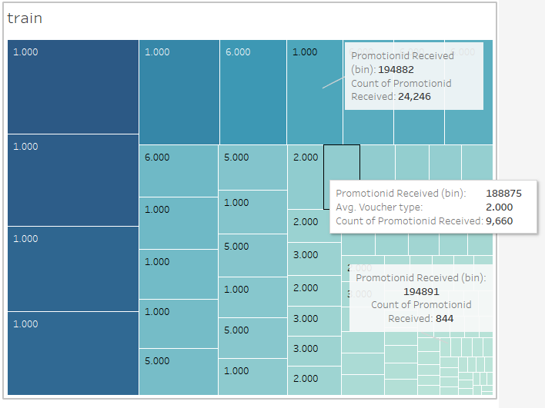

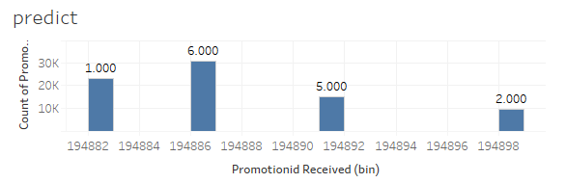

Slide 9
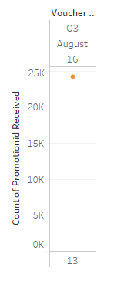
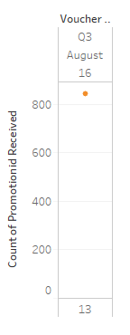
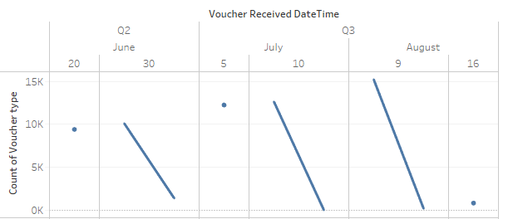
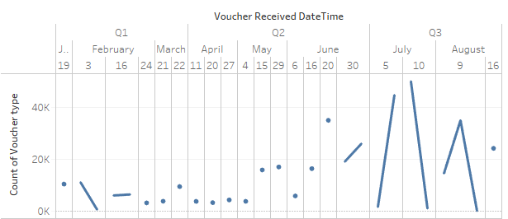
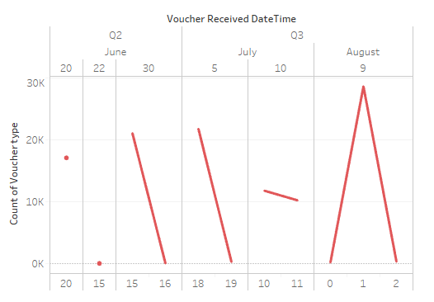
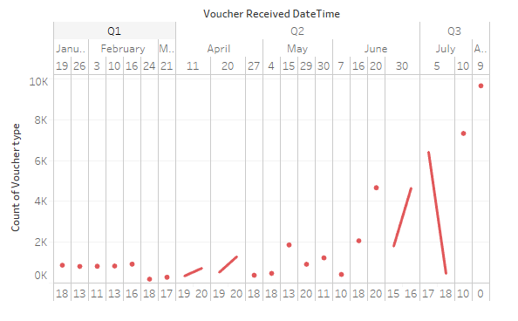
194882 (Type 1)
194891 (Type 5)
Type 6
Type 2

Slide 10

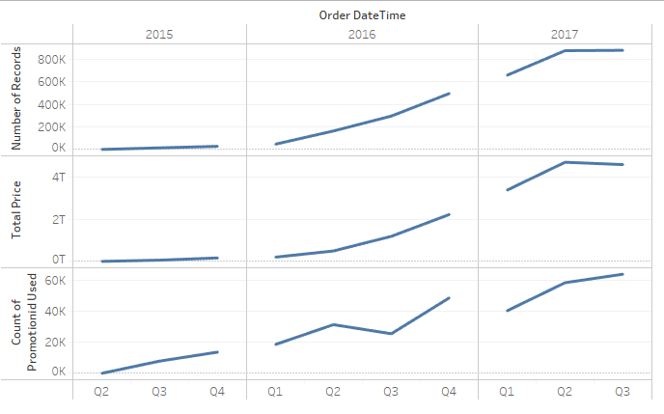
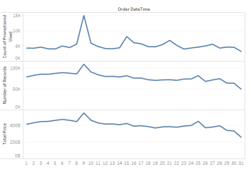
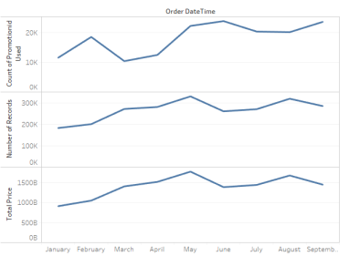
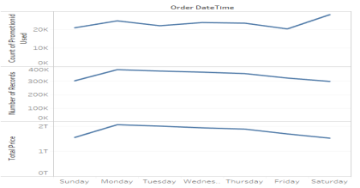
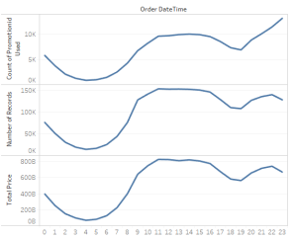
transaction
2017-2015 transaction data
Difference:
Weekday
Day
Quarter
Month
Same:
hour
Only focus on 2017

Slide 11
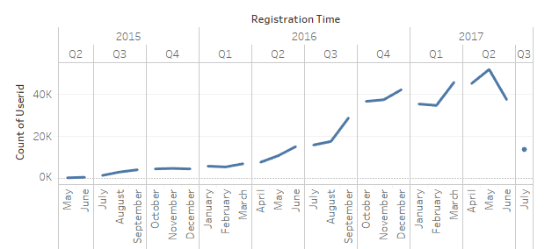
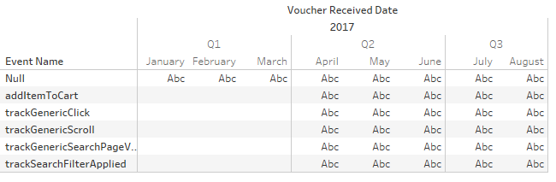
user

Slide 12

Data Split

Slide 13
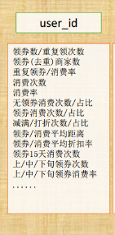
User
registration_time
Is_seller
Gender
Email_verified
Birthday
# of Received Vouchers (all)
# of Received Vouchers (1/3 month)
# of Received Vouchers (2/3 month)
# of Received Vouchers (3/3 month)
# of Voucher used
# of Voucher unused
% of Voucher used
# of shops (shopping without voucher)
# of shops (use vouchers)
# of shops (all)
# of transitions
# of transitions (1/3 month)
# of transitions (2/3 month)
# of transitions (3/3 month)
Voucher type
# of total price
# of total price (1/3 month)
# of total price (2/3 month)
# of total price (3/3 month)
Voucher
Date
features

Slide 14
analysis

Slide 15
model
Blending two levels x
averaging, Ranking, 加权融合
Stacking x
GBDT与LR融合方案 x
GBDT & libFFM
Xgboost
Gbdt
rf

Slide 16
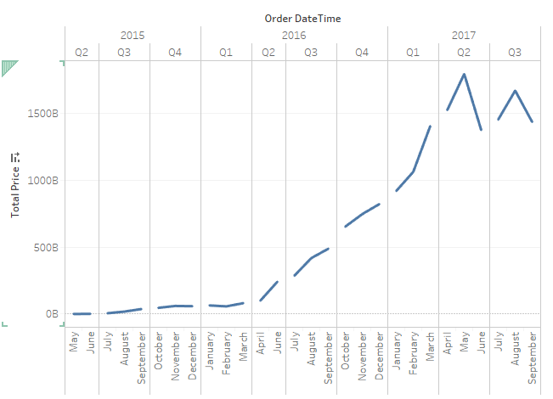
2543/78903 predict data in transition

