Slide 1
Customer Repurchase Prediction
Guo
Jing

Slide 2
Task description
Movtivation
The objective of the vouchers is to motivate these buyers to start to buy things from the platform again and hopefully they will continue the purchases subsequently.
It is important to automatically identify the group of ‘inactive’ buyers, who are likely to
(1) use the “reactivation” vouchers sent to them (2) continue the purchase behavior subsequently.
Objective
The main objective of the task is to predict which buyers will use the vouchers and continue to purchase after receiving coupons.
The prediction is made based on a user’s purchase behavior generated from the shopping history.

Slide 3
Model construction
1
2
3
4
Data
Feature engineering
Model construction
Result & Discussion
Data source
Data probing
Three super groups (13 subgroups): user, voucher, date
Feature extraction
Normalization and missing values
Parameter tuning
Model selection
Data balance & cleaning

Slide 4

Data source
shopping history for a large set of buyers who were targeted for the reactivation campaign.

Slide 5
Source | Attributes | Time span
Training (710078,9) | userid, promotionid_recieved (voucher_code), voucher_received_time,used?,repurchased_x (15d,30d,60d,90d) | 2017.1-8 (sparse)
Predict (78903,4) | userid, promotionid_recieved (voucher_code), voucher_received_time | 2017.8.16
Transactions | Userid,shopid,total_price,order_time,promotionid_used | 2015 Q2- 2017 Q3
User profiles | Userid,registration_time,is_seller,gender,…
Likes | Userid,voucher_received_date,status,ctime
view_log_0-30 | Userid,promotionid_received,date,event_name,count | 2017.4-2017.8
Voucher_distribution_active_date | Userid,promotionid_received,time,date,active sessions counts | 2017.2(16)-2017.8(16)
Voucher_mechanics | Promotionid,discount,max_value

Slide 6
Data probing
view_log_0-30
Predict
Training
Likes
Transactions
User profiles

Slide 7
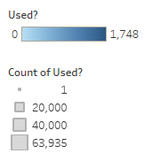
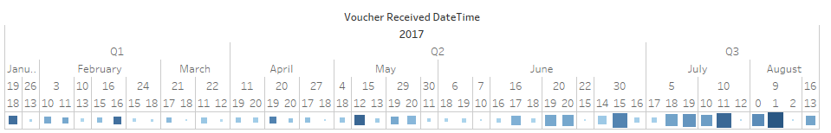

Training data & predict data

Slide 8
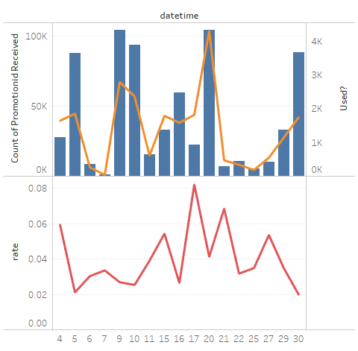
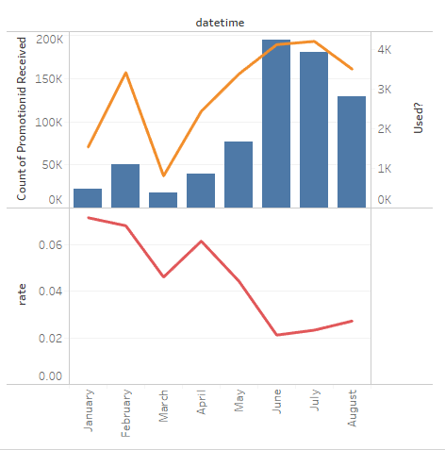
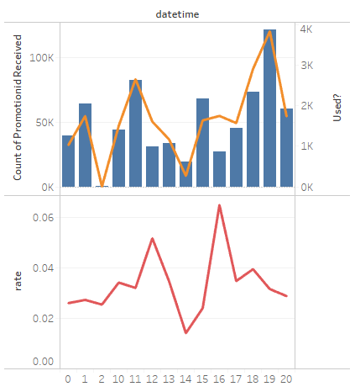

Slide 9
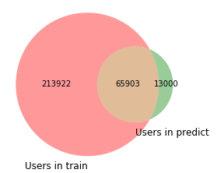

Slide 10
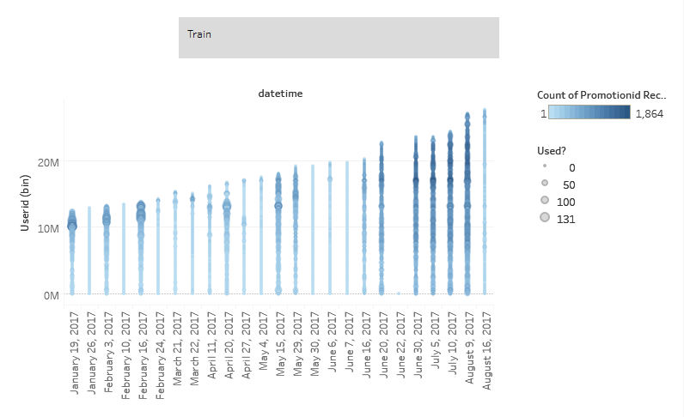
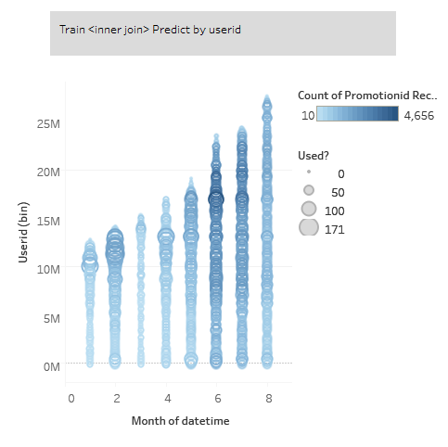

Slide 11
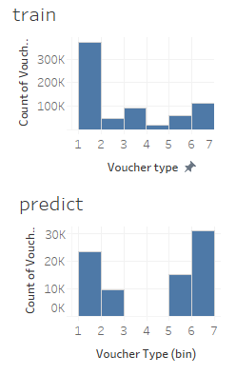
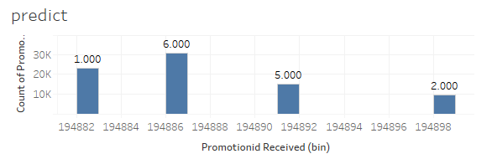
Voucher mechanics
Discount | Max_value | Type
20 | 1000000 | 1
50 | 2000000 | 2
50 | 1500000 | 3
20 | 1500000 | 4
50 | 1000000 | 5
30 | 1000000 | 6
94 promotion IDs (92 in train, 4 in predict)

Slide 12
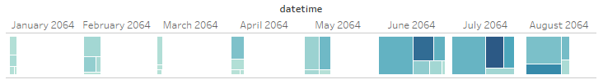
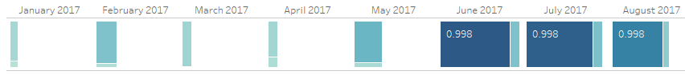
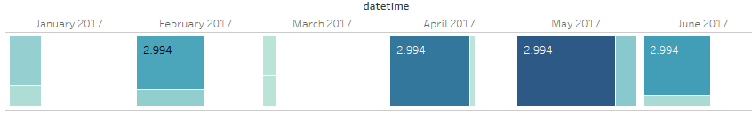
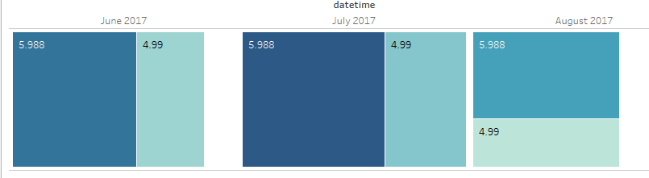
Type 1,2
Type 3,4
Type 5,6

Slide 13
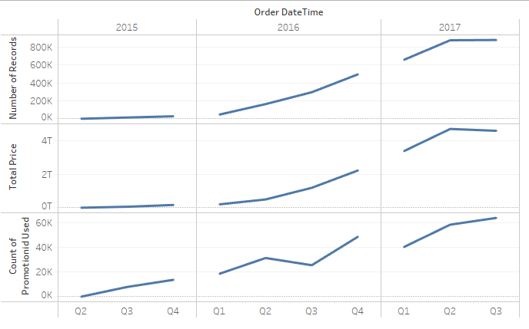
Transaction history
279803 (out of 279825 users in the training data) can be found in the transactions table.
78895 (out of 78903 users in the predict data) can be found in the transactions table.

Slide 14
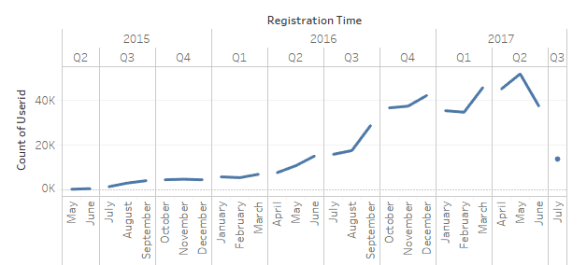
User profiles

Slide 15
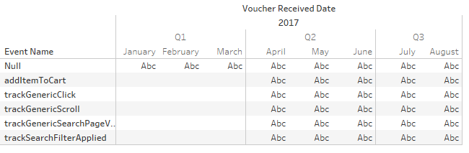
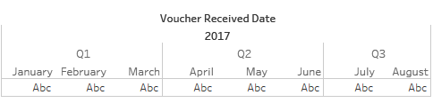
View logs
Active sessions

Slide 16
Model construction
1
2
3
4
Data
Feature engineering
Model construction
Result & Discussion
Data source
Data probing
Three super groups (13 subgroups): user, voucher, date
Feature extraction
Normalization and missing values
Parameter tuning
Model selection
Data balance & cleaning

Slide 17
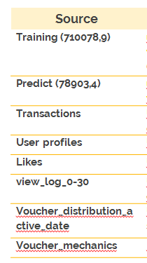
Three super groups (13 subgroups): user, voucher, date
User
Voucher
Date
Voucher received time – Registration time
% of Voucher (use/all)
# of shops (use vouchers)
% total_price (use/all)
Recent shop time – received time
Recent use voucher time – received time
....
Weekday
Hour
Month
Day
1/3-3/3 month
1/4-4/4 quarter
Isweekend
...
discount
Max_value
Type
...

Slide 18
Model construction
1
2
3
4
Data
Feature generation
Model construction
Result & Discussion
Data source
Data probing
Three super groups (13 subgroups): user, voucher, date
Feature extraction
Normalization and missing values
Parameter tuning
Model selection
Data balance & cleaning

Slide 19
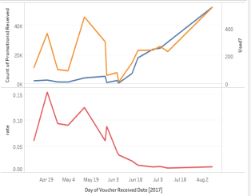
Data splitting
Training
Set | Time span | N/P
Training set 1 | 4.11-8.9 | 34:1
Training set 2 | 4.11-8.9 | 13:1
Validation set | 8.16 (training data) | 33:1
Predict set | 8.16 (predict data) | ?
Validation
Z-score (MinMaxScale) is used to normalize continuous values.
Predict

Slide 20
Model construction
1
2
3
4
Data
Feature generation
Model construction
Result & Discussion
Data source
Data probing
Three super groups (13 subgroups): user, voucher, date
Feature extraction
Normalization and missing values
Parameter tuning
Model selection
Data balance & cleaning

Slide 21
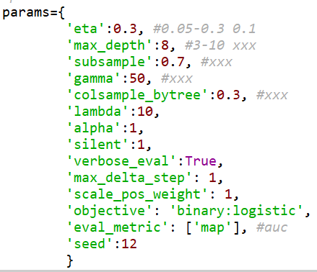
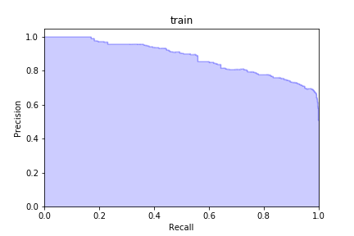
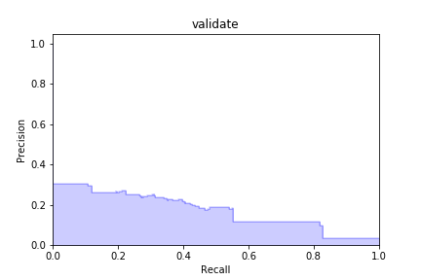
Model selection: Xgboost
 | 0 | 1
0 | 30 | 3 | 33
1 | 0.4 | 0.6 | 1

Slide 22
Discussion
Likes table
Data balance & cleaning
SMOTEENN, CNN
Model selection
RF, GBDT, LR
Ensemble methods

Slide 23
Thanks!
GitHub: https://github.com/NetLand-NTU/Shopee

