Slide 1
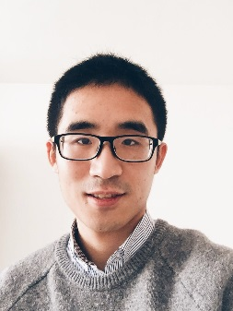
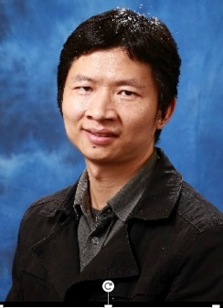
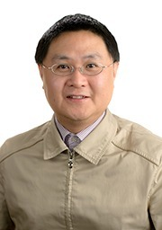
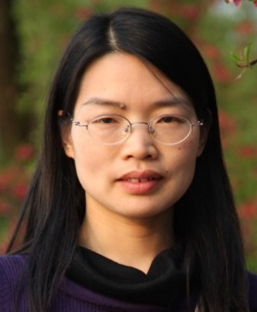
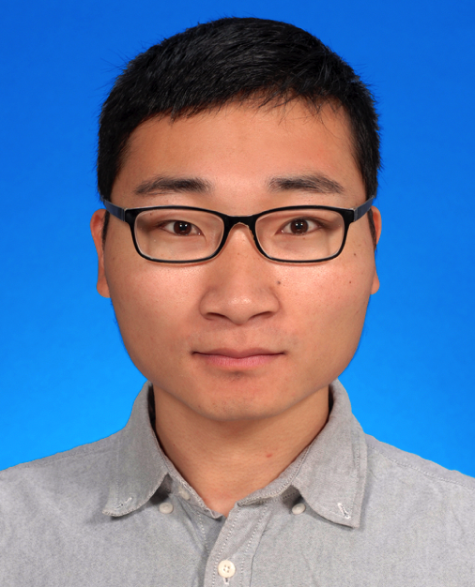

DVC: An End-to-end Deep Video Compression Framework
Guo Lu¹, Wanli Ouyang², Dong Xu³, Xiaoyun Zhang¹, Chunlei Cai¹, Zhiyong Gao¹
¹Shanghai Jiao Tong University
²The University of Sydney, SenseTime Computer Vision Research Group
³The University of Sydney
Guo Lu
Wanli Ouyang
Xiaoyun Zhang
Dong Xu
Chunlei Cai
Zhiyong Gao

Slide 2
Video Compression
Traditional codecs rely on classical prediction-transform architecture and hand-crafted techniques.
Video data contributes to more than 80% internet trafﬁc and video compression aims at reducing the storage size and bandwidth.
H.261
H.262
H.263
H.264
H.265
1990
1995
2000
2005
2010
Deep learning has been widely used for a lot of vision tasks for its powerful representation ability.
What happens when video compression meets deep learning?

Slide 3
Video Compression
Related Work
Learning Based Image Compression
CNN based autoencoder Ballé et al ICLR’17, ICLR’18
RNN based autoencoder Theis et al ICLR’17
Ignore the temporal redundancy
Learning Based Video Compression
Formulate video compression as frame interpolation. Wu et al ECCV’18
Not End-to-end optimized
Johannes Ballé, Valero Laparra, Eero P. Simoncelli, End-to-end Optimized Image Compression, ICLR’17
Lucas Theis, Wenzhe Shi, Andrew Cunningham, Ferenc Huszár, Lossy Image Compression with Compressive Autoencoders, ICLR’17
Johannes Ballé, David Minnen, Saurabh Singh et al, Variational image compression with a scale hyperprior, ICLR’18
Chao-Yuan Wu, Nayan Singhal, Philipp Krahenbuhl, Video Compression through Image Interpolation, ECCV’18

Slide 4
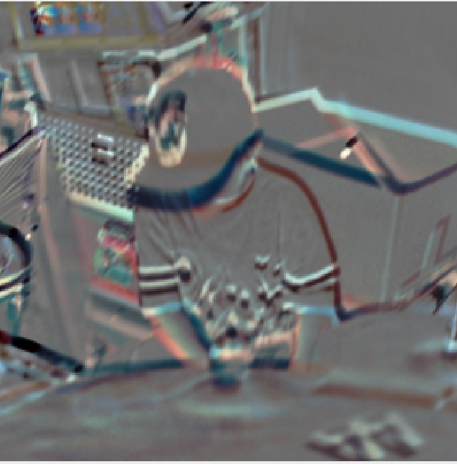
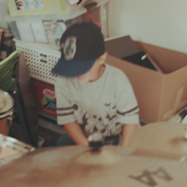
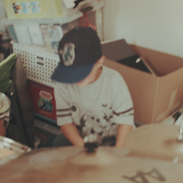
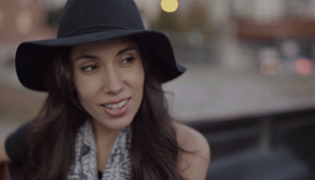
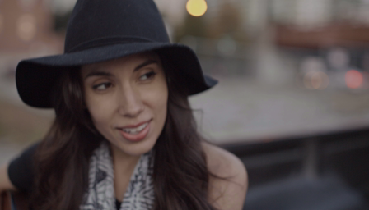
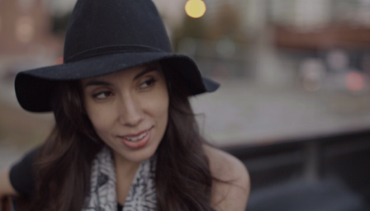
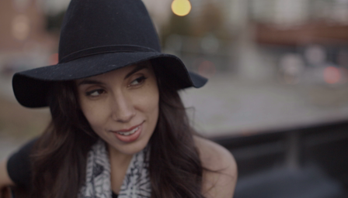








Traditional Video Compression
Previous Frame
Current Frame
Classical architecture
Transform
Transform
Q
Prediction Residual
-
$$r_{t}$$
Motion Estimation
$$x_{t}$$
$$x_{t}$$
Inverse
Transform
Current
Frame
Linear Transform (DCT)
$${\hat{r}}_{t}$$
$${\overline{x}}_{t}$$
Motion Compensation
Entropy Coding
Quantization
$${\hat{x}}_{t}$$
$$v_{t}$$
Linear Inv-Transform (IDCT)
Prediction
Motion Compensation
Block based
Motion Estimation
$${\hat{x}}_{t−1}$$
Decoded Frames Buffer
Reconstructed Residual
Prediction Residual

Slide 5
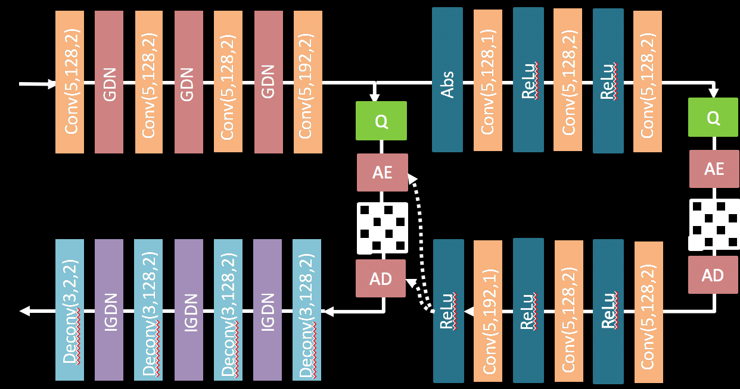


























Deep Video Compression Model
Method
Transform
Q
-
Residual Encoder Net
Q
$$r_{t}$$
$$y_{t}$$
$${\hat{y}}_{t}$$
$$x_{t}$$
Inverse
Transform
Residual Decoder Net
Current
Frame
$$v_{t}$$
MV Encoder
$${\hat{r}}_{t}$$
$${\hat{v}}_{t}$$
$${\hat{y}}_{t}$$
$${\hat{x}}_{t−1}$$
Pooling
Pooling
Residual Block
Residual Block
Residual Block
Conv(3,64,1)
$${\overline{x}}_{t}$$
Motion Compensation
Bit Rate
Estimation Net
Concatenate
Motion Compensation Net
Entropy Coding
Conv(3,128,2)
Conv(3,128,2)
GDN
GDN
GDN
Conv(3,128,2)
$${\hat{x}}_{t}$$
$$w({\hat{x}}_{t−1},{\hat{v}}_{t})$$
Conv(3,128,2)
$$m_{t}$$
$${\hat{v}}_{t}$$
$${\hat{m}}_{t}$$
Q
$$v_{t}$$
MV Decoder Net
$${\hat{m}}_{t}$$
$${\hat{m}}_{t}$$
$${\hat{v}}_{t}$$
Q
$${\overline{x}}_{t}$$
$$m_{t}$$
Deconv(3,2,2)
Deconv(3,128,2)
Deconv(3,128,2)
Conv( 3,3,1)
Deconv(3,128,2)
Conv(3,64,1)
Up sampling
IGDN
IGDN
Residual Block
Up sampling
Residual Block
Block based
Motion Estimation
IGDN
Residual Block
MV Encoder Net
$${\hat{x}}_{t−1}$$
$$v_{t}$$
Optical Flow Net
Decoded Frames Buffer
MV Decoder
$$\min{λD+ R}$$

Slide 6
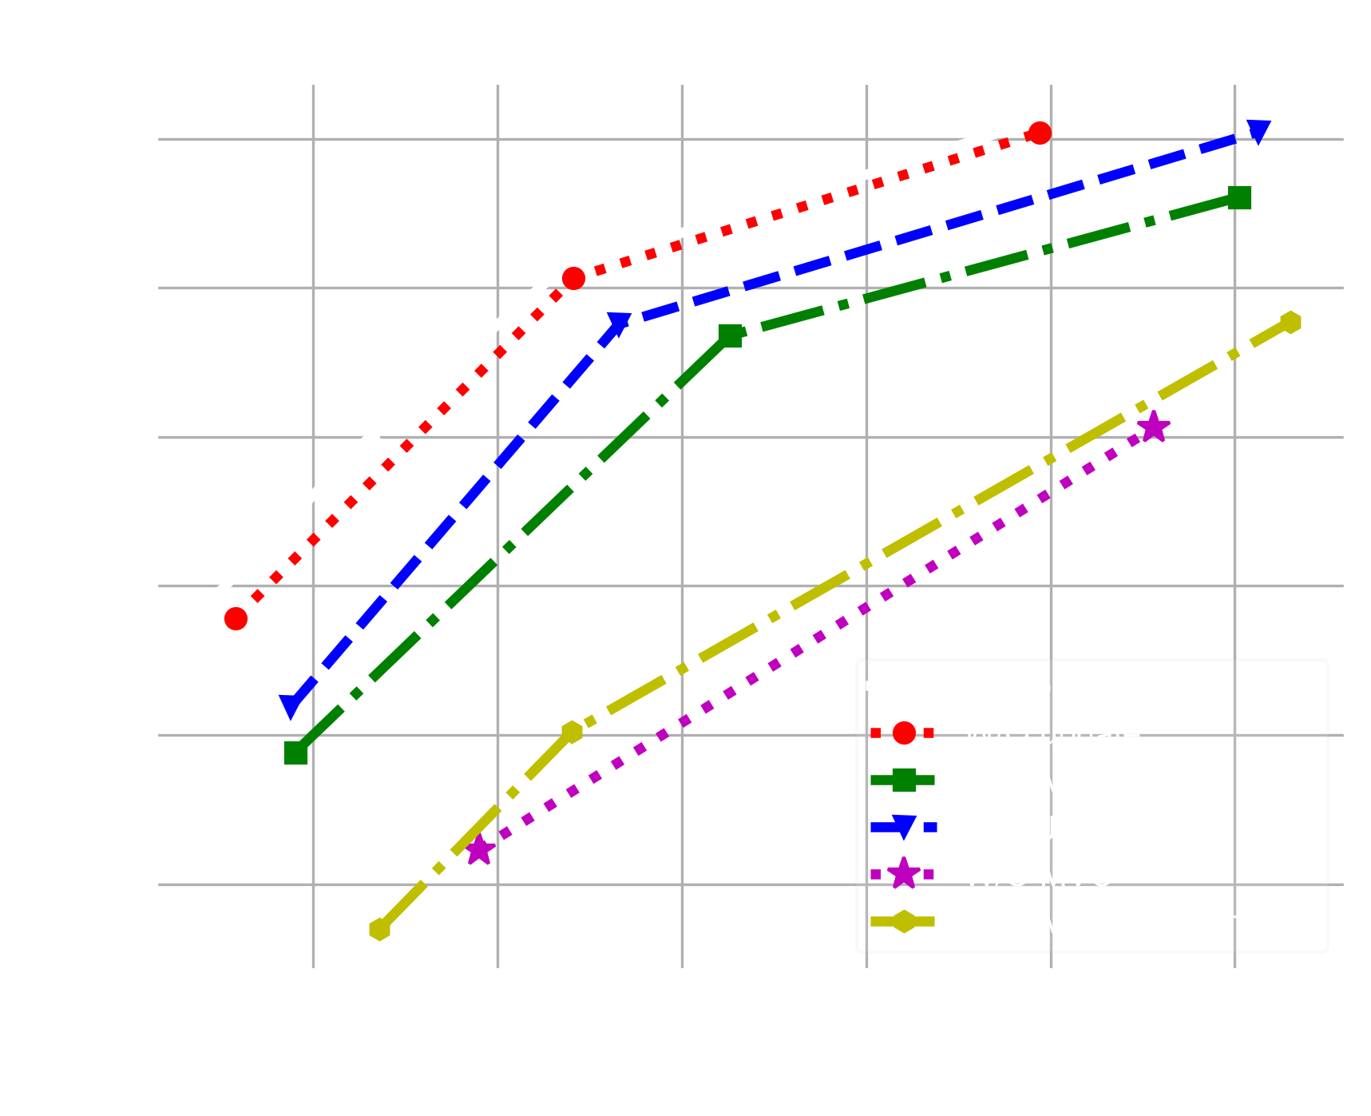

Deep Video Compression Model
Experiments
Ablation Study
Motion Compensation Network
Joint Training
Motion Compression Network
Motion Information
Buffer update
Code Link
https://github.com/GuoLusjtu/DVC

Slide 7
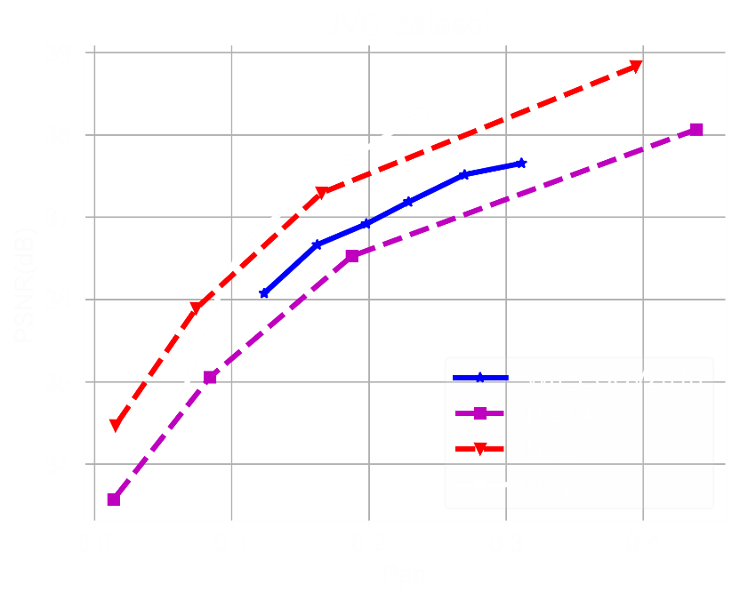
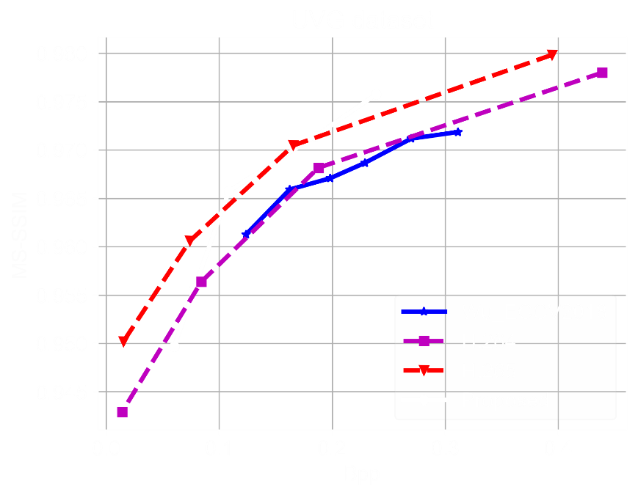
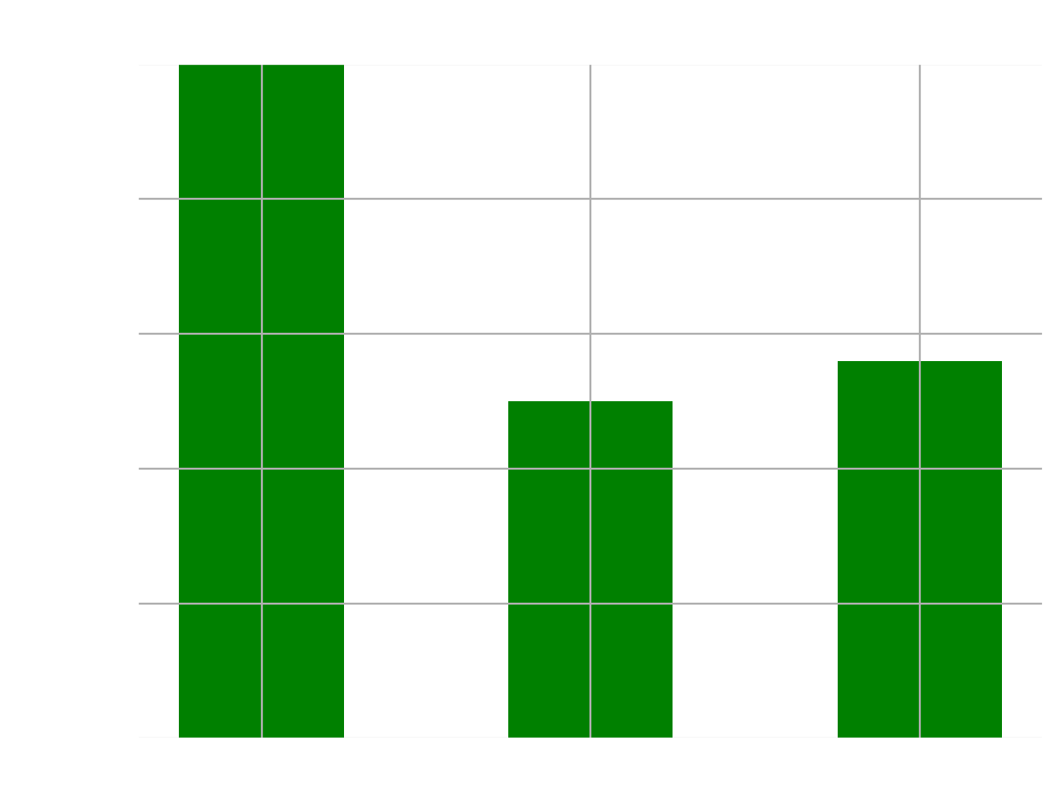
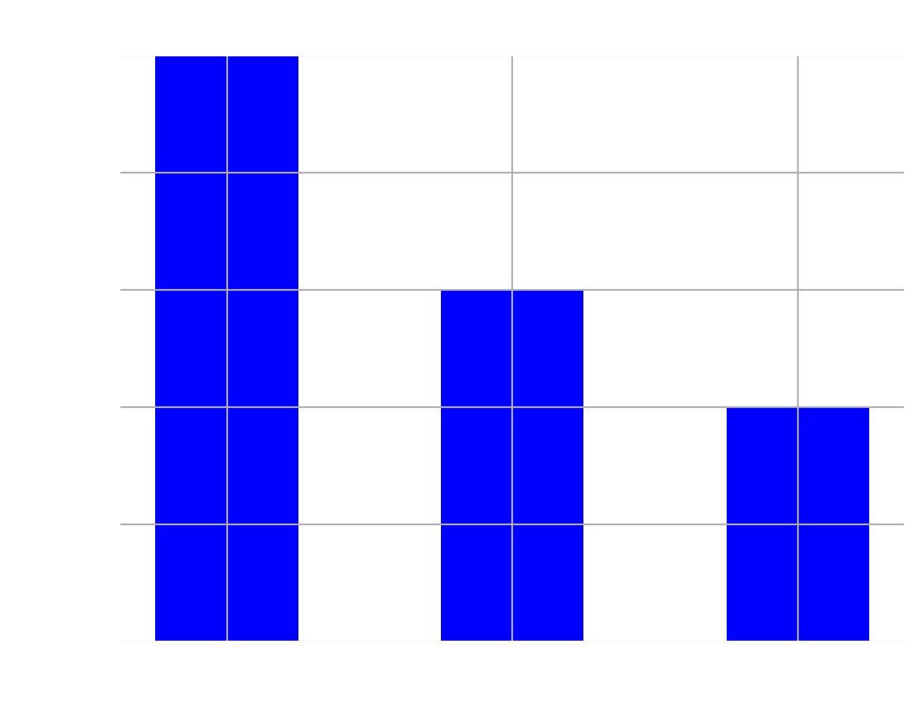
Deep Video Compression Model
Experiments
Code Link
https://github.com/GuoLusjtu/DVC

