Slide 1
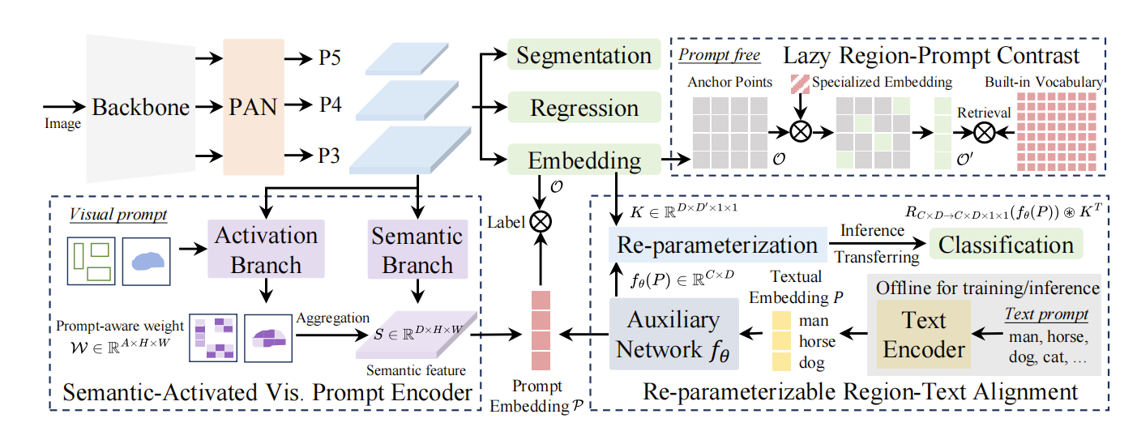
YOLOE: Real-Time Seeing Anything
Support three diverse prompt mode
Text prompts：Re-parameterizable Region-Text Alignment (RepRTA) strategy.
- Re-parameterizable lightweight auxiliary network
- refines and enhances pretrained textual embedding
- for better visual-textual alignment
Visual prompts：Semantic-Activated Visual Prompt Encoder (SAVPE).
- Semantic branch：generate prompt-agnostic semantic features.
- Activation branch：provide grouped prompt-aware weights. (by formalize RoI as masks)
- aggregation to derive improved visual embedding.
Prompt-free：Lazy Region-Prompt Contrast (LRPC) strategy.
- Built-in large vocabulary for category retrieval
- Specialized embedding learning
- retrieve all objects

Slide 2

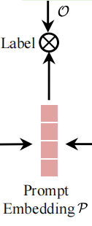
Semantic-Activated Vis. Prompt Encoder(SAVPE)
Re-parameterizable Region-Text Alignment (RepRTA)
Normalized prompt embeddings P:
- serve as the classification weights
- contrast with the anchor points' object embeddings O
- obtain category labels.
Note：
O：[N, D]
P：[C, D]
N：the number of anchor points
C：the number of prompts
D：the feature dimension of embeddings

Slide 3
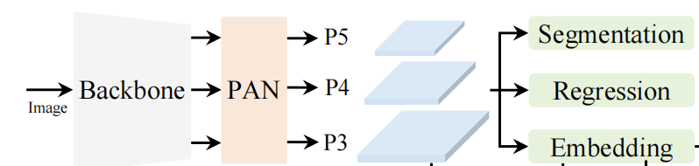


Backbone and PAN
- extracts multi-scale features
Regression head
- predicts the bounding box for anchor point
Segmentation head
- produces the prototype and mask coefficients.
Object embedding head (classification head)
- last 1× convolution layer output channel changes from class number c to the embedding dimension D.

Slide 4
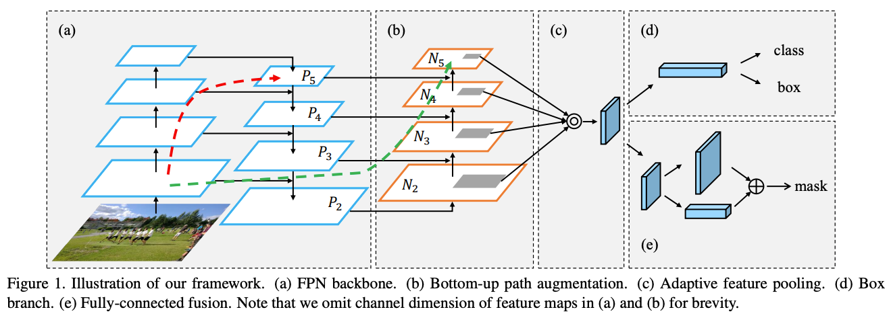
PANnet (2018年)

Slide 5
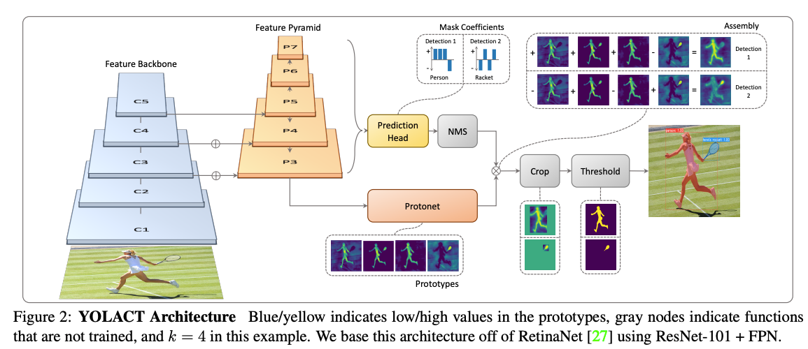
Yolact (2019年)

Slide 6

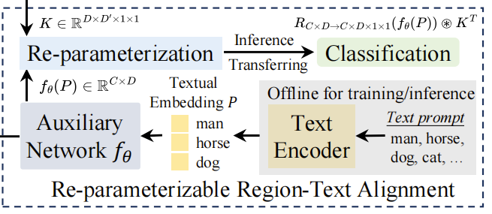


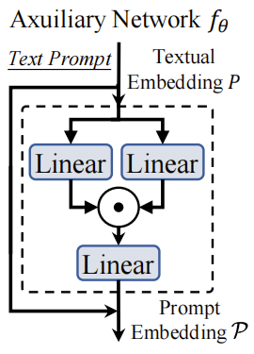

Anchor points’ object embedding
Textual embedding
CLIP text encoder
-input the text prompts of T
-ouput pretrained textual embedding
P = TextEncoder(T)
a lightweight auxiliary network fθ
- input the pretrained textual embedding
- output the enhanced textual embedding
P = fθ(P)
Note：
T：[C, D]
O：[N, D]
P：[C, D]
The structure of fθ

Slide 7

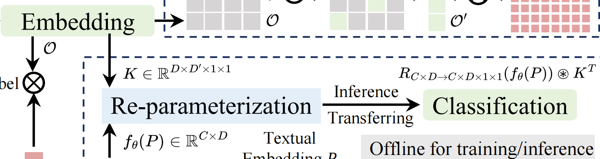


Training stage:
- I is input features
- K is the kernel parameters of last convolution layer in the object embedding head
Inference stage:
- The final predication is:

Slide 8

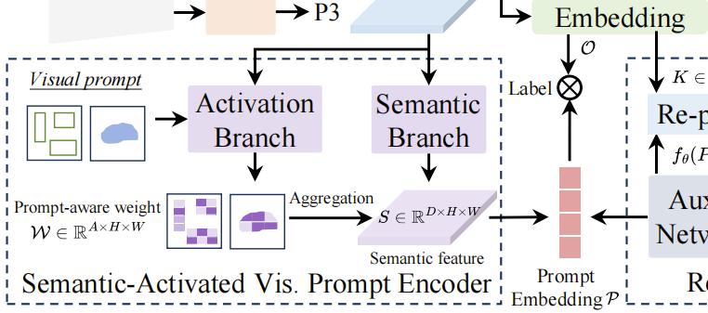
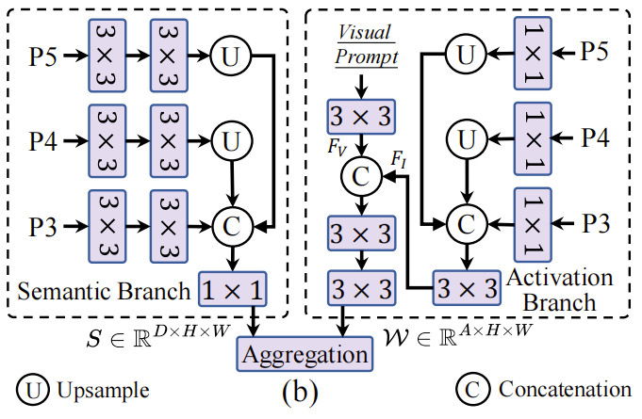
Semantic branch (similar structure as object embedding head.)
- input PAN feature {P3, P4, P5}
- output prompt-agnostic semantic features S ∈ [D, H, W]
Activation branch
- input PAN feature {P3, P4, P5} -> F_{I}∈ [A, H, W]
- input visual prompt -> prompt feature F_{V} ∈ [A, H, W]
- concatenate F_{I} and F_{V} -> W ∈ [A, H, W]
Aggregation to produce informative prompt embedding
- P = W * S^{T}
The structure of SAVPE

Slide 9
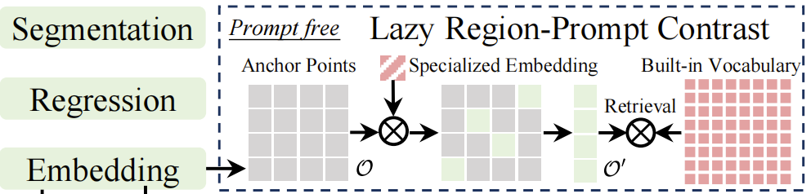


input a specialized prompt embedding P_{s}
input a built-in large vocabulary
input all anchor points O
Only anchor points in O′ are lazily matched against the built-in vocabulary

