Slide 1
Progress Report
Predicting an Agent's Next Tool Call from Partial Reasoning
predicts the tool call before the reasoning is finished
Guo Yibo
2026.8

Slide 2
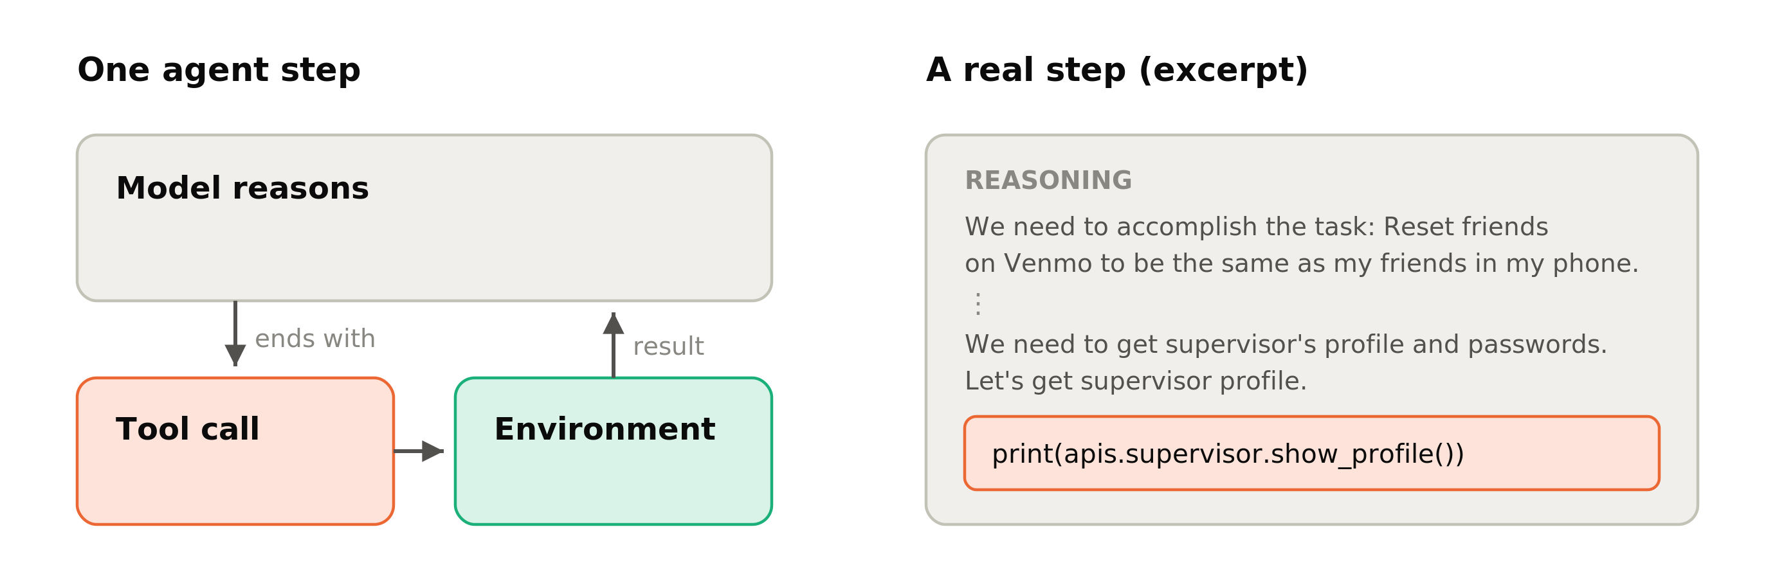
Agents and tool calls
An agent solves a task in steps
  reason → call a tool → observe the result → continue reasoning
Each step ends in one tool call
  everything before it is reasoning text

Slide 3
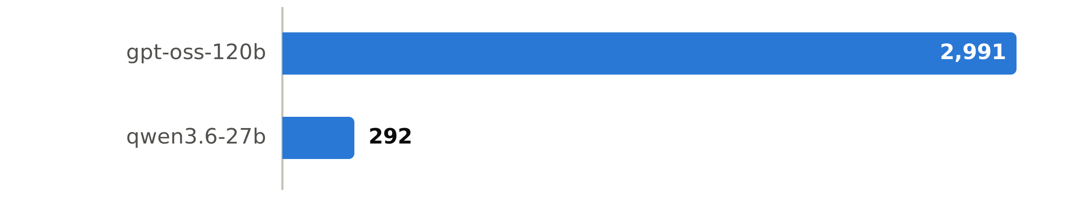
Reasoning is expensive
Tool agents follow the ReAct pattern [Yao et al., 2022]
  reasoning text makes the plan, actions get information from the environment
  Median reasoning length per step: 2,991 characters (gpt-oss-120b) vs 292 (qwen3.6-27b)
  One evaluation run over 168 AppWorld tasks: 3.3M–5.7M tokens
  Some single steps reach the 8,192-token generation limit

Slide 4
From overthinking in chat to agents
Prior work studies overthinking in chat and math settings [Chen et al., 2024]
  They found many reasoning tokens are spent on easy problems
We study the same cost problem in the agent setting
Key difference in the agent setting
  the next tool call is a classification problem over a fixed tool set, not open-ended generation

Slide 5
Toolformer: inserting API calls into text
A language model can learn where to insert an API call in the middle of text, and how to use the returned result in the following text [Schick et al., 2023]
Our question
  can a separate small model predict the call before the agent writes it out itself?

Slide 6
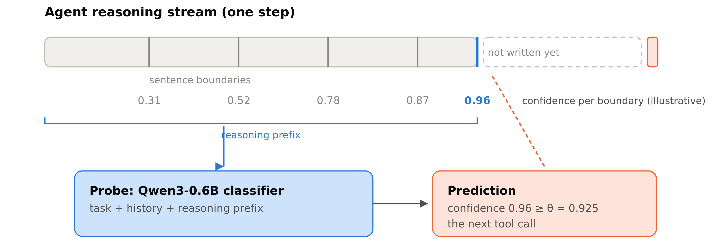
Our method: a probe that reads the reasoning prefix
A small probe model (about 1/30 of the agent model's inference cost) runs alongside the agent
  At each sentence boundary, the probe reads plain text
    task description + recent history + reasoning prefix
  When the probe's confidence exceeds a threshold θ, it outputs a prediction of the next tool

Slide 7
The two tasks and two models
AppWorld
  the agent operates phone apps (email, shopping, music, …) through API calls to finish everyday tasks
  many distinct tools, each with its own arguments
ALFWorld
  the agent acts in a text-described household (go somewhere, pick something up, put it down, …) to complete houseworks
  few action types, repeated often
Models
  gpt-oss-120b and qwen3.6-27b

Slide 8
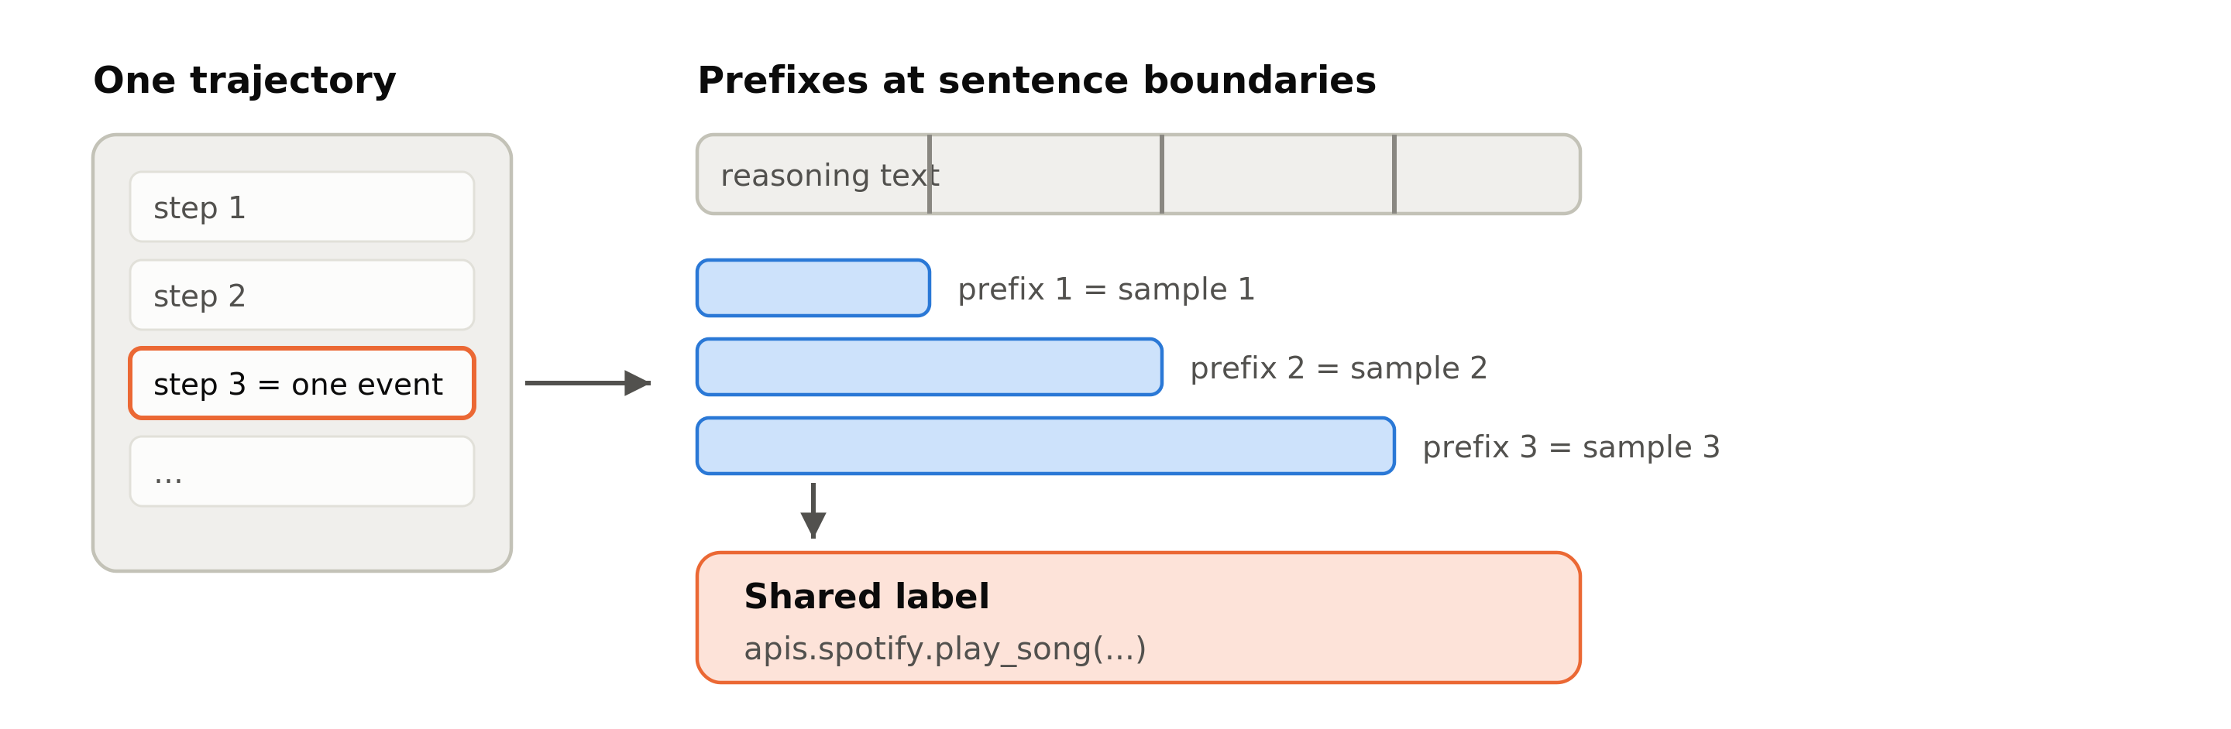
From trajectories to training data
  1. Run the agent on the training tasks and record complete trajectories
  2. Take every tool-call step; the reasoning text before the call is the raw material
  3. Cut that reasoning text at sentence boundaries; each prefix becomes one training sample (at most 64 per step)
  4. Label each sample with the tool that was actually called at that step

Slide 9
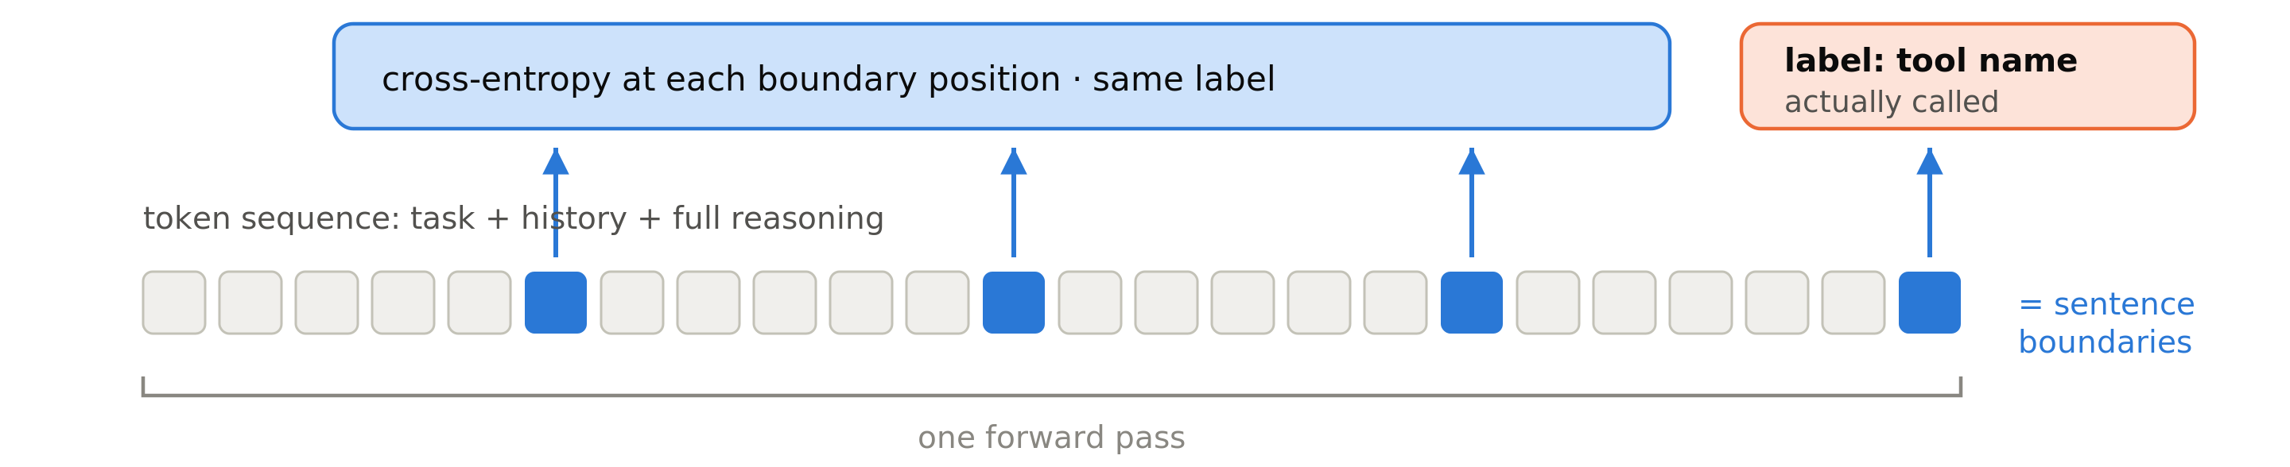
Probe training
Qwen3-0.6B-Base, full fine-tuning, with a linear classification head over tool names
  One forward pass per event, with supervision at every sentence-boundary position
  Each position is weighted 1/w, w is the number of steps in a single trajectory
ModernBERT-base (150M), same procedure
Why we chose these two kinds of models:
  Qwen3 is causal, so it is cheaper since we only need to add additional tokens when following the agent
  We need to send all tokens to BERT for each sentence
  Although Qwen3 is 600M, it is still overall faster compared to an 150M BERT

Slide 10
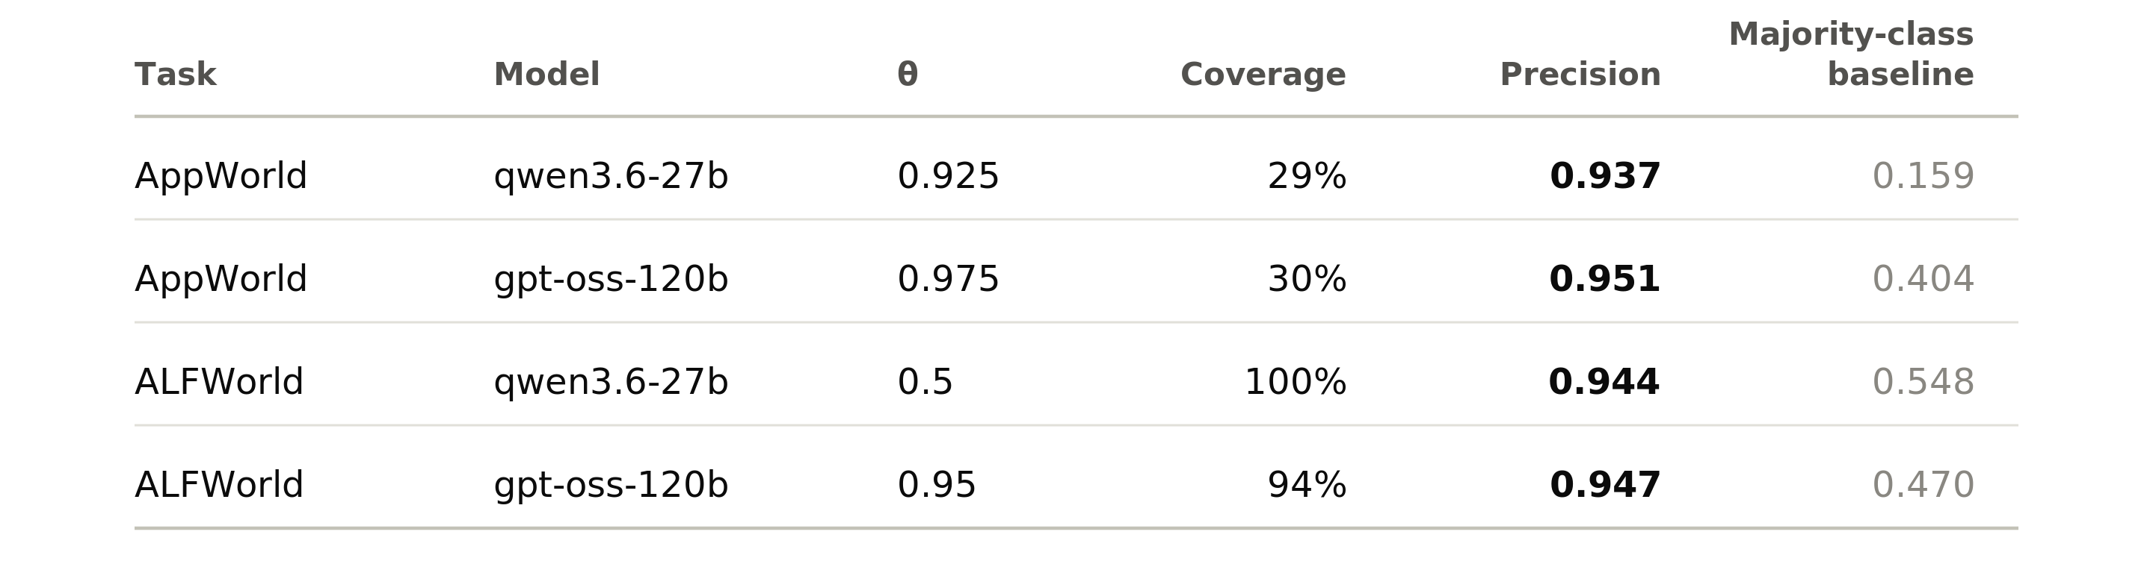
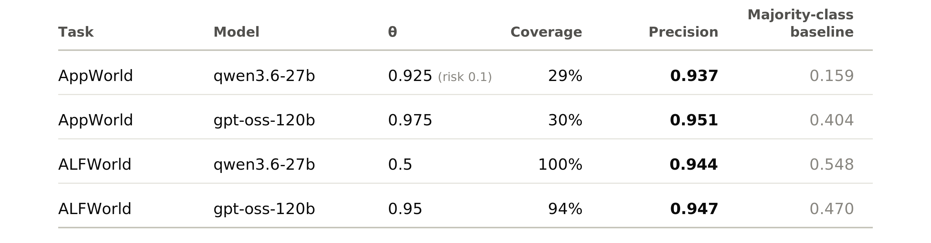
Main result: precision and coverage
We choose θ on a validation split so that precision reaches ~0.95, then freeze it
  Coverage is how many token

Slide 11
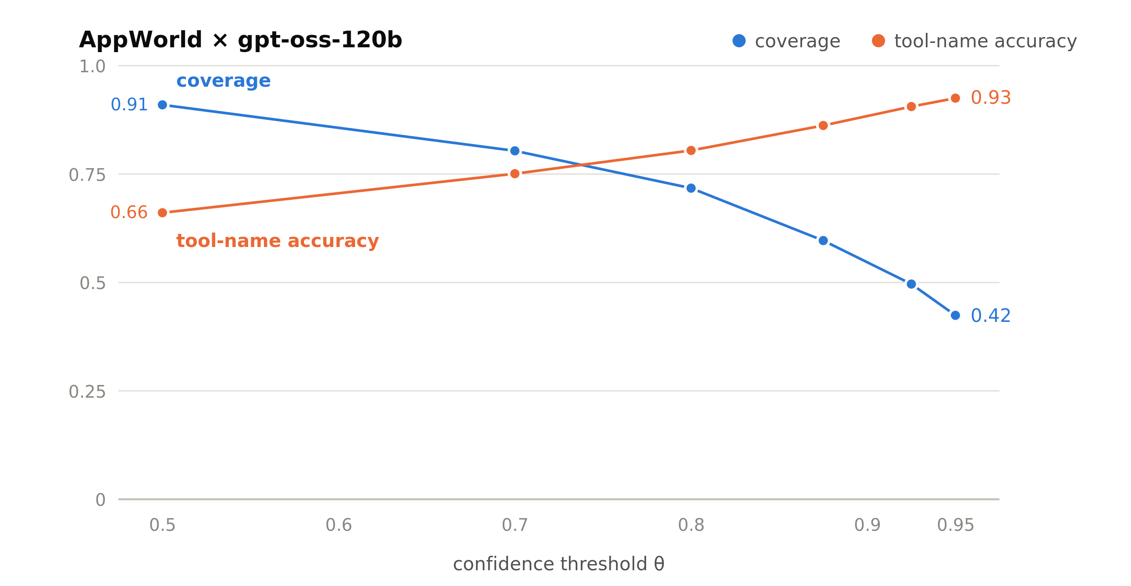
Precision–coverage trade-off over θ
Higher θ
  fewer predictions, higher accuracy
θ is chosen according to the acceptable error rate
AppWorld × gpt-oss. Numbers come from a different evaluation run than page 11 (here θ = 0.95 gives 0.925; there θ = 0.975 gives 0.951).

Slide 12
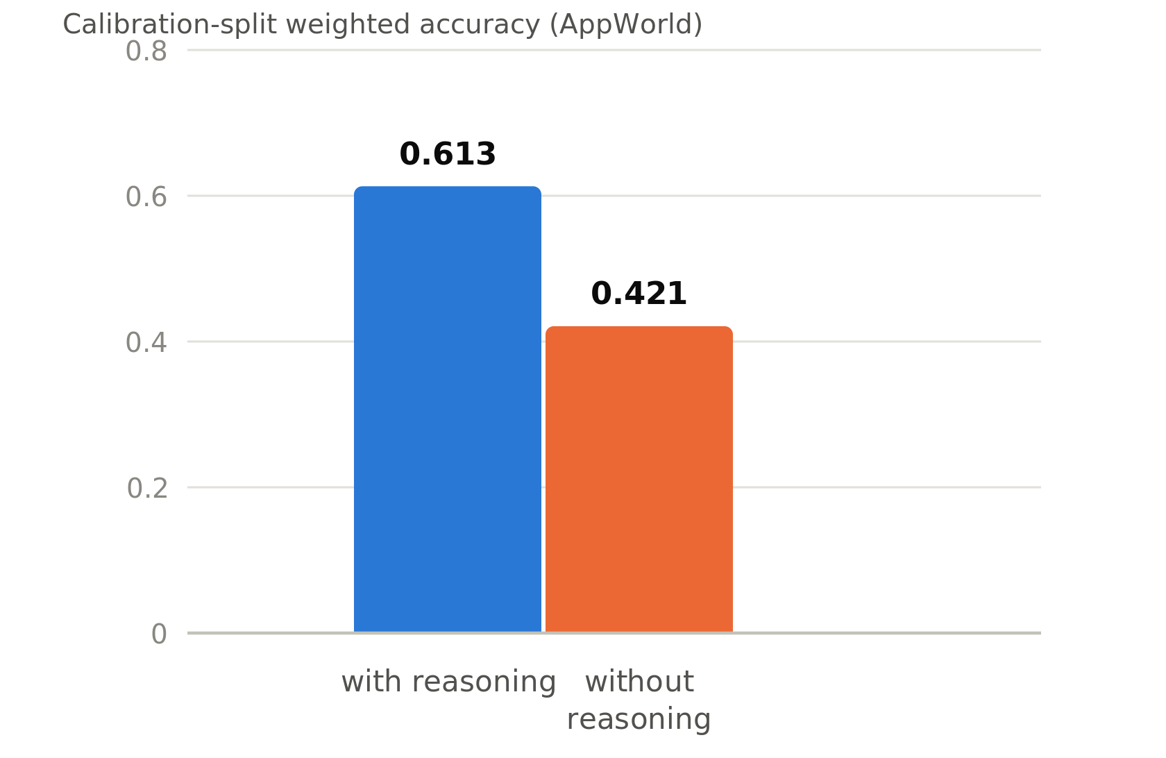
How early the prediction happens, and what it depends on
Earliness 0.58–0.84 (higher = earlier)
  predictions happen well before the reasoning is finished
Ablation
  removing the reasoning text from the input drops the calibration-split weighted accuracy from 0.613 to 0.421 (AppWorld)
  the prediction depends on the reasoning text, not on the task description alone

Slide 13
Summary of current results
On 30%–100% of events (depending on the task), the next tool can be predicted with ≥ 94% precision, well before the reasoning is finished
Transformers is better that BERT, on both cost and performance

Slide 14
Future work: three directions
Injection
  execute the predicted call early and feed it back to the agent
    where to insert it: into the ongoing chain of thought, or elsewhere in the context
    whether to hand the model the tool result before it asks for it
Predicting the arguments
  beyond the tool name
    extract argument values from the text, or fix the tool name and let the agent model write the arguments
Tool types
  handle read-only and state-changing tools differently
    early execution is safe for read-only tools, not for state-changing ones

