Slide 1
Predicting an Agent's Next Tool Call from Partial Reasoning
A lightweight probe predicts the tool call before the reasoning is finished
Work-in-progress report
y-guo
2026.8

Slide 2
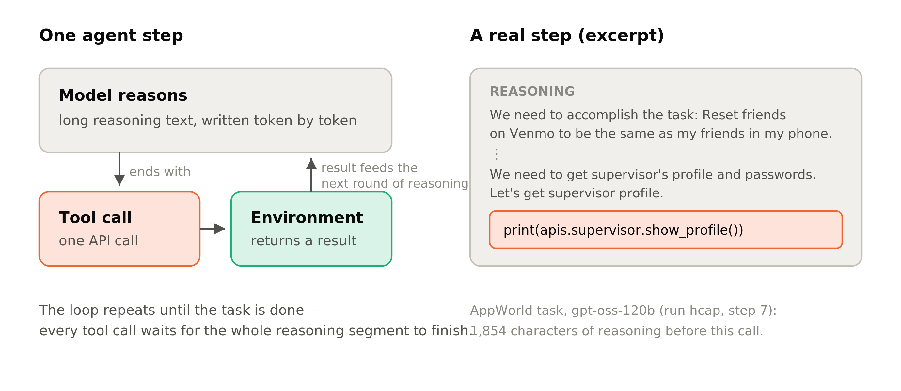
Agents and tool calls
An agent solves a task in steps: reason → call a tool → observe the result → continue reasoning.
Each step ends in one tool call; everything before it is reasoning text.

Slide 3
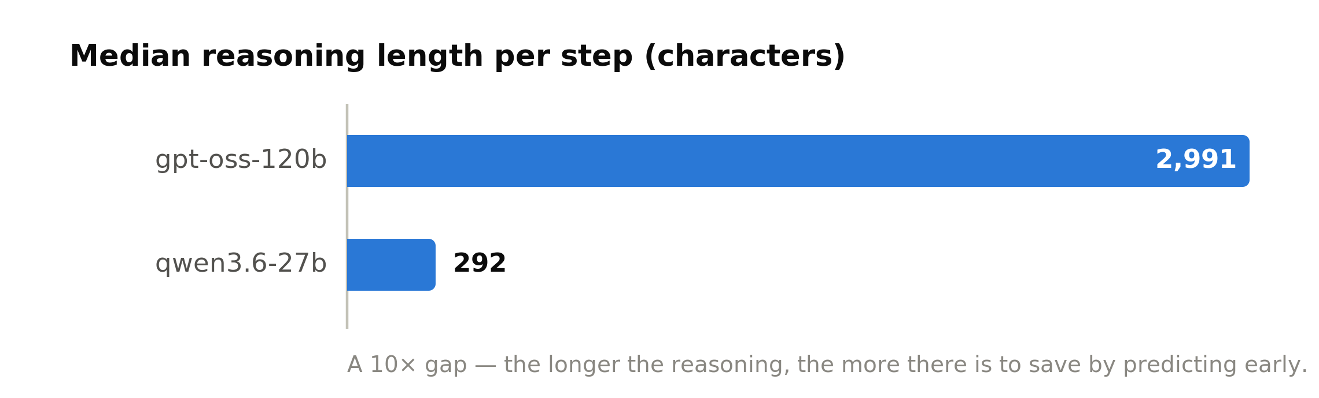
Reasoning is expensive
Tool agents follow the ReAct pattern: reasoning text makes the plan, actions get information from the environment. (Yao et al., 2022, arXiv:2210.03629)
  Median reasoning length per step: 2,991 characters (gpt-oss-120b) vs 292 (qwen3.6-27b).
  One evaluation run over 168 AppWorld tasks: 3.3M–5.7M tokens.
  Some single steps reach the 8,192-token generation limit.

Slide 4
From overthinking in chat to agents
Prior work studies overthinking in chat and math settings: many reasoning tokens are spent on easy problems. (Chen et al., 2024, arXiv:2412.21187)
We study the same cost problem in the agent setting.
Key difference in the agent setting: the next tool call is a classification problem over a fixed tool set, not open-ended generation.
Classification has a trivial baseline: always predicting the most frequent tool. All results are compared against this majority-class baseline.

Slide 5
Toolformer: inserting API calls into text
A language model can learn where to insert an API call in the middle of text, and how to use the returned result in the following text. (Schick et al., 2023, arXiv:2302.04761)
Our question: can a separate small model predict the call before the agent writes it out itself?

Slide 6
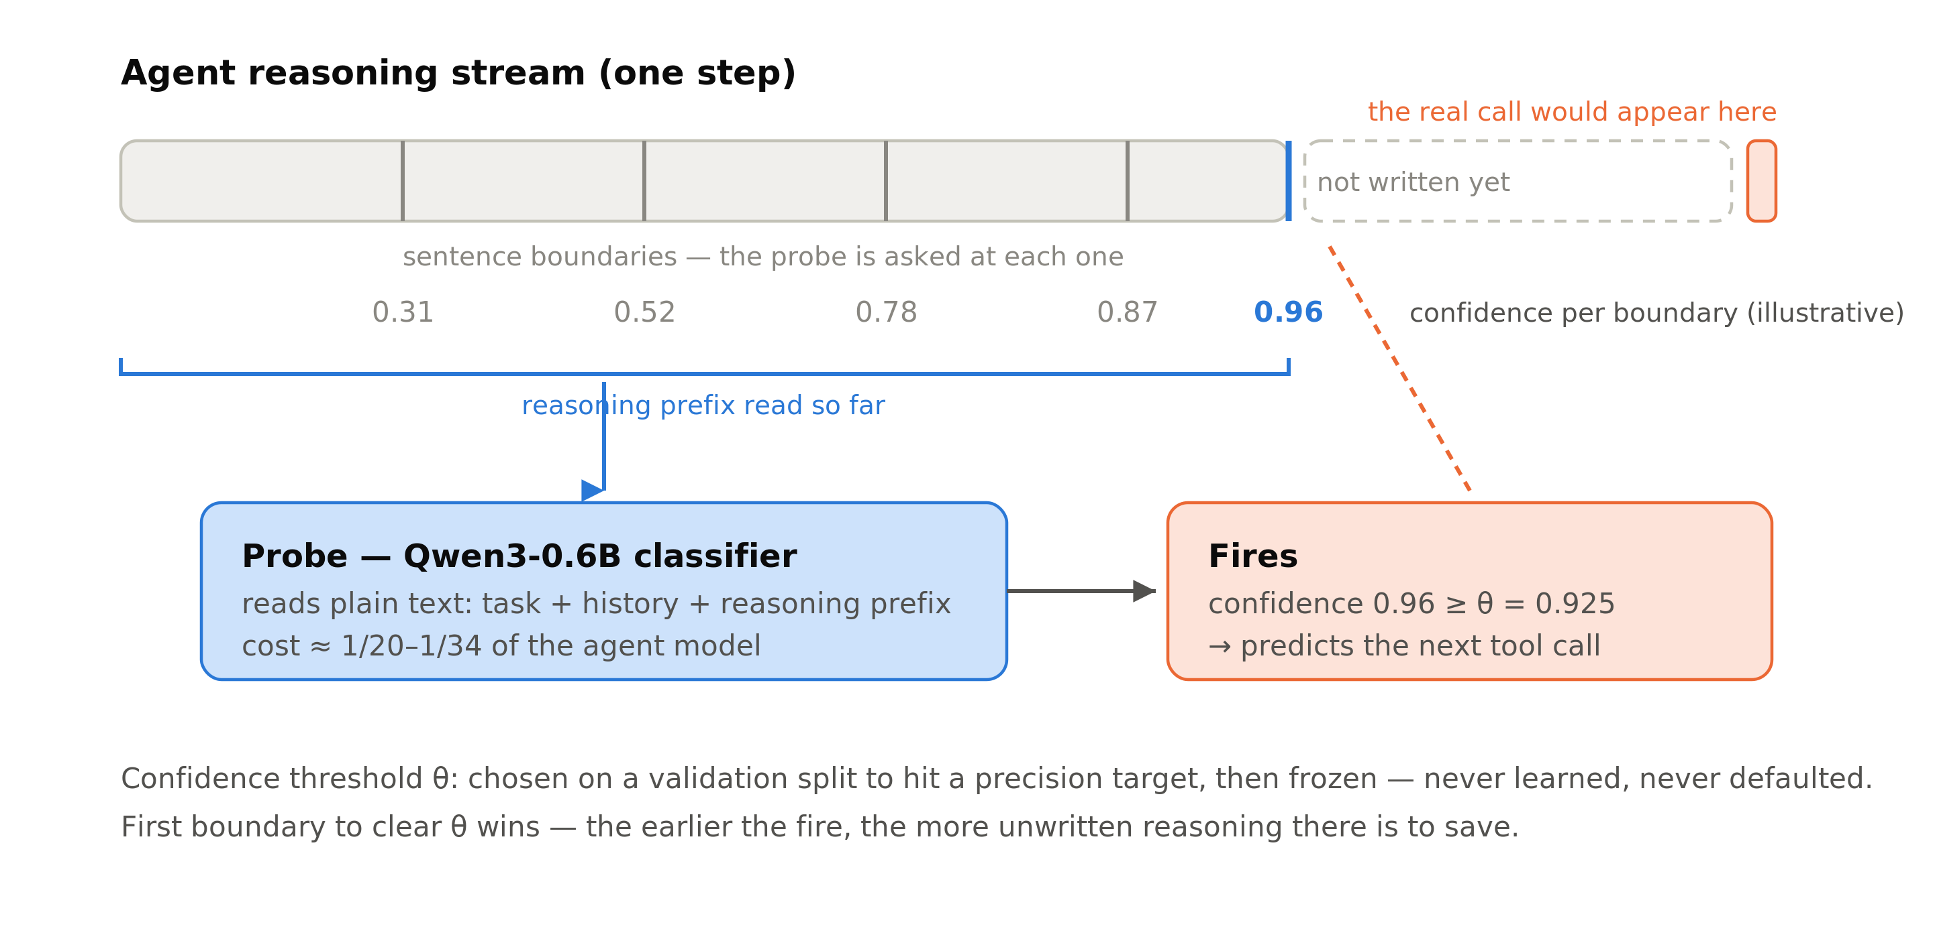
Our method: a probe that reads the reasoning prefix
A small probe model (1/20–1/34 of the agent model's inference cost) runs alongside the agent.
  At each sentence boundary, the probe reads plain text: task description + recent history + reasoning prefix.
  When the probe's confidence exceeds a threshold θ, it outputs a prediction of the next tool.

Slide 7
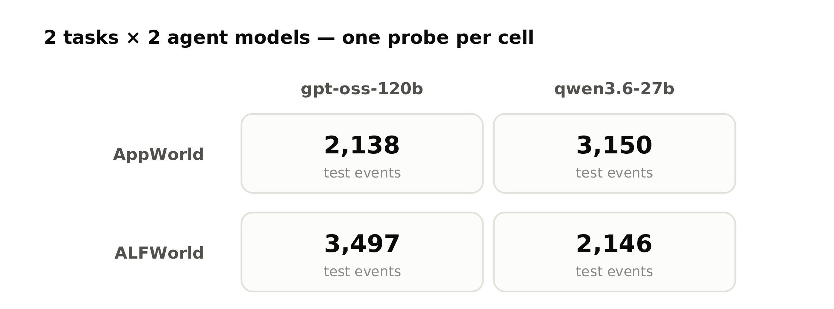
Setup: 2 tasks × 2 agent models
Official task splits (AppWorld: 90 train / 57 validation / 168 test tasks).
Data is split by task, so no task appears in both training and test.
All models are run with vLLM; one probe is trained per task × model pair.

Slide 8
The two tasks and two models
AppWorld: the agent operates phone apps (email, shopping, music, …) through API calls to finish everyday tasks — many distinct tools, each with its own arguments.
ALFWorld: the agent acts in a text-described household (go somewhere, pick something up, put it down, …) to complete chores — few action types, repeated often.
Models: gpt-oss-120b and qwen3.6-27b.

Slide 9
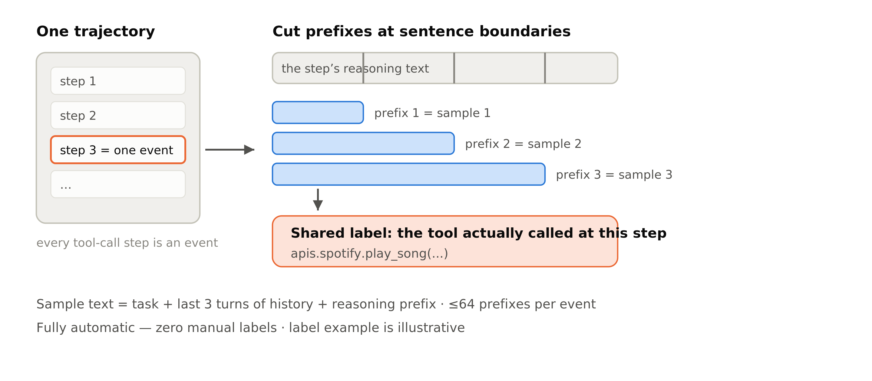
From trajectories to training data
  1. Run the agent on the training tasks and record complete trajectories.
  2. Take every tool-call step; the reasoning text before the call is the raw material.
  3. Cut that reasoning text at sentence boundaries; each prefix becomes one training sample (at most 64 per step).
  4. Label each sample with the tool that was actually called at that step.

Slide 10
Probe training
Qwen3-0.6B-Base, full fine-tuning, with a linear classification head over tool names.
  One forward pass per event, with supervision at every sentence-boundary position.
  Each position is weighted 1/mᵢ, so the training distribution matches deployment, where the probe is queried at every sentence boundary.
    Learning rate 1e-5 · 3 epochs · max length 4,096 with left truncation (the end of the reasoning is kept) · fp32 weights with bf16 computation · fixed random seed.
  Baseline probe: ModernBERT-base (150M), same procedure.

Slide 11
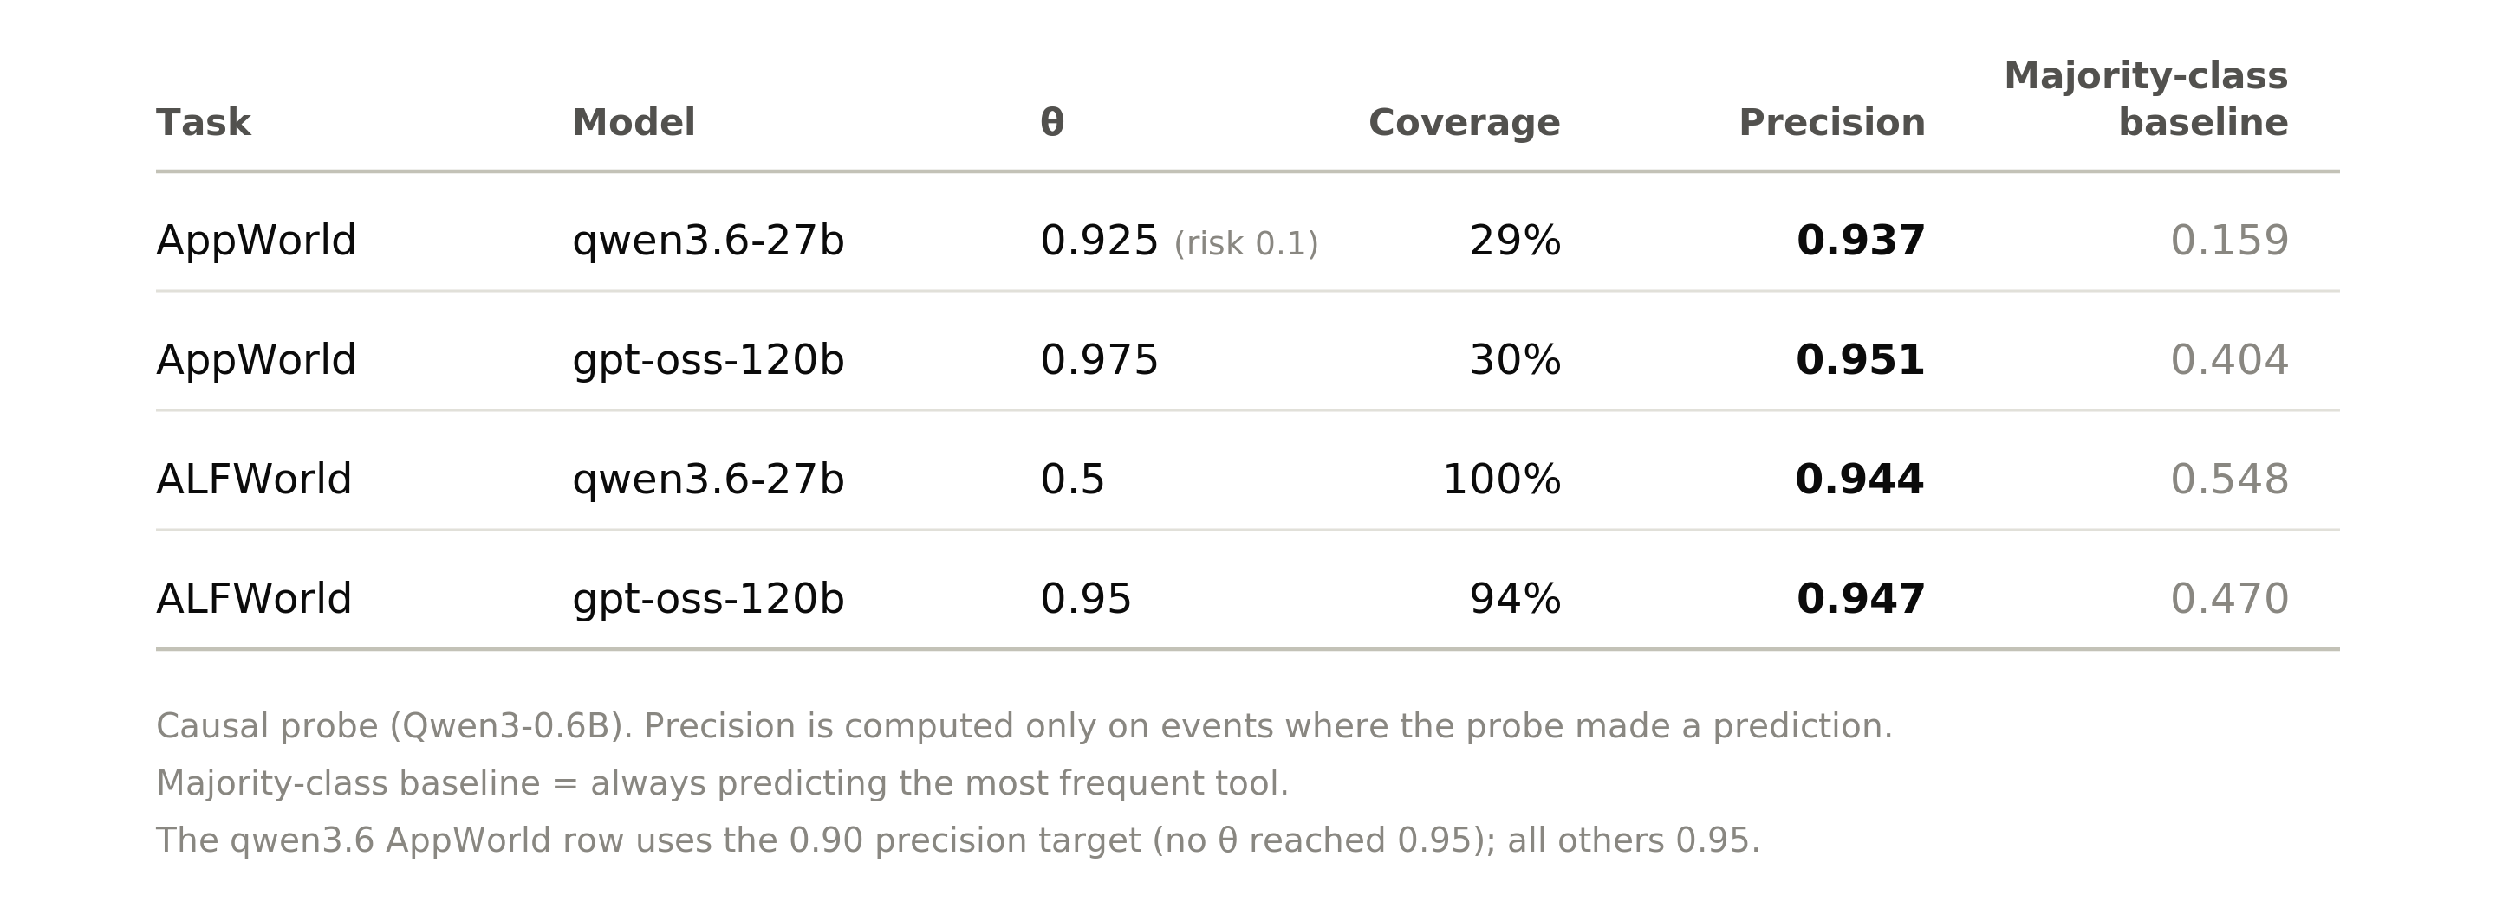
Main result: precision and coverage
We choose θ on a validation split so that precision reaches ~0.95, then freeze it. Coverage is what remains: the fraction of events where the probe is still confident enough to predict.

Slide 12
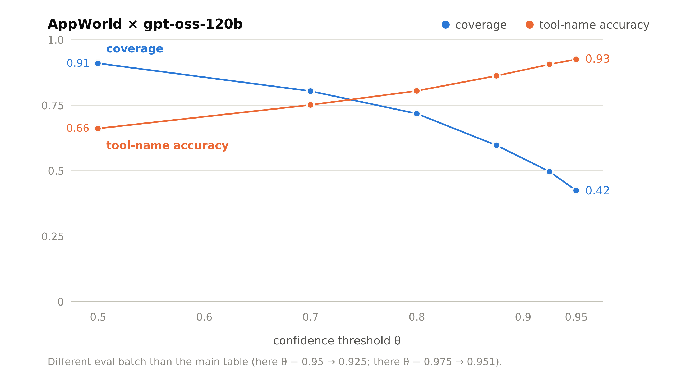
Precision–coverage trade-off over θ
Higher θ: fewer predictions, higher accuracy. θ is chosen according to the acceptable error rate.

Slide 13
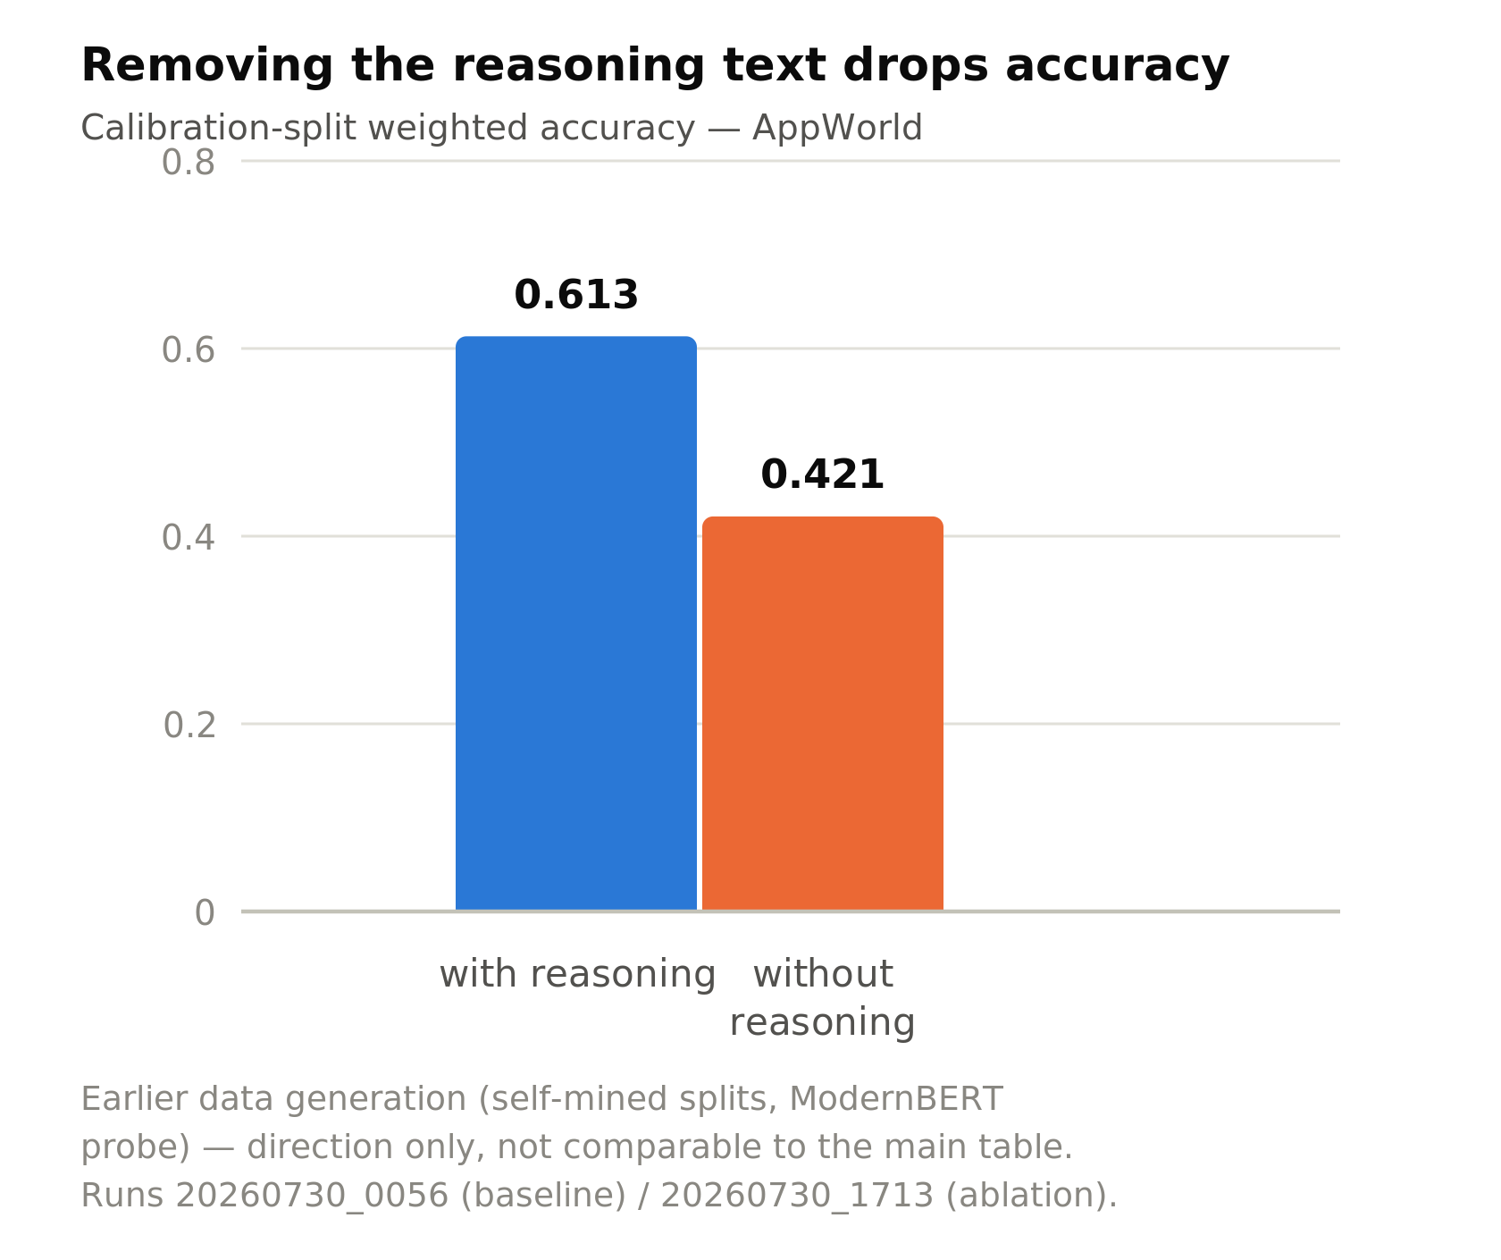
How early the prediction happens, and what it depends on
Earliness 0.58–0.84 (higher = earlier): predictions happen well before the reasoning is finished.
Ablation: removing the reasoning text from the input drops the calibration-split weighted accuracy from 0.613 to 0.421 (AppWorld). The prediction depends on the reasoning text, not on the task description alone.

Slide 14
Summary of current results
On 30%–100% of events (depending on the task), the next tool can be predicted with ≥ 94% precision, well before the reasoning is finished.
precision and coverage (p. 11) · trade-off over θ (p. 12) · earliness and ablation (p. 13)

Slide 15
Future work: three directions
Injection: execute the predicted call early and feed it back to the agent — where to insert it (into the ongoing chain of thought, or elsewhere in the context), and whether to hand the model the tool result before it asks for it.
Predicting the arguments: beyond the tool name — extract argument values from the text, or fix the tool name and let the agent model write the arguments.
Tool types: handle read-only and state-changing tools differently — early execution is safe for read-only tools, not for state-changing ones.

