Slide 1
RequireJS
应用与分析
猎豹游戏平台前端组

Slide 2
content
1 初步
2 入门
3 进阶
4 后续
猎豹游戏平台前端组

Slide 3
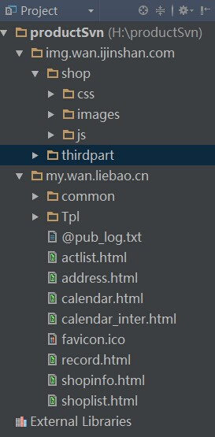
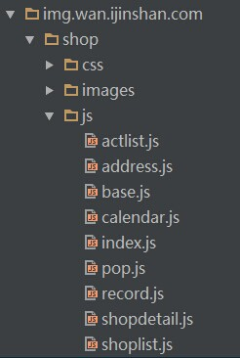
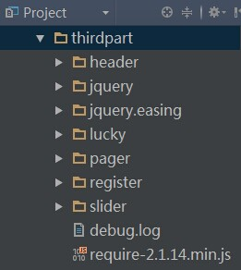
项目文件结构
JS文件结构
thirdpart和requirejs
猎豹游戏平台前端组

Slide 4
index.html
<script src="../../img.wan.ijinshan.com/thirdpart/require-2.1.14.min.js"></script>
<script>
require.config({
baseUrl: '../../img.wan.ijinshan.com/',
paths: {
jQuery: 'thirdpart/jQuery/1.8.2/jquery.min',
base: 'shop/js/base',
index: 'shop/js/index',
calendar: 'shop/js/calendar',
pop: 'shop/js/pop',
CommonTitle: 'thirdpart/header/1.0.0/CommonTitle'
},
shim: {
'jQuery': {exports: 'jQuery'},
'jQuery.easing': {
deps: ['jQuery'],
exports: 'jQuery.fn.easing'
}
}
});
猎豹游戏平台前端组

Slide 5
目录层级表示
"./" 根目录。
"../" 上一层目录。
"/" 当前目录。
猎豹游戏平台前端组

Slide 6
index.html
require([
'jQuery',
  'index',
  'base',
  'calendar',
  'pop',
  'thirdpart/jquery.easing/1.3/jquery.easing.min',
  'thirdpart/slider/1.2/slider',
  'thirdpart/header/1.0.0/header_login',
  'thirdpart/lucky/Helper/Login/1.0.0/Login',
  'CommonTitle'
], function (jQuery, index, base, calendar, pop, easing, slider, header_login, Login, CommonTitle) {
//do nothing
});
</script>
猎豹游戏平台前端组

Slide 7
index.js
define(function(require){
  //var _win = window;
  var $ = require('jQuery');
  var _bAPP = require('base');
  var slider = require('thirdpart/slider/1.2/slider');
  //此处省略若干index首页业务代码
  domRender();
  return {
  //init: function () {
  // domRender();
  //},
  //首页的积分及商品兑换
  pagefill: function (divEle, type) {
  pageFill(divEle, type);
  }
  }
});
猎豹游戏平台前端组

Slide 8
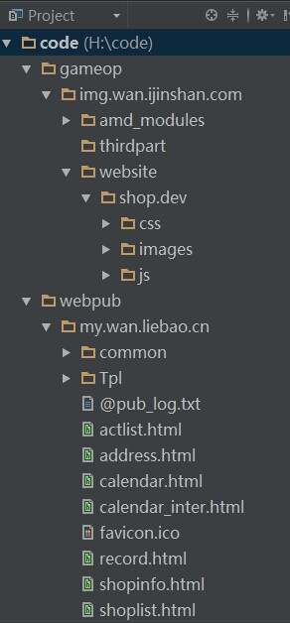
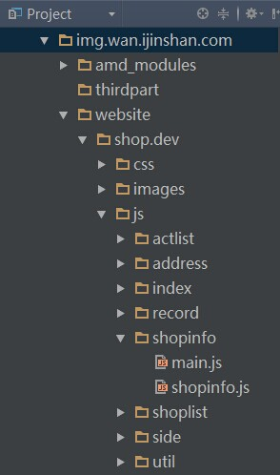
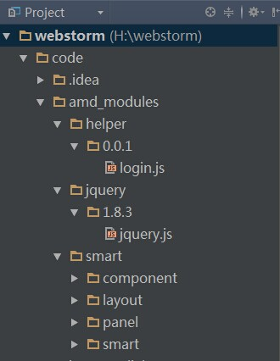
猎豹游戏平台前端组

Slide 9
shoplist.html
<script type="text/javascript" src="http://wan.liebao.cn/static/js/i-header.js?t=201407141458">
</script>
<script type="text/javascript" src="http://img.wan.ijinshan.com/thirdpart/require/2.1.14/require-2.1.14.min.js" data-main="http://img.wan.ijinshan.com/website/shop.dev/js/shoplist/main.js">
</script>
猎豹游戏平台前端组

Slide 10
main.js
require.config({
baseUrl: "http://img.wan.ijinshan.com/amd_modules/",
paths: {
app : "../website/shop.dev/js/",
util: "../website/shop.dev/js/util/"
}
});
require([
'jquery/1.8.3/jquery',
'app/shoplist/shoplist',
'util/base/0.0.1/base',
'util/calendar/0.0.1/calendar',
'util/pop/0.0.1/pop',
'helper/0.0.1/login',
'header/0.0.1/header_login',
'header/0.0.1/header_login_CommonTitle',
'pager/0.0.1/pager'
], function (jquery, shoplist, base, calendar, pop, Login, header_login, header_login_CommonTitle, pager) {
//code
});
猎豹游戏平台前端组

Slide 11
shoplist.js
define('app/shoplist/shoplist', ['jquery/1.8.3/jquery'], function( $ ){
//main code
var _win = window,
_Url = 'http://credit.wan.liebao.cn/index.php/api/',
hash = location.hash,
hash_index = hash === '#real' ? 1 : (hash === '#virtual' ? 0 : -1)
...............
pageFill = function(filter){.............};
..................
domRender();
});
猎豹游戏平台前端组

Slide 12
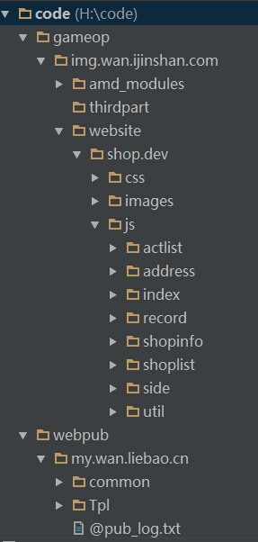
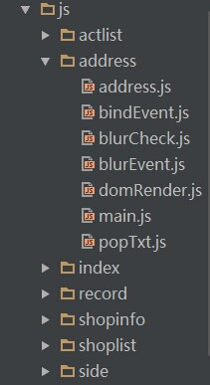
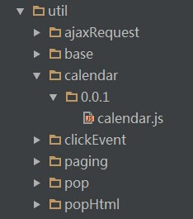
猎豹游戏平台前端组

Slide 13
main.js
require.config({
baseUrl: "http://img.wan.ijinshan.com/amd_modules/",
paths: {
app : "../website/shop.dev/js/",
util: "../website/shop.dev/js/util/",
jquery : "jquery/1.8.3/jquery"
}
});
require(['app/address/address'], function ( address ) {
});
猎豹游戏平台前端组

Slide 14
address.js
define('app/address/address', ['jquery', 'app/address/bindEvent', 'app/address/domRender'], function($, bindEvent, domRender){
domRender();
bindEvent();
});
猎豹游戏平台前端组

Slide 15
bindEvent.js
define(['jquery', 'util/base/0.0.1/base', 'helper/0.0.1/login', 'header/0.0.1/header_login', 'app/address/blurCheck', 'app/address/popTxt', 'app/address/blurEvent'], function ( $, _bAPP, LOGIN, Login, blurCheck, poptxt, blurEvent) {
var _URL = 'http://credit.wan.liebao.cn/index.php/api/',
INPUTS = ['realname', 'mobile', 'address'],
NULL_LINK = '',
isOk = {};
var userInpt = function() {.....};
return function ( ) {
$('dd input').on('blur',function(){.....});
$('dd textarea').on('blur',function(){.......});
$('#btnok').unbind('click').bind('click', function (e) {....... });
$('.btns>.btn-real', '#winpop').unbind('click').bind('click', function (e) {.});
}
});
猎豹游戏平台前端组

Slide 16
blurEvent.js
define(['jquery'], function ( $ ) {
var regexps = {.....},
isOk = {};
return function(curInput){
........
//validate form
if (curId == 'realname') {
} else if (curId == 'mobile') {
//some code
}
$msg_dd.removeClass('error').addClass('ok');
$msg_txt.removeClass('errortxt');
return isOk;
}
});
猎豹游戏平台前端组

Slide 17
blurCheck.js
define('app/address/blurCheck', ['jquery', 'app/address/blurEvent'], function ( $, blurEvent ) {
//@description blurCheck: blur事件的顺序执行
return function(that){
/**
* description 输入框的blur事件判断
* @param curInput
*/
$cur = $(that[0]);
$cur.on('blur', blurEvent($cur[0]));
return isOk;
}
});
猎豹游戏平台前端组

Slide 18
domRender.js
define(['jquery', 'helper/0.0.1/login', 'header/0.0.1/header_login'], function ( $, LOGIN, Login ) {
var _win = window,
location = _win.location,
_URL = 'http://credit.wan.liebao.cn/index.php/api/';
var queryString = function(name){
var name = name.replace(/[\[]/, "\\\[").replace(/[\]]/, "\\\]") || '';
var regex = new RegExp("[\\?&]" + name + "=([^&#]*)"),
results = regex.exec(location.search);
return results == null ? "" : decodeURIComponent(results[1].replace(/\+/g, " "));
},
goodsid = queryString('item');
return function(){
........
};
});
猎豹游戏平台前端组

Slide 19
popTxt.js
define('app/address/popTxt', ['jquery/1.8.3/jquery'], function ( $ ) {
var tipinfo = null,
userObj = null;
return function (userObj) {
//goodsname：成功兑换后的提示包括物品名称，
userObj = userObj || {};
var showname = $('#goodsname').text(),
pnum = $("#sign-point").text(),
msg = userObj.msg || '',
content = $('#showtxt').attr('data-html');
return tipinfo = {
'tit': '温馨提示',
'con': '',
'addrtit': '信息确认',
'addrcon': ( ......),
..........
};
};
});
猎豹游戏平台前端组

Slide 20
Thanks for listening

