Slide 1
积分商城模块化实现
郭 永 峰
2014.7.31

Slide 2


Slide 3
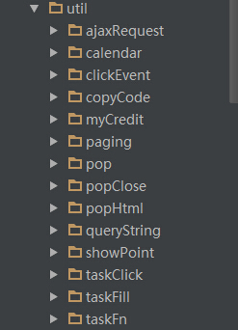
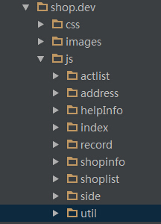
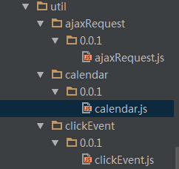
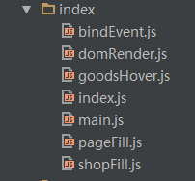
util
JS文件结构
index

Slide 4
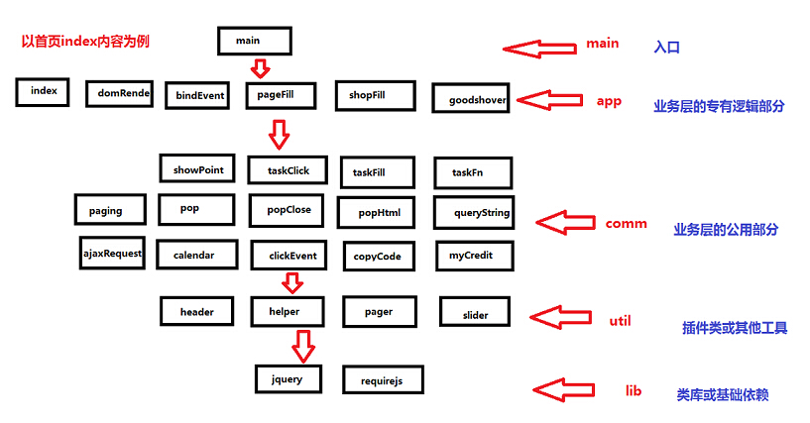
图解

Slide 5
Index.html
<div class="sign-calendar">
<!--#include virtual="/calendar.html" -->
</div>
<script type="text/javascript" src="http://wan.liebao.cn/static/js/i-header.js"></script>
<script type="text/javascript" src="http://img.wan.ijinshan.com/amd_modules/require/2.1.14/require.js" data-main="http://img.wan.ijinshan.com/website/shop.dev/js/index/main.js"></script>

Slide 6
main.js
require.config({
baseUrl: "http://img.wan.ijinshan.com/amd_modules/",
paths: {
app : "../website/shop.dev/js/",
util: "../website/shop.dev/js/util/"
}
});
require(['app/index/index'], function ( index ) {
});

Slide 7
index.js
/**
* 积分商城首页加载
* @describe 根据设计图做新的调整，添加实物商品、虚拟商品首页显示格式及重新布局任务积分
*/
define(['app/index/domRender'], function( domRender ){
});

Slide 8
domRender.js
define('app/index/domRender', ['jquery/1.8.3/jquery', 'app/index/bindEvent', 'slider/0.0.2/slider', 'app/index/pageFill', 'util/taskFill/0.0.1/taskFill'], function ( $, bindEvent, slider, pageFill, taskFill ) {
var portUrl = 'http://credit.wan.liebao.cn/index.php/api/',
nopic = 'http://img.wan.ijinshan.com/website/shop/images/nopic.jpg',
_URL = {
'pageUrl' : portUrl + 'index',
'taskUrl' : portUrl + 'drawDown'
},
$goodEle = $('.gift-show','div.gift-change'),
$creditEle = $('.task-box','div.get-integral');
/**
* @description 页面DOM结构填充
*/
taskFill($creditEle,'tasks'); //做任务得积分内容填充
pageFill($goodEle,'goods', 1); //实物商品兑换内容填充
pageFill($goodEle,'goods'); //虚拟商品兑换内容填充
/**
* @description 焦点图滑动
*/
$('.tabcon li').slider({
navMenuObj: '.tabs span',//导航对象
prevCurObj: '.nextCur',//向前按钮对象
nextCurObj: '.prevCur',//向后按钮对象
isAuto: true,//是否自动滚动 自动滚动：true；不自动滚动：false
playType: 'fade',//消息效果 fade或slide
durTime:0,
effectTween: 'easeIn'
});
bindEvent();
});

Slide 9
bindEvent.js
define('app/index/bindEvent', ['jquery/1.8.3/jquery', 'util/taskClick/0.0.1/taskClick'], function ( $, taskClick ) {
return function() {
var $taskList = $('.list-items', '.right .minh');
for (var i = 0, len = $taskList.length; i < len; i++) {
$taskList.eq(i).index = i;
$taskList.eq(i).on('click', function () {
for (var i = 0, len = $taskList.length; i < len; i++) {
($taskList.eq(i).removeClass('on'))(i);
}
$taskList.eq($taskList.eq(i).index).addClass('on');
});
}
taskClick();
};
});

Slide 10
bindEvent.js
define('app/index/bindEvent', ['jquery/1.8.3/jquery', 'util/taskClick/0.0.1/taskClick'], function ( $, taskClick ) {
return function() {
var $taskList = $('.list-items', '.right .minh');
for (var i = 0, len = $taskList.length; i < len; i++) {
$taskList.eq(i).index = i;
$taskList.eq(i).on('click', function () {
for (var i = 0, len = $taskList.length; i < len; i++) {
($taskList.eq(i).removeClass('on'))(i);
}
$taskList.eq($taskList.eq(i).index).addClass('on');
});
}
taskClick();
};
});

Slide 11
pageFill.js
define('app/index/pageFill', ['jquery/1.8.3/jquery', 'util/ajaxRequest/0.0.1/ajaxRequest', 'util/clickEvent/0.0.1/clickEvent', 'app/index/bindEvent', 'app/index/shopFill', 'app/index/goodsHover'], function ( $, ajaxRequest, clickEvent, bindEvent, shopFill, goodsHover ) {
return function (domhtml, typesign, shopsign) {
ajaxRequest({
'filldiv' : (domhtml||''),
'urltype' : 'index',
'dataObj' : {type : (typesign || ''), goods_type : (shopsign || 0)},
'callback' : function(json){
json = json || {};
if(json.code == 1){
var data = json.data;
if ( typesign == 'goods' ) {//实物商品兑换list
var goods = null,
goodsHtml = [];
//实物商品填充
if(shopsign == '1'){
goodsHtml = shopFill(data);
$('.gift-show','#real').html(goodsHtml);
//虚拟商品填充
}else{
goodsHtml = shopFill(data);
$('.gift-show','#virtual').html(goodsHtml);
}
}
bindEvent();
goodsHover();
}
}
});
}
});

Slide 12
shopFill.js
define('app/index/shopFill', ['jquery/1.8.3/jquery'], function ( $ ) {
/**
* @description 实物、虚拟商品填充
* @param data
* @returns {string}
*/
return function(data){
var goods = data.goods,
recommend = goods.recommend || [],
normal = goods.normal || [],
// 判断是否有推荐，如果没有则取normal的第一个，推荐首页仅用第一个
gItemRec = recommend.length ===0 ? (normal[0] || {} ): (recommend[0] || {}),
goodsHtml = [],
goodId = gItemRec.id || 1,
goodUrl ="/shopinfo.html?item=" + goodId || "/shoplist.html",
//@description num为容错的数字 数值超过10000显示为9999+
num = Number(gItemRec.exchanged_num || 0);
num = num>=10000?('9999+'):num;
//省略若干行
});

Slide 13
goodsHover.js
define('app/index/goodsHover', ['jquery/1.8.3/jquery'], function ( $ ) {
return function () {
var $goodEle = $('.gift-show','div.gift-change');
$('.big-box',$goodEle).hover(function(){
$(this).find('.inter').addClass('on');
},function(){
$('.big-box',$goodEle).find('.inter').removeClass('on');
});
$('.small-box',$goodEle).hover(function(){
$(this).find('.pos,div.bgmask').addClass('on');
},function(){
$('.small-box',$goodEle).find('.pos,div.bgmask').removeClass('on');
});
}
});

Slide 14
Confuse
1 调试
2 逻辑拆分
3 流程图

Slide 15
The Next

Slide 16


Slide 17
Require.js — Too complicated
Browserify — A much better module loader
Angular Dependency Injection — Solves most of our problems

Slide 18
Thanks for listening
See you in someday

