Slide 1
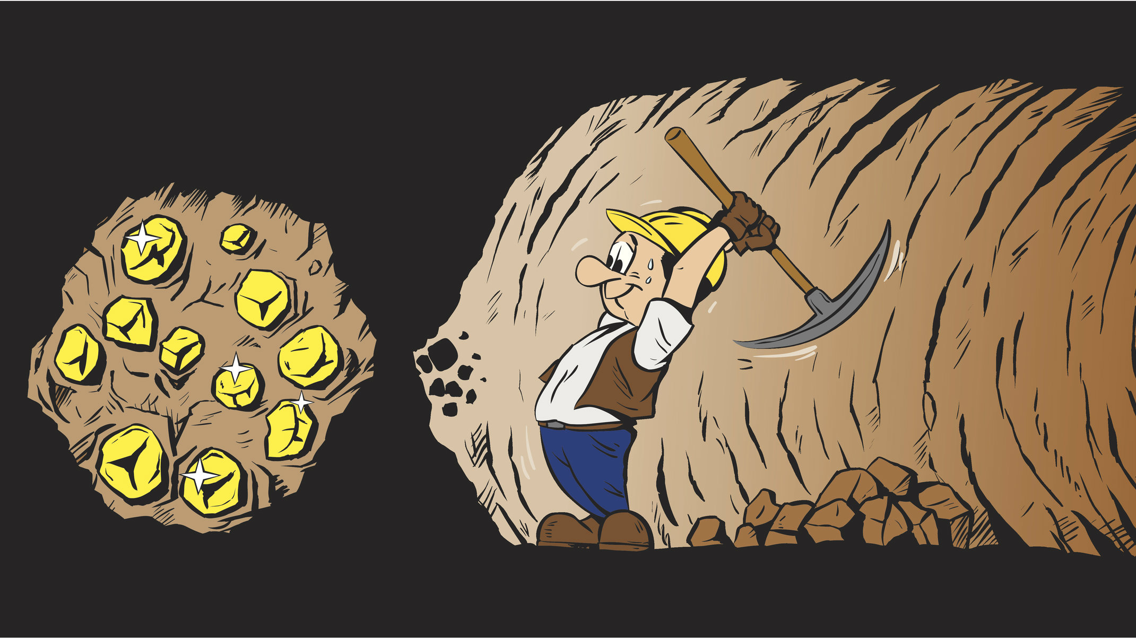
Mining for gold
Notes:
I need to make a table of the potential driver mutations. This is going to be from the spreadsheet where I have all of the mutations that reach over 50% frequency in the populations.
This should be at the population level.

Slide 2
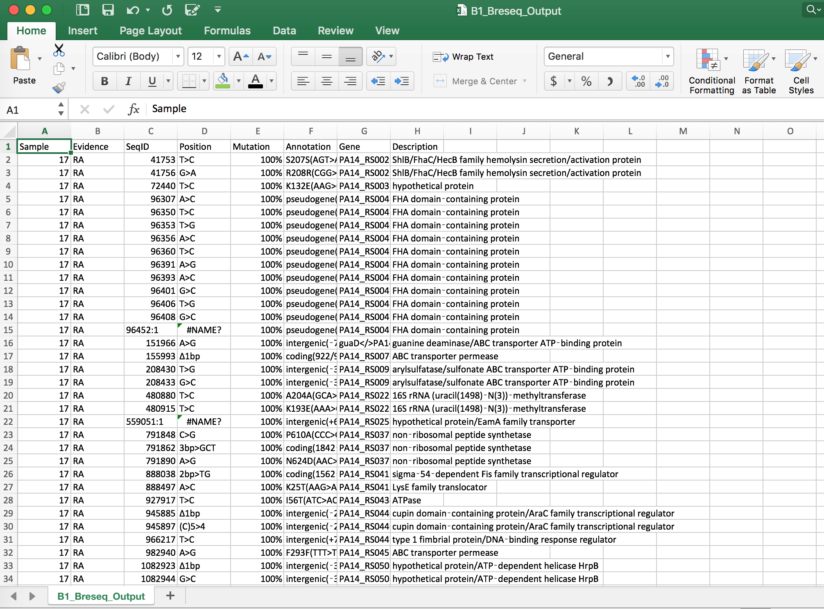
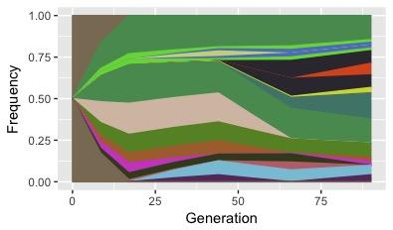
Can we minimize human input in time series analysis of population data?
Frequency
Time (Days)
Breseq output
Muller Diagrams

Slide 3
Time course population workflow
R filtering
Ancestral mutations
Must reach 10%
Must change by 10%
>1 time point
!= 100% throughout
Breseq_Cat script on Beagle
Compile data in one spreadsheet
Matlab scripts
Predicts genotypes
Can plot genotypes
*
*
*
Conversion from matlab variables to ggMuller data frames
*
Ggmuller
*
*
* = requires human input

Slide 4
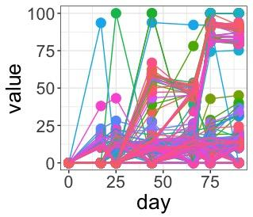
Genotypes are determined by maximum parsimony
Simplest definition is the best.
Notes:
Minimizing the number of changes.
there is a lot of math that I don't fully understand, but I can get the general sense of what's going on.
by default the first entry is a genotype. it then calculates the likelihood that everything else is in that genotype. the first mutation to not fit the criteria (having a probability of being related < .1) you become genotype 2. determine this probability by comparing the difference between the trajectories against a normal distribution

Slide 5
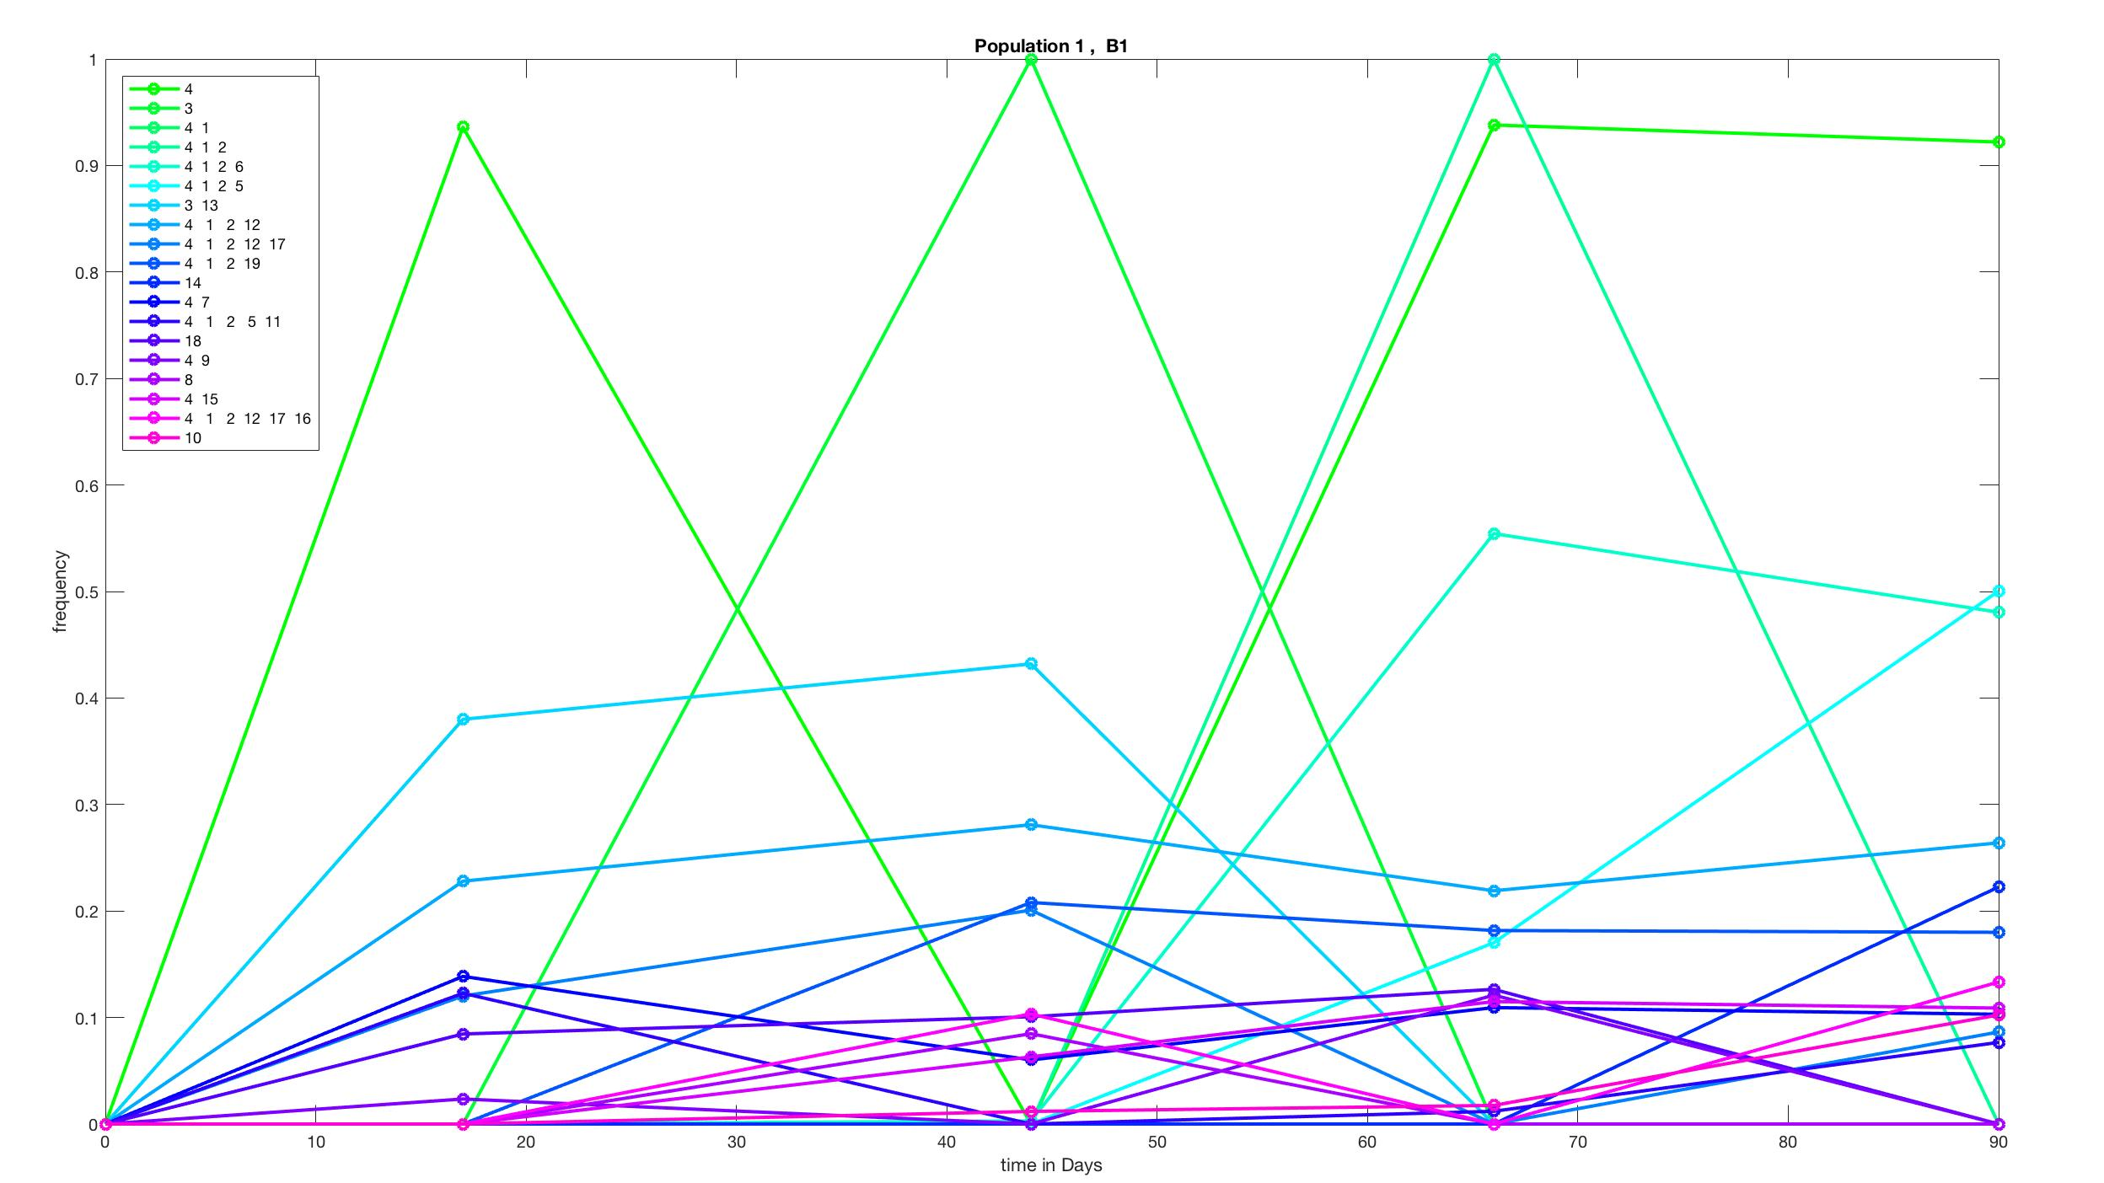
Genotypes are determined by maximum parsimony
Simplest definition is the best.
First mutation is genotype 1
If probability mutation 2 is in same genotype is < .1 grouped. If not it I genotype 2.
Comparisons made against normal distribution
File has to be specially formatted in an excel file
Notes:
Minimizing the number of changes.
there is a lot of math that I don't fully understand, but I can get the general sense of what's going on.
by default the first entry is a genotype. it then calculates the likelihood that everything else is in that genotype. the first mutation to not fit the criteria (having a probability of being related < .1) you become genotype 2. determine this probability by comparing the difference between the trajectories against a normal distribution

Slide 6
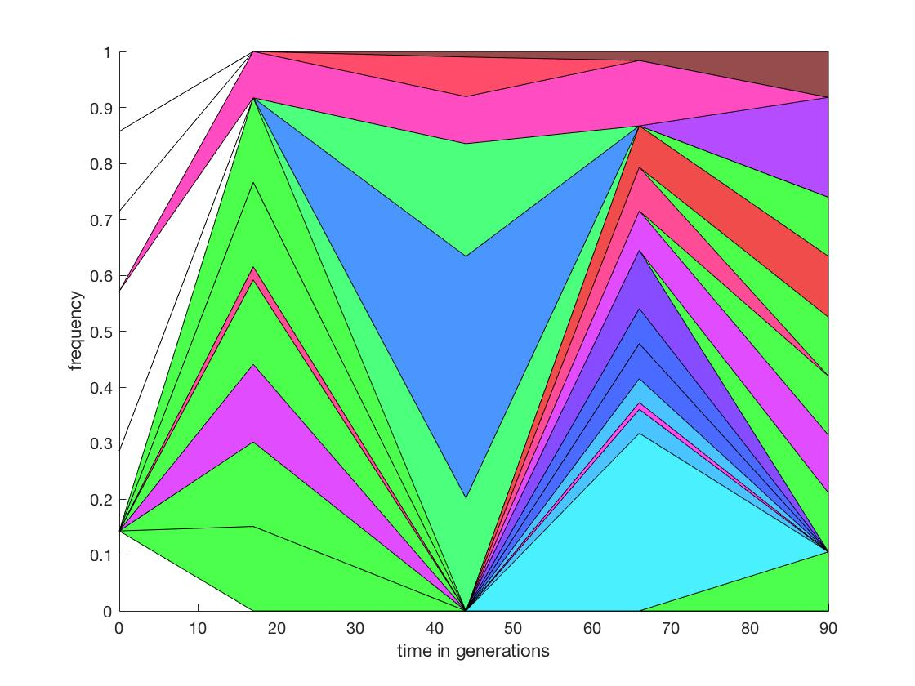
Four criteria for nesting trajectories:
1. If two trajectories, at a given time point, are at >50%, then either (1) one is on the background of the other, (2) they are actually part of the same cluster
2. Fixations: Everything that went extinct when something else fixed was in a different background
3. Derivatives: if increase of one is always (usually) associated with increase of another, then same background; if decrease, then different
4. Low frequency genotypes associated according to probability (this is necessarily ambiguous)
Notes:
Matlab puts into clusters and I need those pictures in another slide
I need to have counts of total number of mutations at the different time points for the populations. I have this data somewhere, but it needs to be put in a user friendly system.

Slide 7
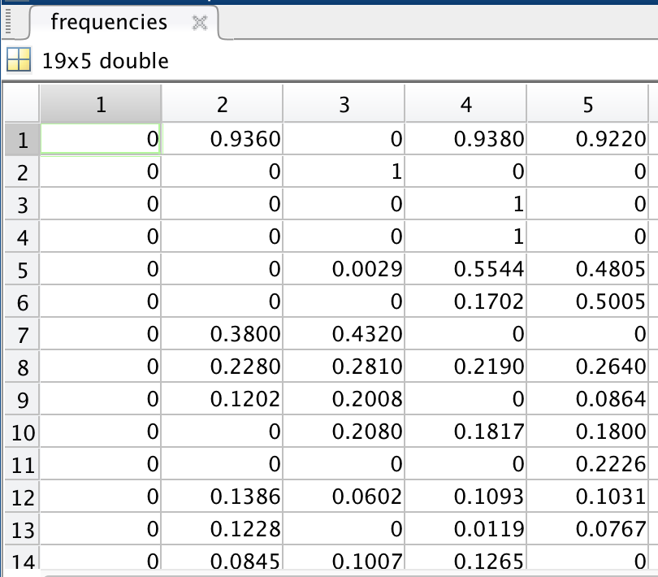
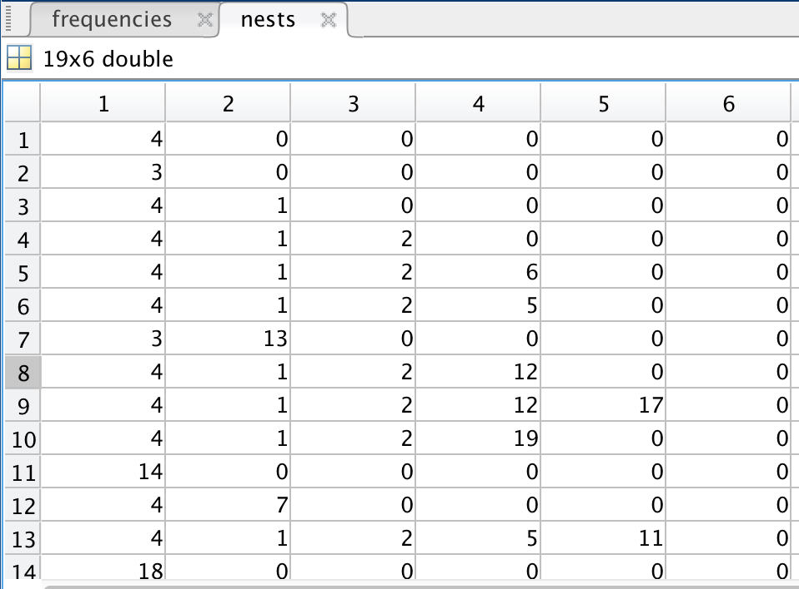
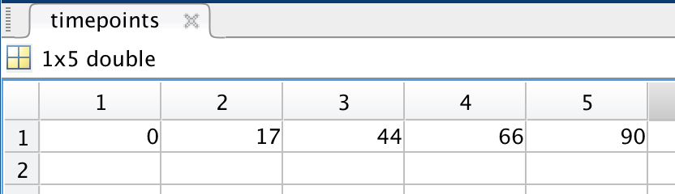
Matlab organizes all information into 3 variables
Frequencies
Nests
Timepoints

Slide 8
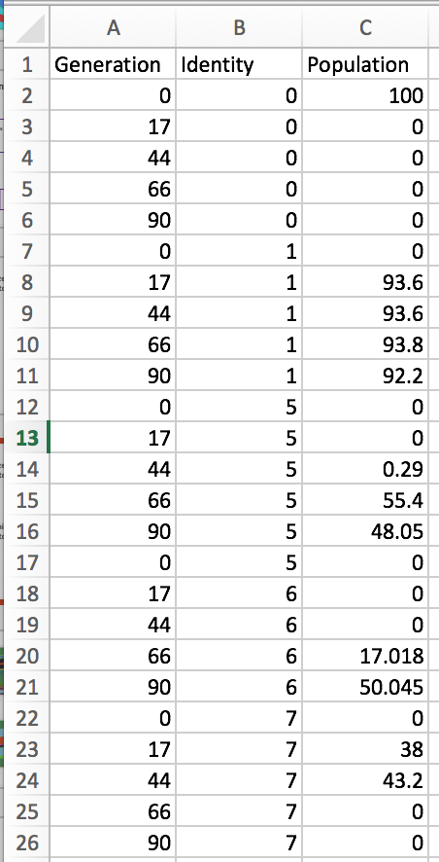
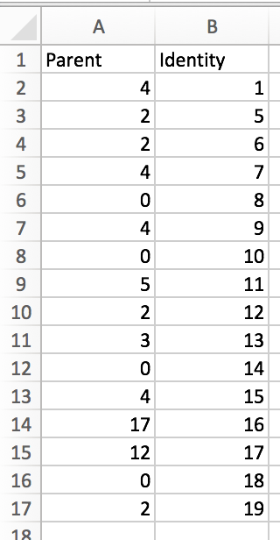
Matlab organizes all information into 3 variables
Pop
Edges
Timepoints
Frequencies
Nests
ggmuller organizes all information into 2 variables
Pop
Edges

Slide 9
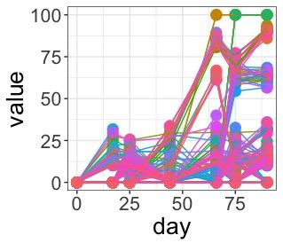
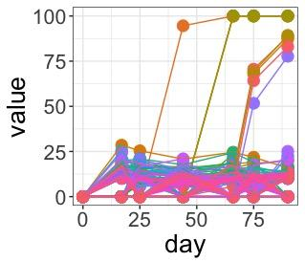
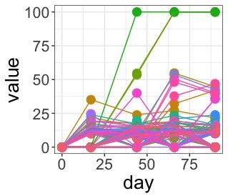
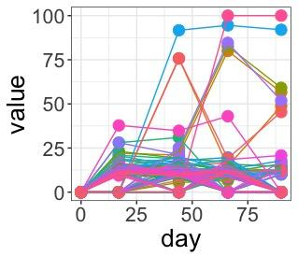
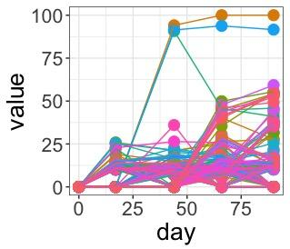
B1
B2
B3
P1
P2
P3
Notes:
Matlab puts into clusters and I need those pictures in another slide
I need to have counts of total number of mutations at the different time points for the populations. I have this data somewhere, but it needs to be put in a user friendly system.

Slide 10
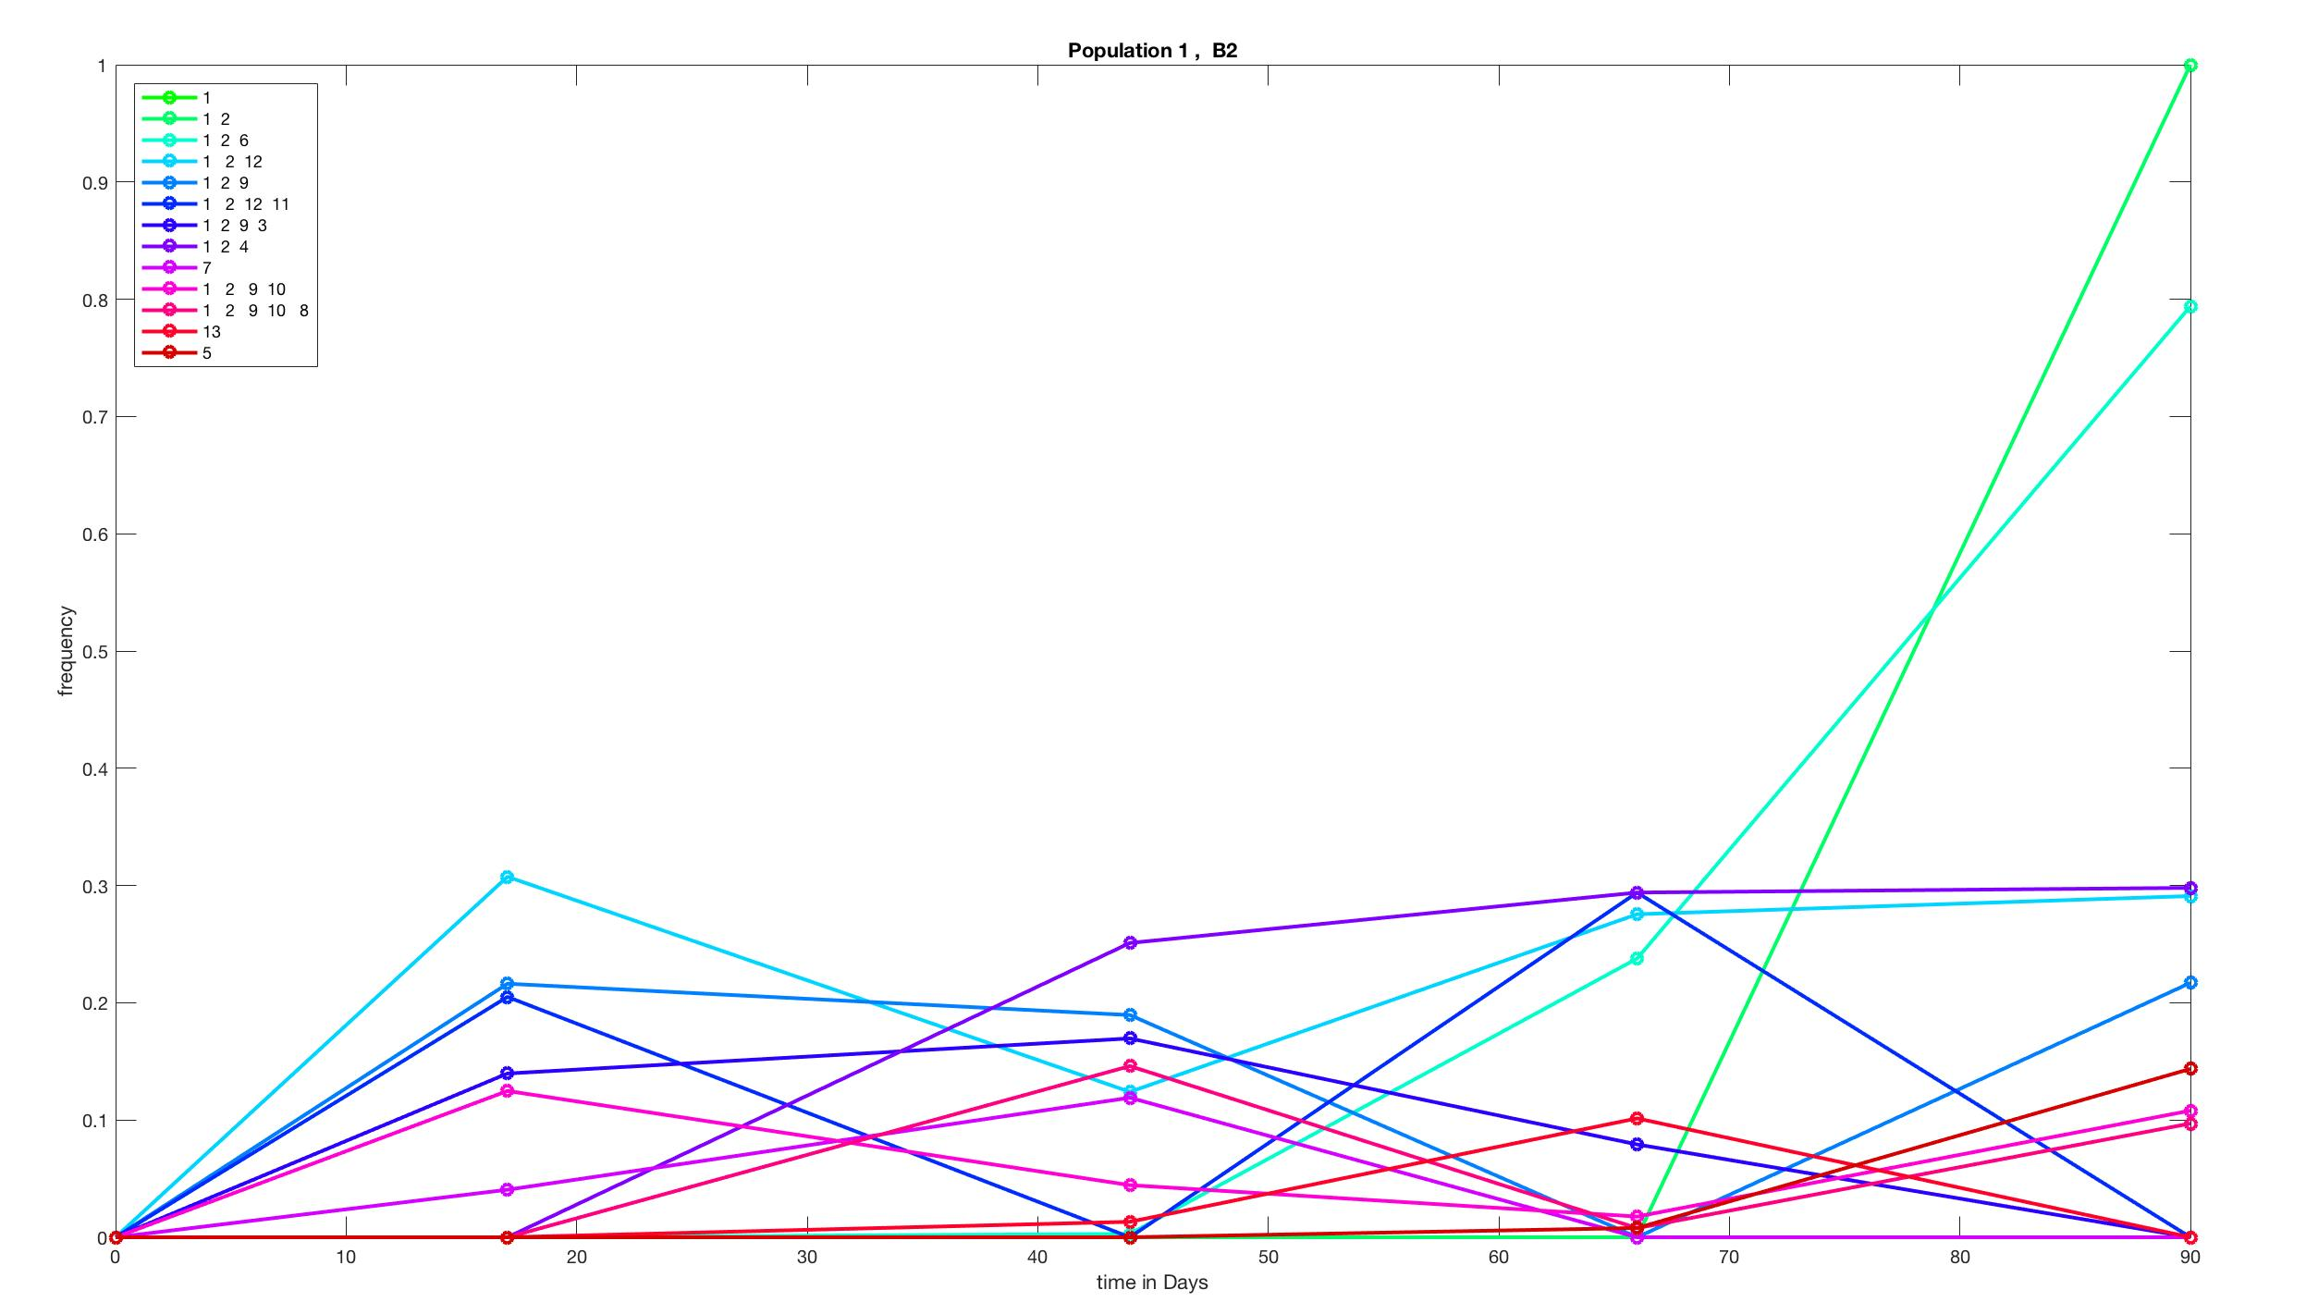
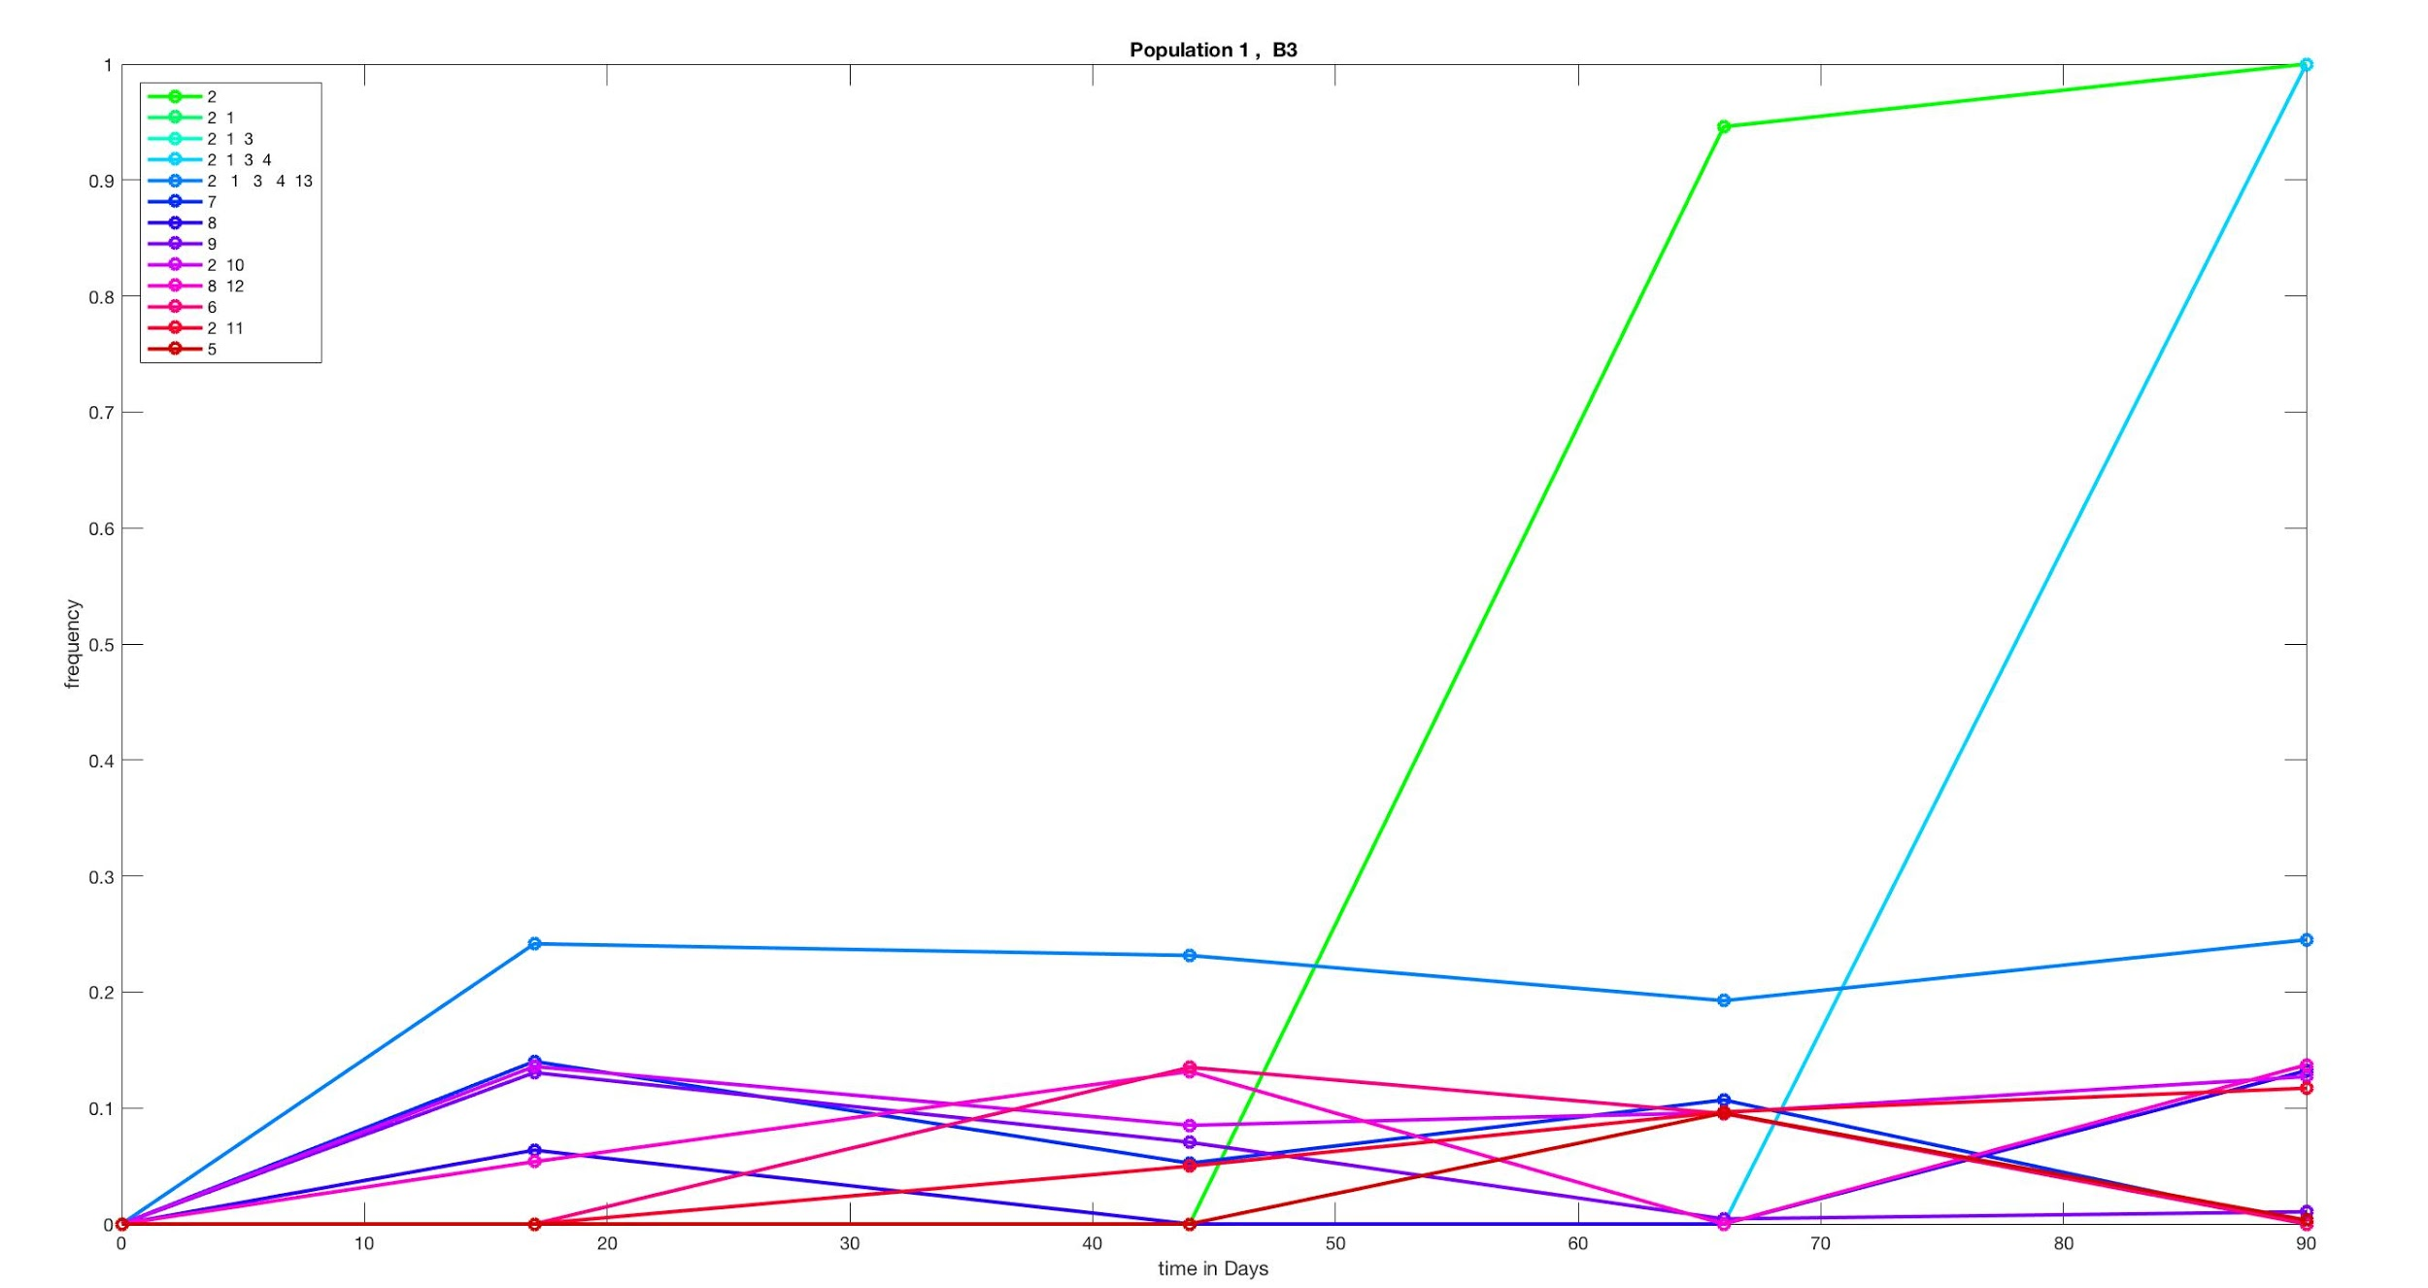
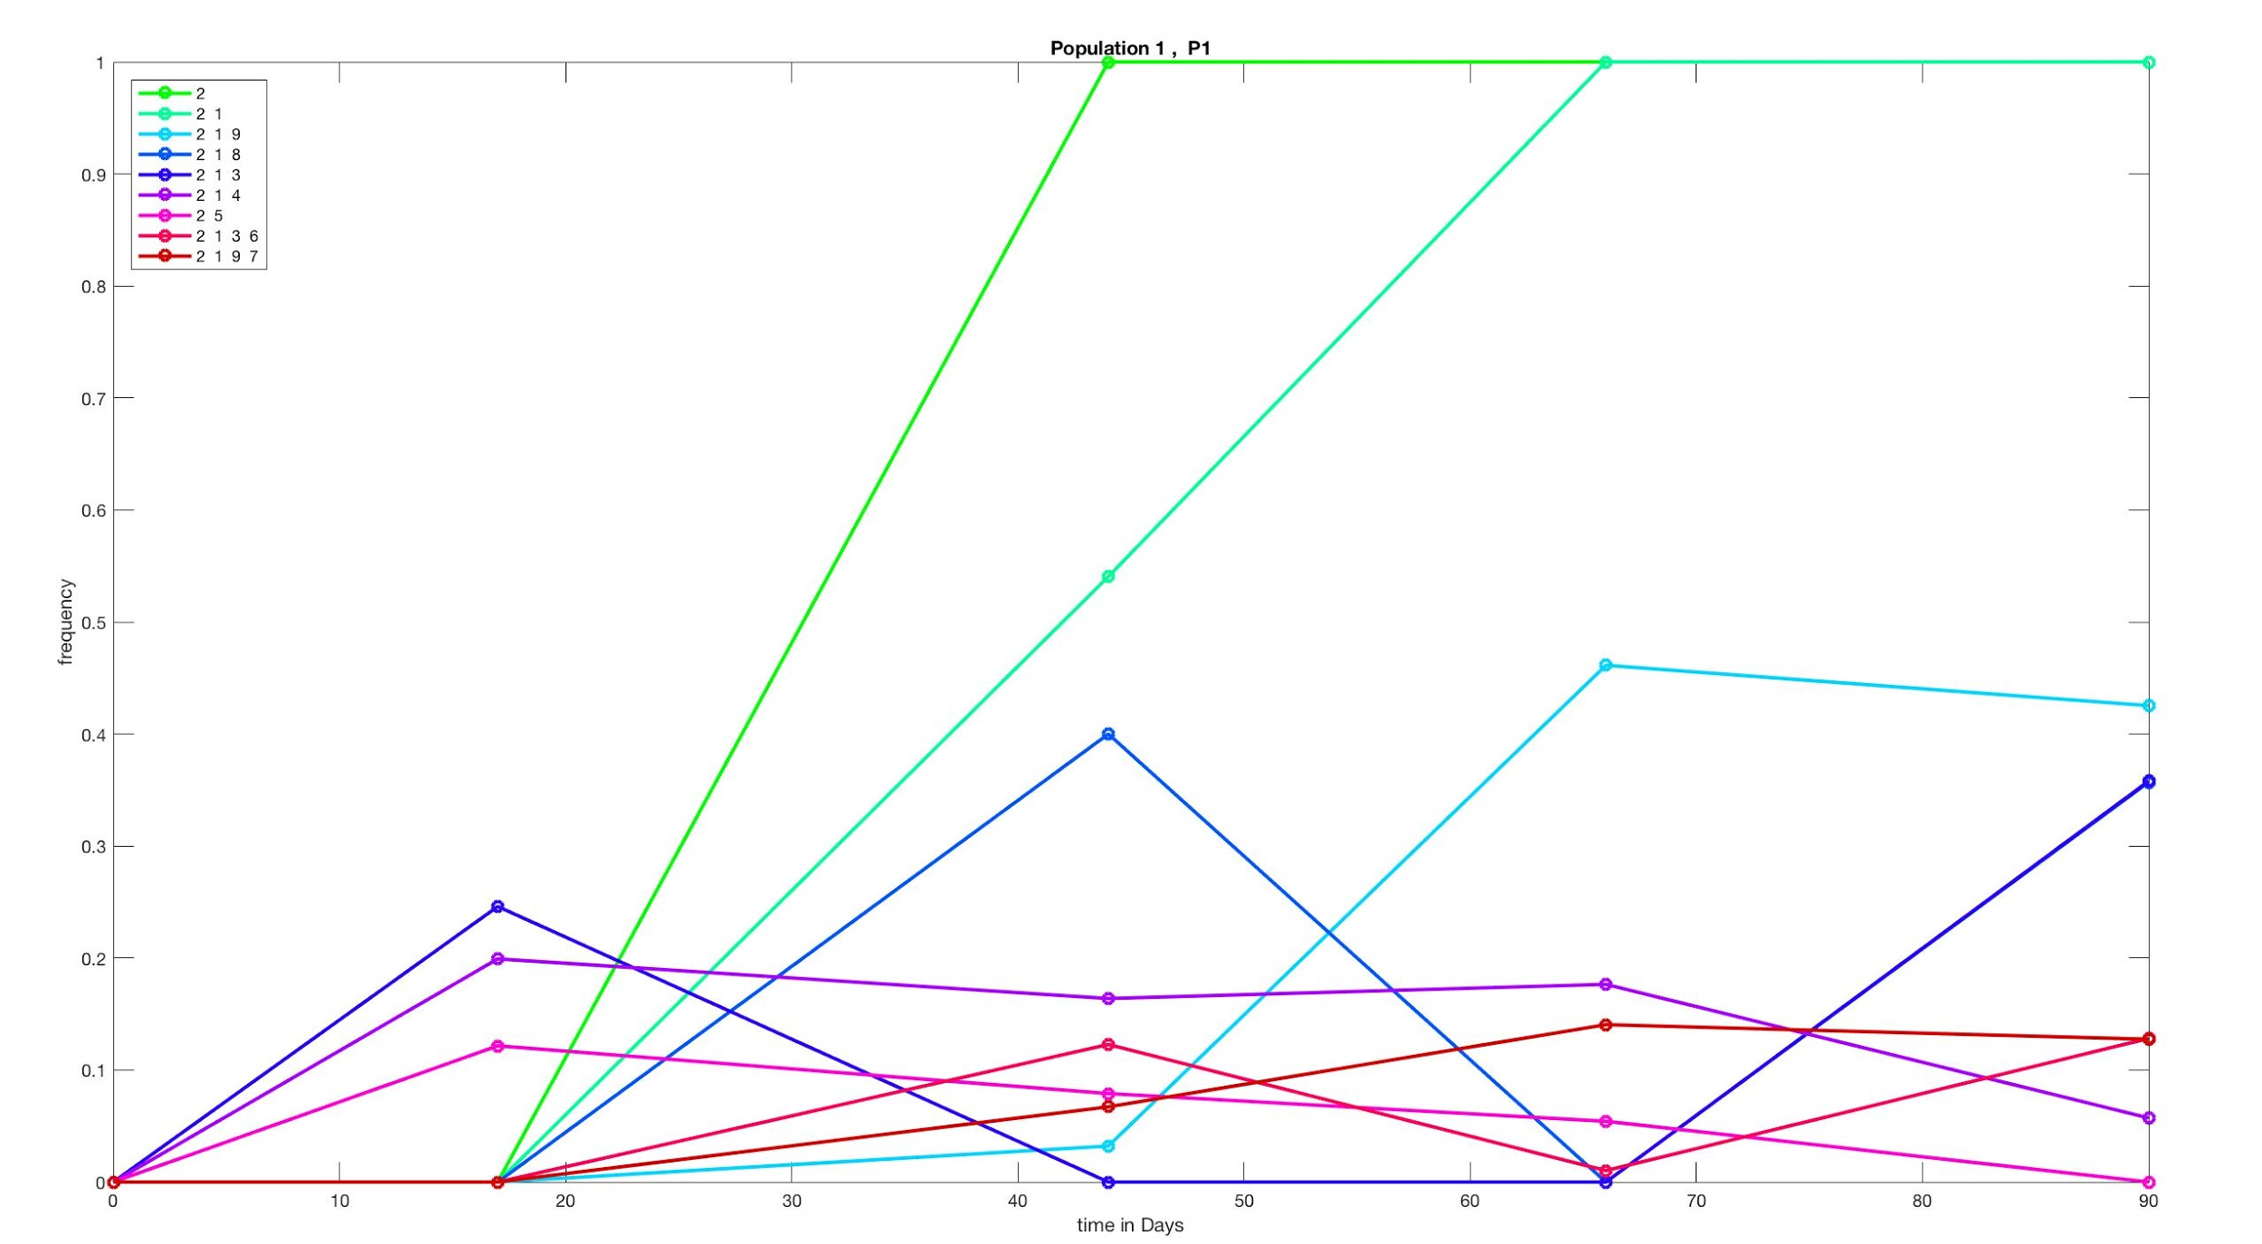
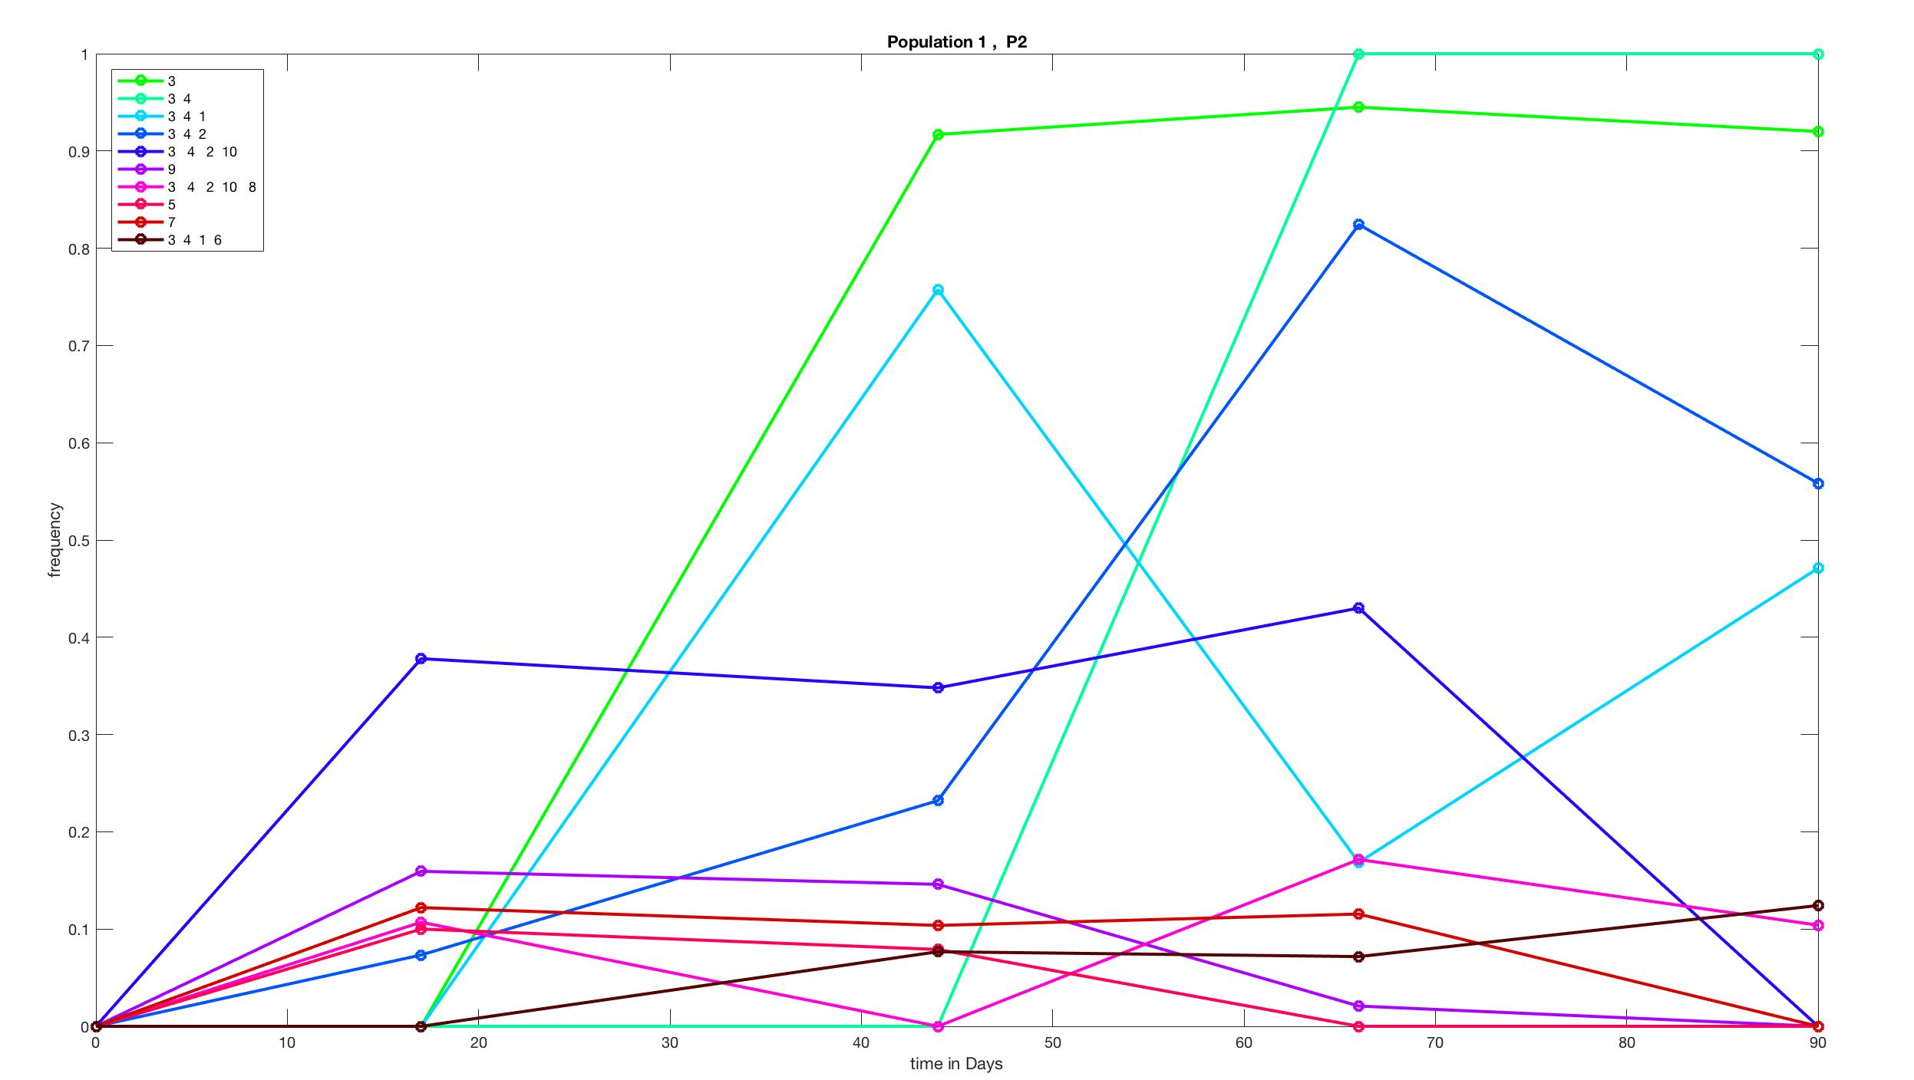
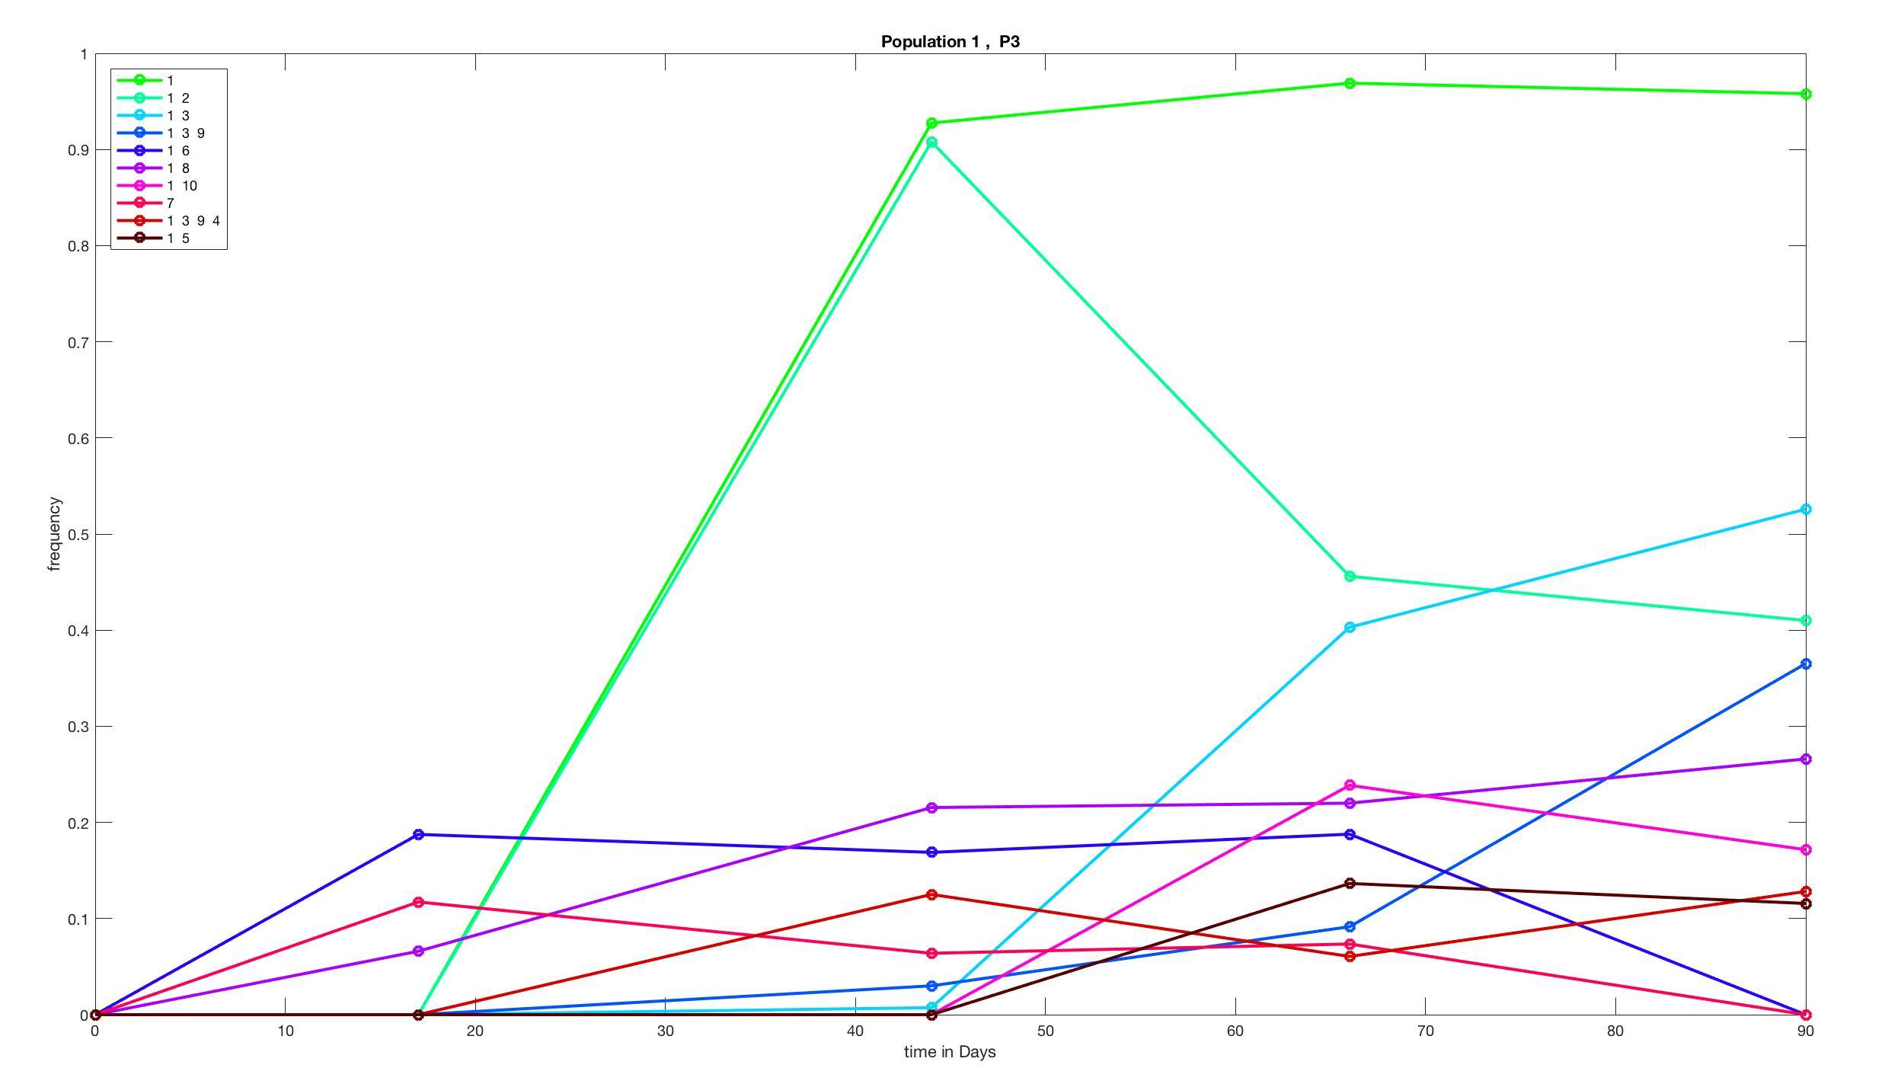
B1
B2
B3
P1
P2
P3
Notes:
Needs to be cohort lineage plots with keys for what mutations are in the sweeping clusters.
Cohorts are determined in MatLab – files came out as eps so I need to recreate them and save as jpeg.

Slide 11
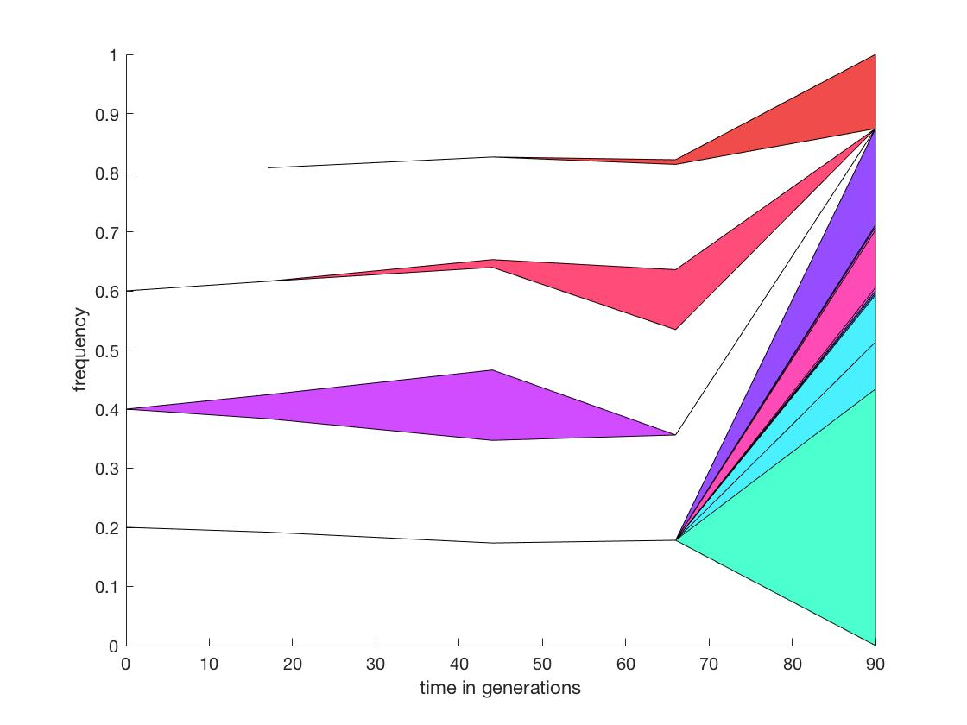
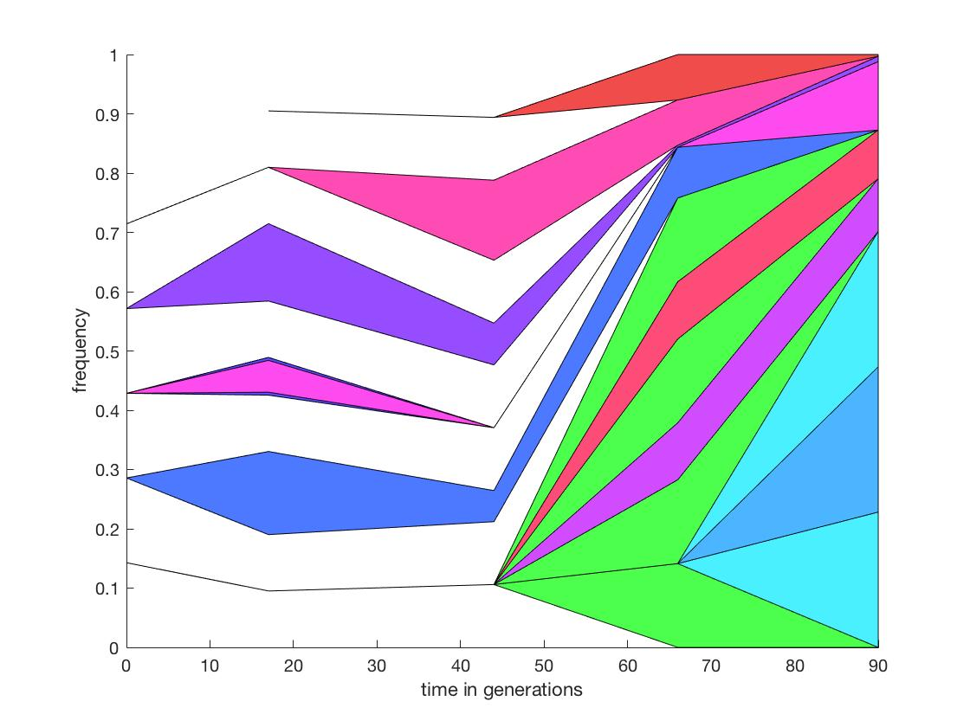
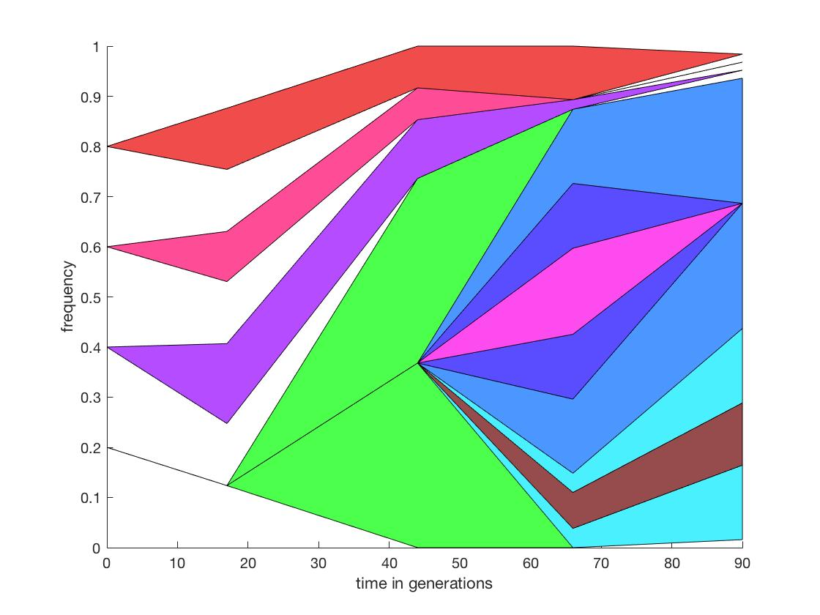
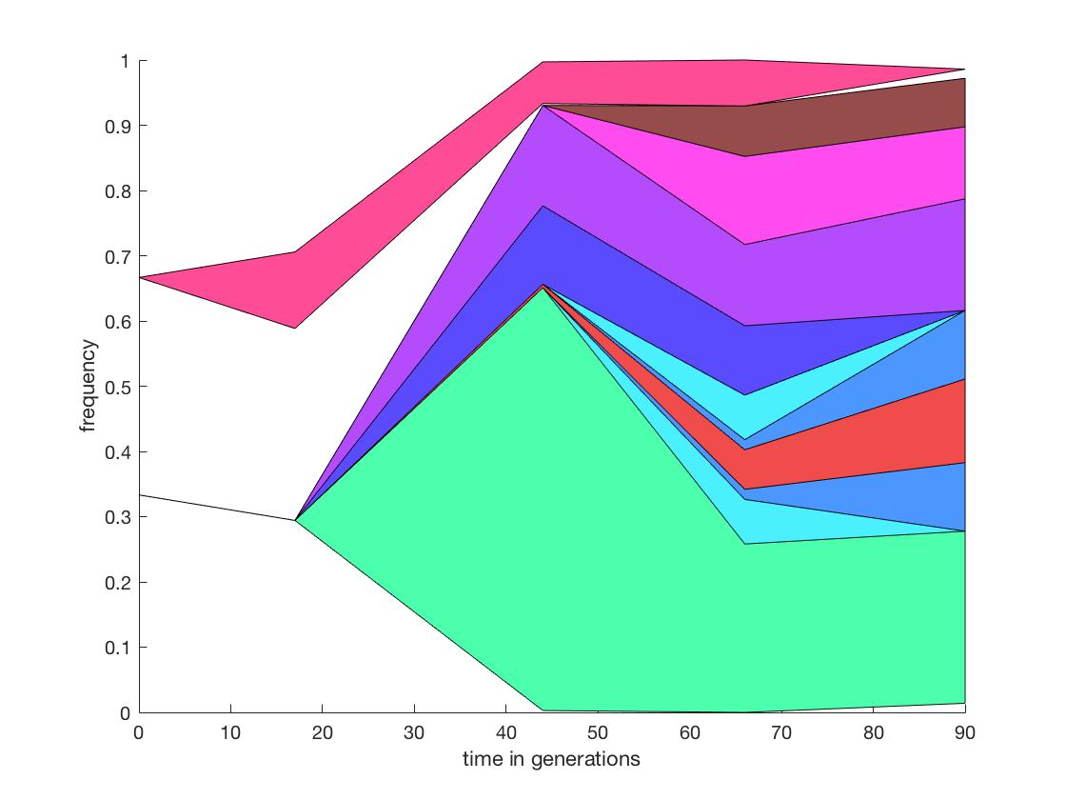
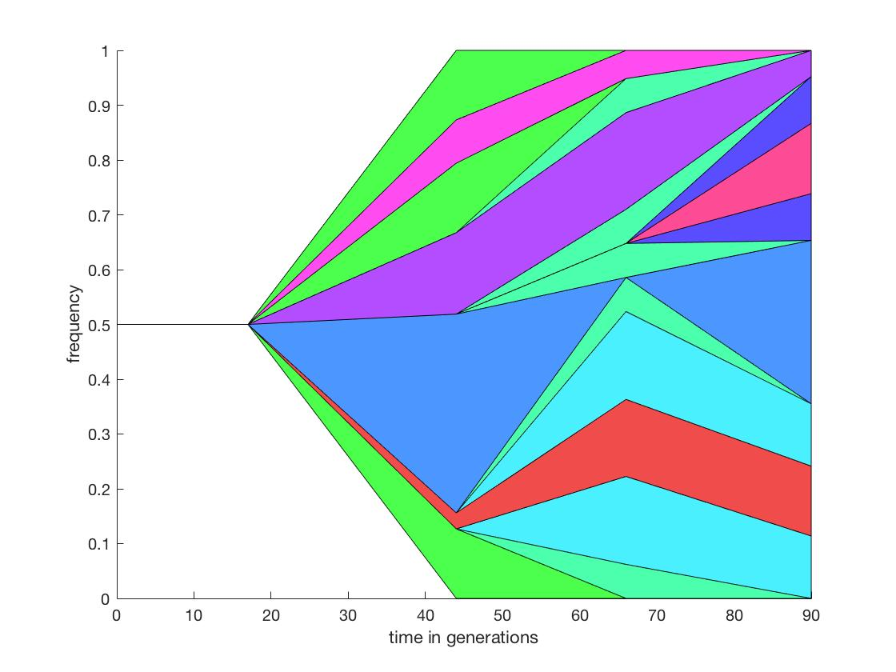
B1
B2
B3
P1
P2
P3
Notes:
These are matlab pictures. Matlab is leaving out some of the mutations that fix, best examples in B2 and B3 populations.
These data I believe can be put into ggmuller with slight modifications. → This is high priority.

Slide 12
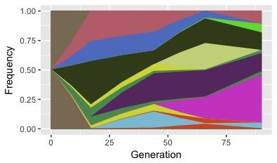
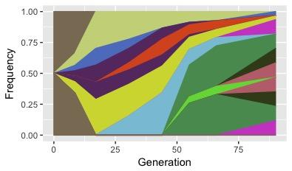
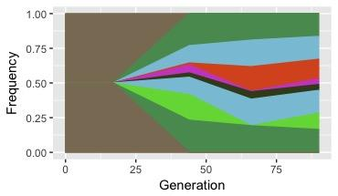
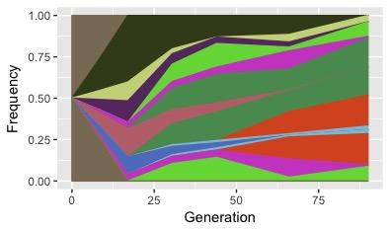
B1
B2
B3
P1
P2
P3
Odd errors
Notes:
These are my ggmuller plots
Current Problem: Getting mutations specific to the lineages out of matlab
Do people want me to wrap these things into functions? Probably easiest and I would do it anway when I naturaly get

Slide 13
Example data set with code
Drive > Katrina > Methods > ggmuller example
Matlab scripts
Drive > Katrina > Matlab Muller Diagram Scripts
Notes:
Populaion mutation stats-
NS
SYN
INDEL
Repeats
Non coding

Slide 14
Mutators and the SOS response
Initial observation by Vaughn – There are a lot of mutations in DNA replication genes

Slide 15
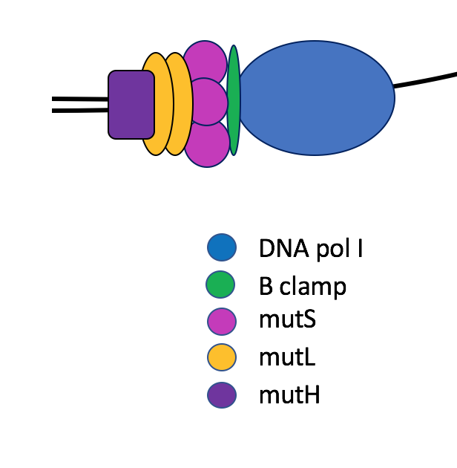
Mismatch repair associates with a replication fork at the beta clamp
Notes:
Looking at these data sets I see the typical 2 component systems, iron acquisition, flagella, wspA occasionally
But then there is another set.
Seems to be in the active sites of
Appear to be loosening the shape restraints needed for proteins

Slide 16
Why are there so many mutations in replication genes?
Hypothesis:
These are creating hypermutators. Second order selection
A response to the DNA damage. Specifically potentially a response to SOS activation. (thanks to Vaughn and Matt Culyba)
Notes:
Allowing them to handle the extra mutational load.

Slide 17
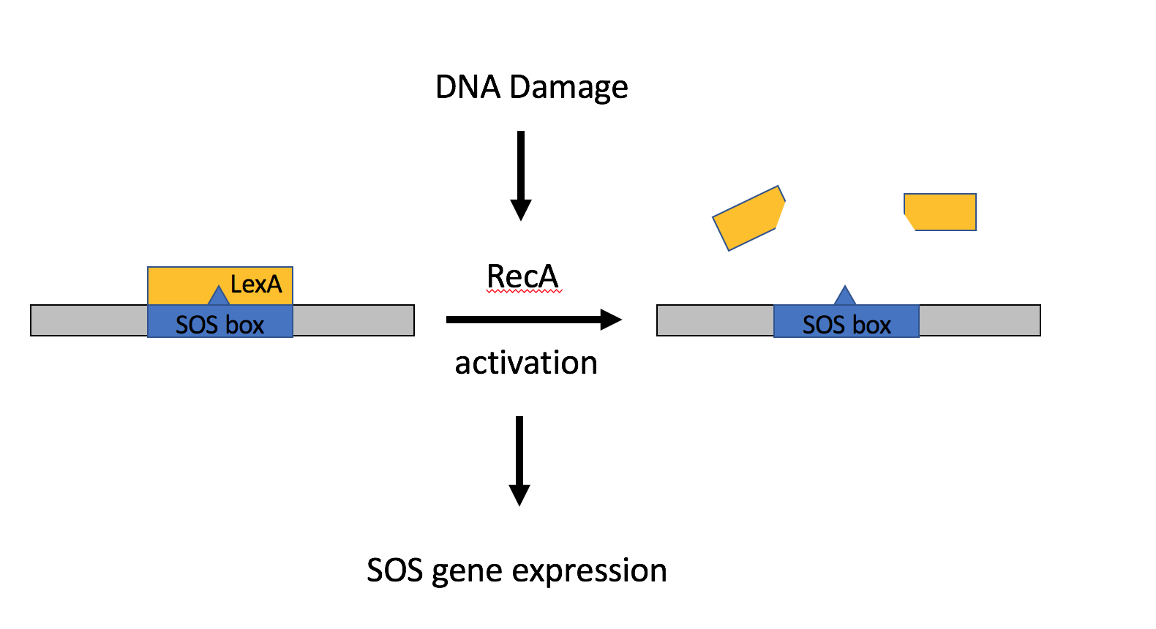
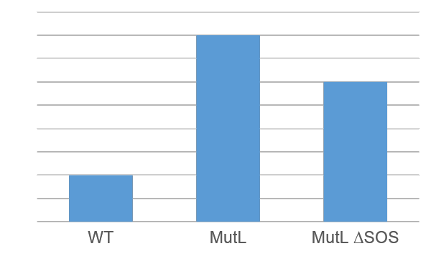
Large amounts of DNA damage lead to induction of the SOS response
Representation – No real numbers
Matt Culyba
Notes:
Then allows transcription of 50+ genes that

Slide 18
The suspicious genes are in DNA replication, transcription and translation
rcsC – peroxide stress
lexA -
rpoS – starvation/stationary phase
rpoE – heat stress
PA14_RS04165 - Sigma 54 like
PA14-Rs22670 – nucleotidyltransferase - likely not real.
GroES - chaperone
RpoB/ RpoC – RNA pol
TopA
responses to stress
Catalytic subunits
Not seen in WT
Notes:
Rcsc regulates osmC – necessary for protection against peroxides (stress)
rpoE – heat stress sigma factor
Rpos – starvation/stationary factor sigma factor

