Slide 1
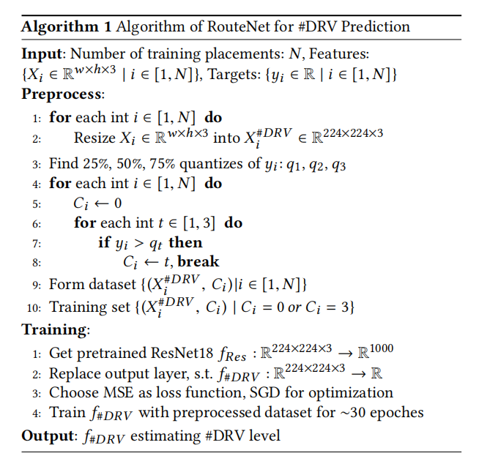
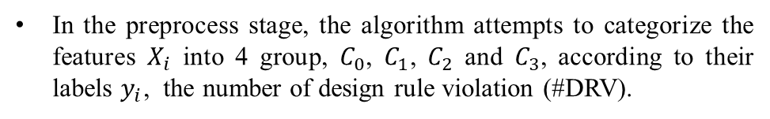
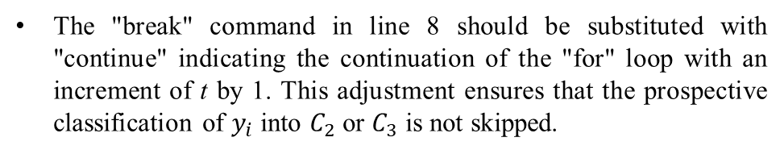
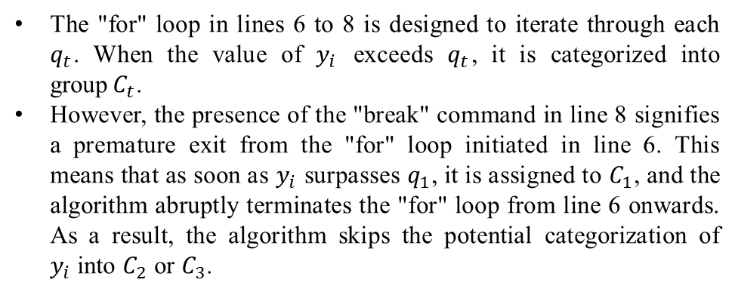
A Minor Issue in Line 8, Algorithm 1, RouteNet
Task
In the preprocess stage, the algorithm attempts to categorize the features $X_{i}$ into 4 group, $C_{0}$, $C_{1}$, $C_{2}$ and $C_{3}$, according to their labels $y_{i}$, the number of design rule violation (#DRV).
Issue
The "for" loop in lines 6 to 8 is designed to iterate through each $q_{t}$. When the value of $y_{i}$ exceeds $q_{t}$, it is categorized into group$C_{t}$.
However, the presence of the "break" command in line 8 signifies a premature exit from the "for" loop initiated in line 6. This means that as soon as $y_{i}$ surpasses $q_{1}$, it is assigned to $C_{1}$, and the algorithm abruptly terminates the "for" loop from line 6 onwards. As a result, the algorithm skips the potential categorization of $y_{i}$into $C_{2}$ or $C_{3}$.
continue
Remedy
The "break" command in line 8 should be substituted with "continue" indicating the continuation of the "for" loop with an increment of t by 1. This adjustment ensures that the prospective classification of $y_{i}$into $C_{2}$ or $C_{3}$ is not skipped.

Slide 2
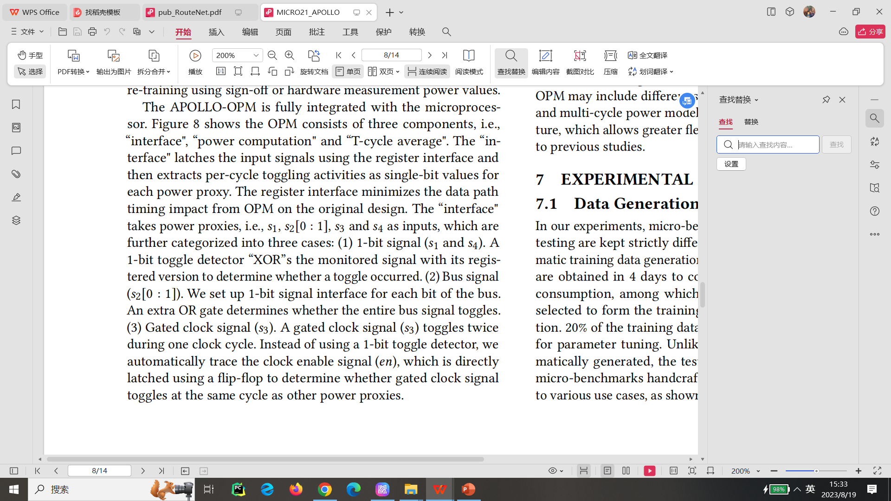
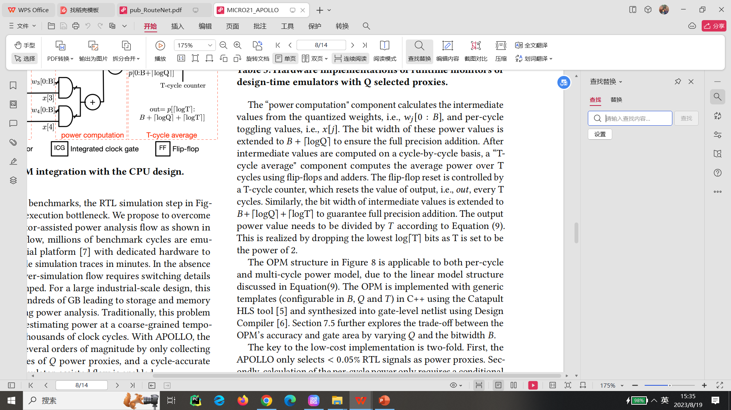
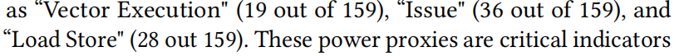
Some Minor Typos in APOLLO
In line 9-10, section 6
Issue
I have noticed that some of the left and right quotation marks in APOLLO don't seem to match properly. This might be due to a configuration issue with LaTeX.
In line 13, section 6
In line 25, section 6
In line 29-30, section 6
In line 31-32, section 7.4

