Slide 1



Global Coordinate System Evolution: Driving Forces and National Case Studies
GIS-2025
The Arrow of Coordinates, Directing the Future
Jiale Guo
2024 Fall Geoinformatics
May 29 th, 2025
01

Slide 2

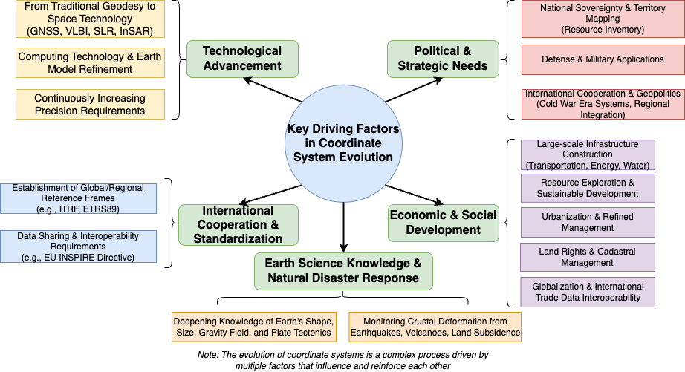
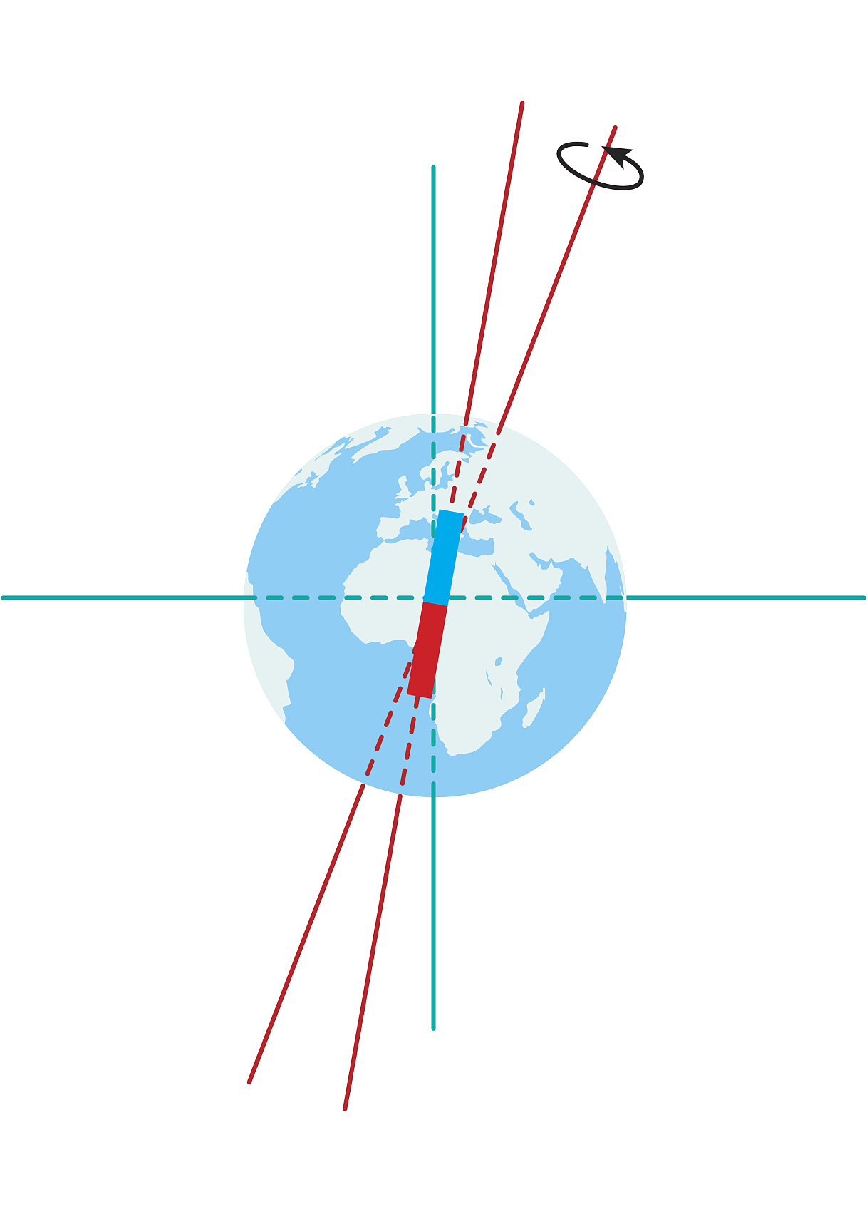

The Driving Compass of Coordinate System Evolution)
Classification of Major Driving Forces:
Complexity and Dynamism of Evolution：
1. Not dominated by a single factor: In most cases, it is the result of the combined effects of multiple factors.
2. Phased changes in dominant factors: The dominant driving factors for the evolution of the coordinate system may vary across different countries at different stages of historical development.
02

Slide 3

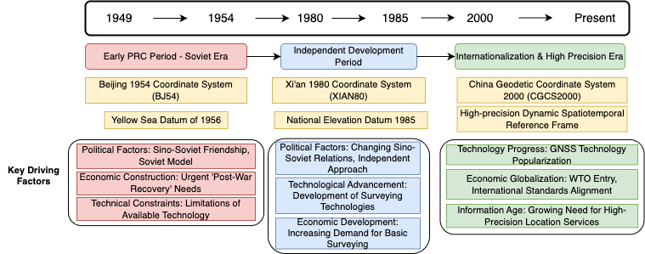
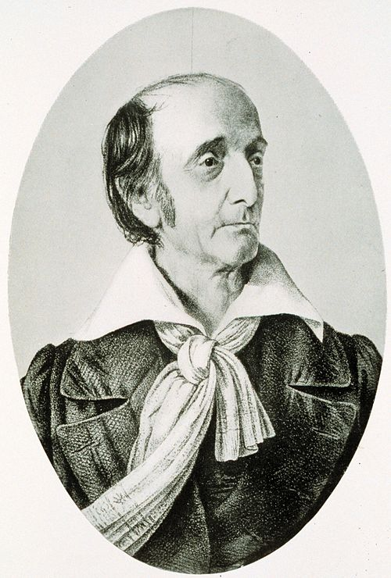
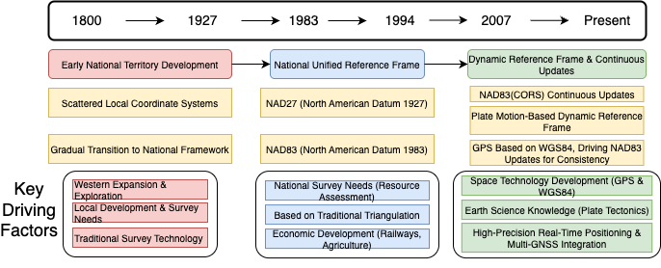
The Soaring Dragon and The Star-Spangled Banner's Mark
China: A Journey from Following to Leading in Coordinate Systems
Aerospace spatiotemporal intelligence refers to PNTRC, which is a real-time space-based information service system integrating positioning, navigation, timing, remote sensing, and communication services.
PNTRC enables the integration of communication satellites, navigation satellites, and remote sensing satellites, thereby providing minute-level fast, accurate, and agile services for remote sensing information from acquisition to application terminals on a global scale.
Professor Deren Li from Wuhan University, former President of the International Society for Photogrammetry and Remote Sensing (ISPRS), Academician of the Chinese Academy of Sciences, Academician of the Chinese Academy of Engineering, Academician of the Eurasian Academy of Sciences, and Academician of the International Academy of Astronautics.
United States: Pragmatism and Technological Frontiers in Coordinate Exploration
https://en.wikipedia.org/wiki/Ferdinand_Rudolph_Hassler
03
Notes:
First, allow me to introduce our team information. The project, categorized under Asset Damages and Risks Assessment, includes Angelica Ceoloni from Management Engineering, and four of us from Geoinformatics. Our project is "Improving Flood Damage Assessment Process in the Arno River Basin using Earth Observation Data and the SHUD Model"The significance of this project lies in exploring the integration of advanced numerical hydrological models, specifically SHUD, with modern Earth Observation techniques. Our aim is to develop a more accurate and efficient methodology for flood risk and damage assessment within the flood-prone Arno River Basin. This research possesses significant scientific value and relevance for practical applications, offering improved decision support for sectors such as insurance, consulting, and emergency management.

Slide 4

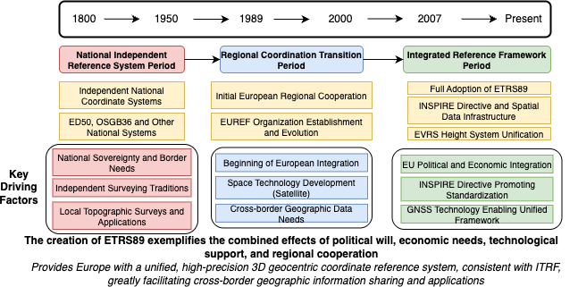
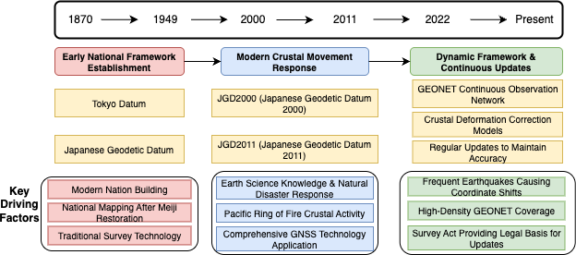
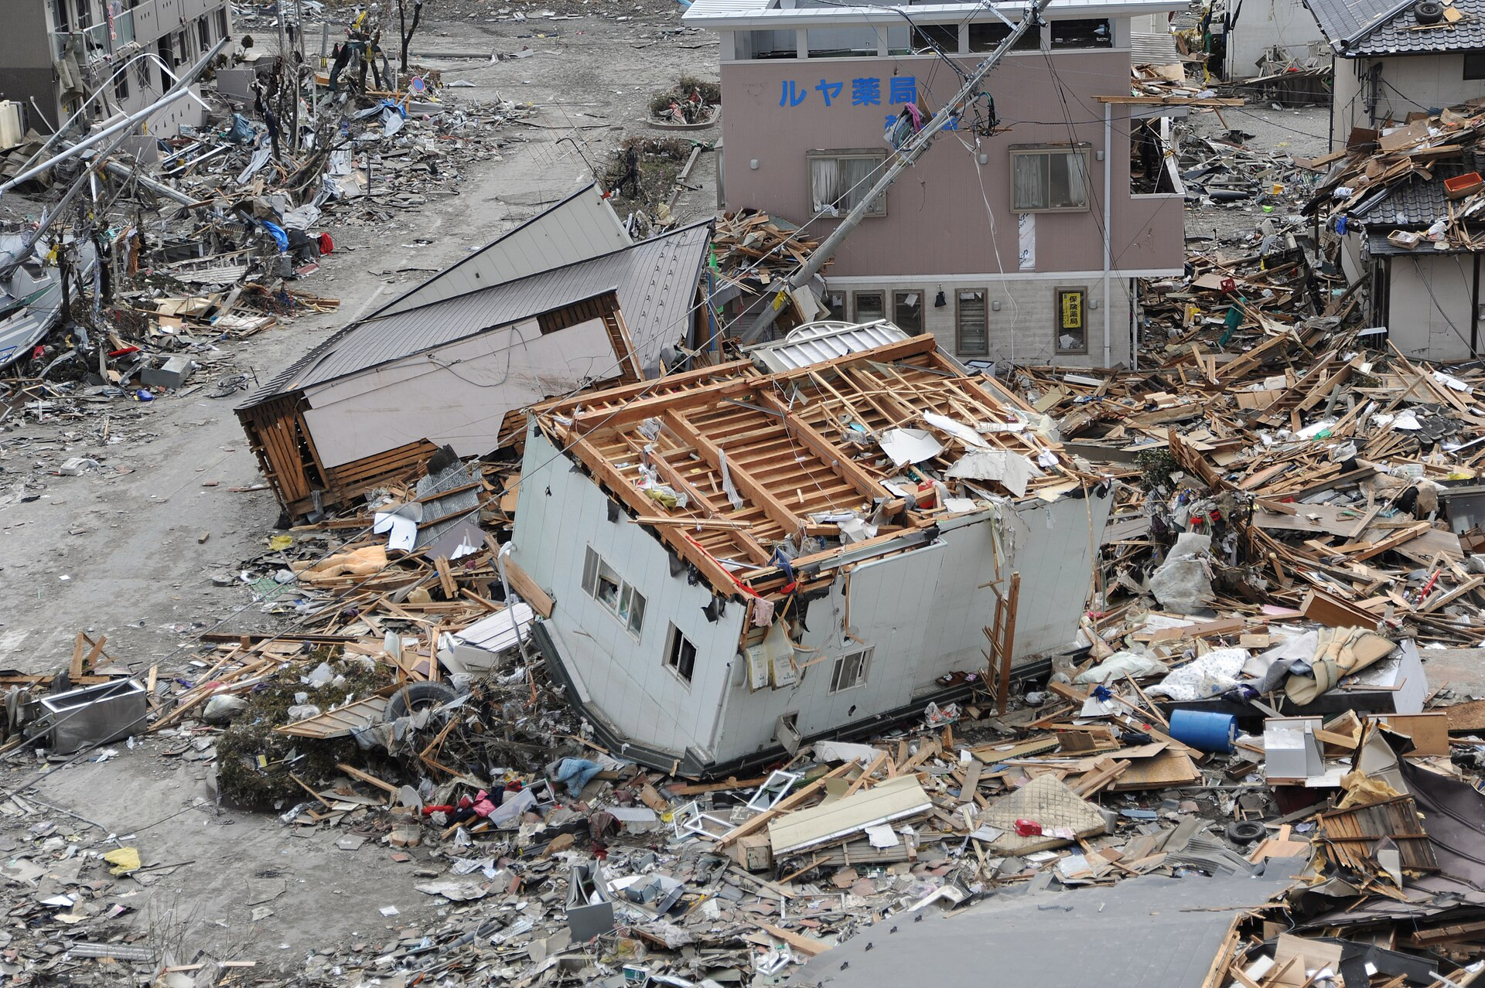
European Synergy and an Island Nation's Resilience
(EU): Standardization under the Wave of Integration - ETRS89
Japan: Coordinate Maintenance and Innovation on the Seismic Belt
04
Notes:
First, allow me to introduce our team information. The project, categorized under Asset Damages and Risks Assessment, includes Angelica Ceoloni from Management Engineering, and four of us from Geoinformatics. Our project is "Improving Flood Damage Assessment Process in the Arno River Basin using Earth Observation Data and the SHUD Model"The significance of this project lies in exploring the integration of advanced numerical hydrological models, specifically SHUD, with modern Earth Observation techniques. Our aim is to develop a more accurate and efficient methodology for flood risk and damage assessment within the flood-prone Arno River Basin. This research possesses significant scientific value and relevance for practical applications, offering improved decision support for sectors such as insurance, consulting, and emergency management.

Slide 5

Conclusion and Outlook: Positioning the Future, Mapping the World
Conclusion
国家 | 演进阶段 | 近似时期 | 主要驱动因素 | 时代特征 / 关键产出
中国 | 建国初期 (BJ54等) | 1950s - 1970s | 政治与战略需求 | 政治导向（苏式体系），国家统一与大规模建设需求，奠定基础。
 | 独立自主 (西安80) | 1970s - 1990s | 政治与战略需求 | 国家主权与安全优先，自主研发，精度提升，服务国家发展。
 | 全球化与高精度 (CGCS2000) | 2000s - 至今 | 技术进步 , 经济与社会发展 , 国际合作与标准化 | 技术驱动（GNSS），融入全球（ITRF兼容），满足信息化社会高精度需求。
美国 | 国家版图构建 (NAD27) | 19世纪末 - 1980s初 | 政治与战略需求 | 国家统一测绘，资源开发，基于经典大地测量，服务国家扩张与发展。
 | 空间时代 (NAD83) | 1980s - 2000s初 | 技术进步 | 技术驱动（空间技术、GPS/WGS84影响），地心参考系，精度大幅提升，初步全球化。
 | 动态与实时 (NAD83更新与未来) | 2000s - 至今 | 技术进步, 经济与社会发展, 地球科学认知与灾害应对, 国际合作与标准化 | 响应地壳运动与灾害，高频更新，实时服务（CORS），与WGS84等全球系统精细协调。
欧洲 (欧盟) | 一体化需求 (ETRS89之前) | < 1980s | 政治与战略需求 (各国层面) | 各国独立坐标系林立，数据不兼容，阻碍跨境合作与区域发展。
(以ETRS89为代表) | 区域协同与标准化 (ETRS89) | 1990s - 至今 | 技术进步, 政治与战略需求 (欧盟层面), 经济与社会发展 , 国际合作与标准化 | 政治经济一体化驱动，统一高精度框架（ITRF兼容），促进数据共享（INSPIRE）。
日本 | 近代化测绘 (东京基准) | 明治维新 - 20世纪末 | 政治与战略需求 | 国家现代化，国土基本图制作，满足基础建设与国防需求。
 | 高精度与灾害应对 (JGD2000/2011+) | 2000s - 至今 | 技术进步, 经济与社会发展 , 地球科学认知与灾害应对, 国际合作与标准化 | 地震频发国情驱动，技术支撑（GEONET），高频更新与形变改正，保障社会经济活动。
Global Dynamic Reference Frame: Further considering factors such as plate motion, Earth rotation variations, and tides to achieve higher precision and a "living" coordinate datum.
Continuous Refinement and Application Deepening of ITRF: The importance of the International Terrestrial Reference Frame (ITRF) as a global standard is becoming increasingly prominent.
Ongoing Innovation and Multi-System Integration of GNSS Technologies: The coexistence and interoperability of multiple systems such as GPS, GLONASS, Galileo, and BeiDou will provide more robust and higher-precision positioning services, placing greater demands on coordinate systems.
Proliferation of Real-Time Precise Positioning Services: Emerging fields like autonomous driving, the Internet of Things, and smart cities have strong demand for real-time, high-precision, and seamless coordinate services.
Deep Integration of Geographic Information Systems and Earth System Science: As the "language" of spatial data, coordinate systems will play a more critical role in understanding and addressing global climate change and resource-environment challenges.
05

