Slide 1
Predicting Synthetic Lethality in Cancer via Metabolic Networks
Joo Sang Lee
Center for Bioinformatics and Computational Biology, University of Maryland
ISCB DC RSG Summer 2016 Workshop
June 15, 2016

Slide 2
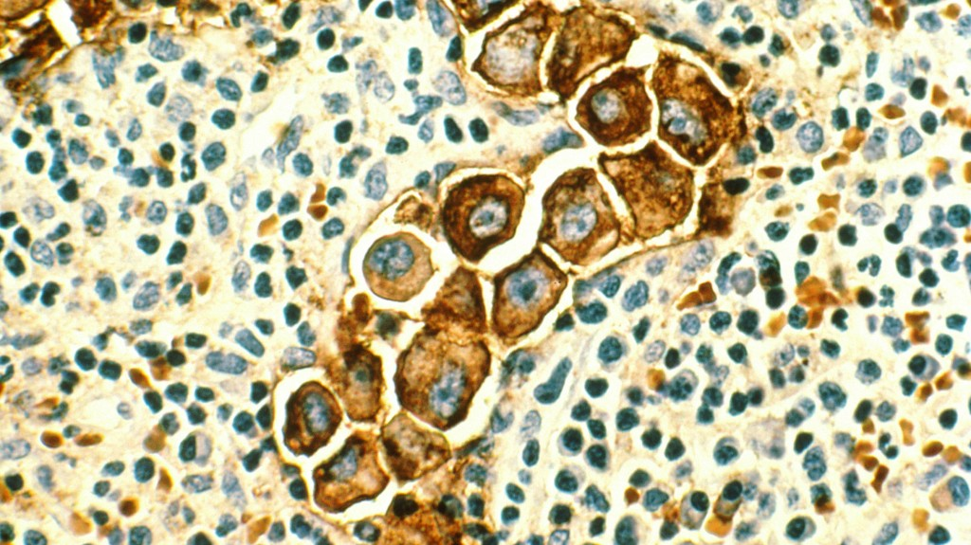
8.2M
Death
worldwide/year
70% 
Incidence
past 2 decades
Notes:
Cancer causes half a million death in the US every year, and constructs $100B market for its treatment.
The way cancer is typically treated nowadays, when cancer patient comes to hospital
a biopsy will be taken and it will pass various tests to determine treatments.
Conventional technology for doing this is to screen few marker genes with histological testing,
e.g. the staining of nucleus and the checking of marker gene in the second figure
,which has been the case for the past tens of years.
Such methods are rapidly being overtaken by precision medicine.
which is to tailor cancer treatments to individual patient based on hundreds of biomarkers.

Slide 3

Side effect
killing healthy cells

Slide 4
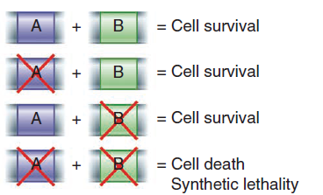
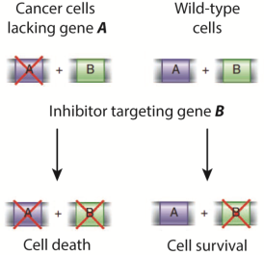
What is Synthetic Lethality (SL) and why is it important in treating cancer
Definition: Two genes are Synthetic Lethal (SL) if the single inhibition of either genes is not lethal but the inhibition of both genes is lethal.
Opportunity: Given an inactive gene in a specific cancer, inhibiting its SL-partner(s) is a selective treatment (Hartwell et al. 1997).

Slide 5
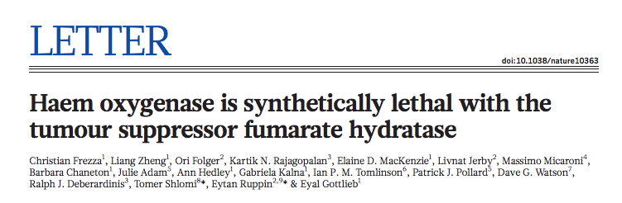
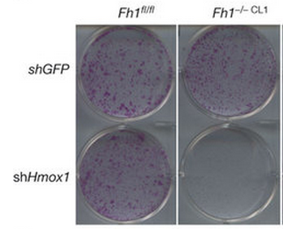
FH1
FH1
HMOX1
HMOX1

Slide 6
Identifying Synthetic Lethal interactions between metabolic genes
nutrient uptake
gene B
gene A
biomass production

Slide 7
Outline
Introduction to metabolism and metabolic networks
Metabolic network modeling
Constraints-based modeling
Flux balance analysis
Metabolic network modeling package
COBRA toolbox
in silico gene knockout experiment

Slide 8
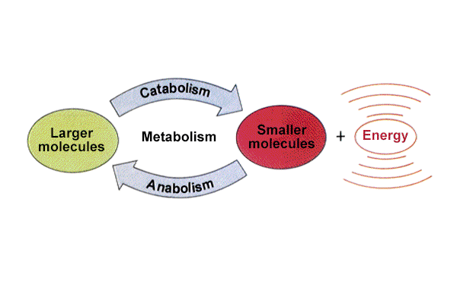
Cellular metabolism
The set of chemical reactions that breaks down nutrients to generate energy and building blocks and
use them to construct components of a cell
Breakdown
Proteins to Amino Acids, Starch to Glucose
Synthesis
Amino Acids to Proteins, Glucose to Starch

Slide 9
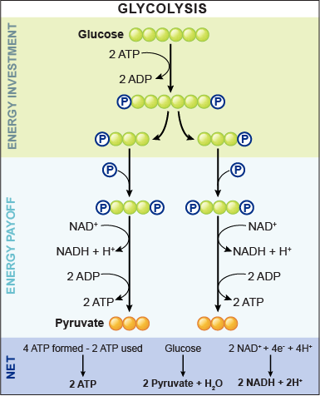
Glycolysis

Slide 10
Glycolysis
metabolites
reactions

Slide 11
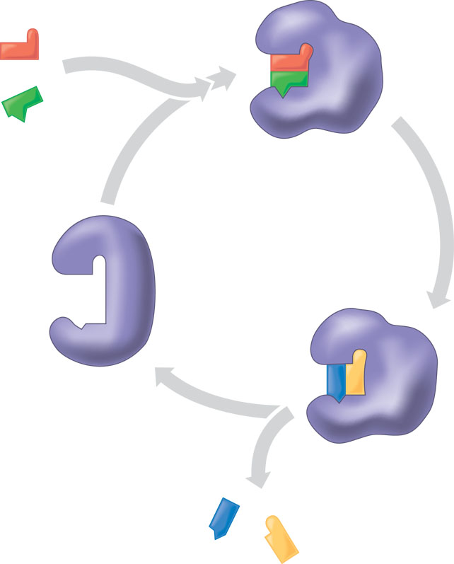
Metabolic reactions
A chemical process that converts
a set of metabolites (reactants) to
another set of metabolites (products)
via enzyme-catalysis.
Reaction stoichiometry
2H₂ + O₂ -> H₂O
Reaction directionality
thermodynamics
Substrates
Enzyme-substrate
complex
Enzyme
Products

Slide 12
Metabolic Network Models
The application of computational methods to predict the network behavior usually requires additional data other than the network topology
A ‘GS metabolic network model’ is a collection of such data:
Reaction stoichiometry
Cellular localization
Transport and exchange reactions
Biomass reaction
Gene-protein-reaction association

Slide 13
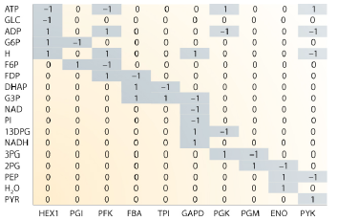
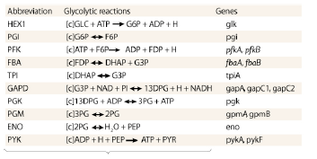
Stoichiometric Matrix
Stoichiometric matrix – network topology with stoichiometry of biochemical reactions (denoted S)
A Metabolite that exists in multiple compartments is represented with multiple rows in the matrix

Slide 14
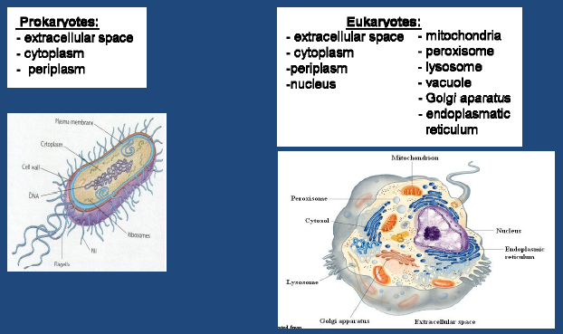
Metabolic Network Model: Cellular Localization (I)

Slide 15
Metabolic Network Model: Cellular Localization (II)
Algorithms: PSORT and SubLoc to predict the cellular localization of proteins based on nucleotide or amino acid sequences
High-throughput experimental approaches such as immunofluorescence and GFP tagging of individual proteins.

Slide 16
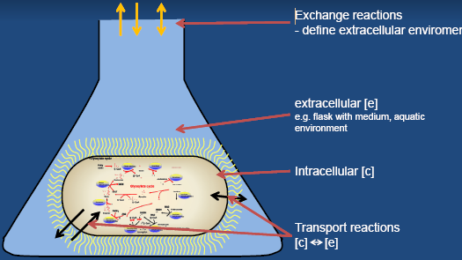
Metabolic Network Model: Transport and Exchange Reactions
An extra-cellular compartment is also included in the model
Transport reaction move metabolites between compartments (across membrane boundaries)
Glucose[c] <-> Glucose[e]
Exchange reaction move metabolites across the model boundary
Glucose[e] <->
lactate
glucose

Slide 17
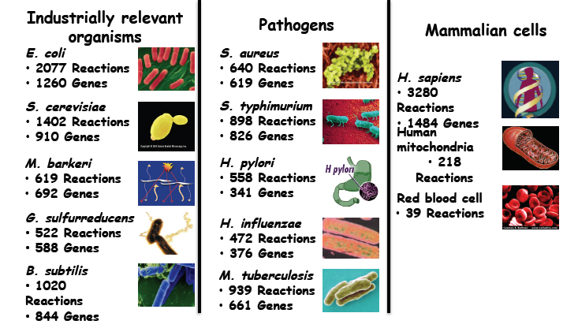
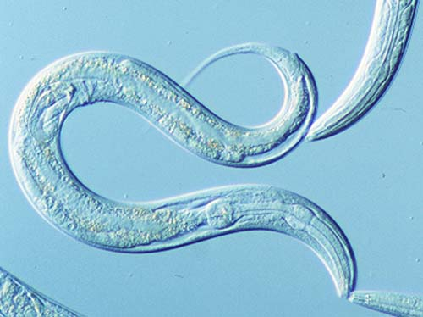
Available Metabolic Models ~100 organisms in bacteria, archaea, and eukaryota
2251
1366
C. elegans
1273 reactions
1985 genes

Slide 18
3. Kinetic modeling
Metabolic Network Modeling

Slide 19
Modeling Cellular Metabolism
Dynamical systems
Requires kinetic
constants (mostly
unknown)
Optimization theory
Constrained space of
possible steady-
state network
behaviors
Graph theory
Structural network
properties: degree
distribution, centrality,
clusters, etc.
Kinetic Models
Constraint-Based Models
Topological Network
Accuracy
Scale

Slide 20
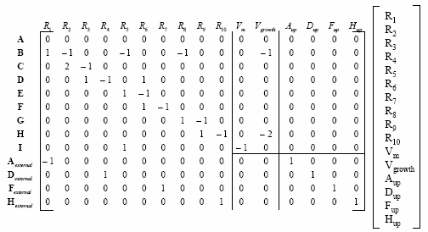
Kinetic Modeling
Predict changes in metabolite concentrations
m – metabolite concentrations vector - mol/mg
S – stoichiometric matrix
v – reaction rates vector - mol/(mg*h)
A set of Ordinary Differential
Equations (ODE)
Reaction rate equation
Kinetic parameters
Requires knowledge of m, f and k!

Slide 21
Constraint-based modeling (CBM)
Assumes a quasi steady-state
No changes in metabolite concentrations (within the system)
Metabolite production and consumption rates are equal
Representing the ‘average’ flow in the network over a long enough period of time
The reaction rate vector v is referred to as a ‘steady-state flux distribution’
No need for information on metabolite concentrations, reaction rate equations, and kinetic parameters

Slide 22
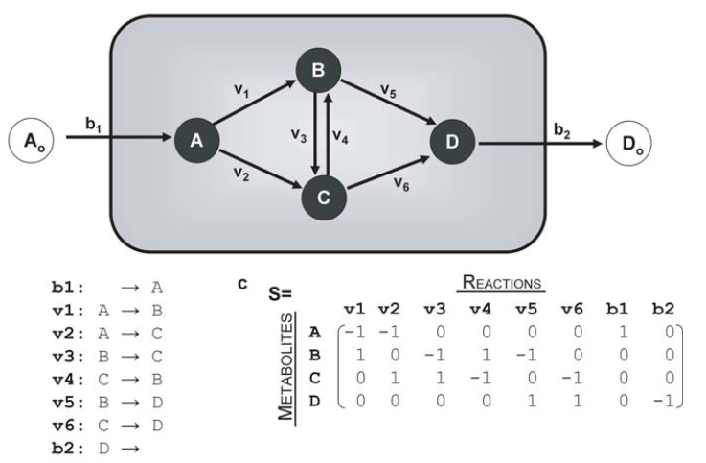
Constraint-Based Modeling 1. The steady state assumption
The steady-state assumption
Reactions
S
V
0
Metabolites
=
The rate in which each metabolite is being consumed is equal to the rate in which it is being produced
A: – V1 – V2 + b1 = 0
B: V1– V3 + V4 – V5 = 0
C: V2 + V3 – V4 – V6 = 0
D: V5 + V6 – b2 = 0
# of metabolites = # of constraints
# of reactions - # of variables

Slide 23
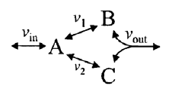
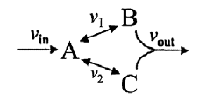


Constraint-Based Modeling 2. Add constraints
Thermodynamic constraints (irreversibility)
Mass balance constraint
(steady-state)
Maximum enzyme capacity
Assuming mass balance
Thermodynamic constraints
Capacity constraints

Slide 24
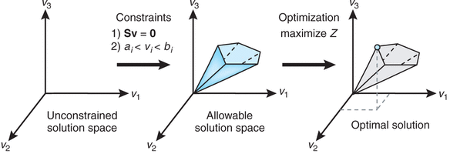
Constraint-Based Modeling 3. Define objective function
Addition of constraints reduce solution space, but usually not to a single point.
How to find a particular solution of the system?
We are looking for a solution which optimizes the production of certain metabolites (e.g. biomass production): Flux Balance Analysis (FBA)

Slide 25
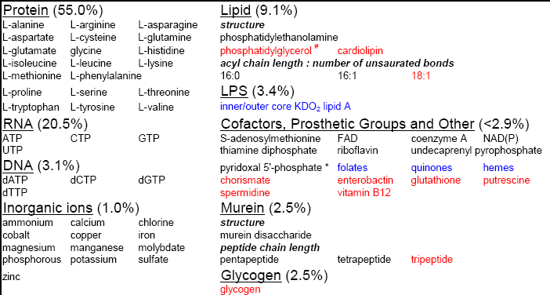
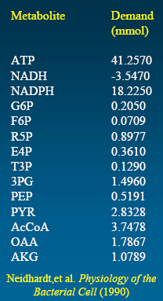
Biomass reaction
A putative reaction that represents the metabolites required for
producing 1gDW of the organism’s biomass
These precursors are removed from the
metabolic network in the corresponding ratios:
41.1 ATP + 18.2 NADH + 0.2 G6P… -> biomass

Slide 26
Mathematical formulation
max v_{bio} (biomass production)
s.t.
S v = 0 (steady-state condition)
a_{i} ≤ v_{i} ≤ b_{i} (additional constraints)
Assuming mass balance
Thermodynamic constraints
Capacity constraints
J.D. Orth et al., What is the flux balance analysis? Nat. Biotech. (2010)
Notes:
To model the system, I employed the three computational methods. The first one I used to model the optimal states is the flux balance analysis. FBA is a tool to predict a steady state metabolic properties. One start from the reaction network. For this example network, A is converted to 2 b and b is converted to C or D. One forms the stoichiometric matrix with metabolites on rows and reactions on the columns, where the almost exact values of stoichiometric coefficients are available from the biochemistry. At steady state, where the concentration of metabolites does not change over time, all the metabolites produced has to be consumed during certain time interval. This is implemented by S.V=0. The second constraint model upper and lower bounds of the reaction rate from reaction irreversibility, environmental condition and cell maintenance requirements. Since there are more reactions than metabolites in metabolic network, the system is underdetermined. Introducing an objective function solves this problem. Typically the biomass production is used as an objective function, since the growth is one of the most significant selective pressure for proliferating cells.

Slide 27
Constraint-based modeling applications
Phenotype predictions:
Growth rates across media
Knockout lethality
Nutrient uptake/secretion rates
Intracellular fluxes
Growth rate following adaptive evolution
Bioengineering:
Strain design – overproduce desired compounds
Biomedical:
Predict drug targets for metabolic disorders
Studying an array of questions regarding:
Dispensability of metabolic genes
Robustness and evolution of metabolic networks

Slide 28
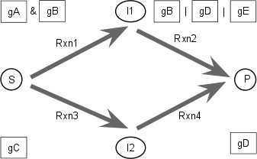
Gene-Reaction Mapping
Notes:
Now let's think of the genes that regulates each reaction.

Slide 29
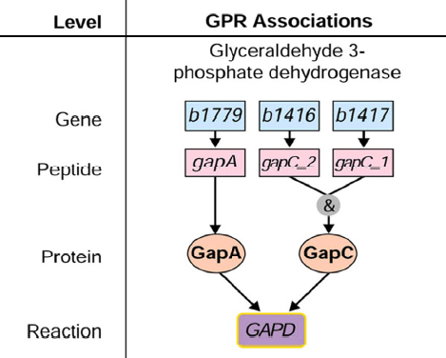
Gene-Reaction Mapping
= b1779 | b1416 & b1417

Slide 30
Predicting Knockout Lethality
A gene knockout is simulated by setting the flux through the corresponding reaction to zero
The corresponding reactions are identified by evaluating the Boolean gene-to-reaction mapping in the model

Slide 31
Biomass flux prediction after KO
WT growth rate
optimal growth rate after KO
growth rate
adaptive evolution
>50 generations
gene KO
time

Slide 32
3. Kinetic modeling
Metabolic Network Modeling Tools

Slide 33
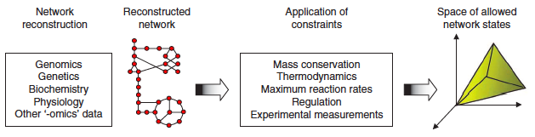
COBRA toolbox
The Constraint-Based Reconstruction and Analysis (COBRA)
Based on MATLAB environment
Readable language format: Systems Biology Markup Language (SBML)
Overview of Constraint-based reconstruction and analysis (COBRA)
(Schellenberger J, et al, 2011)

Slide 34
Installation of COBRA toolbox
Please refer to the protocols:
Becker SA, et al. Quantitative prediction of cellular metabolism with constraint-based models: the COBRA Toolbox. Nature Protocols, 2007, 2(3): 727–738
Schellenberger J, et al. Quantitative prediction of cellular metabolism with constraint-based models: the COBRA Toolbox v2.0. Nature Protocols, 2011, 6(9):1290–2307.
https://github.com/opencobra/cobratoolbox/
A Computer
MATLAB
COBRA toolbox
SBML Toolbox

Slide 35
Procedures for using the COBRA toolbox
Initializing the toolbox {initCobraToolbox}
Reading SBML format models into Matlab {model = readCbModel(fileName);}
Changing lower and/or upper bounds of flux through reactions in the model {model = changeRxnBounds(model, rxnNameList, boundValue, boundType);}
Printing out reaction formulas {printRxnFormula(model,rxnNameList);}
Simulating maximal growth using flux-balance analysis (FBA) {solution=optimizeCbModel(model);}
Simulating gene deletion phenotypes
https://opencobra.github.io/cobratoolbox/docs/cobra/

Slide 36
Reconstructed networks
Available at http://vmh.uni.lu/ (http://bigg.ucsd.edu/models)
Human: RECON2.v04.mat
The structure of reconstructed networks on COBRA (Example)
model =
rxns: {7440x1 cell}
mets: {5063x1 cell}
genes: {2140x1 cell}
rxnGeneMat: [7440x2140 double]
subSystems: {7440x1 cell}
S: [5063x7440 double]
lb: [7440x1 double]
ub: [7440x1 double]
rev: [7440x1 double]
c: [7440x1 double]
b: [5063x1 double]
Reactions
Metabolites
Genes
Gene-reaction mapping
Localization
Stoichiometric matrix
Lower bound
Upper bound
Reaction direction
Objective coefficient
Vector of zero (dm/dt)

Slide 37
Task 1 Growth rate optimization
Use FBA to predict flux distribution for optimal growth on glucose minimal media
load(‘RECON2.v04.mat’);
model = modelR204;
solution1 = optimizeCbModel(model);
printFluxVector(model, solution1.x, true, true);
The expected result for the objective value (Biomass flux, h⁻¹):
f = 3.1981
Thiele I et al. A community-driven global reconstruction of human metabolism. Nat Biotechnol. 2013

Slide 38
Task 2 Change medium condition
Define medium condition by changing the reaction bounds of exchange fluxes to obtain the corresponding optimal growth rates and flux distributions
model2 = changeRxnBounds(model, {'EX_glc2(e)'}, [-0.1], ‘l‘);
...
solution2 = optimizeCbModel(model2);
printFluxVector(model2, solution2.x, true, true);
The expected result (Biomass flux, h⁻¹):
f=0.0983
Folger O et al. Predicting selective drug targets in cancer through metabolic networks. Mol Syst Biol. 2011

Slide 39
Task 3. Gene knockout screening
Perform single gene knockout screening
modelA = deleteModelGenes(model,{’2271.1’},0)
solution3 = optimizeCbModel(modelA)
modelB = deleteModelGenes(model,{’3163.1’},0)
solution4 = optimizeCbModel(modelB)
Perform double gene knockout screening
[model5,hasEffect,constrRxnNames,deletedGenes] = deleteModelGenes(model,{’3163.1’,’2271.1’},0)
solution5=optimizeCbModel(model5)

Slide 40
Task 3. Gene knockout screening
Perform single gene knockout screening
modelA = deleteModelGenes(model,model.genes(i),0)
solutionA = optimizeCbModel(modelA)
modelB = deleteModelGenes(model, model.genes(j),0)
solutionB = optimizeCbModel(modelB)
Perform double gene knockout screening
[modelAB,hasEffect,constrRxnNames,deletedGenes] = deleteModelGenes(model, model.genes([i,j]),0)
solutionAB=optimizeCbModel(modelAB)

Slide 41
Task 4. Identifying synthetic lethal pairs
Perform single gene knockout screening
modelA = deleteModelGenes(model,model.genes(i),0)
solutionA = optimizeCbModel(modelA)
modelB = deleteModelGenes(model, model.genes(j),0)
solutionB = optimizeCbModel(modelB)
Perform double gene knockout screening
[modelAB,hasEffect,constrRxnNames,deletedGenes] = deleteModelGenes(model, model.genes([i,j]),0)
solutionAB=optimizeCbModel(modelAB)

Slide 42
Task 4. Identifying synthetic lethal pairs
Compare the growth defect due to two single KOs and one double KO
grA = solutionA.f / solution.f
grB = solutionB.f / solution.f
grAB = solutionAB.f / solution.f
SL: grAB < d_{lethality} , grA, grB > d_{viability}

Slide 43
Reference
Becker SA, et al. Quantitative prediction of cellular metabolism with constraint-based models: the COBRA Toolbox. Nature Protocols, 2007, 2(3): 727–738
Kauffman KJ, Prakash P, Edwards JS. Advances in flux balance analysis. Current Opinion in Biotechnology. 2003, 14: 491–496.
Orth JD, Thiele I, Palsson B. What is flux balance analysis. Nature Biotechnology. 2010, 28(3): 245–248.
Schellenberger J, et al. Quantitative prediction of cellular metabolism with constraint-based models: the COBRA Toolbox v2.0. Nature Protocols, 2011, 6(9):1290–2307.
Folger O, Jerby L, Frezza C, Gottlieb E, Ruppin E, Shlomi T. Predicting selective drug targets in cancer through metabolic networks. Mol Syst Biol. 2011, 7:501.

Slide 44
Summary
Metabolism and metabolic networks
Metabolic network modeling
Flux balance analysis
COBRA Toolbox
In silico gene knockout experiment

Slide 45
그림1 합성 치사 작용 (A) 합성 치사 작용의 원리 (B) 합성 치사 작용을 통한 암의 선택적인 치료

