Slide 1

进 展 汇 报
汇报人：郭晋康
导 师：束传存 教授

Slide 2
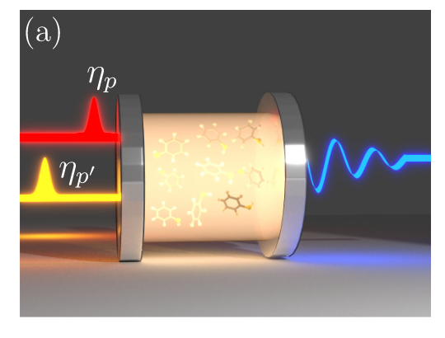
文献阅读情况
反射镜处的相互作用：
连续化处理：
自由外场：
代入算符运动方程：

Slide 3
文献阅读情况
b_{in}(t)
a(t)
t₀
t₁
t₀ → t
b_{out}(t)
两边同时积分：
t → t₁
input–output relation:

Slide 4
文献阅读情况
b_{in,L}(t)
a(t)
b_{in,R}(t)
t₀
t₁
b_{out,L}(t)
b_{out,R}(t)
which holds in both linear and nonlinear regimes, as well as in the Fourier domain. that in the ultrastrong coupling regime, the input-output relations are significantly modified due to the breakdown of the rotating wave approximation (RWA).
下一步差分透射谱。

Slide 5
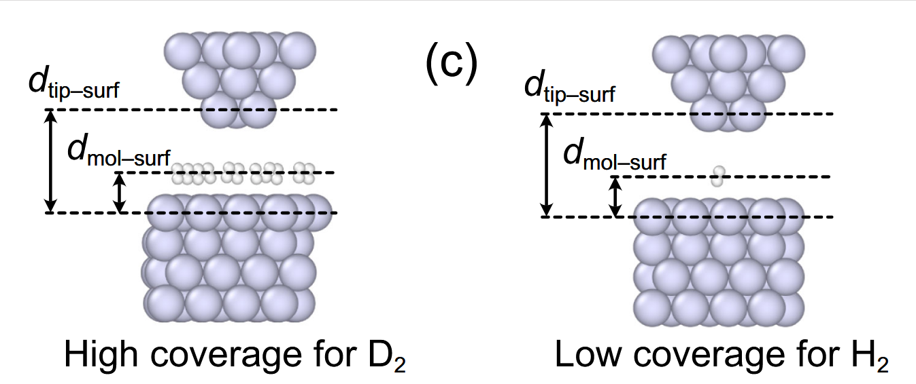
文献阅读情况
Further, we note that even though these simulations provide a clear indication that quantum mechanical effects affect the density of the molecular coverage of the surface.
本来打算当作课堂作业完成，与龙老师及学生分析后需要HPC（百原子量级）。
下一步：算简单结构的吸附能完成作业，先在个人电脑上实现基本模块计算，需要增加复杂度再使用HPC。着手有限元分析。
Picocavity-Enhanced Raman Spectroscopy of Physisorbed H2 and D2 Molecules

