Slide 1
MVDR Applied in Ultrasound Imaging
Marko Jakovljevic
Based on Broadband Minimum Variance Beamforming for Ultrasound Imaging by
Iben Kraglund Holfort, Fredrik Gran, and Jorgen Ardent Jensen

Slide 2
Motivation
Apply adaptive beamforming on ultrasound data.
  Continuously update apodization weights.
  Constrained optimization problem.
MVDR beamformer:
  Optimization: minimize the output power
  Constraint: the signal emerging from the direction of interest is passed w/o distortion.
Looking for improved resolution and contrast.
Explore sensitivity to steering errors.

Slide 3

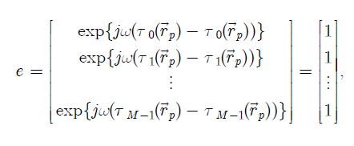
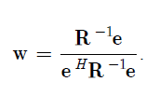
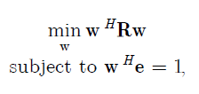

Theory
Output:

Slide 4
Parameters used for FIELD II simulation
Transducer type | Linear array
Element pitch | 110 um
Element kerf | 35 um
Element height | 6 mm
Center frequency | 7 MHz
Bandwidth | 0.6
Speed of sound | 1540 m/s
Excitation pulse | Two cycle sinusoid at f₀
No. of transmit elements | 1
No. of receive elements | 129
No. of beams | 193

Slide 5
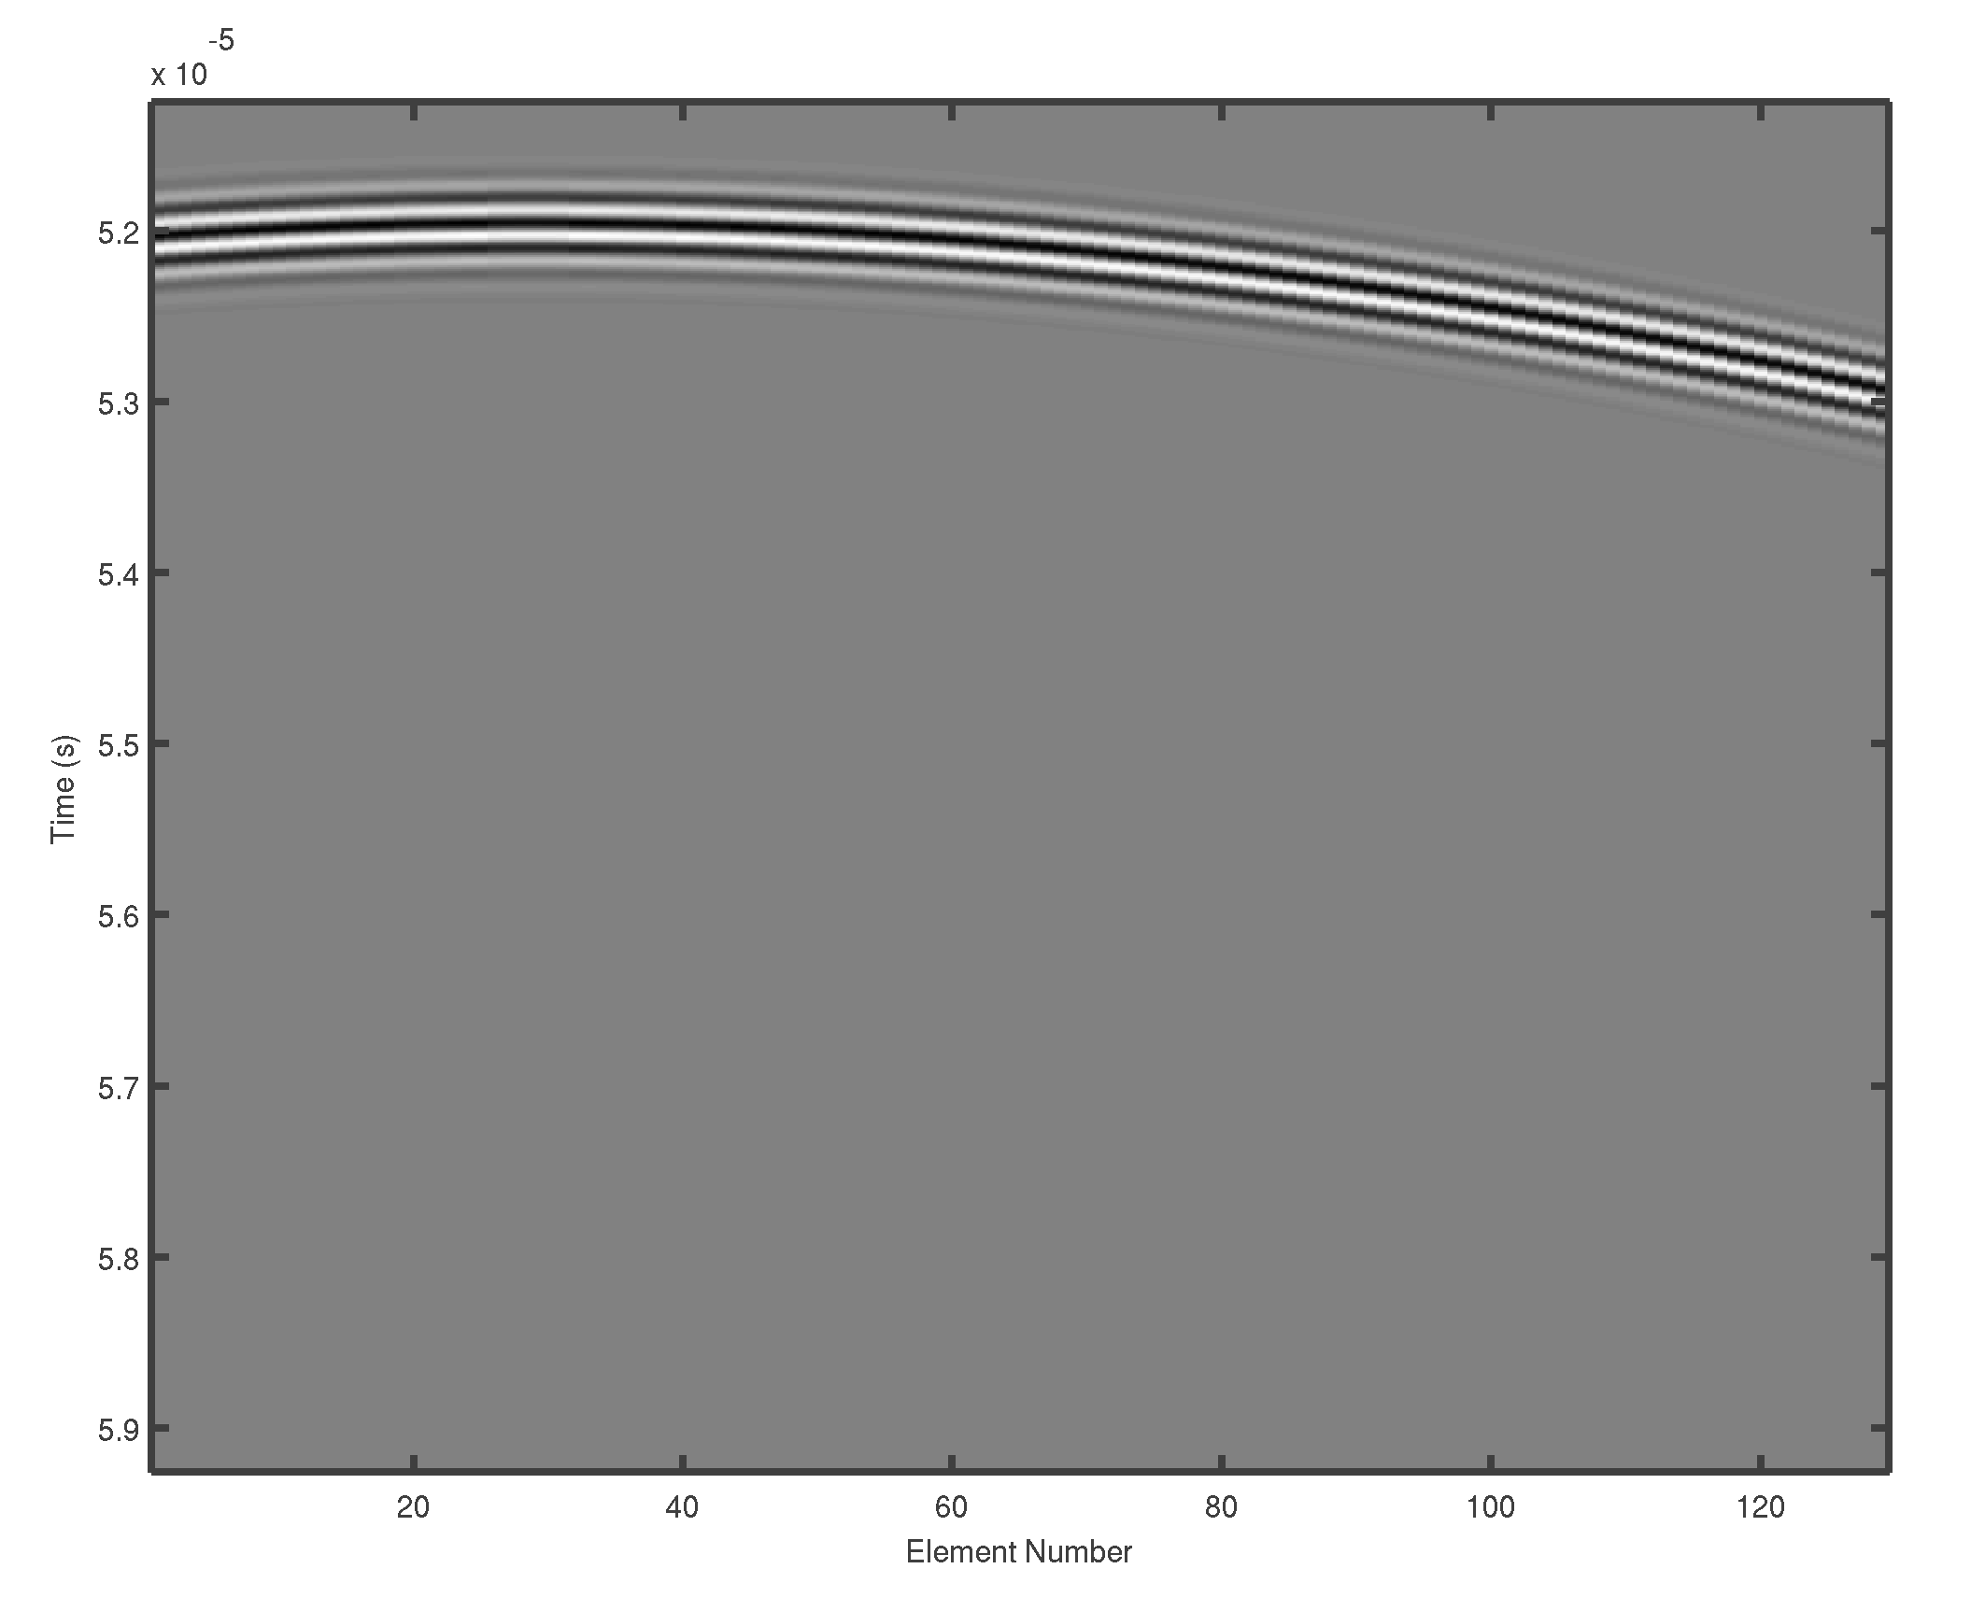
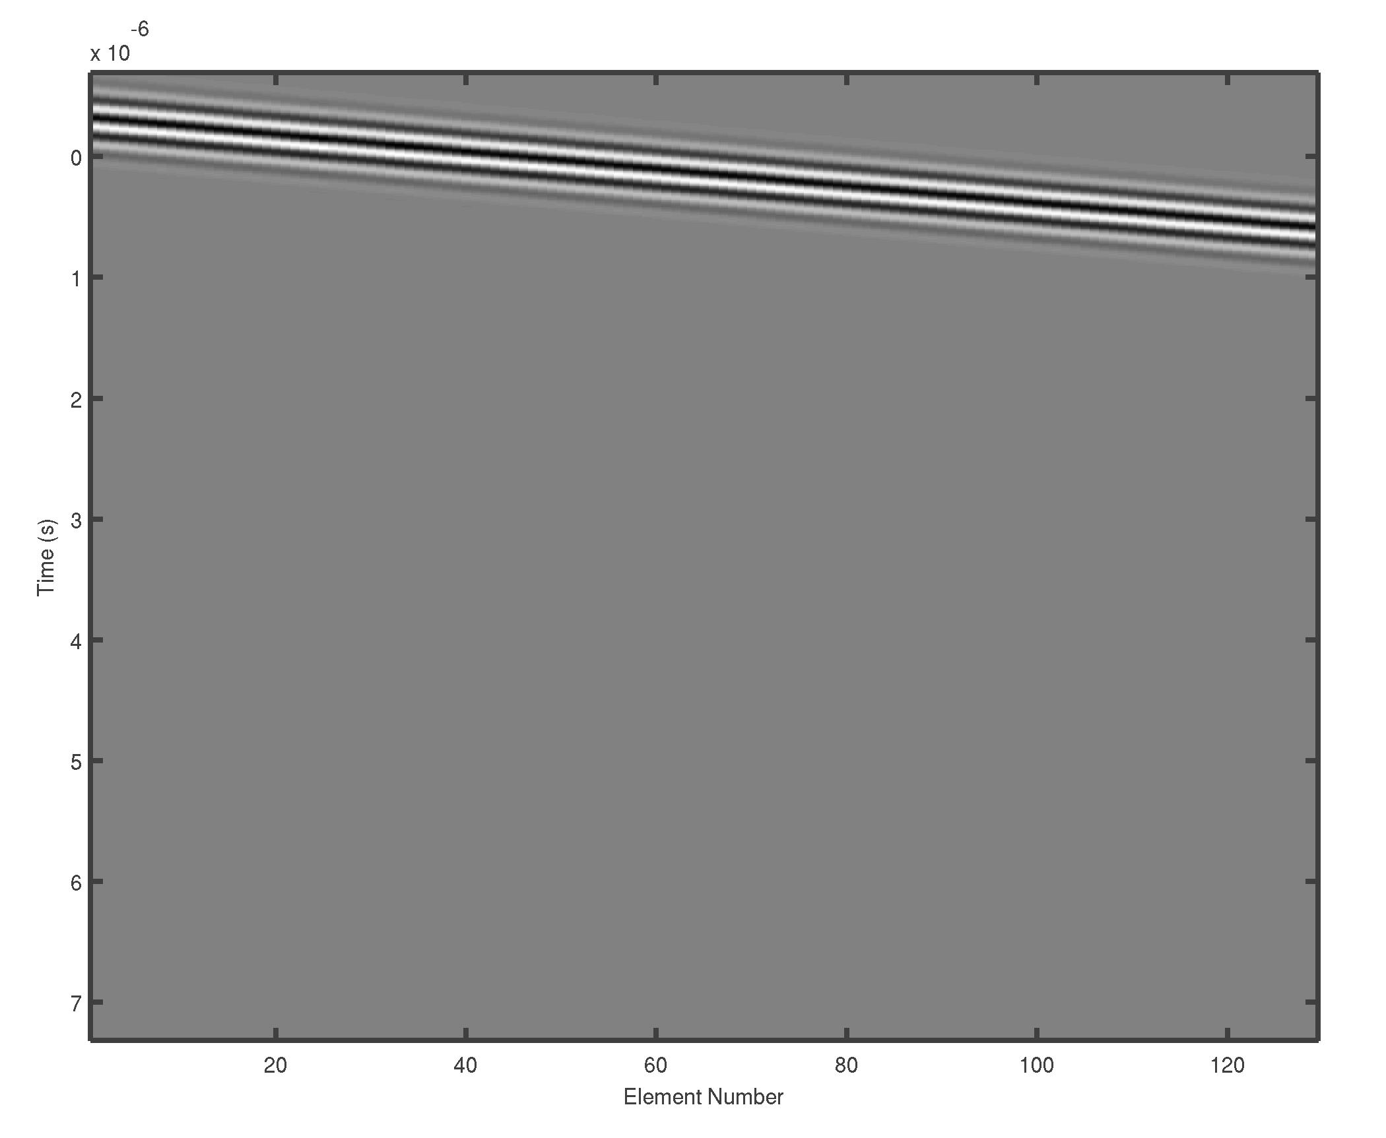
Methods: focusing rf data
Unfocused
Focused

Slide 6
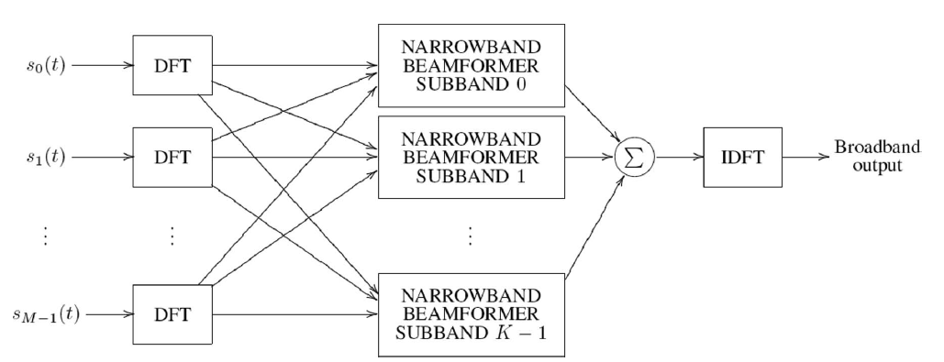
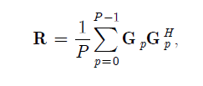
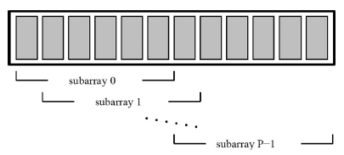
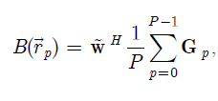
Methods: breaking data into subbands and spatial smoothening

Slide 7
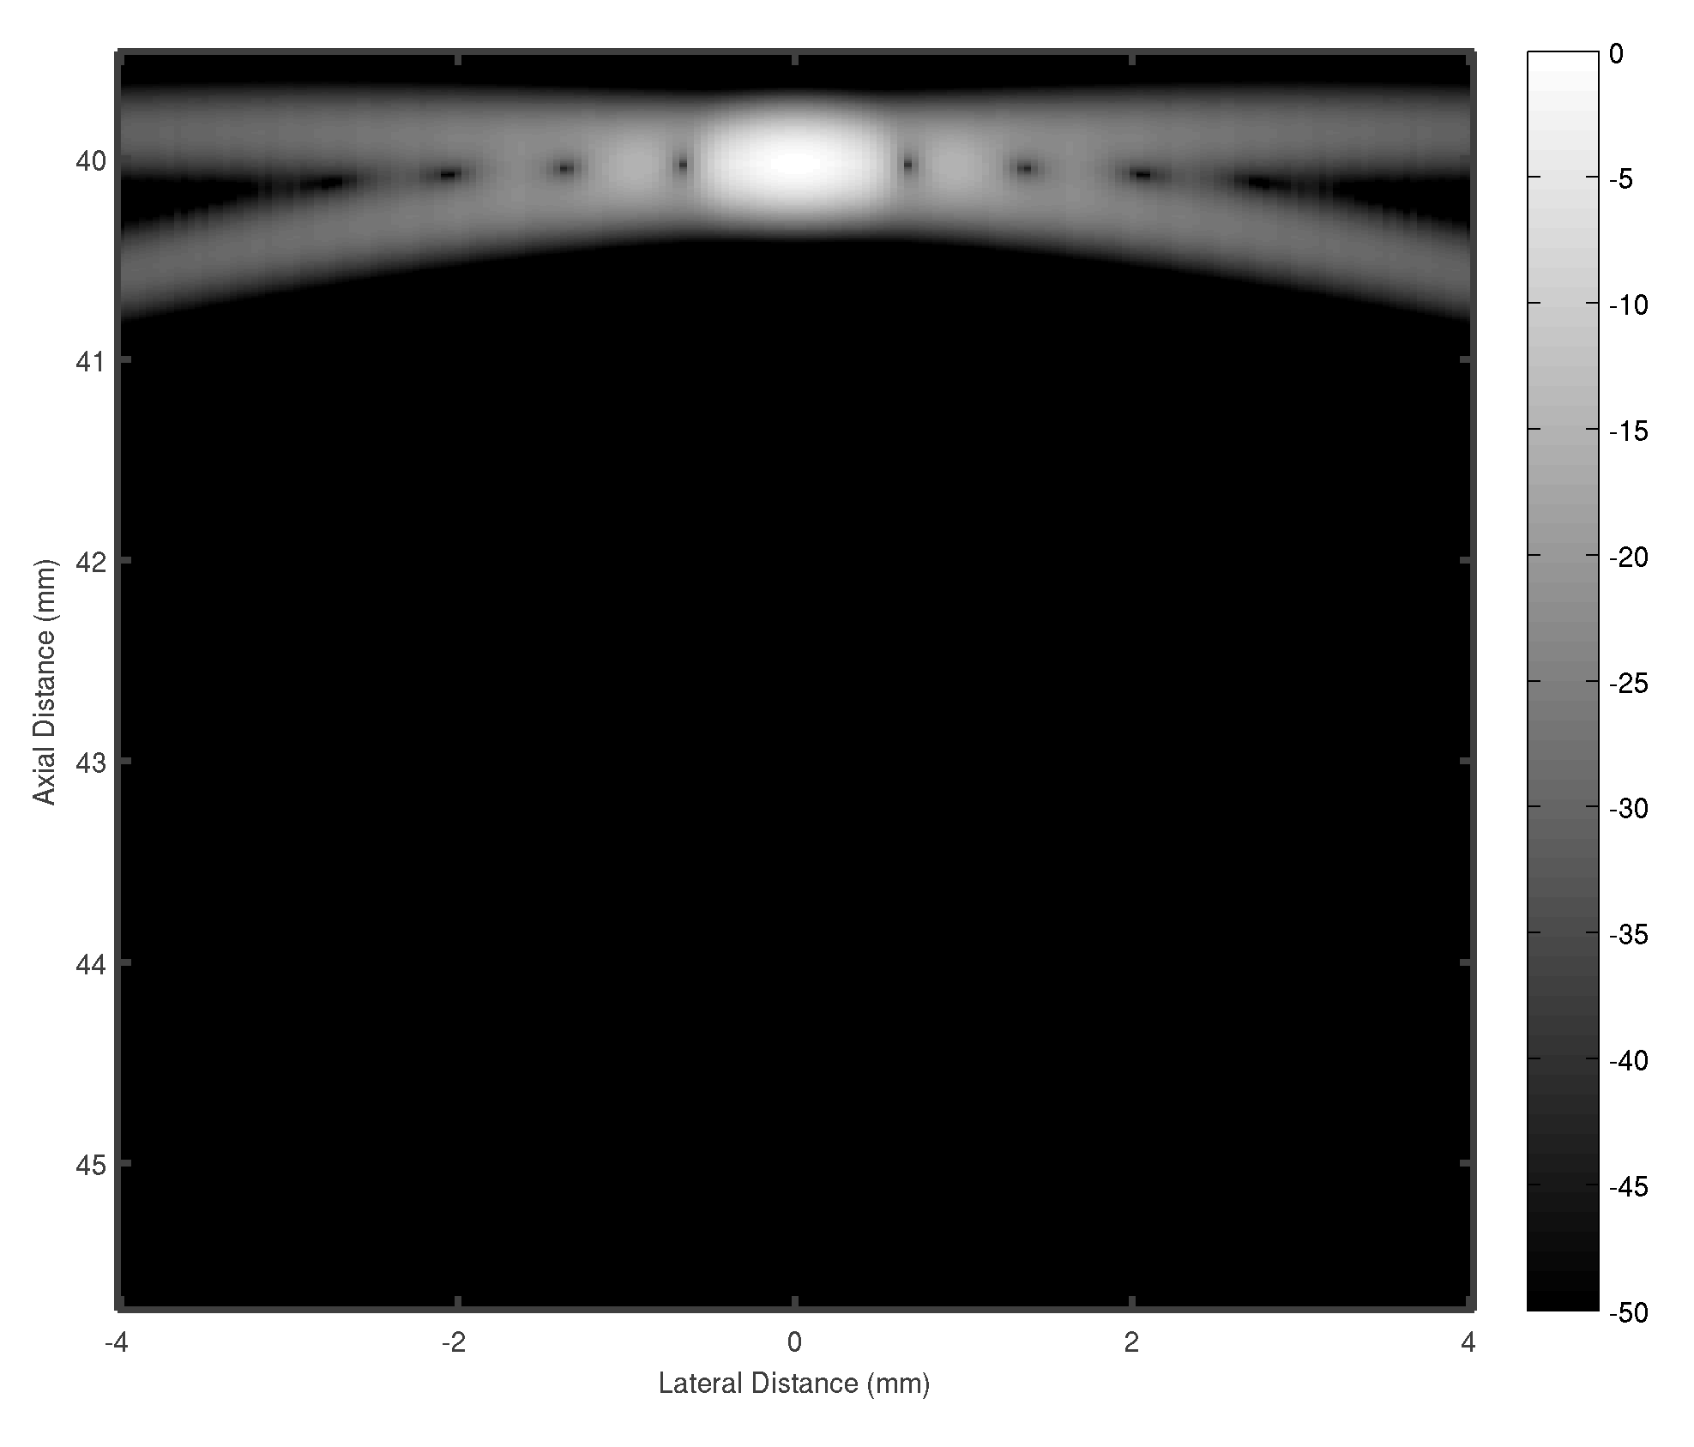
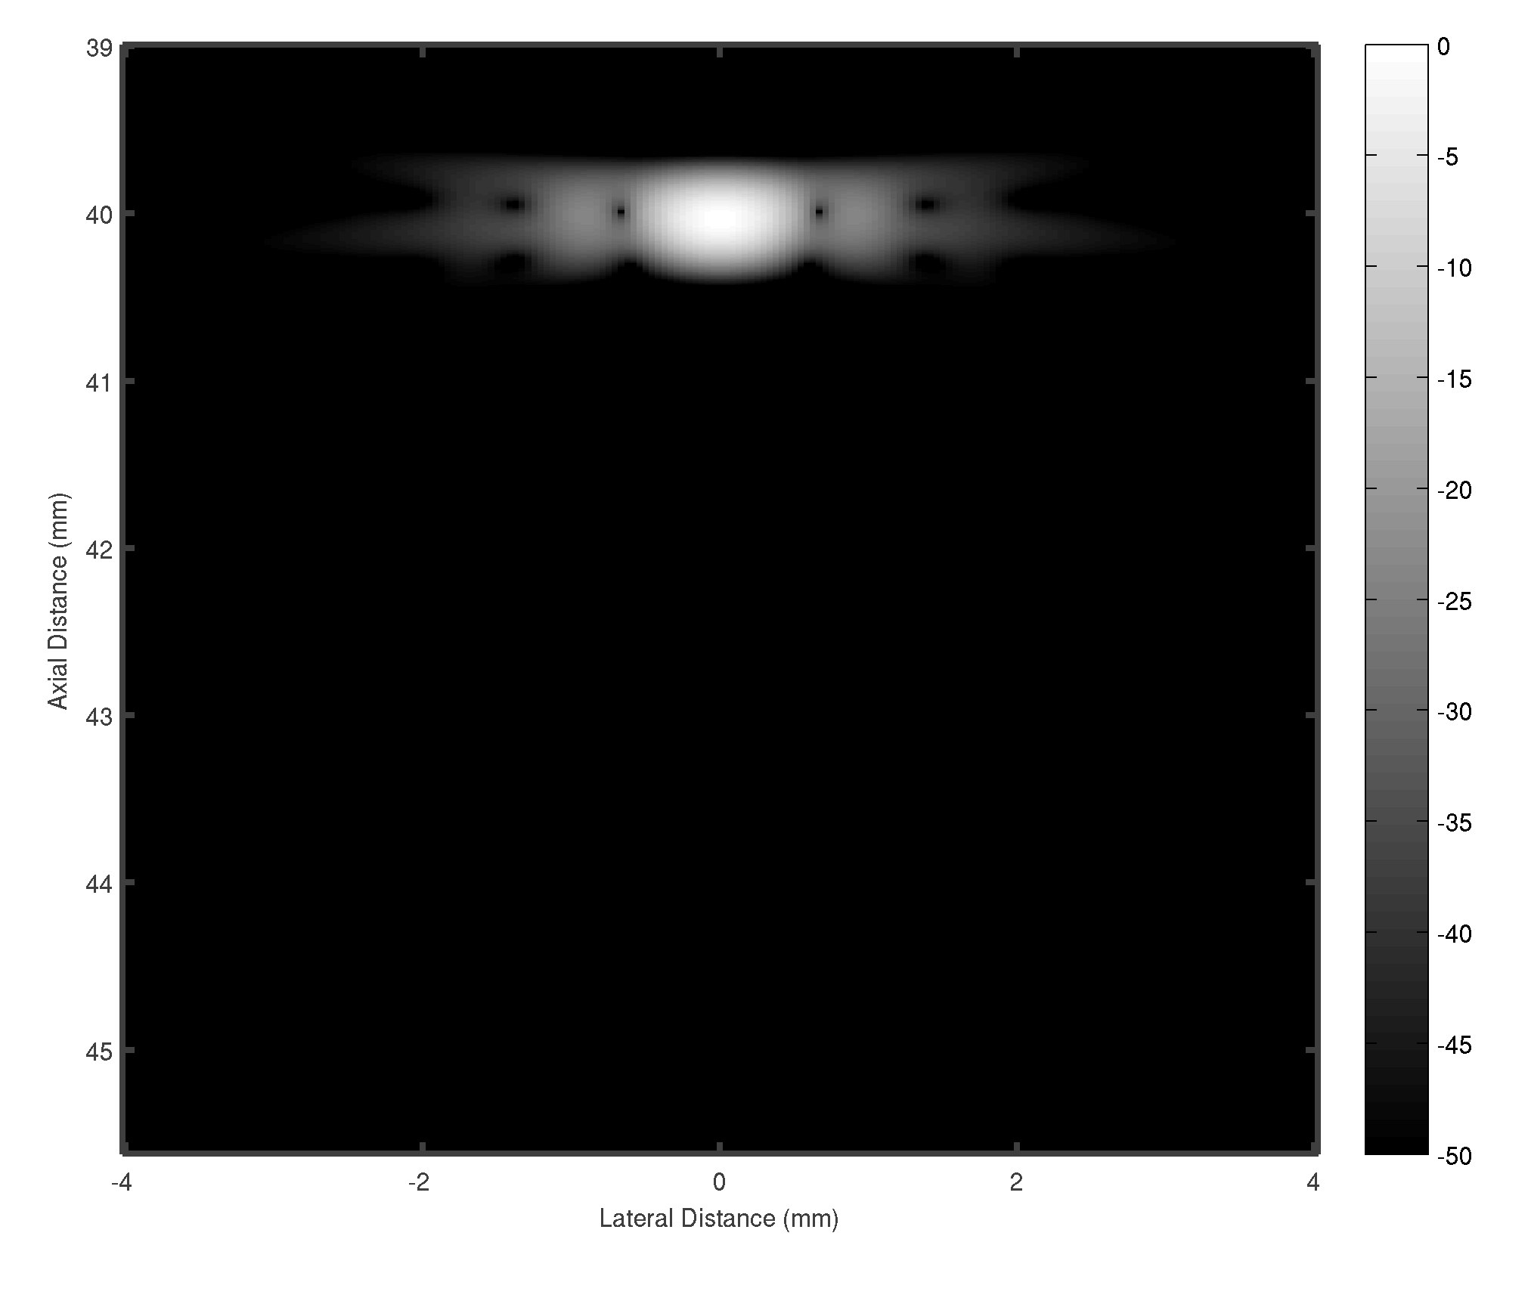


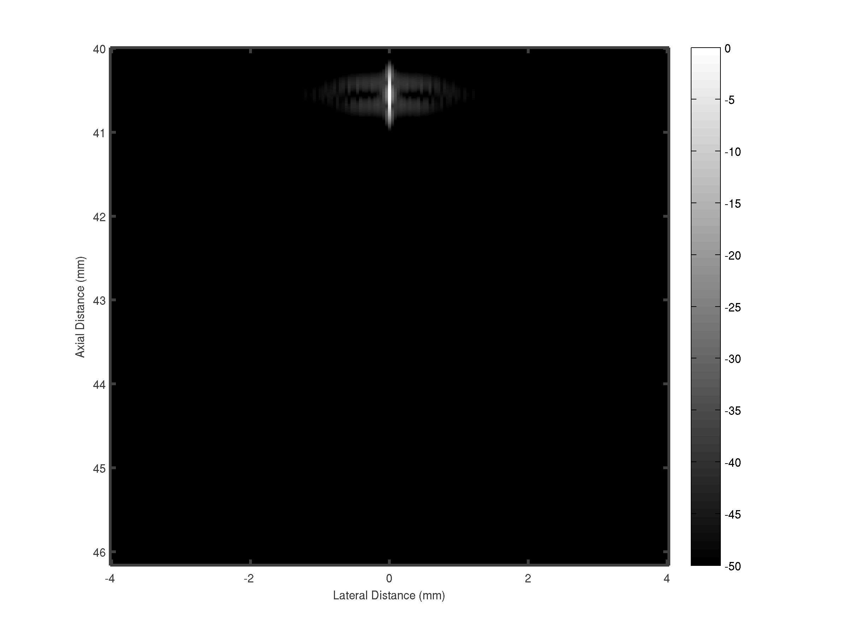

Beamformed responses of a single point target
 | PSL | FWHM
DS | -15 dB | 0.82 mm
MVDR | - 46 dB | 0.06 mm
Linescan | -24 dB | 0.6 mm

Slide 8
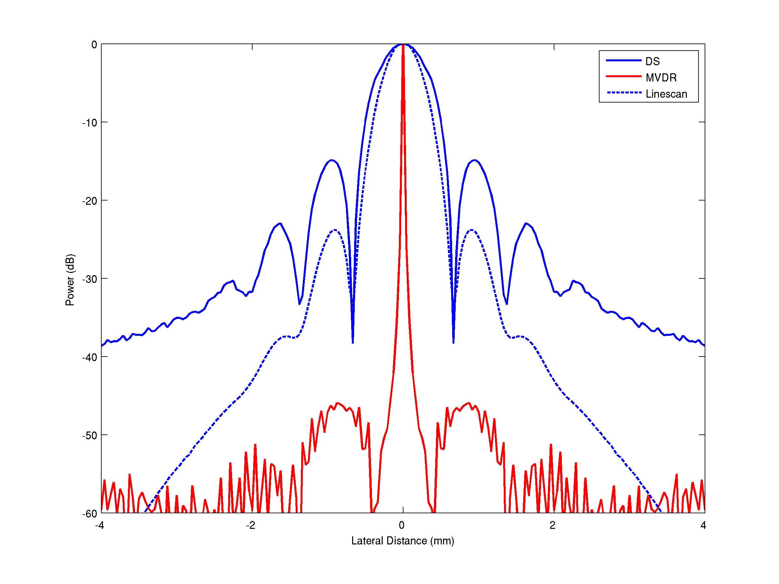
Single point target: lateral profiles

Slide 9
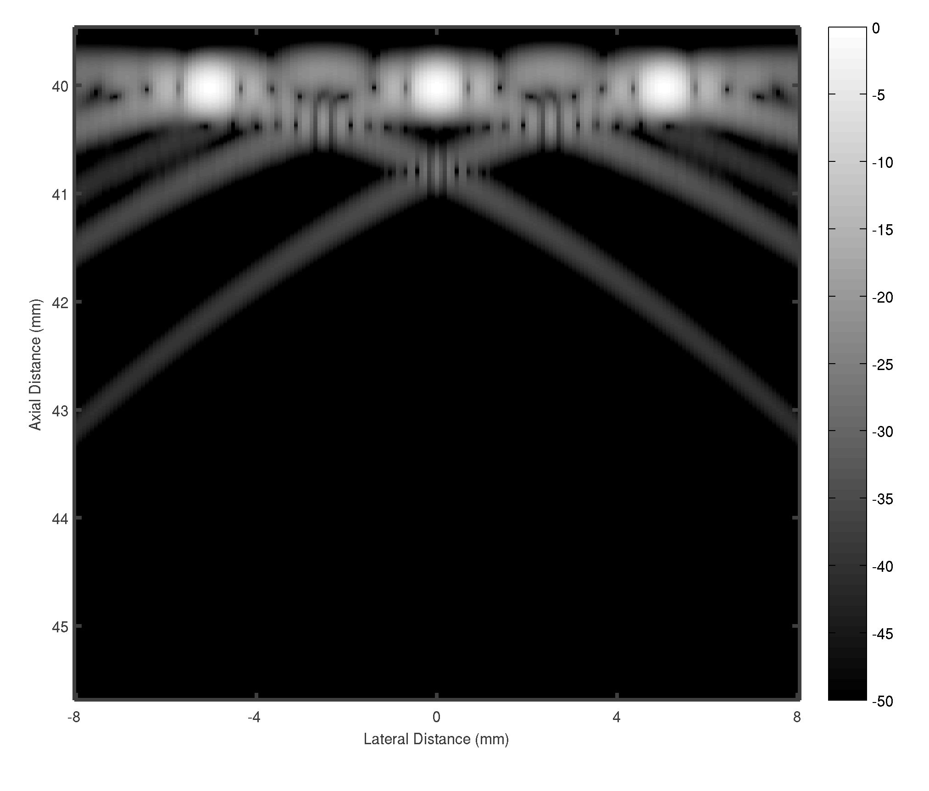
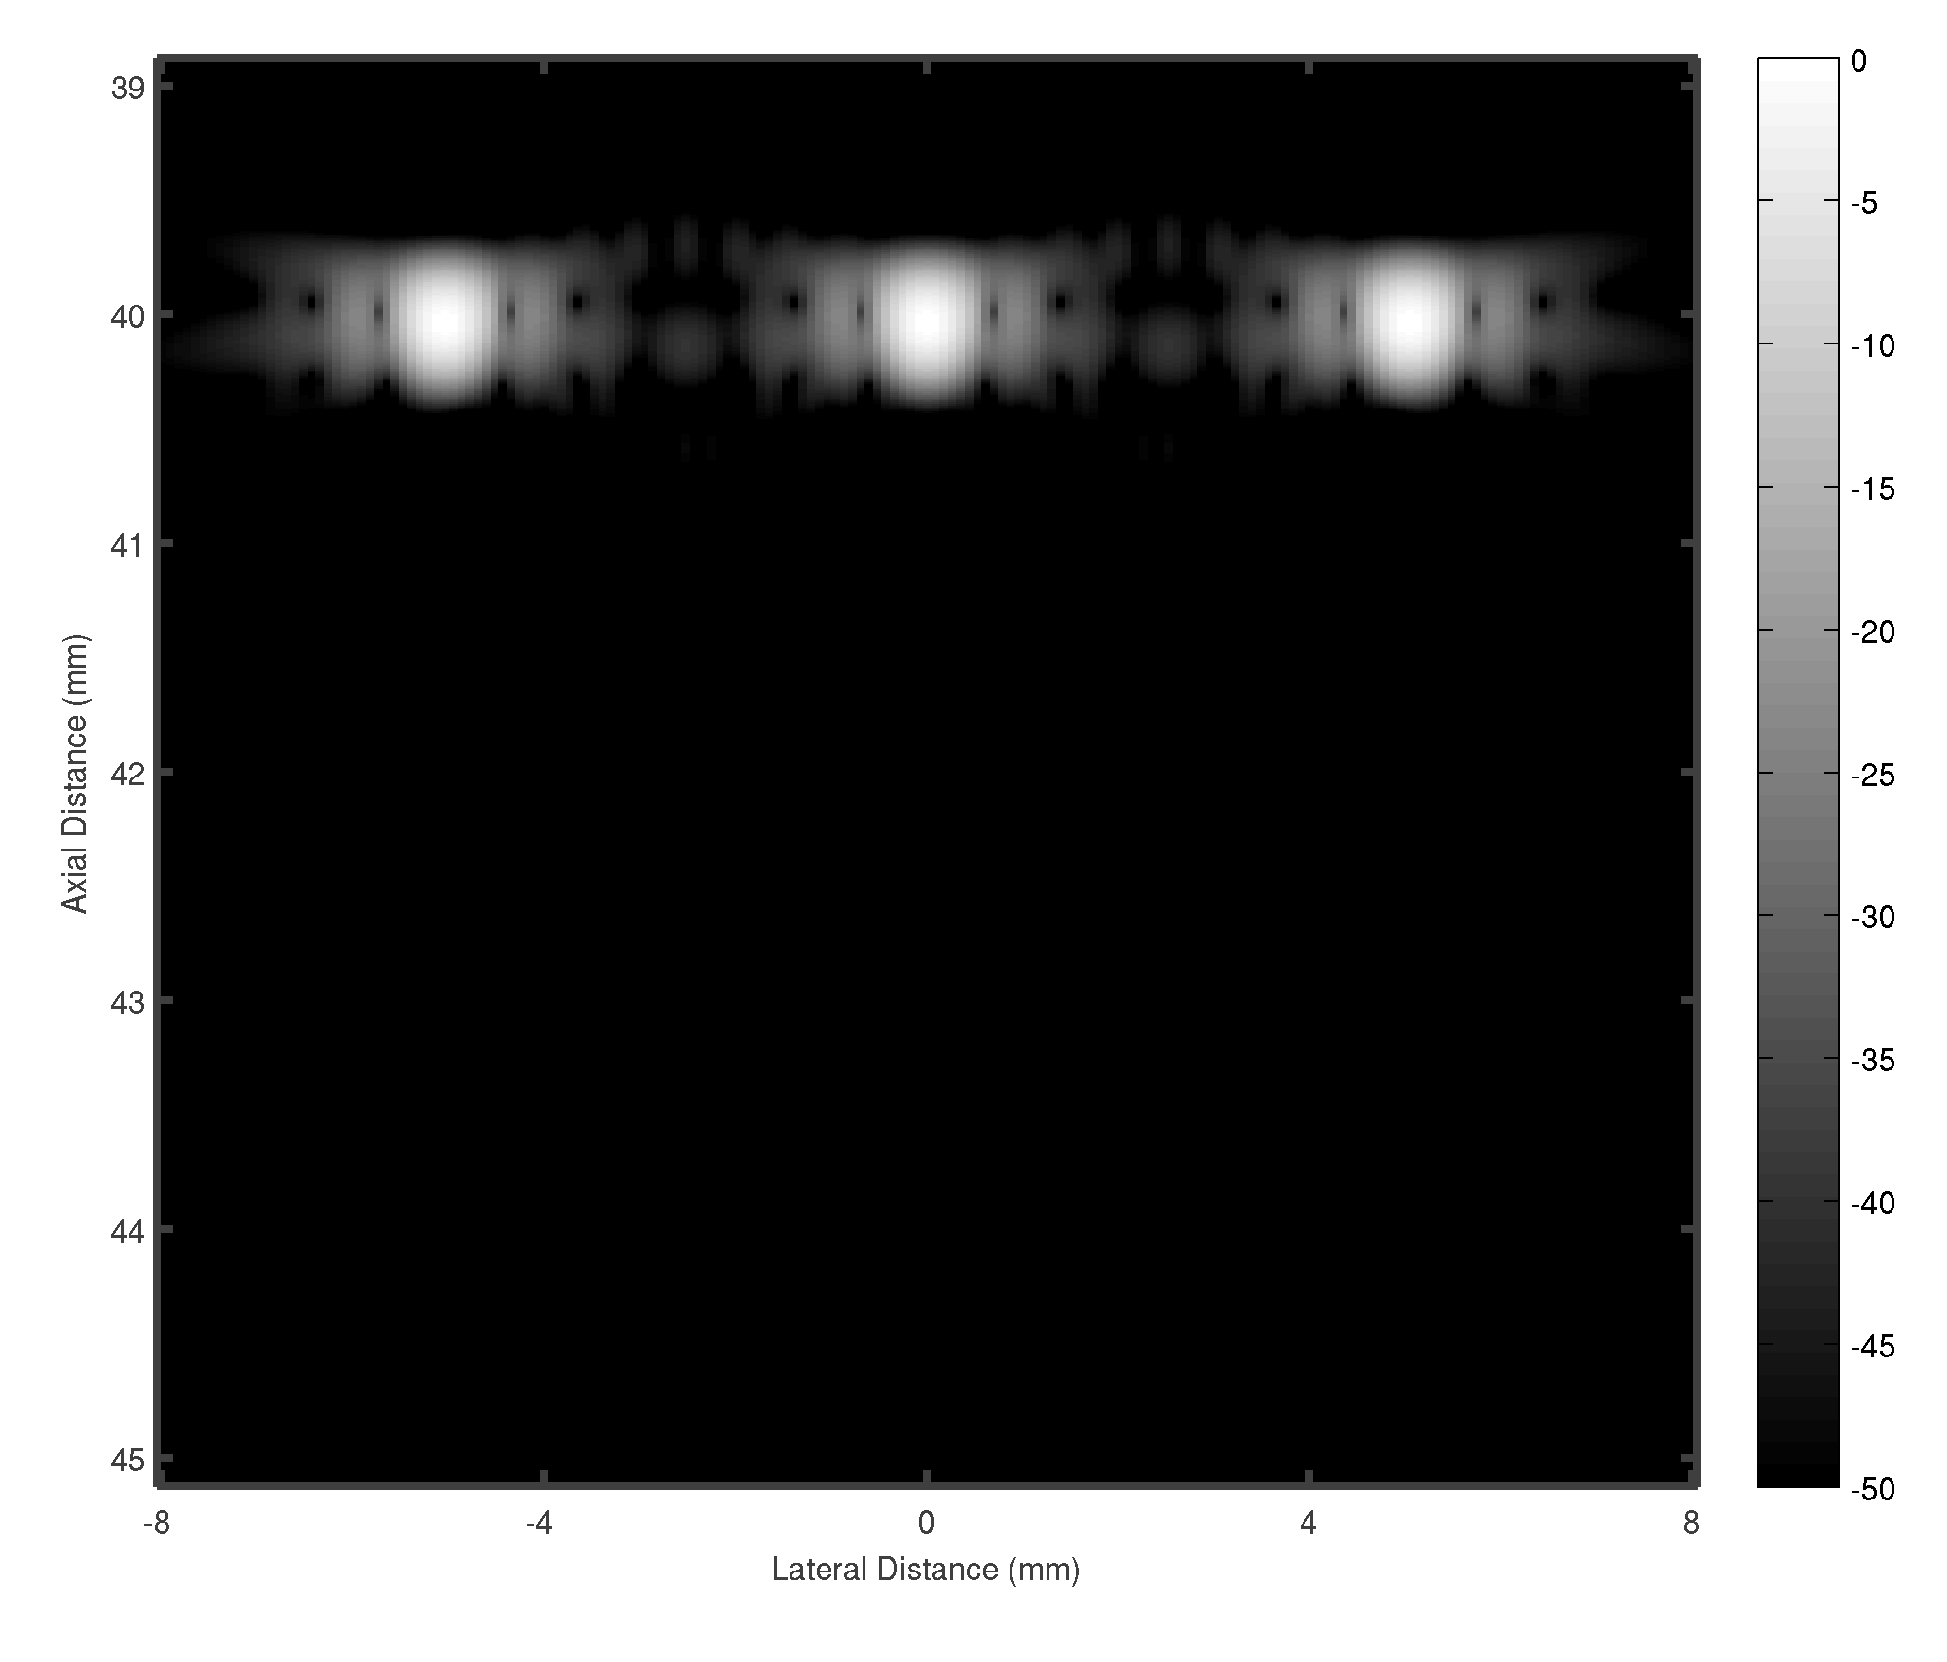

Beamformed responses of three point targets spaced 5 mm apart
 | PSL | FWHM
DS | -15 dB | 0.82 mm
MVDR | - 41 dB | 0.06 mm
Linescan | -24 dB | 0.6 mm

Slide 10
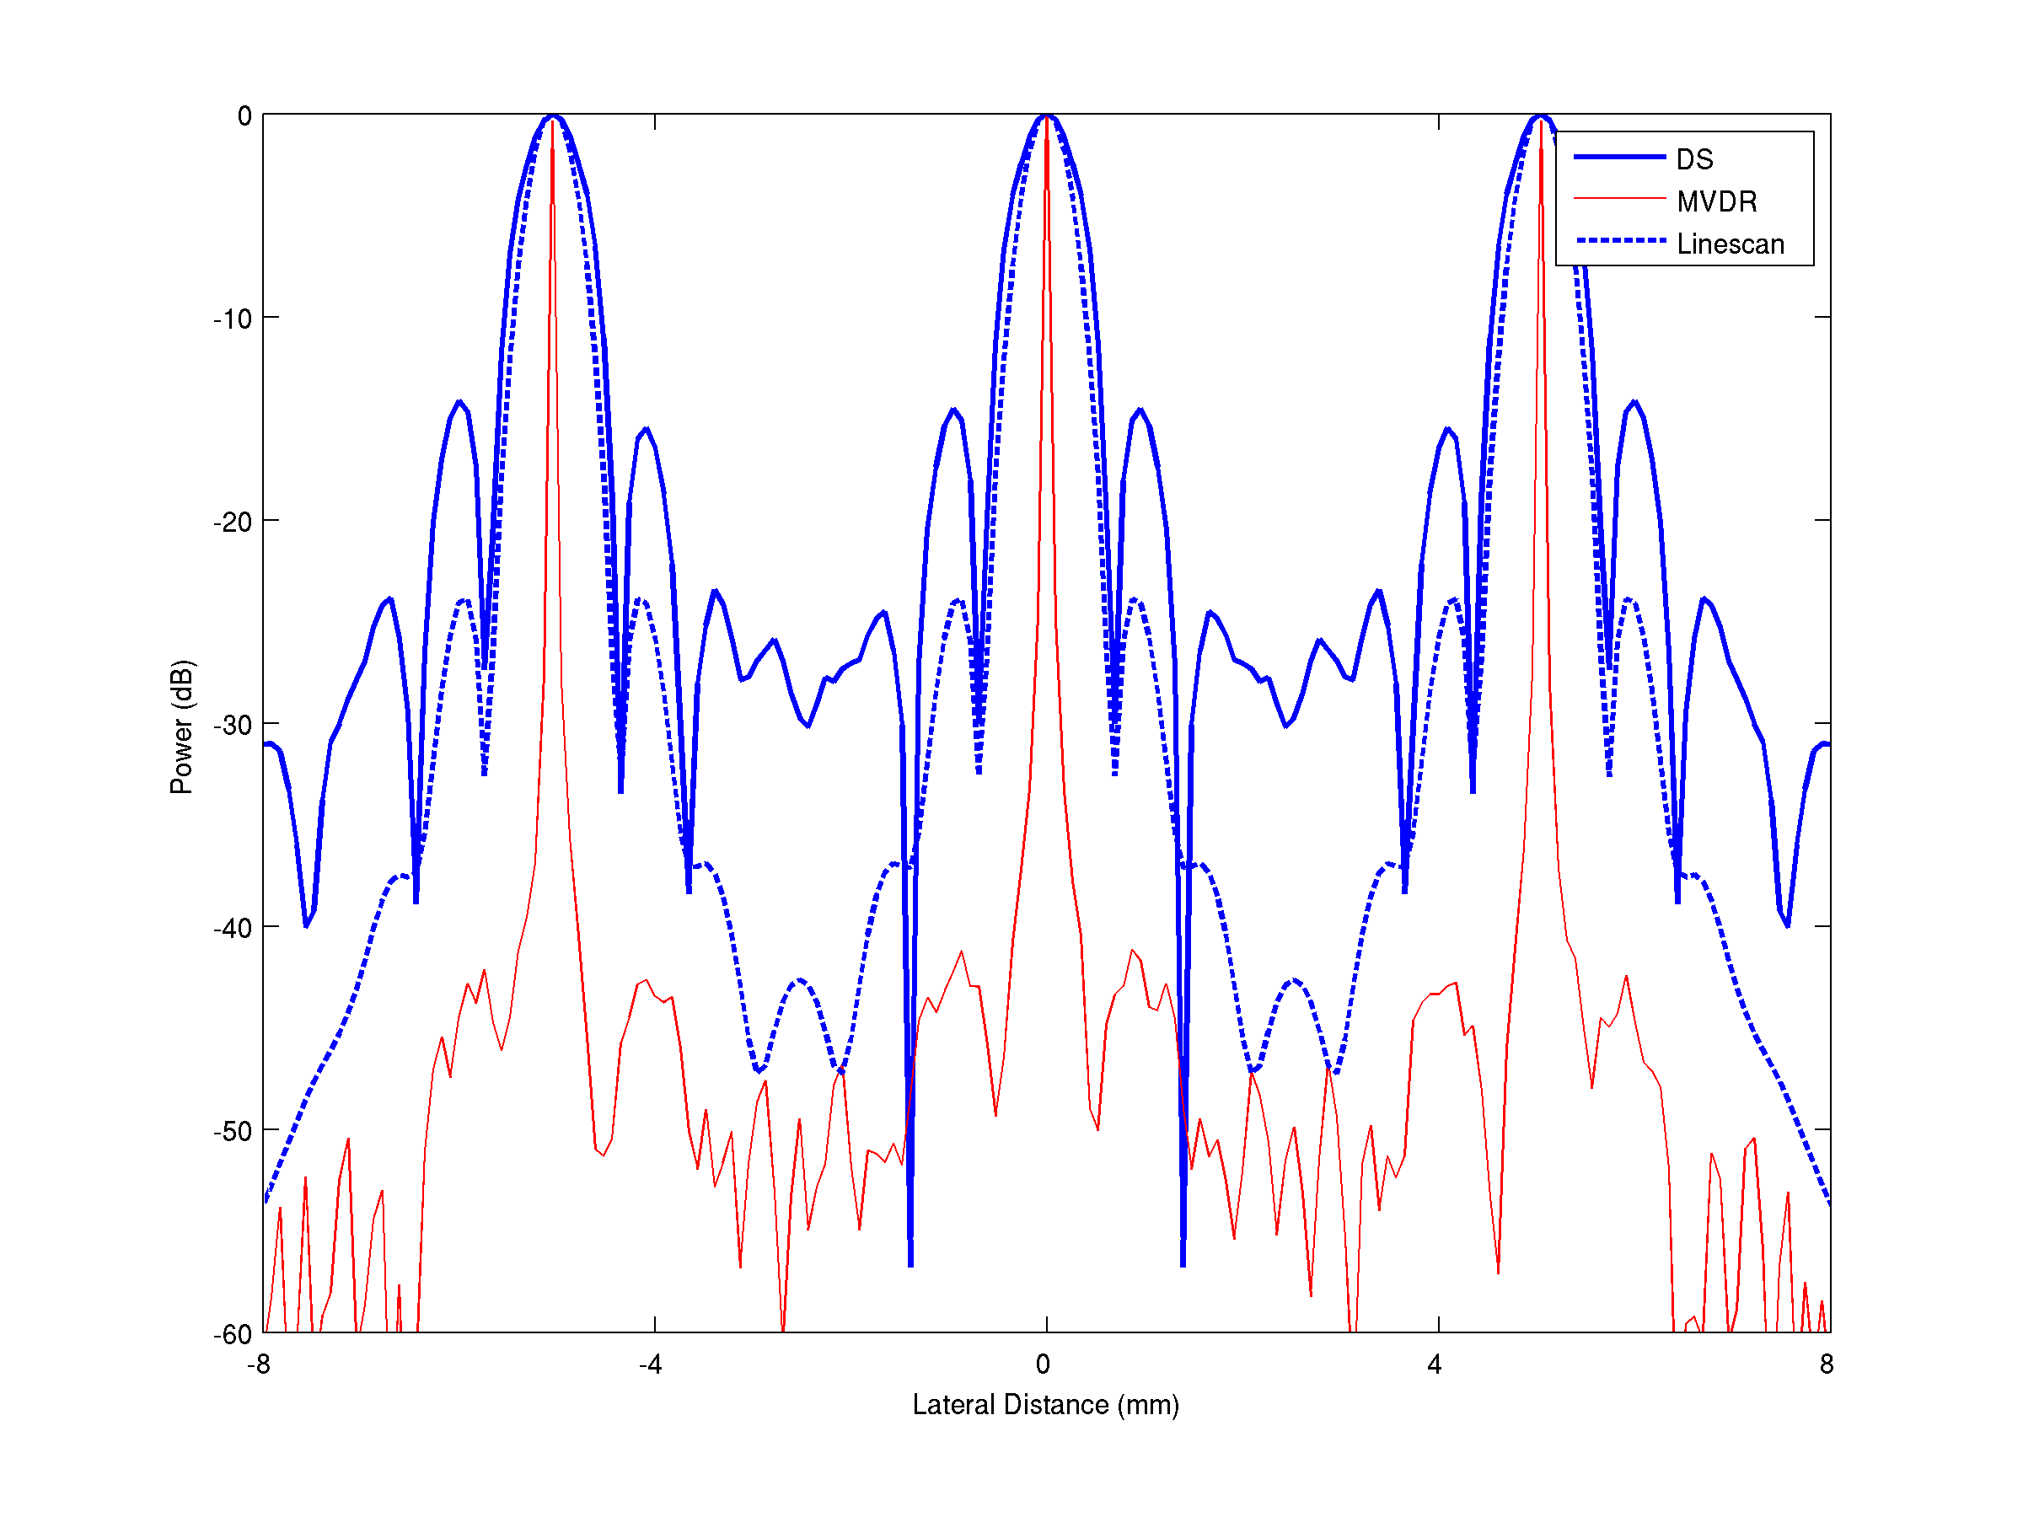
Three point targets spaced 5 mm apart: lateral profiles

Slide 11
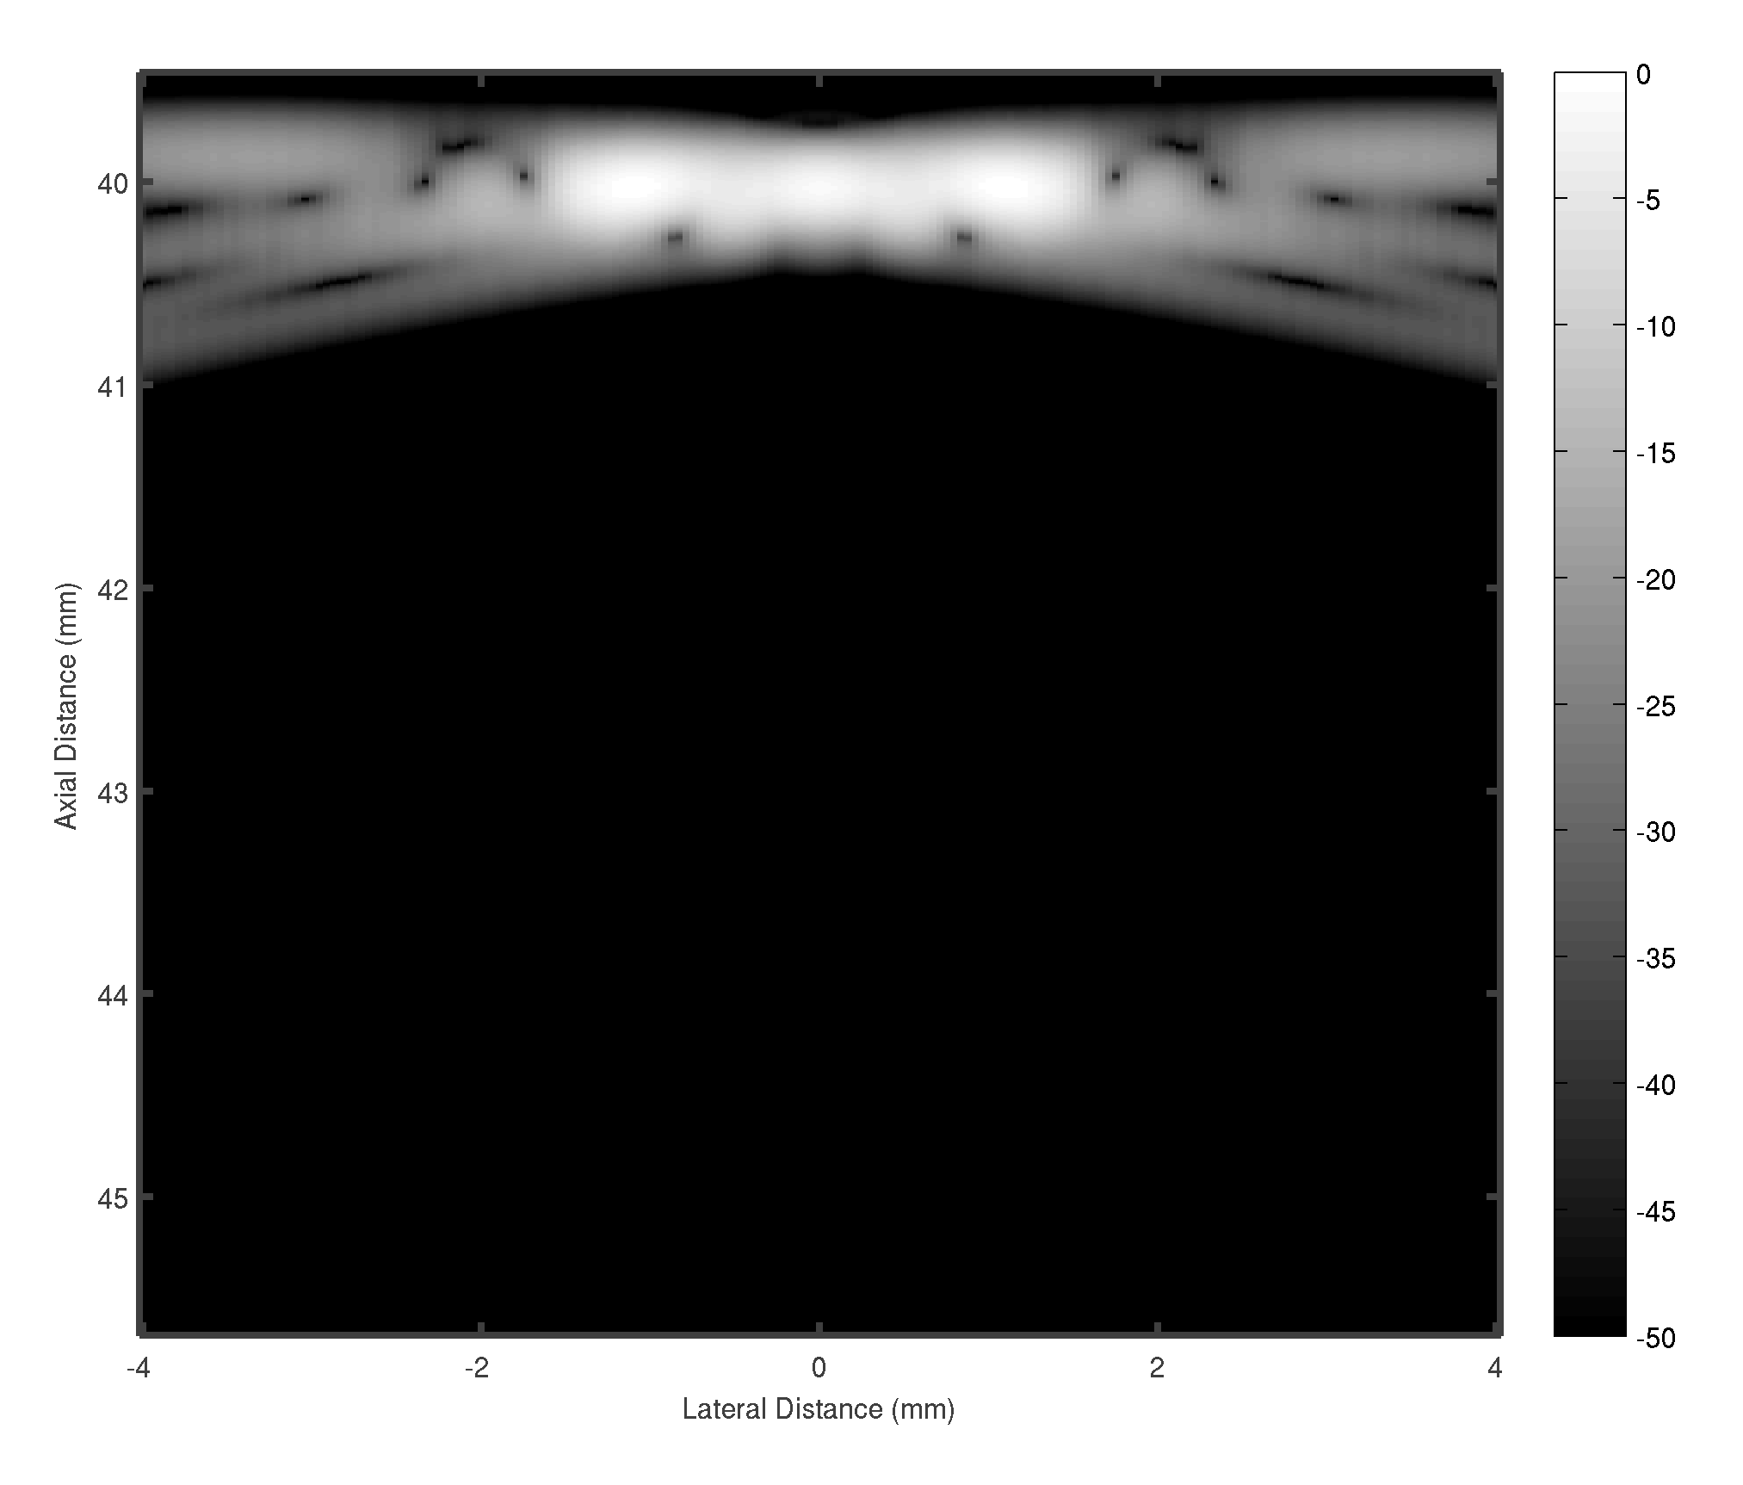
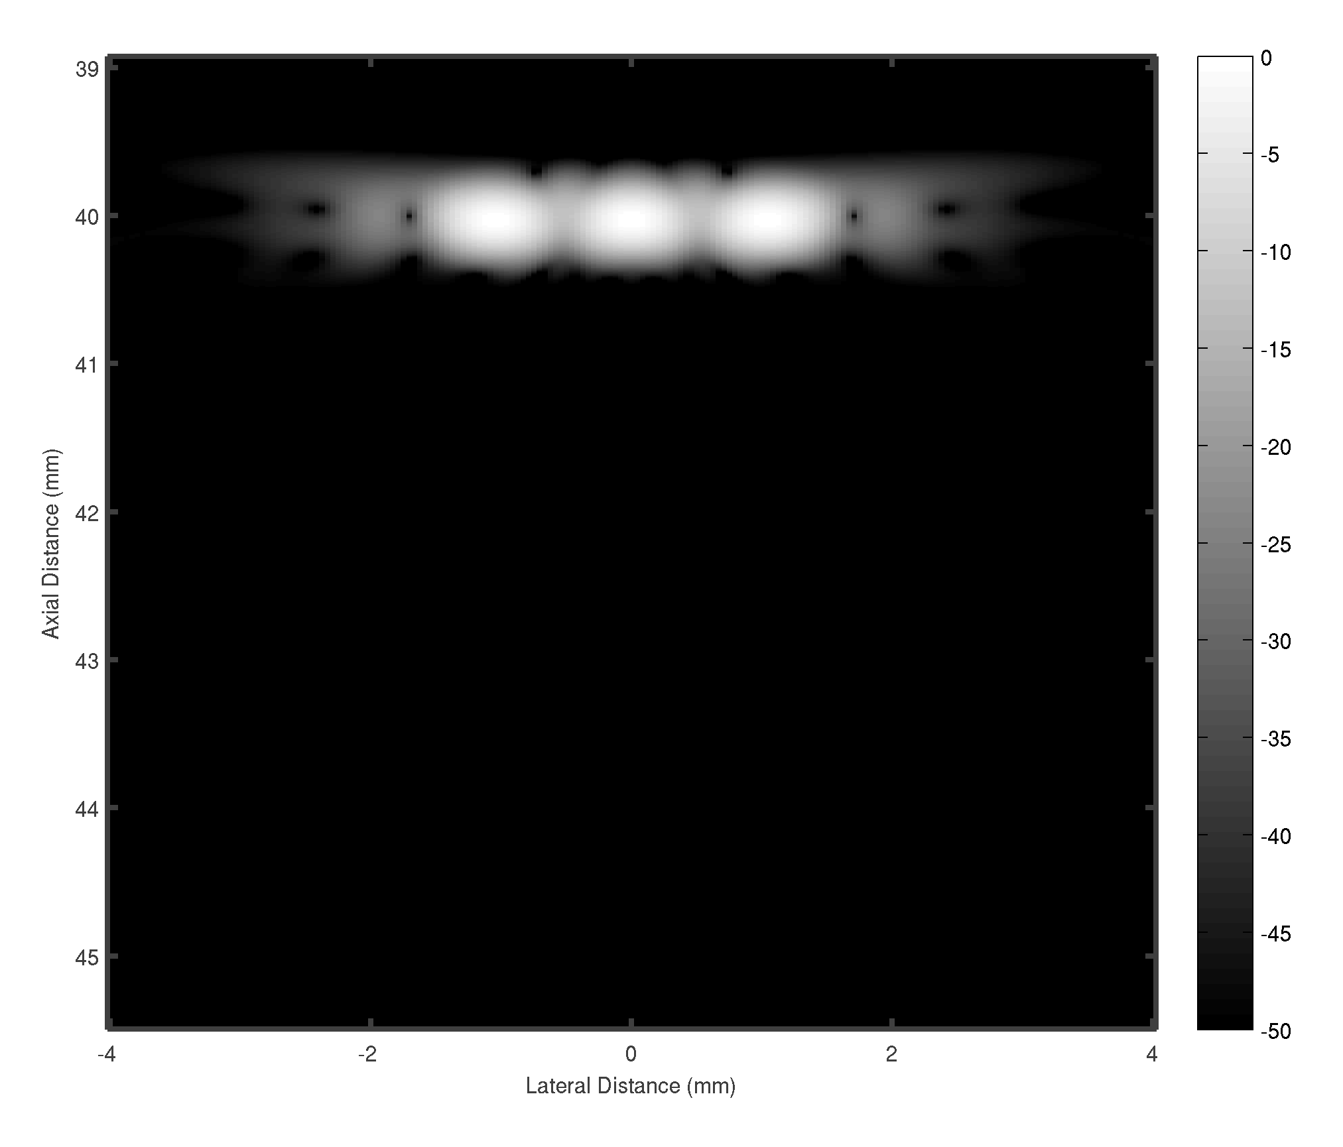
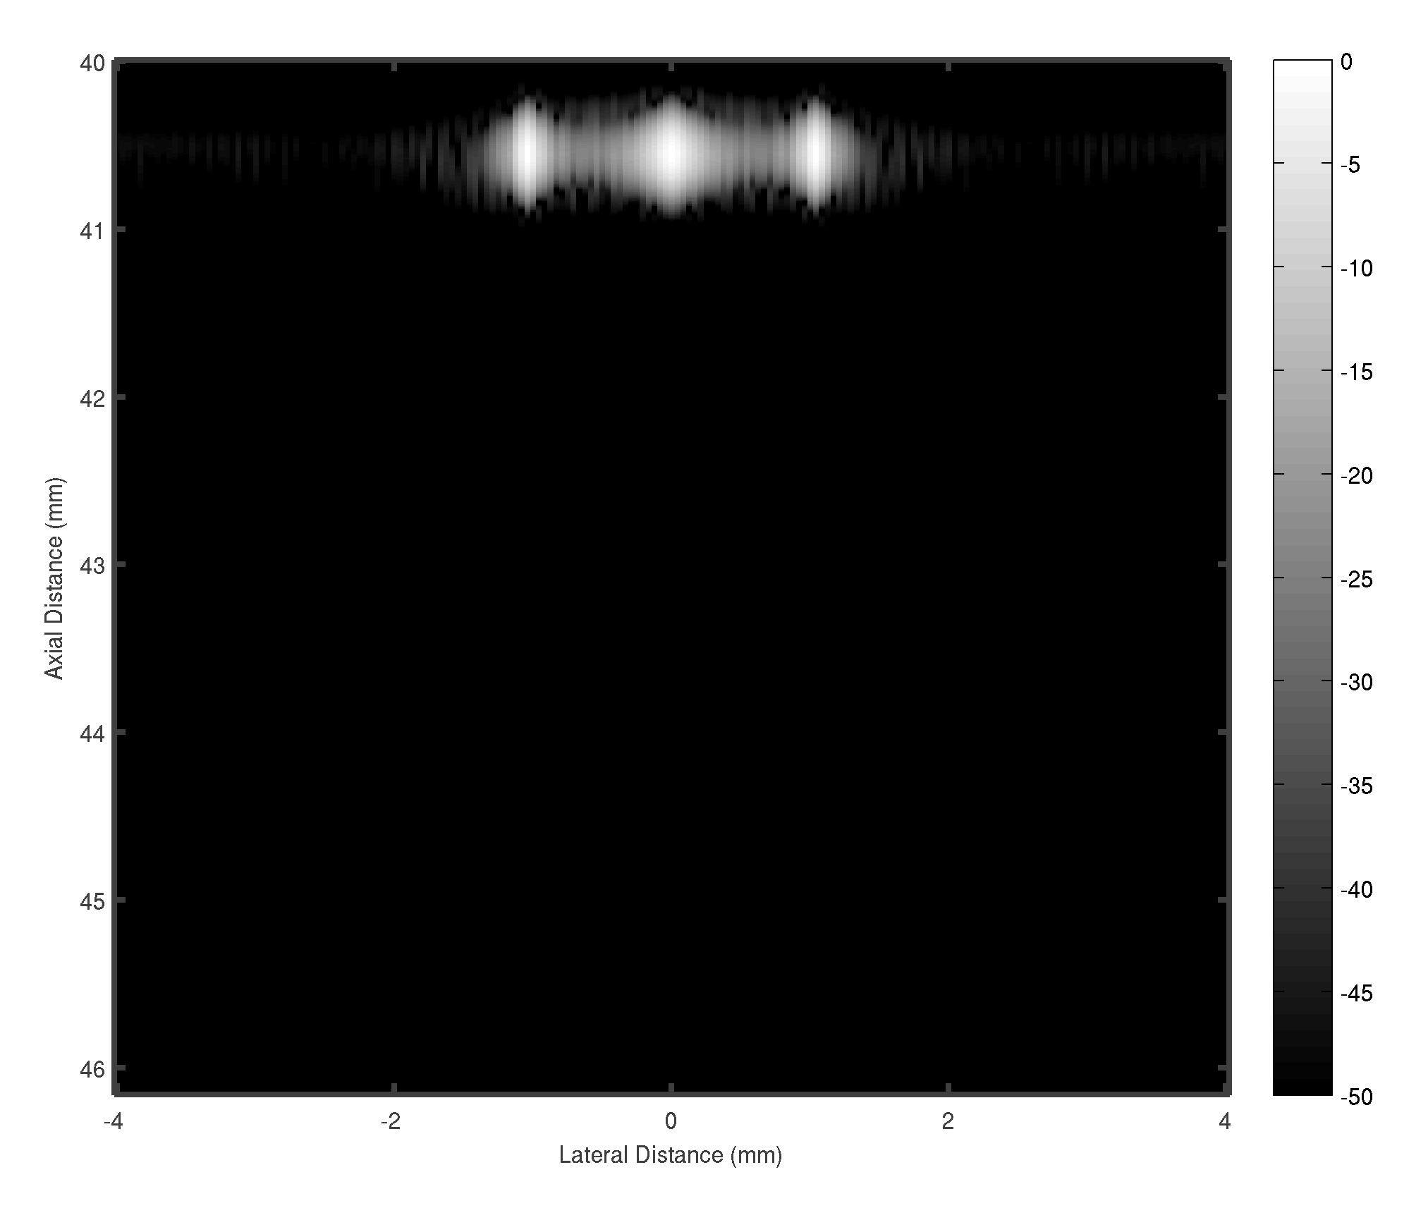
Beamformed responses of three point targets spaced 1 mm apart
 | Dip | FWHM
DS | -4 dB | N/A
MVDR | - 23 dB | 0.2 mm
Linescan | -12 dB | 0.6 mm

Slide 12
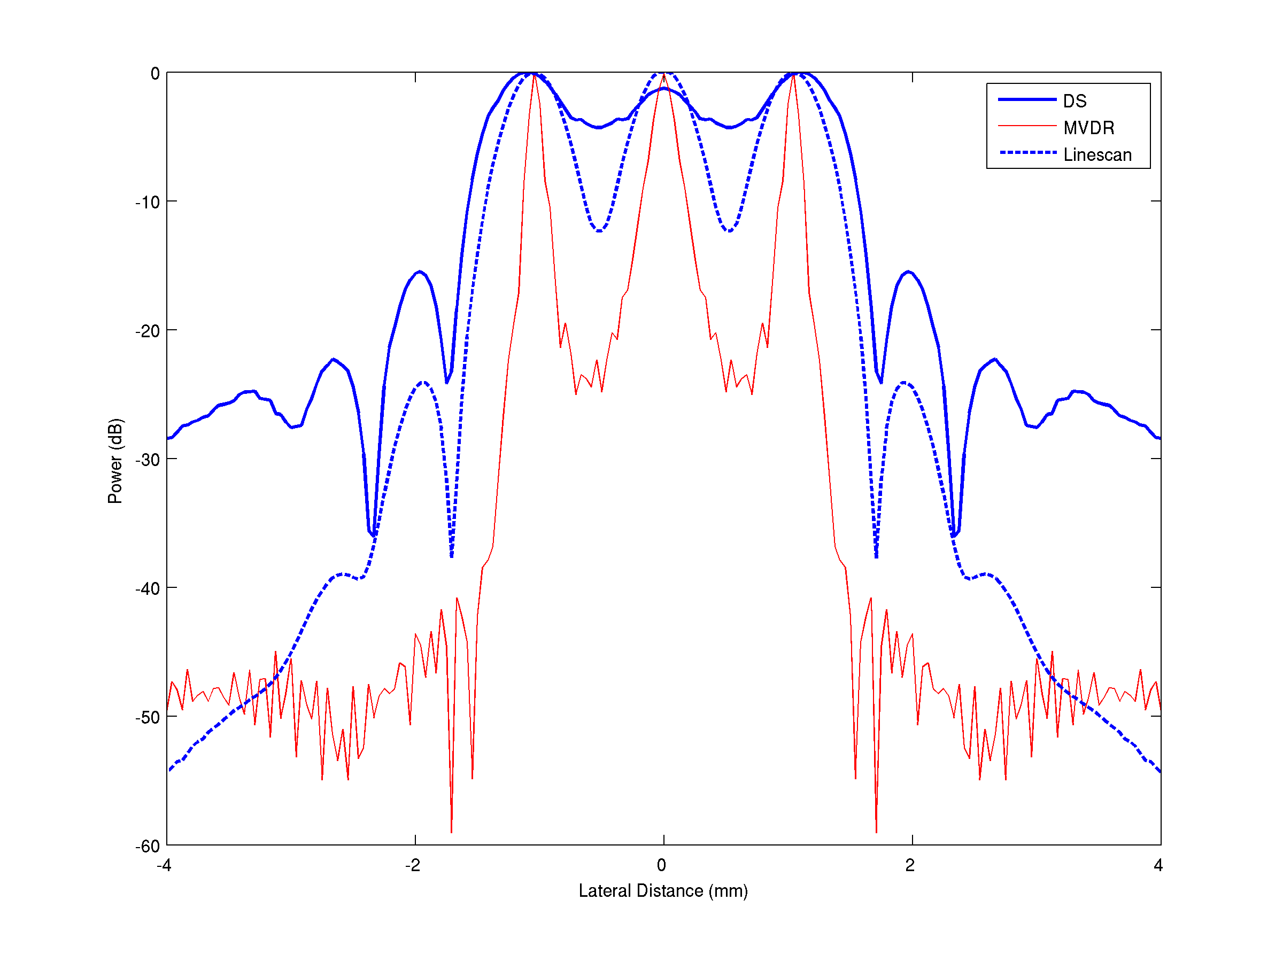
Three point targets spaced 1 mm apart: lateral profiles

Slide 13
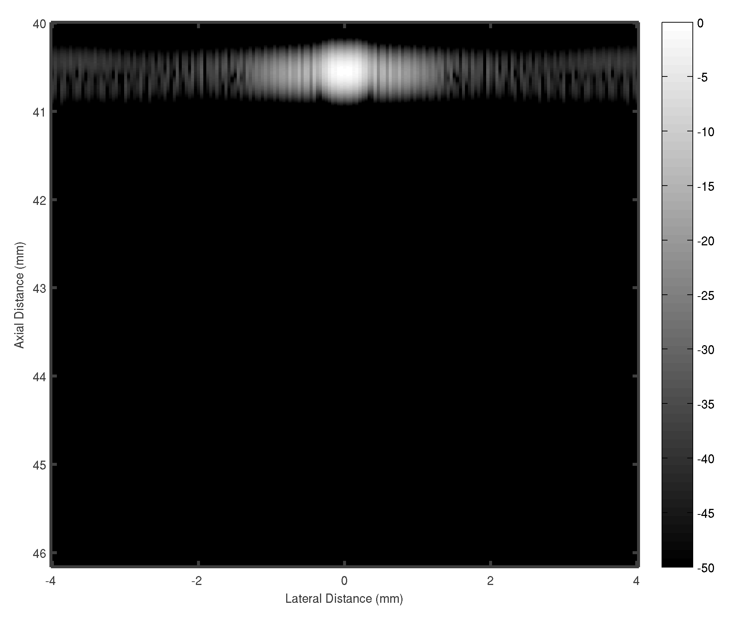


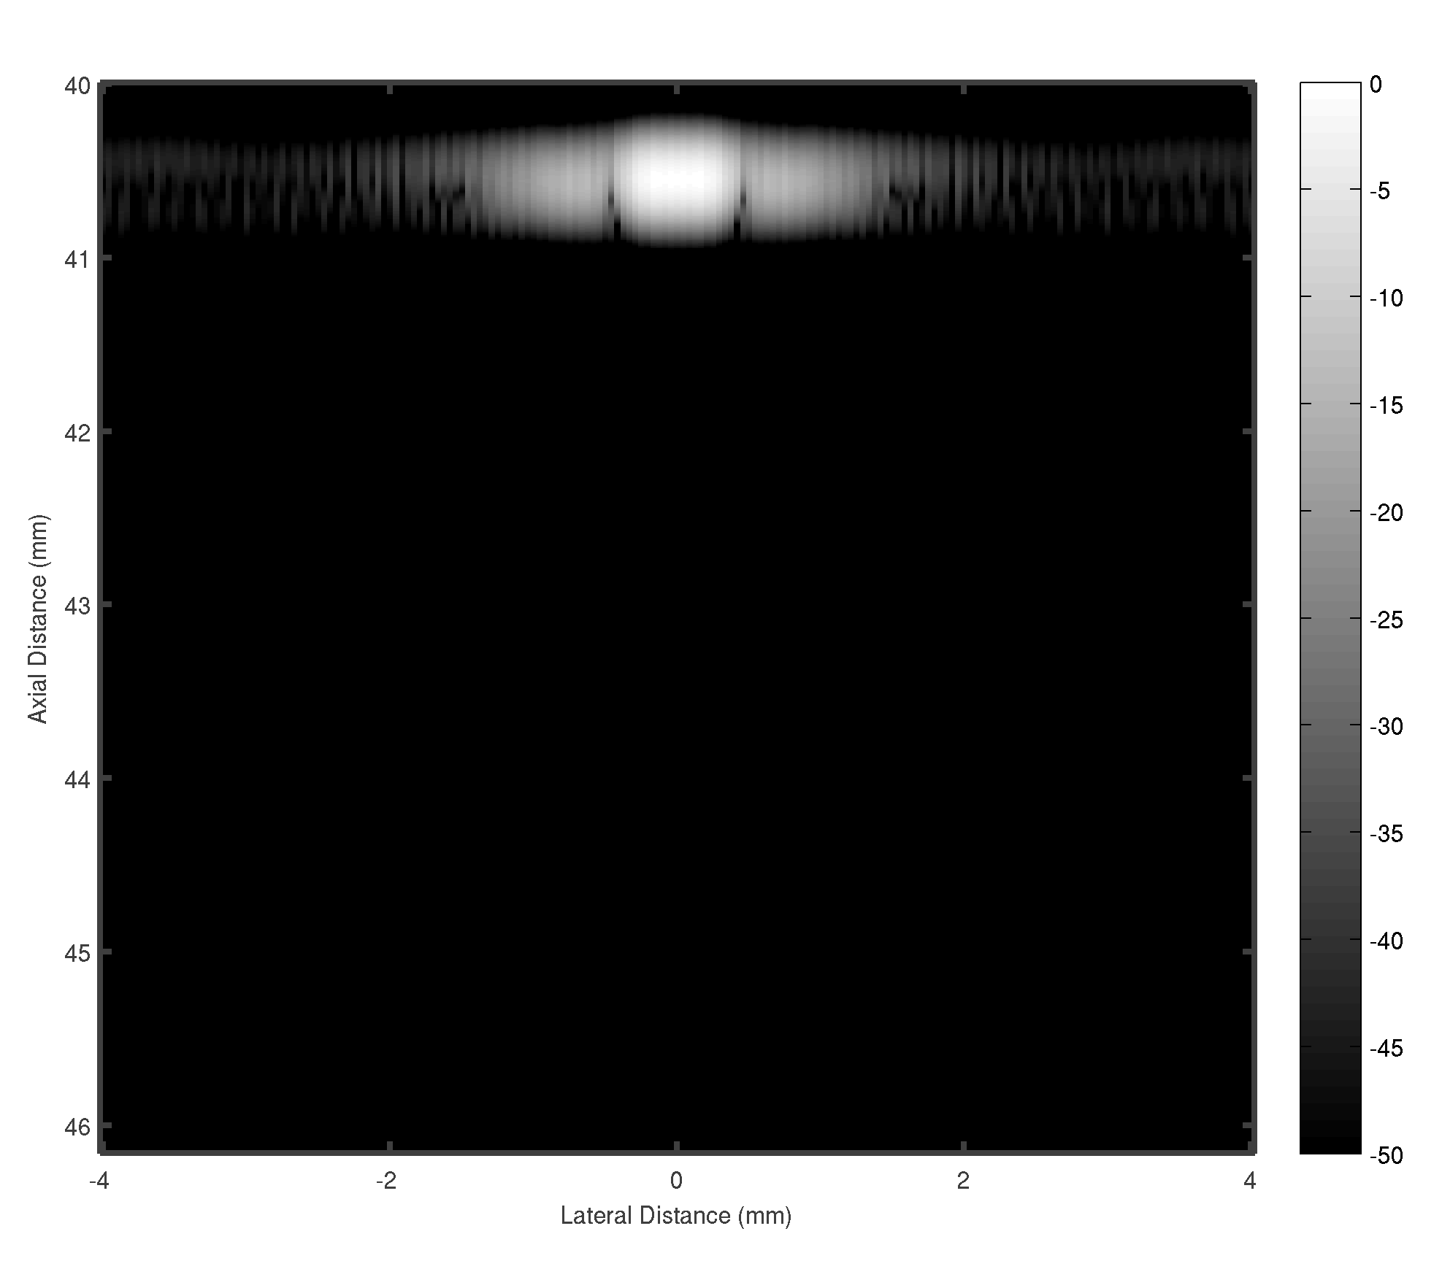
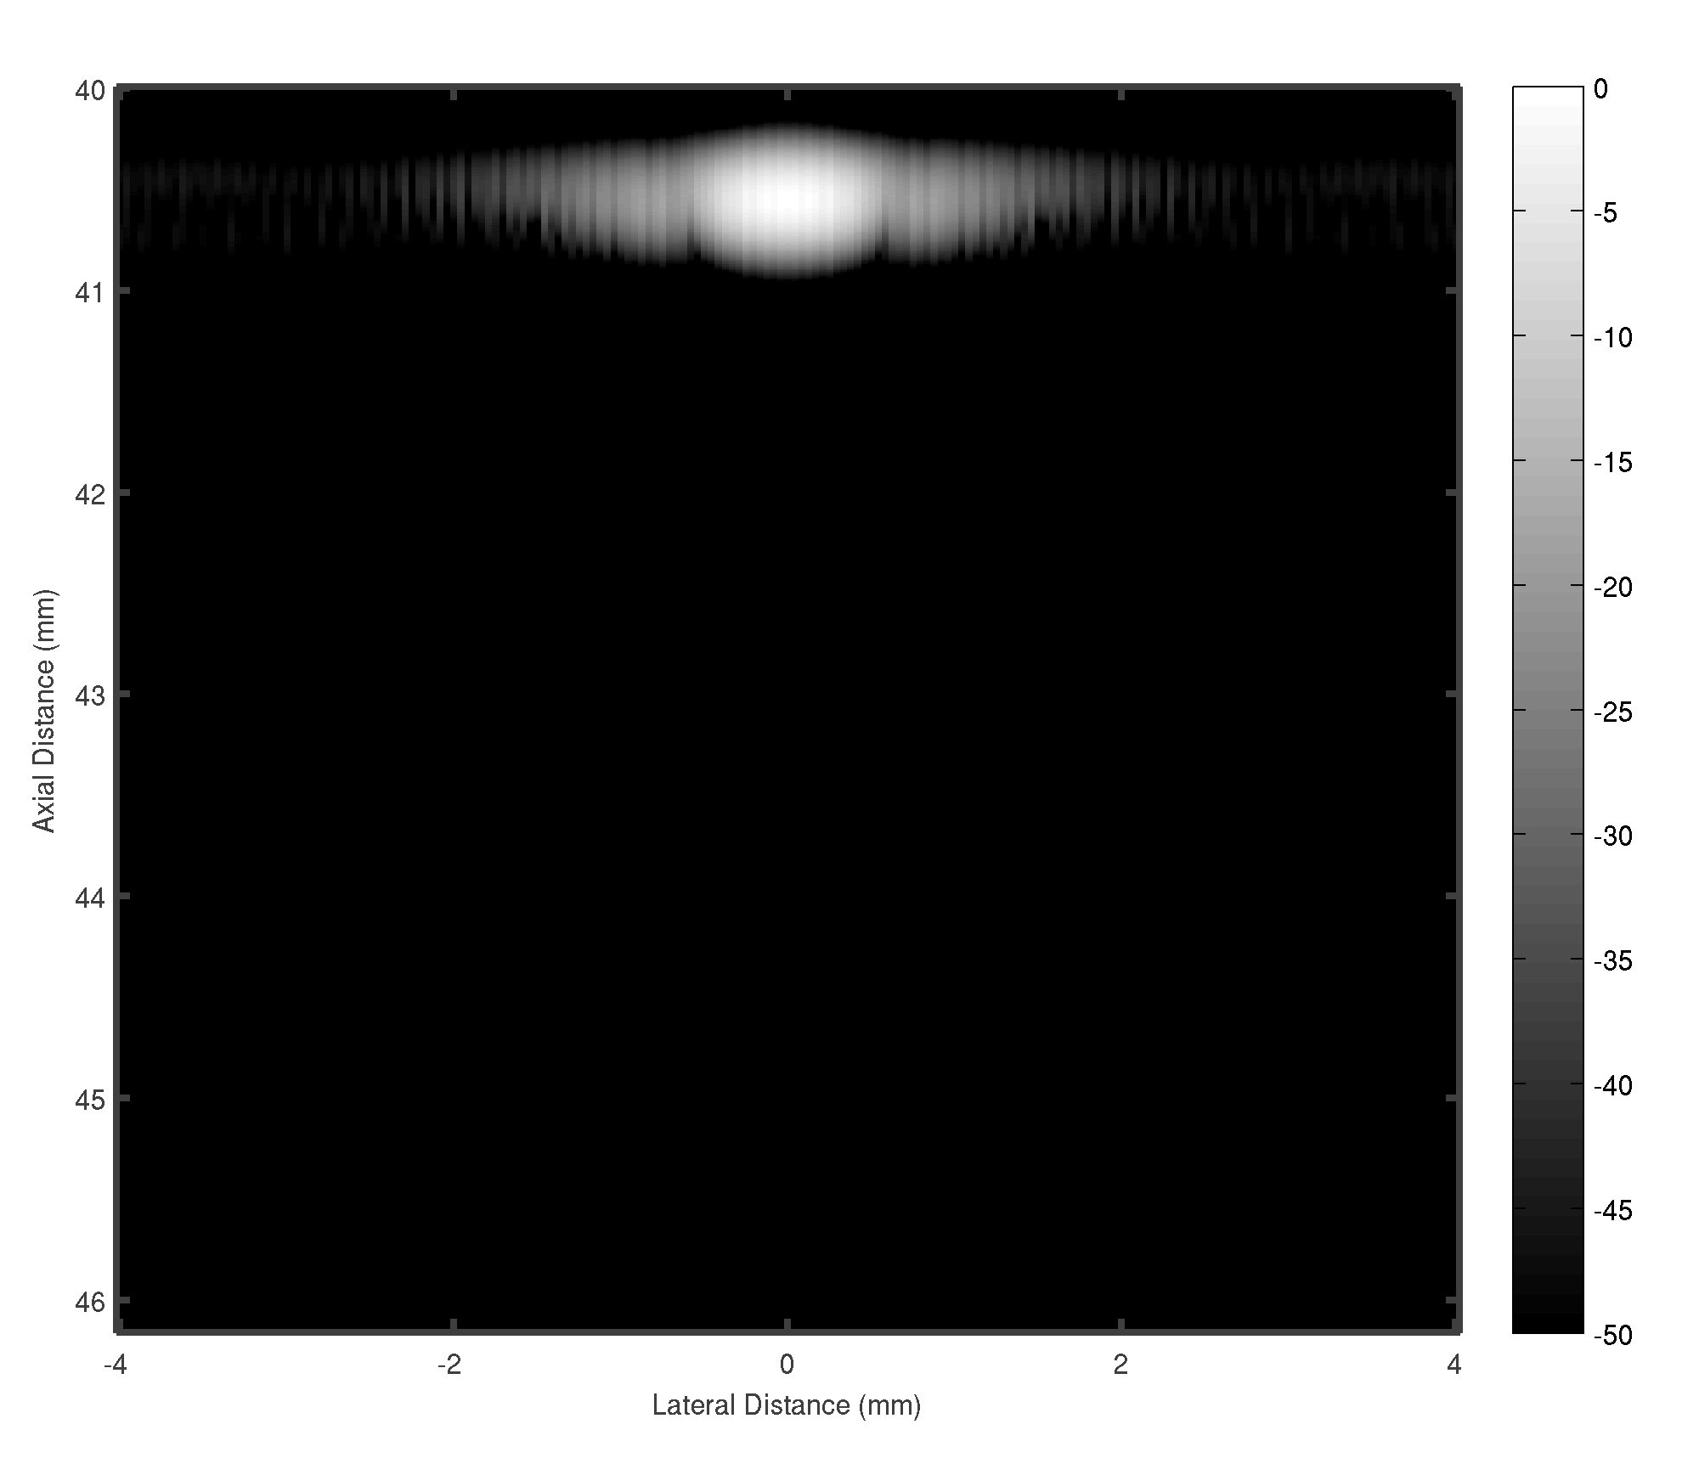


Sensitivity to sound speed errors: beamformed responses

Slide 14
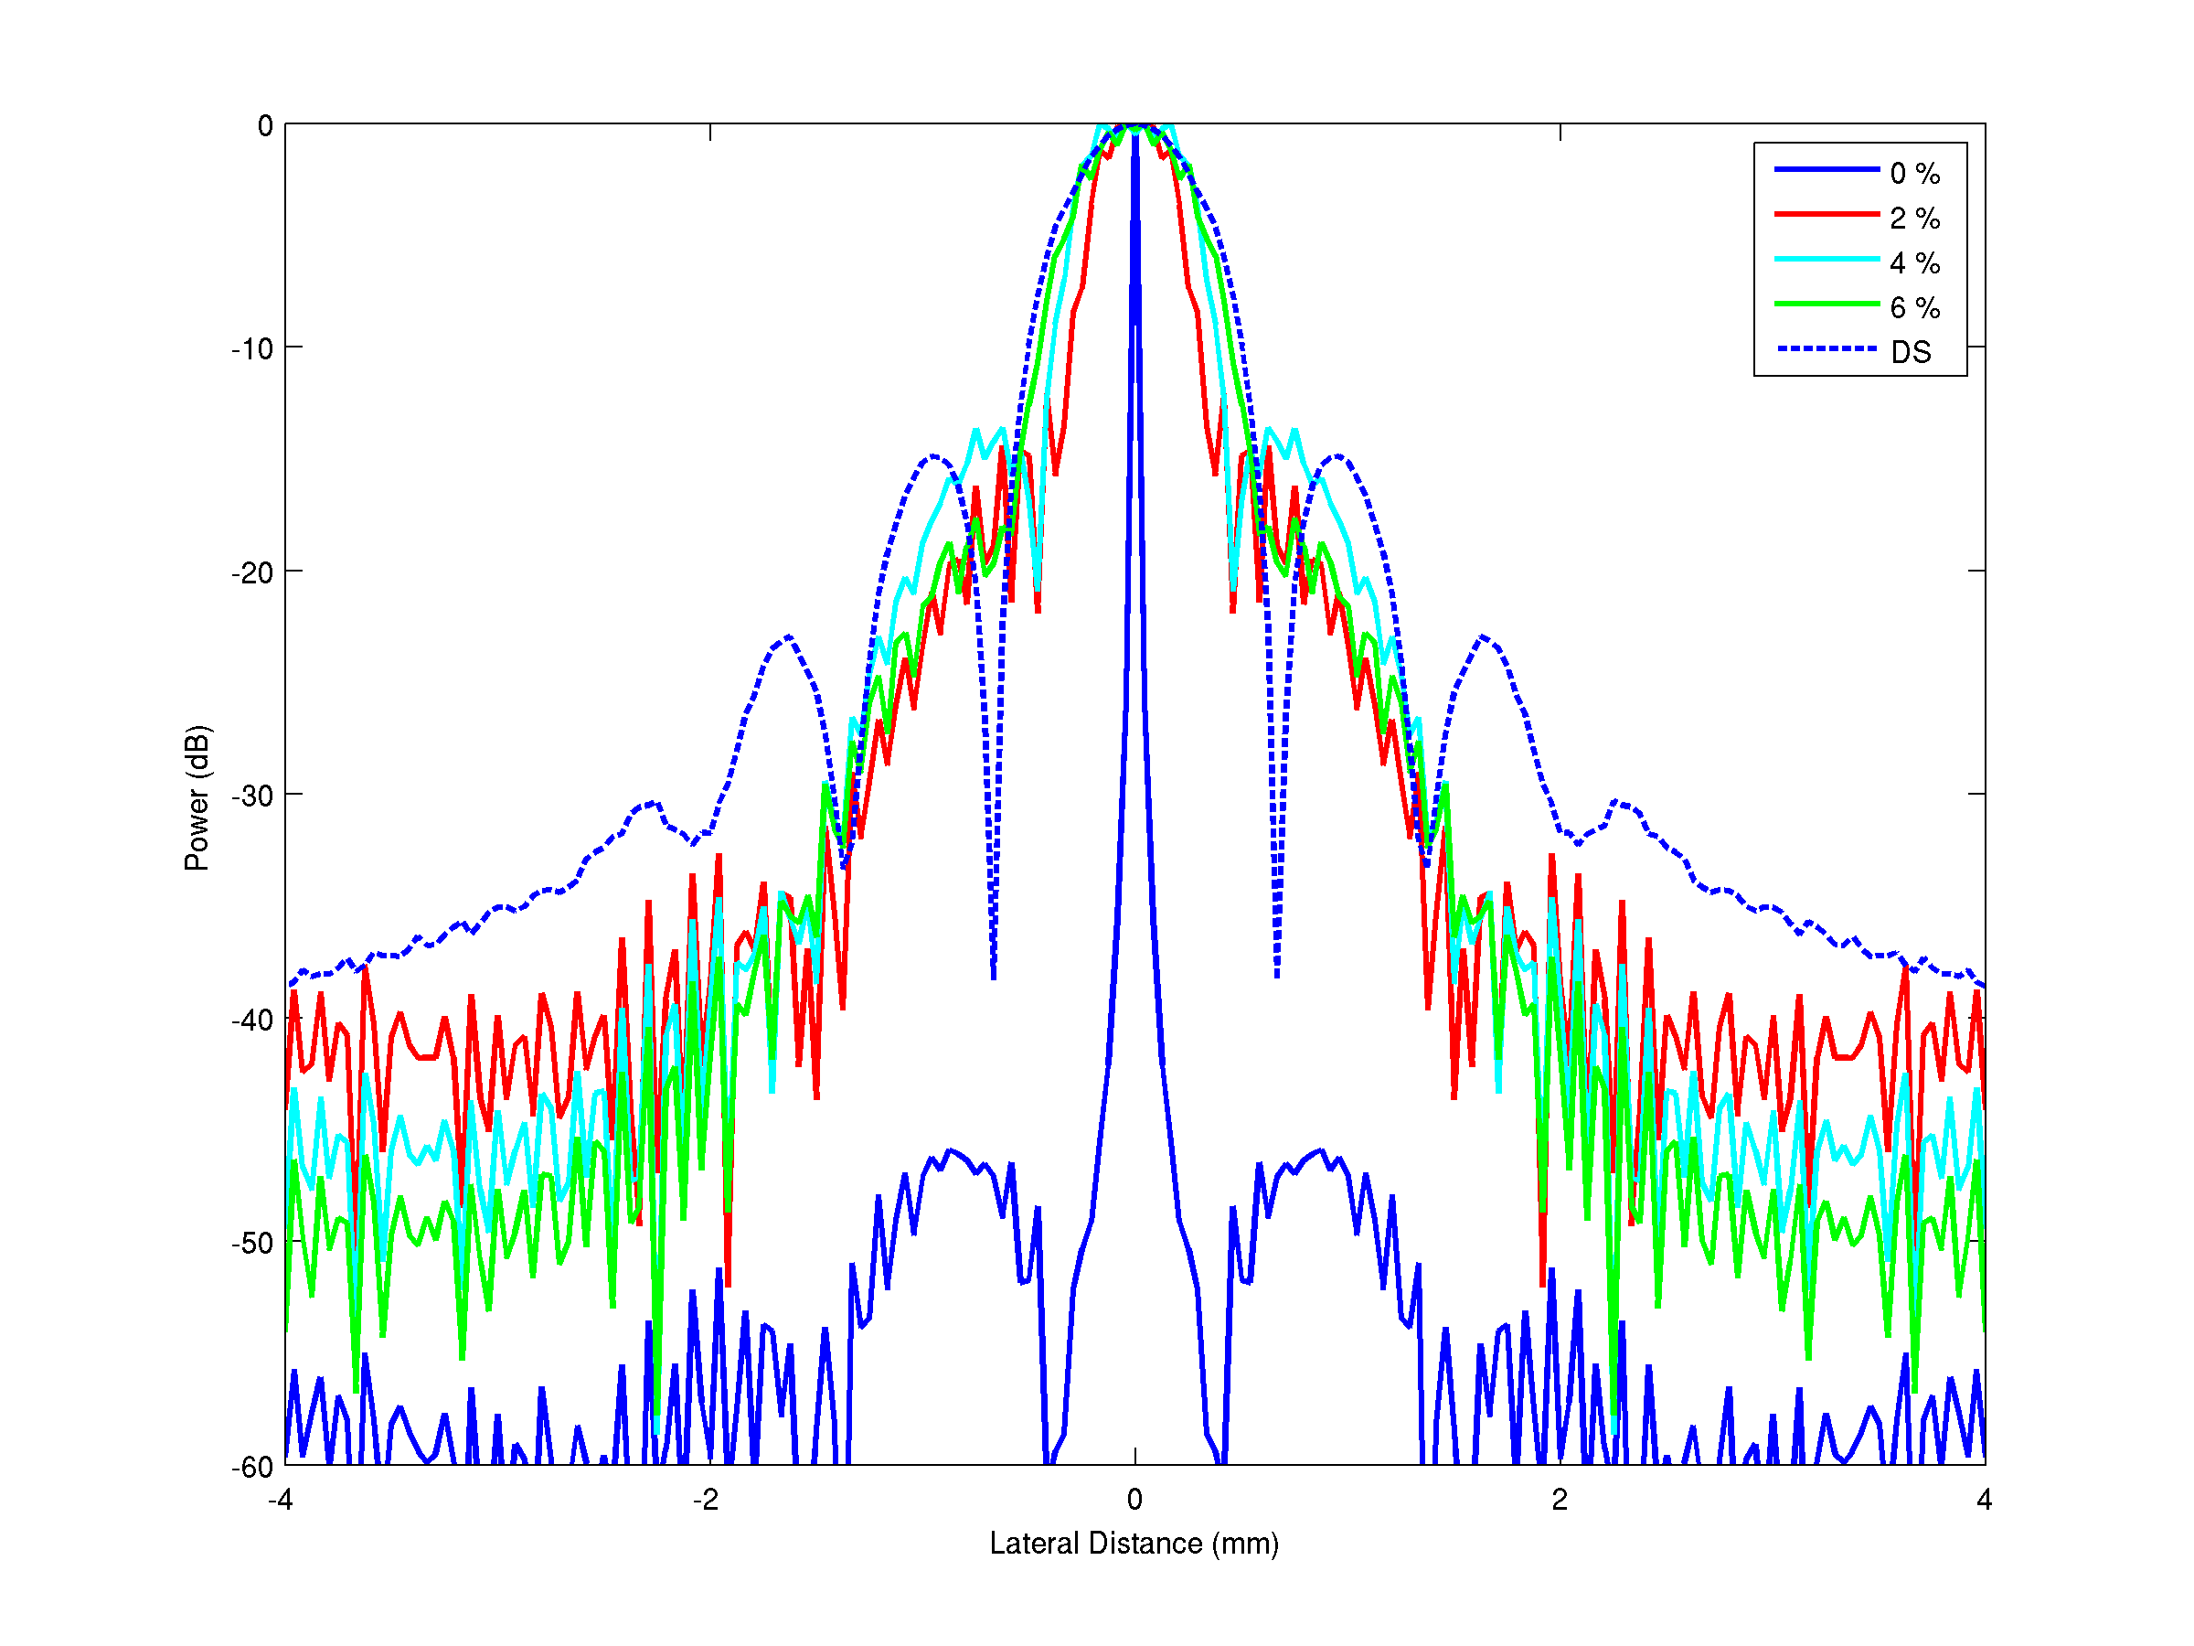
Sensitivity to sound-speed errors: lateral profiles

Slide 15
Sidelobes and resolution at the depth of maximum peak
 | Error | PSL | FWHM
DS | 0% | -15 dB | 0.82 mm
MVDR | 0% | - 46 dB | 0.06 mm
 | 2% | -18 dB | 0.40 mm
 | 4% | -16 dB | 0.55 mm
 | 6% | -15% | 0.64 mm

