Slide 1
Simulating Crowds in Real-Time
with Agent-Based Modelling
and a Particle Filter
Dr. Kevin Minors
GISRUK 2019

Slide 2
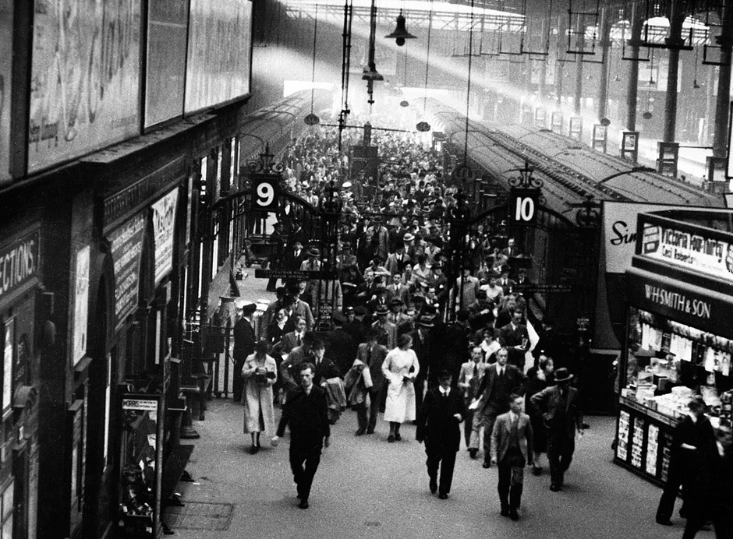
Motivation

Slide 3
Motivation

Slide 4
The Problem
Reality
Time

Slide 5
The Problem
Measurement
Prediction

Slide 6
The Problem
Measurement
Estimate
Prediction

Slide 7
A Solution – Particle Filter
Measurement
Predict
Particles

Slide 8
A Solution – Particle Filter
Reweight

Slide 9
A Solution – Particle Filter
Resample

Slide 10
A Solution – Particle Filter
Estimate

Slide 11
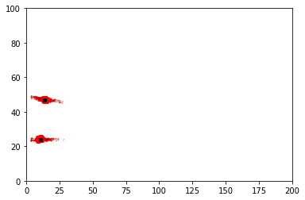
Example

Slide 12
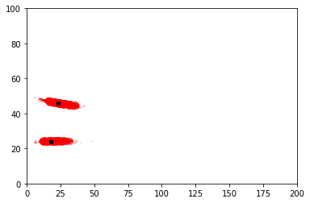
Example

Slide 13
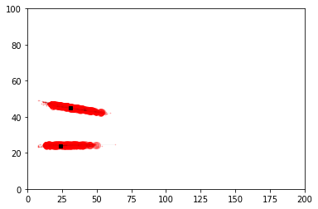
Example

Slide 14
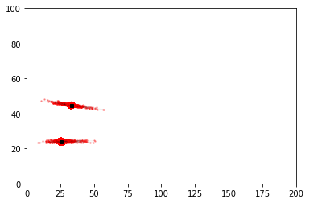
Example

Slide 15
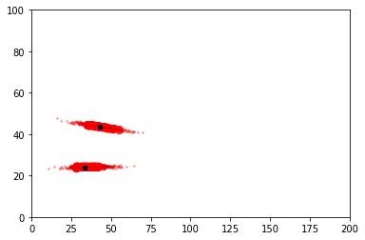
Example

Slide 16
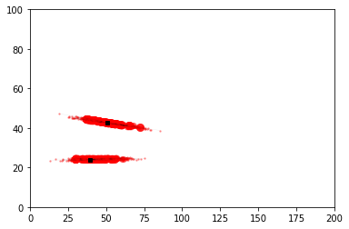
Example

Slide 17
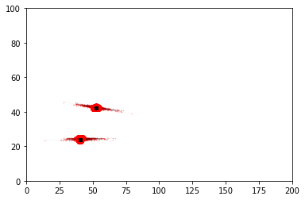
Example

Slide 18
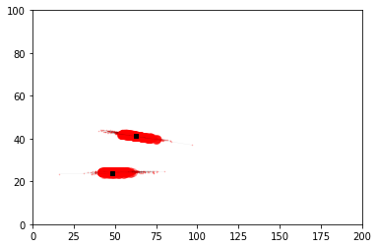
Example

Slide 19
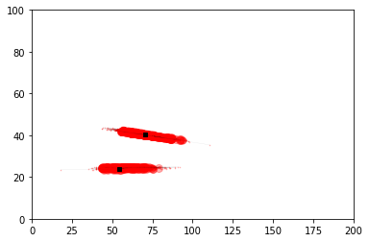
Example

Slide 20
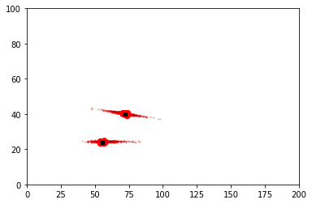
Example

Slide 21
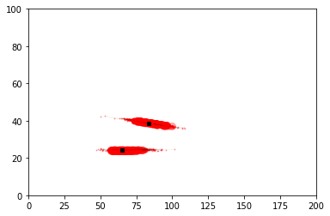
Example

Slide 22
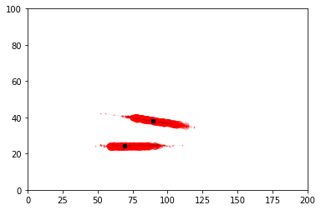
Example

Slide 23
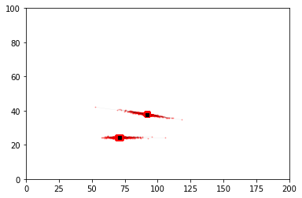
Example

Slide 24
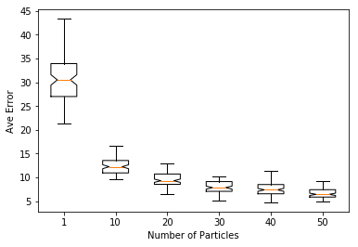
Results

Slide 25
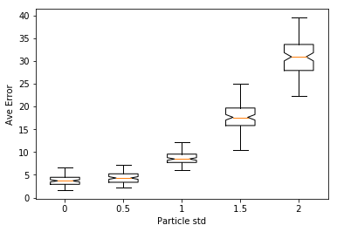
Results

Slide 26
Results
Particles
Error
Agents

Slide 27
Summary

Slide 28
Summary

Slide 29
Simulating Crowds in Real-Time
with Agent-Based Modelling
and a Particle Filter
Dr. Kevin Minors
GISRUK 2019

