Slide 1
Robert Clay
Understanding and Quantifying Uncertainty in Agent-Based Models for Smart City Forecasts
Notes:
Name
title

Slide 2
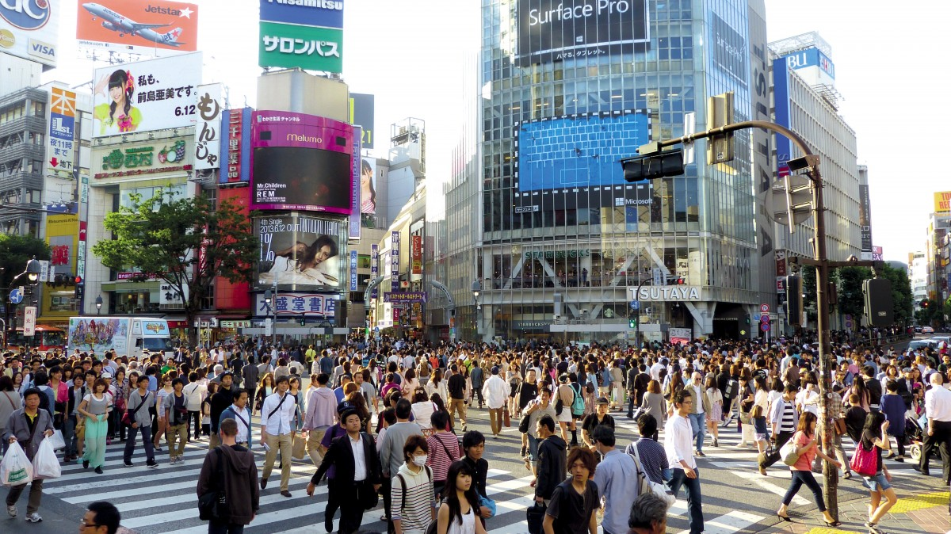
Notes:
Smart cities definition
Most of current scs focus on Macro scale looking at crowd aggregates, large scale topographies and long term time scales.
Want to look at micro scale individuals/small groups as well as small areas such as corridors

Slide 3
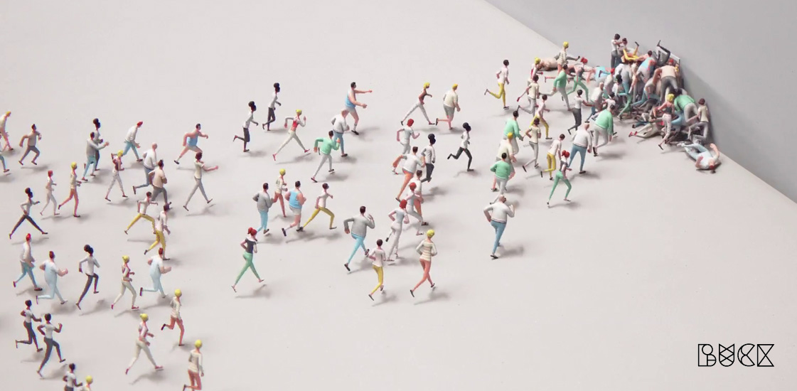
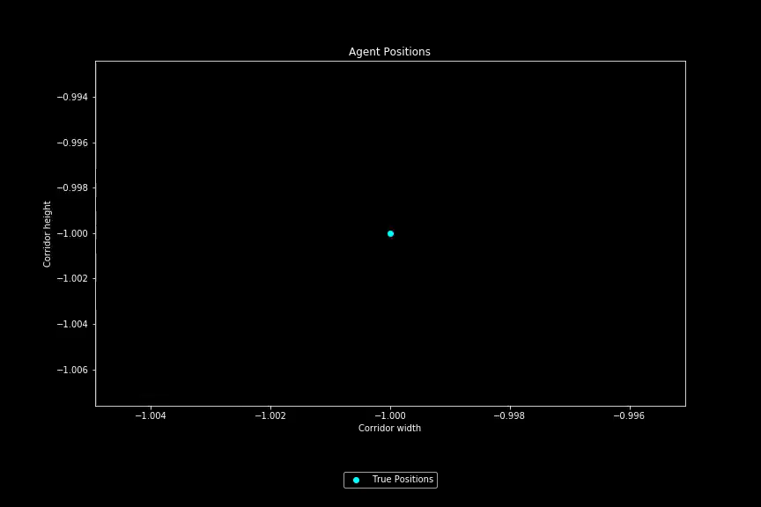
What are Agent-Based Models?
Notes:
Do this using an abm.
An ensemble of submodels for each person and their interactions.
Allows analysis for small scale

Slide 4
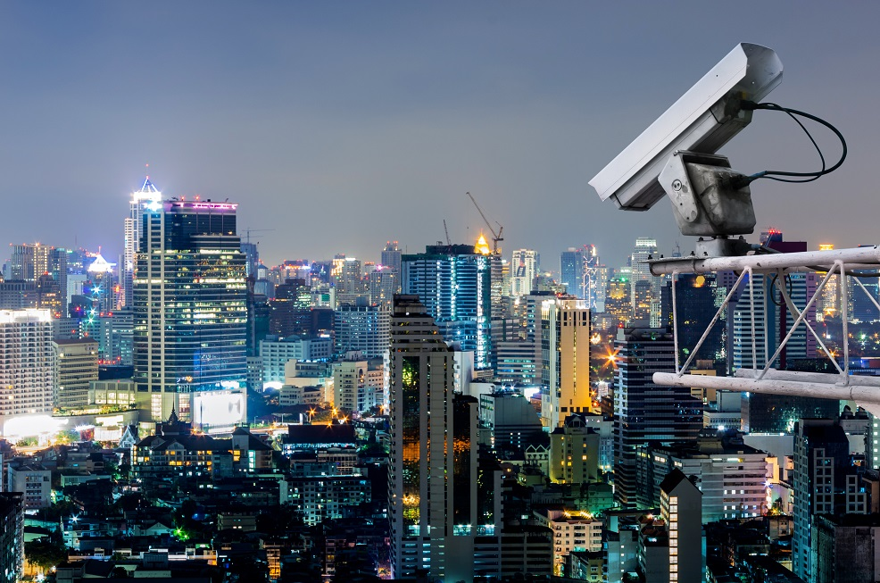
Smart Cities Data is Unreliable.
Notes:
One major stumbling block in SCs is uncertainty.
Much of the data gathered is unreliable, partial, or aggregated.
-cameras partial unreliable
-Footfall counters - aggregated
-gps unreliable/partial e.g. underground

Slide 5
Data Assimilation
t
t+1

Slide 6
Uncertainty
Particle Filter
?
?
t
t+1
Notes:
One method of measuring uncertainty is pf. Given initial “ground truth”, repeat stepping provides varied results with noisy sensors.
Discard unsuitable results based on some criteria such as distance from “truth”
PF can require a large amount of points which can suffer under computationally intensive points
Rather than this random sampling of points can we be more efficient in the sampling

Slide 7
Uncertainty
Unscented Kalman Filter
?
?
t
t+1
Notes:
Ukf aims to achieve this. Instead of repeated stochastic measurements only a fixed number of measurements are made.
These measurements are taken such that they represent the uncertainty in the state at time t
All these agents are then stepped forwards to t+1.
Due to clever math these agents also represent uncertainty in the state at time t+1
Efficient,high dimensional, non-linear and tracks each agent.

Slide 8
50 Agents over a 200x100m Corridor
Results
Explain parameters 50 agents 0.1/0.8 observed
generally

Slide 9
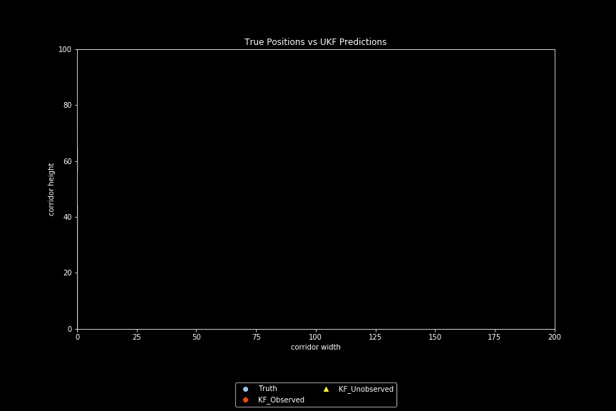
Predictions with 40 of 50 Agents Observed

Slide 10

Predictions with 5 of 50 Agents Observed

Slide 11

Predictions with 25 of 50 Agents Observed

Slide 12
What’s Next?
Notes:
Whats next
Run experiments to test full efficacy of UKF to include in a paper
Begin adoption of “realism”. Between partials, aggregates, PADs , flows and sensor fusion.
Cameras, wifi sensors, footfall counters
Further parameters including agent,speed, crowding measures etc.

