Slide 1
Robert Clay
Quantifying Uncertainty in Agent-Based Models for Smart City Forecasts
Prof. Nick Malleson, Dr. Minh Le Kieu, and Dr. Jon Ward
https://github.com/Urban-Analytics/dust
Notes:
Name
Title
supervisors

Slide 2

Smart Cities data are unreliable.
Smart Cities data are highly aggregated.
Notes:
One major stumbling block in SCs is uncertainty.
Much of the data gathered is unreliable, partial, or aggregated.
-cameras partial unreliable
-Footfall counters - aggregated
-gps unreliable/partial e.g. underground
Wish to quantify uncertainty to identify a bad camera and incorporate into prediction

Slide 3
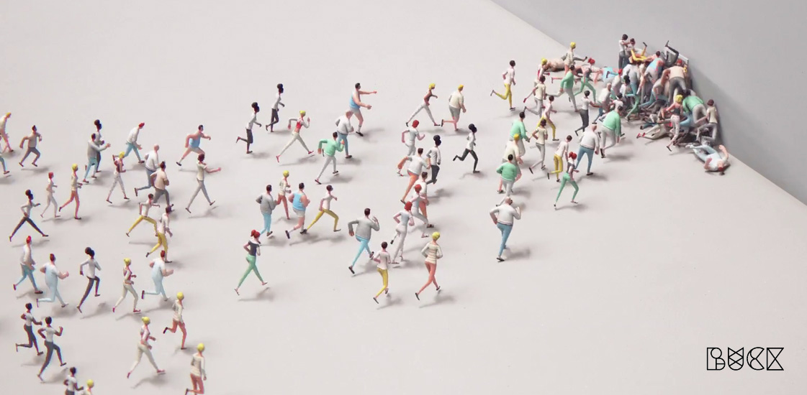
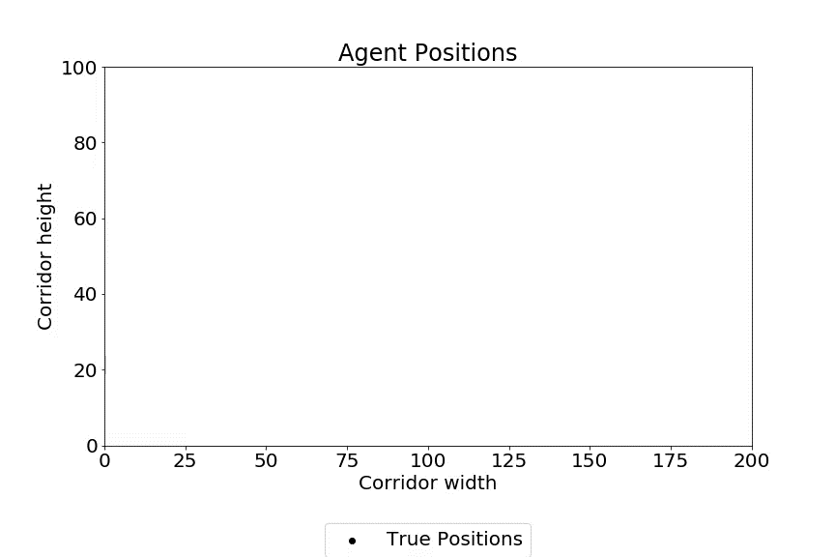
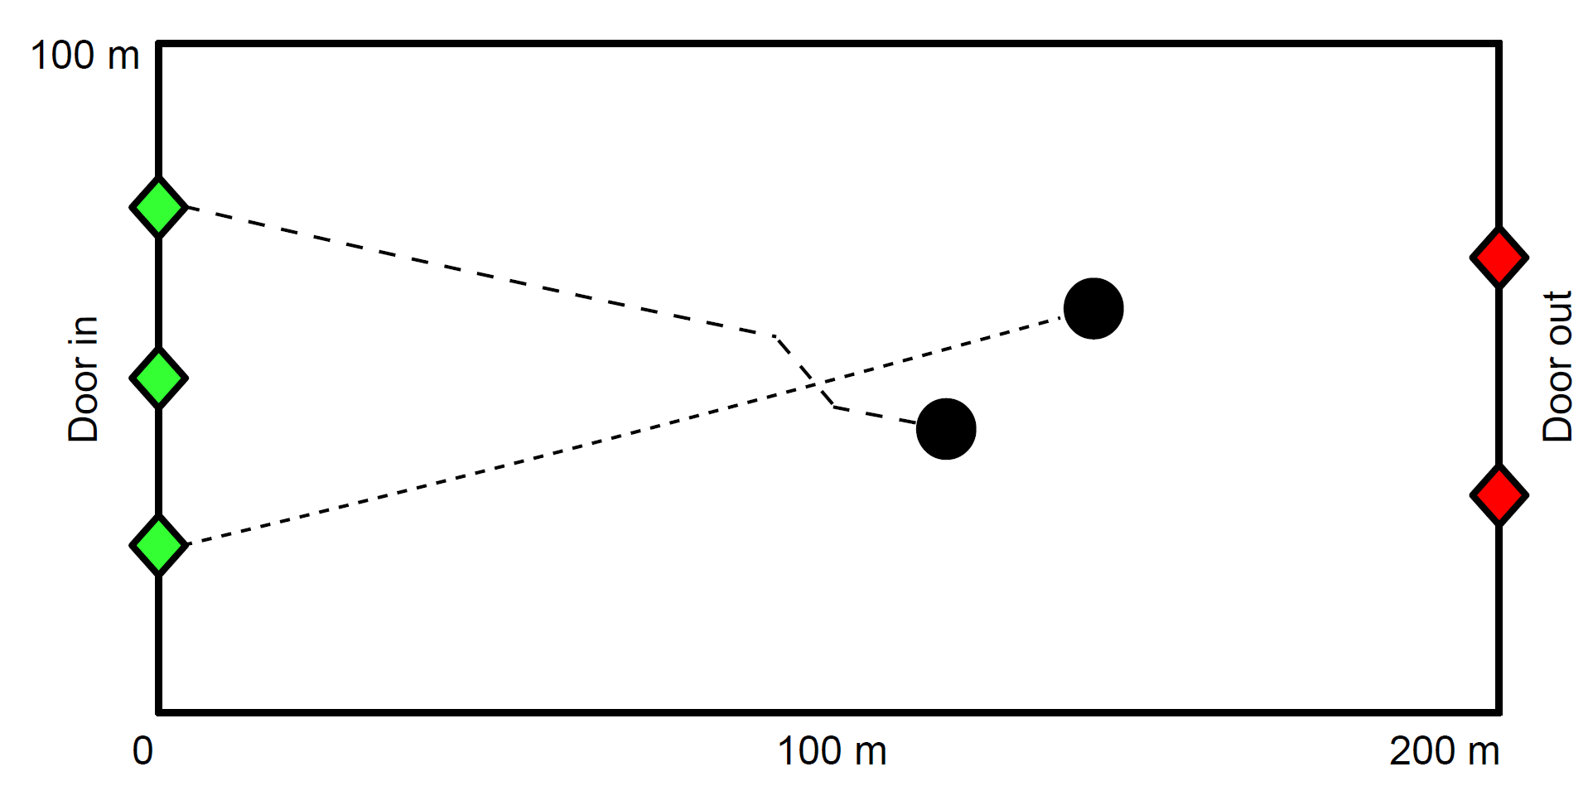
What are Agent-Based Models?
Notes:
Abm explaination
Stationsim explaination
Aim to go from noisy partial data into smooth consistent paths
Do this using data assimilation

Slide 4
Data Assimilation
Observed
Assimilated
Predicted
Notes:
Da explaination
Idea of blending naïve prediction with noisy observations into more smooth consistent paths

Slide 5
Monte Carlo Data Assimilation
- Weak Constraints (flexible)
Robust and accurate
Computationally expensive
Notes:
ABMS seen lots of DA applicton
SS no exception
We have used pf and enkf to great effect already
These methods are accurate, robust, and flexible (work with a lot of data)
However their computational expense fuels motivation for more efficient methods

Slide 6
Unscented Kalman Filter
- Computationally efficient
Strong Constraints (Inflexible)
Can give poor accuracy
Notes:
UKF aims to fill this gap
Main benefit is its highly efficient
Want to see if the how effective UKF is using uncertain, aggregated data.

Slide 7
Notes:
Go back to data
Wish to aggregate already noisy/partial data to induce further uncertainty

Slide 8
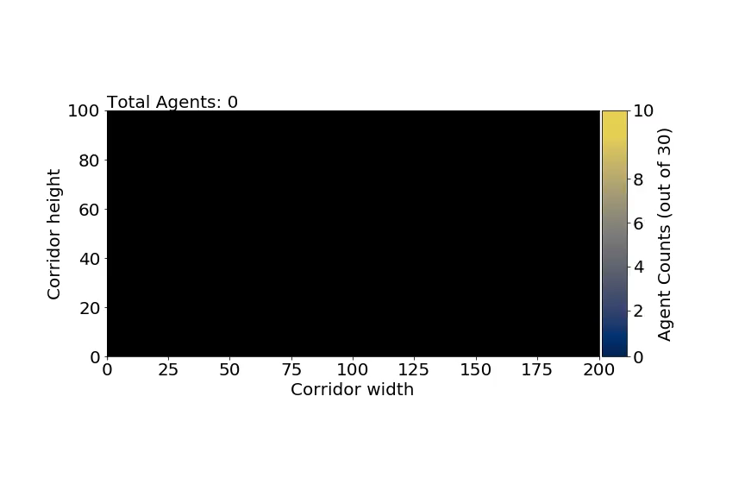
Notes:
Aggregate data into square grid
This is high uncertainty data designed to stress UKF

Slide 9
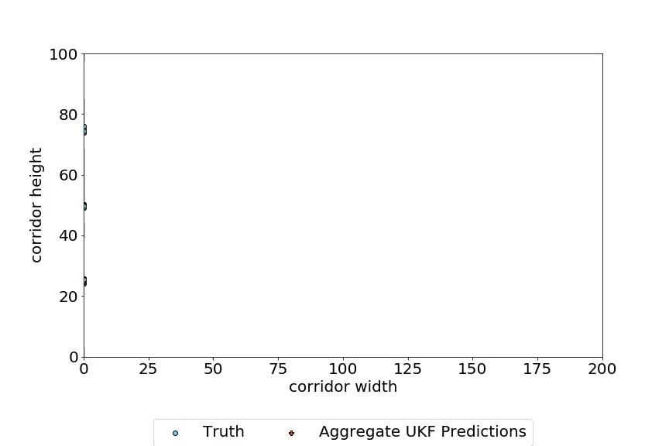
Notes:
Ukf fitted to aggregate data looks like this
Have true positions in blue
Ukf predictions in orange
Snap shot

Slide 10
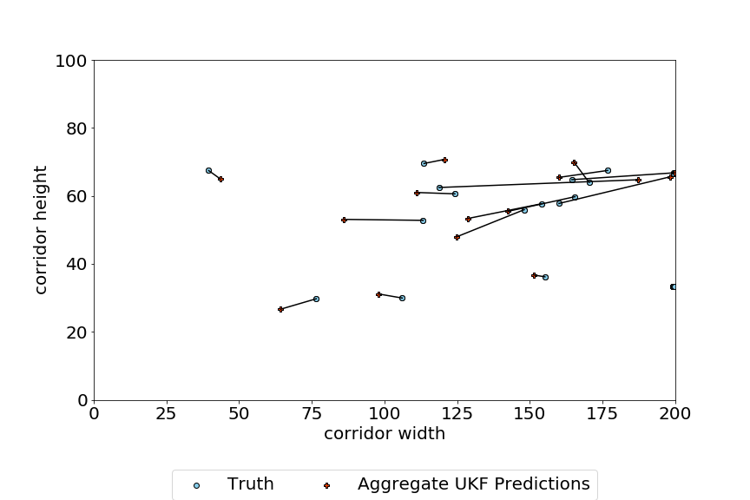
Notes:
Lots of variance in distance between predicted and observed
Wish to test efficacy of UKF by measuring these distances between predicted and true
Do this using simple geometry
Measure length of tether for each agent over time.
Take mean length of tether for each agent over time.
Produce a sample of 30 means (one for each agent) and plot in a histogram

Slide 11
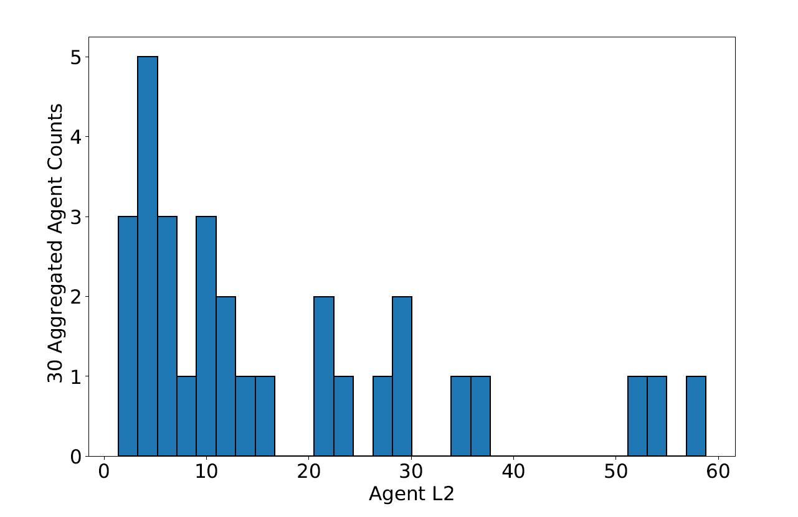
Hist and l2s again
Counts
Agent Euclidean Distance
Notes:
Gives an idea of how effective UKF is.
Majority of agents with low error (<10) but very long tails suggesting a lot of agents struggle.
This can be due to many reasons agents get stuck/ agents sit on vertical border of two squares

Slide 12
Thank you for you time.
https://github.com/Urban-Analytics/dust

