Slide 1
PCA + SVD

Slide 2
Motivation – Shape Matching
There are tagged feature points in both sets that are matched by the user
What is the best transformation that aligns the unicorn with the lion?

Slide 3
Motivation – Shape Matching
Regard the shapes as sets of points and try to “match” these sets
using a linear transformation
The above is not a good alignment….

Slide 4
Motivation – Shape Matching
Alignment by translation or rotation
The structure stays “rigid” under these two transformations
Called rigid-body or isometric (distance-preserving) transformations
Mathematically, they are represented as matrix/vector operations
Before alignment
After alignment

Slide 5
Transformation Math
Translation
Vector addition:
Rotation
Matrix product:
y
x

Slide 6
Transformation Math
Eigenvectors and eigenvalues
Let M be a square matrix, v is an eigenvector and λ is an eigenvalue if:
If M represents a rotation (i.e., orthonormal), the rotation axis is an eigenvector whose eigenvalue is 1.
There are at most m distinct eigenvalues for a m by m matrix
Any scalar multiples of an eigenvector is also an eigenvector (with the same eigenvalue).
Eigenvector of the
rotation transformation
O

Slide 7
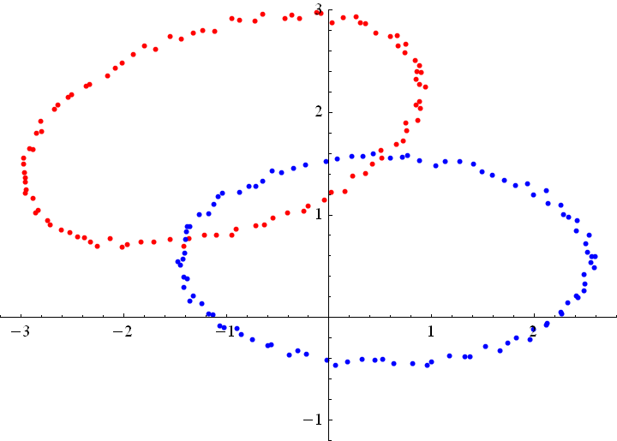
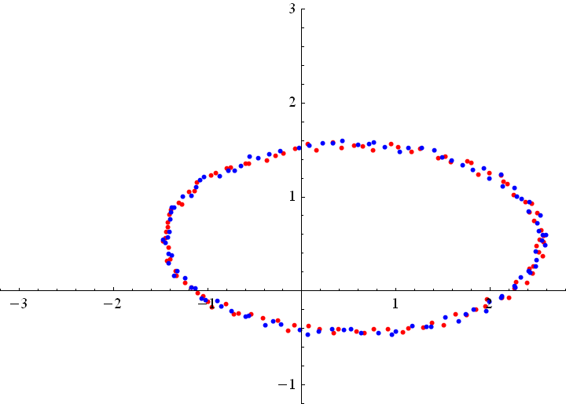
Alignment
Input: two models represented as point sets
Source and target
Output: locations of the translated and rotated source points
Source
Target

Slide 8
Alignment
Method 1: Principal component analysis (PCA)
Aligning principal directions
Method 2: Singular value decomposition (SVD)
Optimal alignment given prior knowledge of correspondence
Method 3: Iterative closest point (ICP)
An iterative SVD algorithm that computes correspondences as it goes

Slide 9
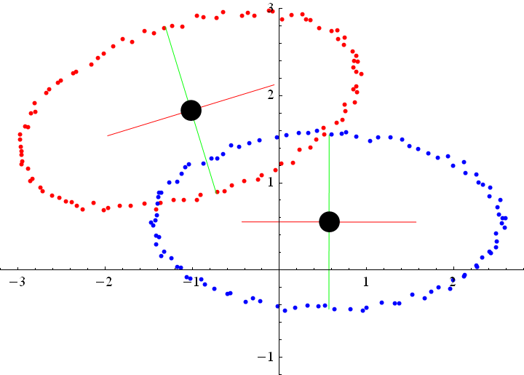
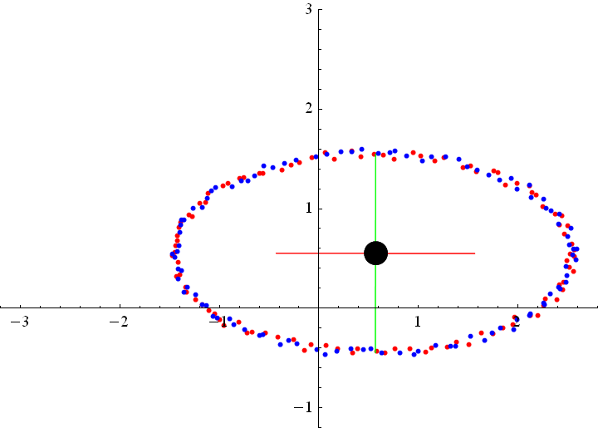
Method 1: PCA
Compute a shape-aware coordinate system for each model
Origin: Centroid of all points
Axes: Directions in which the model varies most or least
Transform the source to align its origin/axes with the target

Slide 10
Method 1: PCA
Computing axes: Principal Component Analysis (PCA)
Consider a set of points p₁,…,p_{n} with centroid location c
Construct matrix P whose i-th column is vector p_{i} – c
2D (2 by n):
3D (3 by n):
Build the covariance matrix:
2D: a 2 by 2 matrix
3D: a 3 by 3 matrix

Slide 11
Method 1: PCA
Computing axes: Principal Component Analysis (PCA)
Eigenvectors of the covariance matrix represent principal directions of shape variation (2 in 2D; 3 in 3D)
The eigenvectors are orthogonal, and have no magnitude; only directions
Eigenvalues indicate amount of variation along each eigenvector
Eigenvector with largest (smallest) eigenvalue is the direction where the model shape varies the most (least)
Eigenvector with the smallest eigenvalue
Eigenvector with the largest eigenvalue

Slide 12
Method 1: PCA Why do we look at the singular vectors? On the board…
Input: 2-d dimensional points
Output:
2nd (right) singular vector
1st (right) singular vector:
direction of maximal variance,
2nd (right) singular vector:
direction of maximal variance, after removing the projection of the data along the first singular vector.
1st (right) singular vector

Slide 13
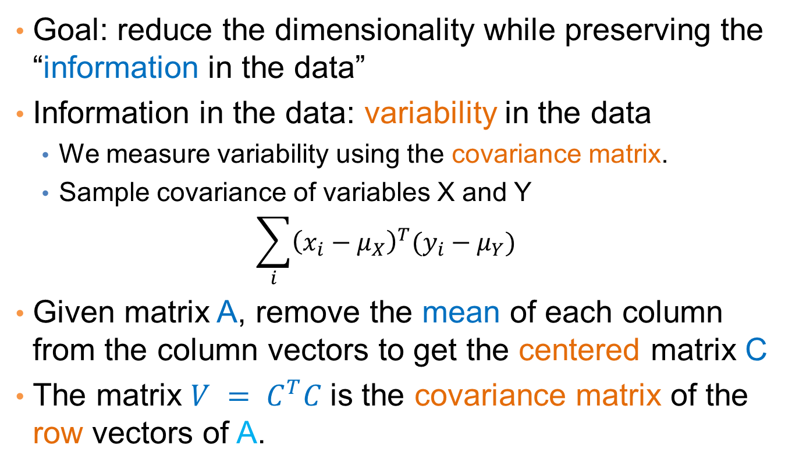
Method 1: PCA Covariance matrix
Goal: reduce the dimensionality while preserving the “information in the data”
Information in the data: variability in the data
We measure variability using the covariance matrix.
Sample covariance of variables X and Y
$$\sum_{i}{{\left(x_{i}−μ_{X}\right)}^{T}(y_{i}−μ_{Y})}$$
Given matrix A, remove the mean of each column from the column vectors to get the centered matrix C
The matrix $V = C^{T}C$is the covariance matrix of the row vectors of A.

Slide 14
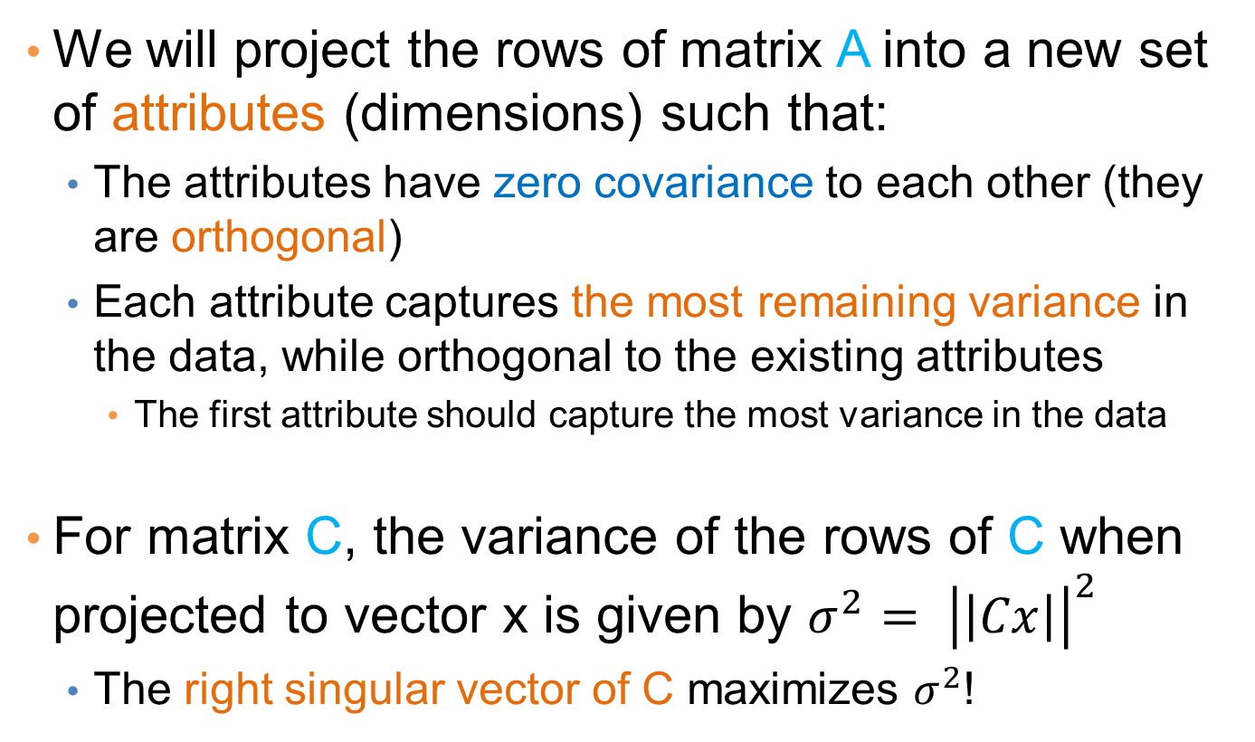
Method 1: PCA
We will project the rows of matrix A into a new set of attributes (dimensions) such that:
The attributes have zero covariance to each other (they are orthogonal)
Each attribute captures the most remaining variance in the data, while orthogonal to the existing attributes
The first attribute should capture the most variance in the data
For matrix C, the variance of the rows of C when projected to vector x is given by ${σ^{2}= \left|\left|Cx\right|\right|}^{2}$
The right singular vector of C maximizes $σ^{2}$!

Slide 15
Method 1: PCA
Input: 2-d dimensional points
Output:
2nd (right) singular vector
1st (right) singular vector:
direction of maximal variance,
2nd (right) singular vector:
direction of maximal variance, after removing the projection of the data along the first singular vector.
1st (right) singular vector

Slide 16
Method 1: PCA Singular values
2nd (right) singular vector
σ₁: measures how much of the data variance is explained by the first singular vector.
σ₂: measures how much of the data variance is explained by the second singular vector.
σ₁
1st (right) singular vector

Slide 17
Method 1: PCA Singular values tell us something about the variance
The variance in the direction of the k-th principal component is given by the corresponding singular value σ_{k}²
Singular values can be used to estimate how many components to keep
Rule of thumb: keep enough to explain 85% of the variation:

Slide 18
Method 1: PCA Another property of PCA
The chosen vectors are such that minimize the sum of square differences between the data vectors and the low-dimensional projections
1st (right) singular vector

Slide 19
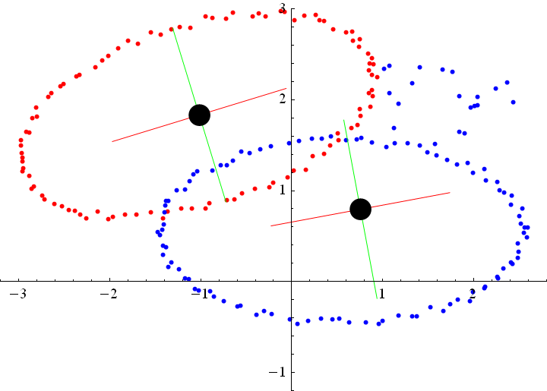
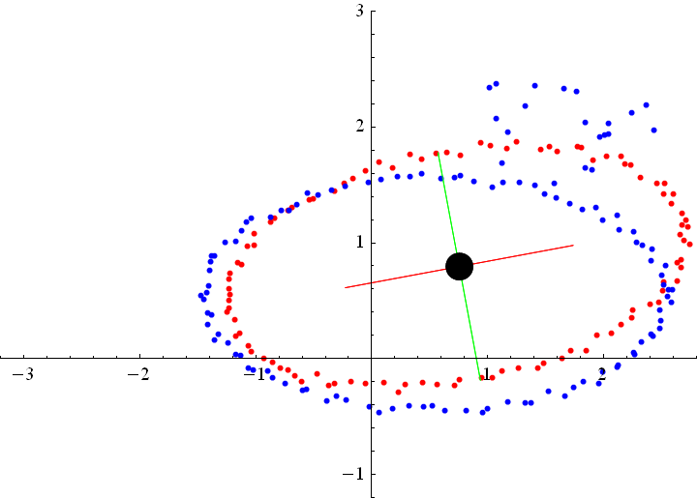
Method 1: PCA
Limitations
Centroid and axes are affected by noise
Noise
Axes are affected
PCA result

Slide 20
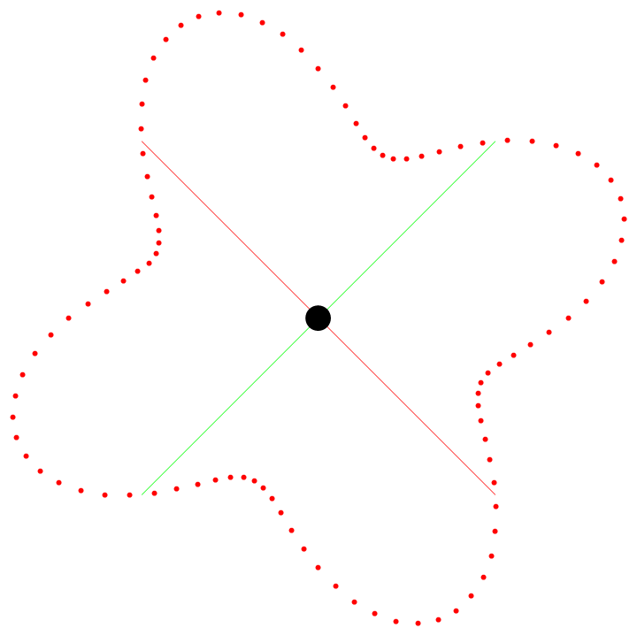
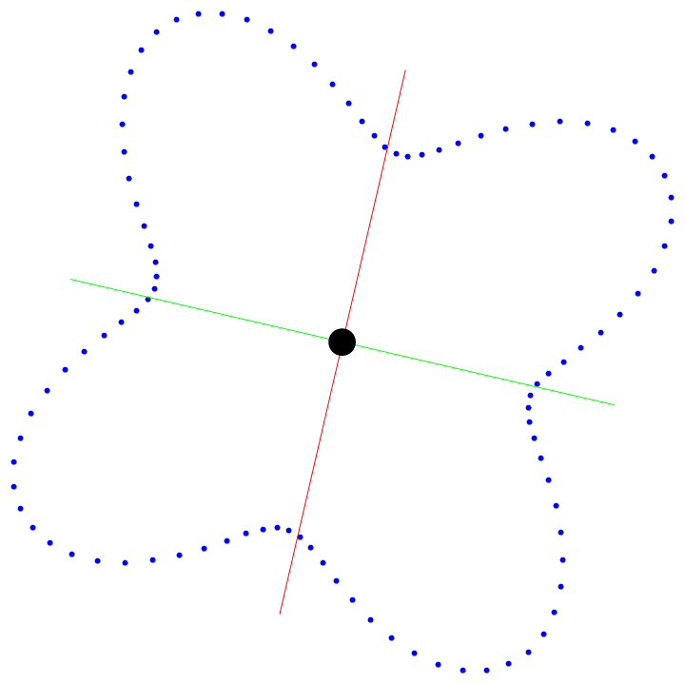
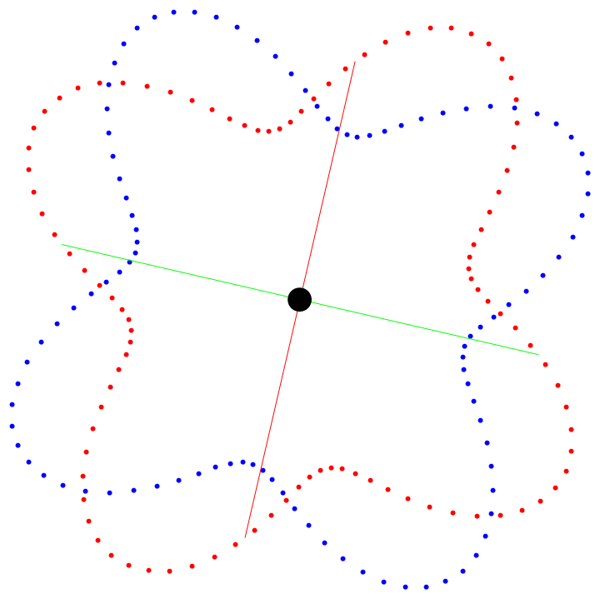
Method 1: PCA
Limitations
Axes can be unreliable for circular objects
Eigenvalues become similar, and eigenvectors become unstable
Rotation by a small angle
PCA result

Slide 21
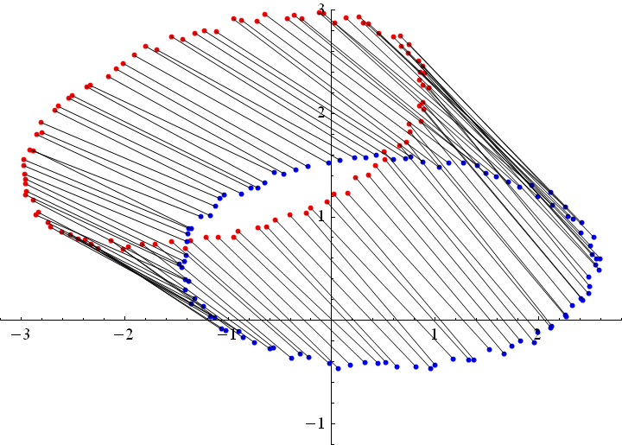

Method 2: SVD
Optimal alignment between corresponding points
Assuming that for each source point, we know where the corresponding target point is.

Slide 22
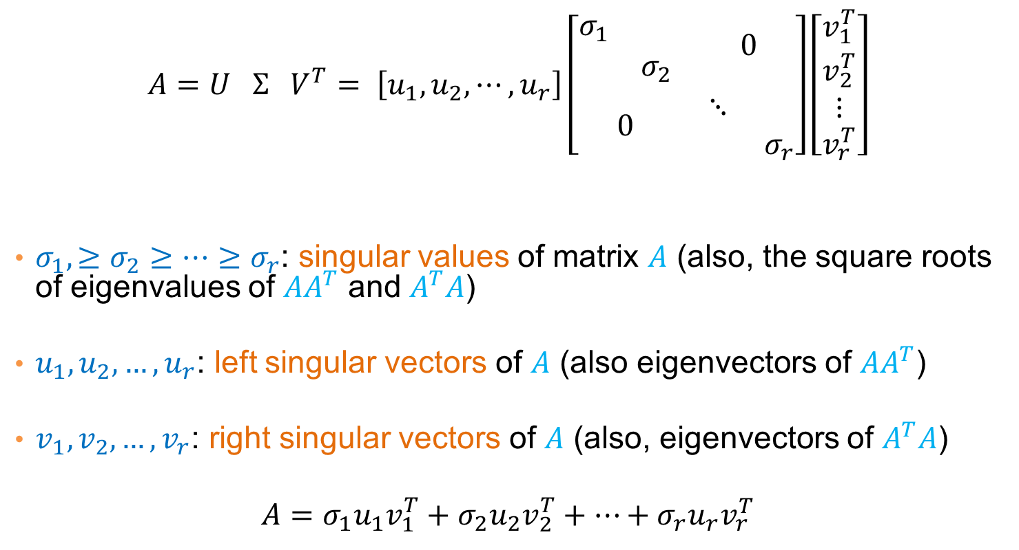
Method 2: SVD Singular Value Decomposition
[n×m] =
[n×r]
[r×r]
[r×m]
r: rank of matrix A
U,V are orthogonal matrices

Slide 23
Method 2: SVD
Formulating the problem
Source points p₁,…,p_{n} with centroid location c_{S}
Target points q₁,…,q_{n} with centroid location c_{T}
q_{i} is the corresponding point of p_{i}
After centroid alignment and rotation by some R, a transformed source point is located at:
We wish to find the R that minimizes sum of pair-wise distances:
Solving the problem – on the board…

Slide 24
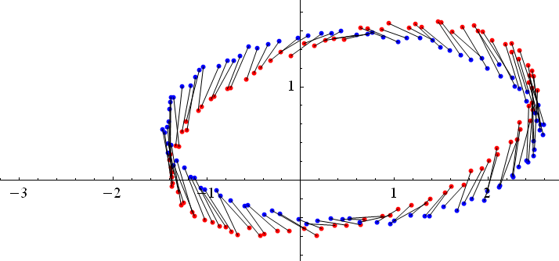
Method 2: SVD
SVD-based alignment: summary
Forming the cross-covariance matrix
Computing SVD
The optimal rotation matrix is
Translate and rotate the source:
Translate
Rotate

Slide 25
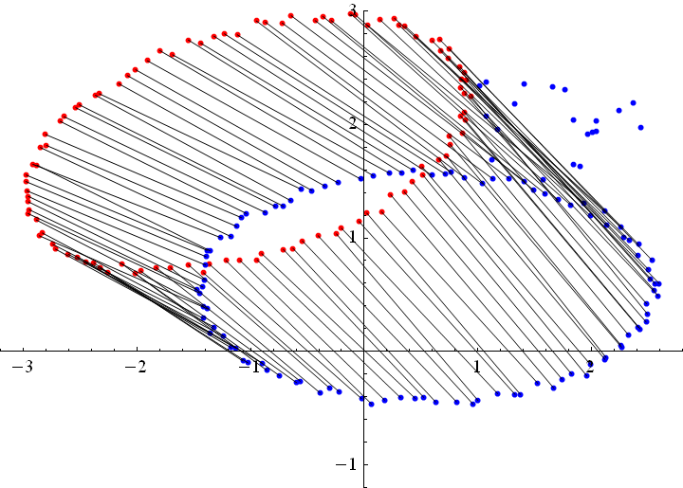
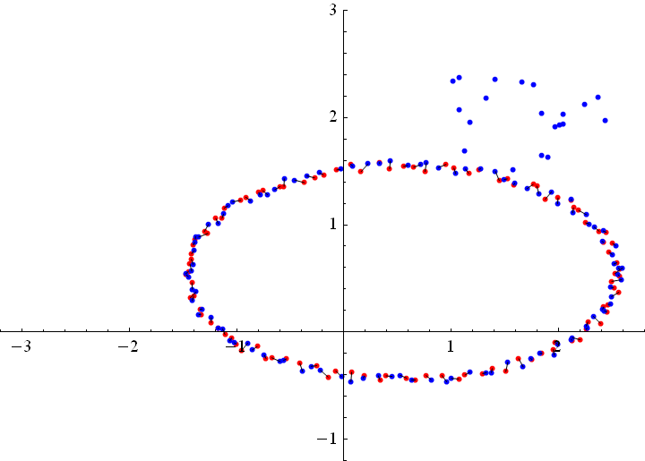
Method 2: SVD
Advantage over PCA: more stable
As long as the correspondences are correct

Slide 26
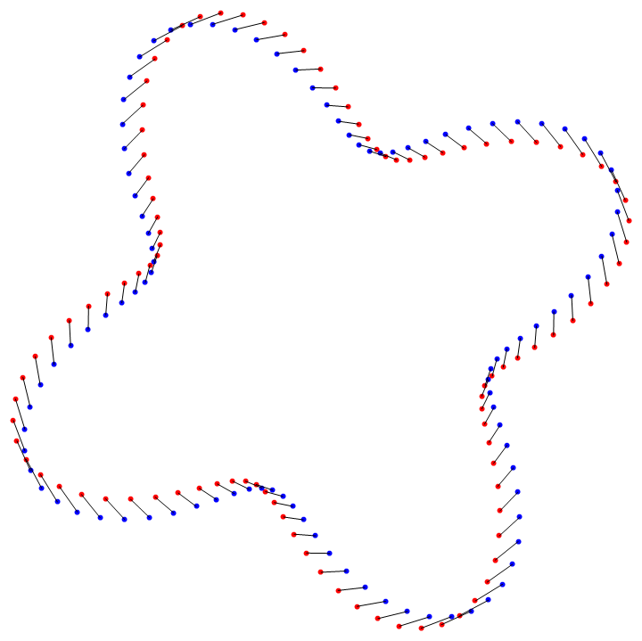
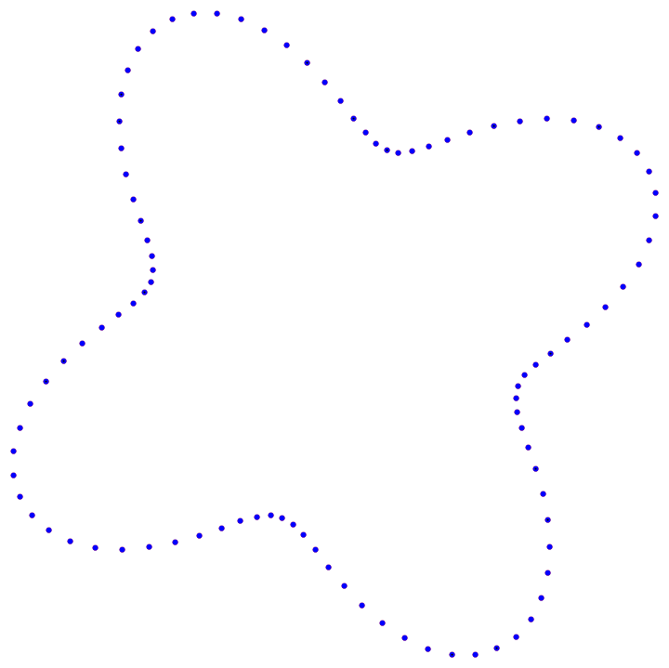
Method 2: SVD
Advantage over PCA: more stable
As long as the correspondences are correct

Slide 27
Method 2: SVD
Limitation: requires accurate correspondences
Which are usually not available

Slide 28
Method 3: ICP
The idea
Use PCA alignment to obtain initial guess of correspondences
Iteratively improve the correspondences after repeated SVD
Iterative closest point (ICP)
1. Transform the source by PCA-based alignment
2. For each transformed source point, assign the closest target point as its corresponding point. Align source and target by SVD.
Not all target points need to be used
3. Repeat step (2) until a termination criteria is met.

Slide 29
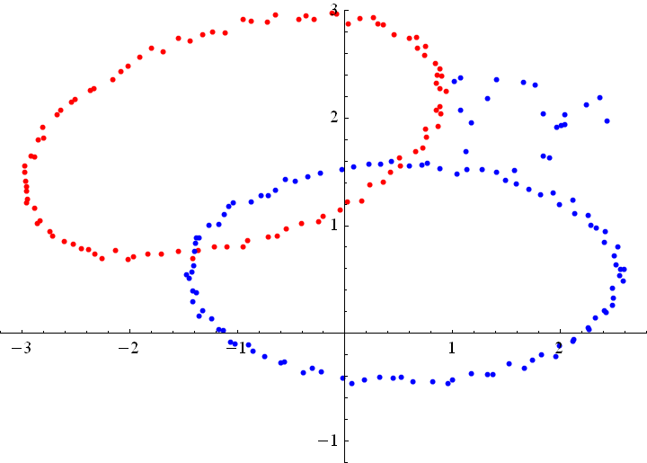
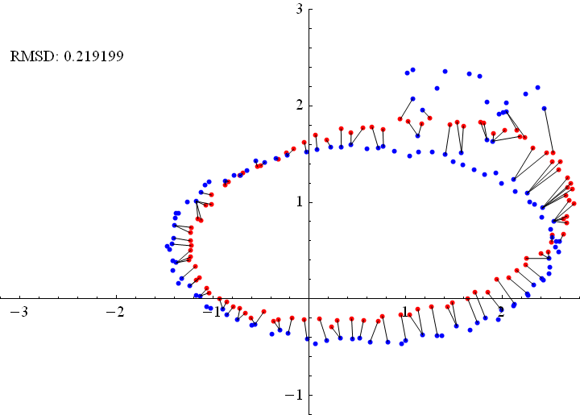
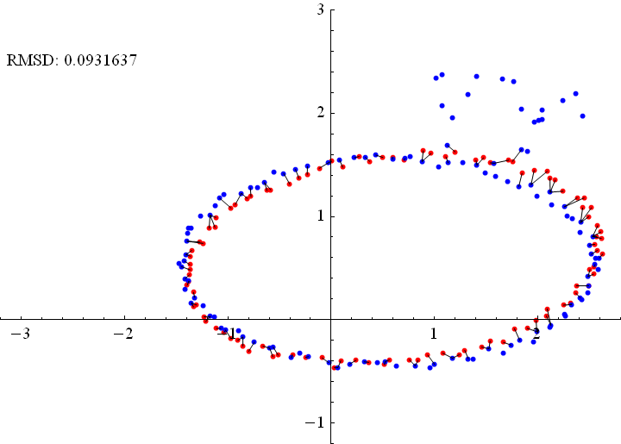
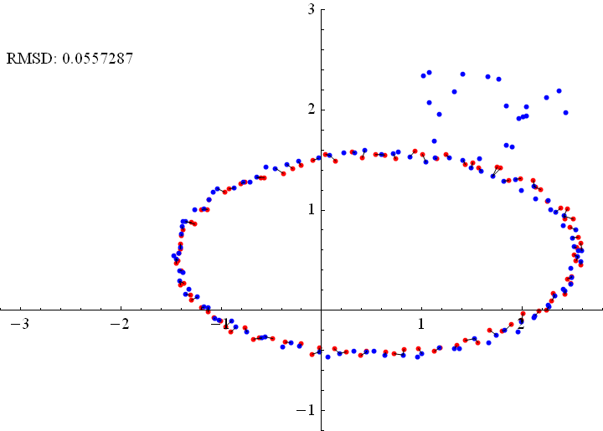
ICP Algorithm
After PCA
After 1 iter
After 10 iter

Slide 30
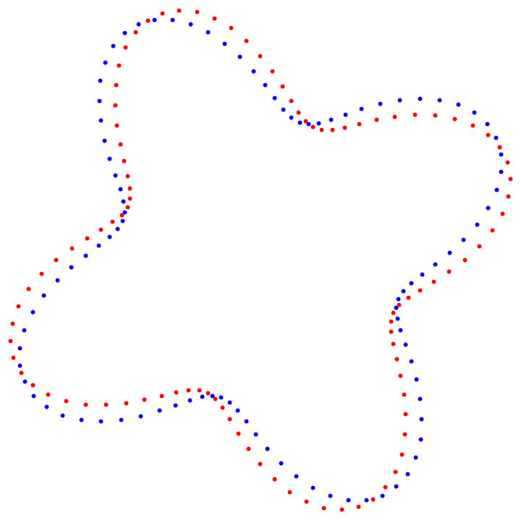
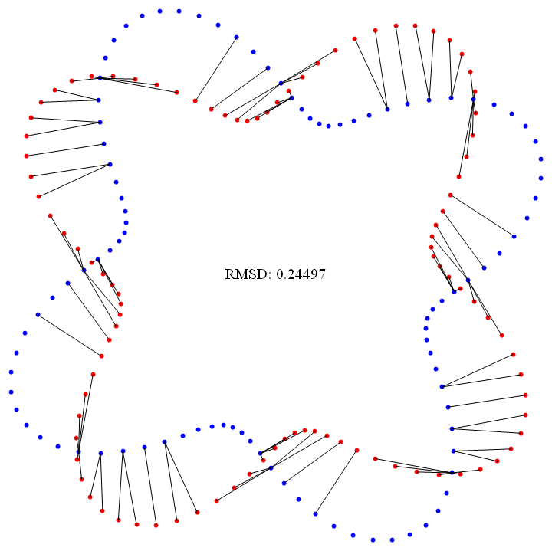
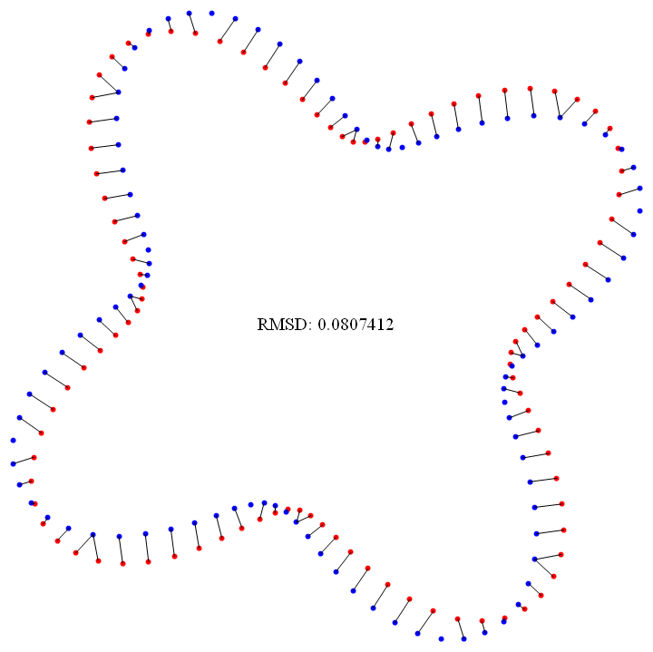
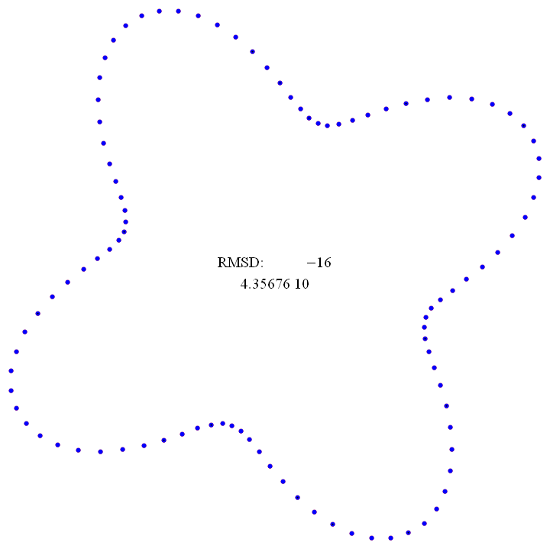
ICP Algorithm
After PCA
After 1 iter
After 10 iter

Slide 31
ICP Algorithm
Termination criteria
A user-given maximum iteration is reached
The improvement of fitting is small
Root Mean Squared Distance (RMSD):
Captures average deviation in all corresponding pairs
Stops the iteration if the difference in RMSD before and after each iteration falls beneath a user-given threshold

Slide 32
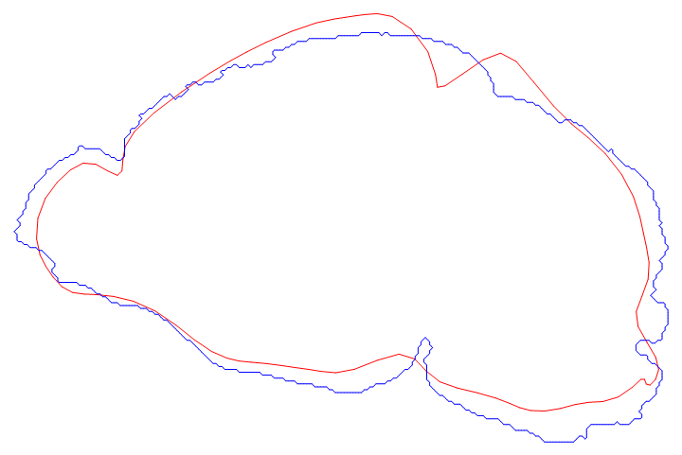
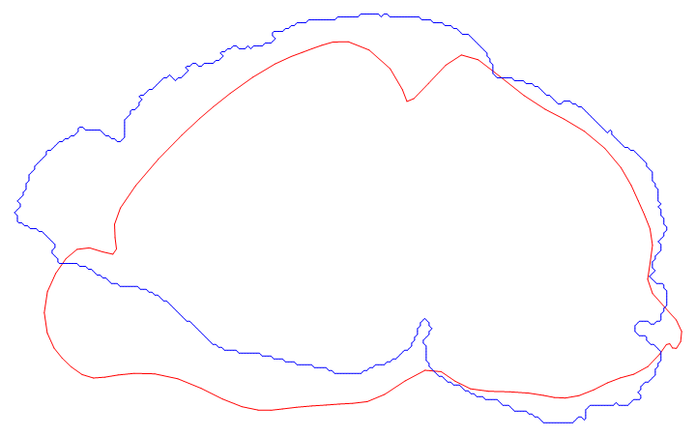
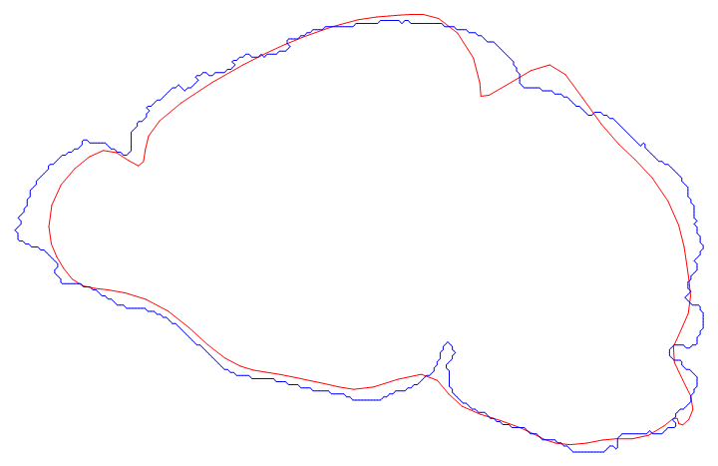
More Examples
After PCA
After ICP

