Slide 1
T = 0
...
T = 4
Build BEV maps
Intergrated
BEV features
Feature
Extractor
Multi-frame
point clouds
1x1 Conv
RoI Pooling
...
Fusion
...
3D Anchor
grid
...
Fused RoI features
RoI Pooling
FC
1x1 Conv
NMS
T = 0
Image features
...
Feature
Extractor
Single frame image
Top K 3D
Proposals

Slide 2
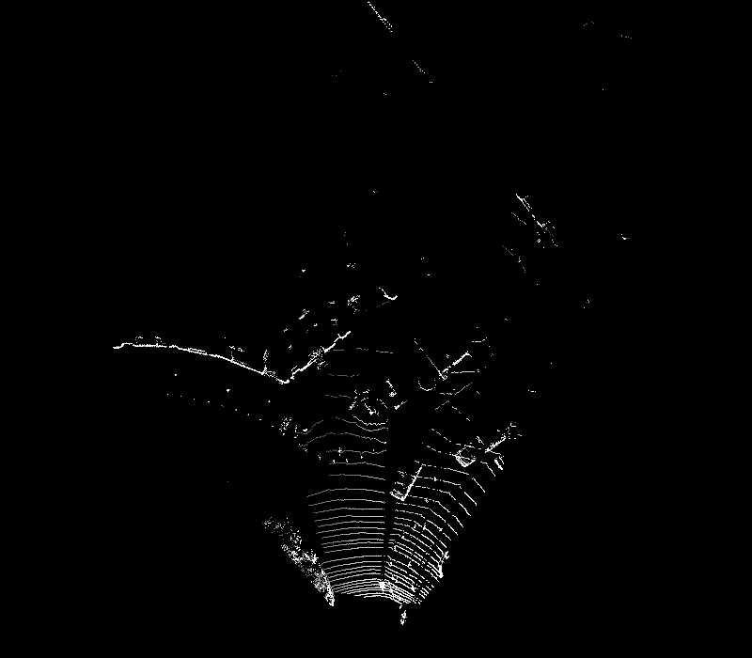
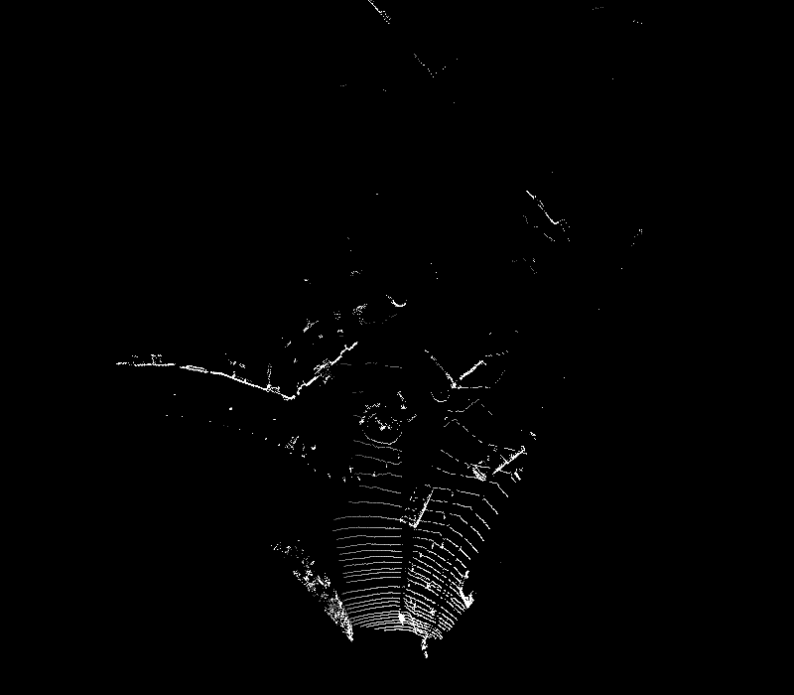

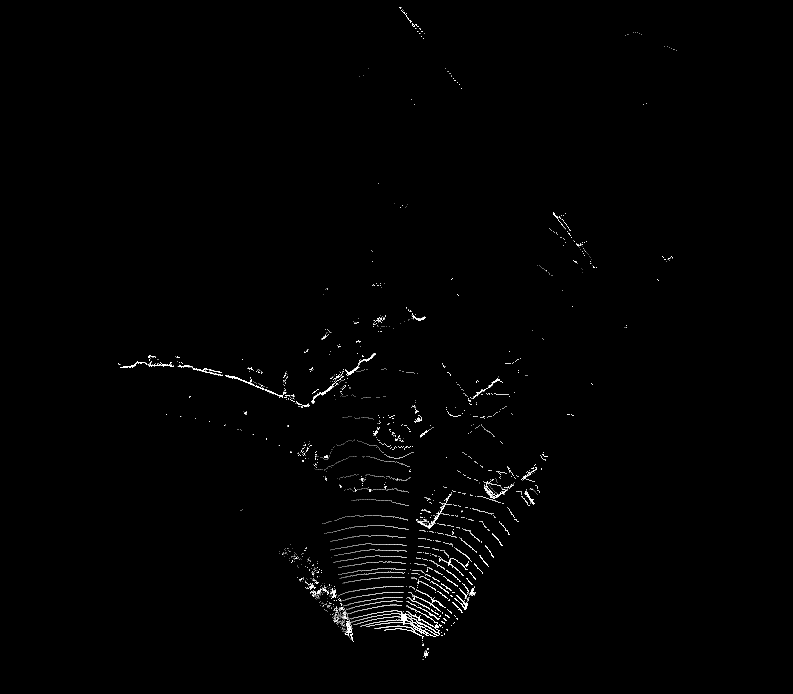
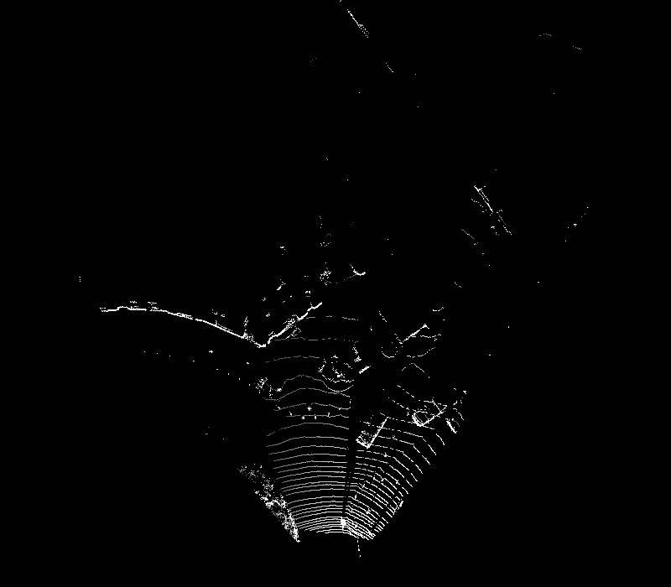
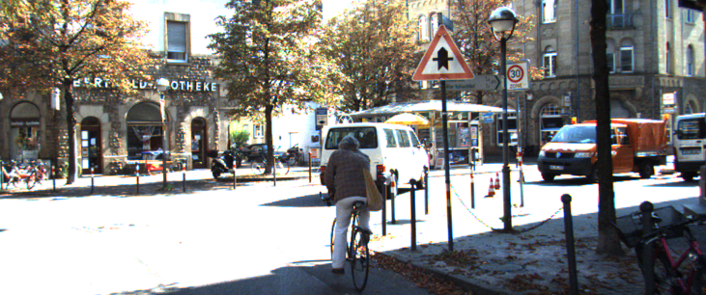
Create
BEV maps
3D Anchor grid
Feature
Extractor
Feature
Extractor
1x1 Conv
...
1x1 Conv
Intergrated
BEV features
Image features
...
RoI
Pooling
RoI
Pooling
Fusion
...
Fused RoI
features
FC
NMS
...
Top K 3D Proposals

Slide 3
BEV
maps
...
...
FC
Frame 0
Feature
Extractor
RoI Pooling
...
Fusion
z
Image
Fused features
NMS
x
Predictions
T = 0
Feature maps
Tracking Module
...
Correlation
FC
...
...
RPN
...
Correlation
features
NMS
z
Top K 3D Proposals
x
Offsets
BEV
maps
...
FC
Frame 1
...
Feature
Extractor
RoI Pooling
...
Fusion
Image
Fused features
NMS
z
T = 4
Feature maps
x
Predictions

Slide 4
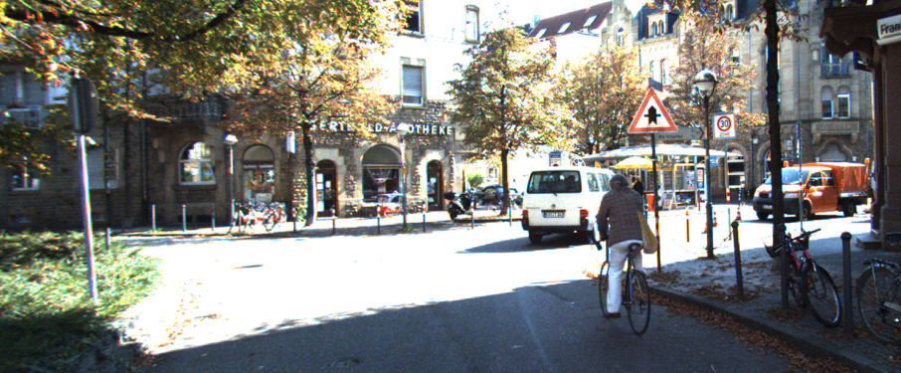

Slide 5
T = 0
...
T = 4
T = 0
Point
clouds
3D Anchor
grid
Image
Create
BEV maps
Feature
Extractor
Feature
Extractor
1x1 Conv
...
1x1 Conv
Intergrated
BEV features
...
Image features
RoI
Pooling
RoI
Pooling
Fusion
...
Fused RoI
features
FC
NMS
...
Top K 3D Proposals

Slide 6
BEV
maps
...
...
FC
Frame 0
Image
Feature
Extractor
RoI Pooling
...
Fusion
Fused features
NMS
Predictions
T = 0
Feature maps
Tracking Module
...
Correlation
FC
...
...
RPN
...
Correlation
features
NMS
Top K 3D Proposals
Offsets
BEV
maps
...
FC
Frame 1
...
Feature
Extractor
RoI Pooling
...
Fusion
Image
Fused features
NMS
z
T = 4
Feature maps
Y
x
Predictions

Slide 7
C
B
ry'
a'
θ'
Car 1'
Car 1
b'
c'
w
d'
D
ry
A
45°
l
a
Car 0
θ
b
c
Car 0'
d
z
E
O
x
F

Slide 8
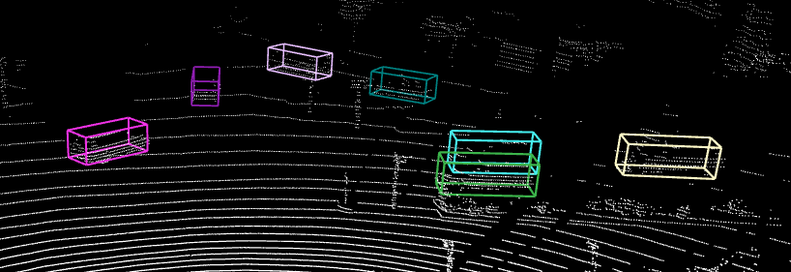
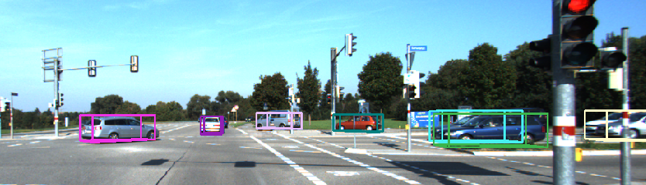
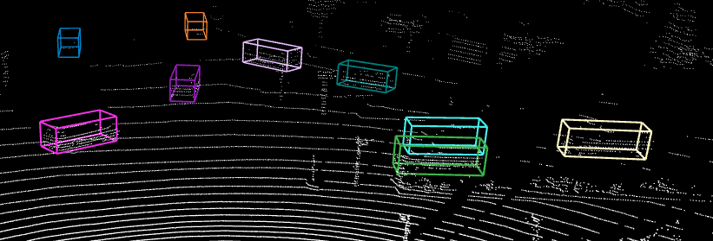
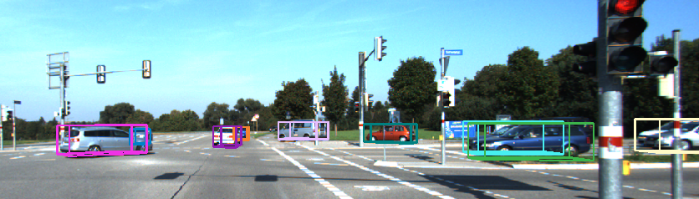


T = 2
T = 1
T = 0

Slide 9
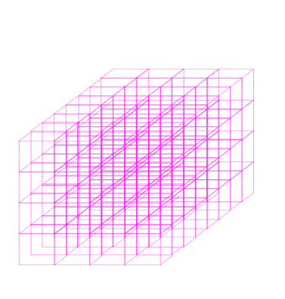
T = t ... t + τ
T = t
Create
BEV maps
3D Anchor
grid
Feature
Extractor
Feature
Extractor
1x1 Conv
...
1x1 Conv
Intergrated
BEV features
...
Image features
RoI
Pooling
RoI
Pooling
Fusion
...
Fused RoI features
FC
NMS
...
Top K 3D Proposals

Slide 10
BEV
...
FC
...
Feature
Extractor
RoI Pooling
...
Fusion
Image
Fused features
NMS
Predictions
Keyframe: T = t
Feature maps
Temporal Module
...
Correlation
FC
...
...
Shared RPN
...
Correlation
features
NMS
Top K 3D Proposals
Offsets
...
FC
BEV
...
Feature
Extractor
RoI Pooling
...
Fusion
Image
Fused features
NMS
z
Keyframe: T = t + τ
Feature maps
Y
x
Predictions

Slide 11
T = t ... t + τ
T = t
Create
BEV maps
3D Anchor grid
Feature
Extractor
Feature
Extractor
1x1 Conv
...
1x1 Conv
Intergrated
BEV features
...
Image features
RoI
Pooling
RoI
Pooling
Fusion
...
Fused RoI features
FC
NMS
...
Top K 3D Proposals

Slide 12
BEV
...
FC
...
Feature
Extractor
RoI Pooling
...
Fusion
Image
Fused features
NMS
Predictions
Keyframe: T = t
Feature maps
Temporal Module
...
Correlation
FC
...
...
Shared RPN
...
Correlation
features
NMS
Top K 3D Proposals
Offsets
...
FC
BEV
...
Feature
Extractor
RoI Pooling
...
Fusion
Image
Fused features
NMS
z
Keyframe: T = t + τ
Feature maps
Y
x
Predictions

Slide 13
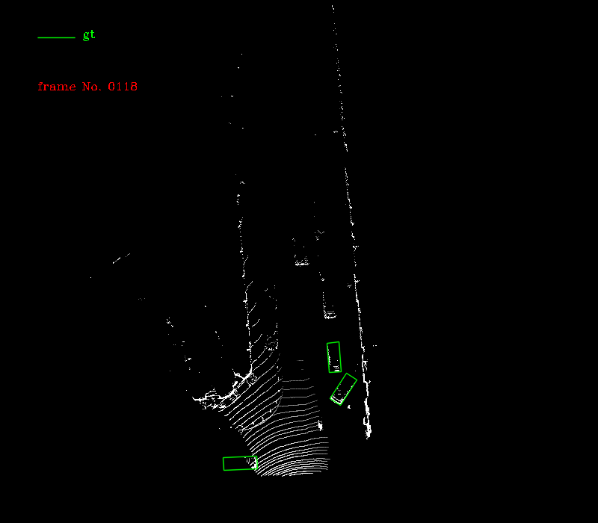
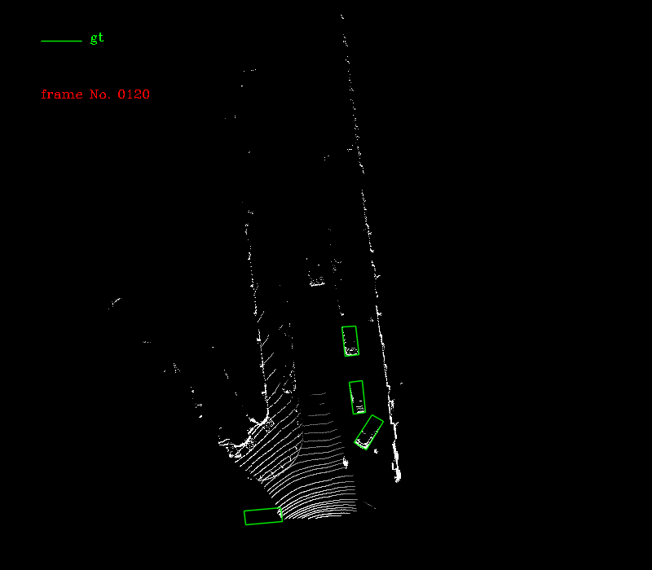
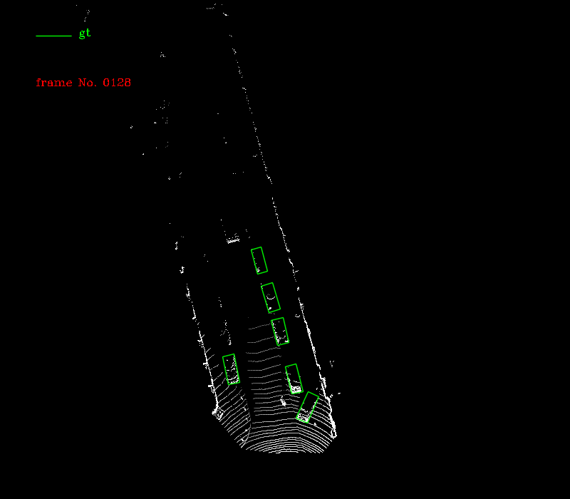
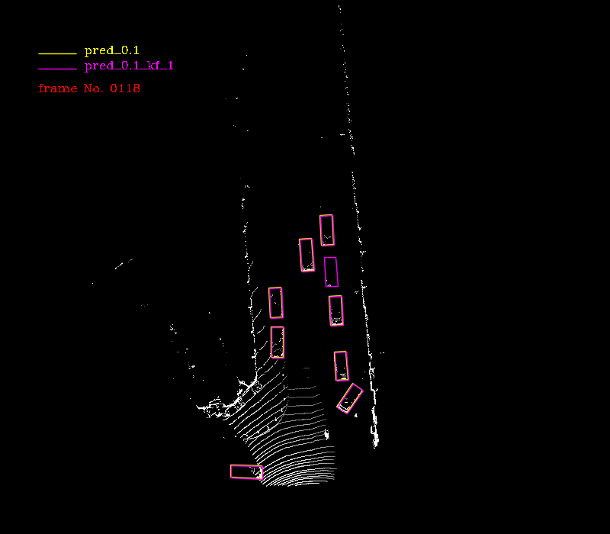
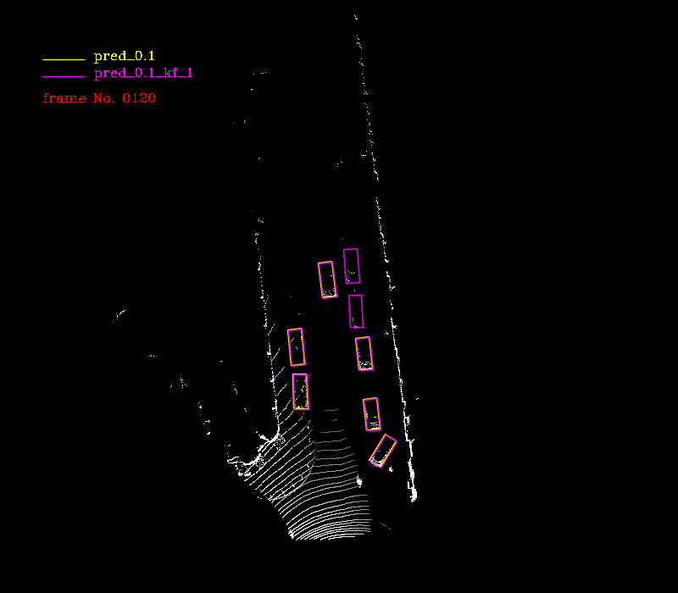
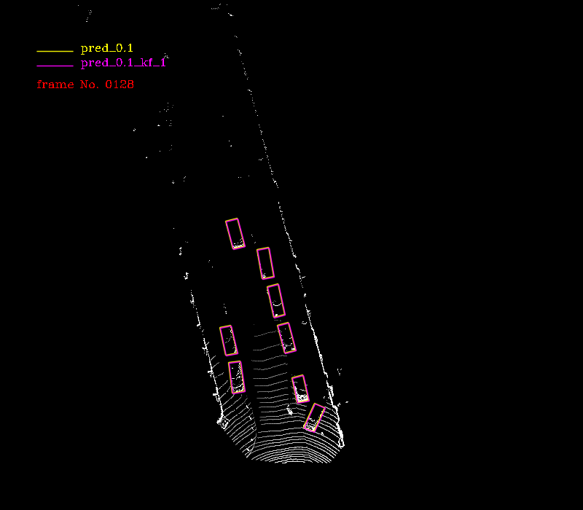
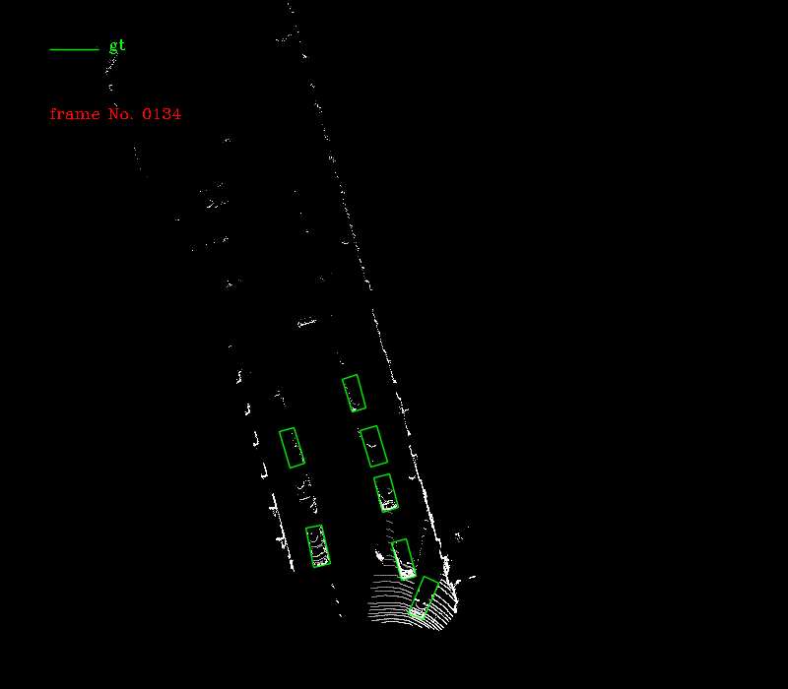
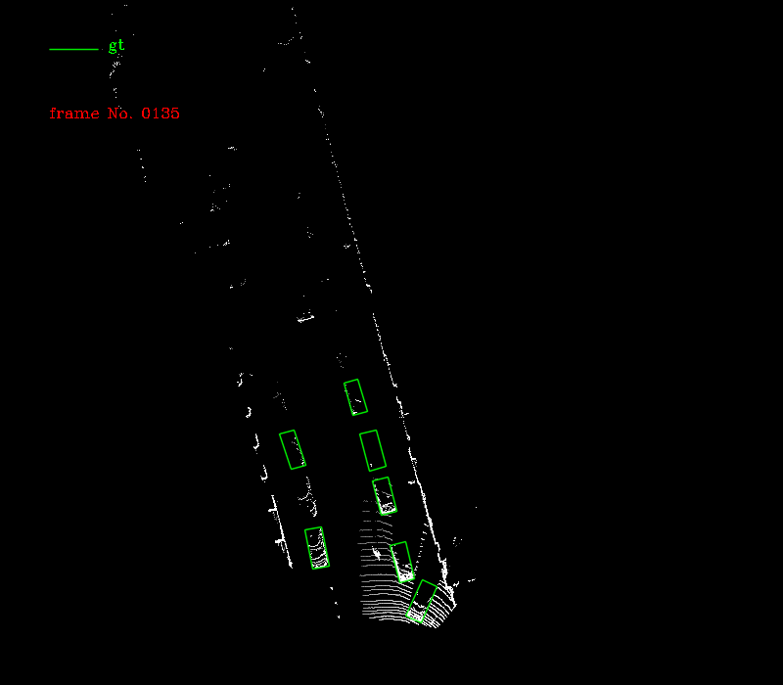
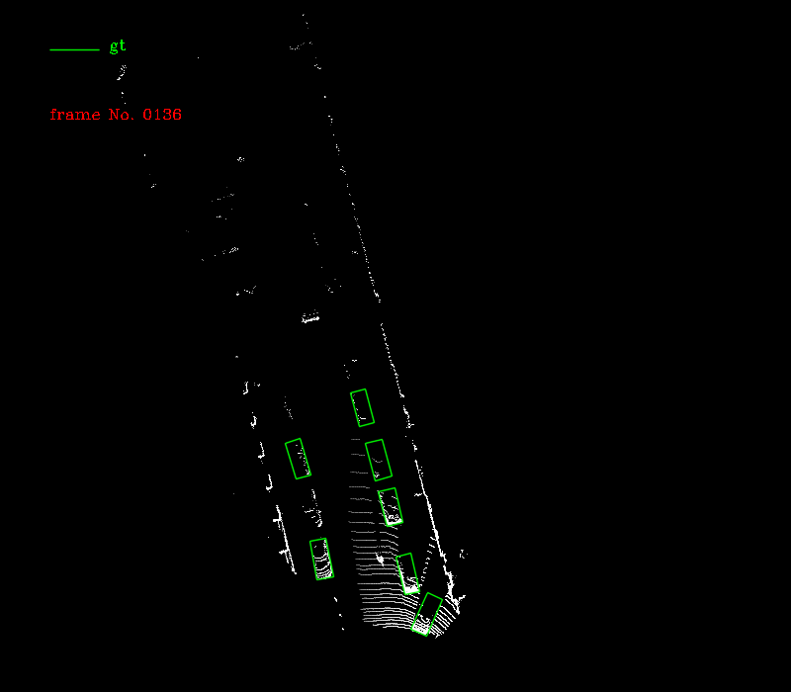
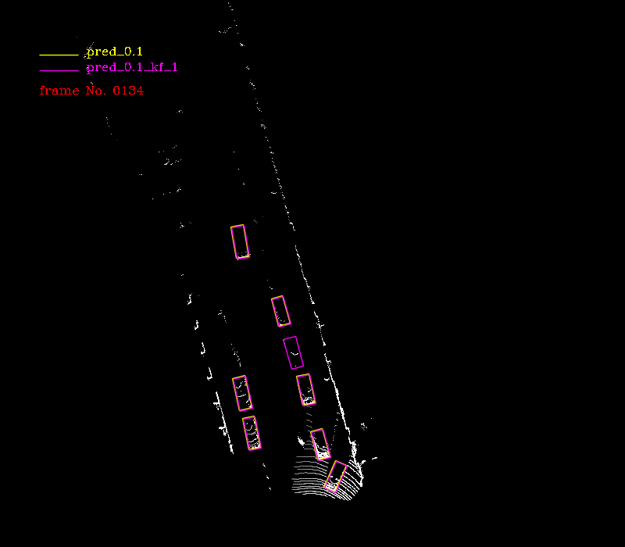
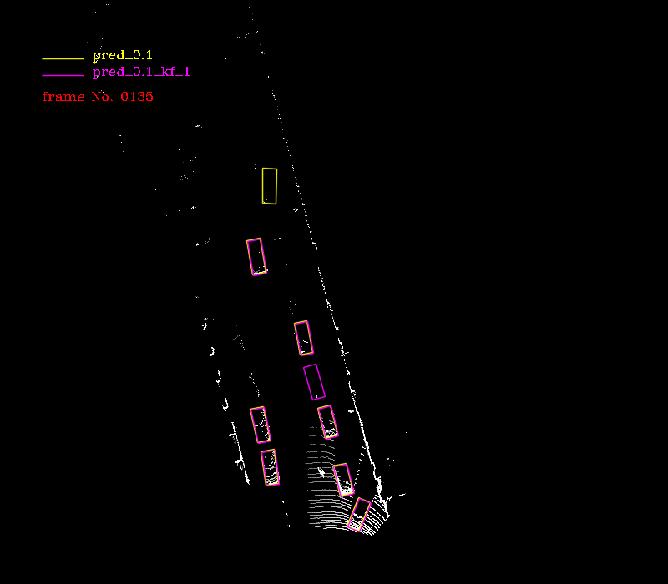
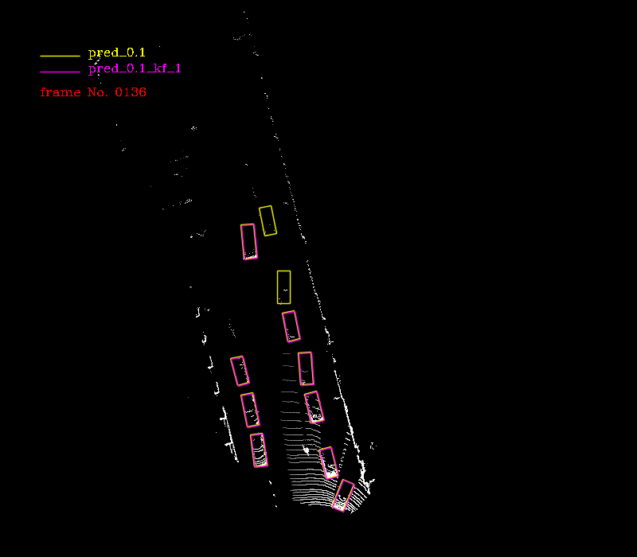
Frame: 118
Frame: 120
Frame: 128
Frame: 134
Frame: 135
Frame: 136

