Slide 1
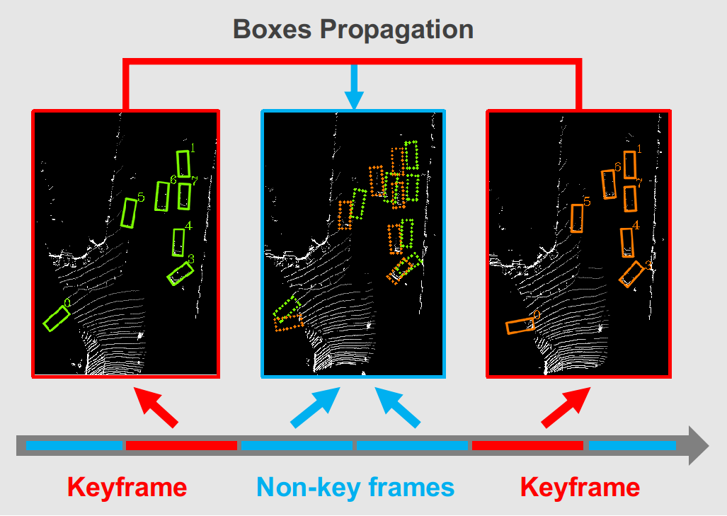
3D Object Detection and Tracking Based on Streaming Data
Xusen Guo, JiangFeng Gu, Silu Guo, Zixiao Xu,
Chengzhang Yang, Shanghua Liu, Kai Huang, and Long Cheng* Data and Computer Science, Sun Yat-sen University, China
A dual-way framework DODT for 3D object detection and tracking with streaming data.
Propose Temporal module to encode temporal information across frames in proposal level.
Develop a motion based interpolation algorithm for prediction propagation.
Obtain significant performance improvements on both detection and tracking tasks.
DODT propagation keyframe predictions to non-key frames

Slide 2
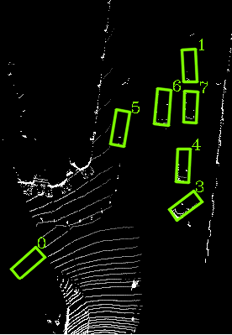
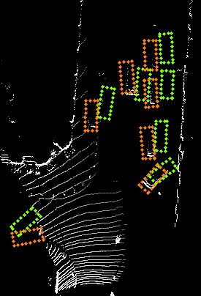
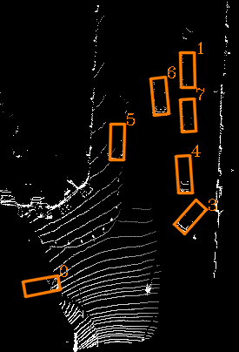
Boxes Propagation
Keyframe
Non-key frames
Keyframe

